Slide 1
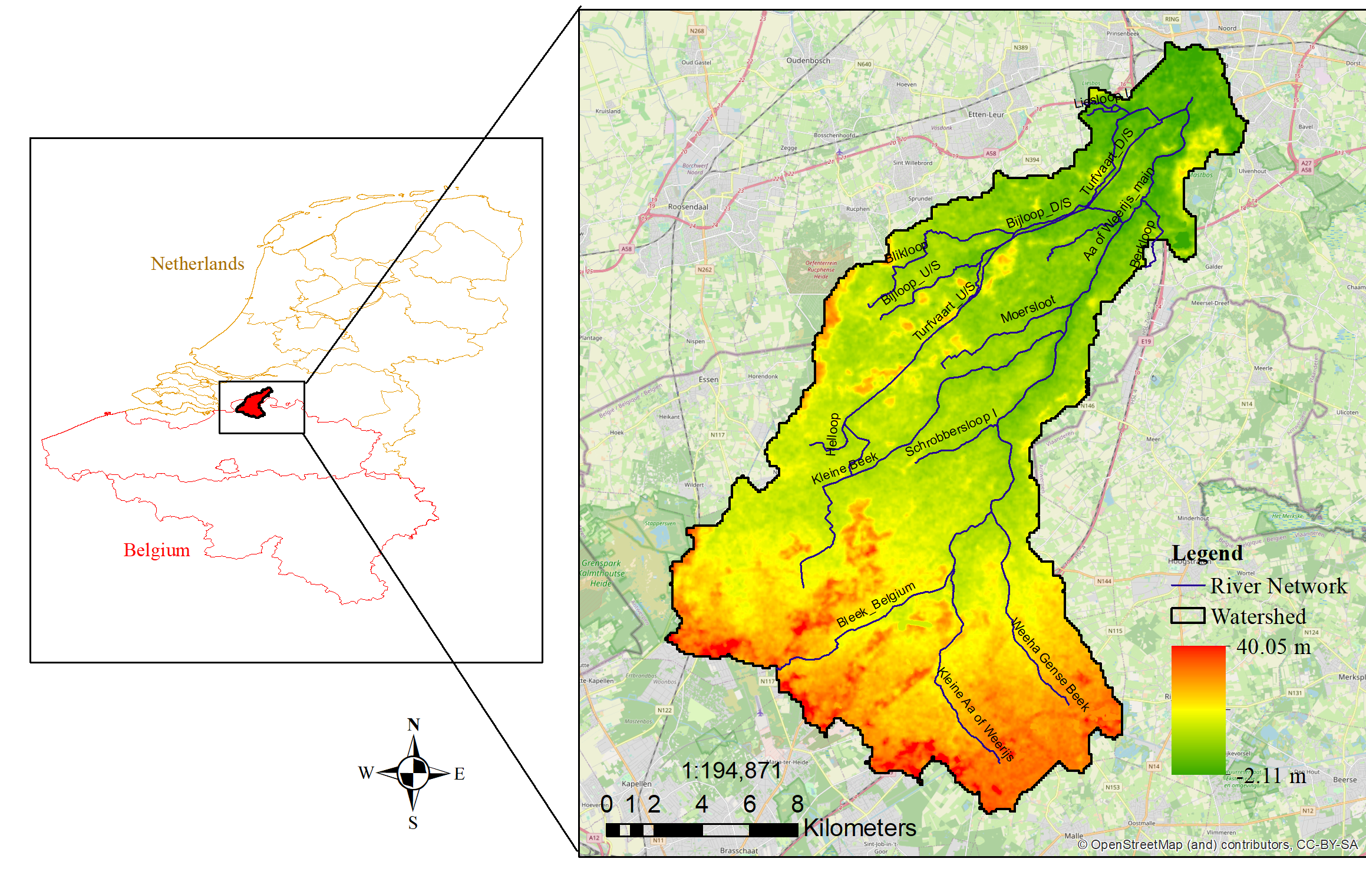
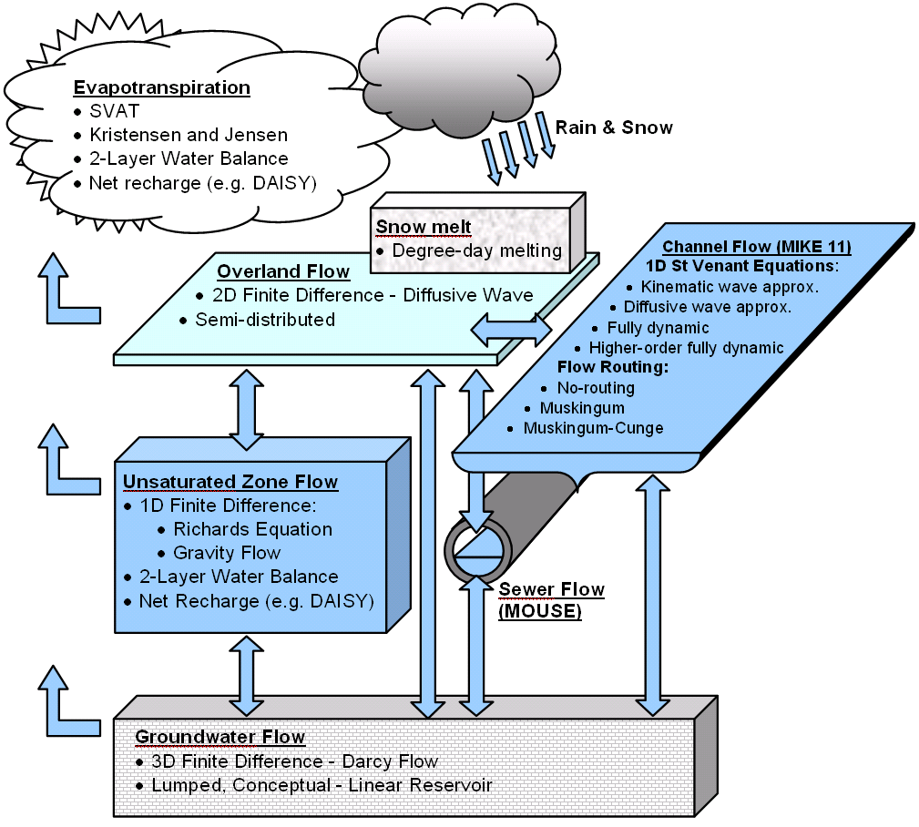
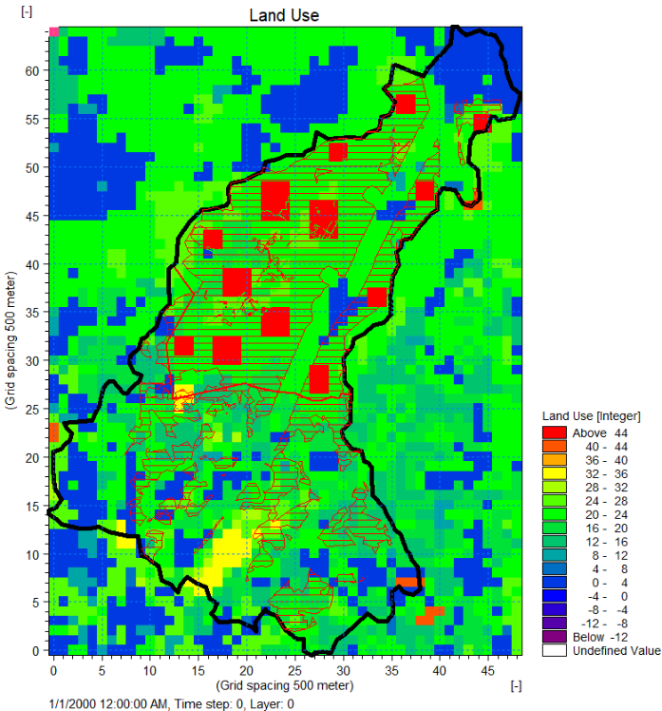
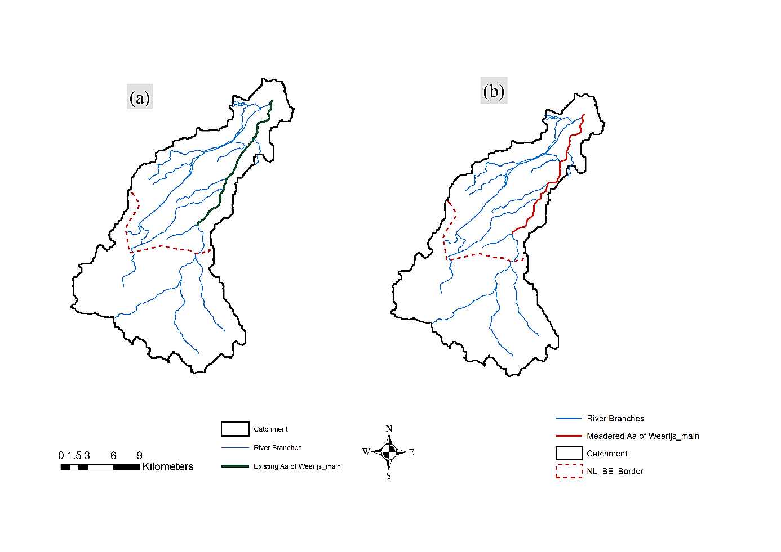
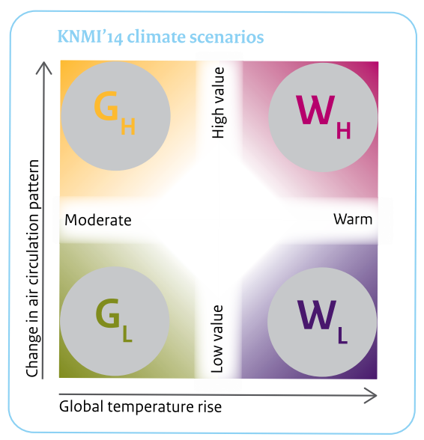
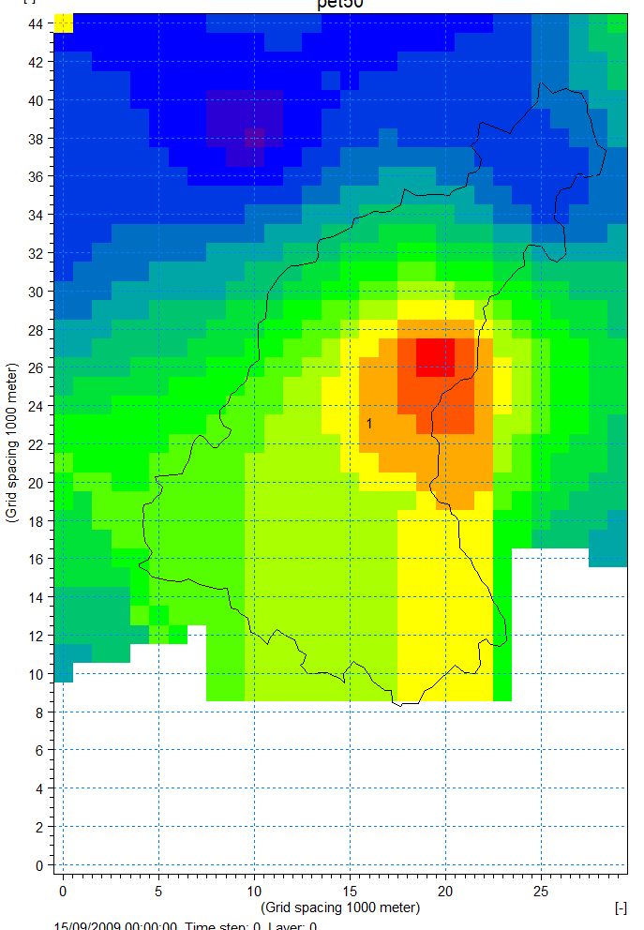
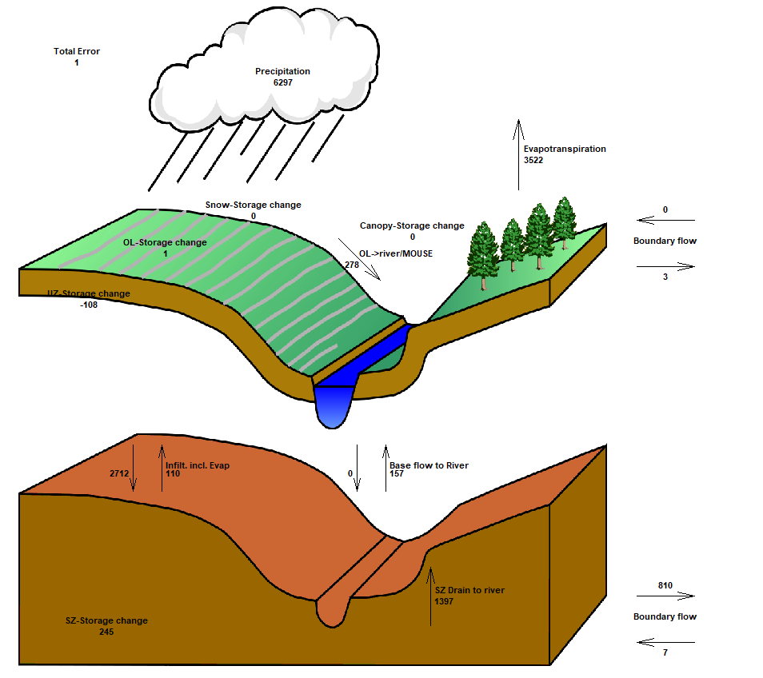
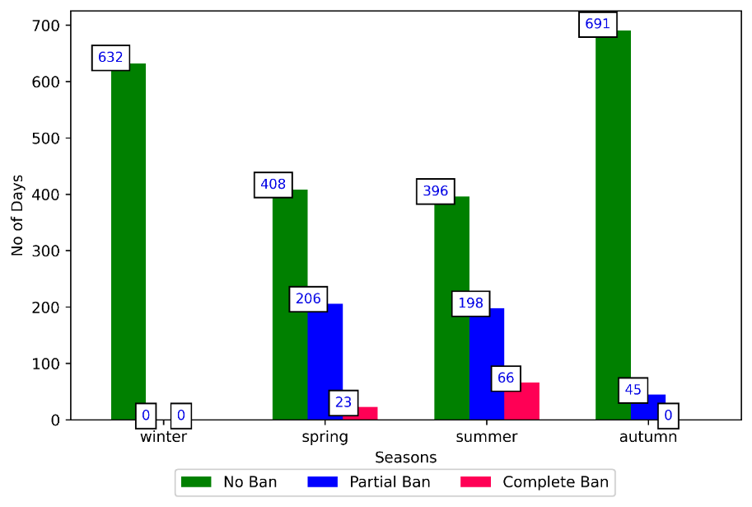
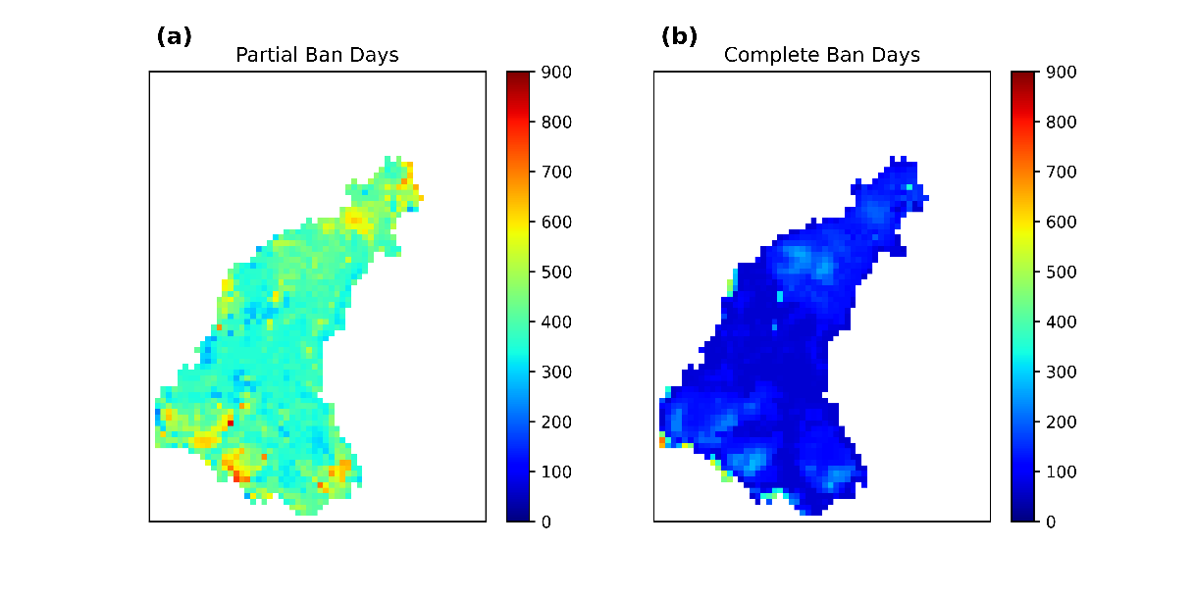
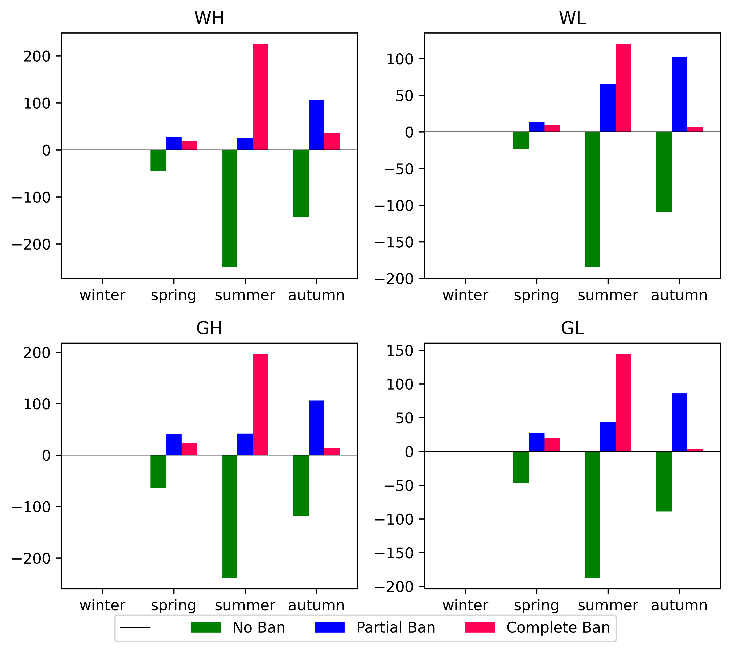
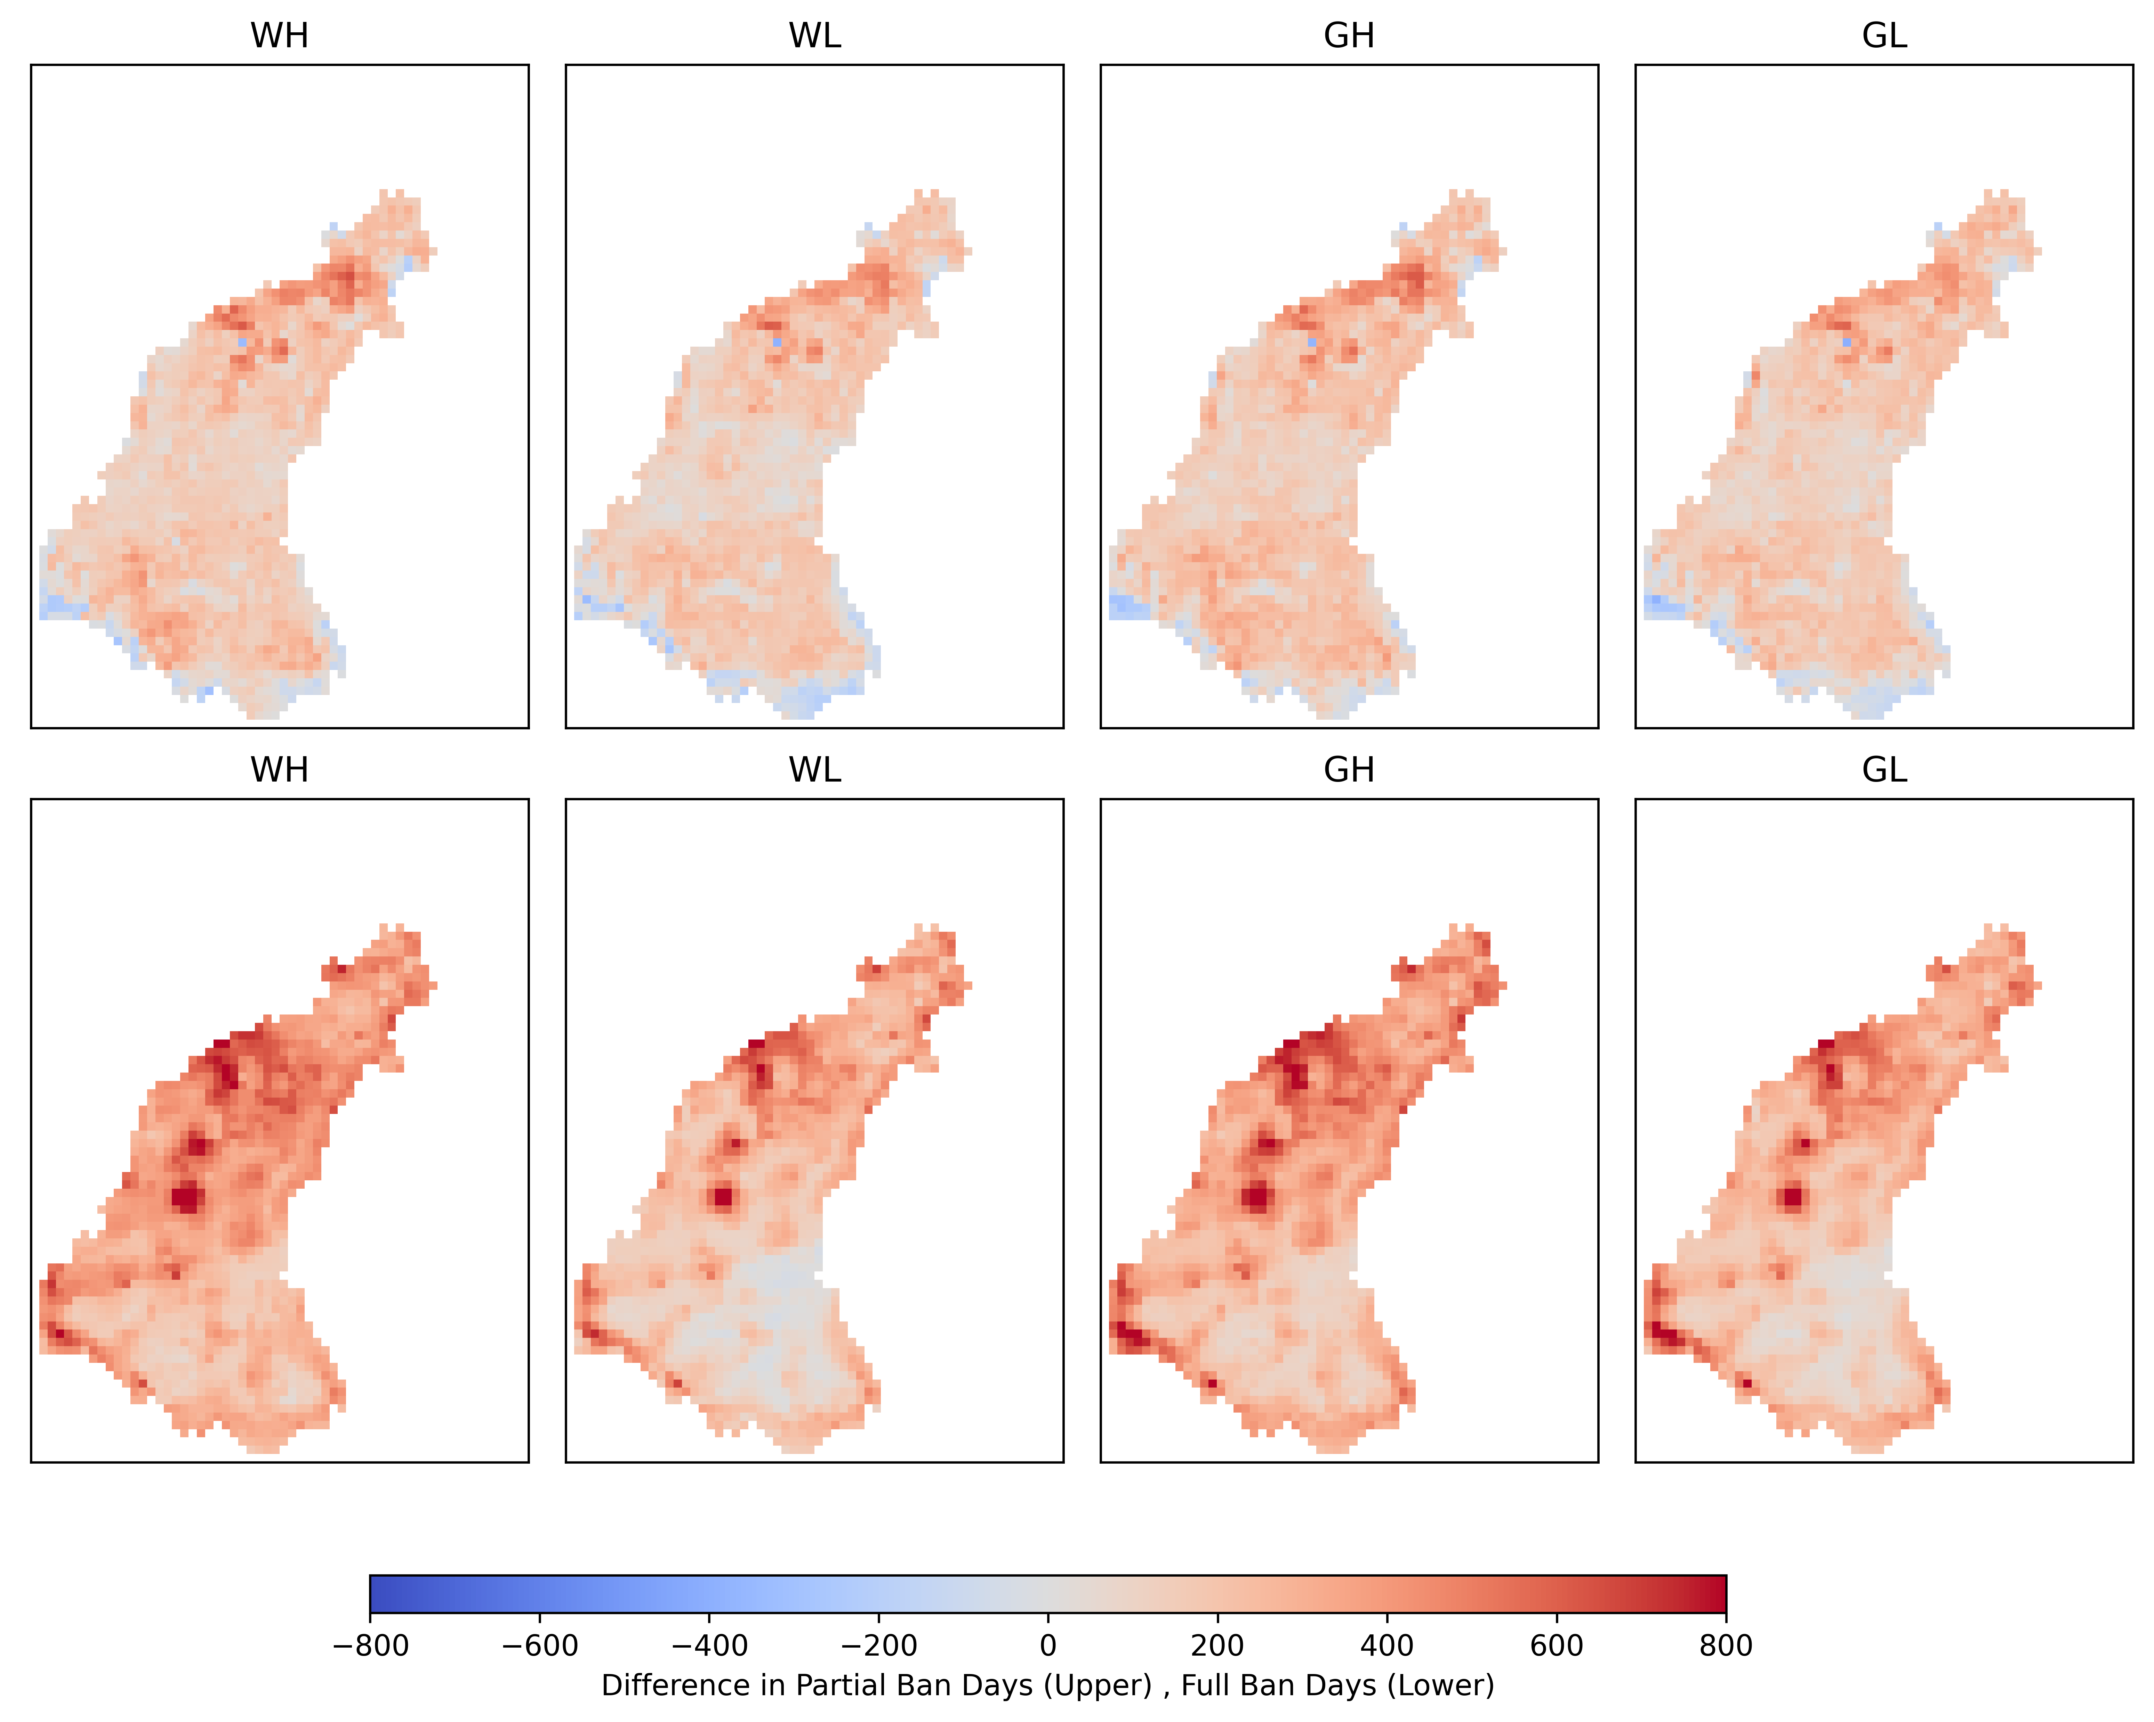
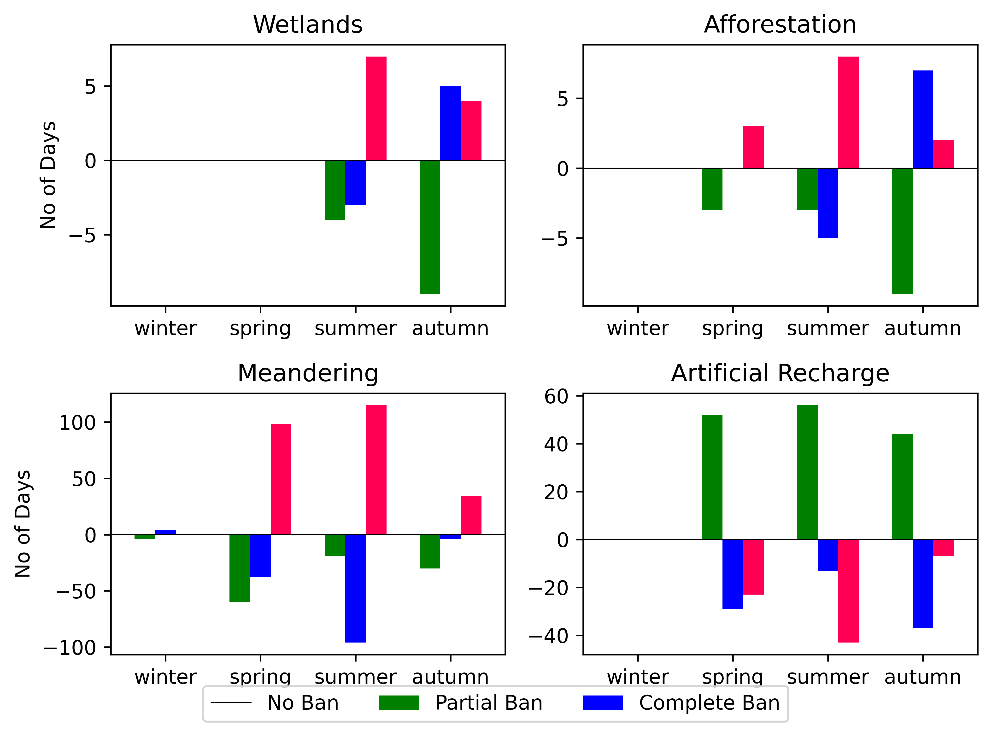
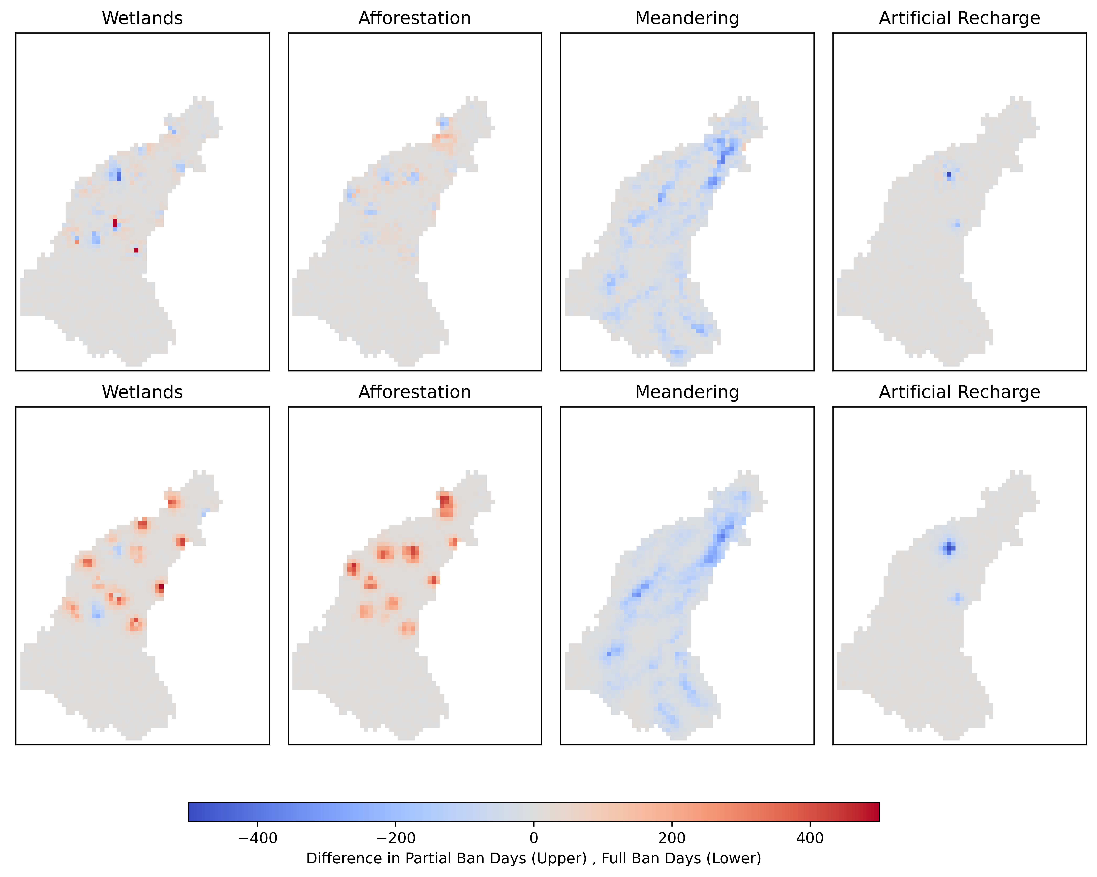
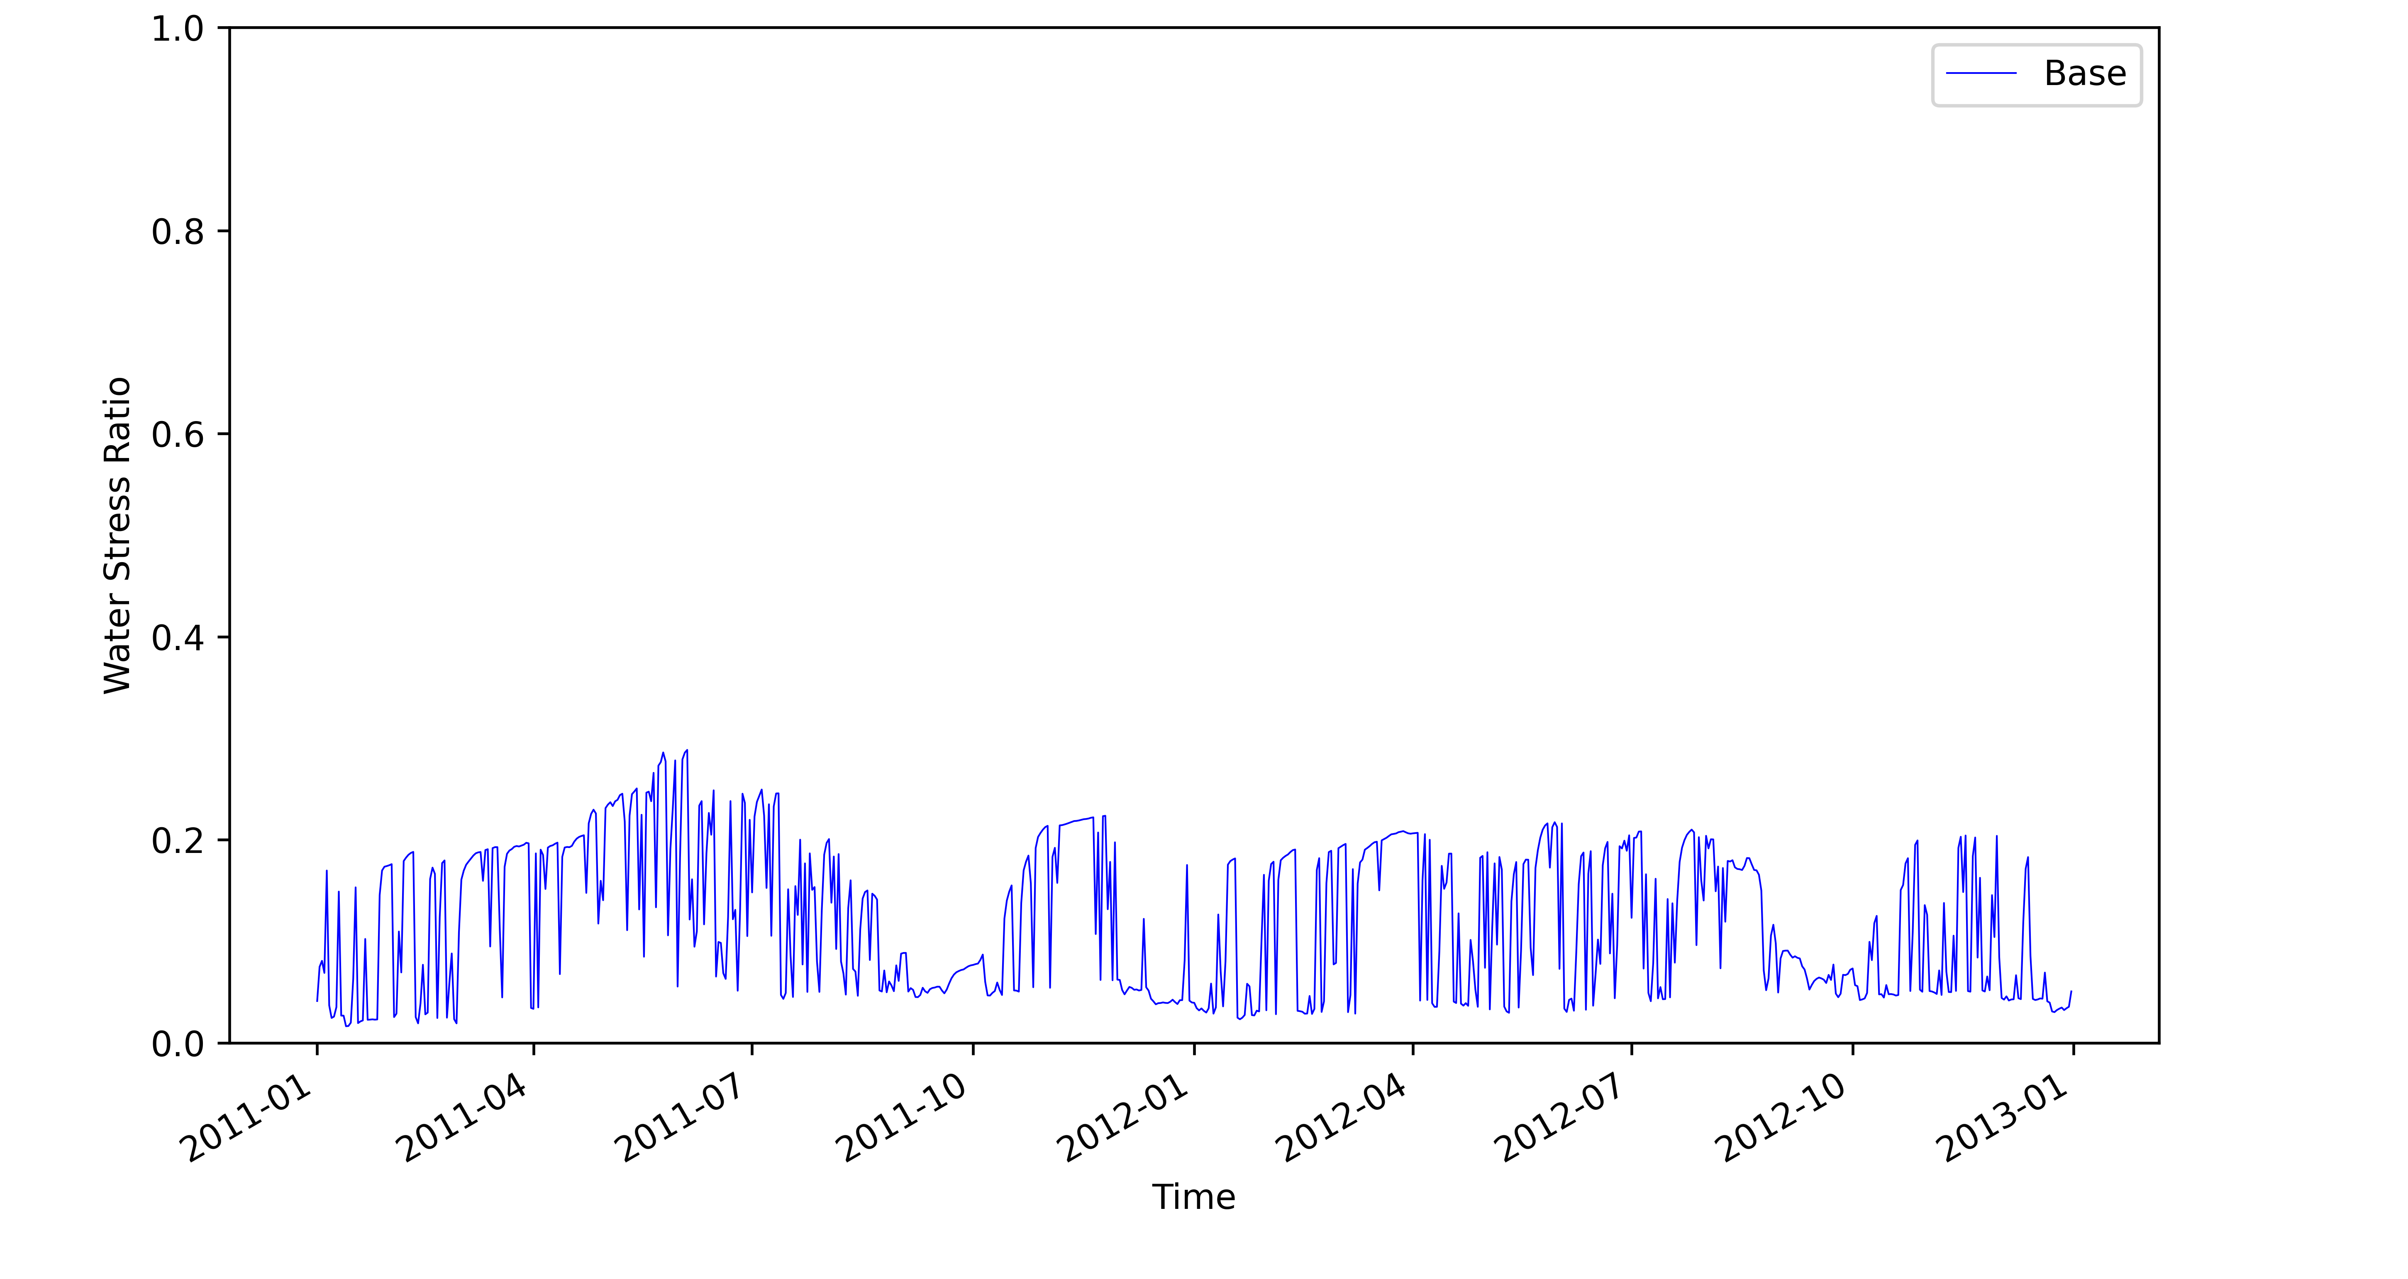
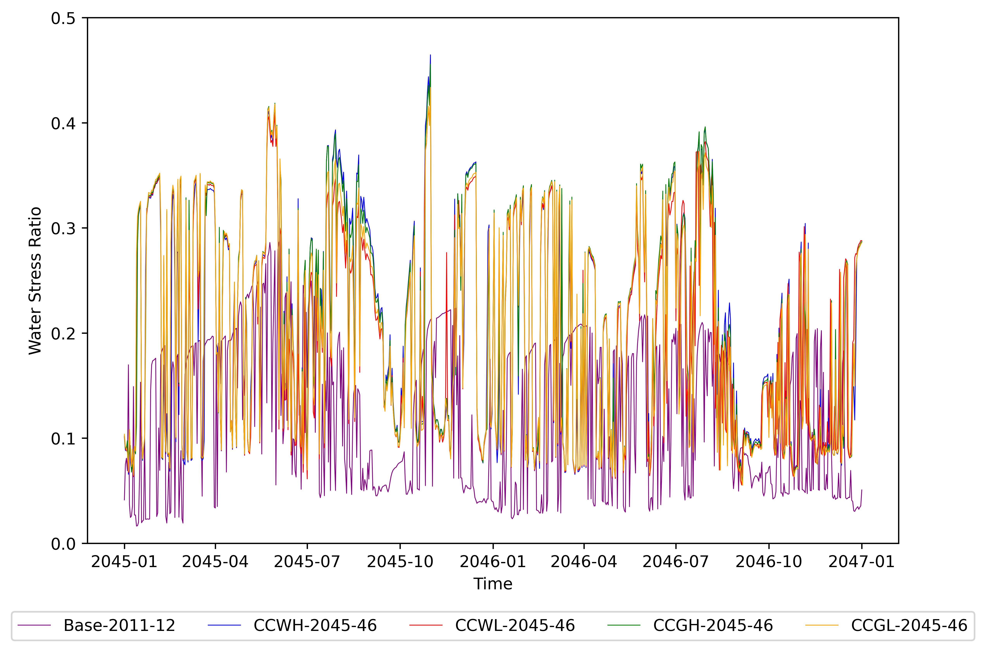
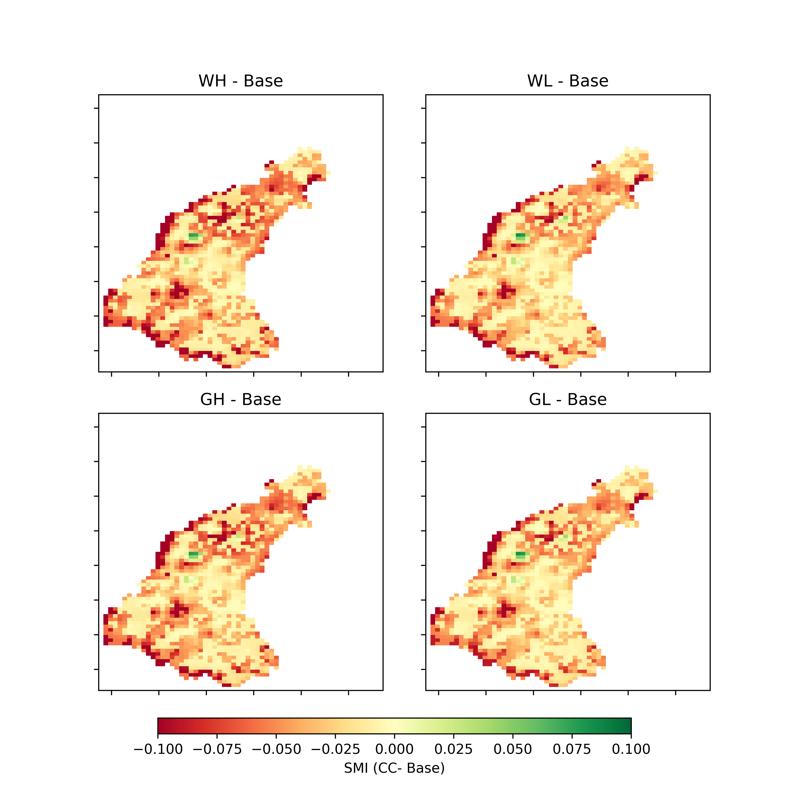
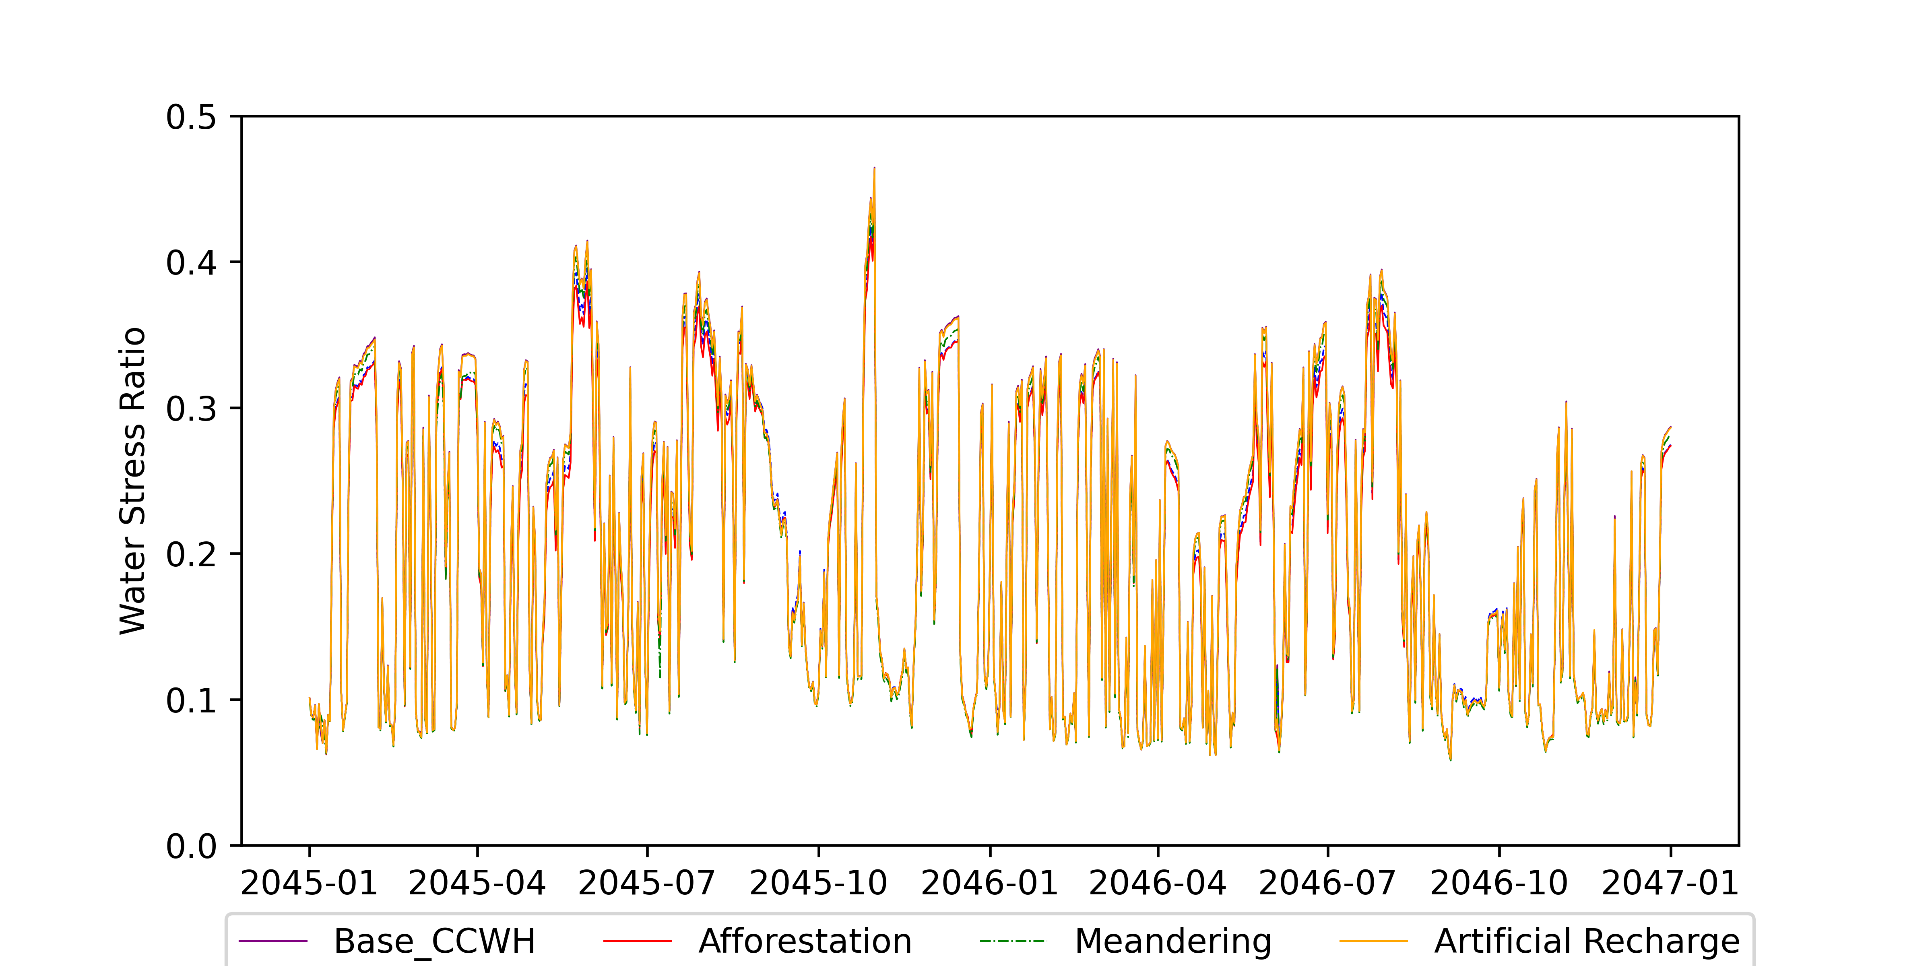
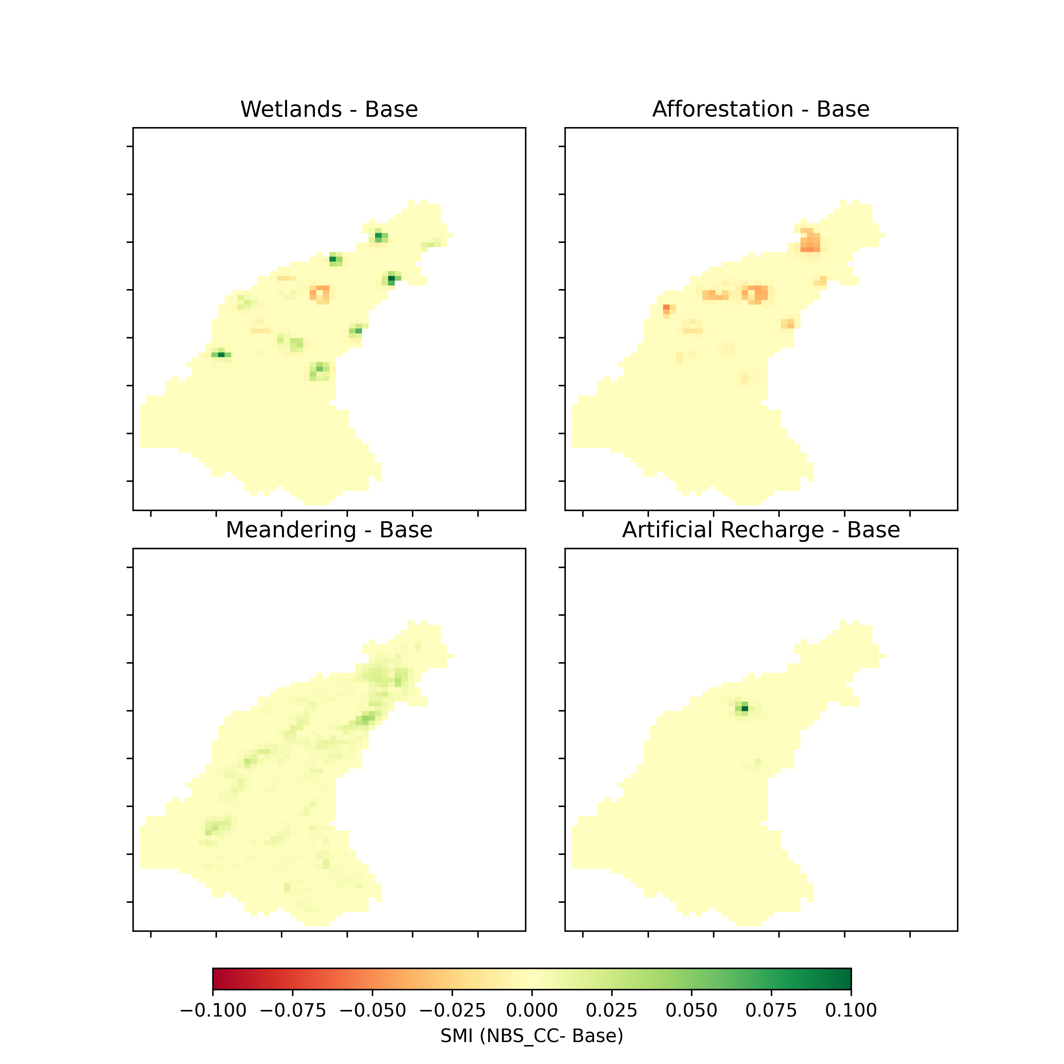
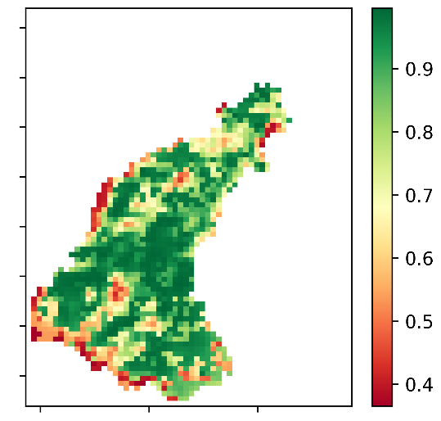
Investigating the effectiveness of Nature-Based Solutions (NBS) for climate change adaptation: The case study of Aa of Weerijs catchment, The Netherlands.
Irfan Nazar, Muhammad Haris Ali, Claudia Bertini, Ioana Popescu, Andreja Jonoski, and Schalk Jan van Andel
1Hydroinformatics department, IHE Delft Institute for Water Education, Westvest 7, 2611 AX Delft, Netherlands
Introduction & Background
Research Methodology
CLC 2018 & NHI
Correlation Coefficient (R)
Wetlands
Anthropogenic climate change is leading to increased frequency, intensity, and societal impacts of hydro-meteorological hazards.
To combat this Adaptation strategies are needed.
Study has been carried in drought-prone Aa of Weerijs catchment.
In the recent past, NBS have gained prominence as an adaptation strategy.
Robustness of NBS is under question.
Selected NBS have been evaluated in coupled MIKE SHE- MIKE 11 model.
EU DEM v1.1
LUCAS
Base Model
NBS
KPIs
CC & NBS
Figure 2. Main methodology steps
Observed GWLs
Figure 1. Location & Topography of the study area
Calibrated at 16 points for groundwater (13) and river discharges (3)
Transboundary between Belgium and The Netherlands
Area: 346 km²
Land Use: Pastures and complex cultivation pattern
Soil Type: Loam and sandy loam
Input Data
Coupled MIKE SHE – MIKE 11 model
Figure 4. Wetland locations
Figure 3. Base model set-up
Water Stress Ratio
Soil Moisture Index
Surface Water Availability
Selected Cell Based ET, GW & WC
Partial & full ban days
Groundwater Water Availability
Figure 5. River Meandering in Aa of Weerijs
Partial & full ban days
Figure 7. KNMI’14 Scenarios
Base Model Results
Climate Change Impact
Figure 6. Key Performance Indicators
NBS Performance under future climate conditions
(a)
(b)
Figure 6. Surface water availability
Figure 7. Groundwater availability partial ban days (a), full ban days (b)
Figure 14. Surface Water Availability
Figure 15. Groundwater Availability
Figure 10. Surface Water Availability
Figure 11. Groundwater Availability
Figure 16. Water stress ratio
Figure 8. Water stress ratio
Figure 9. Soil Moisture Index
Figure 12. Water stress ratio
Figure 13. SMI
Figure 17. SMI
Conclusions
Acknowledgement
The study highlights the importance of considering the complexity and magnitude of the issue when employing Nature-Based Solutions (NBS) and the effectiveness of using MIKE SHE for modeling wetlands, afforestation, meandering, and artificial recharge. It also emphasizes the trade-off between different water balance components and the limited sphere of influence for NBS interventions, which must be appropriately implemented to have a significant impact on the system.000
Research presented here is done under European Union’s Horizon 2020 research and innovation programme: the EIFFEL project (Grant No. 101003518)

