Slide 1
Evaluation of continental-scale ensemble hydrological forecasts from Environment and Climate Change Canada (ECCC): a comparison with forecasts from the Global Flood Awareness System (GloFAS)
Vincent Fortin¹, Silvia Innocenti¹, Étienne Gaborit¹, Dorothy Durnford², Sétigui Keita², Jacob Bruxer³, Marie-Amélie Boucher⁴, Shaun Harrigan⁵, Ervin Zsoter⁵, Milena Dimitrijevic¹, Caroline Sévigny³, Nicole O’Brien³ and Natalie Gervasi³
¹Meteorological Research Division, ECCC ²Meteorological Service of Canada, ECCC ³National Hydrological Service, ECCC ⁴Civil and Building Engineering Dept., U. Sherbrooke ⁵Forecast Department, ECMWF
EGU General Assembly, April 24th 2023

Slide 2
Motivation
GloFAS and NSRPS are two continental-scale prediction systems providing ensemble hydrological forecasts over Canada
Although both GloFAS and NSRPS have been compared to observations, there has been limited comparison of either to other forecasting systems
There is growing interest in Canada towards the use of continental-scale ensemble hydrological forecasting systems, in particular where no other forecasting system is available or as additional guidance to improve skill of local forecasts
An interesting and related practical question is whether forecast quality can be improved by combining GloFAS and NSRPS forecasts and/or post-processing forecasts based on local observation data

Slide 3
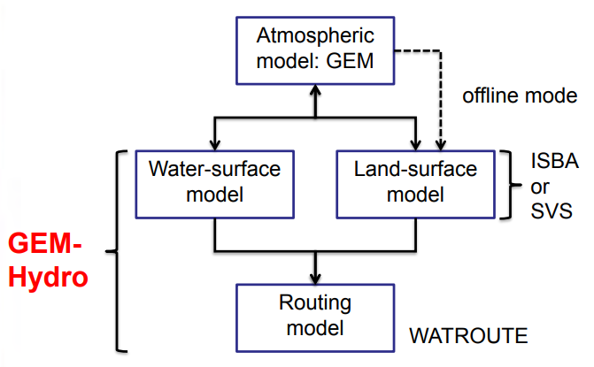
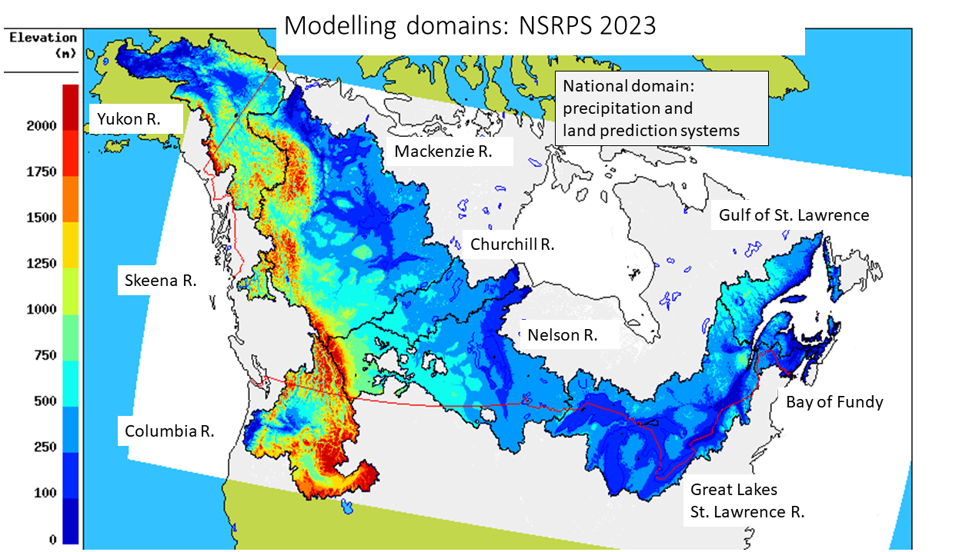
ECCC’s National Surface and River Prediction System (NSRPS)
Offline mode
SVS LSM
slab lake model

Slide 4
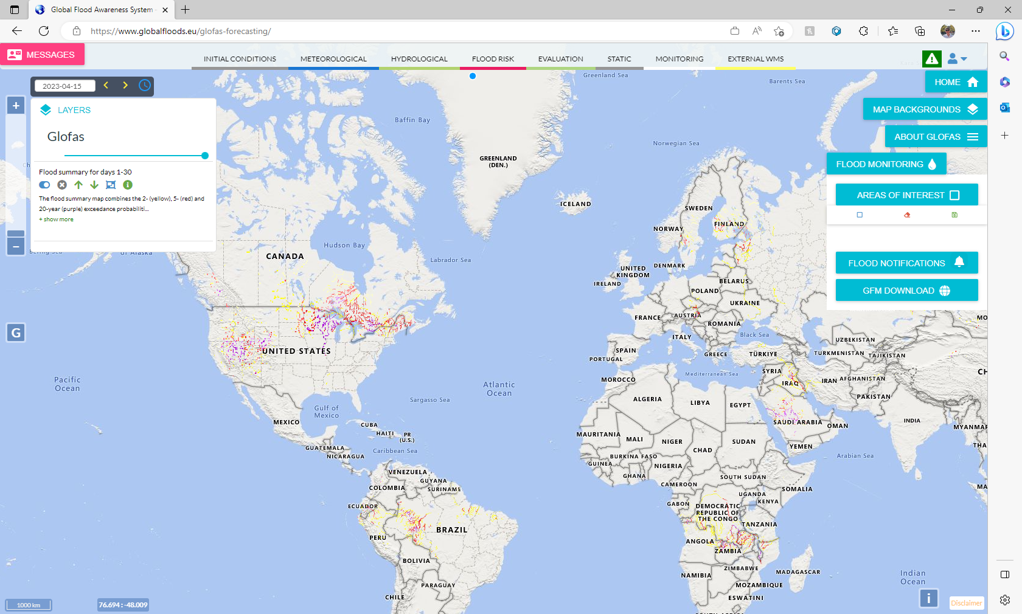
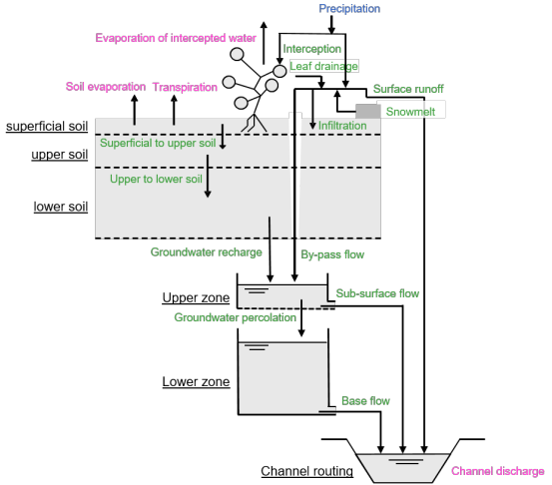
Global flood awareness system (Glofas)
Modelling system based on Lisflood
Developed by Copernicus Emergency Management Service (CEMS)
Forced by ECMWF analyses and forecasts

Slide 5
NSRPS from ECCC vs GLOFAS from CEMS (Versions Operational in 2022)
NSRPS
Resolution: ~ 2.5 km / 1 km
GloFAS
Resolution: ~ 10 km
Covers ~ 50% of Canada
20+1 members
Currently uncalibrated
Assimilation of precip. (radar + in-situ), soil moisture (SMOS+SMAP), snow cover (IMS) and streamflow obs. (in-situ)
Global coverage
50+1 members
Calibrated at some locations
Relies on ERA-5 forcing for initial conditions (no assimilation of precipitation data)
In both systems, ensemble spread reflects only uncertainty in weather forecasts.
Underdispersive forecasts are expected as other sources of uncertainty are ignored.

Slide 6
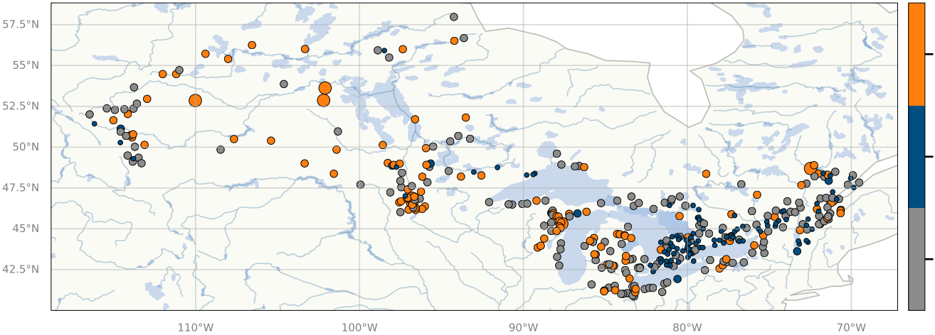
Evaluation Dataset
394 watersheds
≥ 96 km²
for which differences in
watershed delination can be
explained by
differences in resolution
Watersheds with
reservoirs modelled
in GloFAS were
excluded from the
analysis
300
280
260
240
220
200
nb. valid obs.
N. valid obs over evaluation period
2022-02-13 – 2022-12-16
> 2000 km² (n=107)
500 – 2000 km² (n=184)
Drainage area
96 – 500 km² (n=103)

Slide 7
Verification Metrics
Mean daily specific flow is scored (Q/DA) using the Continuous Ranked Probability Score (CRPS) and its decomposition into reliability and potential components
Lower score means better performance, ideal = 0

Slide 8
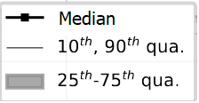
NSRPS
• Mean
CRPS increases with lead time,
i.e. forecast quality as measured by CRPS decreases with lead time for NSRPS
CRPS decreases with lead time,
i.e. forecast quality improves with lead time for GloFAS !?
This behaviour is due to an improvement in reliability with time (see next slide)
• Mean
GloFAS
GloFAS
Distribution of score across watersheds is shown for each lead time

Slide 9
NSRPS
• Mean
GloFAS
GloFAS
Distribution of score across watersheds is shown for each lead time

Slide 10
NSRPS
• Mean
GloFAS
GloFAS – NSRPS
GloFAS – NSRPS > 0 means that NSRPS is better

Slide 11
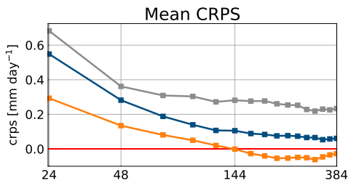
Difference in crps (GLOFAS – NSRPS) Stratified by Drainage Area
Δ CRPS
GloFAS – NSRPS
Difference in performance becomes smaller with time and watershed size
GloFAS outperforms NSRPS for week 2 on the larger watersheds (> 2000 km²)
Δ
Distribution of score across watersheds is shown for each lead time
GloFAS – NSRPS > 0 means that NSRPS is better

Slide 12
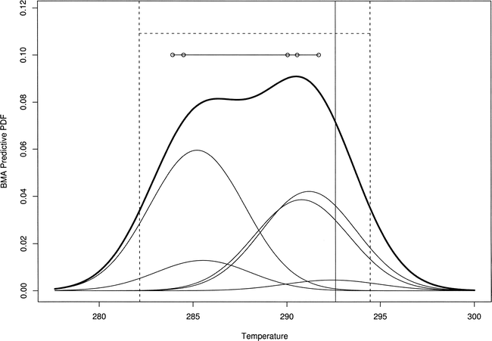
Ensemble BMA Method
Assuming two sets of exchangeable members:
NSRPS (N₁=20) GloFAS (N₂=50)
p(M_{k,1}|y^{T})=p/N₁ p(M_{k,2}|y^{T})=(1–p)/N₂
a_{k,1} = a₁ a_{k,2} = a₂
b_{k,1} = b₁ b_{k,2} = b₂
σ_{k,1} = σ ₁ σ _{k,2} = σ ₂
k
Data transformation:
^{f}_{k} = $\sqrt{Q_{k}}$
y = $\sqrt{Q_{o}}$
Training period:
45 days before the date the forecast is issued
Watersheds > 2000 km², for which NSRPS and GloFAS forecast skill is similar, are considered
Figure reproduced from Raftery et al. (2005). Monthly Weather Review, 10.1175/MWR2906.1, © American Meteorological Society. Used with permission.
For more details on the ensemble BMA method see Fraley et al. (2010). Monthly Weather Review, 10.1175/2009MWR3046.1

Slide 13
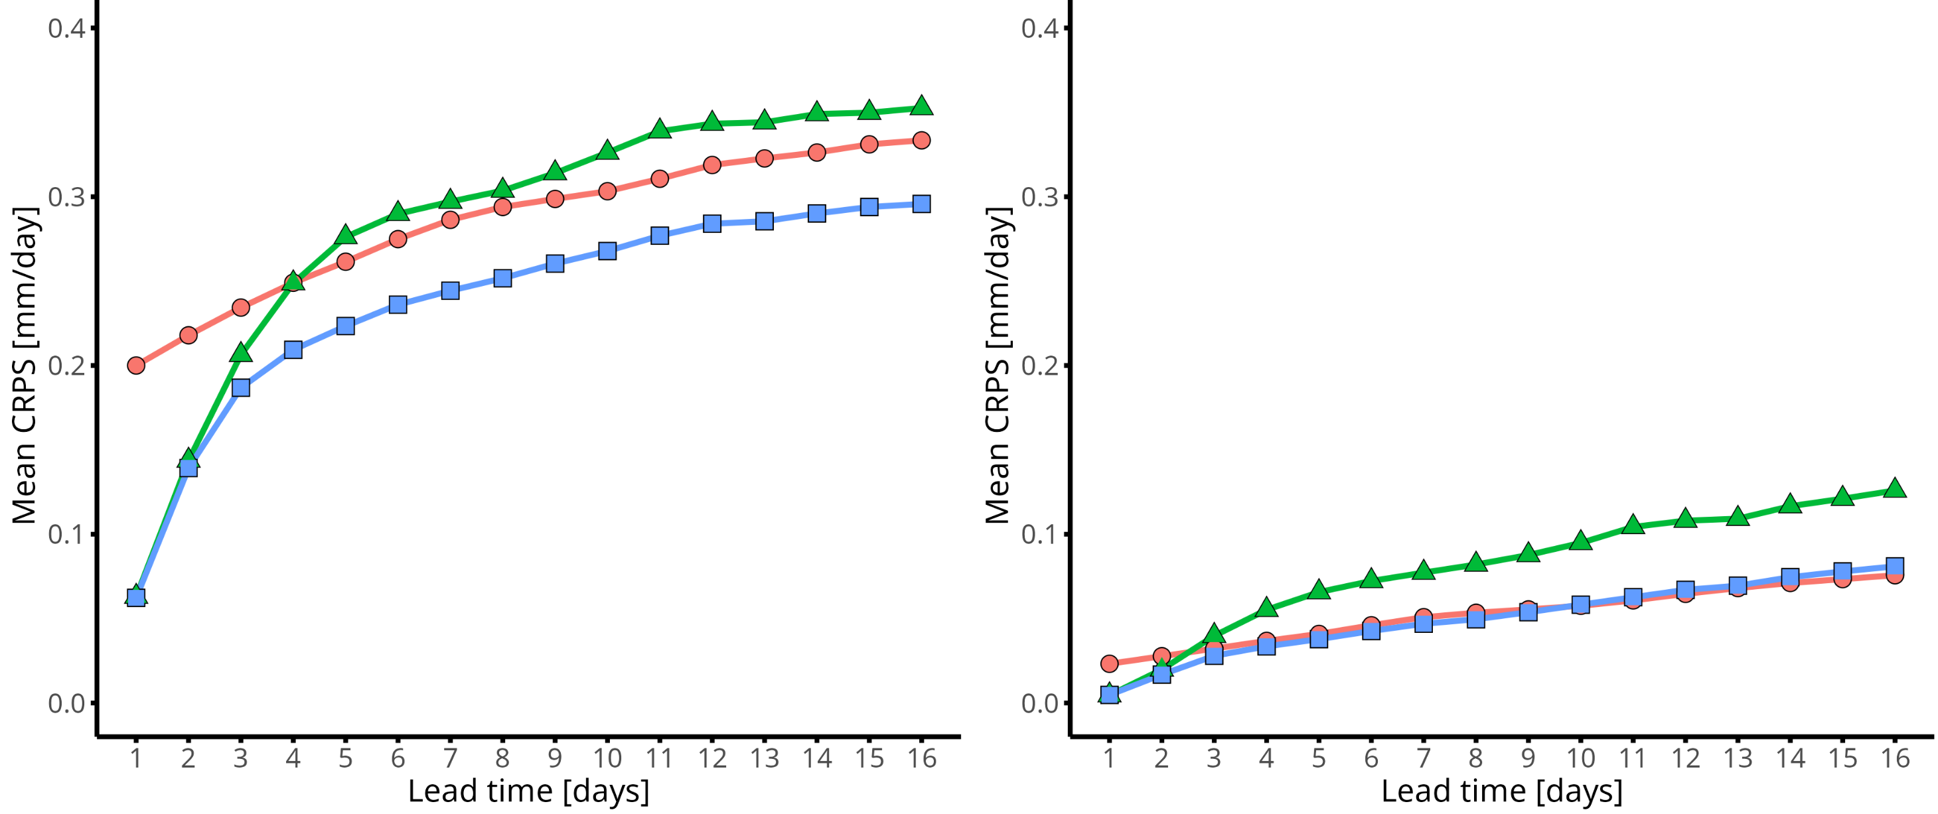
Better performance of GloFAS can be explained by improved reliability.
Multi-model forecasts more reliable for first week, and only slightly worse than GloFAS forecasts for second week
CRPS as a function of lead time after post-processing with the Ensemble BMA method
GloFAS performs better than NSRPS for days > 4
Multi-model forecasts have equivalent or better skill for all lead times

Slide 14
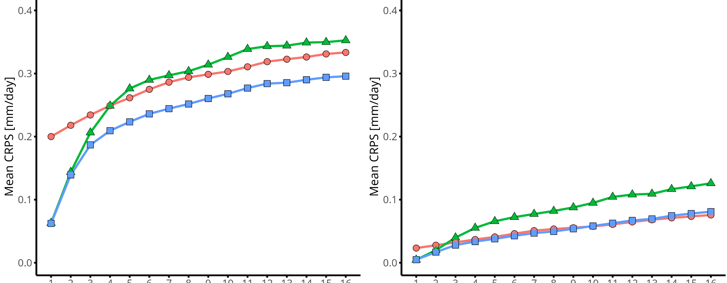
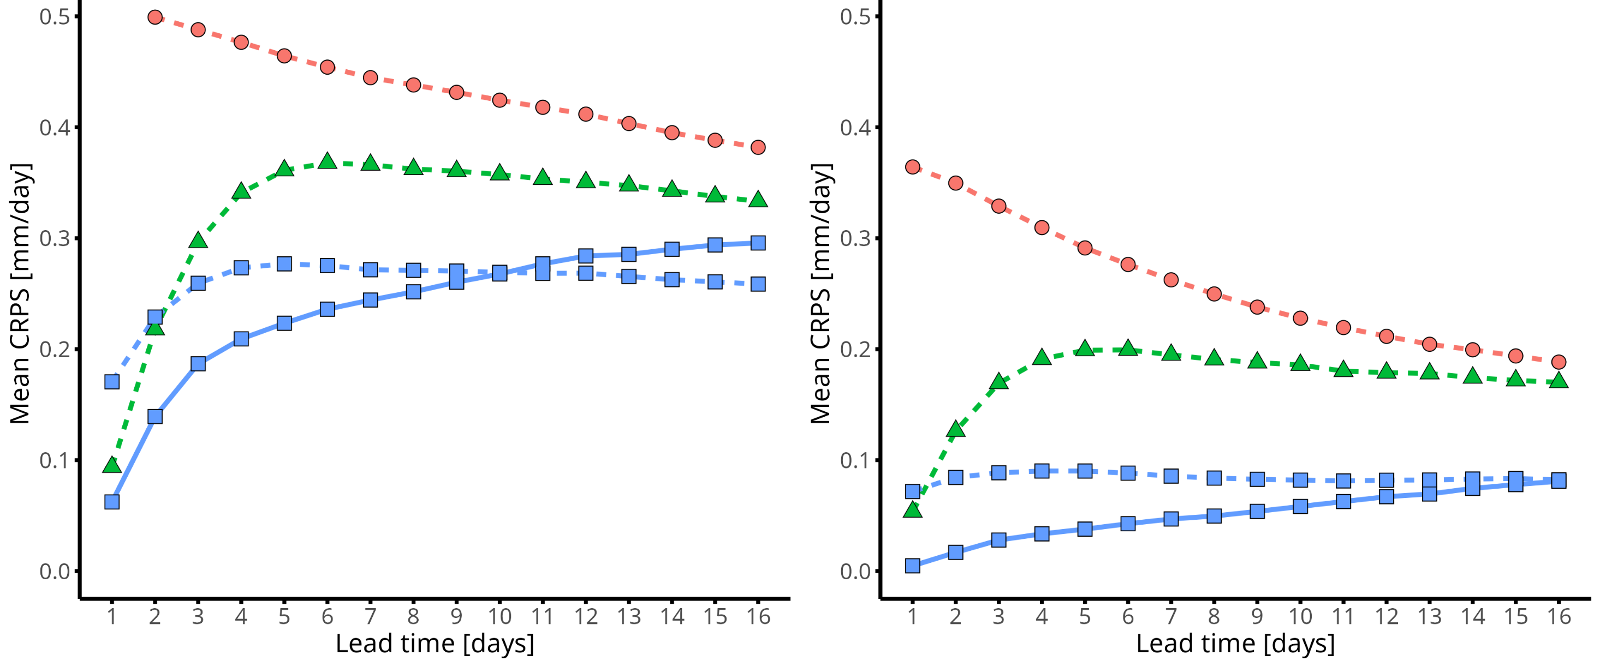
Better performance of GloFAS can be explained by improved reliability.
Multi-model forecasts more reliable for first week, and only slightly worse than GloFAS forecasts for second week
CRPS as a function of lead time after post-processing with the Ensemble BMA method
CRPS before (dashed line) and after (solid line) post-processing
GloFAS performs better than NSRPS for days > 4
Multi-model forecasts have equivalent or better skill for all lead times
Post-processed multi-model forecasts more reliable than raw forecasts for all lead times
Post-processed multi-model forecasts more skillful than raw forecasts for first 10 days

Slide 15
Conclusion
Forecasts issued by ECCC’s NSRPS generally outperform CEMS’s GloFAS
However, for watersheds larger than 2000 km²:
GloFAS outperforms NSRPS starting on day 6 (day 5 with post-processing)
Multi-model forecasts offer the best performance for all lead times
Post-processing using ensemble BMA improves CRPS further for up to 10 days
Future work will involve optimizing the configuration of the ensemble BMA method and taking into account the impact of planned upgrades to both NSRPS and GloFAS in the near future
We expect post-processed, multi-model ensemble forecasts to outperform raw ensemble forecasts from either NSRPS or GloFAS for the foreseable future, even with anticipated upgrades to both systems

