Slide 1
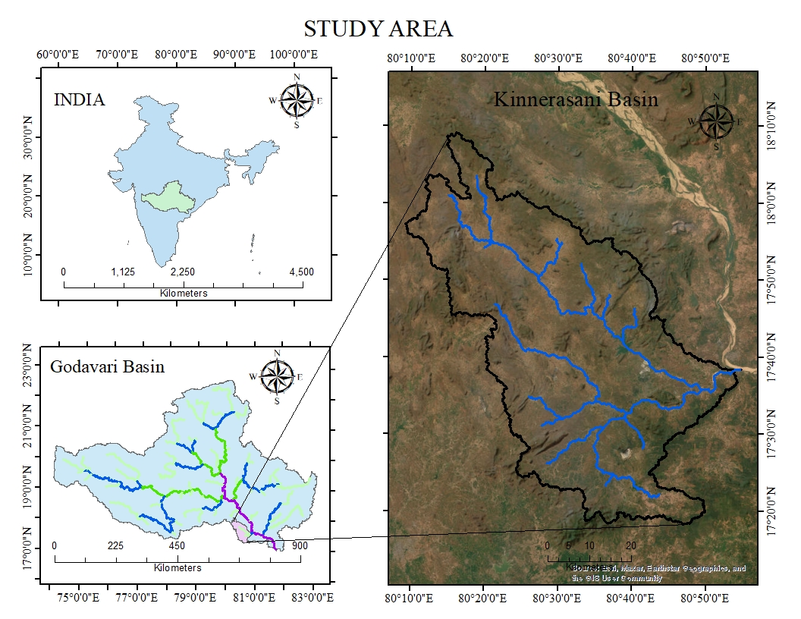
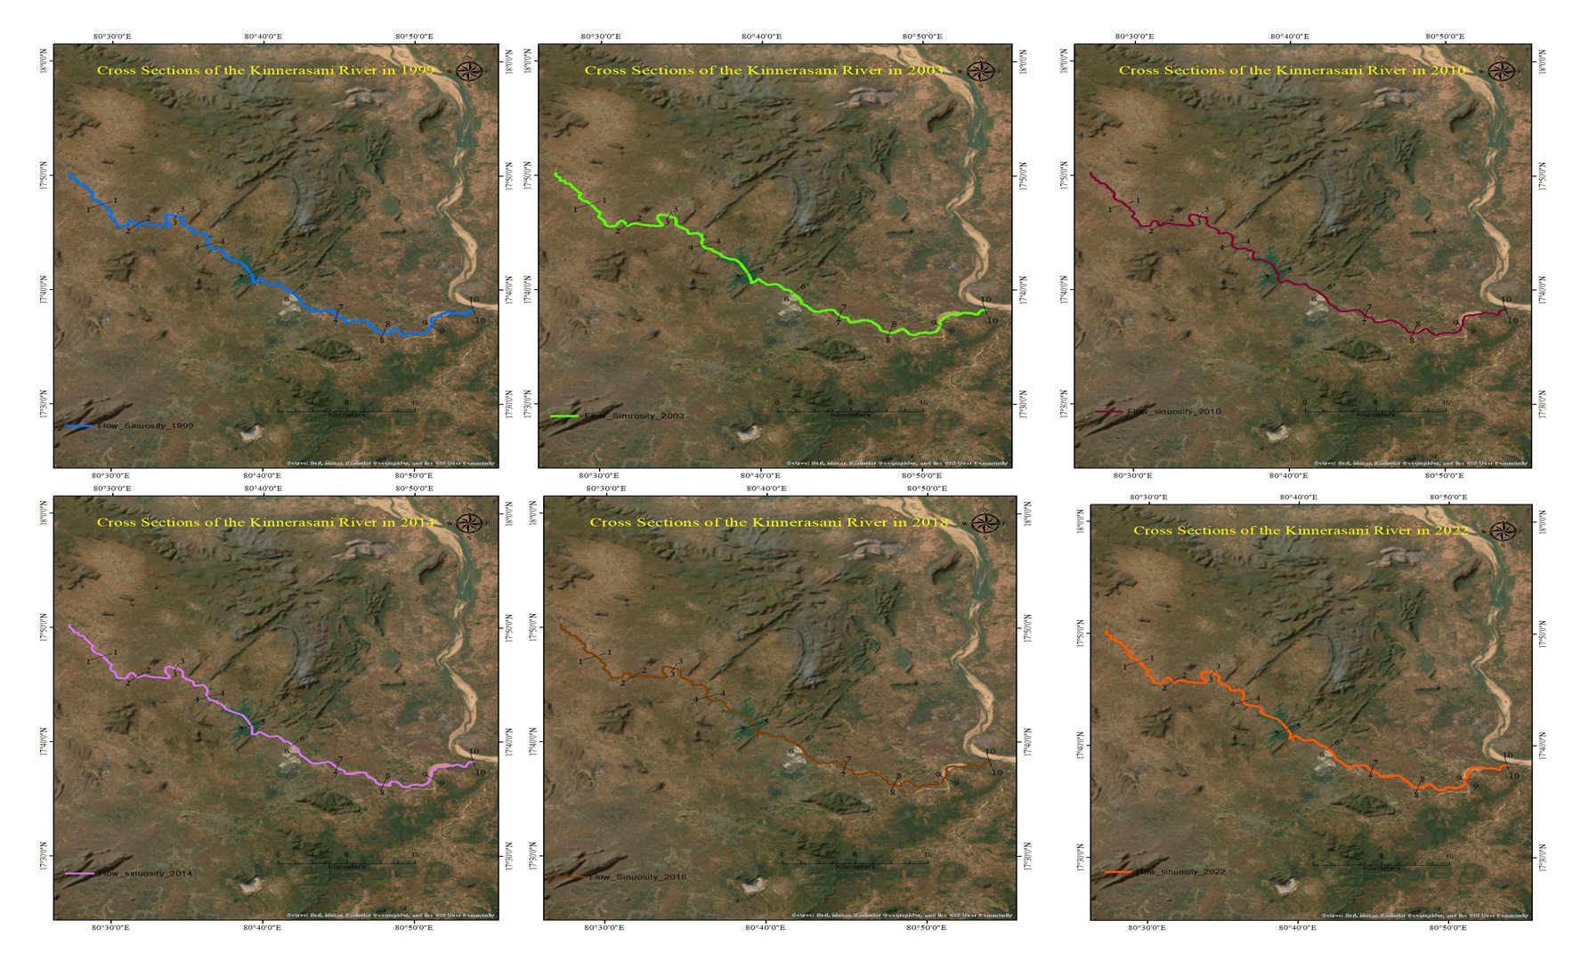
Analyzing the behavioral changes of various fluvial geomorphological parameters using multi-temporal satellite images for the Godavari River, India
Thallam Prashanth and Sayantan Ganguly
Department of Civil Engineering, Indian Institute of Technology Ropar, Rupnagar, Punjab 140001, India
Introduction and Objectives
Workflow
Results
Fluvial geomorphology is the study of various landforms while analyzing the changes that are happening on the earth surface due to climate change and anthropogenic activities. Fluvial geomorphological parameters change due to natural processes like erosion, transportation, and deposition of sediments.
Objectives:
To analyze the changes in various fluvial geomorphological parameters of the Kinnerasani basin, A sub-basin of Godavari River such as Topographic sinuosity index (TSI), Hydraulic Sinuosity Index (HSI), Standard Sinuosity Index (SSI), braiding index, etc.
To perform a river bank shifting analysis by using the various satellite images at different time scales.
To quantify Morphological parameters using ALOS PALSAR Digital Elevation Model (DEM) for the Kinnerasani sub-basins of the Godavari river.
Landsat-5/7/8 and Sentinel-2 TM satellite images
Geometric Correction and Smoothening
Preparation of Standard FCC
Sinuosity Indices
Channel Index (CI)
Valley Index (VI)
Hydraulic Sinuosity Index (HSI)
Topographic Sinuosity Index (TSI)
Standard Sinuosity Index (SSI)
Digitization of River bank and Braided landforms
Braided Indices
Braided Index (BI)
River Water Spread Area Index (RWSAI)
Figure 7: Cumulative shift of the Right riverbank from the year 1994
Figure 3: Workflow of this study
Fluvial geomorphological parameters:
$CI=\frac{CL}{Air length}$
$$BI=\frac{2∗{\sum{L}}_{b}}{L_{r}}+\frac{N_{b}}{L_{r}}$$
$$RWSAI=1−\frac{A_{b}}{A_{r}}$$
CL = Channel Length (m)
VL = Valley Length (m)
L_{b} = Length of the bar (m)
A_{b} = Area of the bar (sq.m)
N_{b} = Number of the bars
A_{r} = Area of the River (sq.m)
$VI=\frac{VL}{Air length}$
$$HSI=\% equivalent of \frac{CI−VI}{CI−1}$$
$$TSI=\% equivalent of \frac{VI−1}{CI−1}$$
$TSI+HSI=1$(Mueller, J.E., 1968)
$$SSI=\frac{CI}{VI}$$
Figure 8: Cumulative shift of the Left riverbank from the year 1994
Conclusions:
The following conclusions can be made from the study:
As per the Standard Sinuosity Index (SSI), the Kinnerasani River can be classified as a meandered river. The SSI value is found to increase w.r.t time.
It is observed that the Hydraulic Sinuosity Index is greater than Topographic Sinuosity Index. Therefore, channel hydraulics is playing a major role in the meandering phenomenon for this river. The maximum shift of the river bank at rate of 11.42 m/year for a period of 28 years (1994-2022).
The study also concludes that the Burgampadu township situated in close vicinity of about 500 m from the Kinnerasani River has become vulnerable to flooding due to shifting of river bank.
It is observed that the braiding index is increasing w.r.t time, due to improper watershed management in the basin. Due to this, the river water spread area index (RWSAI) is decreasing with time.
As the RWSAI is decreasing w.r.t. time, the river is losing its capacity to control the streamflow obtained from the rainfall during monsoon season.
Proper riverbank protection works and disaster management plans must be carried out immediately to mitigate this catastrophe.
Figure 1: Index map of the Study Area
Input Datasets
Results
Figure 4: Sinuosity Indices w.r.t time
Figure 5: BI and BD w.r.t time
Table 1: Morphological parameters of the Kinnerasani Basin
https://www.downtoearth.org.in/news/climate-change/how-climate-change-has-increased-flood-events-in-india-65649 (Last accessed: 22-08-2022)
References:
Linear and Areal Aspects of the Kinnerasani River | Value
Bifurcation Ratio | 3.33
Stream length ratio | 0.42
Rho coefficient | 0.126
Drainage density | 0.113
Stream Frequency | 0.0078
Form factor | 0.338
Circulatory ratio | 0.655
Elongation ratio | 0.19
Mueller, J.E., 1968. An introduction to the hydraulic and topographic sinuosity indexes. Ann. Assoc. Am. Geogr. 58 (2), 371–385.
Thallam ,P., Ganguly,S.,2022. Perenniality Analysis of the Godavari River, India by using River Perenniality Index. American geophysical Union(AGU) fall meeting.
Figure 2: Cross-sections of the Kinnerasani River with respect to time
Figure 6: RWSAI w.r.t time

