Slide 1
A comparative study of UAV-based 3D point cloud analyses
on landslide volume estimation for progressive rockslide
Kuei-Ying Chang, Wei-Kai Huang, Cheng-Han Lin and Ming-Lang Lin

Slide 2
Content
The parameter setting
Sliding and accumulation area
Failure mechanism
Comparison of contour by using DoD and M3C2

Slide 3
The parameters setting

Slide 4
Iterative Closest Points (ICP)
parameter | value
overlap | 50 %
Sampling rate | 50 %
RMS difference | 10⁻⁵
Multiscale model-to-model cloud comparison
parameter | value
Normal Diameter (m) | 2
Projection Diameter (m) | 2
Depth (m) | 60
Subsample cloud (m) | 0.1

Slide 5
Sliding and accumulation area

Slide 6
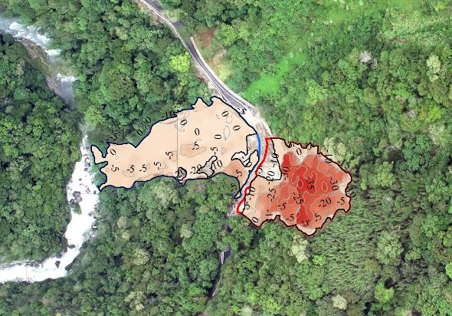
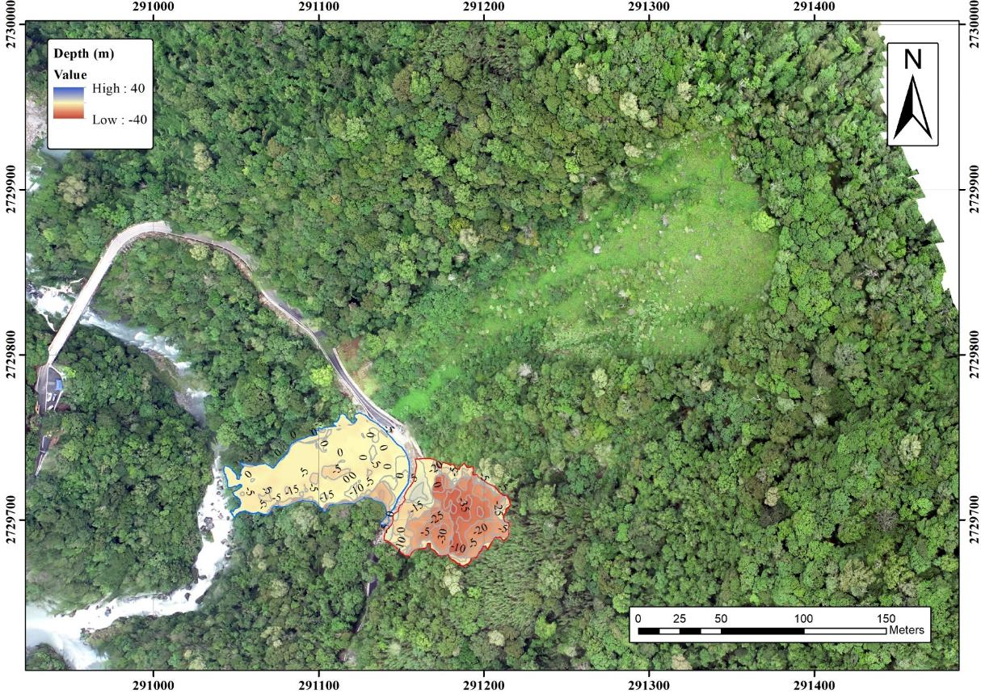
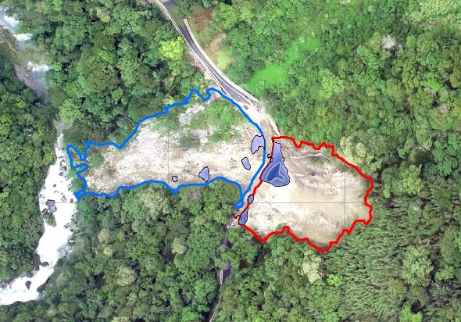
Event1 (UAV survey: 2022/09/14)
sliding
accumulation

Slide 7
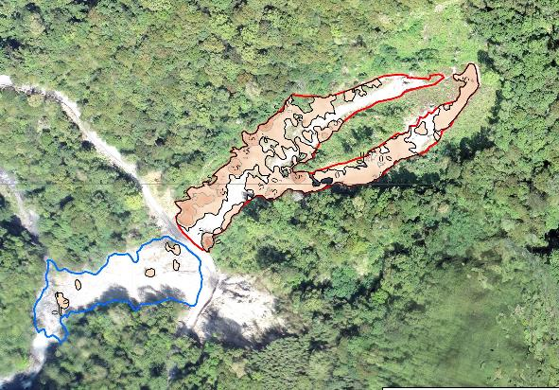
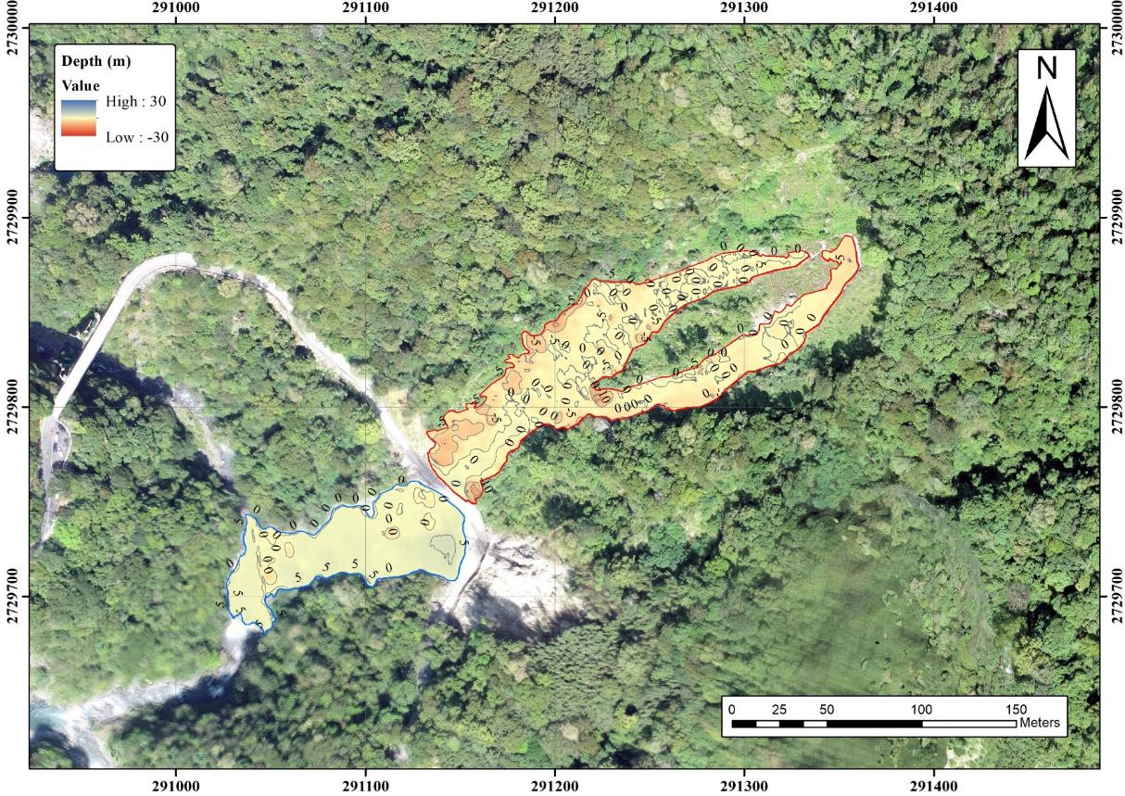
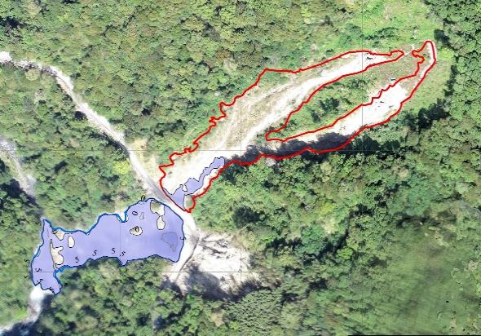
Event2 (UAV survey: 2022/10/03)
sliding
accumulation

Slide 8
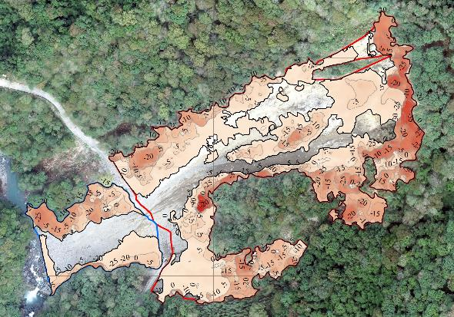
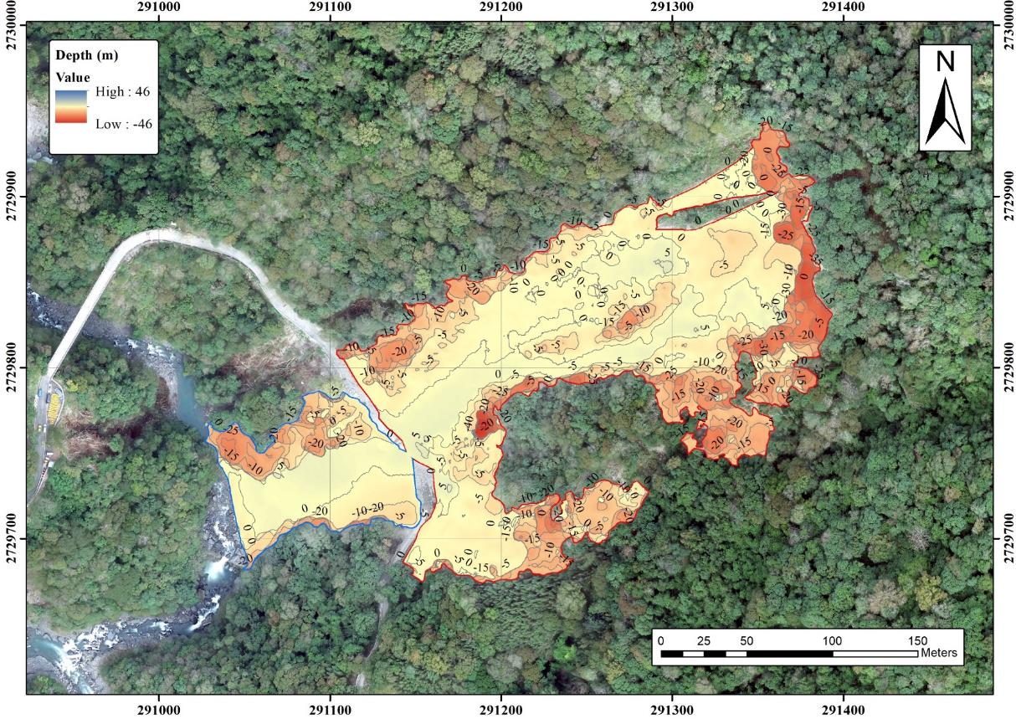
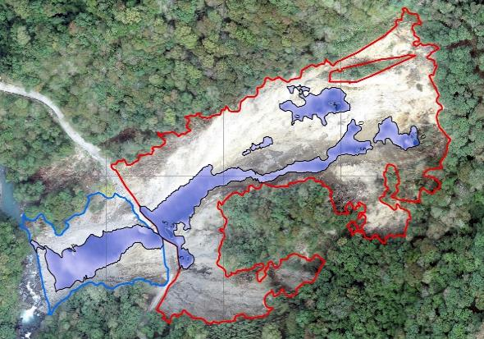
Event3 (UAV survey: 2022/11/22)
sliding
accumulation

Slide 9
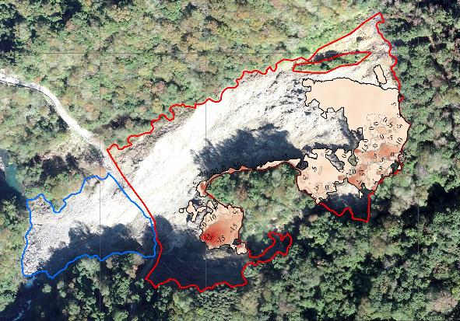
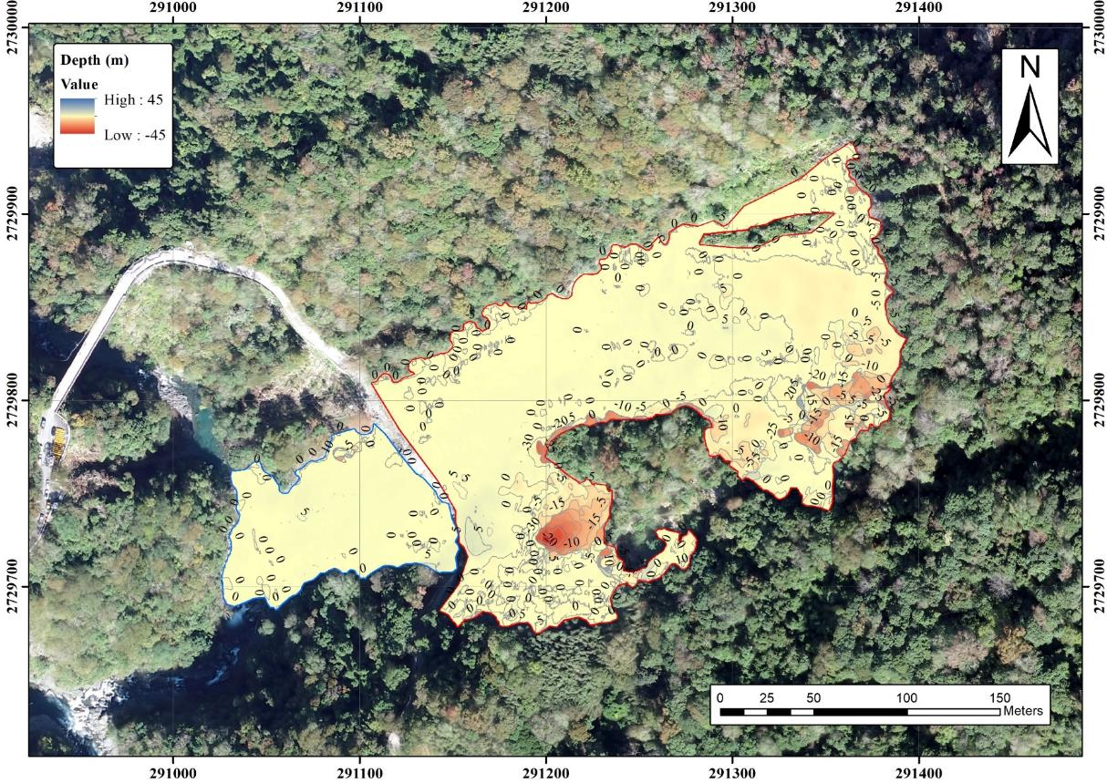
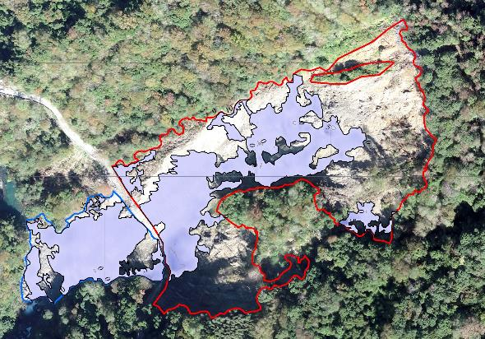
Event4 (UAV survey: 2022/12/19)
sliding
accumulation

Slide 10
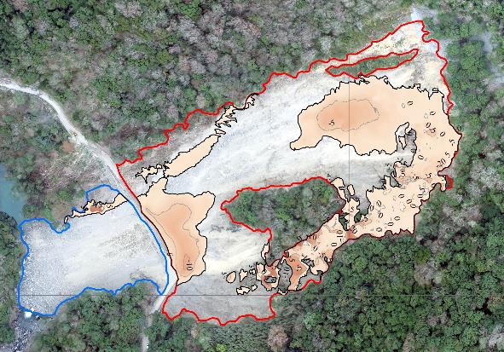
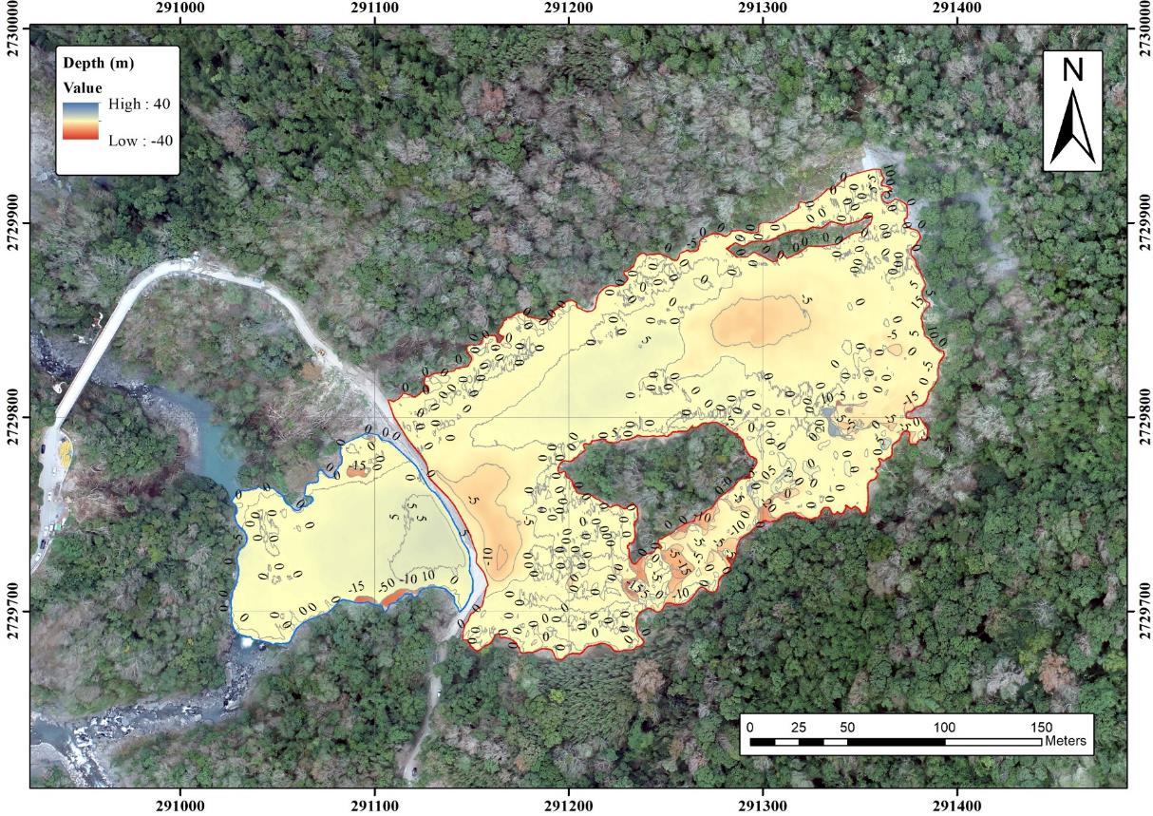
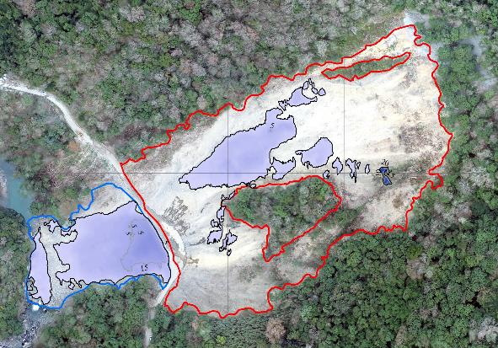
Event5 (UAV survey: 2023/02/03)
sliding
accumulation

Slide 11
Failure Mechanism

Slide 12
Event1 (UAV survey: 2022/09/14)
- Rockslide
A
A’
Highway
A
A’

Slide 13
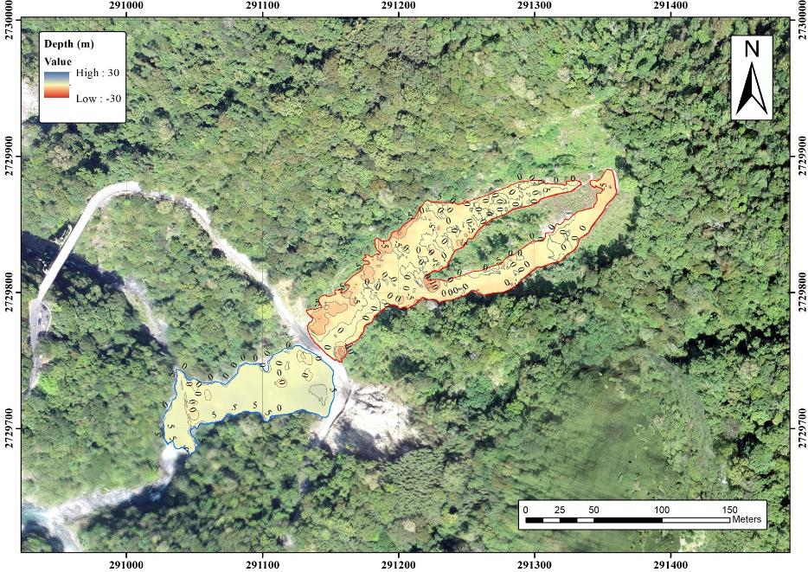
Event2 (UAV survey: 2022/10/03)
- Rock avalanche
B
B’
B’
Highway
B

Slide 14
Event3 (UAV survey: 2022/11/22)
- Rockfall
C
C’
C’
Highway
C

Slide 15
Event4 (UAV survey: 2022/12/19)
- Rockslide
D
D’
Highway
D’
D

Slide 16
Event5 (UAV survey: 2023/02/03)
- Debris avalanche
E
E’
E’
Highway
E

Slide 17
Comparison of contour
by using DoD and M3C2

Slide 18
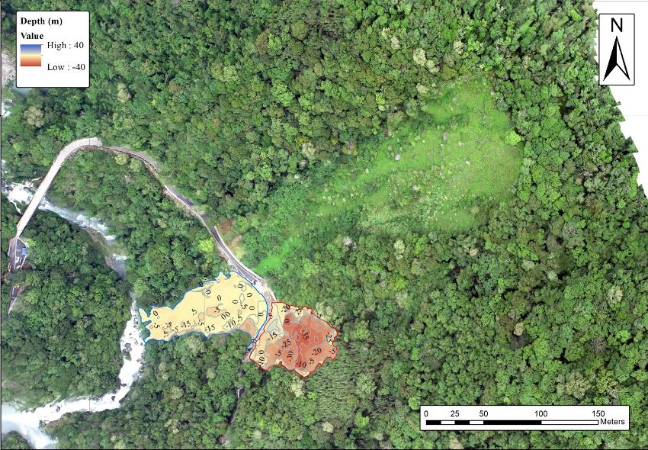
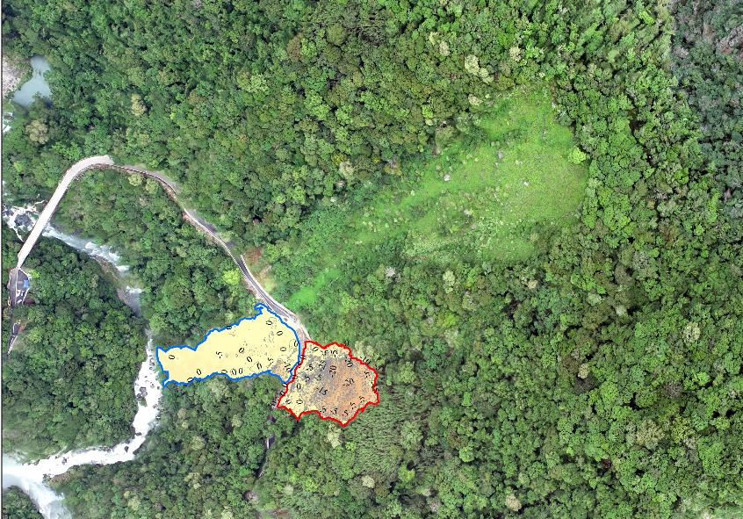
Event1 (UAV survey: 2022/09/14)
- DoD -
- M3C2 -

Slide 19
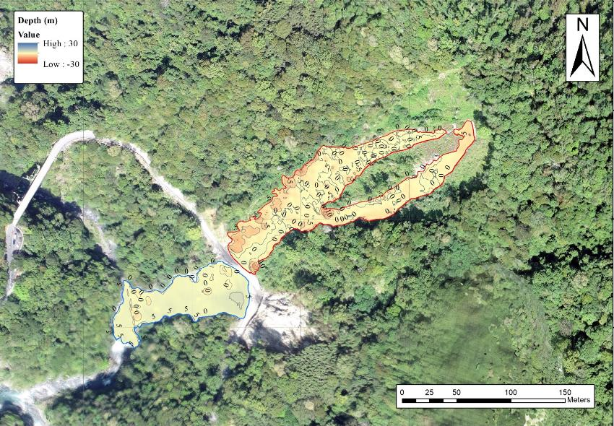
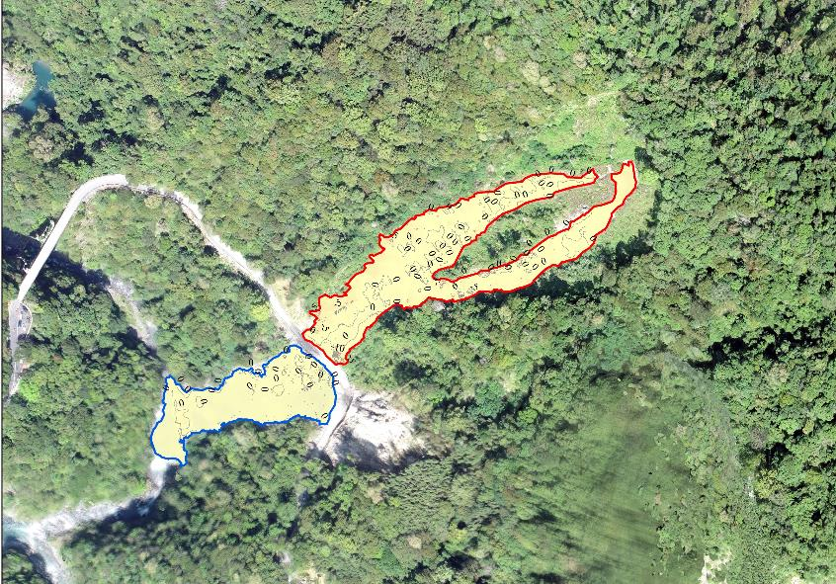
Event2 (UAV survey: 2022/10/03)
- DoD -
- M3C2 -

Slide 20
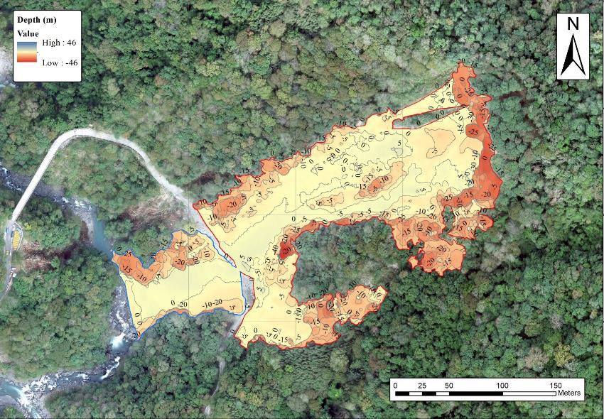
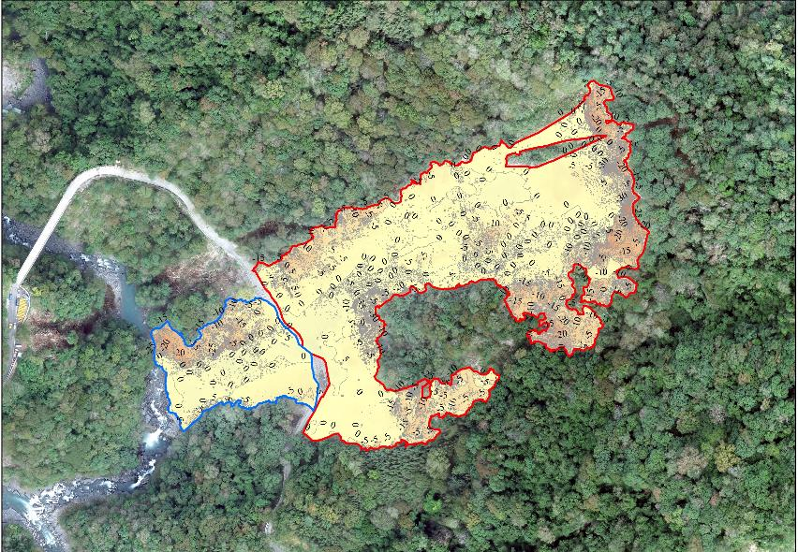
Event3 (UAV survey: 2022/11/22)
- DoD -
- M3C2 -

Slide 21
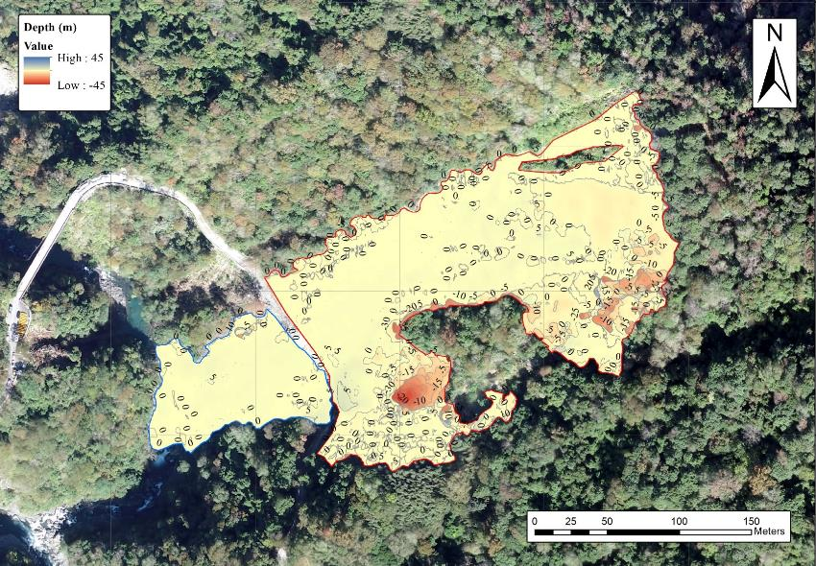
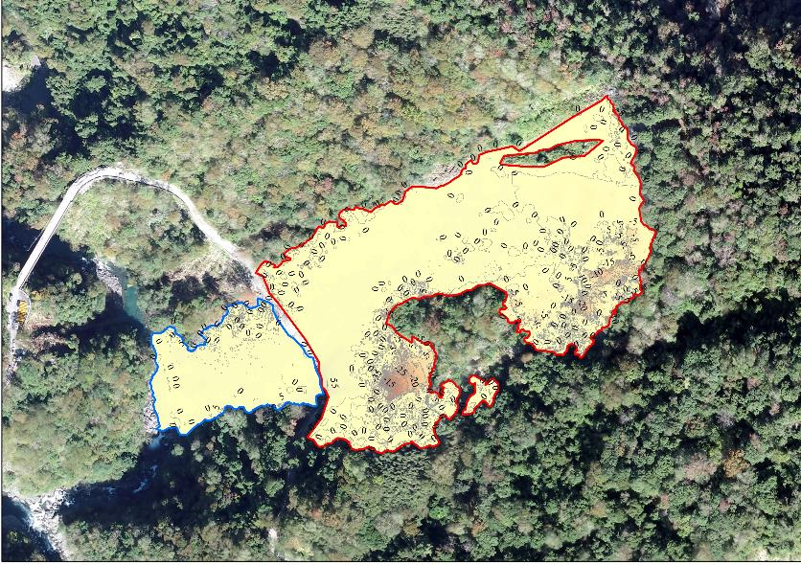
Event4 (UAV survey: 2022/12/19)
- DoD -
- M3C2 -

Slide 22
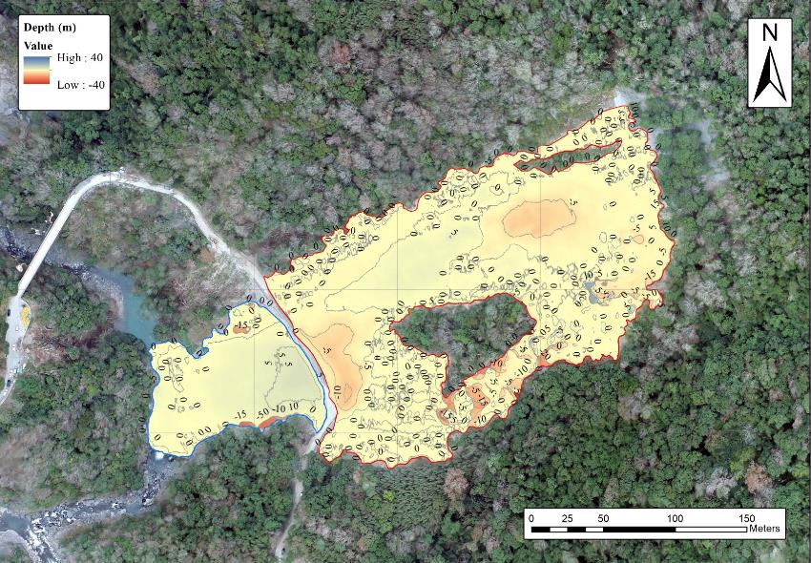
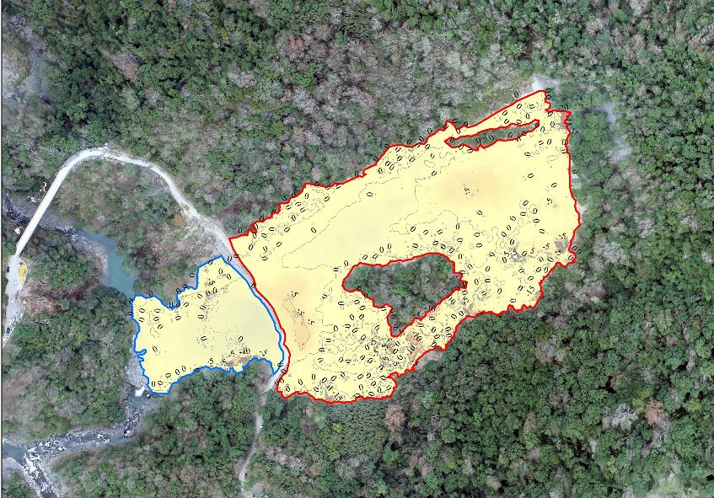
Event5 (UAV survey: 2023/02/03)
- DoD -
- M3C2 -

