Slide 1

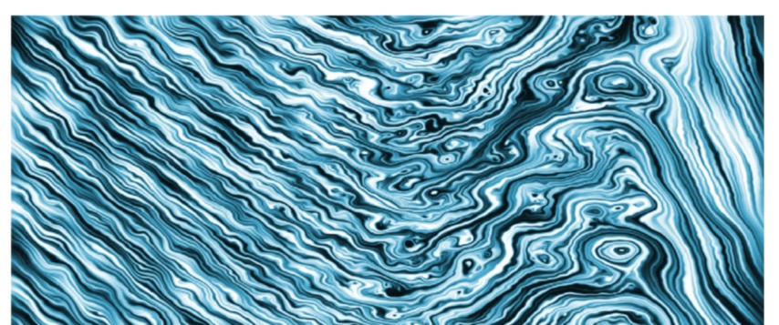

Generation and Decay of Reconnecting Current Structures Downstream of the Bow Shock:
3D Hybrid Simulations
Imogen Gingell¹ (i.l.gingell@soton.ac.uk)
S.J. Schwartz^{2,3}, H. Kucharek⁴, C. Farrugia⁴, L. Fryer¹, J. Plank¹, K. J. Trattner³
1 - Southampton, UK; 2 - Imperial College London, UK; 3 - LASP, Uni. Colorado, USA; 4 - Uni. New Hampshire, USA
Based on: Gingell et al. Physics of Plasmas 30, 012902 (2023);
doi:10.1063/5.0129084
Imogen Gingell
i.l.gingell@soton.ac.uk
Notes:
Observations of Earth’s bow shock have shown that a disordered or turbulent transition region can generate thin current sheets at ion and electron kinetic scales. Indeed, a recent survey of current sheets in the shock has shown that active reconnection occurs across the full range of shock parameters associated Earth’s bow shock. Furthermore, hybrid and particle-in-cell simulations have also shown that reconnection in the transition region can generate magnetic islands (in 2D), flux ropes (in 3D) and similar rope-like “twisted field” current structures. Using observations of Earth’s bow shock by NASA’s Magnetospheric Multiscale mission (MMS), we have identified several of these rope-like current structures embedded in the shock transition region. In each case the associated shock crossings also have observations of active magnetic reconnection. In contrast to typical models of flux ropes, several identified events exhibit an “inverted” rope-like structure for which the axial, core field is anti-parallel to the background, resulting in a full 360° rotation of the magnetic field. By examining the generation of reconnecting structures in hybrid particle-in-cell simulations, we show that these inverted rope-like structures can be generated by instabilities of whistler waves in the shock foot. The structures then contract as they are convected downstream towards the magnetosheath. Using multi-spacecraft analyses to measure size and contraction rates of the inverted rope-like structures observed by MMS, we associate our case studies with different stages of the life of these structures as seen in hybrid simulations. We also explore these current structures as sites for heating and particle acceleration.

Slide 2
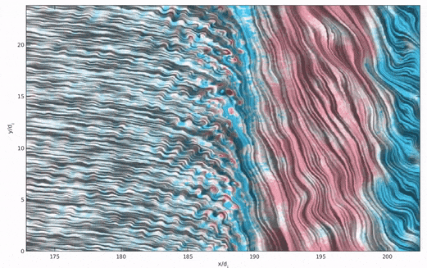
Generation of Reconnecting Current Structures at the Bow Shock - Simulations
Gingell et al. (2017): M_{A} = 8, θ_{Bn} = 40
Bessho et al. (2019, 2020): M_{A} = 11.4, 6.5, θ_{Bn} = 25
‘Long wavelength’ mode likely driven by the back-streaming ions.
‘Short wavelength’ mode associated with whistler waves & electron beams.
Lu et al. (2021): M_{A} = 9.5, θ_{Bn} = 60
Matsumoto et al. (2015): M_{A} = 40, θ_{Bn} = 90
Reconnection driven by an
ion Weibel instability, which generates filaments in the shock foot.
upstream
downstream
downstream
upstream
Which shocks exhibit which reconnection mechanisms?

Slide 3
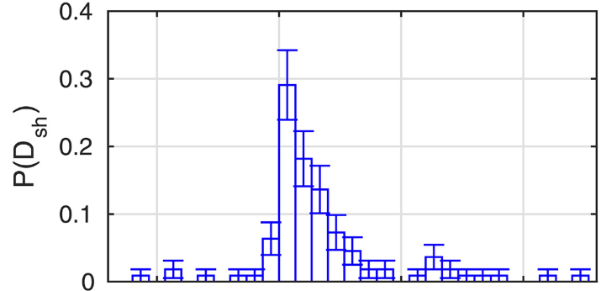

Decay of Reconnecting Current Structures Downstream – MMS Observations
How far downstream do shock-generated reconnection sites persist?
Survey of reconnecting current sheet location (Gingell et al. 2020)
The number of thin current sheets reduces with distance from the shock (Gingell et al. 2020), but…
The observed prevalence of current structures in the magnetosheath seems to be
not strongly affected by shock parameters.
(Gingell et al. 2021)
decay downstream
of shock
D_{sh}/R_{E}

Slide 4
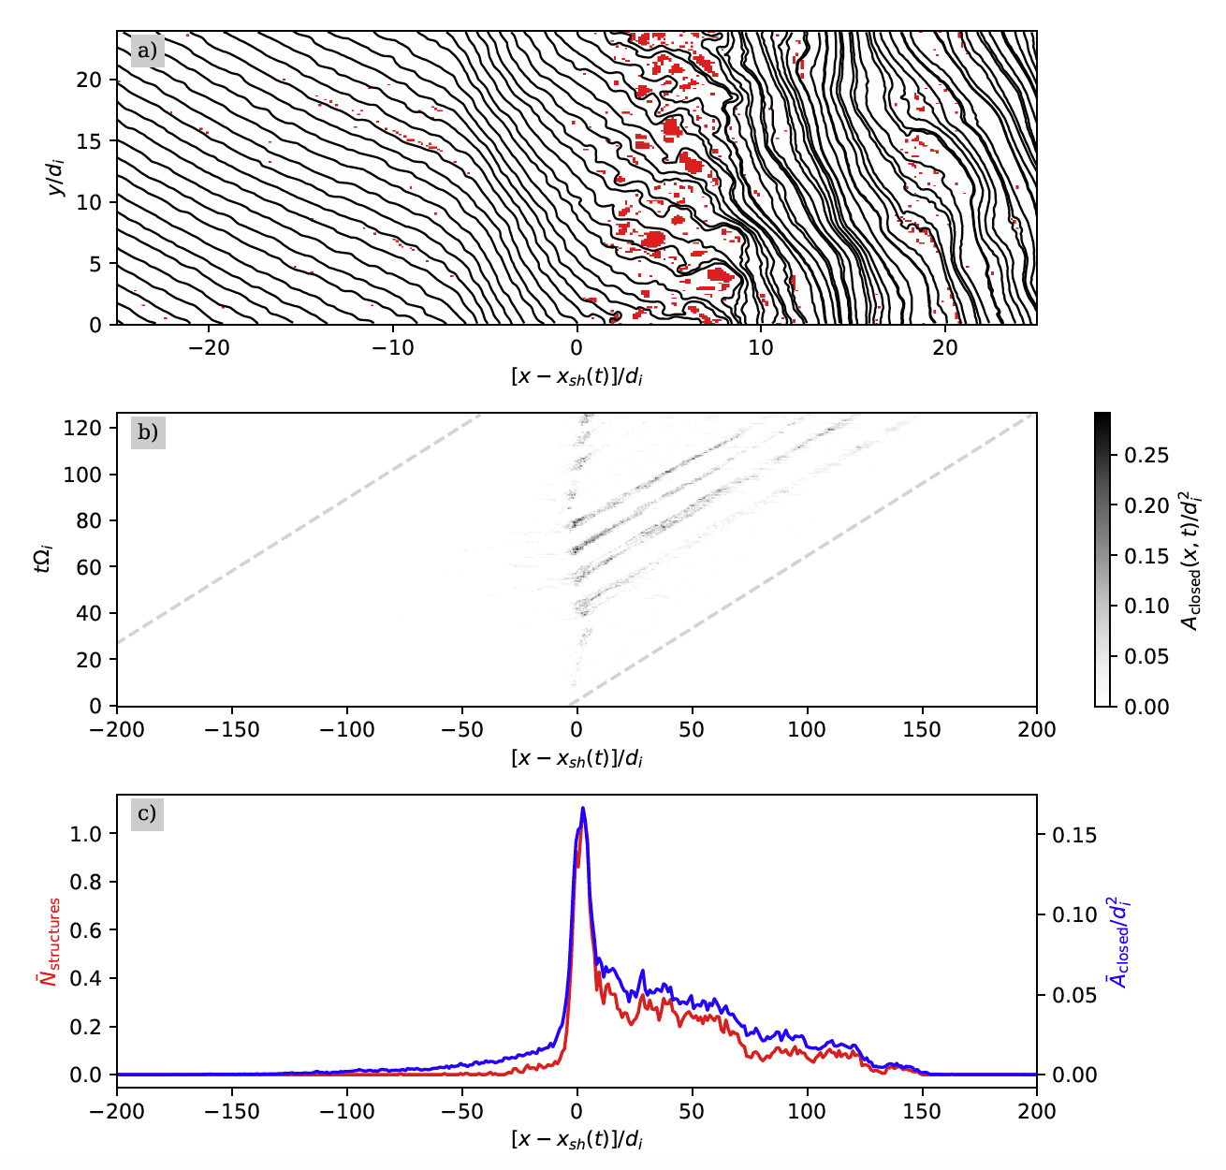
Quantifying Reconnection
Hybrid simulations over broad parameter range:
M_{A} = 3-14 θ_{Bn} = 10-80
Reconnection is quantified using:
area occupied by closed field lines, or
number of closed-field regions
To find regions:
Integrate magnetic field lines from the inflow boundary x=0, to the reflecting boundary at x=x_{max}
‘Closed field’ regions are all cells that are not crossed by any of those field lines.
For full method see:
Gingell et al. Physics of Plasmas 30, 012902 (2023); doi:10.1063/5.0129084
Integrate in y
modulated by
shock reformation
Average
in time
peaks in shock ramp
decays downstream

Slide 5
Parametric Explorations
More parallel shocks have
more closed field area upstream.
The downstream decay rate is not strongly affected by shock orientation, θ_{Bn}
M_{A} = 7.5
Fit a function
f ~ e^{-x/ξ}
Typically ξ ~ 100 d_{i}
(a few R_{E}) for quasi-parallel & super-critical shocks over a broad range of M_{A}
Reconnection by this mechanism occurs only for quasi-parallel shocks.

Slide 6
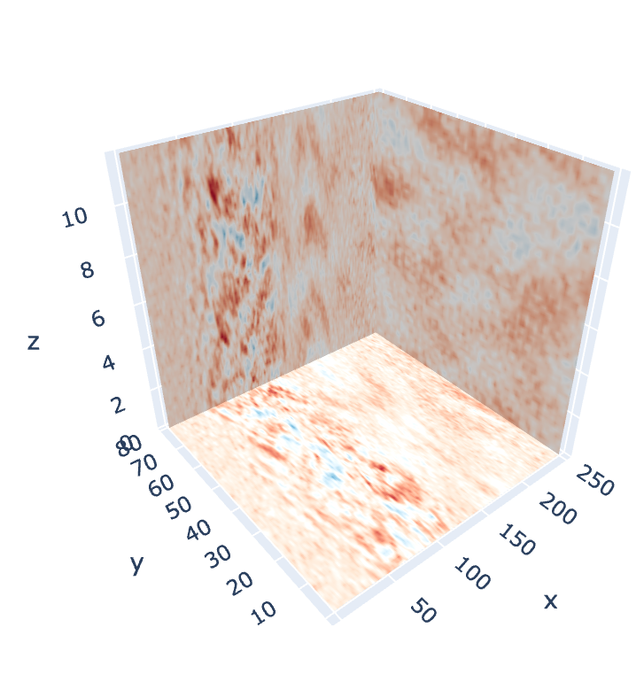
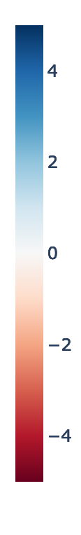
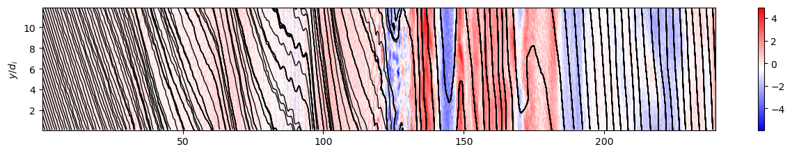
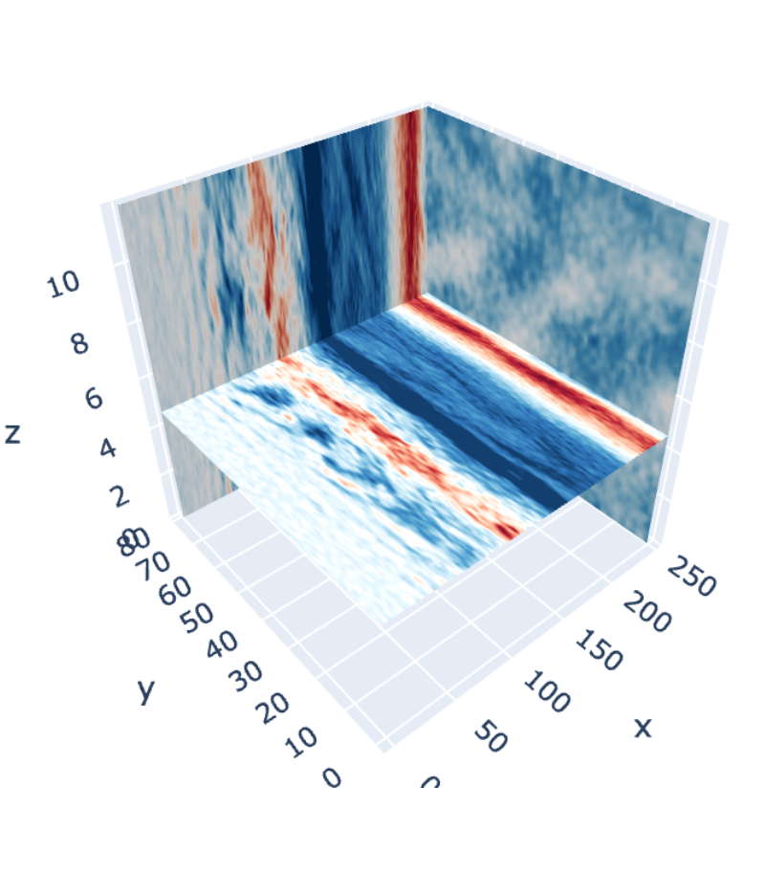
3D Extensions
Ng et al 2022 shows current sheets can be generated at a range of orientations, not just in the co-planarity plane. So….
B_{x}/B₀
Do fully 3D shocks exhibit the same reconnection mechanisms?
θ_{Bn} = 40, M_{A} ~ 7.5
B_{y}/B₀
B_{y}/B₀
Upstream waves become future reconnection sites
Turbulent transition region
Same mechanism as 2D, but with some 3D structuring
Can ‘closed field’ topologies still exist in 3D?

Slide 7
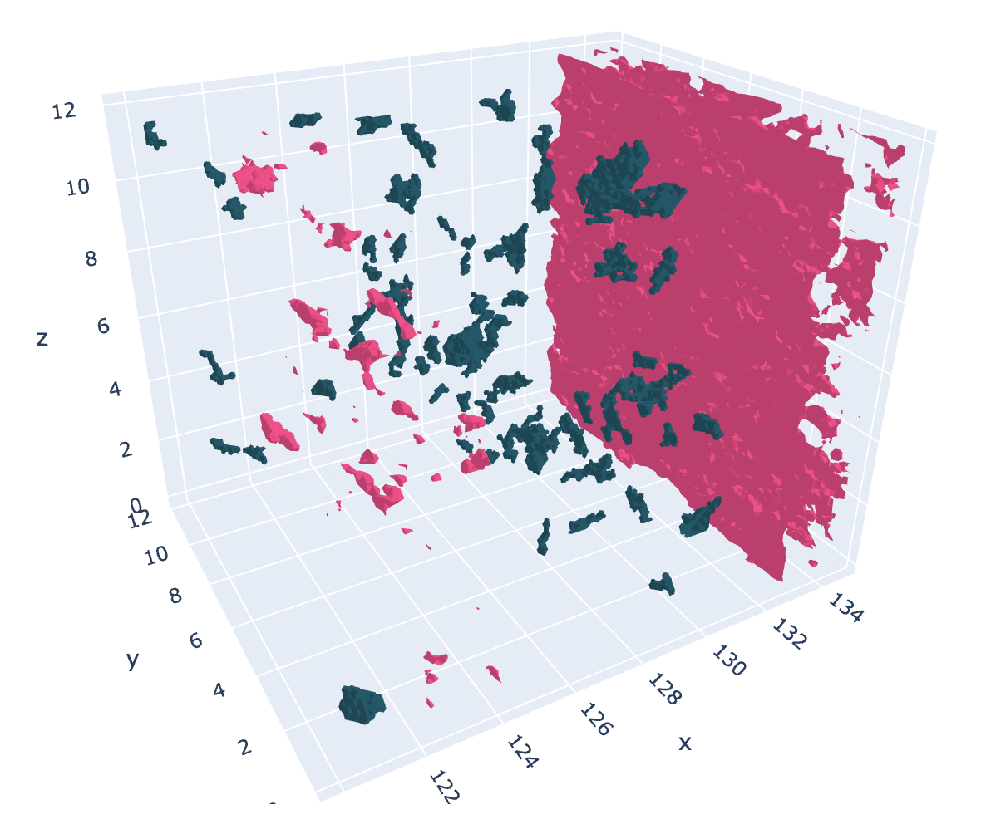
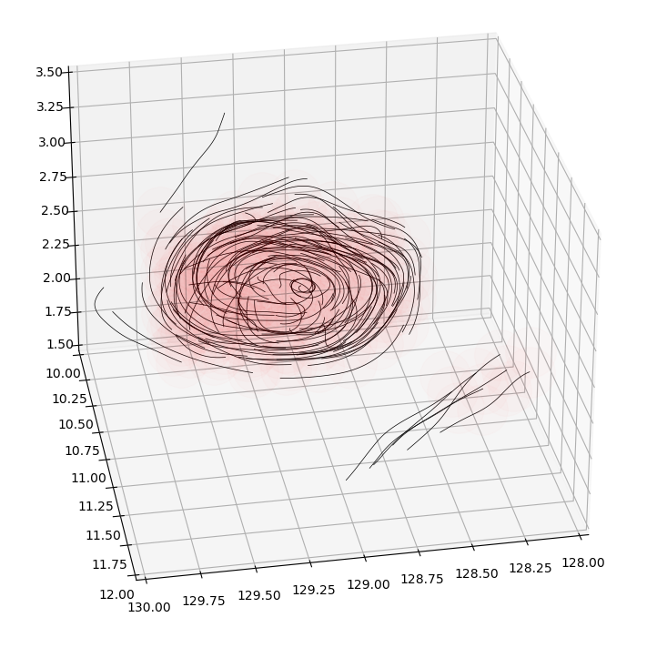
Closed Field Volumes in 3D
Repeat ‘closed-field’ analysis, integrating field lines in 3D.
Method finds ‘closed-field volume.’
Preliminary results suggest closed-field volume can exist in 3D shock simulations.
Closed field volume
B_{y}/B₀ = 5
Rope-like structure inside closed field volumes
Shock ramp
Upstream structures

Slide 8
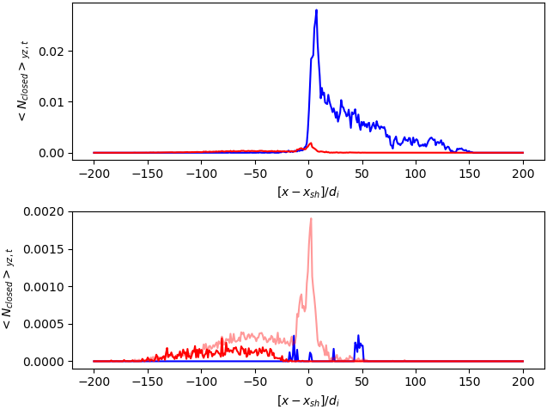
Quasi-Parallel vs Quasi-Perpendicular, 2D vs 3D
    M_{A} = 7.5
    θ_{Bn} = 40
2D
3D
Quasi-Parallel:
Order of magnitude reduction in closed field volume from 2D to 3D
Quasi-Perpendicular:
Significant increase in closed field volume upstream.
(Still much less than quasi-parallel)
    M_{A} = 10.5
    θ_{Bn} = 50
2D
3D q-⟂
3D q-∥

Slide 9
Conclusions
The disordered or turbulent shock transition is generated by a stream instability of back-streaming ions in the upstream (see Bessho+ 2020).
The turbulent region generates coherent structures (current sheets, flux ropes) that can survive through the shock ramp and into the magnetosheath.
Our parametric exploration of shocks using a 2D hybrid particle-in-cell code shows:
Coherent structures generated by the shock gradually decay downstream into the magnetosheath, over a scale length of ~ 100 d_{i} (a few R_{E}) in the magnetosheath.
That decay length scale does not appear to be strongly influenced by the upstream shock parameters (for quasi-parallel shocks).
Our 3D hybrid particle-in-cell runs show:
Three-dimensional closed-field volumes can also be generated in quasi-parallel and (to a lesser extent) quasi-perpendicular shocks.
See: Gingell et al. Physics of Plasmas 30, 012902 (2023); doi:10.1063/5.0129084
Imogen Gingell
i.l.gingell@soton.ac.uk

