Slide 1



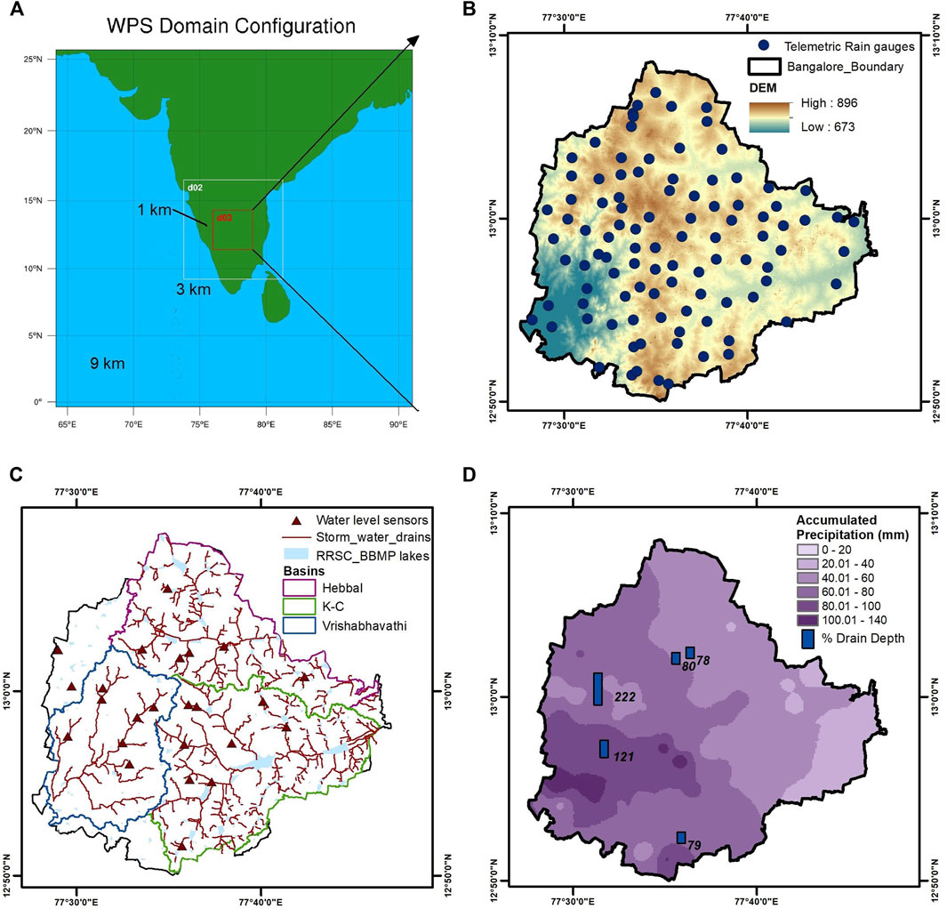
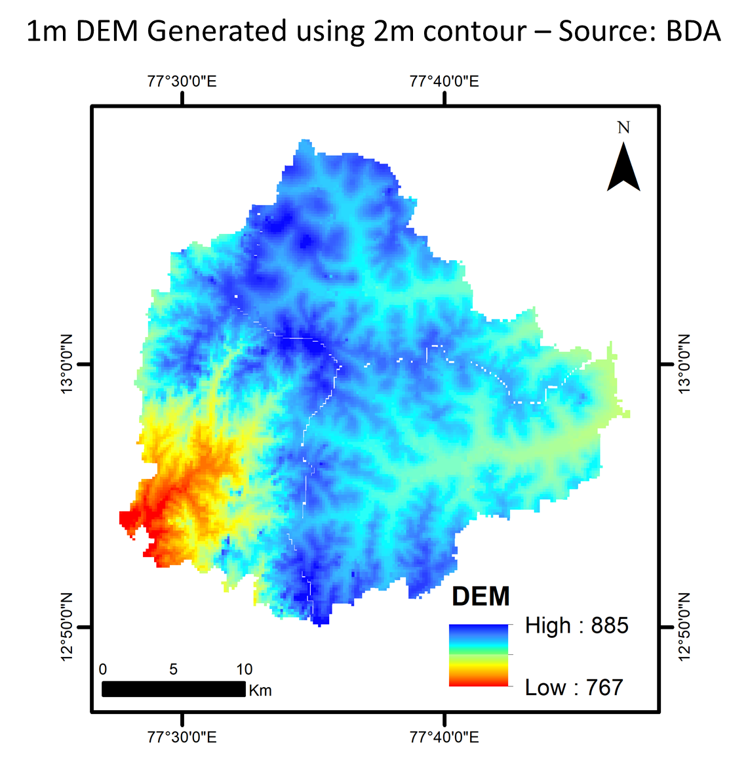
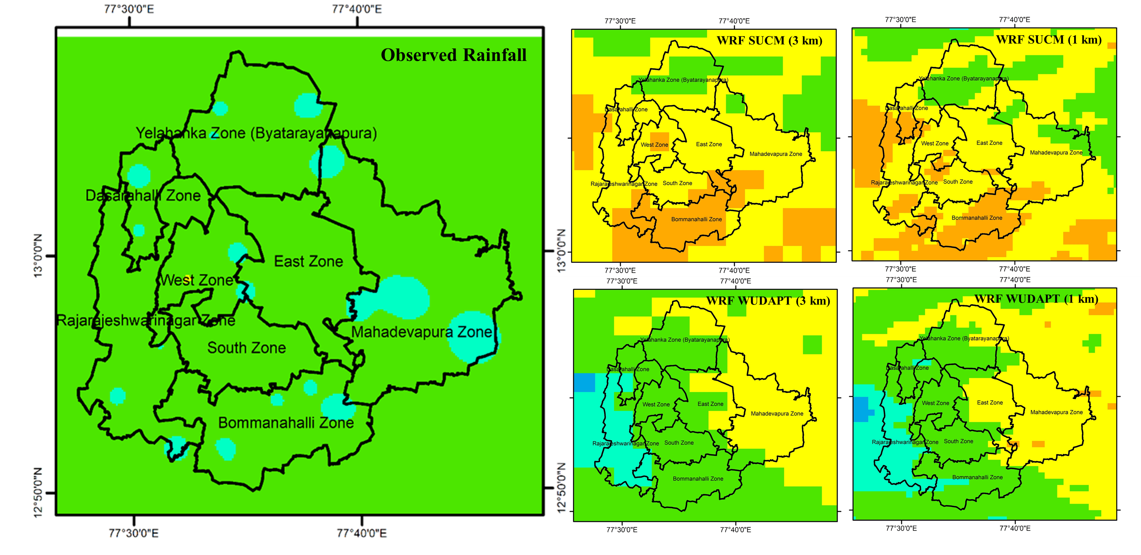
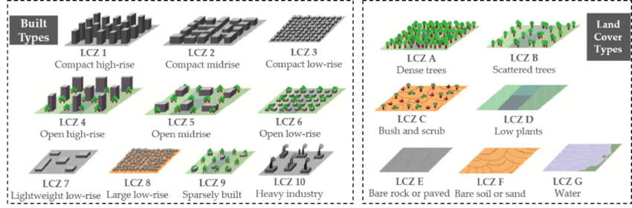
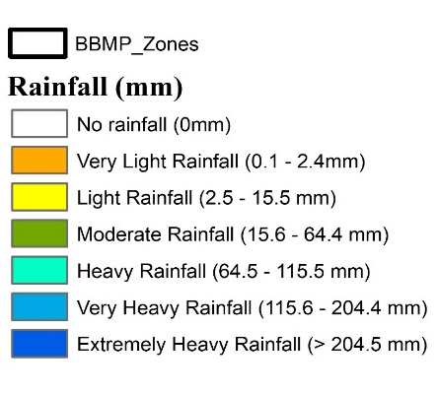
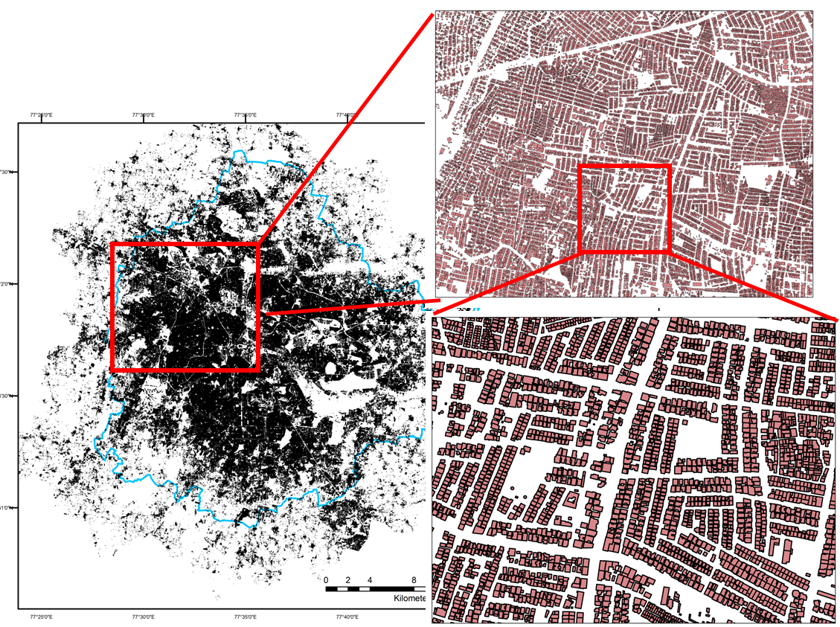
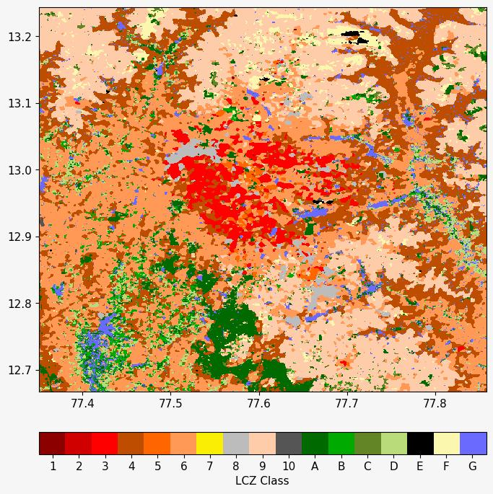
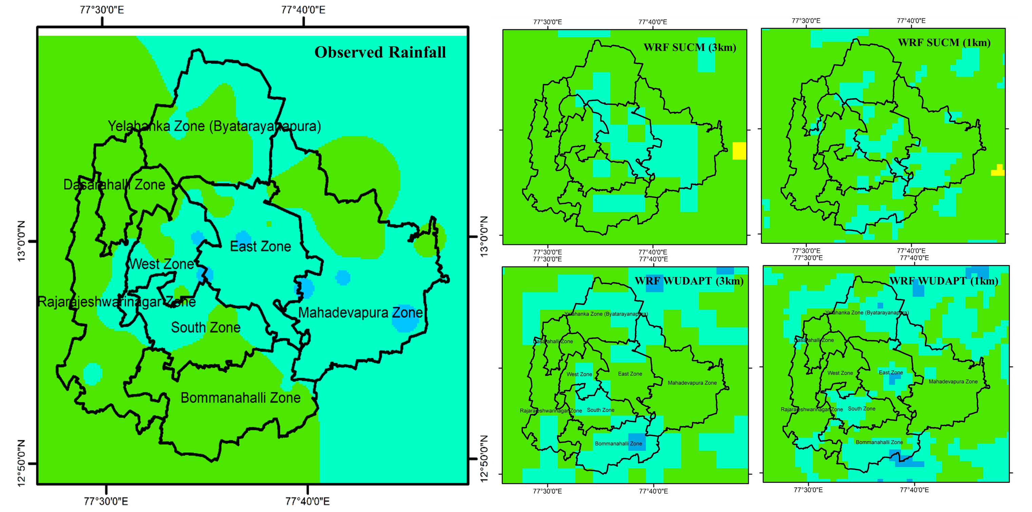
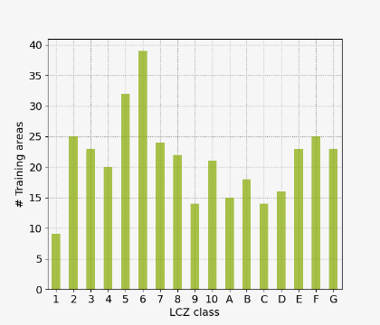
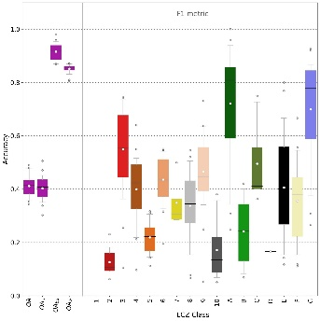
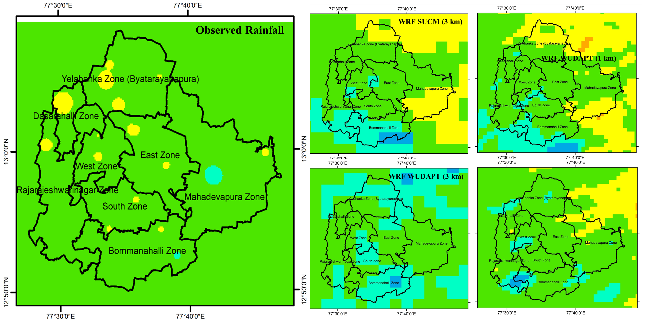
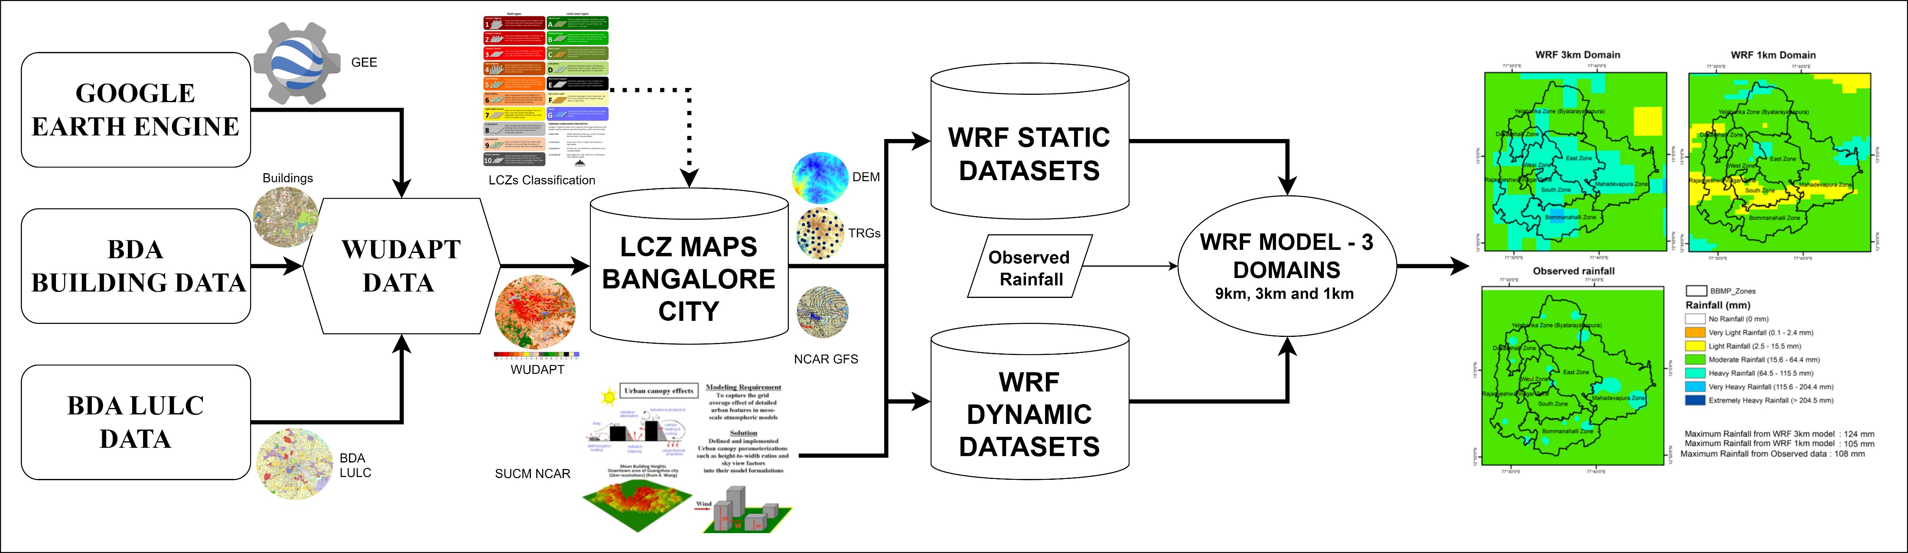
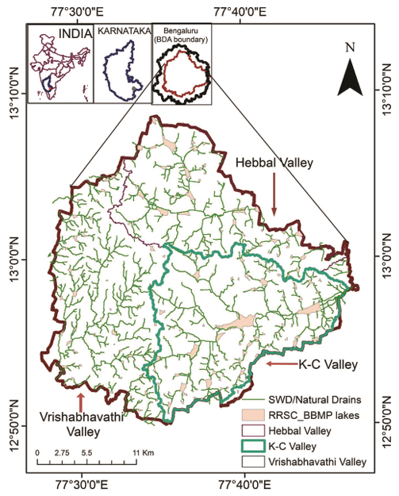









Integration of the WRF Model With Fine-Scale Land Use Data to Simulate Extreme Rainfall Events
Nagaraju Gaddam¹, Abhinav Wadhwa¹, Likhitha Pentakota¹, Gowri Reghunath¹, and Pradeep P Mujumdar^{1,2}
¹Interdisciplinary Centre for Water Research, Indian Institute of Science, Bengaluru, India
²Department of Civil Engineering, Indian Institute of Science, Bengaluru, India
INTRODUCTION
DATASETS USED FOR THE STUDY
METEOROLOGICAL SIMULATIONS FOR RAINFALL FORECASTS
Short-term finer scale rainfall forecast for an urban city – Bengaluru, India
Lack of local meteorological data hinders the development of adequate mitigation measures.
Short-range rainfall forecasts by physics-based parametrization schemes are simulated for Bengaluru city, India.
Heavy rainfall events in the year 2022 are simulated.
Finer spatial and temporal scales for 24 hr rainfall forecasts are proposed in this study.
17 Local Climate Zones (LCZs) for World Urban Database and Access Portal Tools (WUDAPT) are considered.
WRF model is set up for building-scale weather forecast with:
  Single-layer Urban Canopy Model (SUCM)
  WUDAPT - LCZs
Land surface information serves as a driving factor for rainfall/flood forecasting.
Telemetric Rain Gauge (TRG)
2m Digital Elevation Model (DEM)
Storm Water Drains and Lakes
17 LCZs for WUDAPT
Event Date: 29th August 2022
Observed Rainfall: 108 mm
WRF SUCM (3 km): 50 mm
WRF WUDAPT (3 km): 101 mm
WRF SUCM (1 km): 67 mm
WRF WUDAPT (1 km): 123 mm
BDA LULC
Building Data
WUDAPT Data for Bengaluru, India
Event Date: 4th September 2022
Observed Rainfall: 148 mm
WRF SUCM (3 km): 92 mm
WRF WUDAPT (3 km): 93 mm
WRF SUCM (1 km): 113 mm
WRF WUDAPT (1 km): 113 mm
Event Date: 5th September 2022
Observed Rainfall: 99 mm
WRF SUCM (3 km): 155 mm
WRF WUDAPT (3 km): 101 mm
WRF SUCM (1 km): 182 mm
WRF WUDAPT (1 km): 135 mm
Training and Testing Datasets for WUDAPT Development
STUDY AREA
INTEGRATION OF WUDAPT AND SUCM IN WRF MODEL
Spatial Rainfall over Bengaluru City
Spatial Rainfall Patterns Observed with WRF+SUCM and WRF+WUDAPT for Bengaluru City
CONCLUSIONS
Supervised learning algorithm using random forest classification is used for WUDAPT generation.
WUDAPT Accuracy: Overall 92% (for the built-up area: LCZ “1” to LCZ “10”), 85% (for water bodies: LCZ “G”) and 79% (others LCZ “A” to LCZ “F”).
Forecasts of WRF + WUDAPT vs default WRF have shown an improvement at both spatial and temporal scales.
Biasness (spatial shift) is reduced drastically, and the forecasts are well-matched with the observed TRG station rainfall.
Maximum likelihood probability of rainfall forecast: Success Rate (SR) – 70%, Root Mean Square Error (RMSE) – 18%, Nash–Sutcliffe Efficiency (NSE) – 28.19%, Fractional Biasness (FB): 0.37.
Bengaluru urban region – 709 km² area
ACKNOWLEDGEMENTS
CONTACT DETAILS
This research is funded by the project “Urban Modelling: Development of Multi-sectorial Simulation Lab and Science-Based Decision Support Framework to Address Urban Environmental Issues” (Project Sanction Number: MeitY/R&D/HPC/2(1)/2014)) sponsored by DST and MeitY (Under National Supercomputing Mission (NSM)). We would also like to express our gratitude to Karnataka State Natural Disaster Monitoring Centre (KSNDMC), Bengaluru Development Authority (BDA), Bruhat Bengaluru Mahanagara Palike (BBMP), and Regional Remote Sensing Centre (RRSC) for providing us with the valuable data and information necessary for our research. The collaboration and support from these agencies have greatly contributed to the quality and relevance of our findings. We sincerely acknowledge their contribution to our research and express our gratitude for their cooperation.
Name: Abhinav Wadhwa
Research Associate
ICWaR, IISc Bengaluru
Email ID: abhinavw@iisc.ac.in

