Slide 1
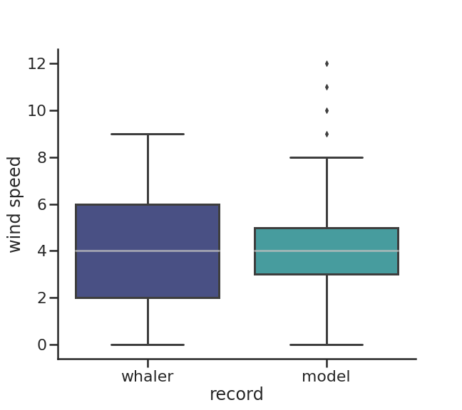
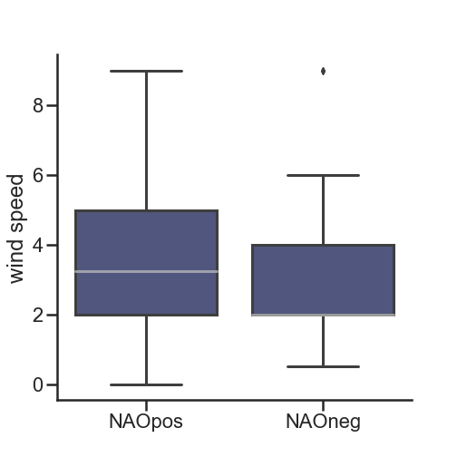
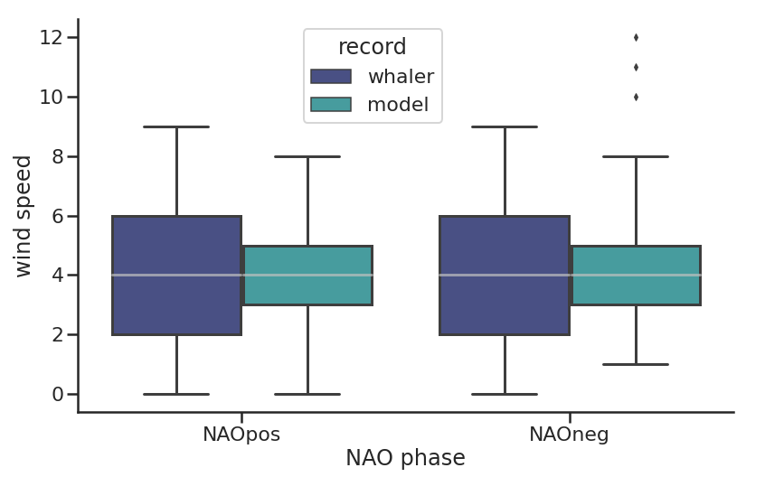
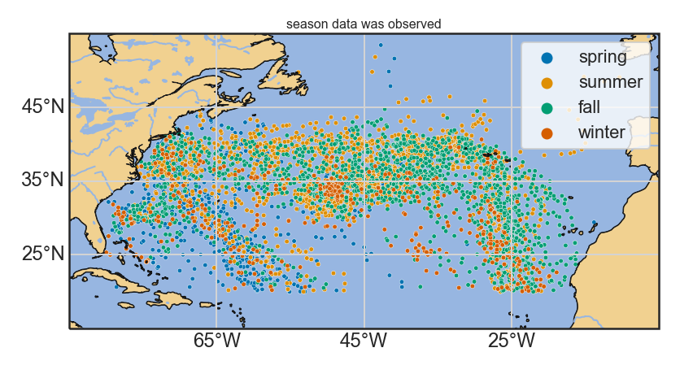
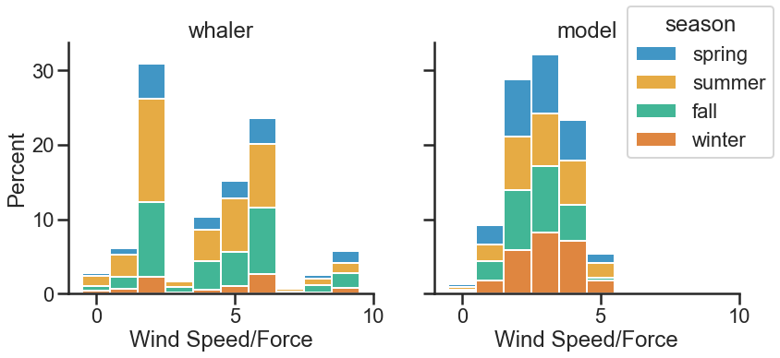
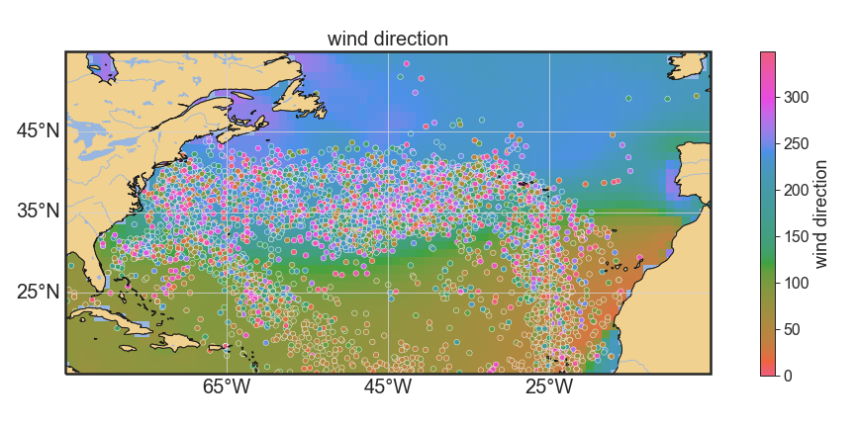
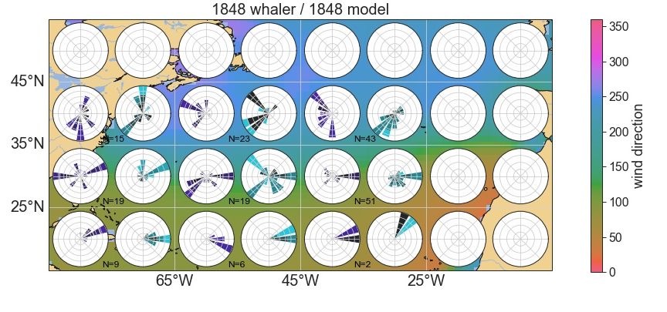
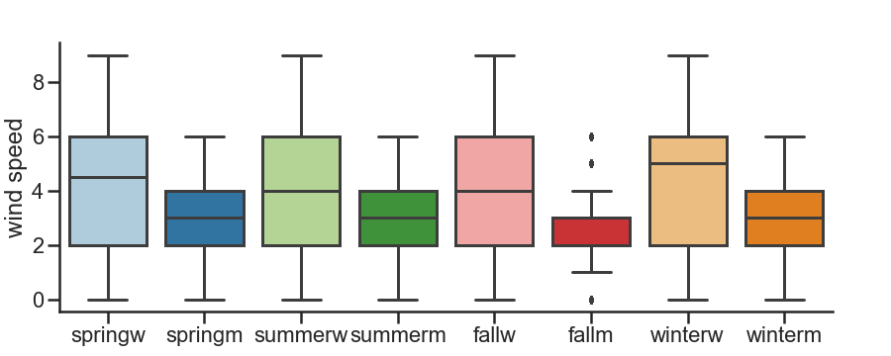
Assessing North Atlantic climate variability since the early 1800s through
historical New England whaling ship logbooks and reanalyses
Neele Sander^{1,2}, Caroline C. Ummenhofer², Bastian Münch³, Timothy D. Walker^{2,4}
¹Christian-Albrechts-Universität zu Kiel, Geomar Helmholtz-Center for Ocean Research, Kiel, Germany; ²Department of Physical Oceanography, Woods Hole Oceanographic Institution, Woods Hole, MA, USA; ³University of Delaware, DE, USA; ⁴Department of History, University of Massachusetts Dartmouth, North Dartmouth, MA, USA
ABSTRACT
Historical wind patterns in the North Atlantic are assessed using U.S. whaling logbooks of voyages from the 19th century, a time when instrumental wind observations were not widely available. The recordings from whaling ship logbooks provide systematic daily to sub-daily information about wind force, wind direction, and other weather observations (e.g., precipitation, sea state) over a period from ca. 1785-1915 and are housed in the New England archives by the New Bedford Whaling Museum, Nantucket Historical Association, and Providence Public Library. The extracted data from the whaling logbooks is quality checked, and the qualitative wind descriptions are transferred to the Beaufort wind force scale to better compare it to the 20th-Century-Reanalysis (20CR). Specifically, the whaling ship logbook-sourced wind recordings are used in conjunction with several indices of North Atlantic climate variability, such as North Atlantic Oscillation (NAO), to explore variations and changes in predominant North Atlantic wind patterns in the past. Here we demonstrate that the wind data from the whaling ship logbooks agrees with mean wind patterns and climate variability reconstructed for the North Atlantic and therefore provides valuable insights into the past wind patterns in this area complementing existing reanalysis products. We further demonstrate how qualitative descriptive wind information can be turned into quantitative information that can be directly compared with numerical data from reanalysis models. Since the comparison of the historical logbook data with 20CR data shows overall good agreement, it can be used to gain a further understanding of the dominant climate patterns in the North Atlantic and might aid the development of improved indices of North Atlantic climate variability, such as the NAO.
RESULTS
Monthly
Almost 5000 daily maritime weather records from the historical whaling ship logbooks in the North Atlantic and 60,000 worldwide
Number of records depends on season: more records in summer & fall, fewer in winter and spring
Wind speeds in whaling records in winter and spring higher than in other seasons (Figure 2a); partly consistent with reanalysis data
Wide windspeed spread in whalers’ data, as they reflect individual daily records (Figure 2b); in contrast, reanalysis of wind speed data approximates a normal distribution for monthly ensemble mean
→ need to be careful when comparing the whalers’ data to monthly reanalysis data
a
b
2. Daily
Only used data points from the reanalysis, which correspond to the whalers’ data in location and time
Both datasets have a similar spread and median (Figure 3a)
When selecting wind data for opposite NAO phases (cf. Figure 1), North Atlantic-wide windspeeds do not differ between NAO phase (Figure 3c)
The data seem to be equally spread between regions with higher expected wind speeds due to NAO positive and NAO negative phases respectively (Figure 3c)
When only regions with positive wind speed anomalies in NAO-positive phases were considered, higher wind speeds in the NAO-positive phase than in the negative phase are seen (Figure 3b)
c
METHODS
The maritime weather data from historical whaling ship logbooks was obtained by archival researchers in New England archives (New Bedford Whaling Museum, Nantucket Historical Association, Providence Public Library), covering the period 1790-1914.
Initial quality check: only data points are retained that have a valid location (latitude and longitude) and useable wind speed/direction.
Study region: Only data points in the North Atlantic (5°-85°W, 15°-55°N) were used for this analysis.
Three datasets of the NOAA/CIRES/DOE 20th Century Reanalysis (V3; Compo et al. 2011) surface wind data were used for comparison with the historical ship logbook:
Monthly and daily ensemble mean for 1836 – 1914 and 1848, respectively, at 1°x1° grid resolution.
Daily ensemble mean data for 1851 – 1914 at 2°x2° grid resolution.
Wind speed calculation: Absolute windspeeds were obtained by taking the square root of the squared and subsequently added u- and v-wind data. To compare the descriptive logbook wind recordings to the reanalysis, it was then converted to the Beaufort wind force scale. The reanalysis wind directions were calculated by taking the arctan of the v-wind divided by the u-wind. The resulting value was then converted to degrees north. Daily model ensemble mean data was compared to the daily model output, by using the nearest corresponding gridpoint to the whalers’ data.
Yearly NAO indices were obtained by taking the index mean for every year and scaling the result. Years with a scaled index value ≥0.5 were seen as NAO positive years, years with a scaled index value of ≤-0.5 were seen as NAO negative years. The NAO analysis was done with multiple NAO indices, the results were all similar, and results only for the index Updated from Jones et al. (1997) is shown (Figure 1).
Data analysis and visualization were done in Python.
a
3. Wind directions
Compared the monthly mean reanalysis wind directions to the wind directions measured by the whalers
The logbook data is overall reflecting the expected wind patterns in the North Atlantic (Figure 4a)
Sorted the data by 20° x 10° lon/lat boxes
Sometimes just very few data points in the region
Compared to daily reanalysis data from 1848 (daily data was filtered the same way as before) (Figure 4b)
→ Wind directions between whalers’ records and reanalyses for daily wind data in 1848 are consistent
Figure 3 | a, Box and Whisker plot of the wind speed distribution of the logbook data and the daily reanalysis data. The median is shown as a grey line. Colors indicate the data source. b, Box and Whisker plot of the wind speed distribution of the logbook data sorted by the NAO phase. Only regions with positive wind speed anomalies in the NAO positive phase were considered. c, Box and Whisker plot of the wind speed distribution of both reanalysis and logbook data sorted by the NAO phase. Colors indicate the same as in a.
b
c
a
CONCLUSION
Here we show that the descriptive logbook wind recordings skillfully compare with reanalysis.
Meaningful quantitative comparison using Beaufort wind force scale.
The whaling ship logbook data and the monthly mean ensemble mean data differ in spread, but since the whalers‘ data resemble just a snapshot observation, one needs to be careful by comparing them directly.
At first glance, changes in North Atlantic wind speeds associated with the NAO do not seem to be reflected in the logbook data; however, when only selecting areas experiencing wind changes, it can be seen that the NAO is represented in the logbook wind data.
Next step: comparing masked regions for daily reanalysis data to the NAO index
Wind directions show overall good agreement with the reanalysis data.
Next step: further comparison with the daily reanalysis data
a
b
d
b
c
N=780
N=2008
N=1615
N=429
REFERENCES
Jones, P.D. et al. 1997: Extension to the North Atlantic Oscillation using early instrumental pre., Jónssonssure observations from Gibraltar and South-West Iceland. Int. J. Climatol. 17, 1433-1450.
Compo, G.P. et al., 2011: The Twentieth Century Reanalysis Project. Quarterly J. Roy. Meteorol. Soc., 137, 1-28. DOI: 10.1002/qj.776/.
Figure 2 | a, Scatterplot of ship logbook weather recordings in the North Atlantic. Colors indicate the season the data was observed. b, Histogram of the observed wind speed. The y-axis shows the amount in percent, colors indicate the same as in a. c, Histogram of the wind speeds obtained from the monthly mean ensemble NOAA/CIRES/DOE 20th Century Reanalysis (V3) data. Axes and colors are the same as in b. d, Box and Whisker plots of the windspeeds obtained from the logbook data (indicated by an w) and model data (indicated by an m) sorted by season. The number of data points by the whalers‘ is indicated by N.
Figure 4 | a, Scatterplot of the wind directions of the logbook data. The background color shading indicates mean wind directions calculated from monthly mean reanalysis data. Wind directions are shown in degrees north. b, Windroses of the winds in the year 1848 measured by the whalers and obtained from the daily reanalysis data. Numbers indicate the amount of data points available in each grid box. Windroses of logbook data are indicated by purple colors, and windroses of reanalysis data by blue. Background color shading indicates the same as in a.
Figure 1 | a, NAO index (Updated from Jones et al. 1997); red bars indicate a positive NAO phase, blue bars a negative NAO phase. b, Annual mean wind anomalies in NAO-positive years indicated by color shading. Arrows indicate the wind anomalies in u- and v-wind directions. c, Wind anomalies in NAO negative years. Colors and arrows as in b.
Acknowledgments
Use of the following datasets is gratefully acknowledged: Twentieth Century Reanalysis Project v3, supported by the U.S. Department of Energy, Office of Science Biological and Environmental Research (BER), by the National Oceanic and Atmospheric Administration Climate Program Office, and by the NOAA Earth System Research Laboratory Physical Sciences Laboratory, accessed through the WHOI CMIP5 Community Storage Server, WHOI, Woods Hole, MA, USA from their website at http://cmip5.whoi.edu. NS acknowledges support by the German Academic Exchange Service (DAAD) through a RISE scholarship; CCU and TDW acknowledge support by the U.S. National Science Foundation through BCS-1852647, the Heinz Family Foundation, and FM Global.

