Slide 1
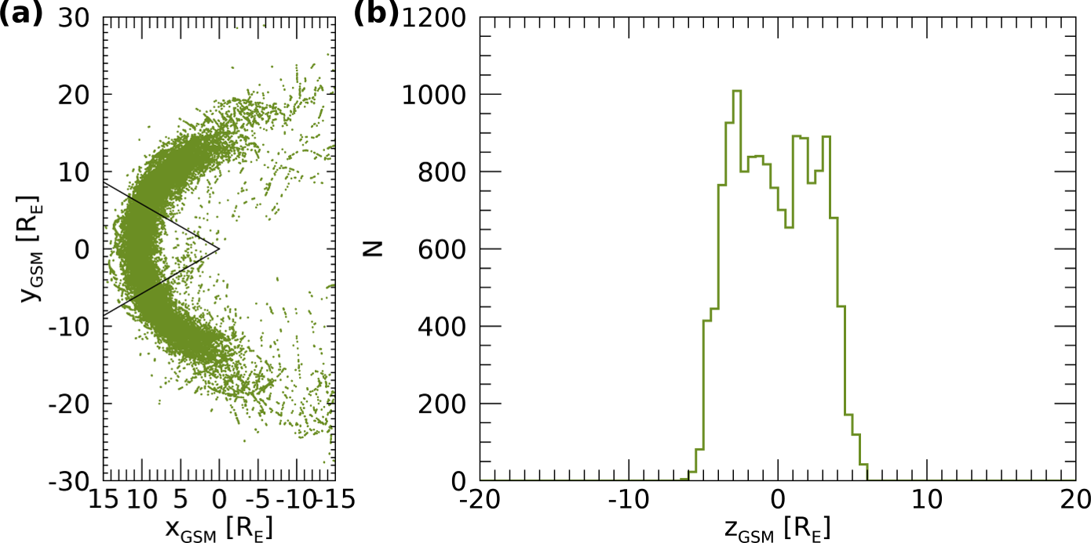
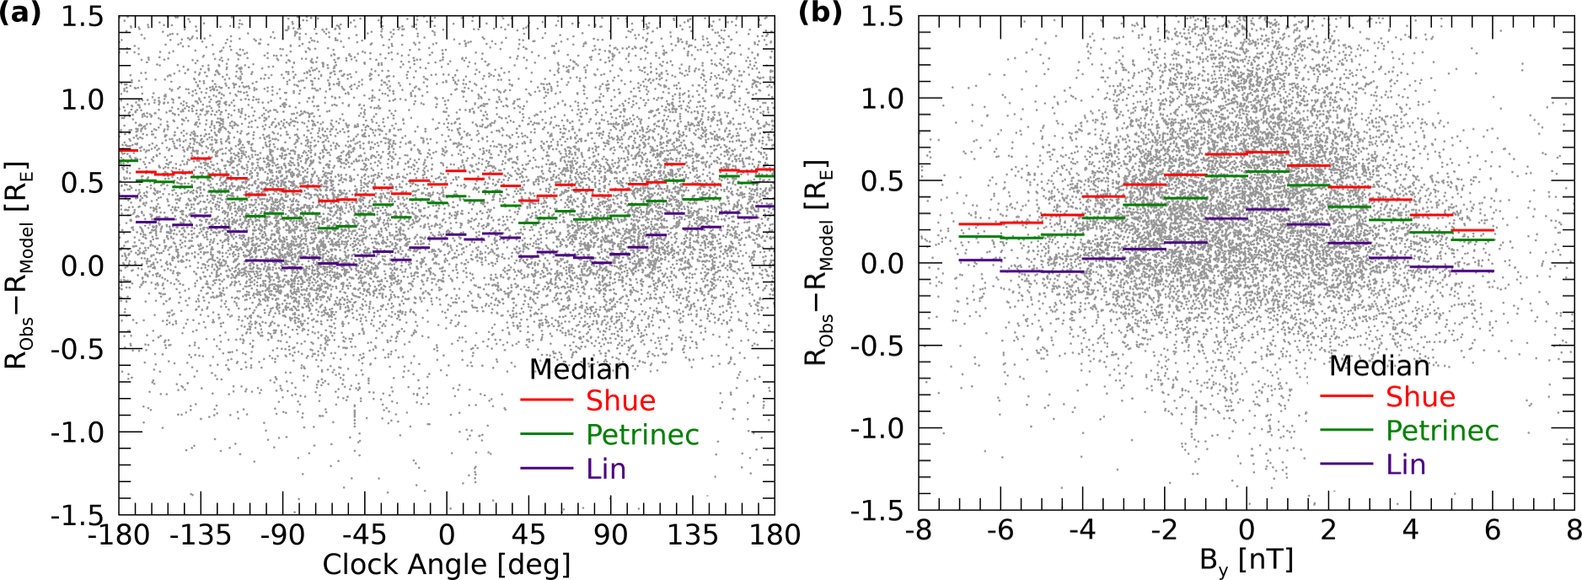
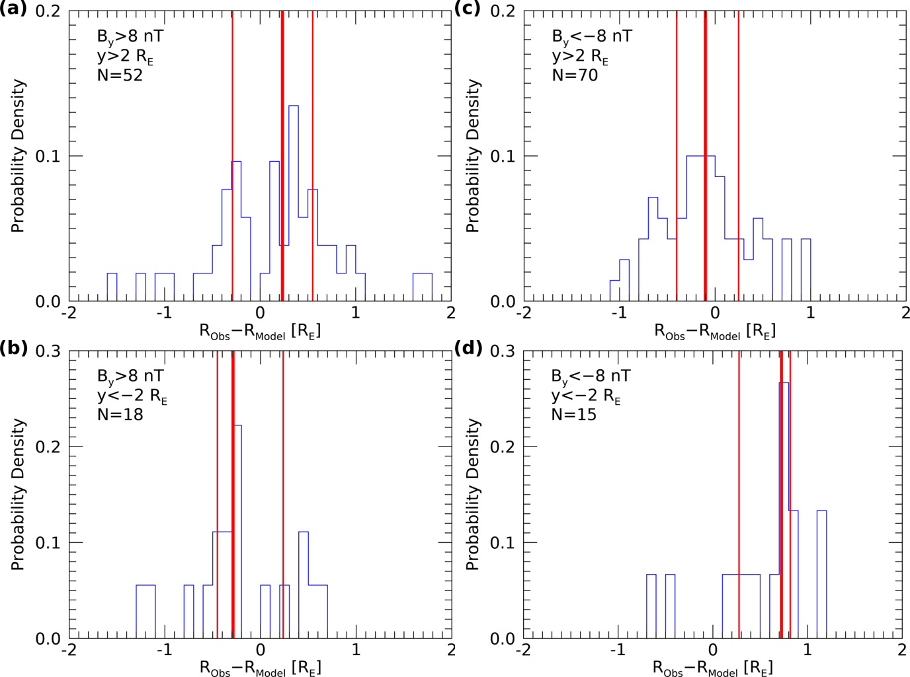
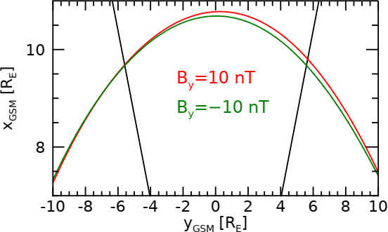
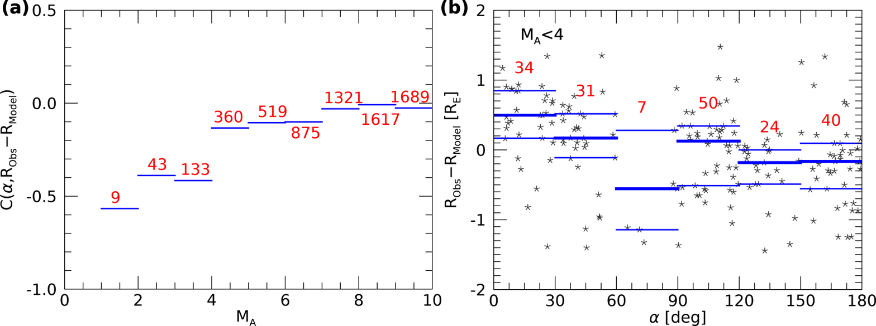
INTERPLANETARY MAGNETIC FIELD EFFECTS ON THE MAGNETOPAUSE LOCATION
Maryam Aghabozorgi Nafchi (ma.aghabozorgi@gmail.com) ⁽¹⁾, František Němec⁽¹⁾, Gilbert Pi ⁽¹⁾, Zdeněk Němeček ⁽¹⁾
Jana Šafránková ⁽¹⁾, Kostiantyn Grygorov ⁽¹⁾, Jiří Šimůnek ⁽²⁾ ⁽¹⁾ Faculty of Mathematics and Physics, Charles University, Prague, Czech Republic ⁽²⁾ Institute of Atmospheric Physics of the Czech Academy of Sciences, Prague, Czech Republic
EGU23-3234ECS
INTRODUCTION
FIGURE 1 – DISTRIBUTION OF DATA SET
FIGURE 2 – DIFFERENCE BETWEEN THE OBSERVED AND MODEL MAGNETOPAUSE DISTANCES VS. CLOCK ANGLE AND IMF B_{Y}
The magnetopause is the boundary between the magnetosphere and the shocked solar wind in the magnetosheath.
Neither the location nor the shape of the magnetopause is constant in time, being dependent on many different factors.
Data set:
Nearly 15,000 magnetopause crossings are used to study the influence of the Interplanetary Magnetic Field (IMF) on the magnetopause location.
Magnetopause crossings identified in the THEMIS A-E, Magion 4, Geotail, and Interball-1 satellite data obtained between 1995 and 2020.
Transmitter hemisphere
Three different empirical magnetopause models (Shue et al.(1997), Petrinec and Russell (1996), and Lin et al. (2010)) were used for this purpose, all providing qualitatively the same results for the prediction of magnetopause location.
IMF clock angle is an important factor controlling the magnetopause location.
The magnetopause crossings are found at larger radial distances at the times of low IMF B_{y} component. Furthermore, not only the IMF B_{y} magnitude but also the IMF B_{y} orientation was found to be of importance at the times of low Alfvén Mach number, resulting in magnetopause asymmetry.
Conjugate hemisphere
SUMMARY AND CONCLUSIONS
1
2
3
(a) Projection of individual magnetopause crossings in the GSM x-y plane; the subsolar region, corresponding to solar zenith angles lower than 30 degrees, is marked by the solid lines.
(b) Histogram of z_{GSM} coordinate of magnetopause crossings identified in the subsolar region.
Only data measured close to the subsolar point are considered further (due to the limited apogee distance of the THEMIS spacecraft and related insufficient sampling of large distances, the magnetopause crossings identified at larger solar zenith angles are biased toward lower distances )
(a) Difference between observed and model magnetopause distances as a function of clock angle. Each point corresponds to a single magnetopause crossing with the average value of the model magnetopause distance predicted by three models used for the calculation of the ordinate. Median values of the differences between observed and model distances obtained for individual models in respective abscissa intervals are shown by the horizontal lines.
($IMF clock angle=arctan⁡(B_{y}/B_{z})$.
(b) Same as panel a) but for the dependence on the IMF B_{y}
FIGURE 3 – HISTOGRAMS OF DIFFERENCES BETWEEN OBSERVED AND MODEL MAGNETOPAUSE DISTANCES FOR EXTREME IMF B_{y}
FIGURE 4 – THE EFFECT OF ALFVÉN MACH NUMBER AND THE ANGLE BETWEEN THE IMF DIRECTION AND POSITIONAL VECTOR
FIGURE 5 – MAGNETOPAUSE MHD MODEL SHAPE
3
1
2
Probability densities of difference between observed and model distances for extreme IMF B_{y} :
(a) B_{y}> 8 nT and y_{GSM} > 2 R_{E}
(b) B_{y} > 8 nT and y_{GSM} < -2 R_{E}
(c) B_{y}< -8 nT and y_{GSM} > 2 R_{E}
(d) B_{y}< -8 nT and y_{GSM} < -2 R_{E}
The thick and thin vertical red lines show the respective median values and 0.25/0.75 quartiles of the differences between observed and model magnetopause distances.
N: the number of crossings for each specific condition.
Qualitatively the same results are obtained for any individually used model.
Conjugate hemisphere
Transmitter hemisphere
MHD model magnetopause shapes obtained for large positive and large negative IMF B_{y} (CCMC model runs). (red) The magnetopause location for B_{y} = 10 nT. (green) The magnetopause location for B_{y} = -10 nT.
The black lines correspond to the region within ±30 degrees from the subsolar point.
Both the direction and the magnitude of IMF B_{y} are important for the magnetopause location.
(a) Correlation between α (the angle between the projections of the crossing positional vector and the IMF vector to the y-z plane) and the difference between observed and model magnetopause distances as a function of the Alfvén Mach number.
(b) Difference between observed and model magnetopause distances as a function of α. The horizontal blue lines show the medians and 0.25 and 0.75 quartiles in the respective intervals.

