Slide 1
Drought risk assessment under climate change impacts utilizing CMIP6 climate models in the coastal zone of the Mekong Delta
Bui Phan Quoc Nghia¹, Indrajit Pal¹, Nuwong Chollacoop², Nguyen Huu Loi³
¹ Disaster Preparedness, Mitigation and Management, Asian Institute of Technology, Thailand
² The National Energy Technology Center, National Energy Technology Center, Thailand
³ Can Tho University, Vietnam

Slide 2
1. INTRODUCTION
In the context of climate change, the Mekong Delta of Vietnam (MDV) experienced extreme droughts in recent years, especially in 2015-2016 and 2020, causing various issues in socio and economy.
The coastal provinces of the MDV usually endured heavy damage during droughts because of their topographical and geographical characteristics.
In the sense that drought might become more severe due to climate change, scientific assessment of drought risk with different scenarios in the coastal zone of the MDV is critically important.
In Vietnam, drought risk assessment has become popular. However, the drought hazard in these studies is only considered data from the past; not potential things that can be happened in the future due to the effects of climate change.
This study aims to assess the drought risk of the coastal zone of the MDV under the impacts of climate change, focusing on the period of 2025 to 2100.

Slide 3
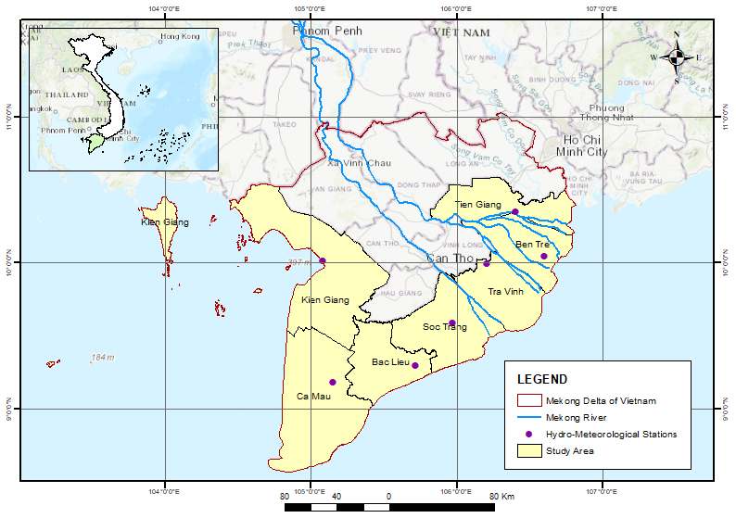
2. STUDY AREA
The study area includes 7 coastal provinces of the MDV.
During previous droughts, the coastal provinces were impacted the most.
In the future, it is sensitive to the impacts of climate change and sea level rise.
That is the reason to choose these provinces as the study area of this research.
Map of study area

Slide 4
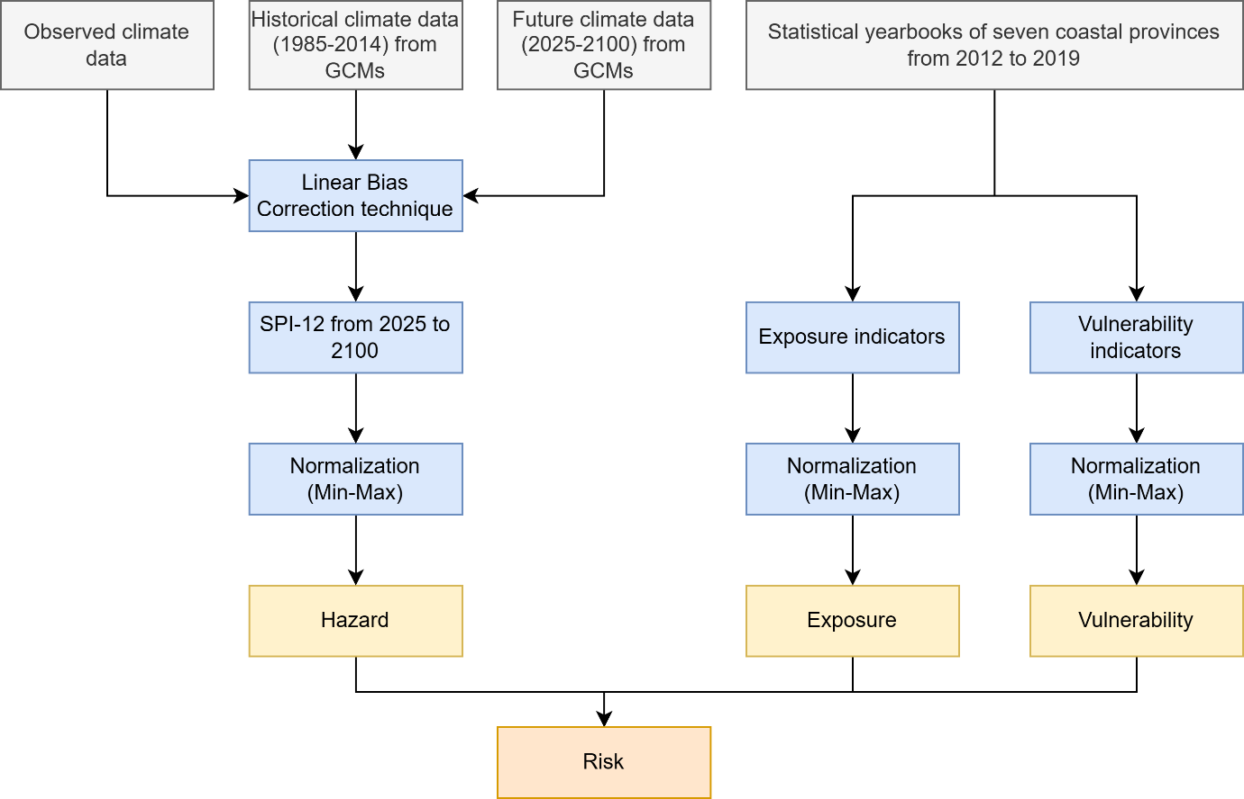
3. METHODOLOGY
Methodology flowchart

Slide 5
3. METHODOLOGY
List of indicators
Factor | Indicator | Description | Unit | Expected sign
Hazard (SSP2 scenario) | SPI-12 of the model ACCESS-ESM1-5 | The physical level of drought |  | Negative
 | SPI-12 of the model MIROC6
 | SPI-12 of the model MRI-ESM2-0
Hazard (SSP5 scenario) | SPI-12 of the model ACCESS-ESM1-5
 | SPI-12 of the model MIROC6
 | SPI-12 of the model MRI-ESM2-0
DEI | Proportion of agriculture production land | Land farm size | % | Positive
 | Proportion of water surface land for fishing | Aquaculture farm size | % | Positive
 | Population |  | Person | Positive
DVI | Unemployment rate of labor force at working age | Income status | % | Positive
 | GDP per capita |  | USD | Negative
 | Rate of Agriculture, Forestry and Fishing in GDP |  | % | Positive
 | Average number of students per teacher | Education quality | Student | Negative
 | Hospital bed per 10.000 inhabitants (Bed) | Health service | Bed | Negative
 | Percentage of urban population provided with clean water by centralized water supply system (%) | Clean water access | % | Negative

Slide 6
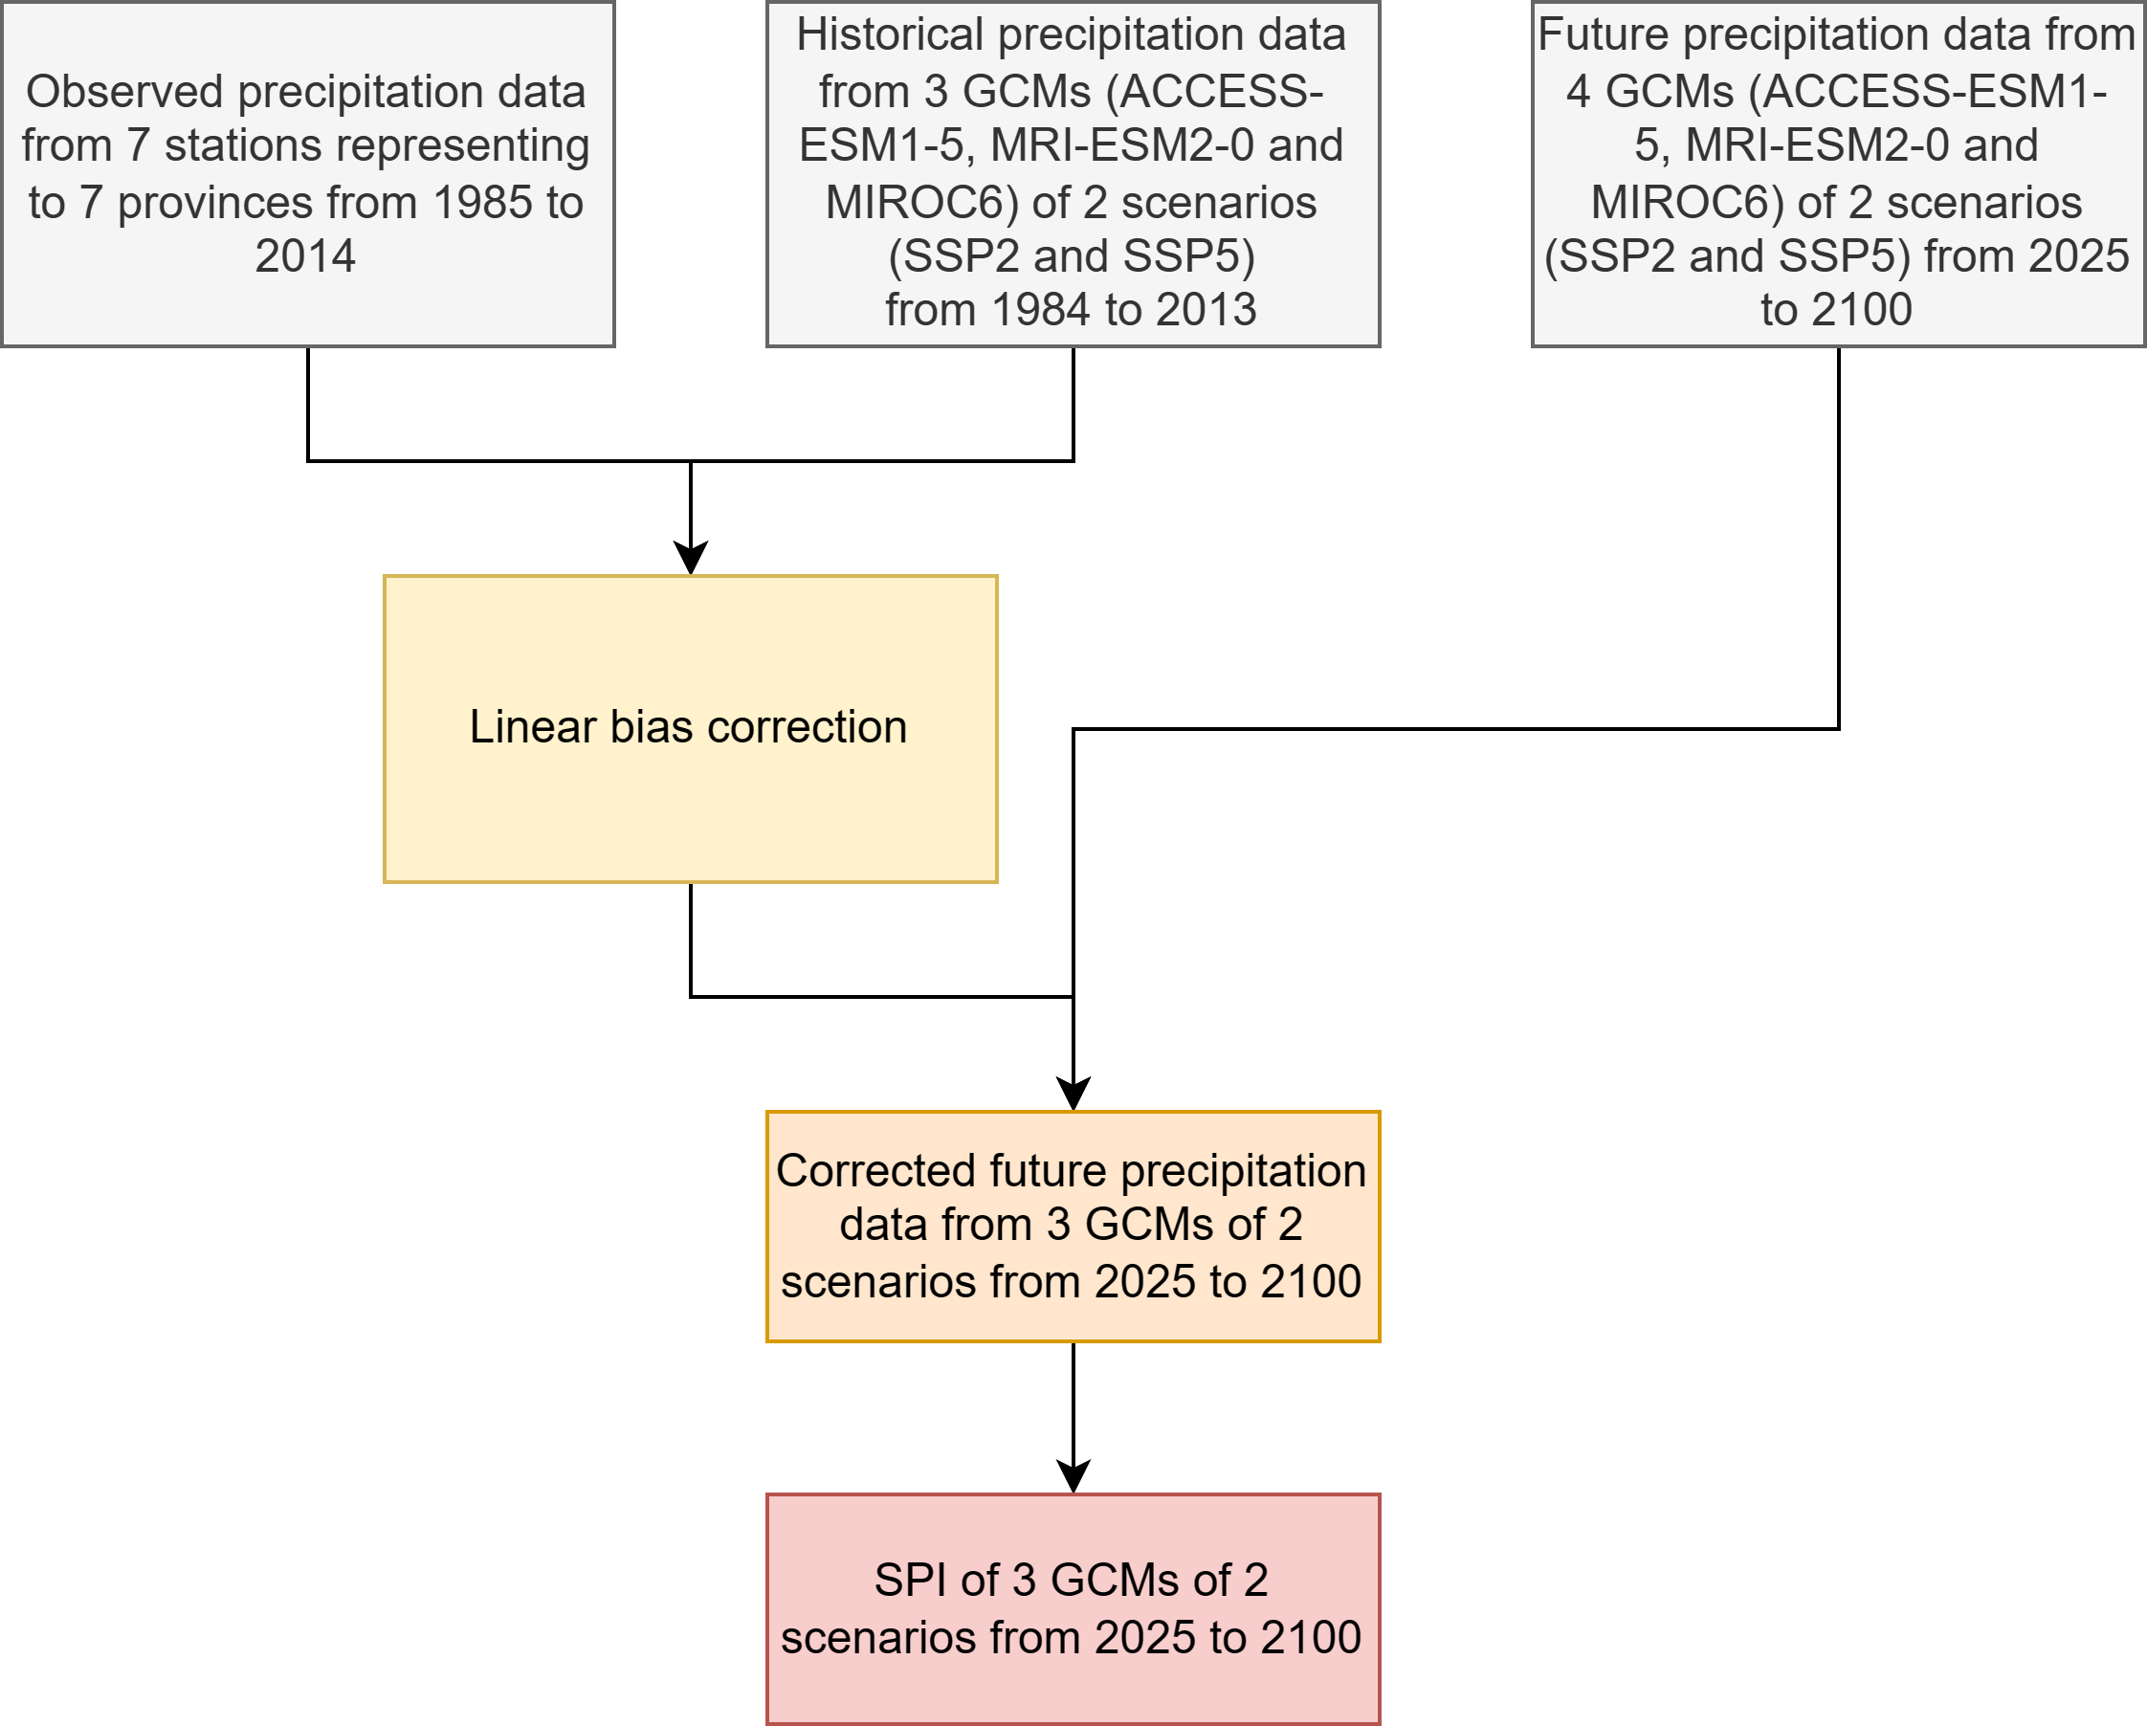
3. METHODOLOGY
FUTURE PRECIPITATION BIAS CORRECTION AND SPI CALCULATING
The equation of linear downscaling for precipitation:
$P_{f}^{∗}= P_{f}\left(d\right).\frac{μ_{m}(P_{obs}\left(d\right))}{μ_{m}(P_{his}\left(d\right))}$
Where, P = precipitation, his = historical run, obs = observation data, f = model future run, μ = average, m = month, d = day, * = bias corrected.
SPI was calculated by the software spi_sl_6 for a time scale of 12 month.

Slide 7
3. METHODOLOGY
INDICATOR NORMALIZATION AND WEIGHTING
The normalization was performed with the min-max method
For indicators with positive correlation to DRI: $x^{∗}=\frac{x −x_{min}}{x_{max} − x_{min}}$
For indicators with negative correlation to DRI: $x^{∗}=\frac{x_{max}−x}{x_{max} − x_{min}}$
Where, $x^{∗}$ = normalized indicator value, $x$ = indicator value, $x_{max}$ and $x_{min}$ = maximum and minimum values respectively.
The equal weighting method has been chosen to employ in this study. This weighting method was applied for DEI, DVH, and DRI.
After obtaining the results, ArcGIS was used to visualize the level of DHI, DEI, DVI, and DRI.

Slide 8
3. METHODOLOGY
DROUGHT HAZARD, EXPOSURE, VULNERABILITY, AND RISK SCORE AND LEVEL
SCORE | LEVEL
0.00 – 0.16 | No or least vulnerability
0.16 – 0.33 | Low vulnerability
0.33 – 0.67 | Medium vulnerability
0.67 – 0.83 | High vulnerability
0.83 - 1 | Extreme vulnerability

Slide 9
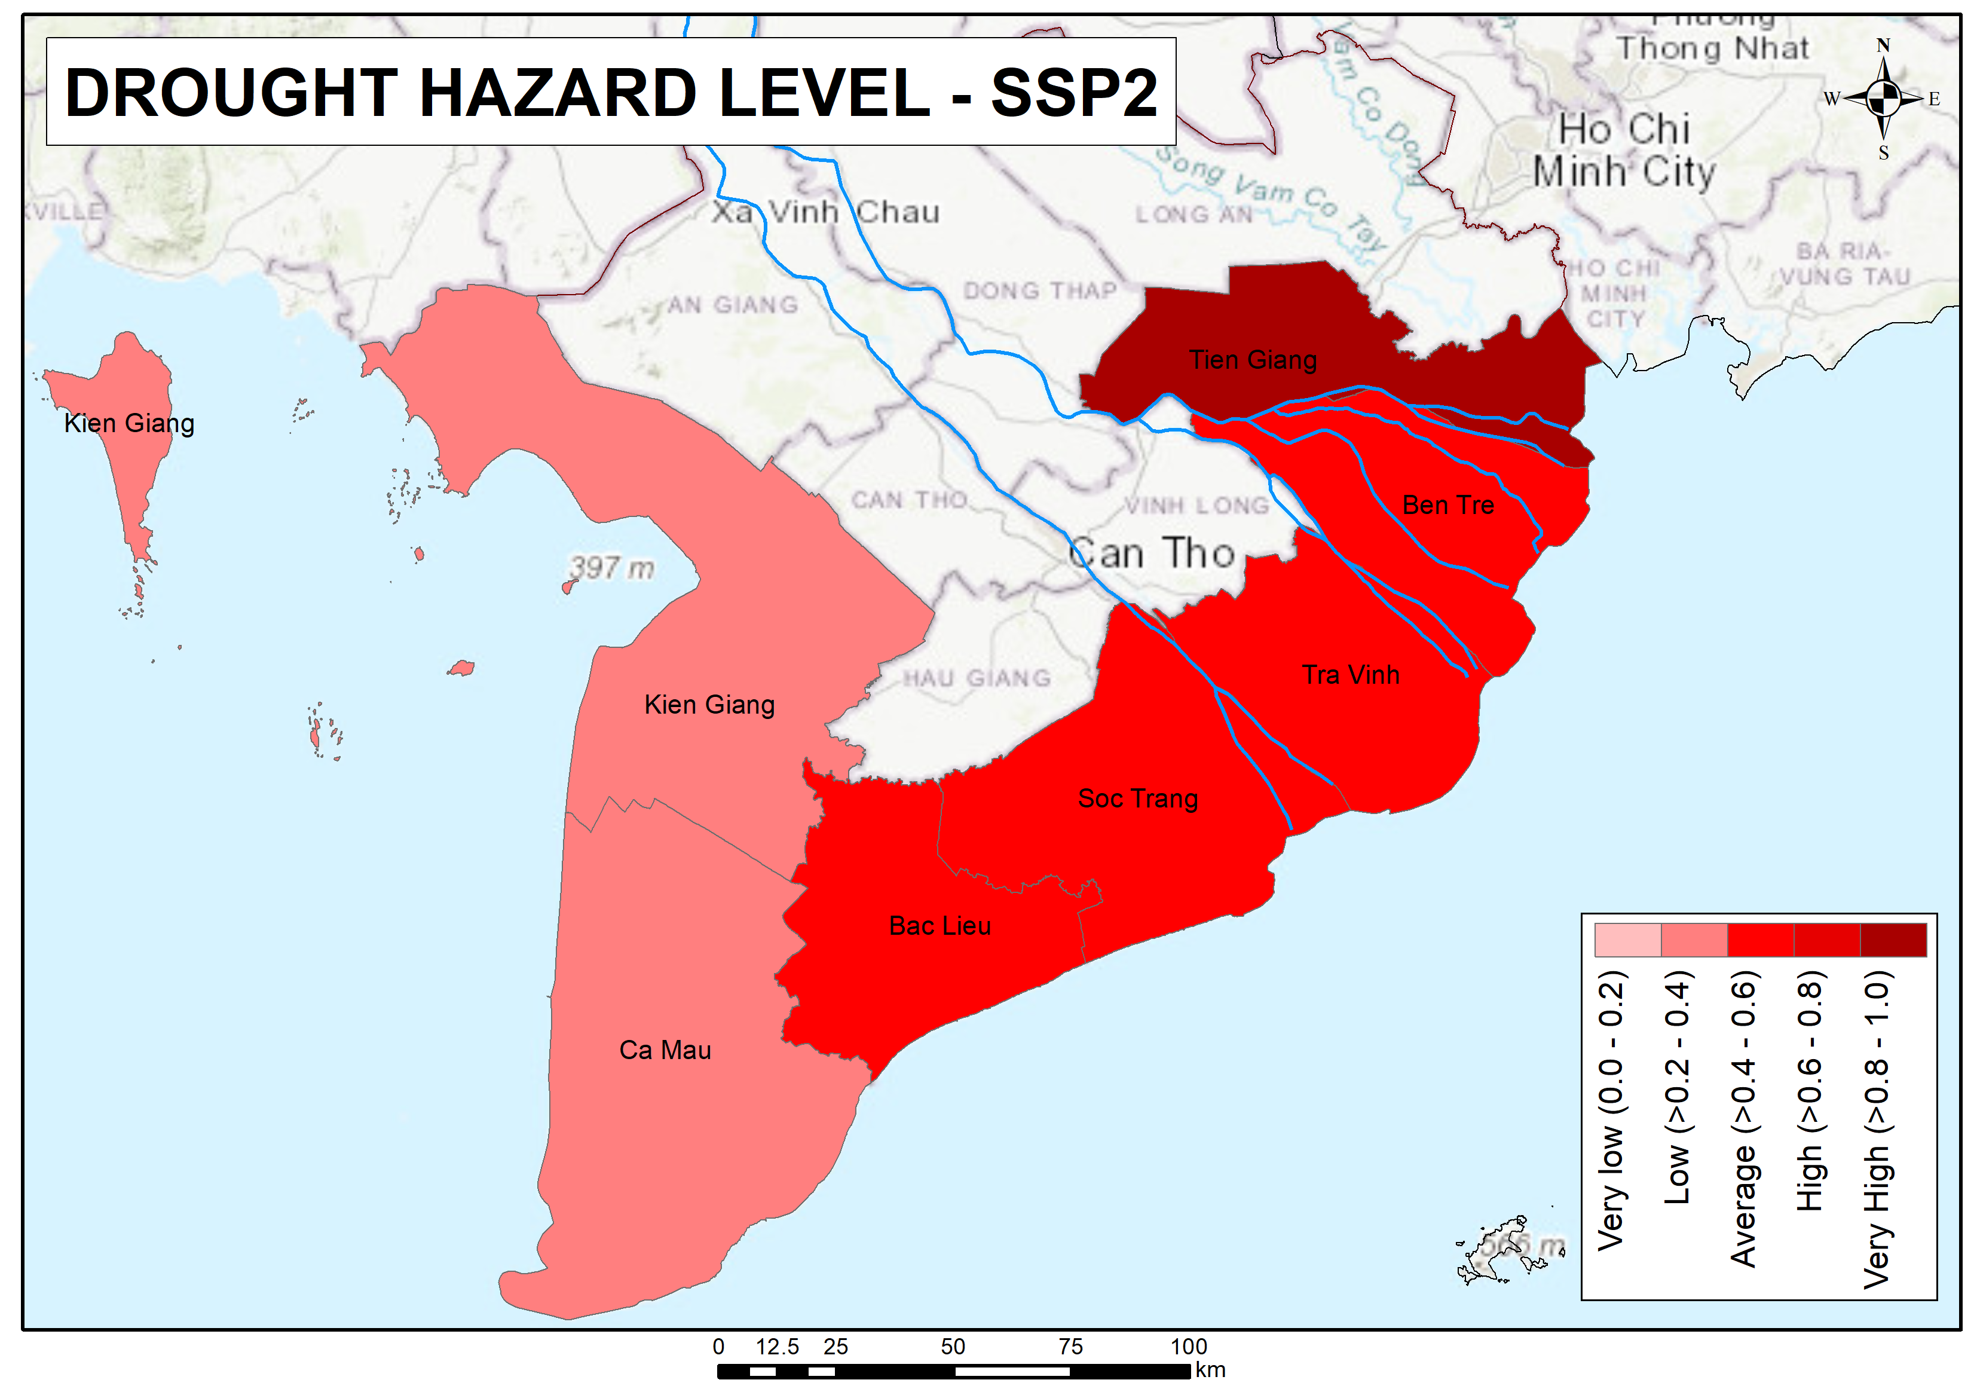
4. RESULTS
DROUGHT HAZARD IN SCENARIO SSP2
The upper map and table show drought hazard in scenario SSP2.
The study uses SPI from 3 models to avoid bias if only use 1 model.
Tra Vinh province has the highest drought hazard score in SSP2.
Kien Giang province is the lowest score and only get contribute from the model MIROC6, but this contribution from MIROC6 score is the highest compared to other provinces

Slide 10
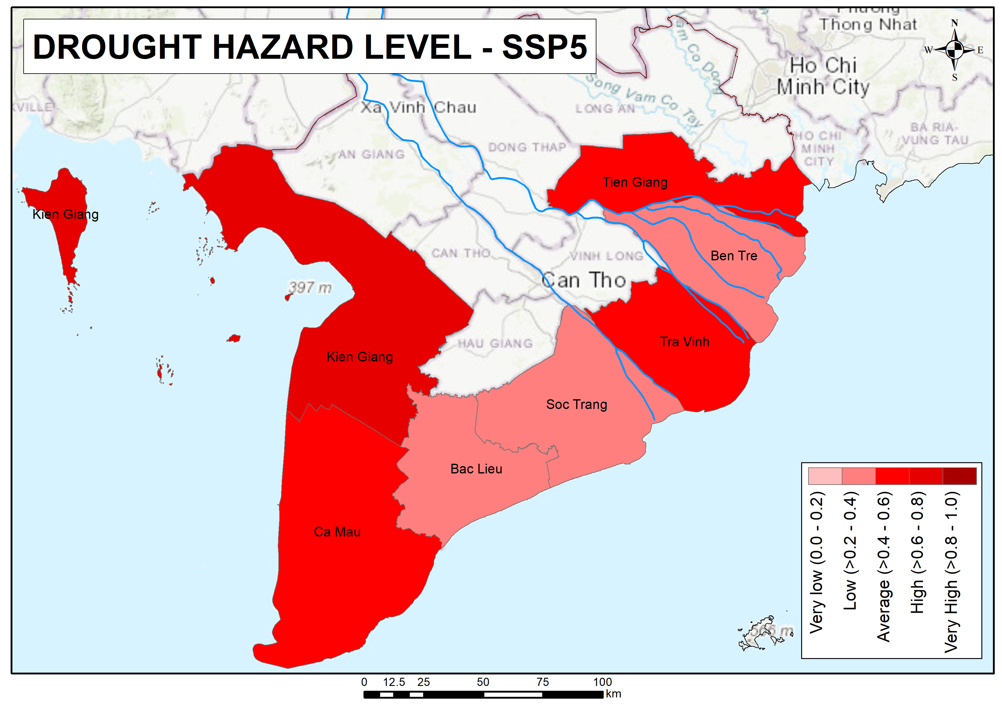
4. RESULTS
DROUGHT HAZARD IN SCENARIO SSP5
The upper map and table show drought hazard in scenario SSP5.
Unlike SSP2, Kien Giang province has the highest score in SSP5 and is at the high level. The scores from the ACCESS ESM1-5 and MRI ESM2-0 are the highest in all seven provinces.
Other six provinces, 3 provinces are at the low level and 3 provinces are at the medium level; Ben Tre province has the lowest score.

Slide 11
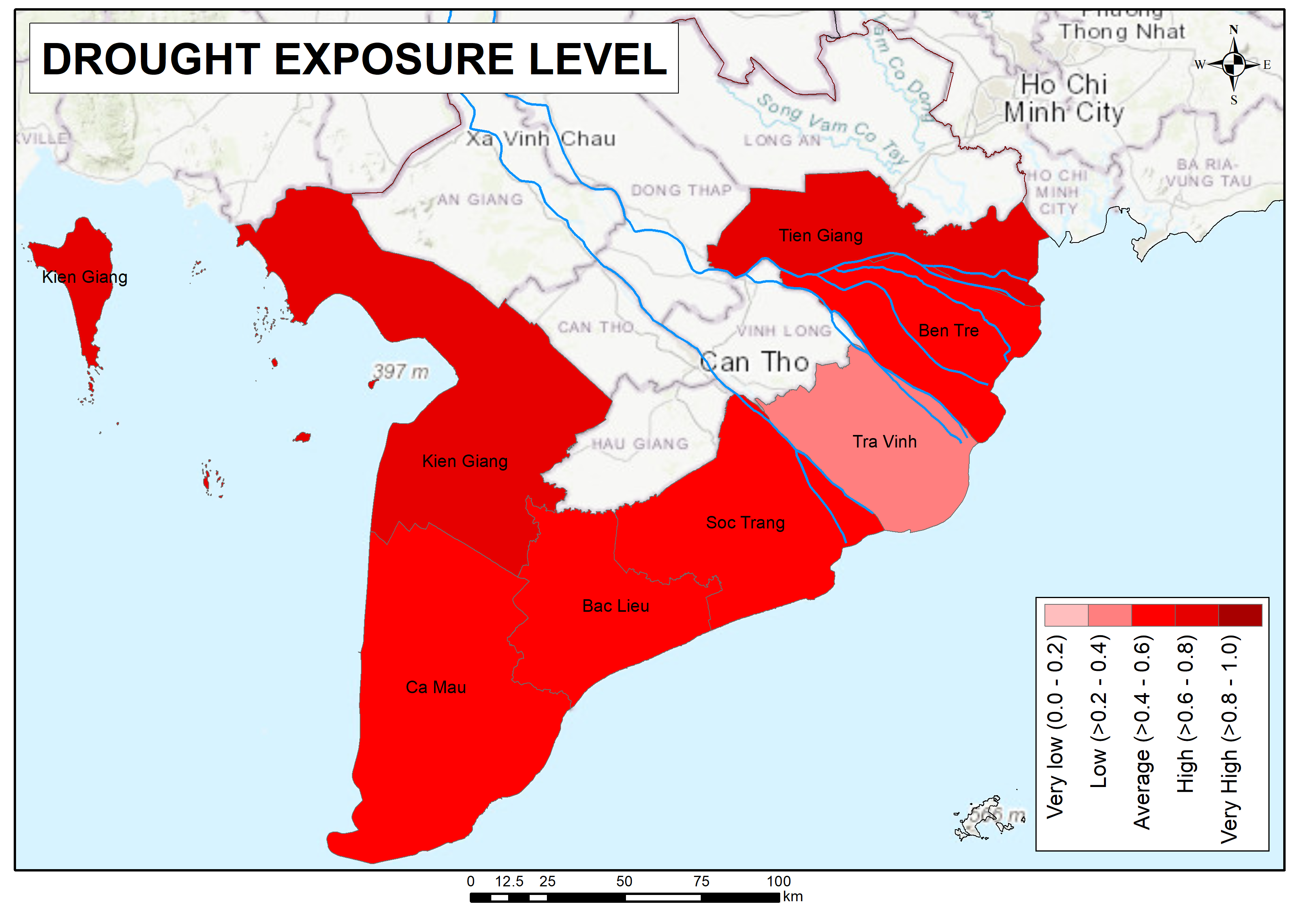
4. RESULTS
DROUGHT EXPOSURE
The upper map and table show drought exposure.
Tien Giang and Kien Giang are at the high level; Tra Vinh is at the low level.
Other provinces are at the medium.

Slide 12
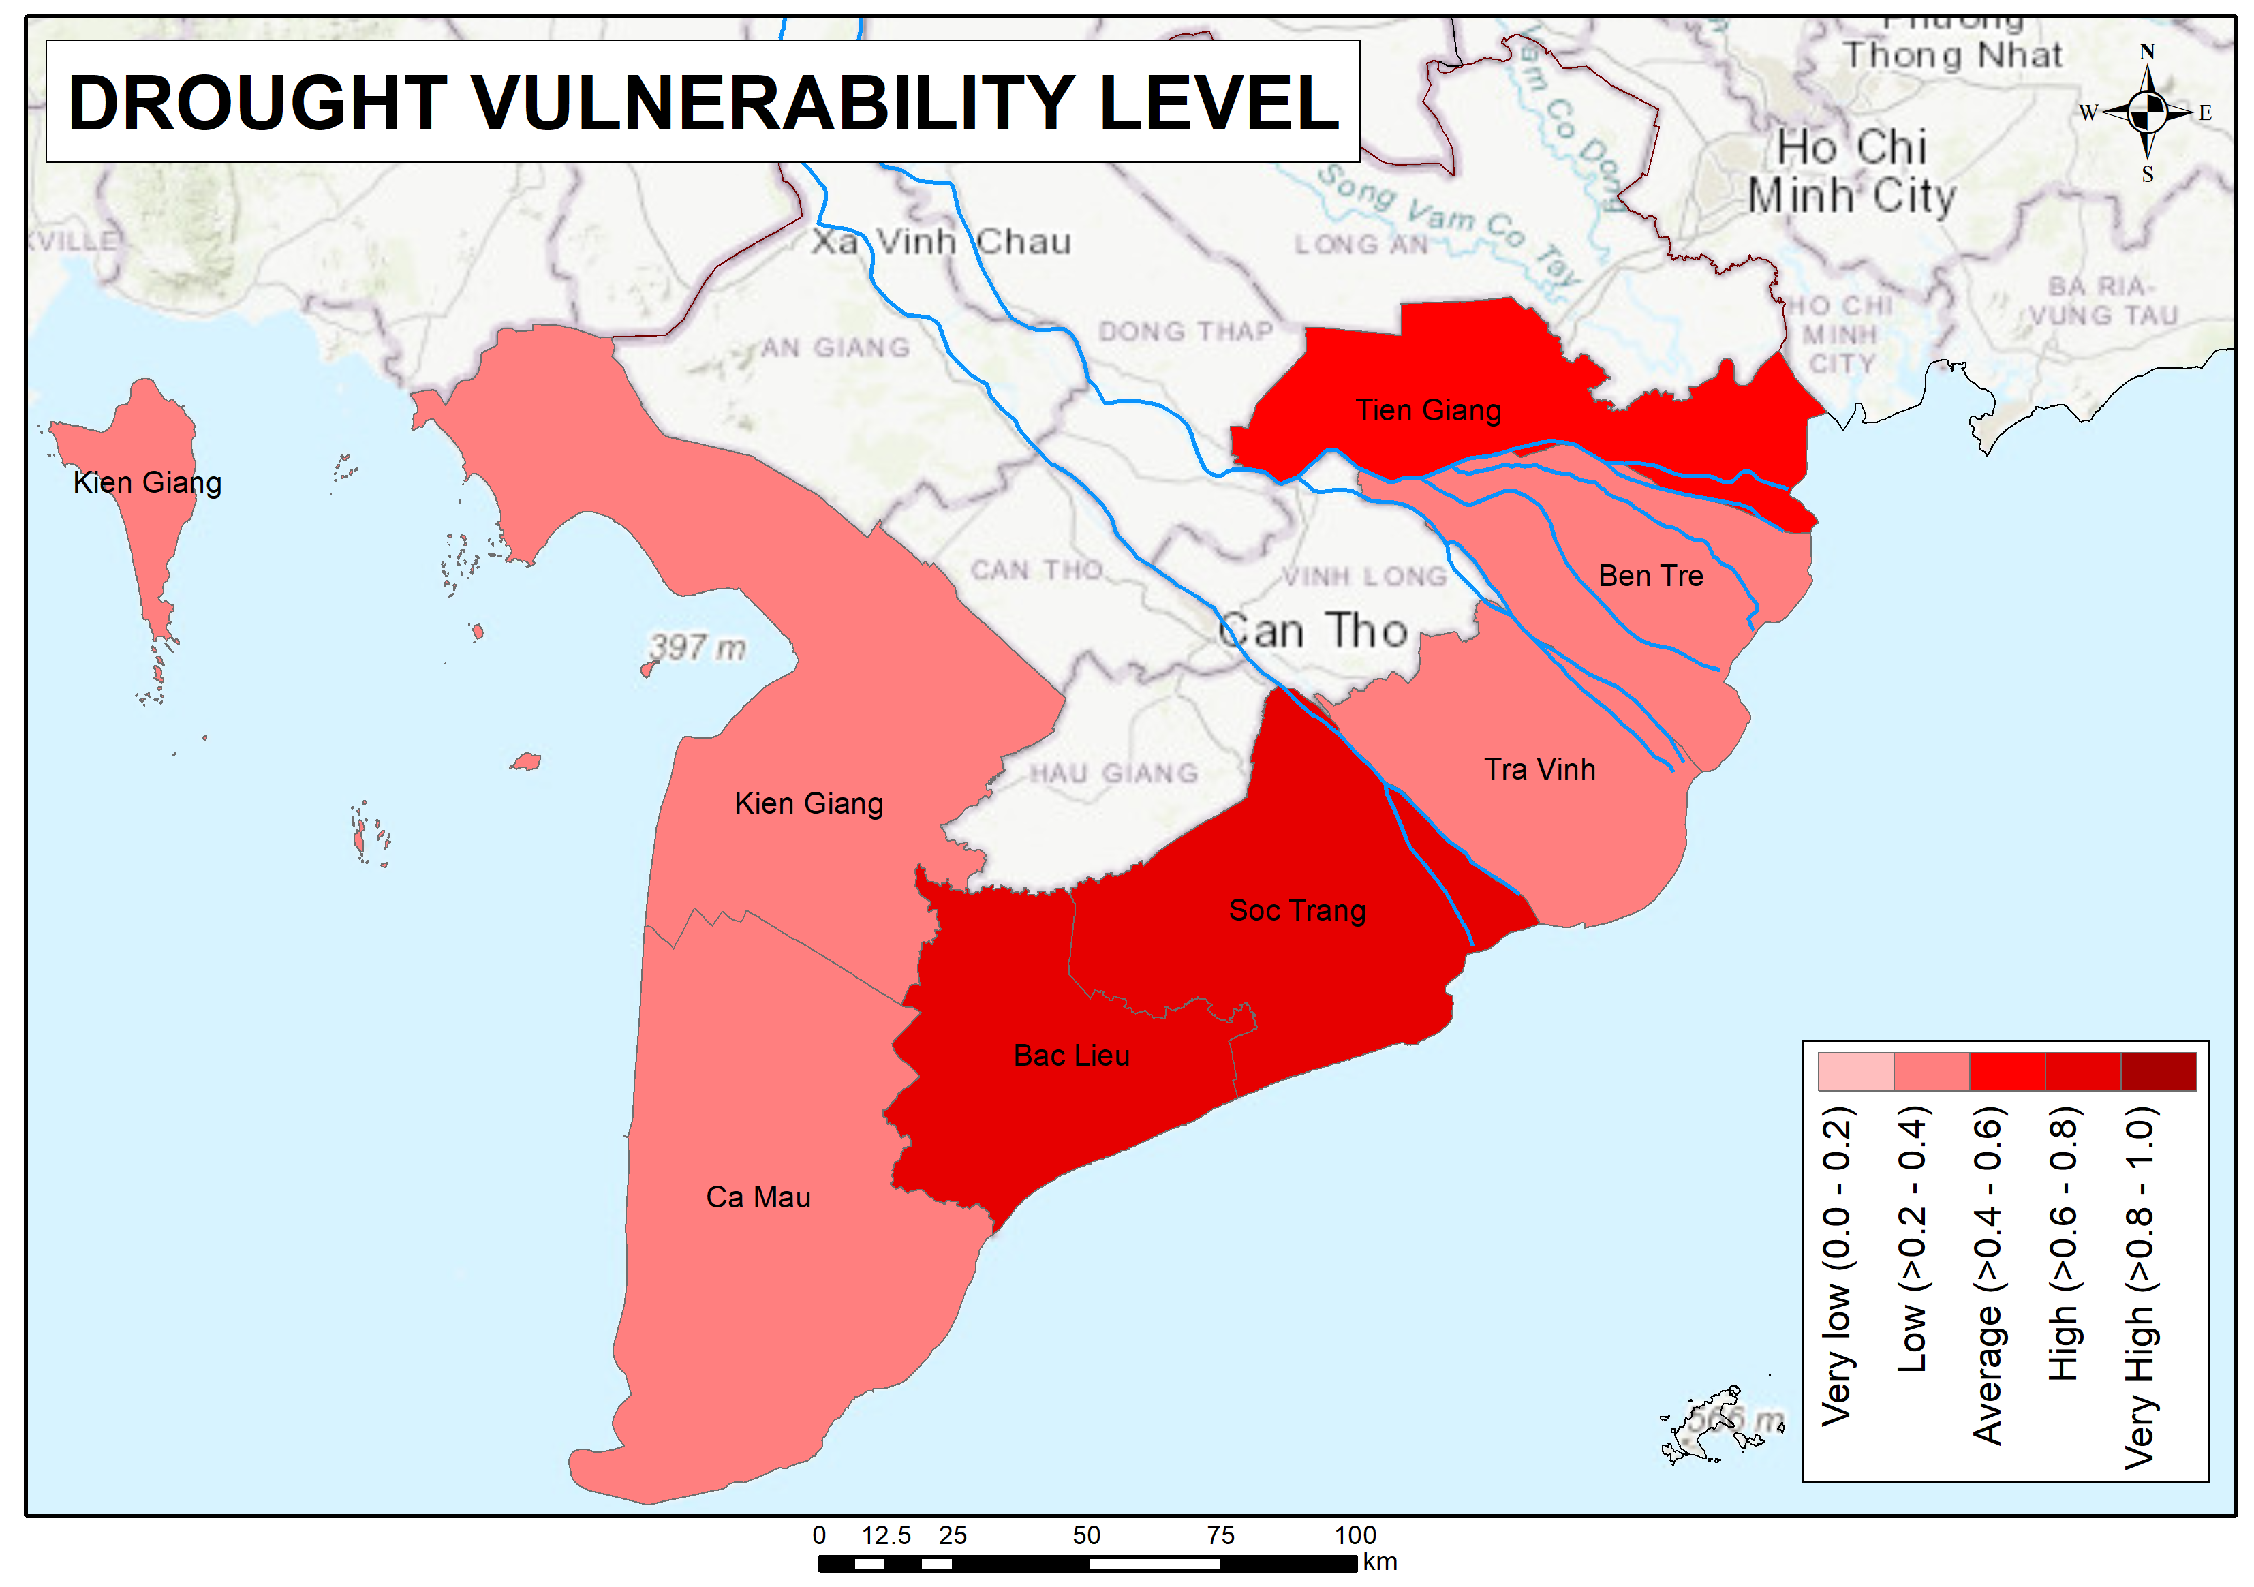
4. RESULTS
DROUGHT VULNERABILITY
The upper map and table show drought vulnerability.
Soc Trang and Bac Lieu are at the high level; Tien Giang is at the medium level.
There are four provinces at the low level which is more than half of the considered provinces in the study area

Slide 13
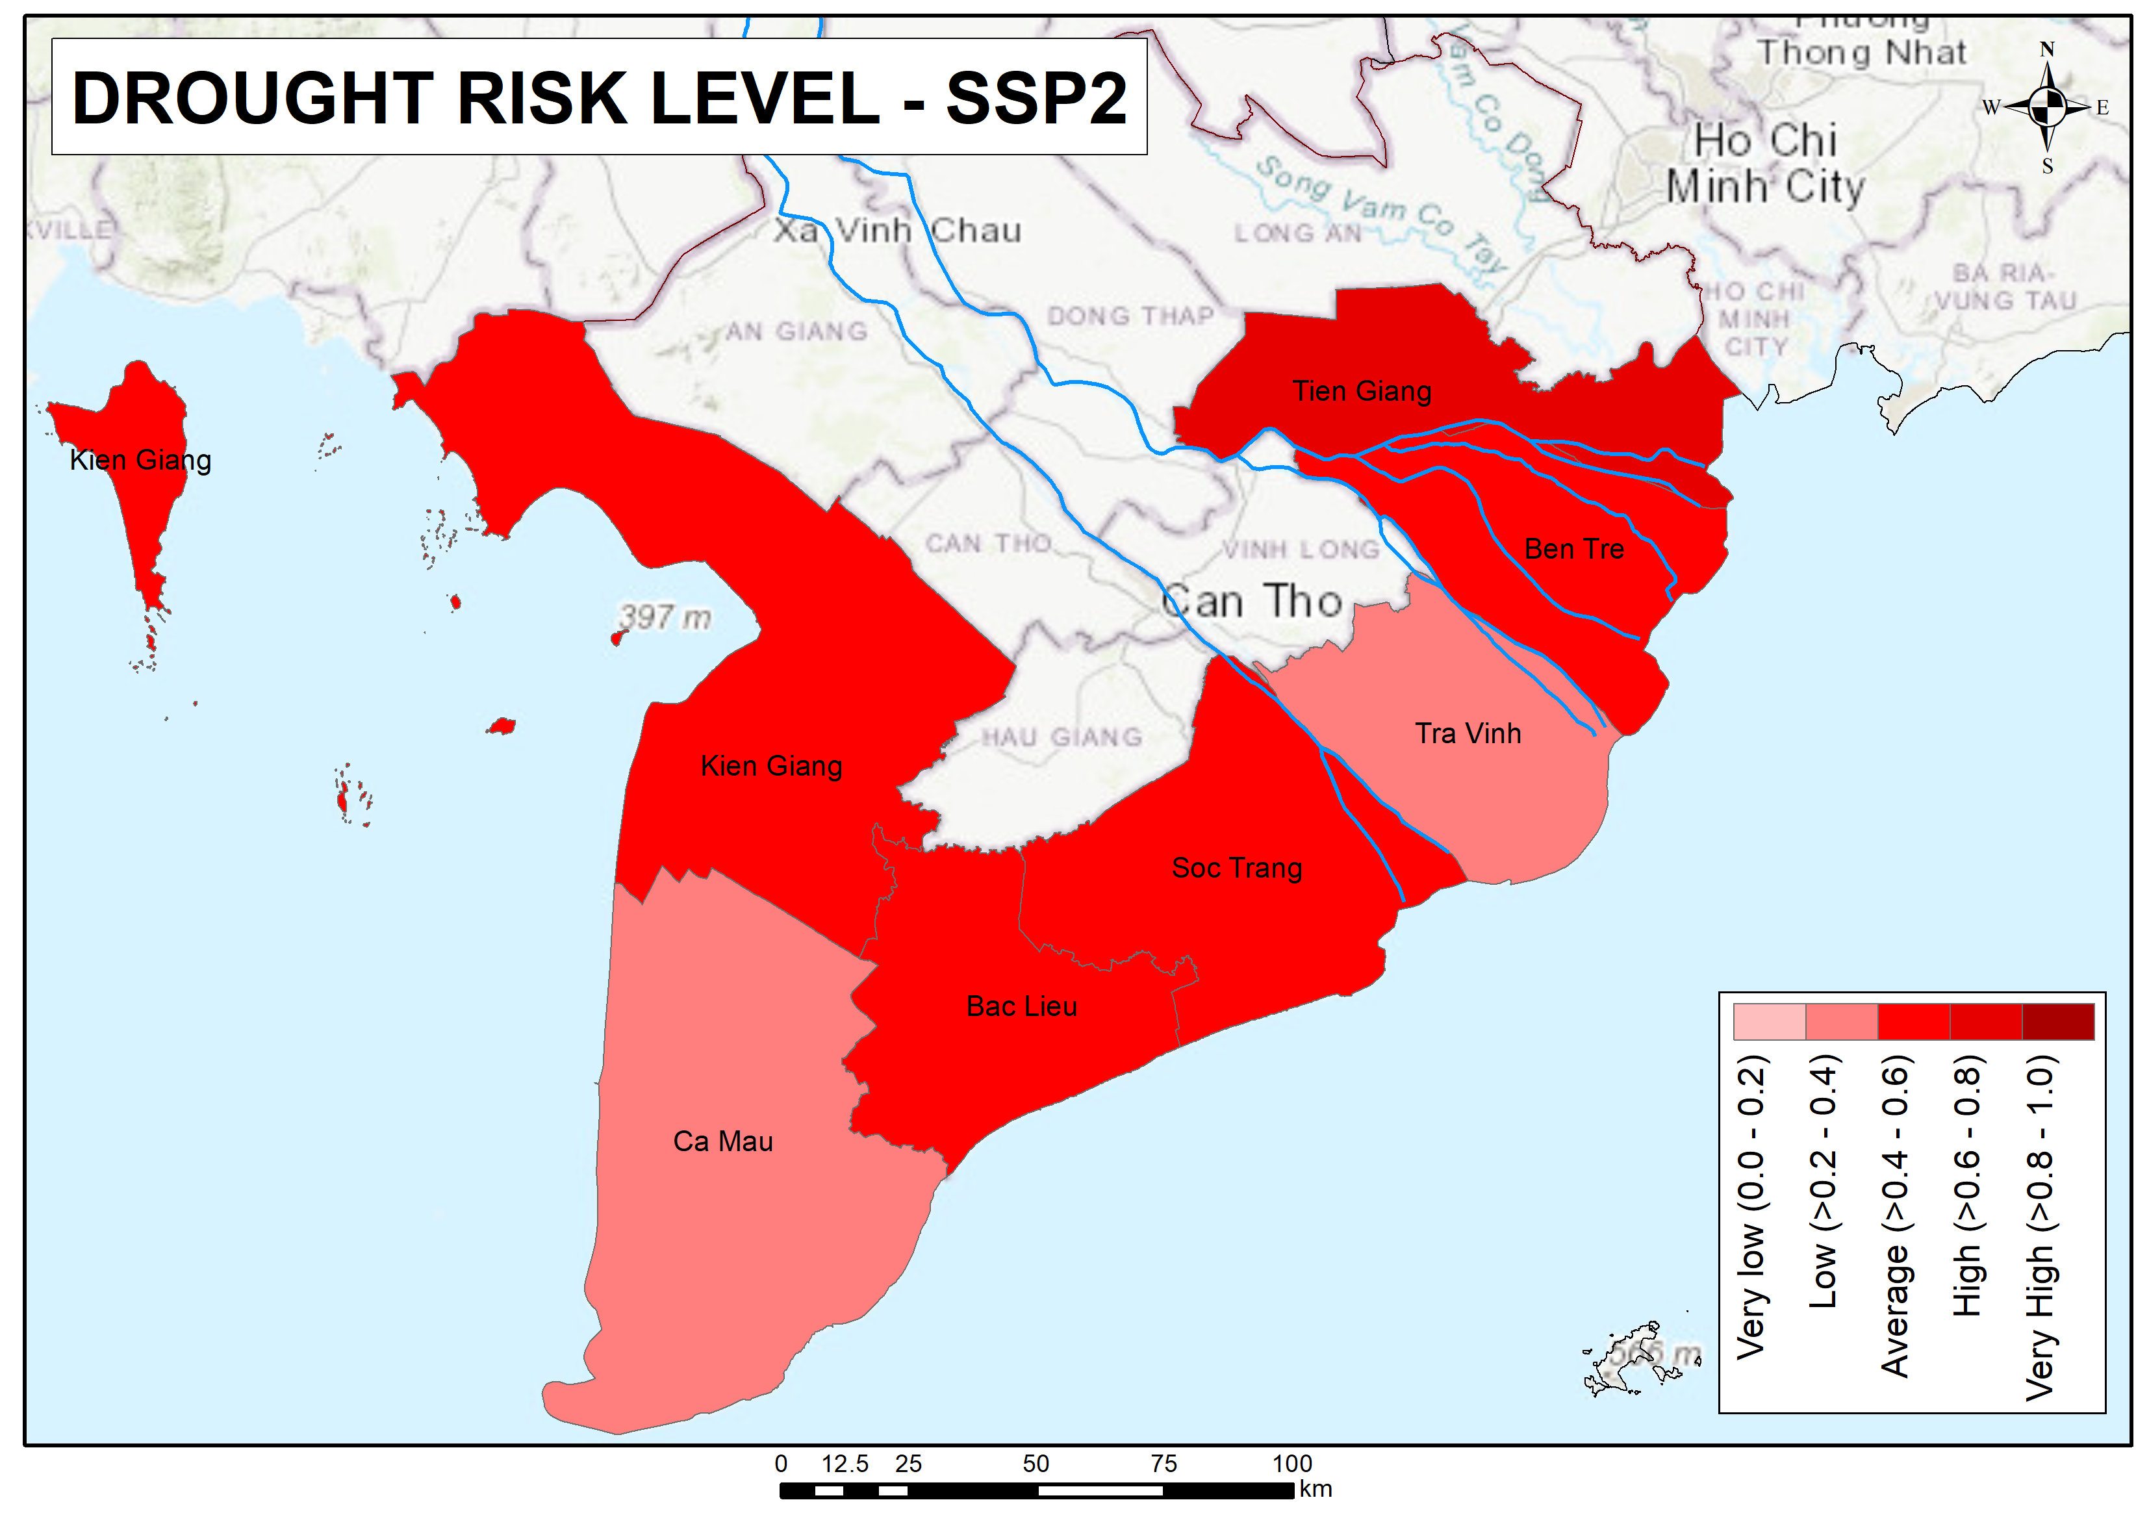
4. RESULTS
DROUGHT RISK IN SCENARIO SSP2
The upper map and table show the drought risk level in SSP2.
Tien Giang with the highest score in drought hazard in SSP2 is the only one at the high level.
Ben Tre, Soc Trang, Bac Lieu, and Kien Giang at the medium level.
Ca Mau and Tra Vinh at the low level.

Slide 14
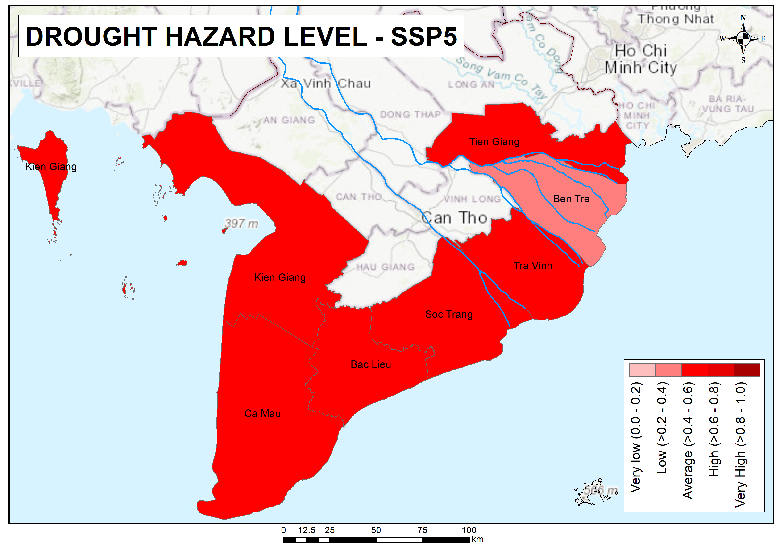
4. RESULTS
DROUGHT RISK IN SCENARIO SSP5
The upper map and table show the drought risk level in SSP5.
Ben Tre with the lowest score in drought hazard in SSP5 is the only one at the low level.
Other provinces are at the medium level

Slide 15
4. CONCLUSION AND RECOMMENDATION
The change in drought hazard in different scenarios makes different impacts on the whole drought risk index. For example, Tien Giang with the highest score of drought hazard makes it the only province at the high drought risk level in SSP2. Or, Ben Tre with the lowest score of drought hazard makes it the only province at the low drought risk level in SSSP5.
Therefore, projecting future climate with various models and scenarios will give a panoramic view of what might be happening in the future and help policymakers and drought managers give reasonable strategies for drought preparedness, mitigation, and adaptation.
The limitation of this study is only considering SPI which means precipitation is the only variable used; and due to the lack of accessible data, indicators of exposure and vulnerability are taken from past reports, not from future projections.
However, it opens a new pathway to assess the hazard risk index where can access better data; and not only assess only drought but also other hazards or multi-hazard.

