Slide 1
Usage of long-term forest research networks to advance understanding of ecosystem services – CLIMB-FOREST
Holger Lange¹, Jaana Bäck², Georg Jocher³, Natascha Kljun⁴, Anne Klosterhalfen⁵, Alexander Knohl⁵, Natalia Kowalska³,
Adam Kristensson⁴, Corinna Rebmann⁶, Teresa Saura-Yera⁷, Alberto Vilagrosa⁸
7
3
5
4
1
6
8
2

Slide 2
CLImate Mitigation and Bioeconomy pathways for sustainable FORESTry
EU H2020 Project
Coordinator: Adam Kristensson (ULUND)
Project period: 1.10.2022 – 31.3.2027
Budget: 6 M€
18 partners from 11 countries
CLIMB-FOREST suggests alternative sustainable pathways for the forest sector to mitigate climate change in entire Europe, considering preservation of biodiversity, ecosystem services, bioeconomy, socioeconomic factors, use of long-lived wood products, and barriers for change. It will have long-term impact by creating attitude change in the policymaking process in the EU and influence foresters to adopt to new forest management strategies.

Slide 3
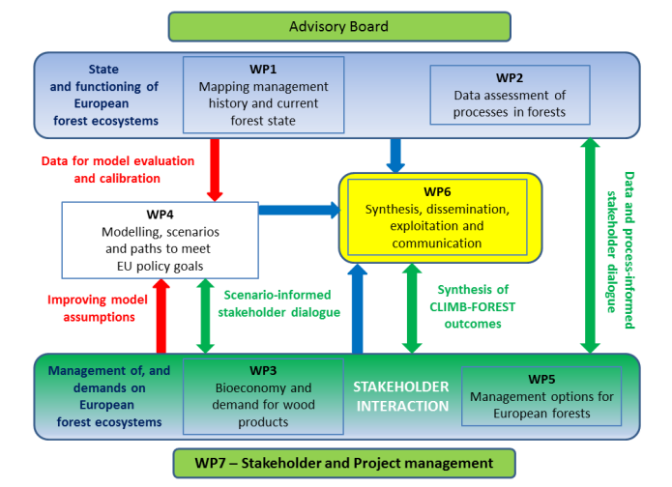
CLIMB-FOREST structure

Slide 4
CLIMB-FOREST in a nut-shell
CLIMB-FOREST aims at proposing alternative management pathways into the future in the Europe. It considers:
current management history maps, and near-future projections
the carbon storage in old-growth forests compared to managed forests
field and remote sensing data on all climate effects, resilience, biodiversity
use, benefits and preferences of long-lived products
coupled actor, trade, biodiversity, dynamic vegetation and climate modelling
modelling based on scenarios and stress-tested for policies
comparison of forest management alternatives by field visits with stakeholders
WP1
WP1
WP2
WP3
WP4
WP4
WP5

Slide 5
WP2: «Data assessment of processes and their impacts on biodiversity and climate effects on forests”
Compile forest data from long-term observation networks, utilize data opportunities from co-located sites (ICOS, eLTER, ICP-Forests, ACTRIS, …)
Assess C and N stocks and fluxes and biodiversity
Investigate biophysical effects of LULUCF strategies and disturbances
Quantify resilience to disturbances from climate extremes and human activities
Quantify atmospheric-chemical effects of management and disturbances
Comparing old-growth and managed forests wrt their response to climate impacts
Establish the relation between soil properties and forest type, management, history and climate
Notes:
From the proposal: a holistic view on all factors influencing direct climate mitigation
effects of forests
trends in C uptake and linkage to a wide variety of feedbacks with other processes
monitored in the forest, such as structure, health, biophysical effects (T2.2), short lived climate forcers (T2.3), and
soil functioning (T2.4)
Climate change impacts on the ecosystem productivity, species adaption and possible
trends in the carbon use efficiency will be derived
The connection to sites without continuous flux measurements
will be achieved with remote sensing data and models
combining satellite data with ongoing spectral
measurements (Eklundh et al. 2011), biophysical data and stand specific variables like tree species, stand age, and
management conditions to disentangle the effects of dynamic and stand-specific factors

Slide 6
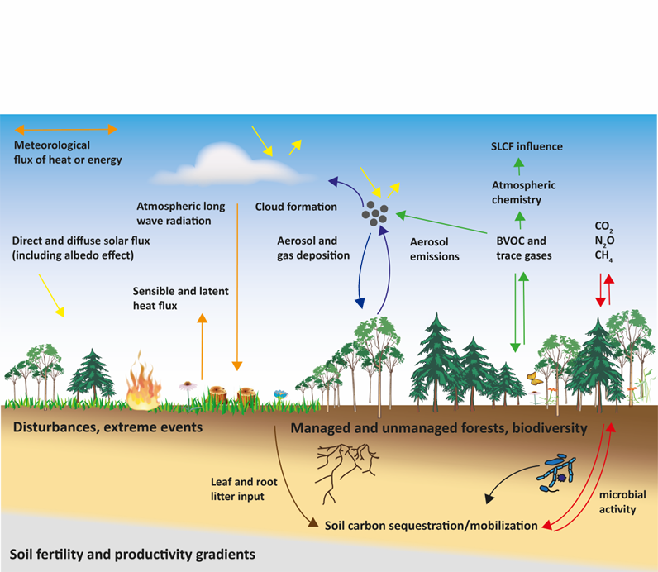
Management and multiple climate effects – WP2
SLCF:
short-lived climate forcers
Kristensson

Slide 7
Forest structure as buffer of climate extremes
Analysis of interrelation between forest structure and forest resilience to climate extremes
buffer capacity and resilience
See poster presentation Klosterhalfen et al.
Forest structure
age, DBH, basal area, canopy height
plant/leaf area index, phenology
tree species composition
horizontal and vertical distributions
diversity indices
Ecosystem Functioning
microclimate
CO₂ and energy fluxes
photosynthetic capacity (GPP_{sat})
WUE
albedo, Bowen ratio
spatial scale
temporal scale
water availability
soil characteristics
topography
climate extremes
masting years
legacy effects
…

Slide 8
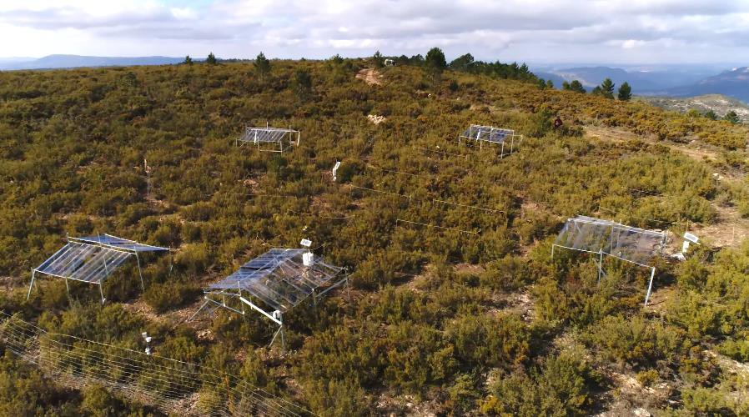
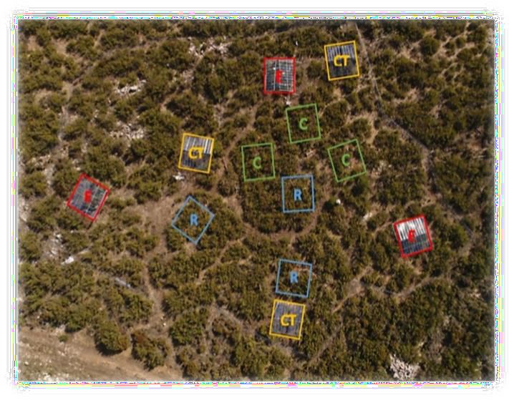
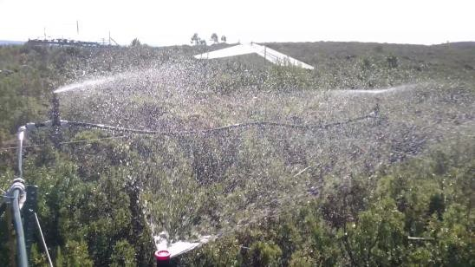
Impact of wildfires and drought extremes on SOC and N dynamics
Effect of fire and subsequent drought
Rainfall exclusion experiment: biomass and root production, litterfall and decomposition
CO2 fluxes in paired plots (burned/unburned, managed/control)
Soil erosion risk, soil fertility, hydrology and erosion risk, plant diversity and C sequestration

Slide 9
Summary
Advance process understanding of forest ecosystems, using flux observations, remote sensing and detailed process modelling
Compare old-growth to managed forests
Evaluate management strategies with stakeholders during field visits and workshops
Agent-based climate scenario modelling of management alternatives up to 2100

