Slide 1
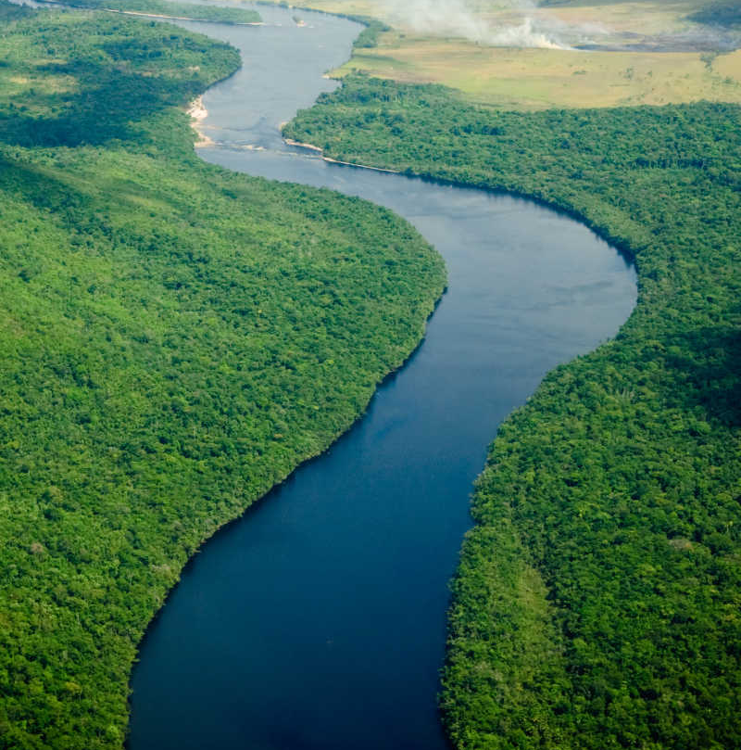
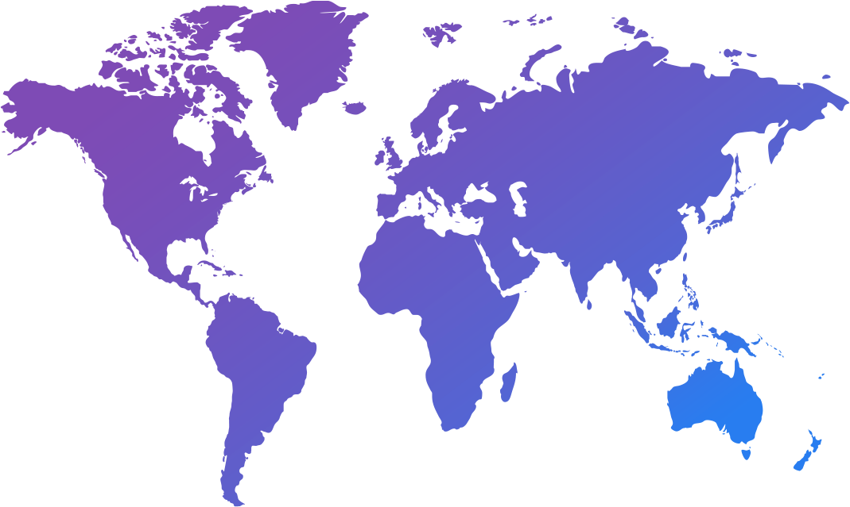
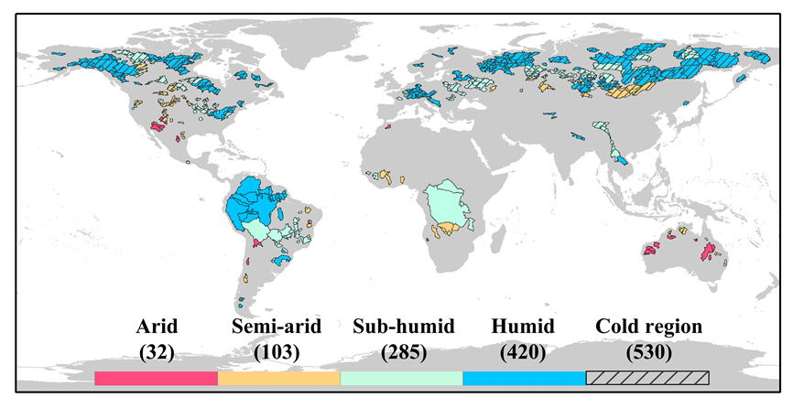
Ying Hou¹, Hui Guo¹, Yuting Yang¹, Wenbin Liu²
¹Tsinghua University, ²Chinese Academy of Sciences
hy20@mails.tsinghua.edu.cn
Global runoff evaluation from climate, hydrological and land surface models
WHERE?
WHICH PRODUCTS?
HOW?
CMIP6
CaMa-Flood
Global River Hydrodynamics Model
ISIMIP2a
840 strictly selected catchments that cover a broad range of climate conditions from 1971 to 2010
&
GLDAS-2.0
Four statistical metrics
2 min
Background
Methodology
Results
Take-home messages
1
Notes:
Hello everybody, my name‘s Ying Hou, a PhD student, you can see my co-authors and we come from Tsinghua University and Chinese Academy of Science. The study I’m gonna present here today is about global runoff evaluation. So our aim is to evaluate how well climate, hydrological, and land surface models simulate runoff.
To carry out this study, we started by selecting 840 catchments based on strict criteria to represent a broad range of climate conditions. And we then evaluated them using global models from CMIP6, ISIMIP2a and GLDAS-2.0. Finally we compared, the simulated runoff with observations using a river routing model, CaMa-Flood with four statistical metrics.

Slide 2
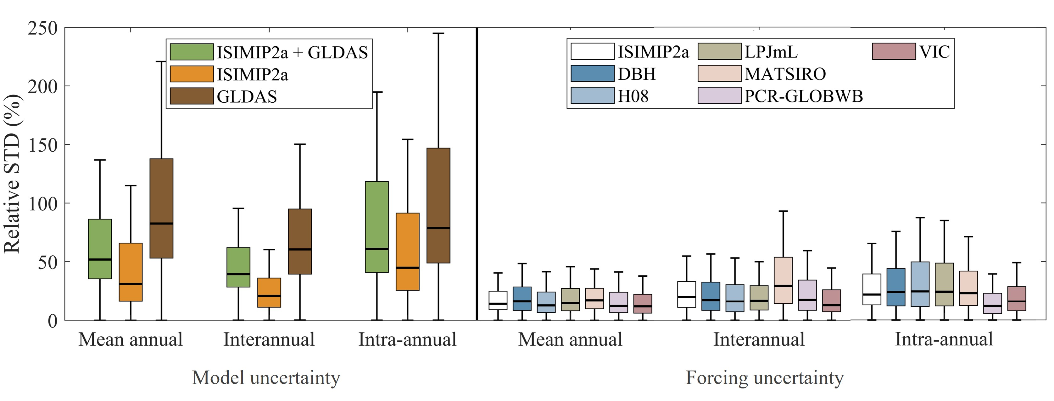
Global runoff evaluation from climate, hydrological and land surface models
Our results: model uncertainty vs forcing uncertainty
Model uncertainties are consistently larger in GLDAS than in ISIMIP2a
Model uncertainties generally result in a larger modeled streamflow uncertainty, compared to that induced by different climatic forcings
Model uncertainty in ISIMIP2a and GLDAS and forcing uncertainty in ISIMIP2a
2 min
Background
Methodology
Results
Take-home messages
2
Notes:
From this objective and methods, we came to some results. One of them is that, in models forced with reanalyzed climate datasets, the model uncertainties are consistently larger in GLDAS than in ISIMIP2a, and model uncertainties generally result in a larger modeled streamflow uncertainty than that induced by different climatic forcings.
This is currently the most comprehensive runoff evaluation work. So for to know more about how we evaluate these products and get more insights on uncertainty analysis. Please visit my PICO number 4 point 11, Thank you very much.

Slide 3
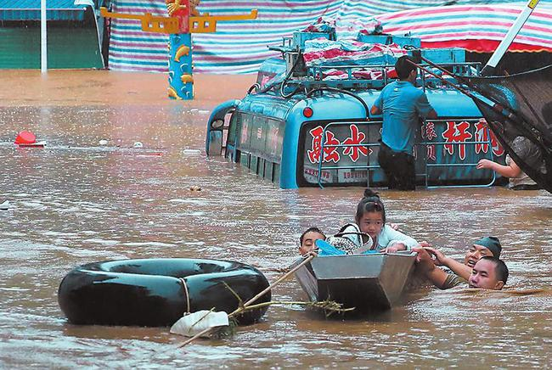
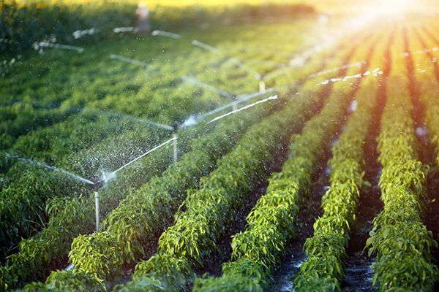
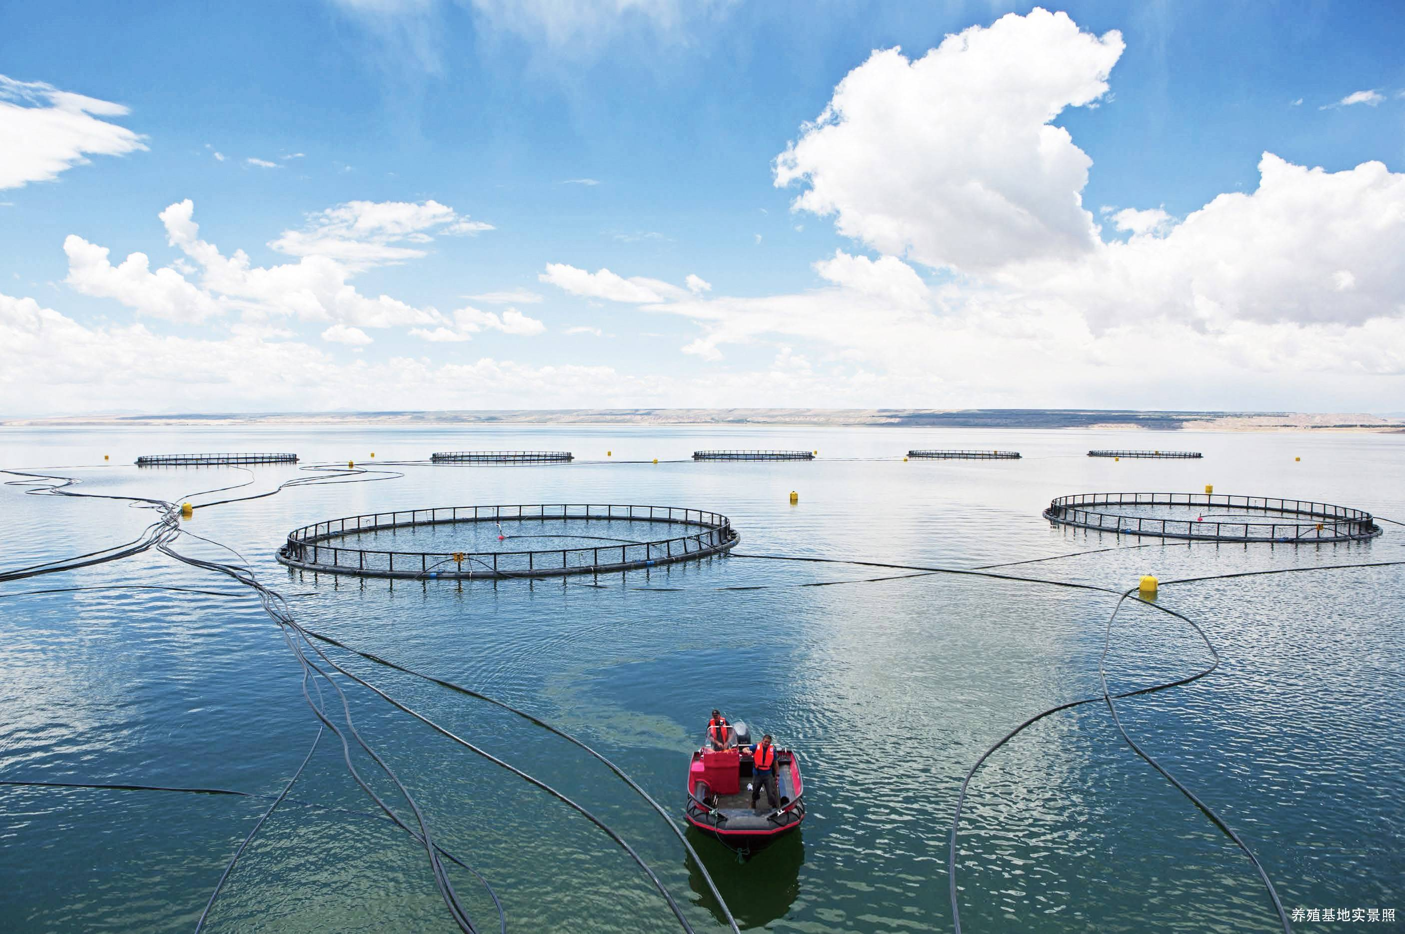
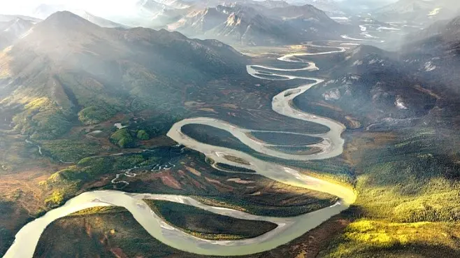
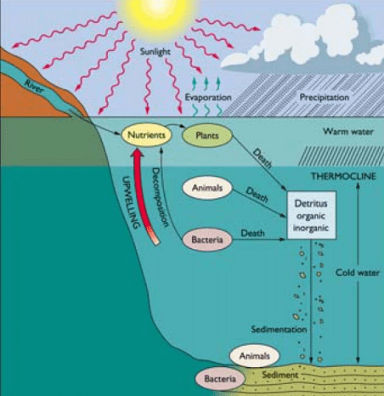
Global runoff evaluation from climate, hydrological and land surface models
River streamflow (Q)
The most direct freshwater resource for various kinds of human needs
Representative indicator of hydrological response to environmental changes at the catchment scale
Water resources
Drought and flood
Agriculture
Fishery
Geomorphy
Biogeochemistry
（Images from Wikipedia）
2 min
Background
Methodology
Results
Take-home messages
3

Slide 4
Global runoff evaluation from climate, hydrological and land surface models
How can we know streamflow change?
Observations
Limitations: spatial discontinuity, short records, data sharing policies
Models
Powerful tools, large uncertainties, limited global evaluation
Questions:
How do these models simulate runoff at different temporal scales?
How do these models perform in different climatic regions?
Where does the uncertainty in simulated runoff come from?
2 min
Background
Methodology
Results
Take-home messages
4

Slide 5
Global runoff evaluation from climate, hydrological and land surface models
Our methodology
1
3
River routing model
Catchment selection
area is larger than 10,000 km²
streamflow records for at least 15 years between 1971 and 2010
with no human interventions
CaMa-Flood
Global River Hydrodynamics Model
Runoff outputs were resampled to 0.25° × 0.25° resolution
and fed into CaMa-Flood
2
Simulated runoff
4
Evaluation metrics
percentage bias (PBIAS)
Pearson correlation coefficient (r)
root mean squared error (RMSE)
standard deviation (STD)
Models from CMIP6, ISIMIP2a and GLDAS-2.0
Click here to see calculations in Page 7
Click here to see details about the evaluated models in Page 6
2 min
Background
Methodology
Results
Take-home messages
5

Slide 6
Global runoff evaluation from climate, hydrological and land surface models
Information about evaluated models
Experiments | Model | Land Surface Model | Resolution (°) | Atmospheric Model/Climate forcing | Reference
CMIP6 | ACCESS-ESM1-5 | CABLE2.4 | 1.875×1.25 | HadGAM2 | Ziehn et al., 2020
 | AWI-ESM-1-1-LR | JSBACH3.20 | 1.875×1.875 | ECHAM6.3.04p1 | Sidorenko et al., 2015
 | CMCC-CM2-HR4 | CLM4.5 | 1.25×0.9375 | CAM4 | Cherchi et al., 2019
 | CMCC-CM2-SR5 | CLM4.5 | 1.25×0.9375 | CAM5.3 | Cherchi et al., 2019
 | CMCC-ESM2 | CLM4.5 | 1.25×0.9375 | CAM5.3 | Cherchi et al., 2019
 | IITM-ESM | Noah v2.7.1 | 1.875×1.915 | IITM-GFSv1 | Swapna et al., 2018
 | MIROC6 | MATSIRO6.0 | 1.40625×1.40625 | CCSR AGCM | Tatebe et al., 2019
 | MPI-ESM-1-2-HAM | JSBACH3.20 | 1.875×1.875 | ECHAM6.3 | Neubauer et al., 2019
 | MPI-ESM1-2-HR | JSBACH3.20 | 0.9375×0.9375 | ECHAM6.3 | Gutjahr et al., 2019
 | MPI-ESM1-2-LR | JSBACH3.20 | 1.875×1.875 | ECHAM6.3 | Mauritsen et al., 2019
 | MRI-ESM2-0 | HAL1.0 | 1.125×1.125 | MRI-AGCM3.5 | Yukimoto et al., 2019
 | NorESM2-MM | CLM5 | 1.25×0.9375 | CAM-OSLO | Seland et al., 2020
ISIMIP2a | DBH | - | 0.5×0.5 | PGFv2, GSWP3, WATCH/WFDEI | Tang et al., 2007
 | H08 |  |  |  | Hanasaki et al., 2008
 | LPJmL |  |  |  | Bondeau et al., 2007
 | MATSIRO |  |  |  | Takata et al., 2003
 | PCR-GLOBWB |  |  |  | Wada et al., 2014
 | VIC |  |  |  | Liang et al., 1994
GLDAS-2.0 | CLSM |  | 0.25×0.25 | PGFv2 | Koster et al., 2000
 | Noah |  | 0.25×0.25 |  | Chen et al., 1996
 | VIC |  | 1.0×1.0 |  | Liang et al., 1994
2 min
Background
Methodology
Results
Take-home messages
6

Slide 7
Global runoff evaluation from climate, hydrological and land surface models
Calculations for evaluation metrics
2 min
Background
Methodology
Results
Take-home messages
7

Slide 8
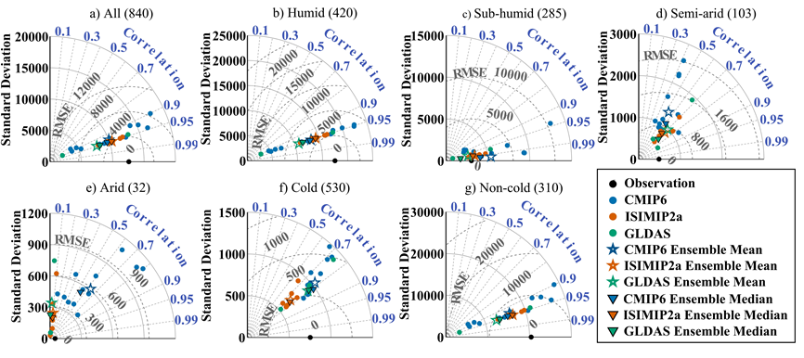
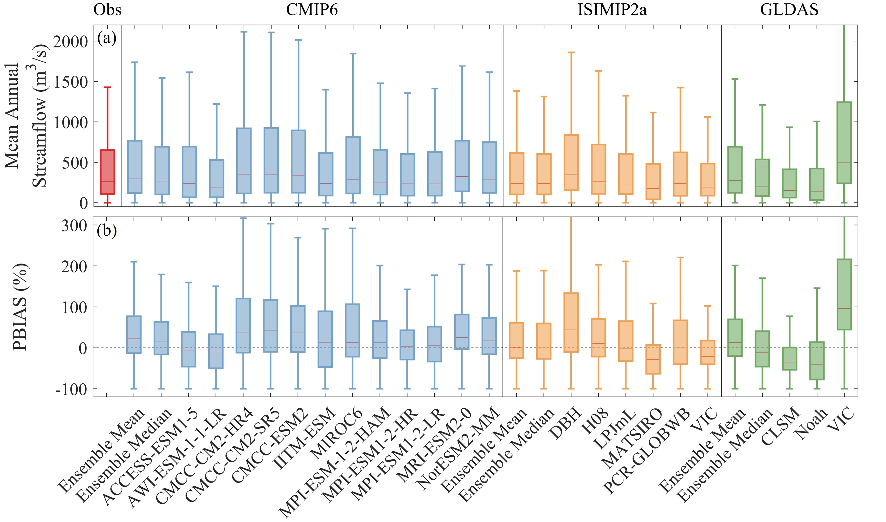
Global runoff evaluation from climate, hydrological and land surface models
Our results: mean annual streamflow
Mean annual Q：
Spatial variability：
10/12 CMIP6-simulated Q show an overestimation, while ISIMIP2a and GLDAS models tend to underestimate Q
Multi-model ensembles (mean or median) effectively reduce Q PBIAS for nearly all individual models participated in the ISIMIP2a and GLDAS
Spatial patterns are generally well captured by all models
All Q estimates tend to perform better in more humid catchments than in more arid catchments, and in non-cold environments than in cold regions
2 min
Background
Methodology
Results
Take-home messages
8

Slide 9
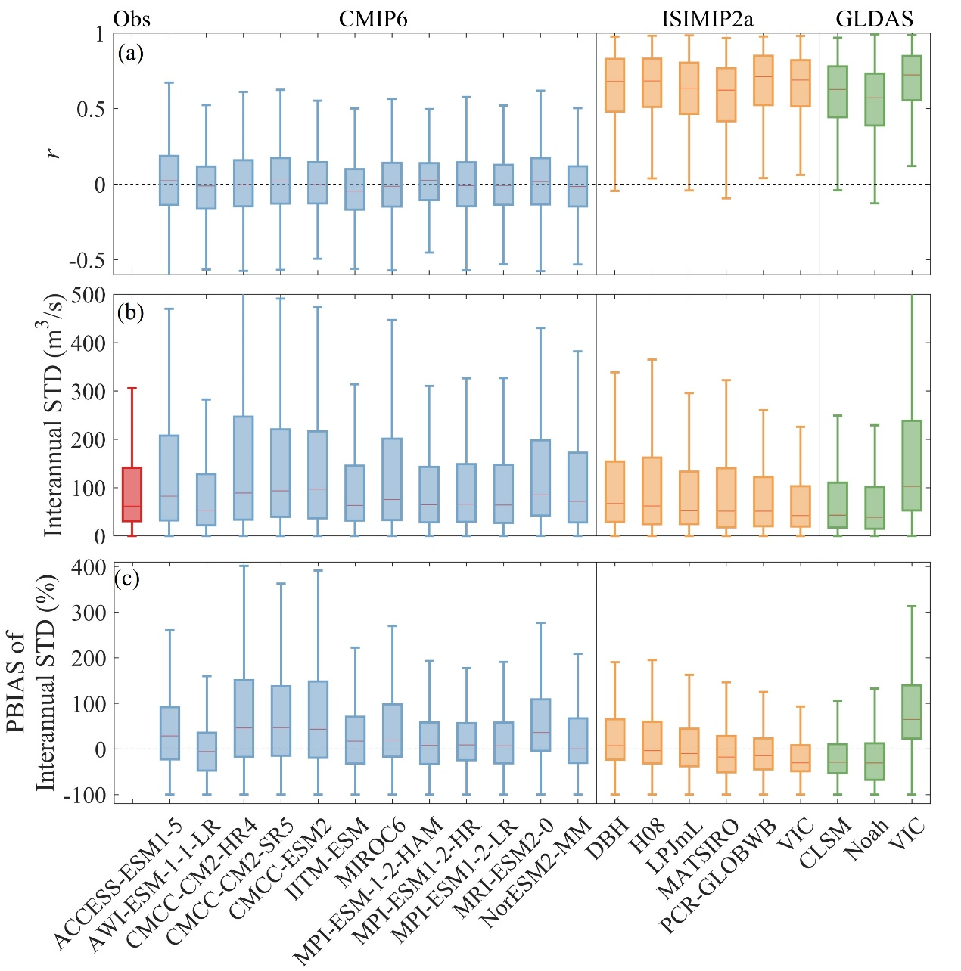
Global runoff evaluation from climate, hydrological and land surface models
Our results: interannual variability
The interannual Q variability is reasonably captured by ISIMIP2a and GLDAS Q estimates but not by CMIP6 Q estimates
2 min
Background
Methodology
Results
Take-home messages
9

Slide 10
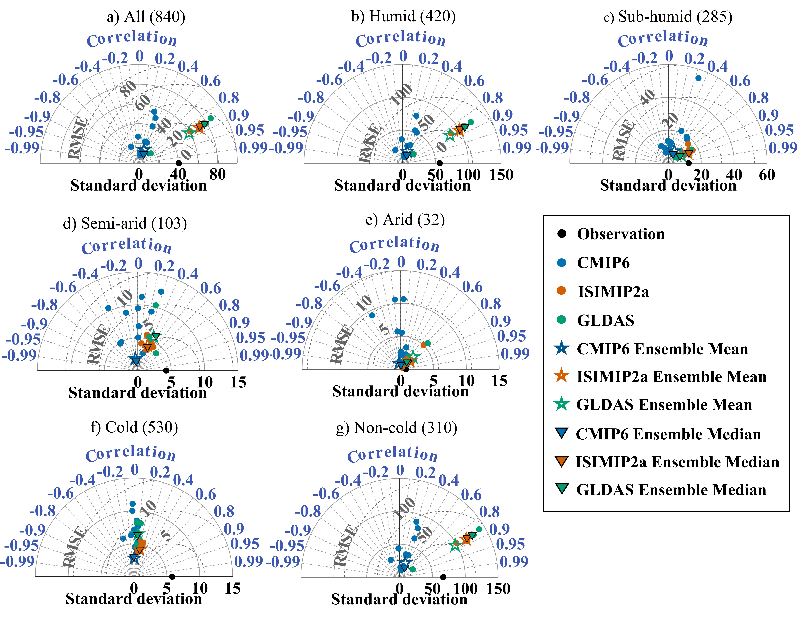
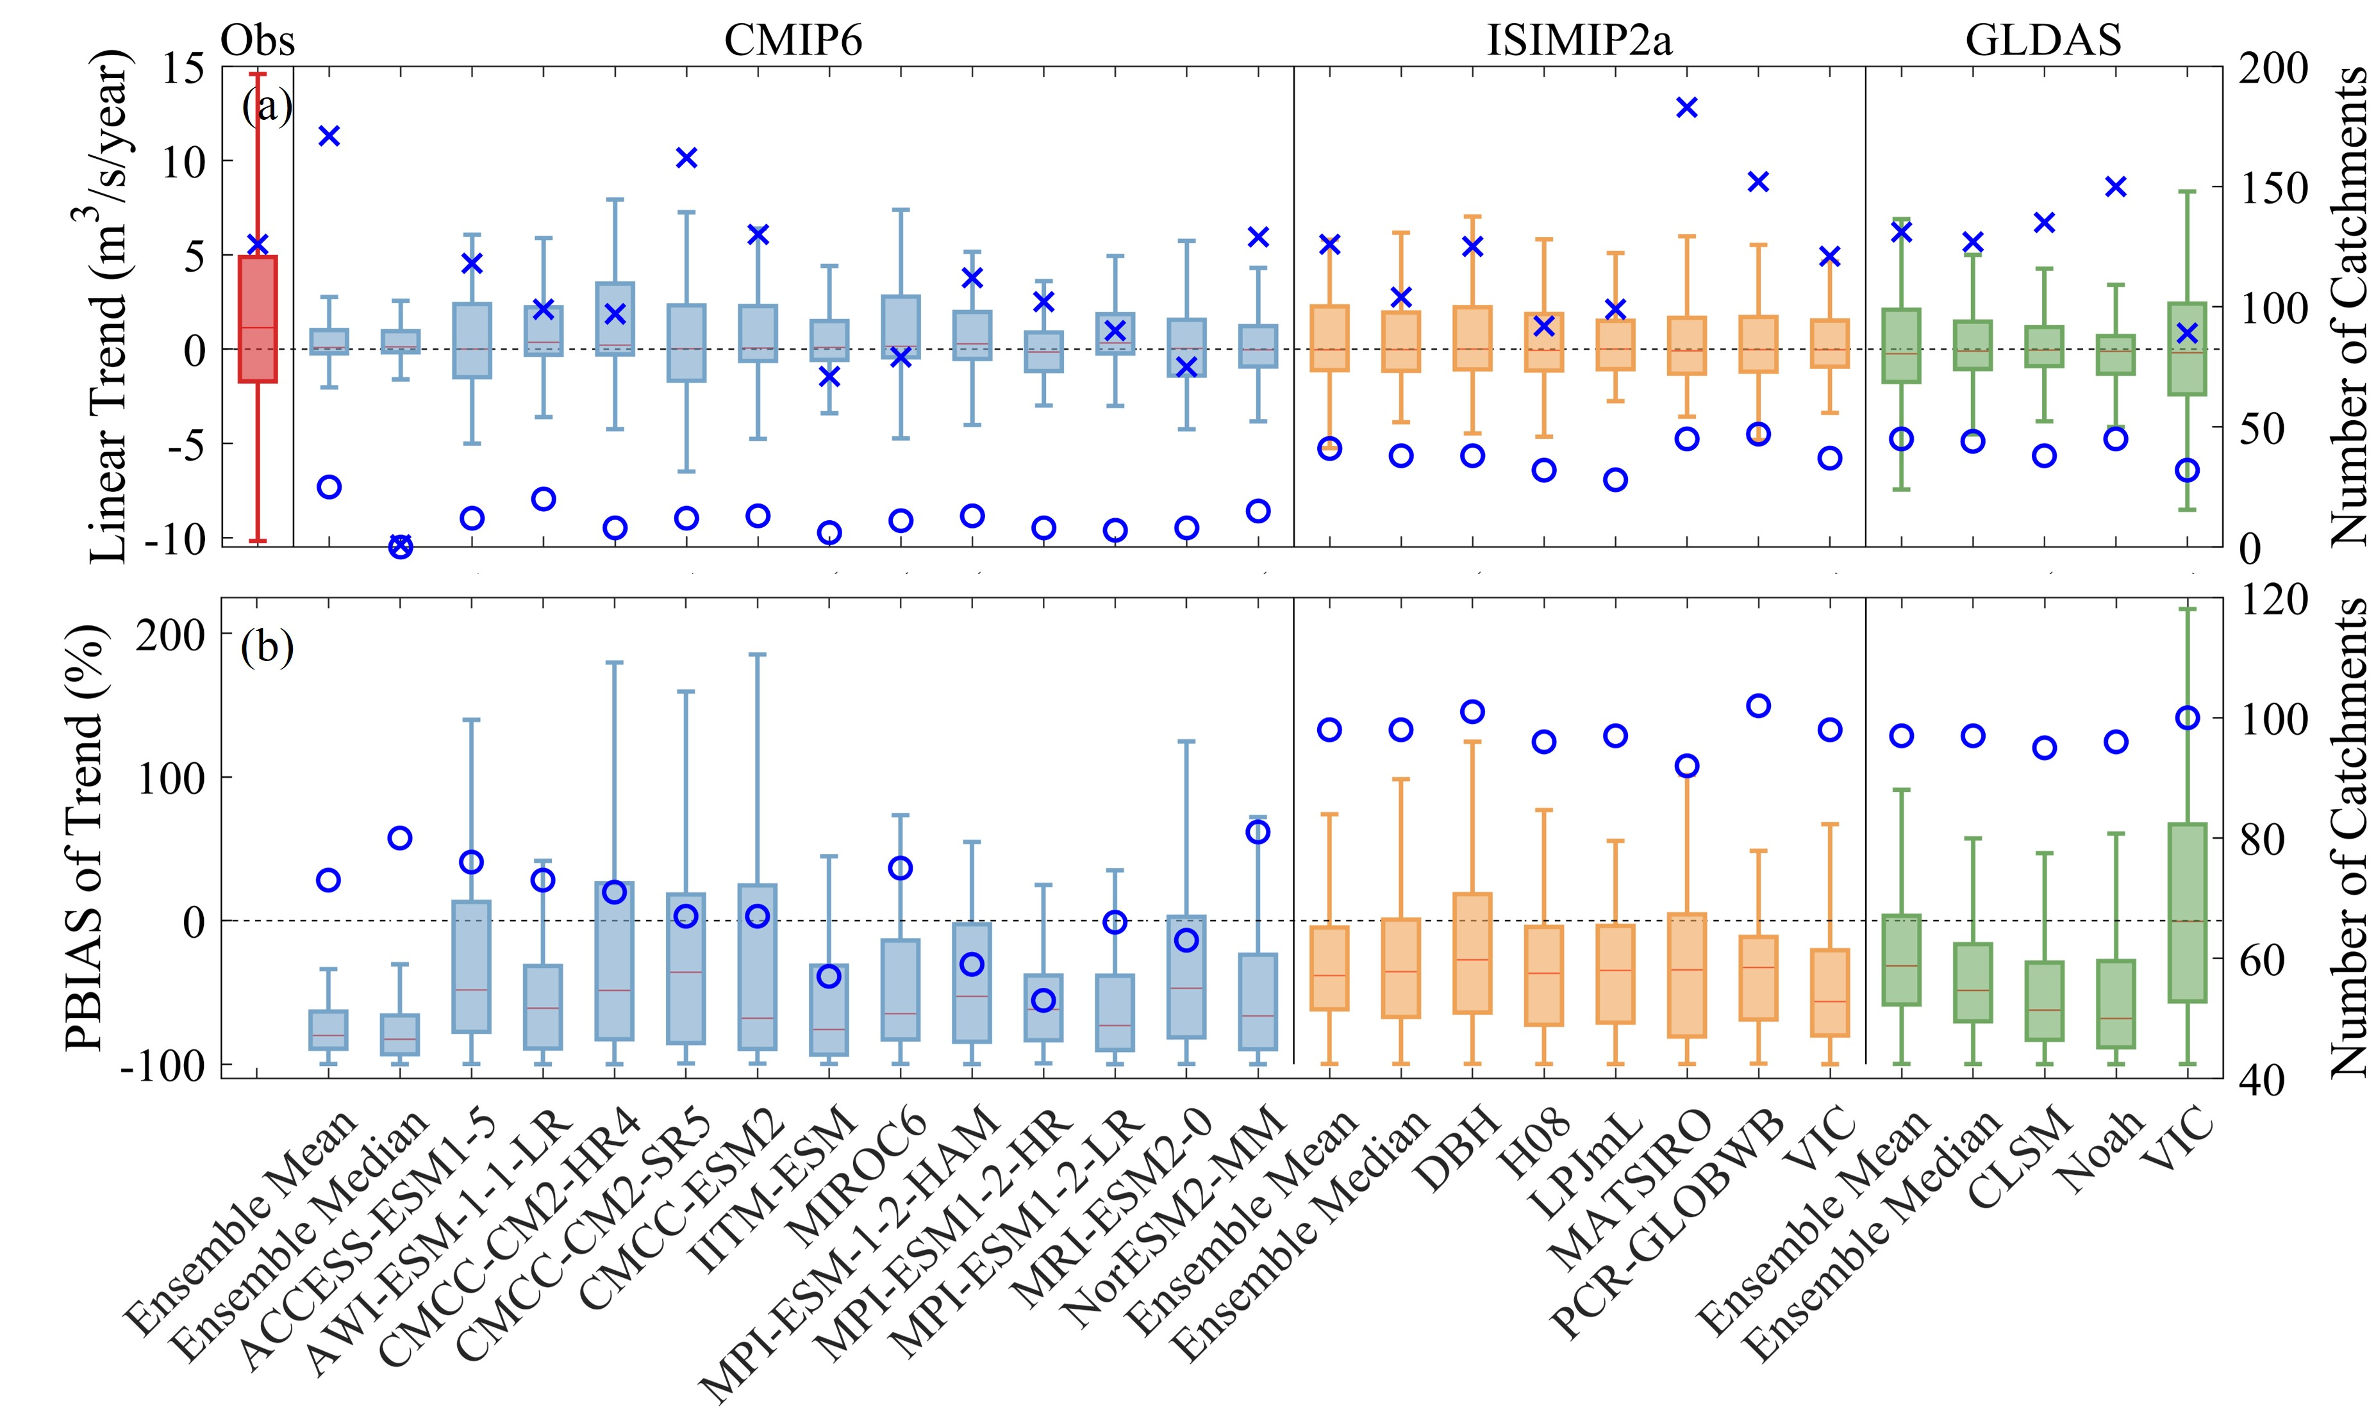
Global runoff evaluation from climate, hydrological and land surface models
Our results: annual Q trend
The sign of significant trends could only be correctly captured in about 10% of catchments by CMIP6 simulated, and about 30% by ISIMIP2a and GLDAS
Underestimation of Q trend are found in all models for catchments where the observed Q trend is significant and the sign of observed Q trend is correctly captured
Multi-model ensembles generally fail to improve the performance especially for CMIP6 models
*The blue crosses in (a) indicate the number of catchments where the Q trend is statistically significant (p < 0.05, t-test) and the blue circles in (a) indicate the number of catchments where both simulated and observed Q trends are significant and the sign of observed Q trend is correctly captured by the modeled Q. The blue circles in (b) indicate the number of catchments where the observed Q trend is significant and the sign of observed Q trend is correctly captured by the simulated Q;
2 min
Background
Methodology
Results
Take-home messages
10

Slide 11
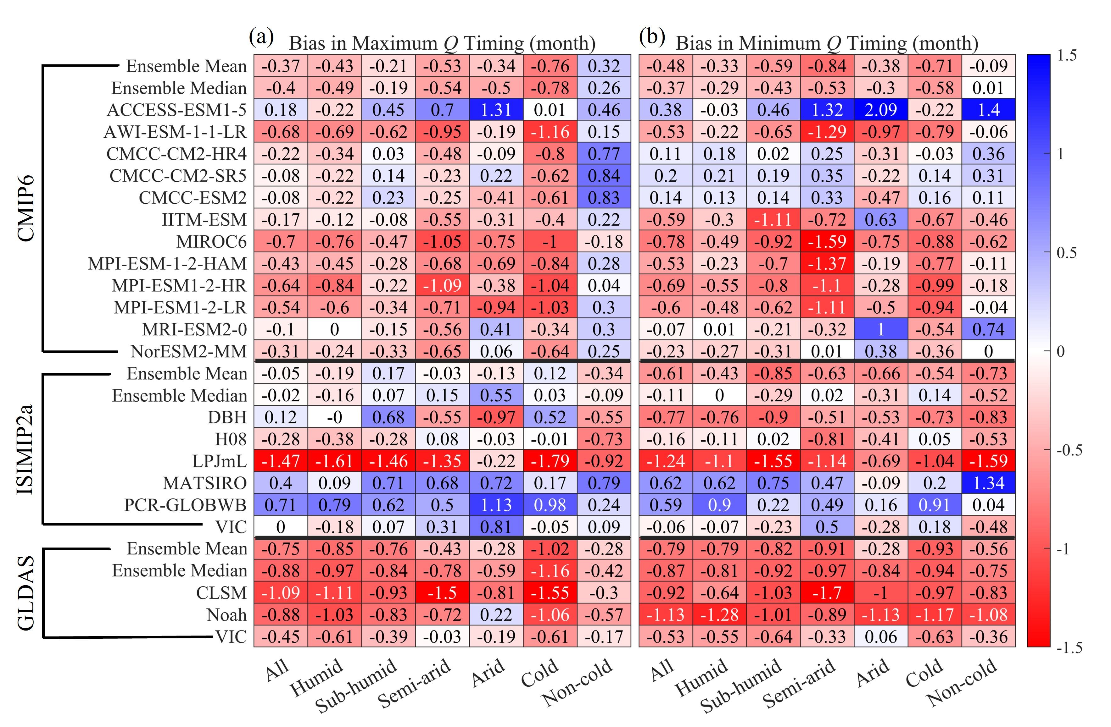
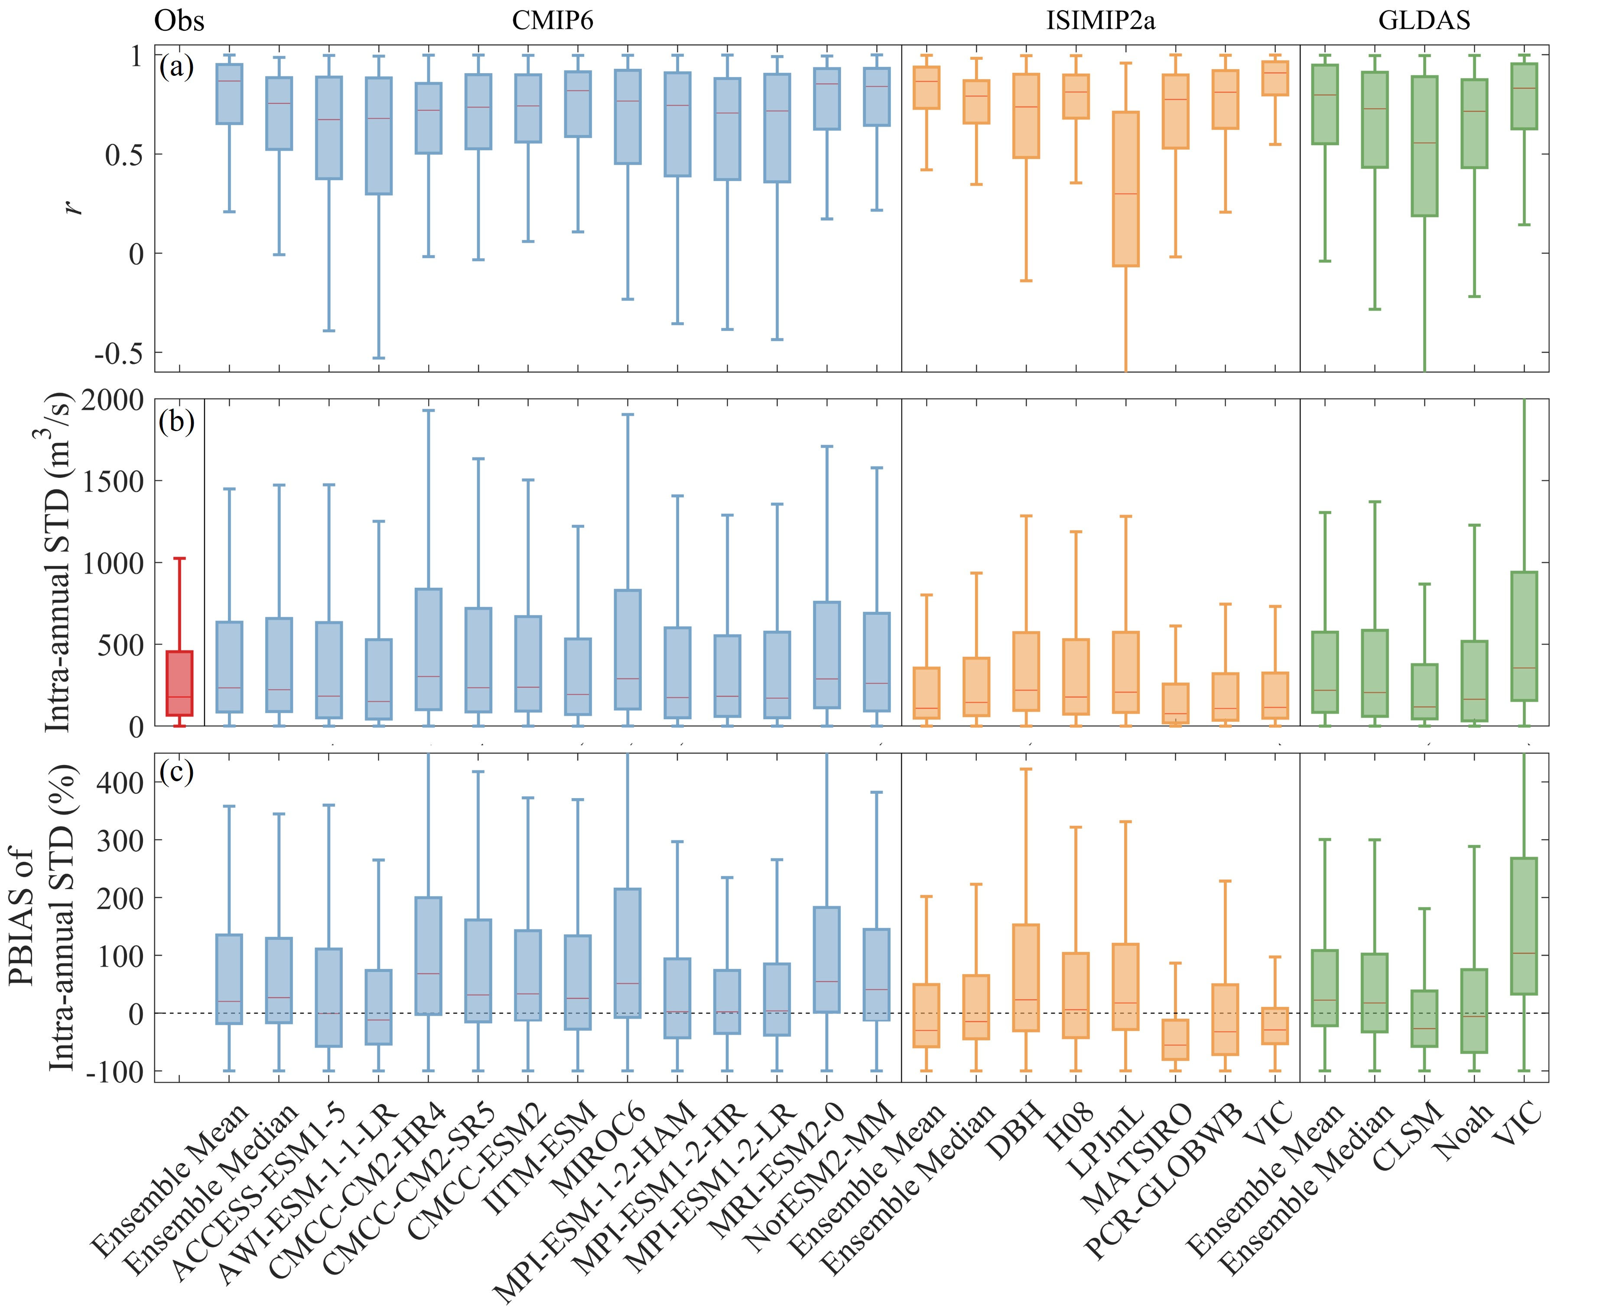
Global runoff evaluation from climate, hydrological and land surface models
Our results: intra-annual cycle of Q
All Q estimates are found to capture the observed intra-annual cycle of Q reasonably well with a median r higher than 0.65 except for LPJmL
An early timing bias of the maximum monthly Q is commonly found in most Q estimates
The multi-model ensembles significantly increase r for all three modeling groups and show smaller biases in the timing than most individual model estimates
2 min
Background
Methodology
Results
Take-home messages
11

Slide 12
Global runoff evaluation from climate, hydrological and land surface models
Our results: model uncertainty vs forcing uncertainty
Model uncertainties are consistently larger in GLDAS than in ISIMIP2a
Model uncertainties generally result in a larger modeled streamflow uncertainty, compared to that induced by different climatic forcings
Model uncertainty in ISIMIP2a and GLDAS and forcing uncertainty in ISIMIP2a
2 min
Background
Methodology
Results
Take-home messages
12

Slide 13
Global runoff evaluation from climate, hydrological and land surface models
Take-home messages
Among the 21 simulated Q examined herein, there is not a single model estimate that could capture the observed Q characteristics satisfactorily from all aspects.
All Q estimates tend to perform better in humid catchments than in more arid catchments, and in non-cold environments than in cold regions.
Multi-model ensemble means and/or medians effectively improve the performance of simulated Q compared to estimates from most of the individual models. However, the ensembles of CMIP6 Q estimates perform even worse than Q estimates from most individual CMIP6 models in estimating mean annual Q and annual Q trend.
For models forced with reanalyzed climate data sets, uncertainties in model structures and parameterizations generally result in a larger modeled Q uncertainty, compared to that induced by different climatic forcings. In addition, the model uncertainties are consistently larger in GLDAS than in ISIMIP2a.
2 min
Background
Methodology
Results
Take-home messages
13

Slide 14
Global runoff evaluation from climate, hydrological and land surface models
Thanks For Your Attention!
Abstract
Full text
Ying Hou¹, Hui Guo¹, Yuting Yang¹, Wenbin Liu²
¹Tsinghua University, ²Chinese Academy of Sciences
hy20@mails.tsinghua.edu.cn

