Slide 1
Paper EGU-3363: Integrating NGS GRAV-D Gravity Observations into High-Resolution Global Models
Daniel Roman, Xiaopeng Li, Philipp Zingerle, Martin Willberg, and Roland Pail
Notes:
Good afternoon – I offer my regrets for not being here in person. I had fully intended to travel, but family circumstances have prevented me from making the trip. Hopefully, you’ll still find this a useful update on the collective efforts between NOAA’s National Geodetic Survey and the Technical University of Munich.

Slide 2
Outline
Recap of previous work
Latest GRAV-D data
Results from Integration
Discussion
EGU General Assembly 2023
23-28 April 2023
Vienna, Austria
Session: G1.5
Session title: Recent Developments in Geodetic Theory and Gravity Field Estimation
Convener: Petr Holota
Co-conveners: Hussein Abd-Elmotaal, Nico Sneeuw, Xiaopeng Li, Robert Cunderlik, Georgios Panou, Lisa Dalheimer
Notes:
I’ll summarize pertinent aspects of the underlying techniques, the updated data and the results of that thus far.

Slide 3
Integrating NGS GRAV-D gravity observations into high-resolution global models
Philipp Zingerle, Martin Willberg, Roland Pail
Institute of Astronomical and Physical Geodesy, Technical University of Munich, Germany
Xiaopeng Li, Daniel R. Roman
NOAA National Geodetic Survey, US
Notes:
The underlying techniques were developed TUM and are summarized in previous presentations and papers.

Slide 4
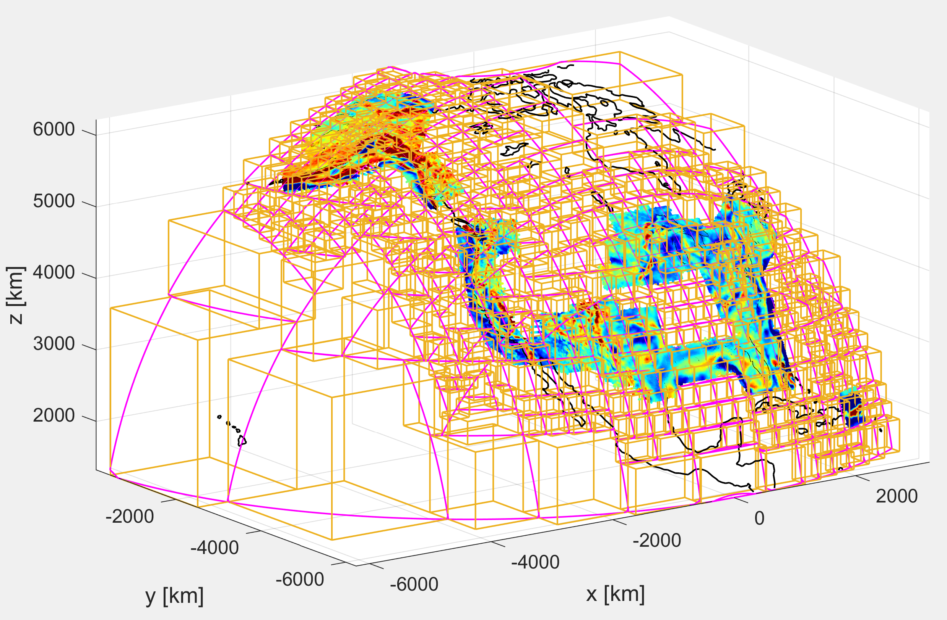
3.1 Gridding – (P)artition-(E)nhanced-LSC (3)
see P-II
PE-LSC
improves LSC by an automated, optimized partitioning
partition size is automatically decreased when local point density is too high
implemented through a 3D divide and conquer algorithm
Notes:
Partitions are developed in variable sizes based on the availability of data coverage. As is seen above, the GRAV-D coverage was somewhat limited over the Conterminous United States.

Slide 5
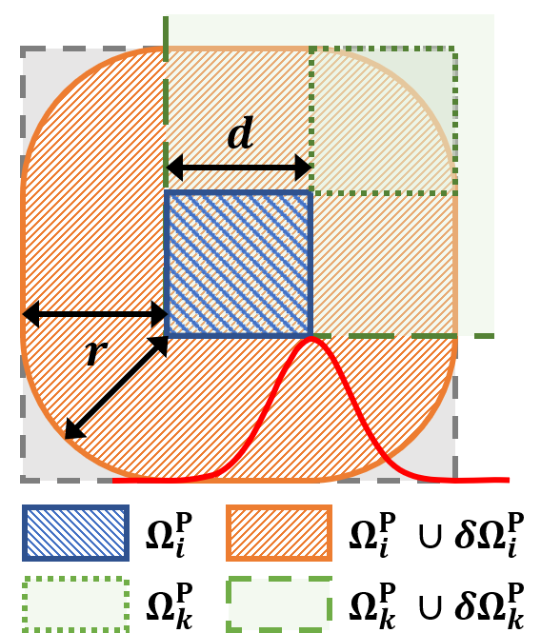
3.1 Gridding – (P)artition-(E)nhanced-LSC (4)
see P-II
PE-LSC
improves LSC by an automated, optimized partitioning
partition size is automatically decreased when local point density is too high
implemented through a 3D divide and conquer algorithm
optimal overlap between partition is considered
LSC kernel is localized (through damping) to minimize fringe effects
Notes:
A cap is effectively used to reduce edge effects and blend adjacent partition solutions.

Slide 6
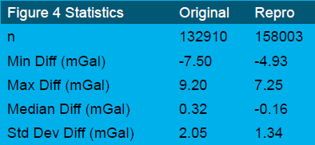
GRAV-D Reprocessing
What’s NEW?
Off-level correction: proper alignment with the gravity vector
Filtering free-air disturbances: instead of full-field gravity
Absolute gravity ties: all reprocessed and checked
Trims and Edits: performed as consistently as possible
ITRF2020 reference frame
GRAV-D observations minus EGM2008 predictions [mGal]. The left panel is the original/published data, and the right is the reprocessed data.
Notes:
Additionally, there were artifacts introduced into the solutions of the various aerogravity campaigns. Improved and more consistent processing techniques have significantly improved the overall quality of the data.

Slide 7
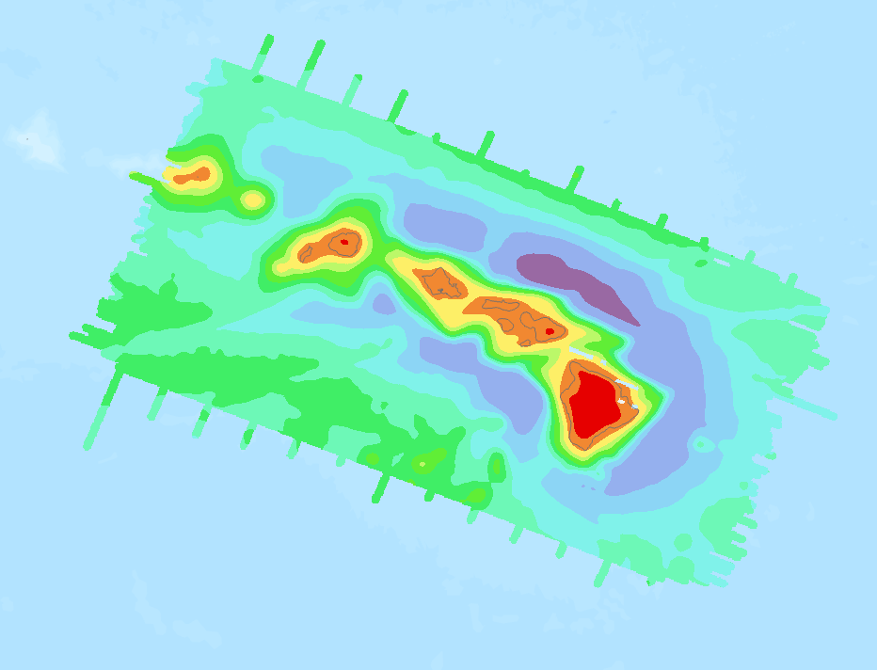
Grid of final product
Alaska and Hawaii
CONUS and PR/VI
Notes:
GRAV-D collection is nearly complete now and should finish by the end of 2023. A sufficient amount of data is available to re-do the previous analysis. More notably though, the re-processing of the data has significantly improved the accuracy and consistency of the resulting aerogravity grids.

Slide 8
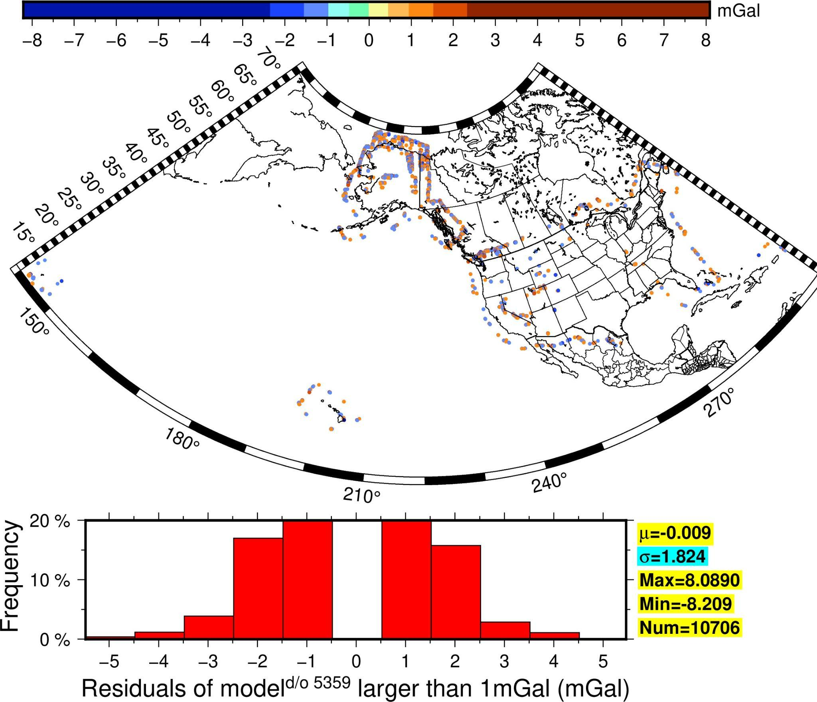
Residual Signal at d/o 5400
Notes:
In an effort to push the envelope, modeling was attempted at higher degrees (5359) than previous modeling (2700). The model fits the data pretty well (mean=1.192533154764726E-3 mGal
std= 0.036471002062511124mGal
min= -8.2091659267
max= 8.0893965422
)except only 10,706 points shows relatively large (>1mGal) residuals. And most of them are along edges with only a few them in the mountain areas.

Slide 9
Discussion
TUM technique continues to show promise at higher d/o
Improved GRAV-D processing clarified higher resolution signal
Iterative approach increased d/o of solutions
Best results cam at about d/o 5400 – roughly twice previous
Some artifacts possibly from unmodeled signal and/or edges of campaign collection boxes
Goal of future work is on ability to resolve through d/o 10,800

Slide 10
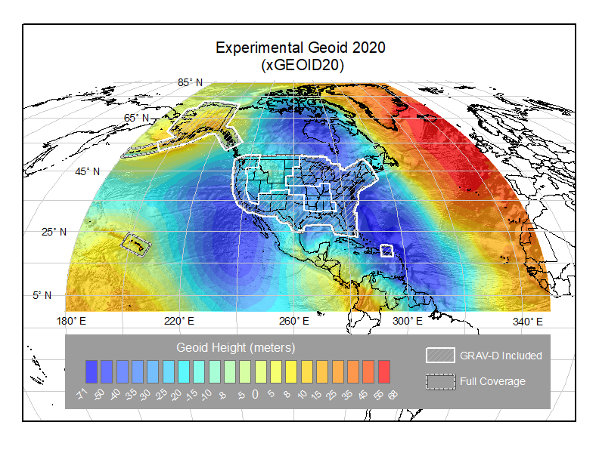
Thank you for your attention
Questions?
Dr. Daniel R. Roman
Senior Advisor for Geodesy
NOAA’s National Geodetic Survey
dan.roman@noaa.gov
https://geodesy.noaa.gov/
Next Model will be GEOID2022 Alfa

