Slide 1
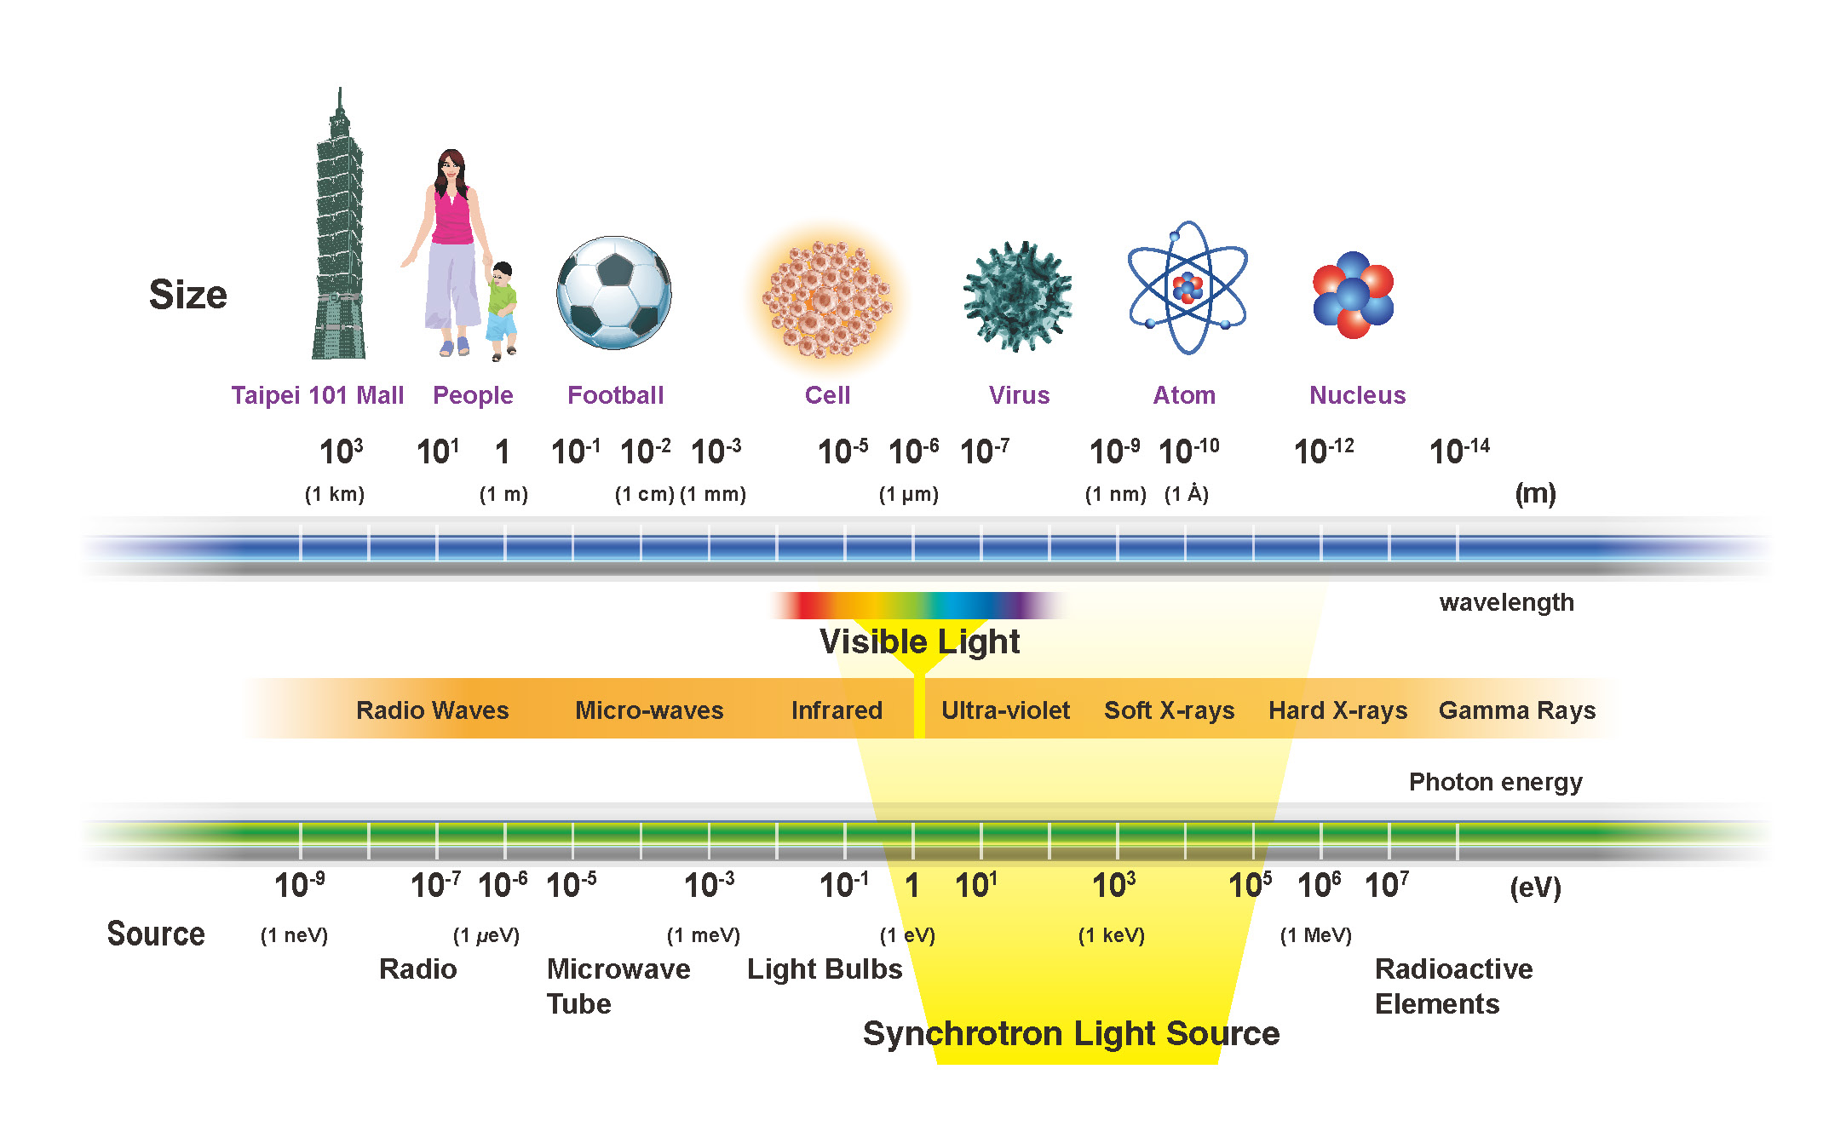
Casting synchrotron light on remagnetized carbonates:
Supplementary material
Casting synchrotron light on remagnetized carbonates:
Supplementary material
Bellon U.*, Trindade, R.I.F., Galante, D., Williams, W.
2023
1. Overview
2. Synchrotron light
Carbonate rocks are excellent recorders of the Earth’s geological evolution. Although they form important sedimentary sequences registering the geomagnetic field, carbonates are often affected by geological processes that post-date their diagenetic origin. These processes (e.g., fluid percolation, biodegradation of organic matter or clay mineral transformations) often provide Fe-ions so new authigenic magnetic particles might be formed. When this happens, carbonate rocks very often lose their primary detrital remanence signal and are imparted on a new magnetic signature. These authigenically formed magnetic minerals in remagnetized carbonates carry specific magnetic signatures compared to those carbonates that were not affected by secondary processes after their formation.
Magnetic minerals are usually in trace levels in carbonate rocks, which makes the task of studying them really hard. Using highly sensitive chemical/imaging techniques to identify magnetic particles within the carbonate matrix and to study the spatial correlation of these with other minerals might offer significant insights in chemical remagnetization events. In that way, synchrotron light provides a powerful source of X-rays to study, at a micro/nanoscale, the carriers of remanence in sedimentary rocks.
Why to use synchrotron radiation to study magnetic minerals?
Because we can get very precise and detailed data in nanoscopic scale, which is vital when studying (individually) stable remanence carriers in rocks, while macroscopic measurements give us information of a population of grains!
WHY is it relevant to step forward in the knowledge of remagnetization of sedimentary rocks?
There is no consensus in the literature regarding the remagnetization processes in carbonate rocks;
Establishing the moment in which these processes take place would allow (indirectly) to date the migration of basin fluids and/or the burial of sediments;
Studies that work with the hypotheses of generation and transformation of authigenic magnetic minerals are based on measurements of macroscopic samples, while microscopic analysis of individual particles are still scarce.
Source: https://www.nsrrc.org.tw/english/lightsource.aspx

Slide 2
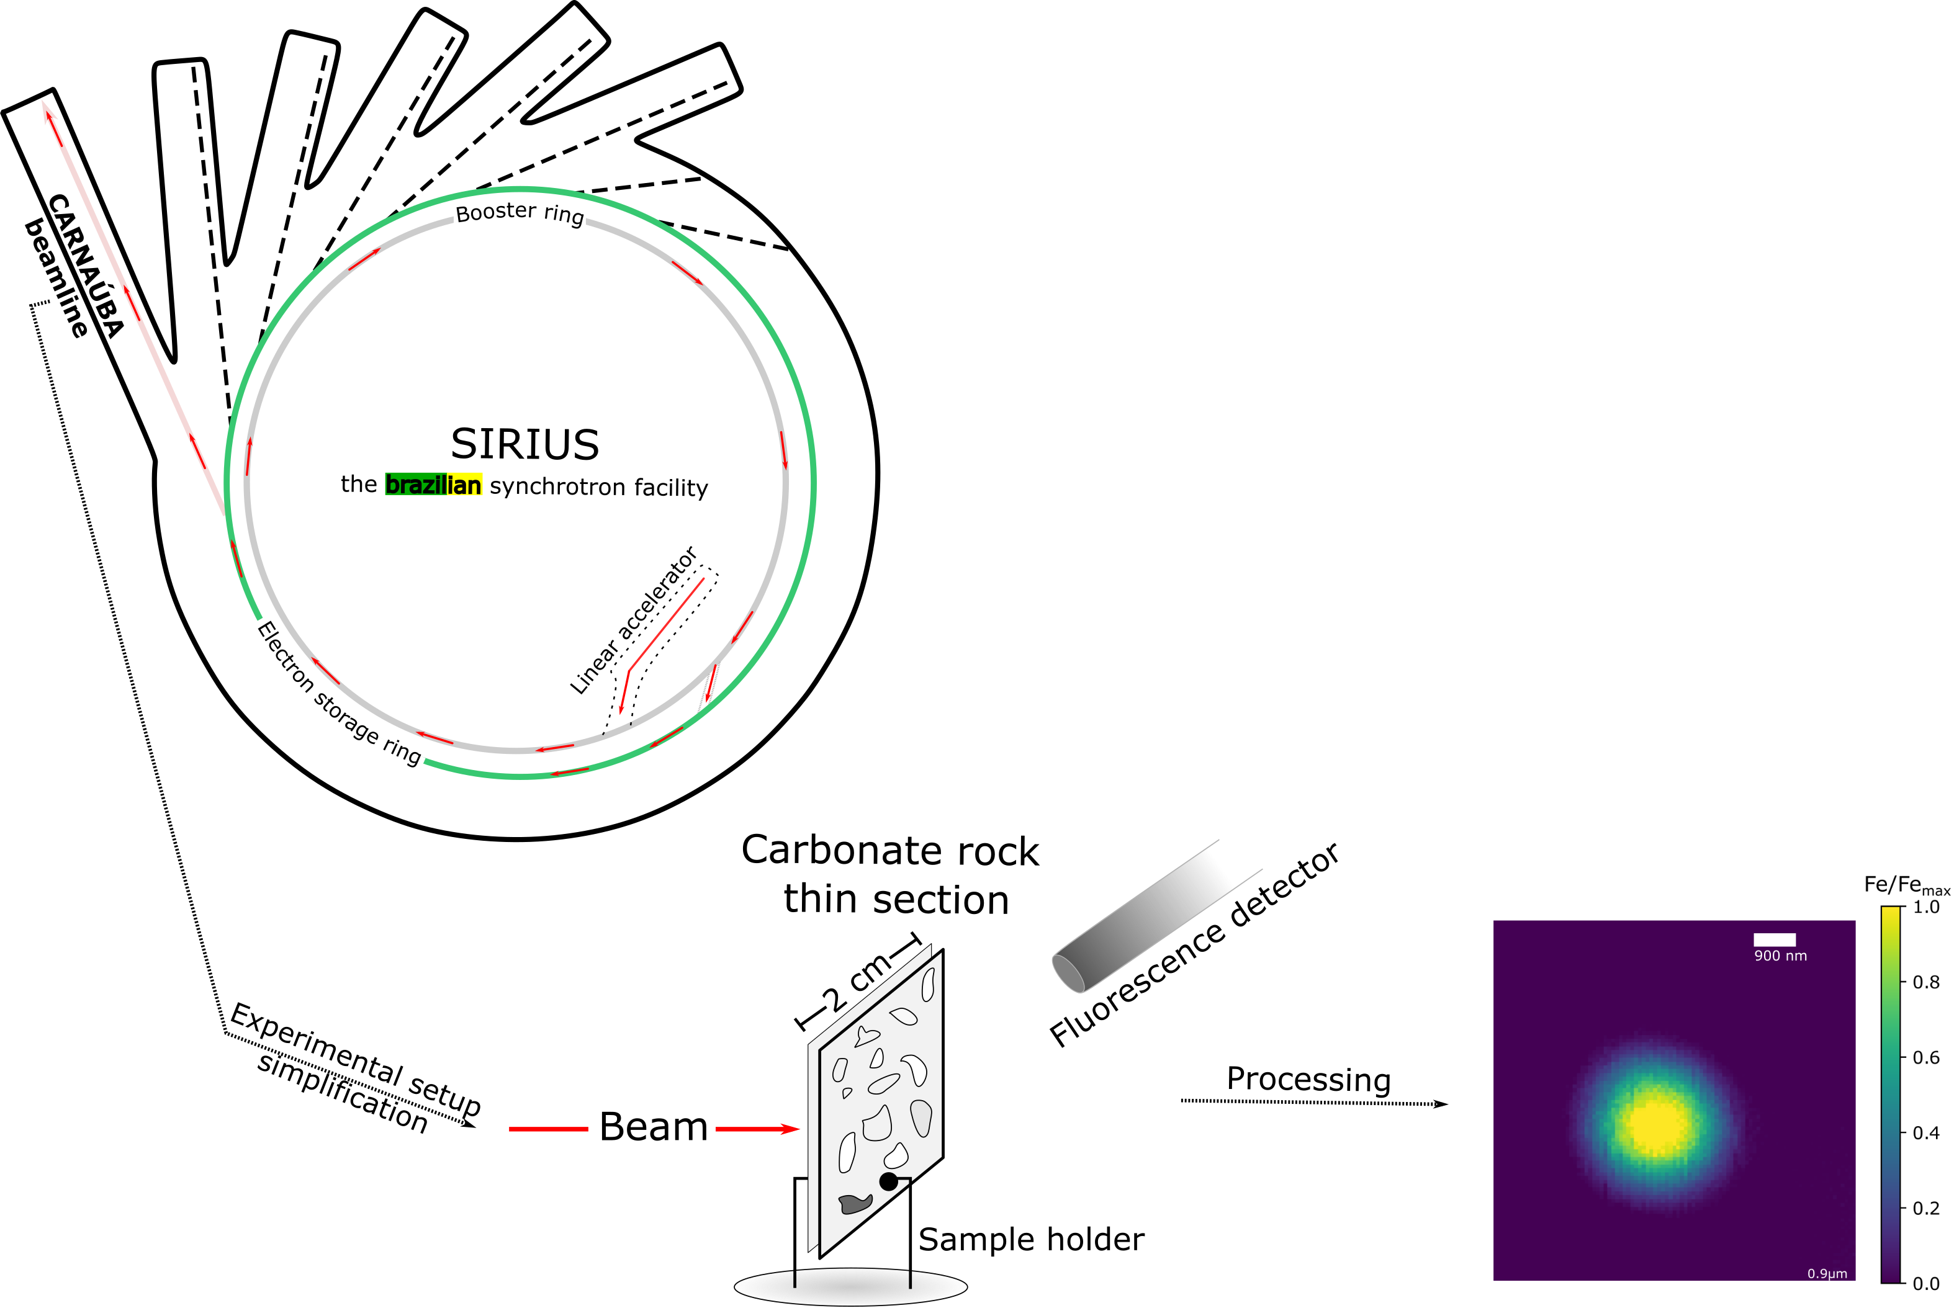
Casting synchrotron light on remagnetized carbonates:
Supplementary material
Bellon U.*, Trindade, R.I.F., Galante, D., Williams, W.
2023
3. Experimental setup
HOW is synchrotron light generated?
Coherent X-ray Nanoprobe Beamline
Electrons are taken from a Cu-source, where they pass through a linear accelerator;
The electrons flow through a booster ring where they reach 99.99% of the speed of light; and
Are redirected to a storage ring, where the radiation is redirected to a beamline;
In experimental stations of the beamlines, the radiation interacts with microscopic regions of a rock, allowing a diverse amount of analysis with a resolution incomparable to other analytical methods.
In this way, we can have not only a highly detailed chemical map (XRF) of a given particle, but also an analysis such as XAS allow us to identify the corresponding mineral phase/oxidation-state.

Slide 3
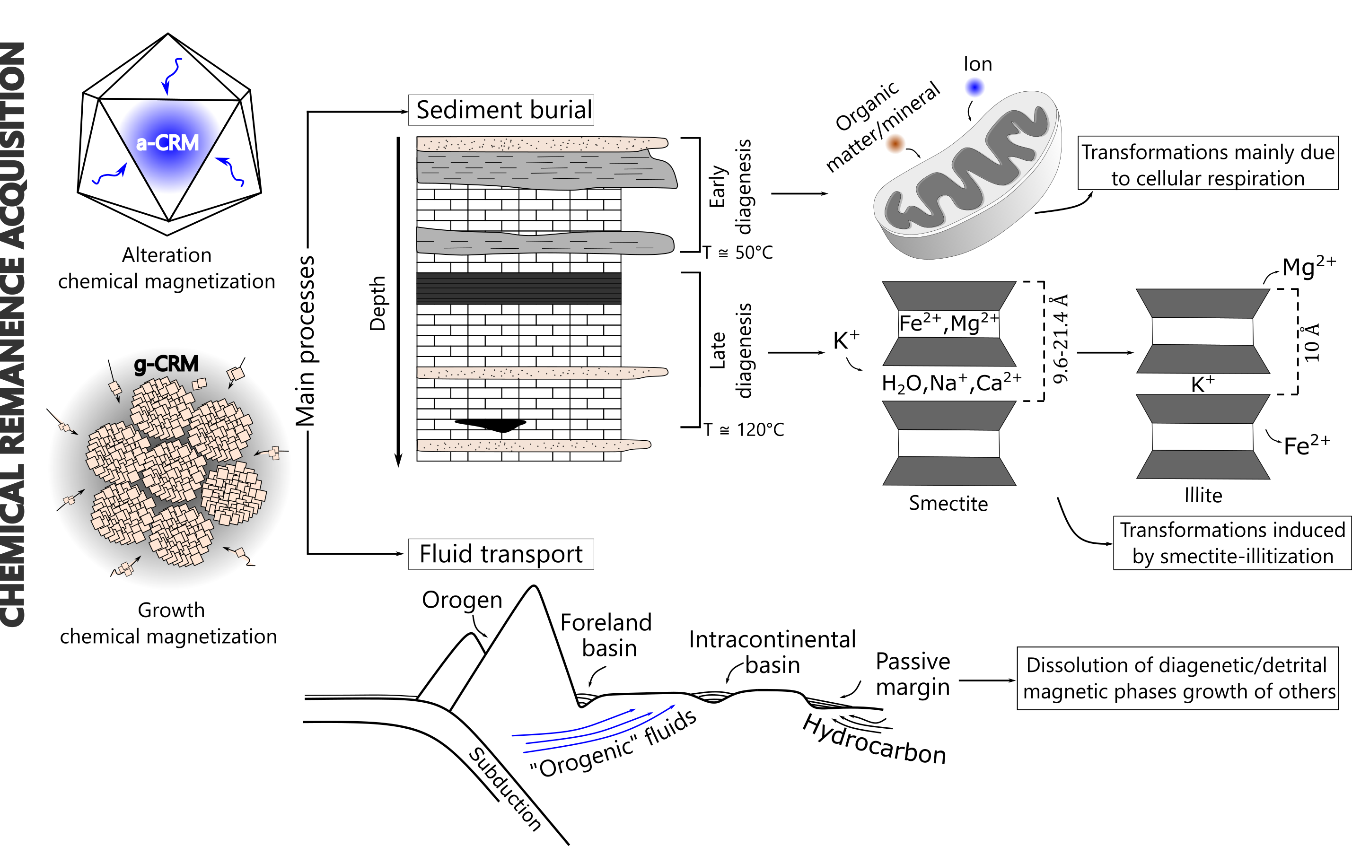
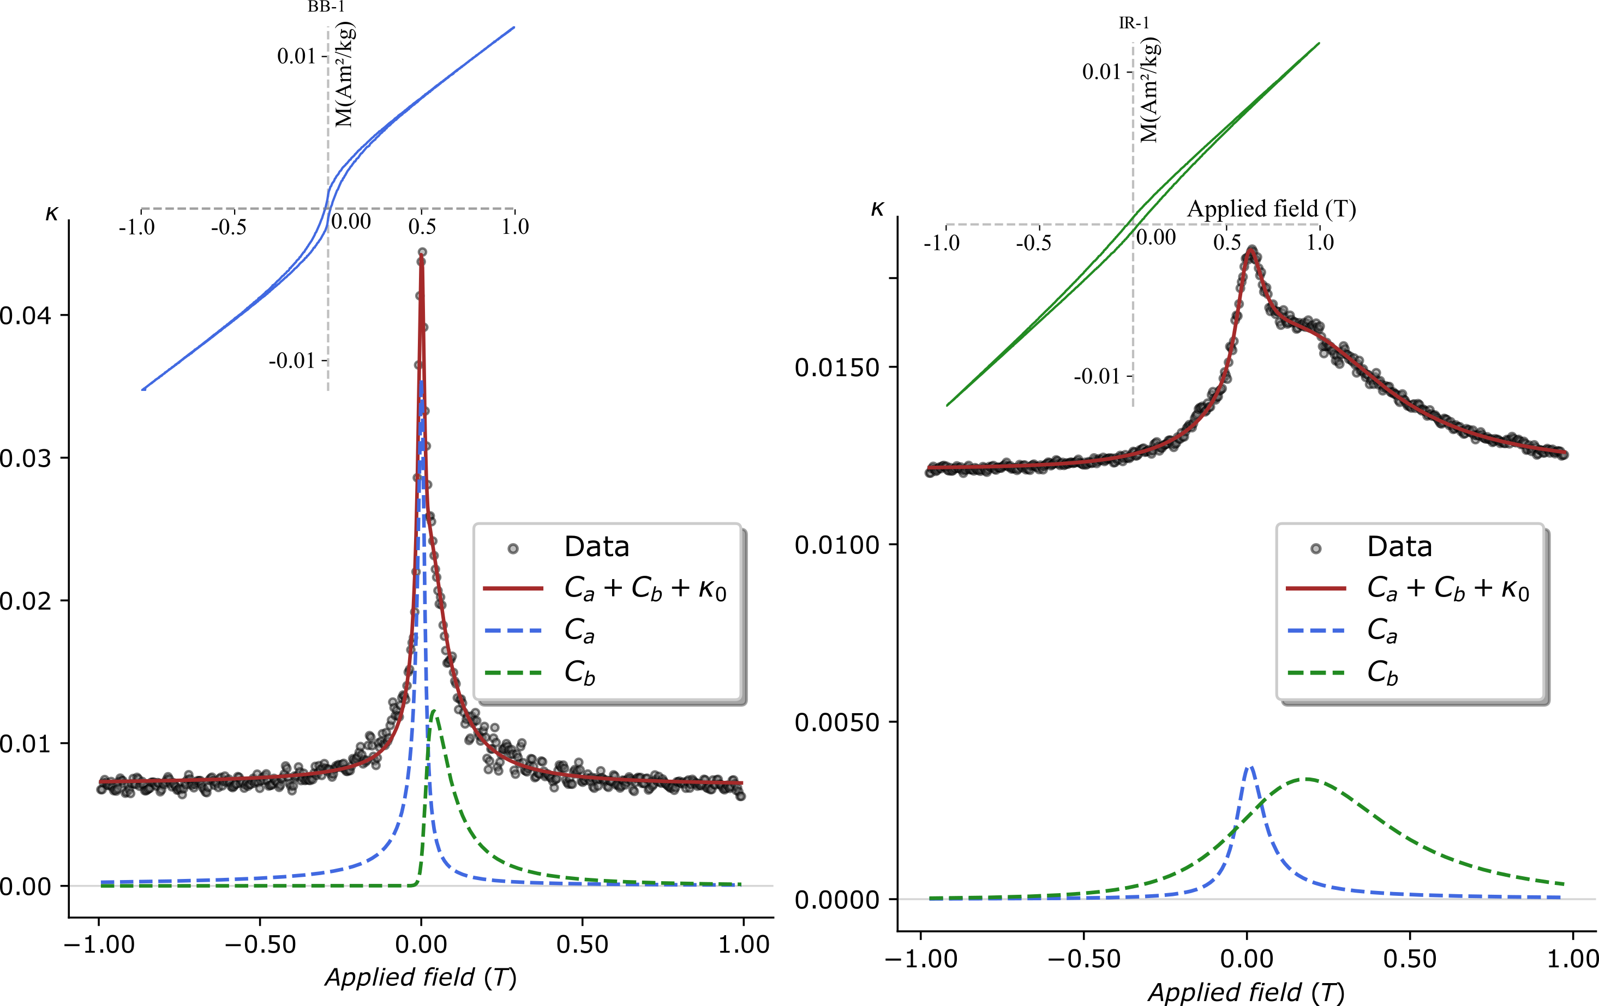
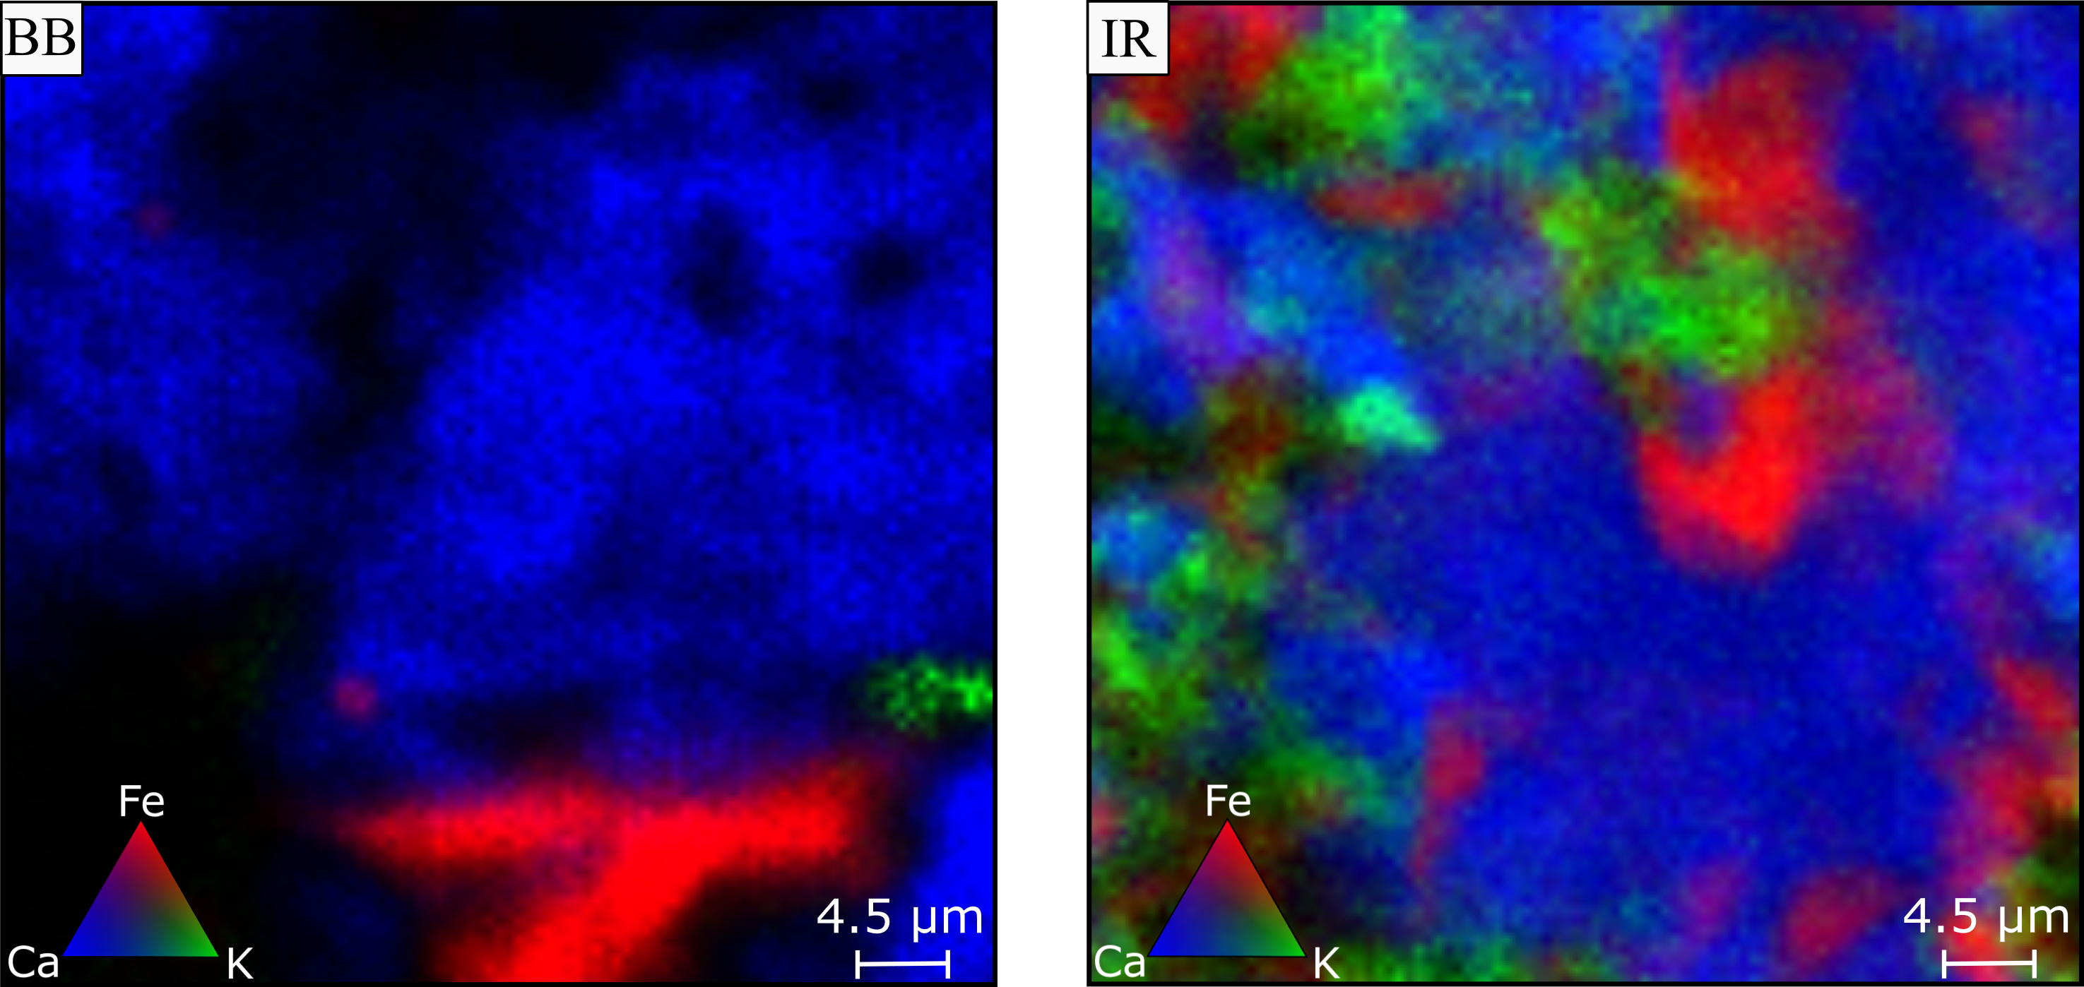
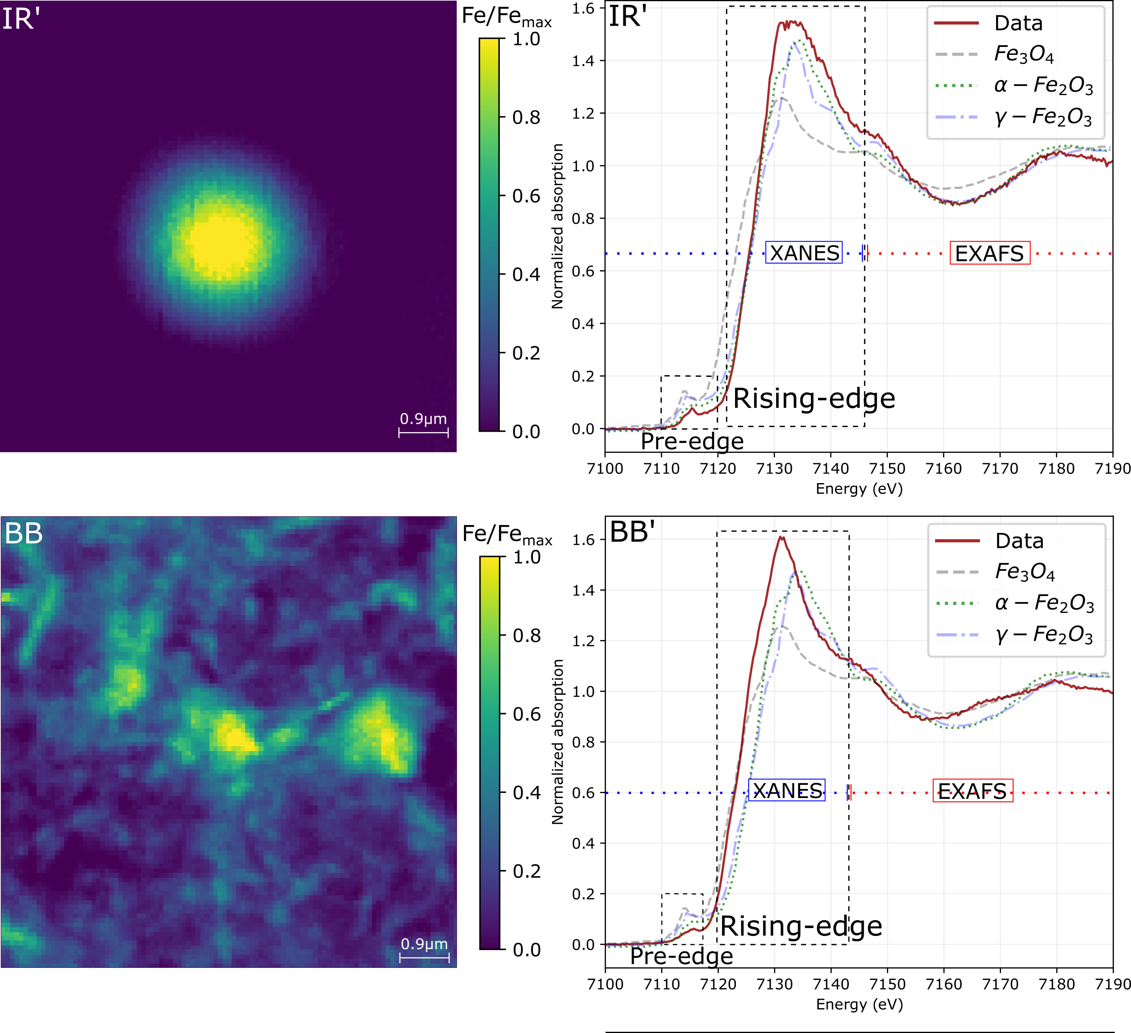
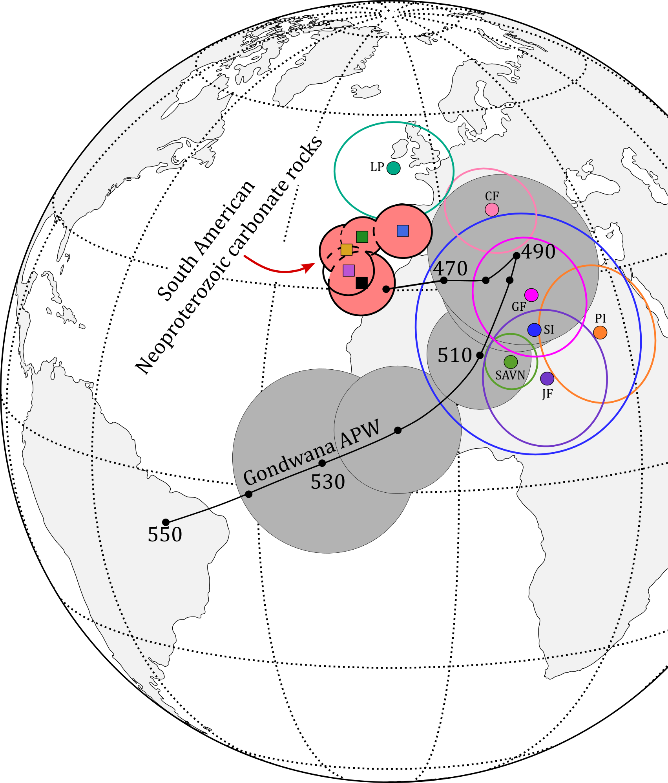
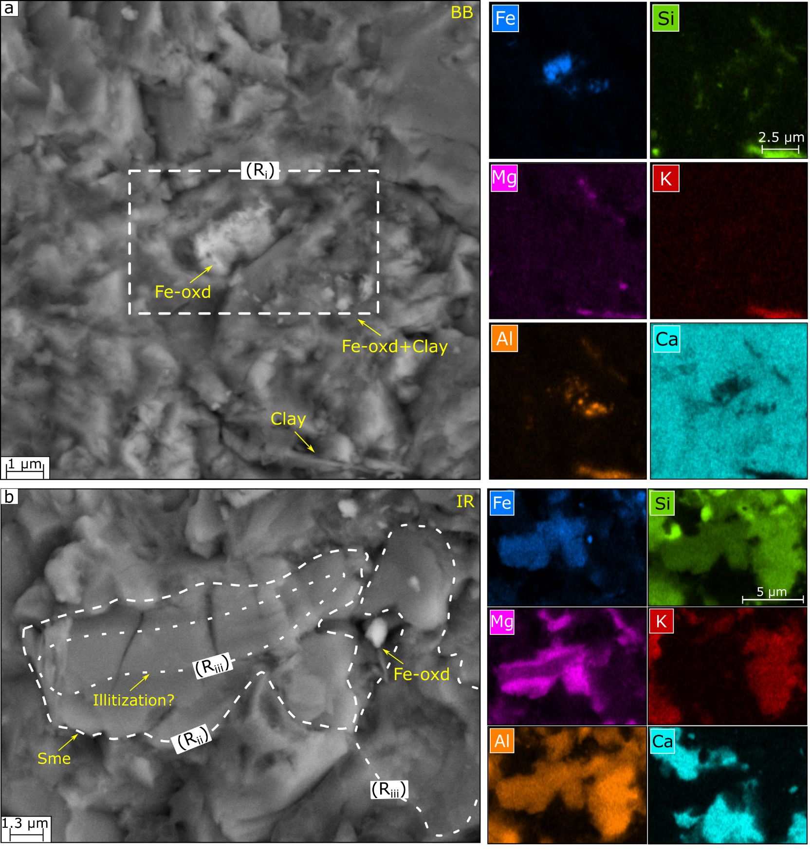
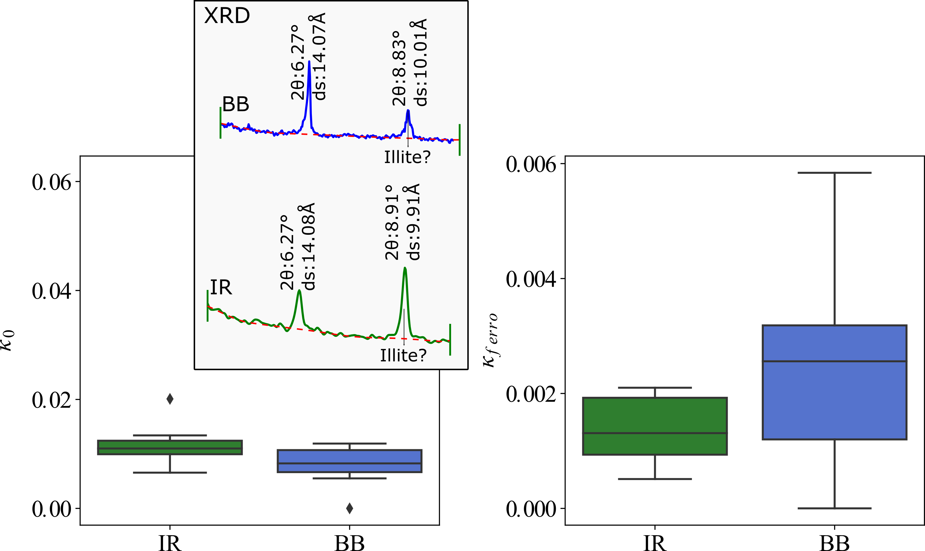
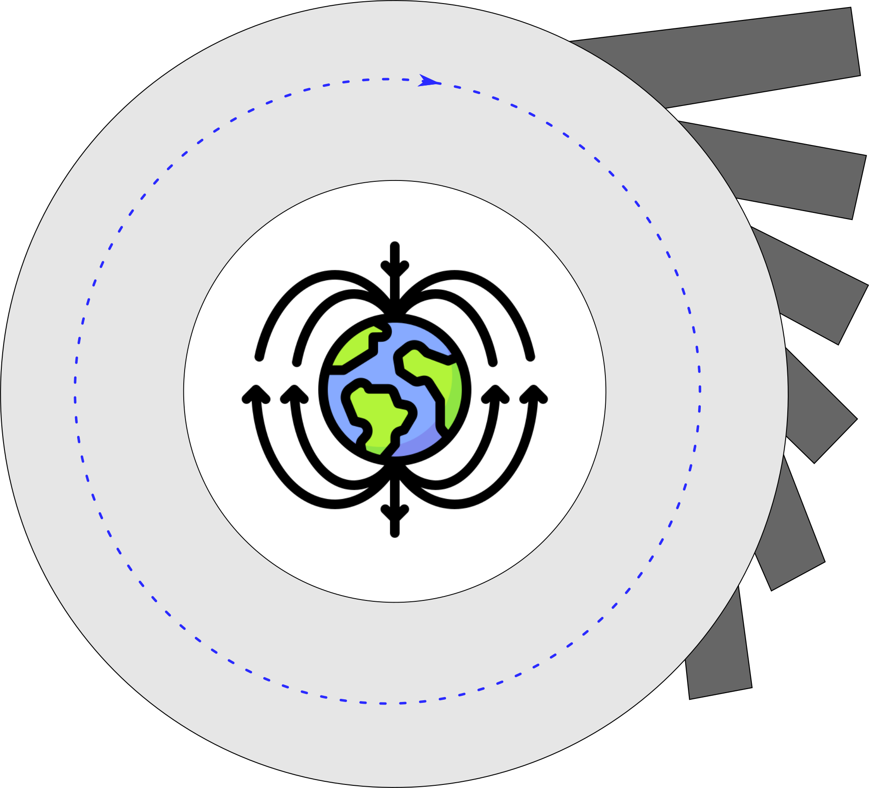
Casting synchrotron light
on remagnetized carbonates
2023
Bellon U.*, Trindade, R.I.F., Galante, D., Williams, W.
General context
Partial results
Synchrotron XRF/XANES
Magnetic hysteresis
parametric unmixing
Spatial correlation:
K and Fe (smectite illitization?)
Spatial correlation:
K and Fe (smectite illitization?)
Wasp w. unmixing:
A SP component +
A SD component
Potbellies unmixing:
Two-coercivity components
Magnetite core +
Maghemite shell: a-CRM
Objective
To investigate, through three-dimensional imaging at the nanoscale the nature of the
carbonate magnetic mineralogy and the growth mechanisms of secondary magnetic crystals and associate them to known examples of remagnetizations in Neoproterozoic carbonate rocks.
SEM-EDS
Paramagnetic
contribution
How?
Chemically pure magnetite: g-CRM
fingerprints
Synchrotron Radiation
Magnetic
experiments
SEM-EDS
Ferromagnetic
contribution
Next steps:
Coherent X-rAy
NAnoprobe BeAmline
CARNAUBA
3D Ptycographic nanotomography
+ micromagnetic models
XRD
Petrography
SEM-EDS
XRF
XANES
Can we reproduce macroscopic magnetic properties
from numerical models of real nanoscopic particles?
Two sets of samples from different basins: Bambuí (BB) and Irecê (IR)

