Slide 1
A Stacking Ensemble Deep Learning Approach for Post-Disaster Building Assessment using UAV Imagery
Presenter: Leon Sim
Advisor: Assistant Prof. Szu-Yun Lin
Department: Construction Engineering and Management

Slide 2
Outline
Background
Literature Review
Methodology
Deep Learning & Object Detection
YOLOv5
Mobilenet
Datasets
Stacking Ensemble
Results
Future Work
Conclusion

Slide 3
Background

Slide 4
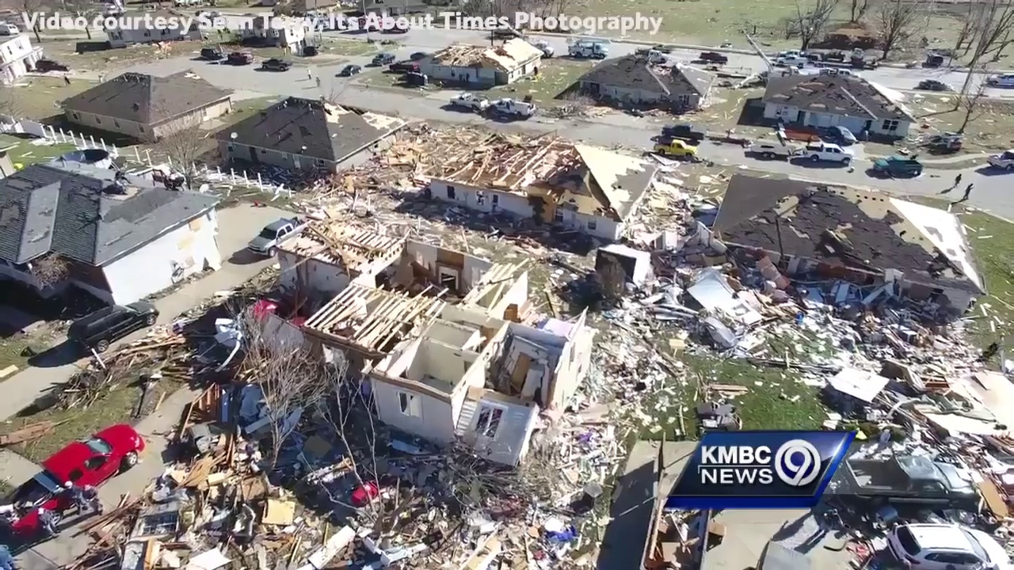
Background
Post-Disaster Building Damage Assessment
When a natural disaster strikes, assessing the damage caused to buildings is crucial for planning efficient rescue operations and reconstruction efforts.
Rapid and accurate damage assessment enables authorities to allocate resources effectively, prioritize the hardest-hit areas, and provide timely support to affected communities.
Fig. 2. UAV deployed at the affected area.
Notes:
https://ema.clermontcountyohio.gov/damage-assessment/
Img Source: https://emilms.fema.gov/is_1001/groups/51.html & https://medium.com/aerial-acuity/drones-assess-the-aftermath-of-a-indonesias-destructive-earthquake-1e60611d0abd

Slide 5
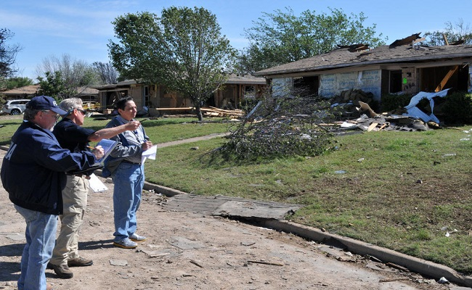
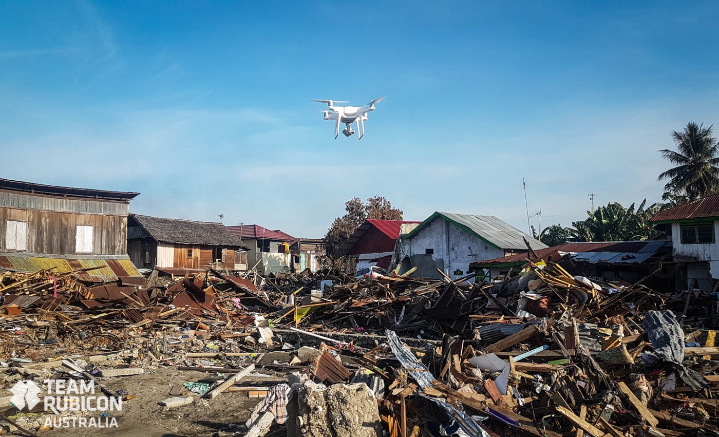
Background
Preliminary damage assessment
Traditional way:
Ground-based surveys
Time-consuming and labor-intensive
Limited coverage and accuracy
Fig. 1. Response team surveying affected area.
Modern way:
UAV imagery and Deep Learning
Faster and more efficient
Wider coverage and higher resolution
Fig. 2. UAV deployed at the affected area.
Notes:
https://ema.clermontcountyohio.gov/damage-assessment/
Img Source: https://emilms.fema.gov/is_1001/groups/51.html & https://medium.com/aerial-acuity/drones-assess-the-aftermath-of-a-indonesias-destructive-earthquake-1e60611d0abd

Slide 6
Background
Comparisons of Existing Remote Sensing Techniques
Satellite Imagery:
Lower spatial resolution
Affected by atmospheric conditions (clouds, haze)
Less frequent image updates
 | UAV | Satellite
Quality | ✔
Precision | ✔
Ease of deployment | ✔
Autonomy |  | ✔
Accessibility |  | ✔
UAV Imagery:
Higher spatial resolution for detailed analysis
Less affected by atmospheric conditions
More frequent updates and on-demand data collection
Table 2. Comparisons of UAV and satellite images
Notes:
https://ema.clermontcountyohio.gov/damage-assessment/
強調無人機在BDA的潛力

Slide 7
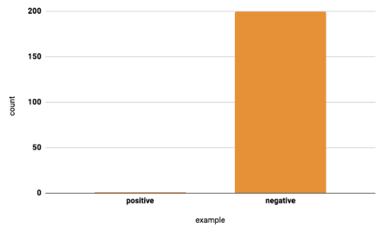
Background
Challenges in UAV Datasets
Large intra-class variation
Small inter-class dissimilarity
Imbalanced data
Notes:
https://ema.clermontcountyohio.gov/damage-assessment/

Slide 8
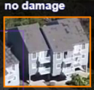
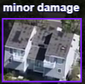
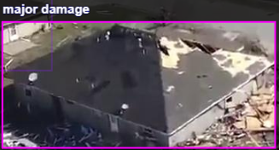
Background
Challenges in Damaged Building Assessment
Ambiguous Classification - the damage type of the dataset confused the AI model (No damage, Minor damage, Major damage, Destroyed)
Data imbalance – normally the quantities of “Major damage” and “Destroyed” are much less than the others.
Degree of Damage | Definition
No damage | no structural damage, habitable without repairs
Minor | uninhabitable, repairs can be completed in less than 30 days
Major | uninhabitable, extensive repairs required that will take more than 30 days to complete
Destroyed | total loss, permanently uninhabitable
Fig. 3. Every instance from each damage class in our dataset.
Table 1. Definitions of four structural losses by FEMA.
Notes:
https://ema.clermontcountyohio.gov/damage-assessment/

Slide 9
Background
Motivations of the study
Enhance disaster response:
Faster and more accurate damage assessment
Prioritize resource allocation and rescue efforts
Support recovery planning:
Better understanding of damage patterns
Informed decision-making for rebuilding and infrastructure improvements
Advance technology in the field:
Develop and refine state-of-the-art deep learning models
Address challenges and limitations of existing techniques
Contribute to disaster preparedness:
Inform policy and planning for future disasters
Strengthen resilience of communities and infrastructure
Notes:
https://ema.clermontcountyohio.gov/damage-assessment/
Img Source: https://towardsdatascience.com/train-validation-and-test-sets-72cb40cba9e7

Slide 10
Literature Review

Slide 11
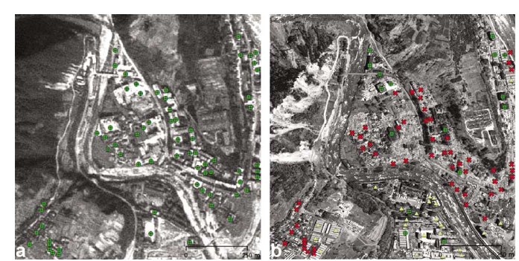
Literature Review
Remote Sensing based building damage assessment
Ehrlich, D., Guo, H. D., Molch, K., Ma, J. W., & Pesaresi, M. (2009). Identifying damage caused by the 2008 Wenchuan earthquake from VHR remote sensing data. International Journal of Digital Earth, 2(4), 309-326.
Very High Resolution (VHR) satellite imagery potential for post-earthquake damage assessment compared to aerial photos.
Satellite data helpful in identifying collapsed buildings, destroyed transportation, and land cover changes.
Challenges in differentiating damage types and limitations in data availability and processing because it performed a change detection analysis by comparing pre- and post-disaster imagery.
Fig. 6. Pre-disaster and Post-disaster Imagery in this study.
Notes:
BDA的現代技術發展要從這裡說起。一開始是使用遙測技術來做BDA

Slide 12
Literature Review
GIS based building damage assessment
Boccardo, P., & Tonolo, F. G. (2015). Remote sensing role in emergency mapping for disaster response. Geomatics, Natural Hazards and Risk, 6(3), 183-203.
Geospatial information:
Data with a geographic component.
Sources:
Satellite imagery, aerial photography, ground-based sensors.
Uses:
Disaster extent and severity assessment, critical infrastructure and resource location.
Limitations:
Limited resolution, cloud cover, atmospheric interference, cost.
Notes:
後來也有研究加入了帶有地理資訊的影像來做BDA

Slide 13
Literature Review
Deep Learning based building damage assessment on Satellite Imagery
Cheng, G., & Han, J. (2016). A survey on object detection in optical remote sensing images. ISPRS Journal of Photogrammetry and Remote Sensing, 117, 11-28.
Four method categories:
Template matching: Comparing template images to detect objects; rigid (fixed shapes) and deformable (varying shapes) templates.
Knowledge-based: Using prior knowledge (geometric and context information) to improve detection accuracy.
OBIA-based: Object-Based Image Analysis; image segmentation and object classification for detecting complex objects.
Machine learning based: SVM, AdaBoost, ANN
Datasets & Metrics: Five public datasets and three standard evaluation metrics reviewed.
Future directions: Deep learning-based feature representation and weakly supervised geospatial object detection.
Notes:
再來是 deep learning 的介入，開始在衛星影像上面做房屋及損害辨識

Slide 14
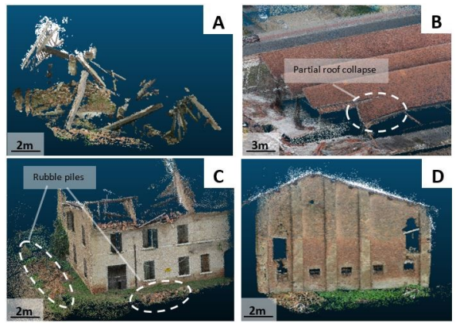
Literature Review
Deep Learning based building damage assessment on UAV Imagery
Fernandez Galarreta, J., Kerle, N., & Gerke, M. (2015). UAV-based urban structural damage assessment using object-based image analysis and semantic reasoning. Natural Hazards and Earth System Sciences, 15(6), 1087-1101.
Contributions：
UAV-based damage assessment approach
Object-based image analysis and semantic reasoning
Urban structural damage evaluation
Limitations：
Dependence on high-quality imagery
Limited to urban environments
Potential issues with object occlusion and shadows
Fig. 6. The 3-D point clouds used to identify the mentioned damage features.
Notes:
後來因為UAV的興起而開始有學者導入UAV來做BDA，而且變成是城市規模的

Slide 15
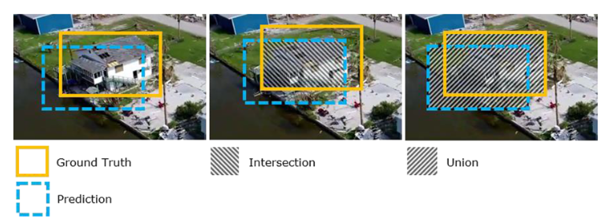
Literature Review
Convolutional neural networks for object detection in aerial imagery
Pi, Yalong, Nipun D. Nath, and Amir H. Behzadan. "Convolutional neural networks for object detection in aerial imagery for disaster response and recovery. " Advanced Engineering Informatics 43 (2020): 101009.
Deep learning for disaster impact assessment
CNN models for aerial object detection
Challenges: resource-intensive, offline computing
Emphasize accurate, timely data crucial for disaster management
Fig. 5. Example of IoU in aerial object detection.
Notes:
這篇提到 object detection 在災後的應用

Slide 16
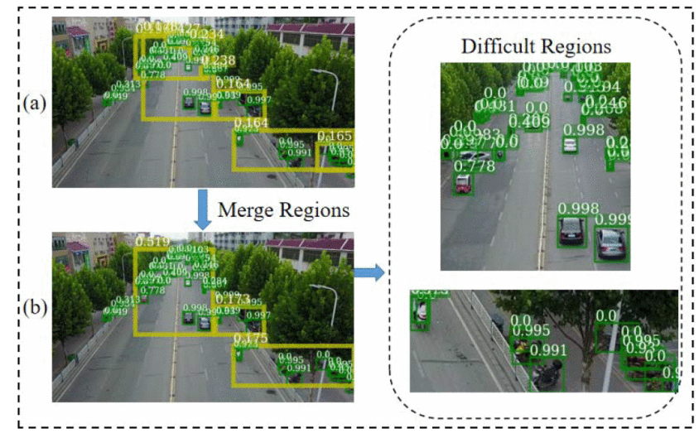
Literature Review
Tackle Challenges in UAV image Object Detection
How to Fully Exploit The Abilities of Aerial Image Detectors
Junyi Zhang et al. (2019)
Targeting the problems of object detection with UAV images:
Small Object
Imbalanced quantity in different classes
Finding difficult regions with predicted box scores, and then re-trained with their network- Difficult Region Estimation network(DREN)
Fig. 5. The workflow of DREN.
Notes:
UAV 的限制有很多，這篇是利用另外一個network 來改善 object detection，因此有了想要增加一個分類器的念頭，啓發了我使用mobilenet

Slide 17
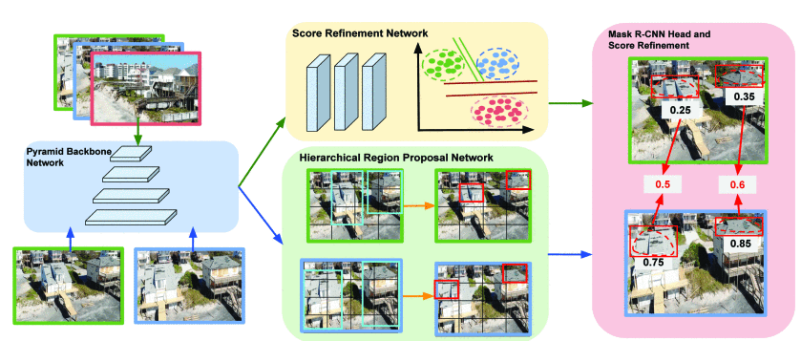
Literature Review
Dual Neural Network - 1
MSNet: A Multilevel Instance Segmentation Network for Natural Disaster Damage Assessment in Aerial Videos Xiaoyu Zhu et al. (2021)
MSNet, contains novel region proposal network and an unsupervised score refinement network for confidence score refinement in both bounding box and mask branches.
Fig. 6. The workflow of MSNet.
Notes:
https://www.proquest.com/docview/2396606718/fulltext/F822CB7EFC5F408FPQ/1?accountid=14229&parentSessionId=cXYrZV8B%2BaTta45e3r5sTq2%2FNtyPzbMeYs0NolWkdAs%3D&parentSessionId=JFjLfzF%2FtjCWYsIZEo9mY6cszNBFJLDzOG2jyPytH%2BI%3D

Slide 18
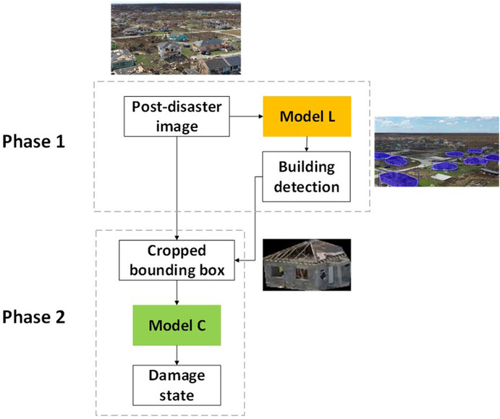
Literature Review
Dual Neural Network - 2
Deep learning for post-hurricane aerial damage assessment of buildings Chih-Shen Cheng et al. (2021)
Stacked PDA model contains two models, Model L for the localization tasks and Model C for the Classification tasks.
Fig. 7. The workflow of model L and model C combination.
Notes:
https://www.proquest.com/docview/2396606718/fulltext/F822CB7EFC5F408FPQ/1?accountid=14229&parentSessionId=cXYrZV8B%2BaTta45e3r5sTq2%2FNtyPzbMeYs0NolWkdAs%3D&parentSessionId=JFjLfzF%2FtjCWYsIZEo9mY6cszNBFJLDzOG2jyPytH%2BI%3D

Slide 19
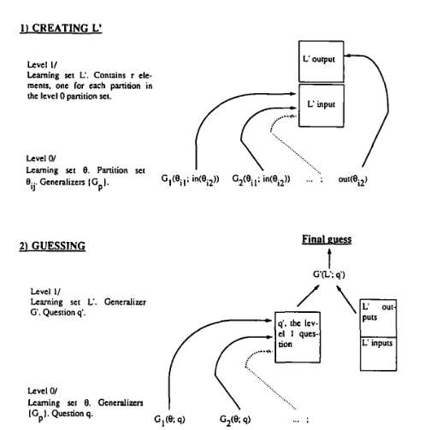
Literature Review
Stacking Ensemble based approach
Wolpert, D. H. (1992). Stacked generalization. Neural networks, 5(2), 241-259.
Stacked generalization is a technique used to improve the accuracy of computer models that make predictions.
It works by combining the predictions of multiple models to create a more accurate final prediction.
Fig. 8. The two stages Involved in the implementation of stacked generalization.
Notes:
https://www.proquest.com/docview/2396606718/fulltext/F822CB7EFC5F408FPQ/1?accountid=14229&parentSessionId=cXYrZV8B%2BaTta45e3r5sTq2%2FNtyPzbMeYs0NolWkdAs%3D&parentSessionId=JFjLfzF%2FtjCWYsIZEo9mY6cszNBFJLDzOG2jyPytH%2BI%3D

Slide 20
Research Methodology
Notes:
首先，我必須簡單的跟大家講解一下我研究的 background
我一開始選擇的主題是利用 UAV 影像對災後地區的房屋損壞預測

Slide 21
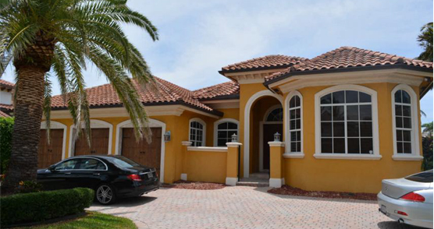
Methodology
Deep Learning for Computer Vision
AI computer vision technique:
Image Classification
AI model
Class:
Building
Input
Output
Notes:
https://ema.clermontcountyohio.gov/damage-assessment/
介紹深度學習是一種機器學習技術，尤其在圖像識別領域取得了顯著的成果。

Slide 22
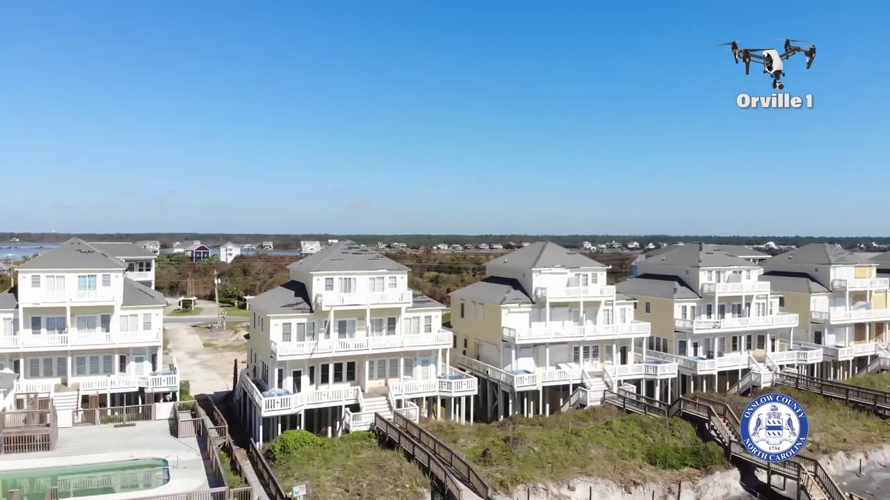
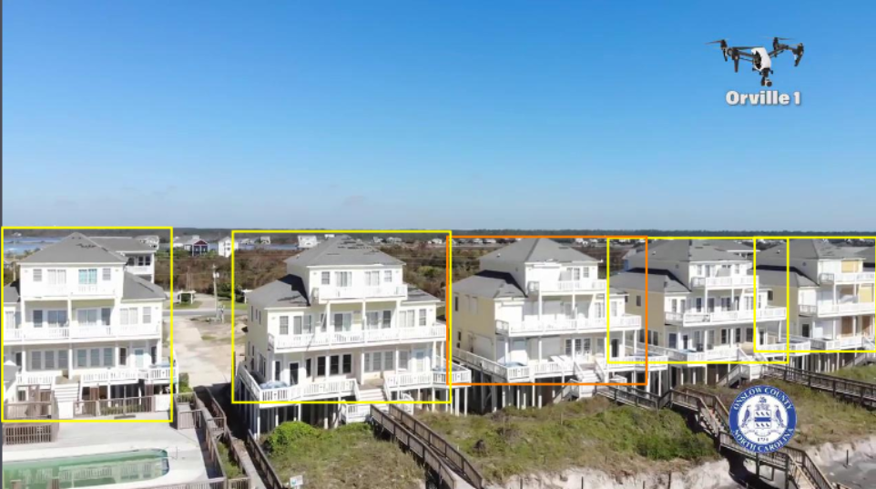
Methodology
Deep Learning for Computer Vision
AI computer vision technique:
Object Detection
No damage
Minor
AI
model
Input
Output
Notes:
https://ema.clermontcountyohio.gov/damage-assessment/
物體檢測是一個圖像處理的子領域，它旨在識別和定位圖像中的多個物體。這與圖像分類有所不同，後者僅對整個圖像進行單一標籤分類。

Slide 23
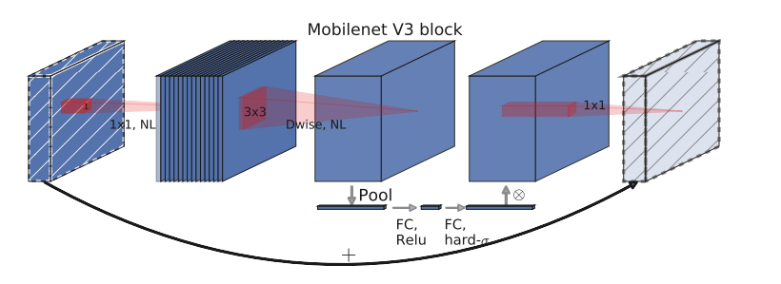
Mobilenet
Methodology
An efficient Convolutional Neural Network (CNN) developed by Google in 2019.
Lightweight: It uses less parameters and computations to do the inference while remaining its precision.
Efficient bottleneck structure: MobileNet V3 employs an improved bottleneck structure that helps reduce the model's computational requirements and parameters.
H-Swish activation function: MobileNet V3 introduces a new activation function called H-Swish which maintains good performance while having lower computational overhead, making the model more efficient.
Channel attention: MobileNet V3 uses a technique called Squeeze-and-Excitation (SE) modules, which improve feature representation by adaptively adjusting the relationships between channels.

Slide 24
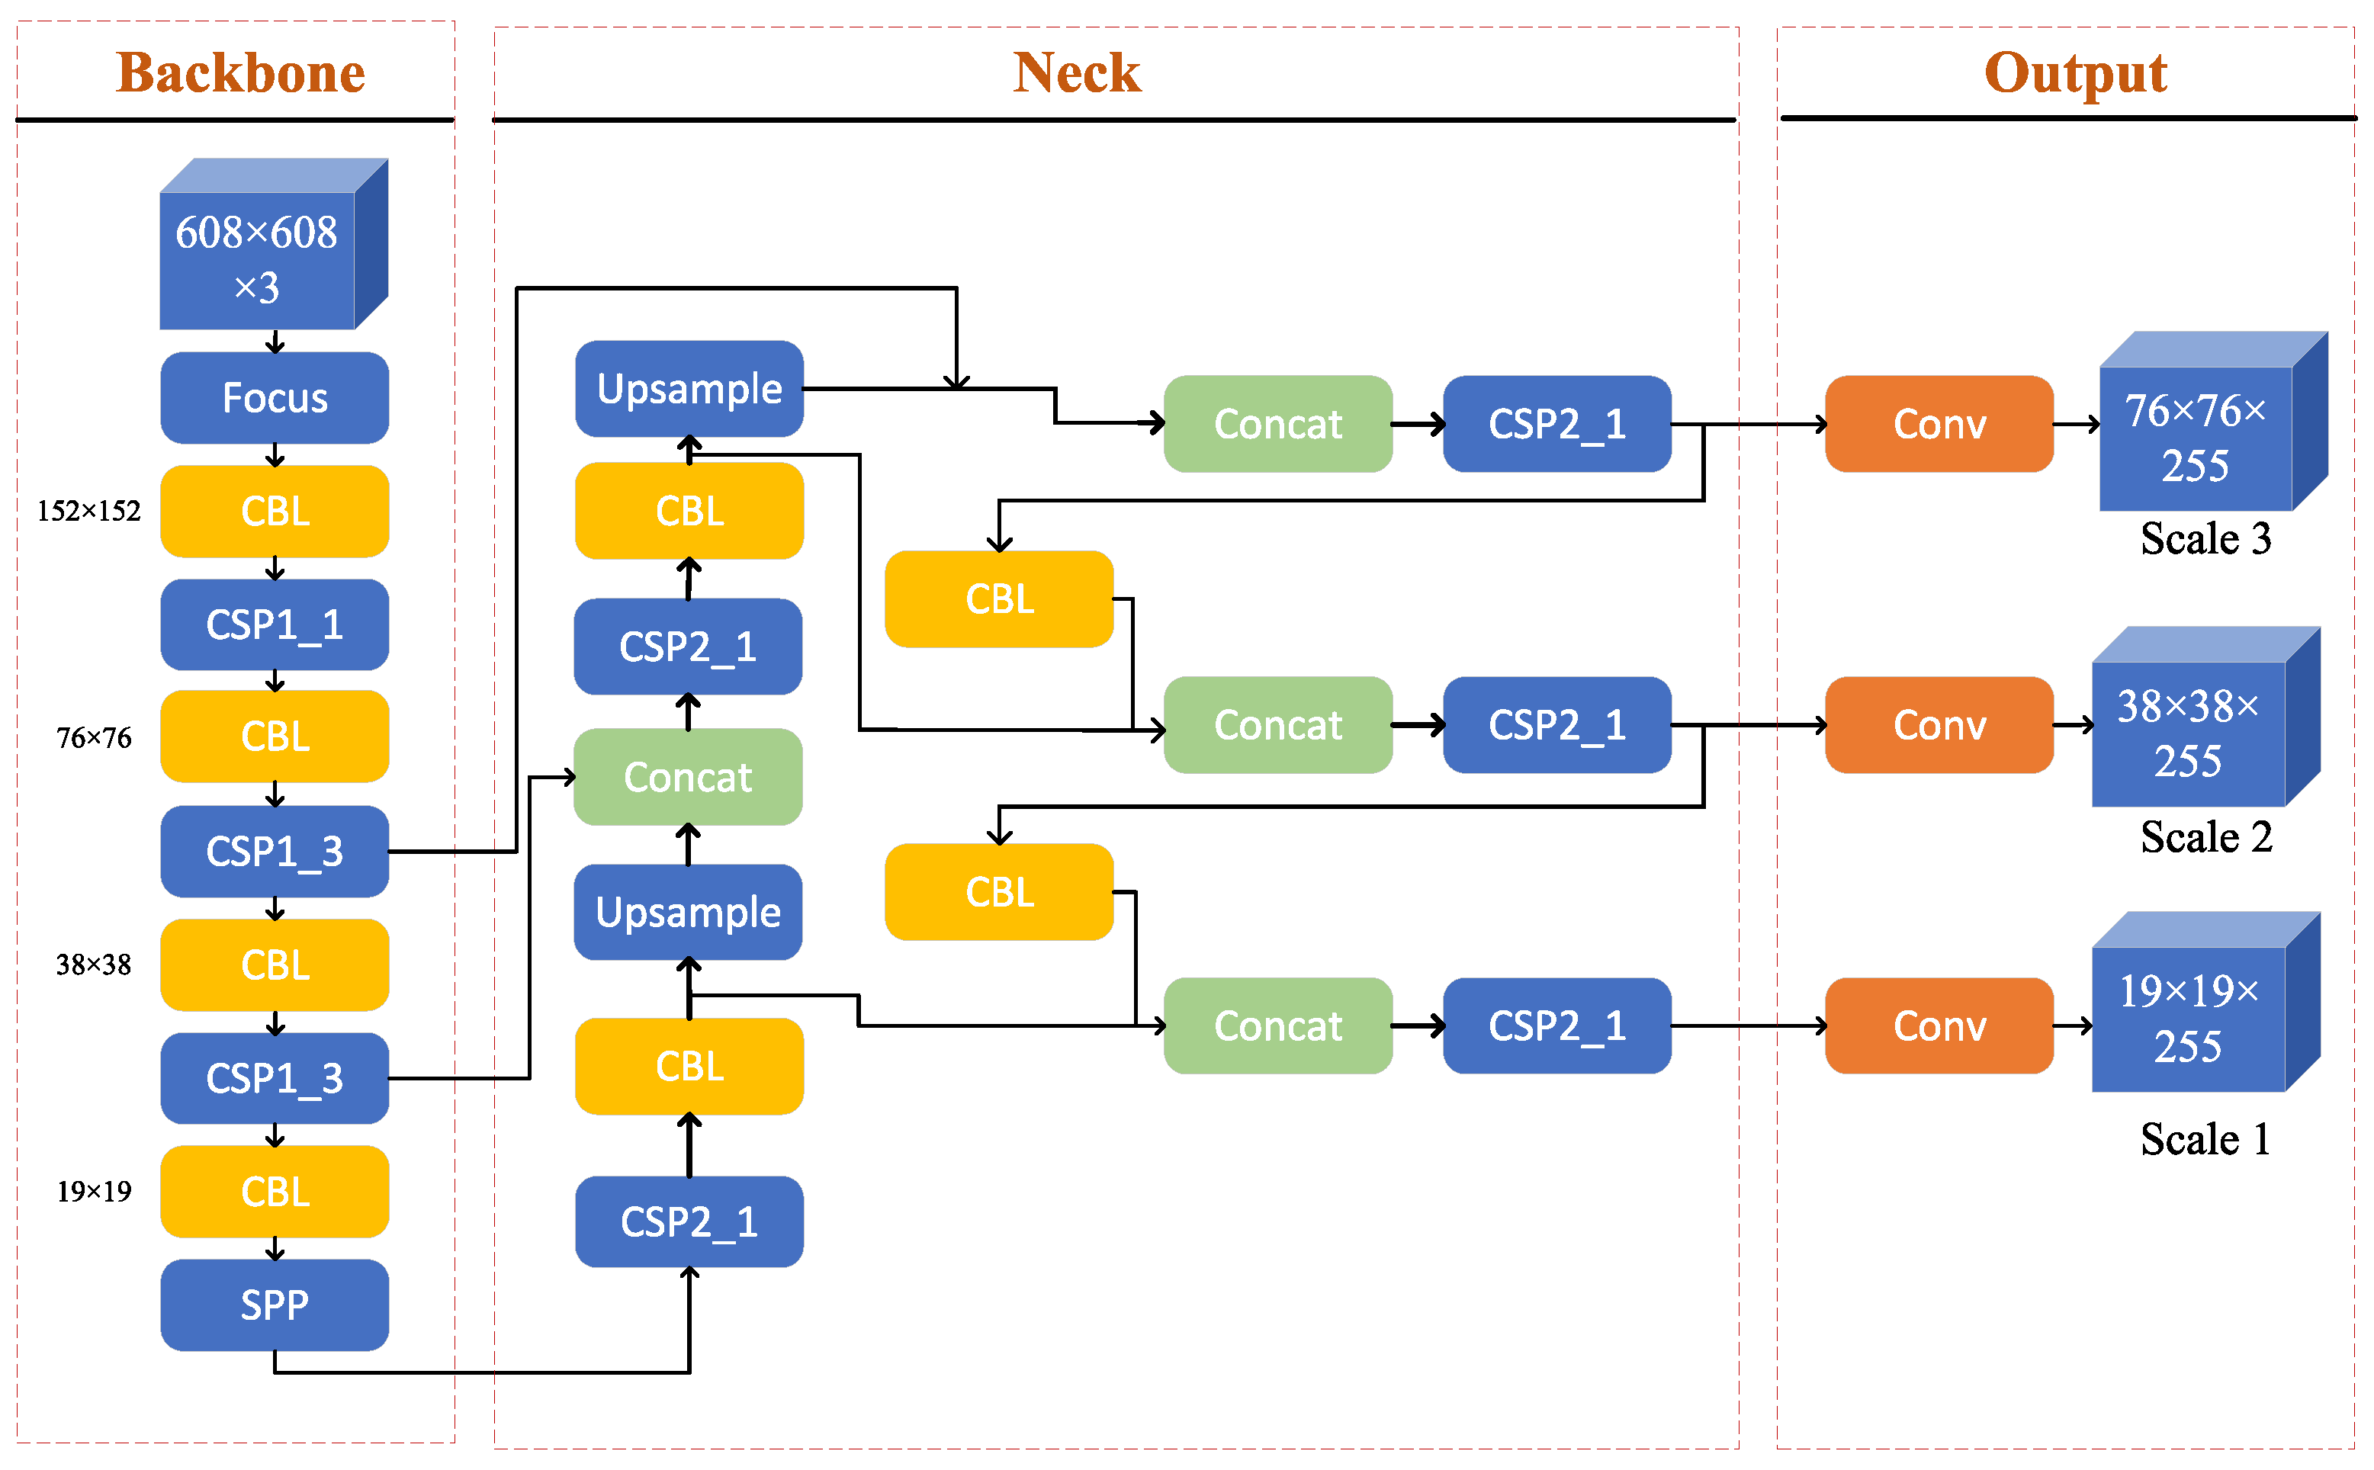
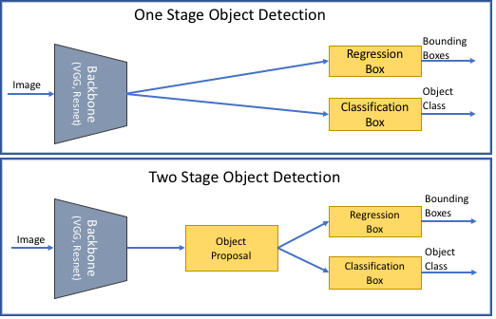
Methodology
One-stage & Two-stage detector
YOLO v5
1) Backbone - A convolutional neural network that collects and forms image features at different levels of detail.
2) Neck - A series of layers to mix and combine image features to pass them forward to prediction.
3) Head - Consumes features from the neck and takes box and class prediction steps.
One-stage detector: SSD, YOLO family, RetinaNet
Two-stage detector: R-CNN, Fast R-CNN, Faster R-CNN
Pros of one-stage detector: Faster, Smaller
Cons of one-stage detector: Less accurate
Fig. 10. The network architecture of YOLO.
Fig. 11. The comparison of one stage and two stage detector.
Notes:
Source: https://www.mdpi.com/2072-4292/13/18/3776
Source: https://www.researchgate.net/figure/Two-stage-vs-one-stage-object-detection-models_fig3_353284602

Slide 25
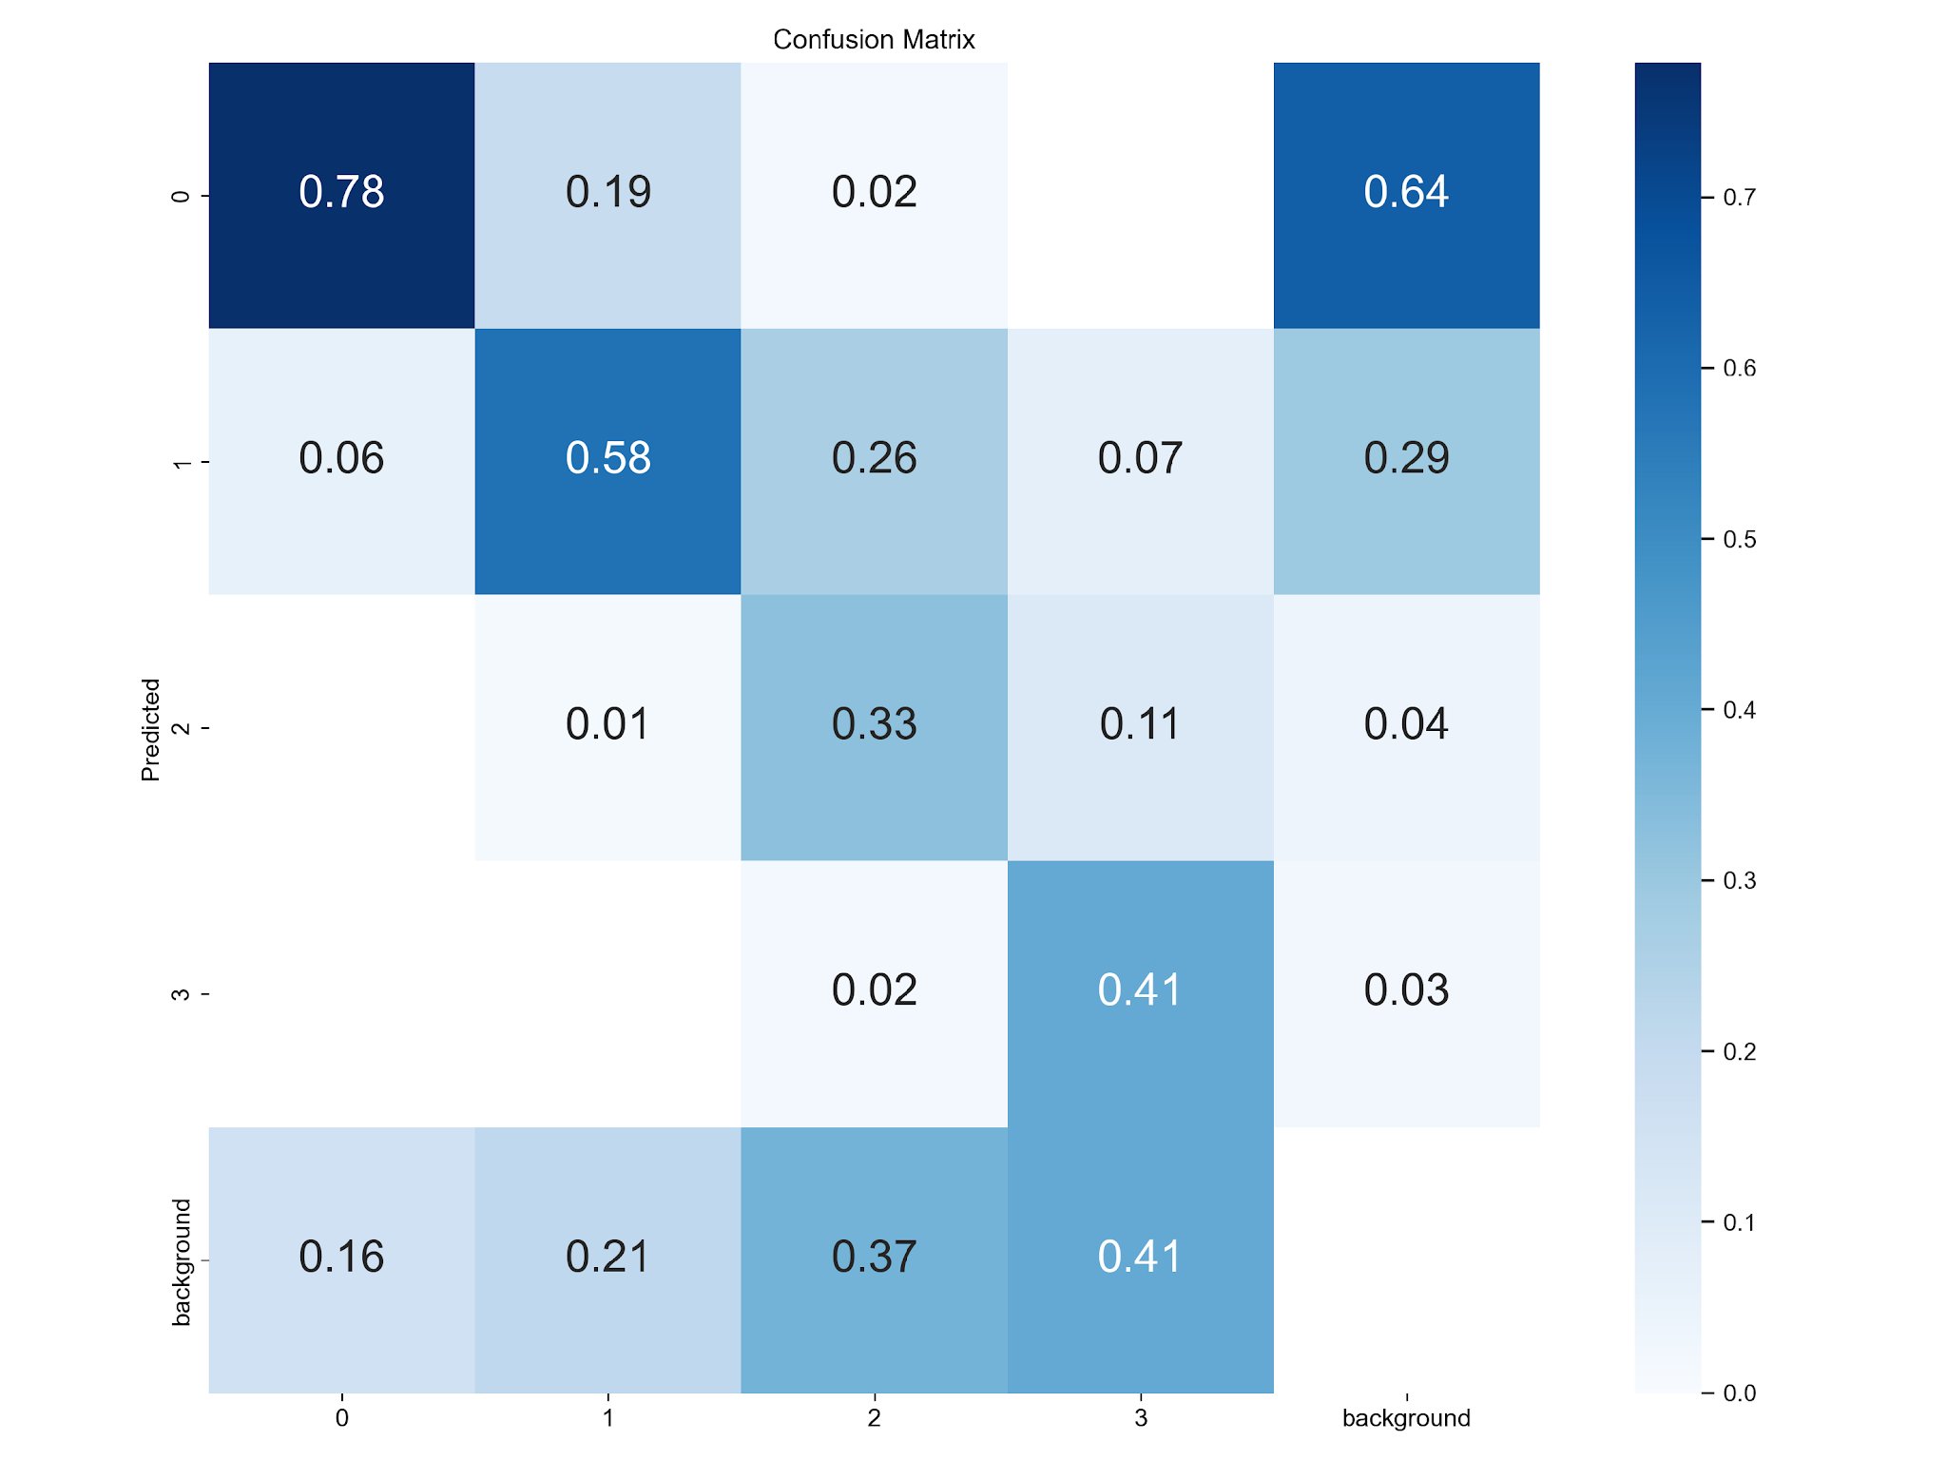
Methodology
Testing results of YOLOv5
The confusion matrix of the prediction
0: No damage
1: Minor
2: Major
3: Destroyed
Images | Instances |  | P | R | mAP50 | mAP50-95
205 (ISBDA validation) | 1629 | all | 0.635 | 0.614 | 0.62 | 0.405
 | 918 | No damage | 0.678 | 0.829 | 0.804 | 0.526
 | 523 | Minor damage | 0.615 | 0.664 | 0.646 | 0.425
 | 107 | Major damage | 0.539 | 0.43 | 0.452 | 0.312
 | 81 | Destroyed | 0.707 | 0.531 | 0.577 | 0.355
Table 5. Testing results of YOLOv5 on validation dataset.
The performances of the "minor" and "major" classes are unsatisfactory.
Fig. 12. The confusion matrix of the results on validation dataset.

Slide 26
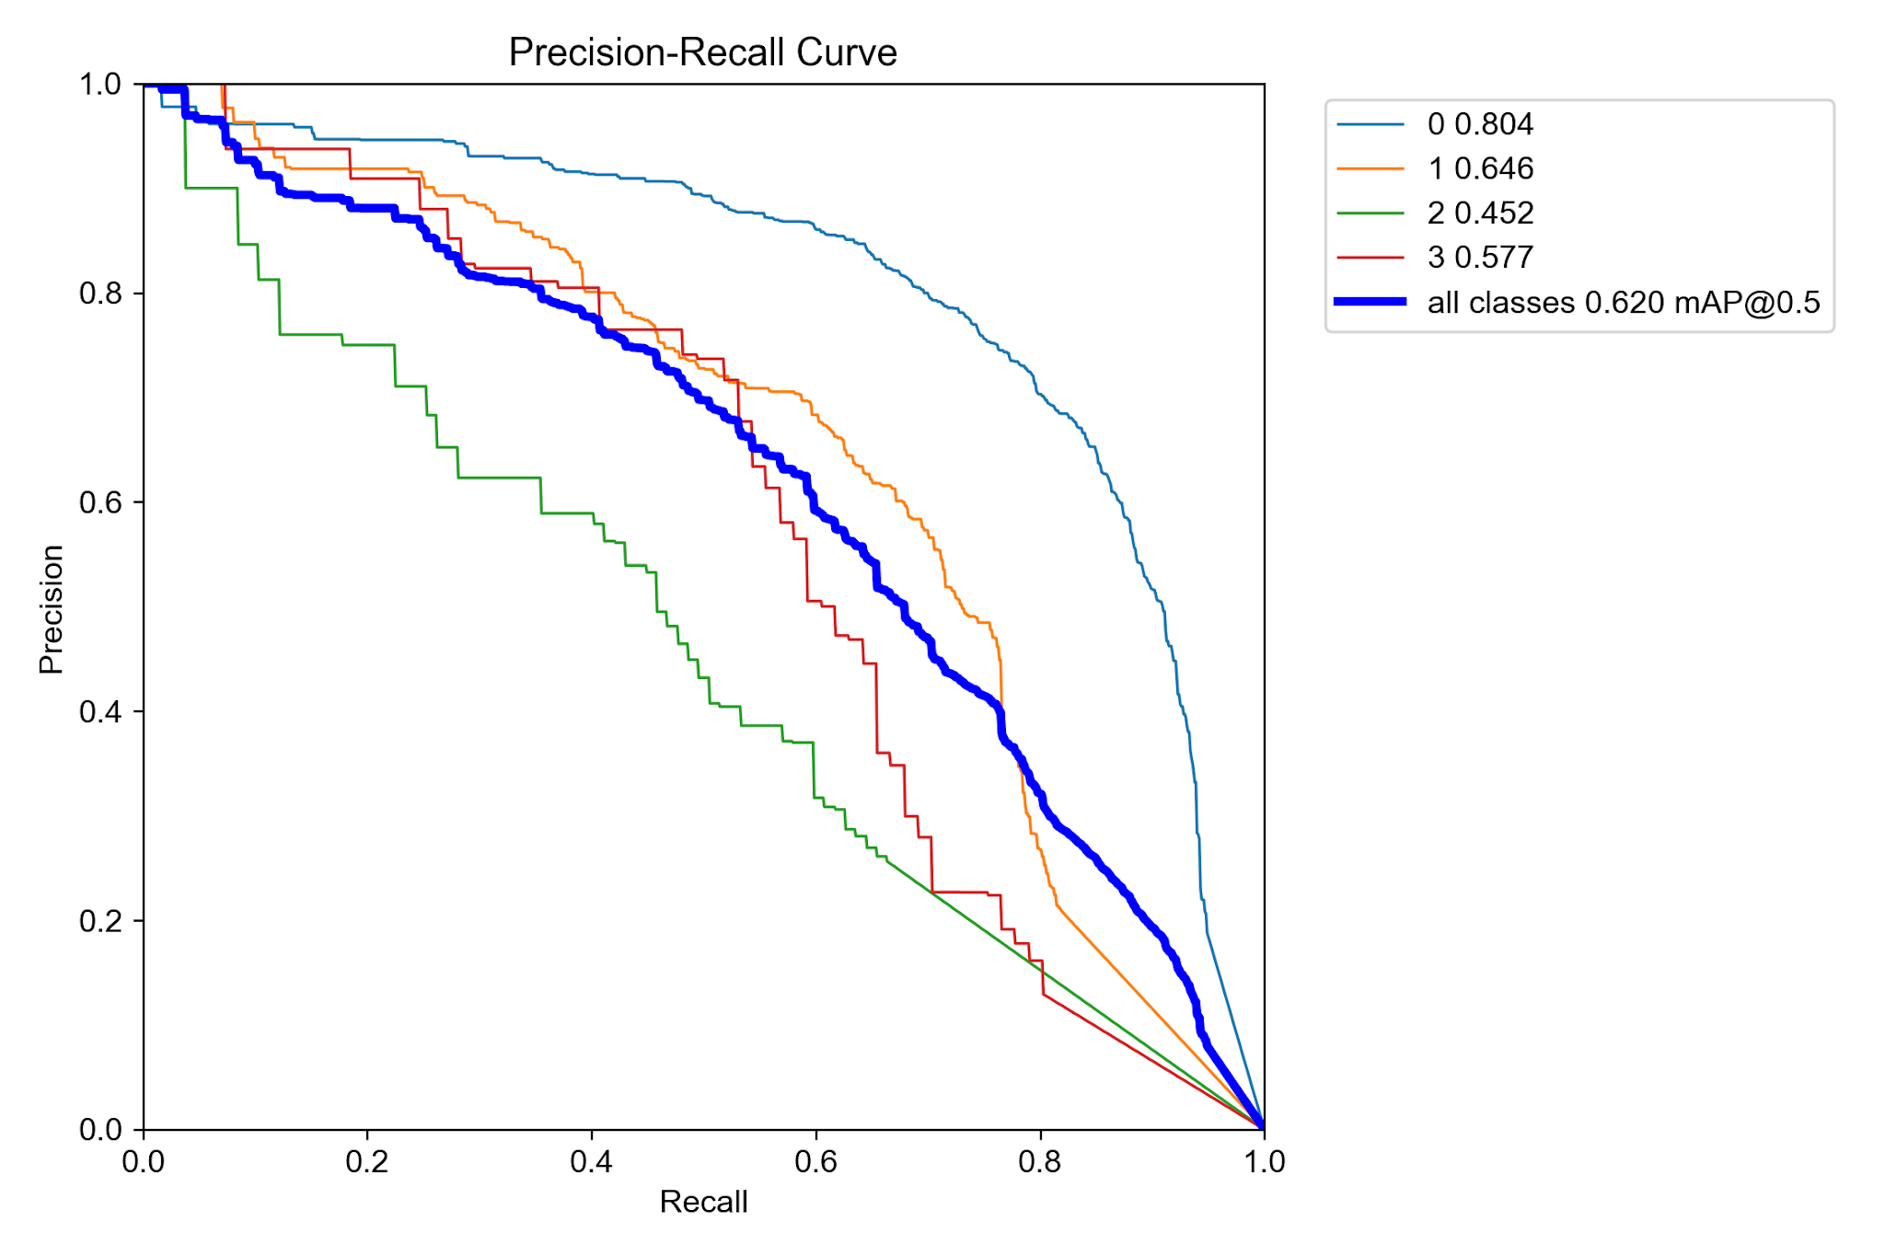
Methodology
Testing results of YOLOv5
0: No damage
1: Minor
2: Major
3: Destroyed
Fig.13. Precision-Recall Curve of the YOLOv5 detections.

Slide 27
Combining Predictions from YOLOv5 & Mobilenet
Goal: We wish to enhance the classification between minor damage and major damage
Methodology
Input images
Testing results from training dataset
{x1, y1, x2, y2, no_conf, min_conf, maj_conf, des_conf, pred_cls}
YOLO v5
Object Detector
Training weights
Input images
(cropped building images)
Classification results
{ slight_conf, severe_conf}
Mobilenet
Classifier
Trained Classifier

Slide 28
Methodology
Data
UAV Images
Cropped Building Images
Level-1 classifiers
(base models)
YOLO v5
Mobilenet
[x1, y1, x2, y2]
YOLO v5 predictions for each building
[x1, y1, x2, y2,
no_damage_conf, minor_damage_conf, major_damage_conf, destroyed_conf]
Mobilenet predictions
{slight_conf, severe_conf}
Level-1 predictions
Level-2 classifier
(meta learner)
Neural Network
Level-2 prediction
(Final predict)
Final Predictions
{no_damage_conf, minor_damage_conf, major_damage_conf, destroyed_conf}

Slide 29
Data
Notes:
首先，我必須簡單的跟大家講解一下我研究的 background
我一開始選擇的主題是利用 UAV 影像對災後地區的房屋損壞預測

Slide 30
Data
Datasets
Training Dataset: The actual dataset that we use to train the model (weights and biases). The model sees and learns from this data.
Validation Dataset: The validation set is used to evaluate a given model. We use this data to fine-tune the model hyperparameters. Hence the model occasionally sees this data, but never does it “Learn” from this. We use the validation set results, and update higher level hyperparameters.
Test Dataset: It provides the gold standard to evaluate the model, and is only used once a model is completely trained
Fig. 3. Visualization of how dataset is split before AI training and testing.
Notes:
https://ema.clermontcountyohio.gov/damage-assessment/
Img Source: https://towardsdatascience.com/train-validation-and-test-sets-72cb40cba9e7

Slide 31
Data
ISBDA dataset
Originated from MSNet paper
1030 images were collected from social media platform in the aftermath of several hurricane disasters.
Damage States | Slight | Severe | Debris
Count | 2119 | 560 | 282
Table 1. The distribution of the original dataset
Figure 8. The annotations of the original dataset

Slide 32
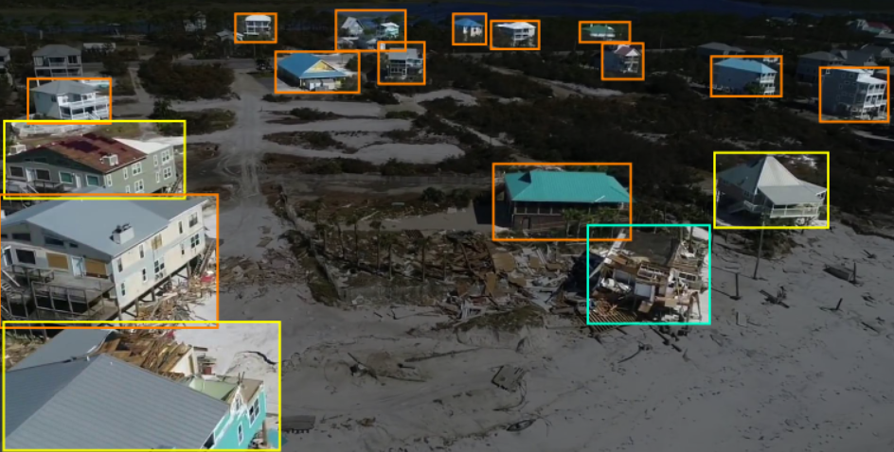
Data
Training Data
Dataset 1 – YOLOv5
Test Data
Contains 70% of the modified ISBDA dataset with ground truth and labels.
Contains 10% of the modified ISBDA dataset with ground truth and labels.
Validation Data
Contains 20% of the modified ISBDA dataset with ground truth and labels.
Damage States | Slight | Severe | Debris
Count | 2119 | 560 | 282
Table 3. The distribution of the original dataset
Damage States | No Damage | Minor damage | Major Damage | Destroyed
Count | 4650 | 2597 | 494 | 381
Figure 9. The annotations of the modified dataset
Table 4. The distribution of the modified dataset

Slide 33
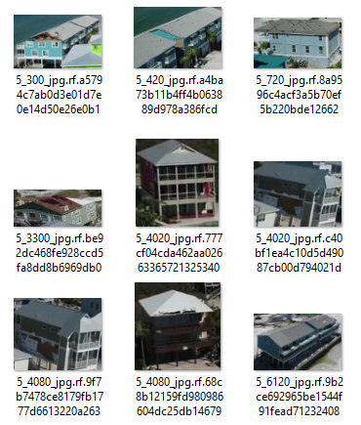
Data
Training Data
Dataset 2 – Mobilenet
Test Data
Cropped building images from training dataset (Dataset 1).
Predictions from YOLOv5 on test dataset (Dataset 1).
We will get a set of predictions of each building
{[x1, y1, x2, y2, class 0 prob., class 1 prob., class 2 prob., class 3 prob., pred. class] * N}
from the inference of YOLOv5
Classification
Mobilenet designed only responsible for predicting two damage classes, which are “slight” and “severe”.
For training, we combined the instances of “no damage” & “minor” from Dataset 1 into “slight”, while combining the instances of “major” & “destroyed” into “severe”.

Slide 34
Data
Training Data
Dataset 3 – Meta learner
Test Data
Combined predictions of YOLOv5 and Mobilenet on validation dataset (Dataset 1).
Combined predictions of YOLOv5 and Mobilenet on test dataset (Dataset 1).
Predictions from YOLOv5
Predictions from Mobilenet
Training features
Targets
Notes:
在 testing 時是否有餵座標，導致meta learner混亂？

Slide 35
Results
Notes:
首先，我必須簡單的跟大家講解一下我研究的 background
我一開始選擇的主題是利用 UAV 影像對災後地區的房屋損壞預測

Slide 36
Results
YOLOv5 vs. Stacking Ensemble on test dataset
YOLOv5
(Baseline)
Stacking Ensemble
(Neural Network as meta learner)

Slide 37
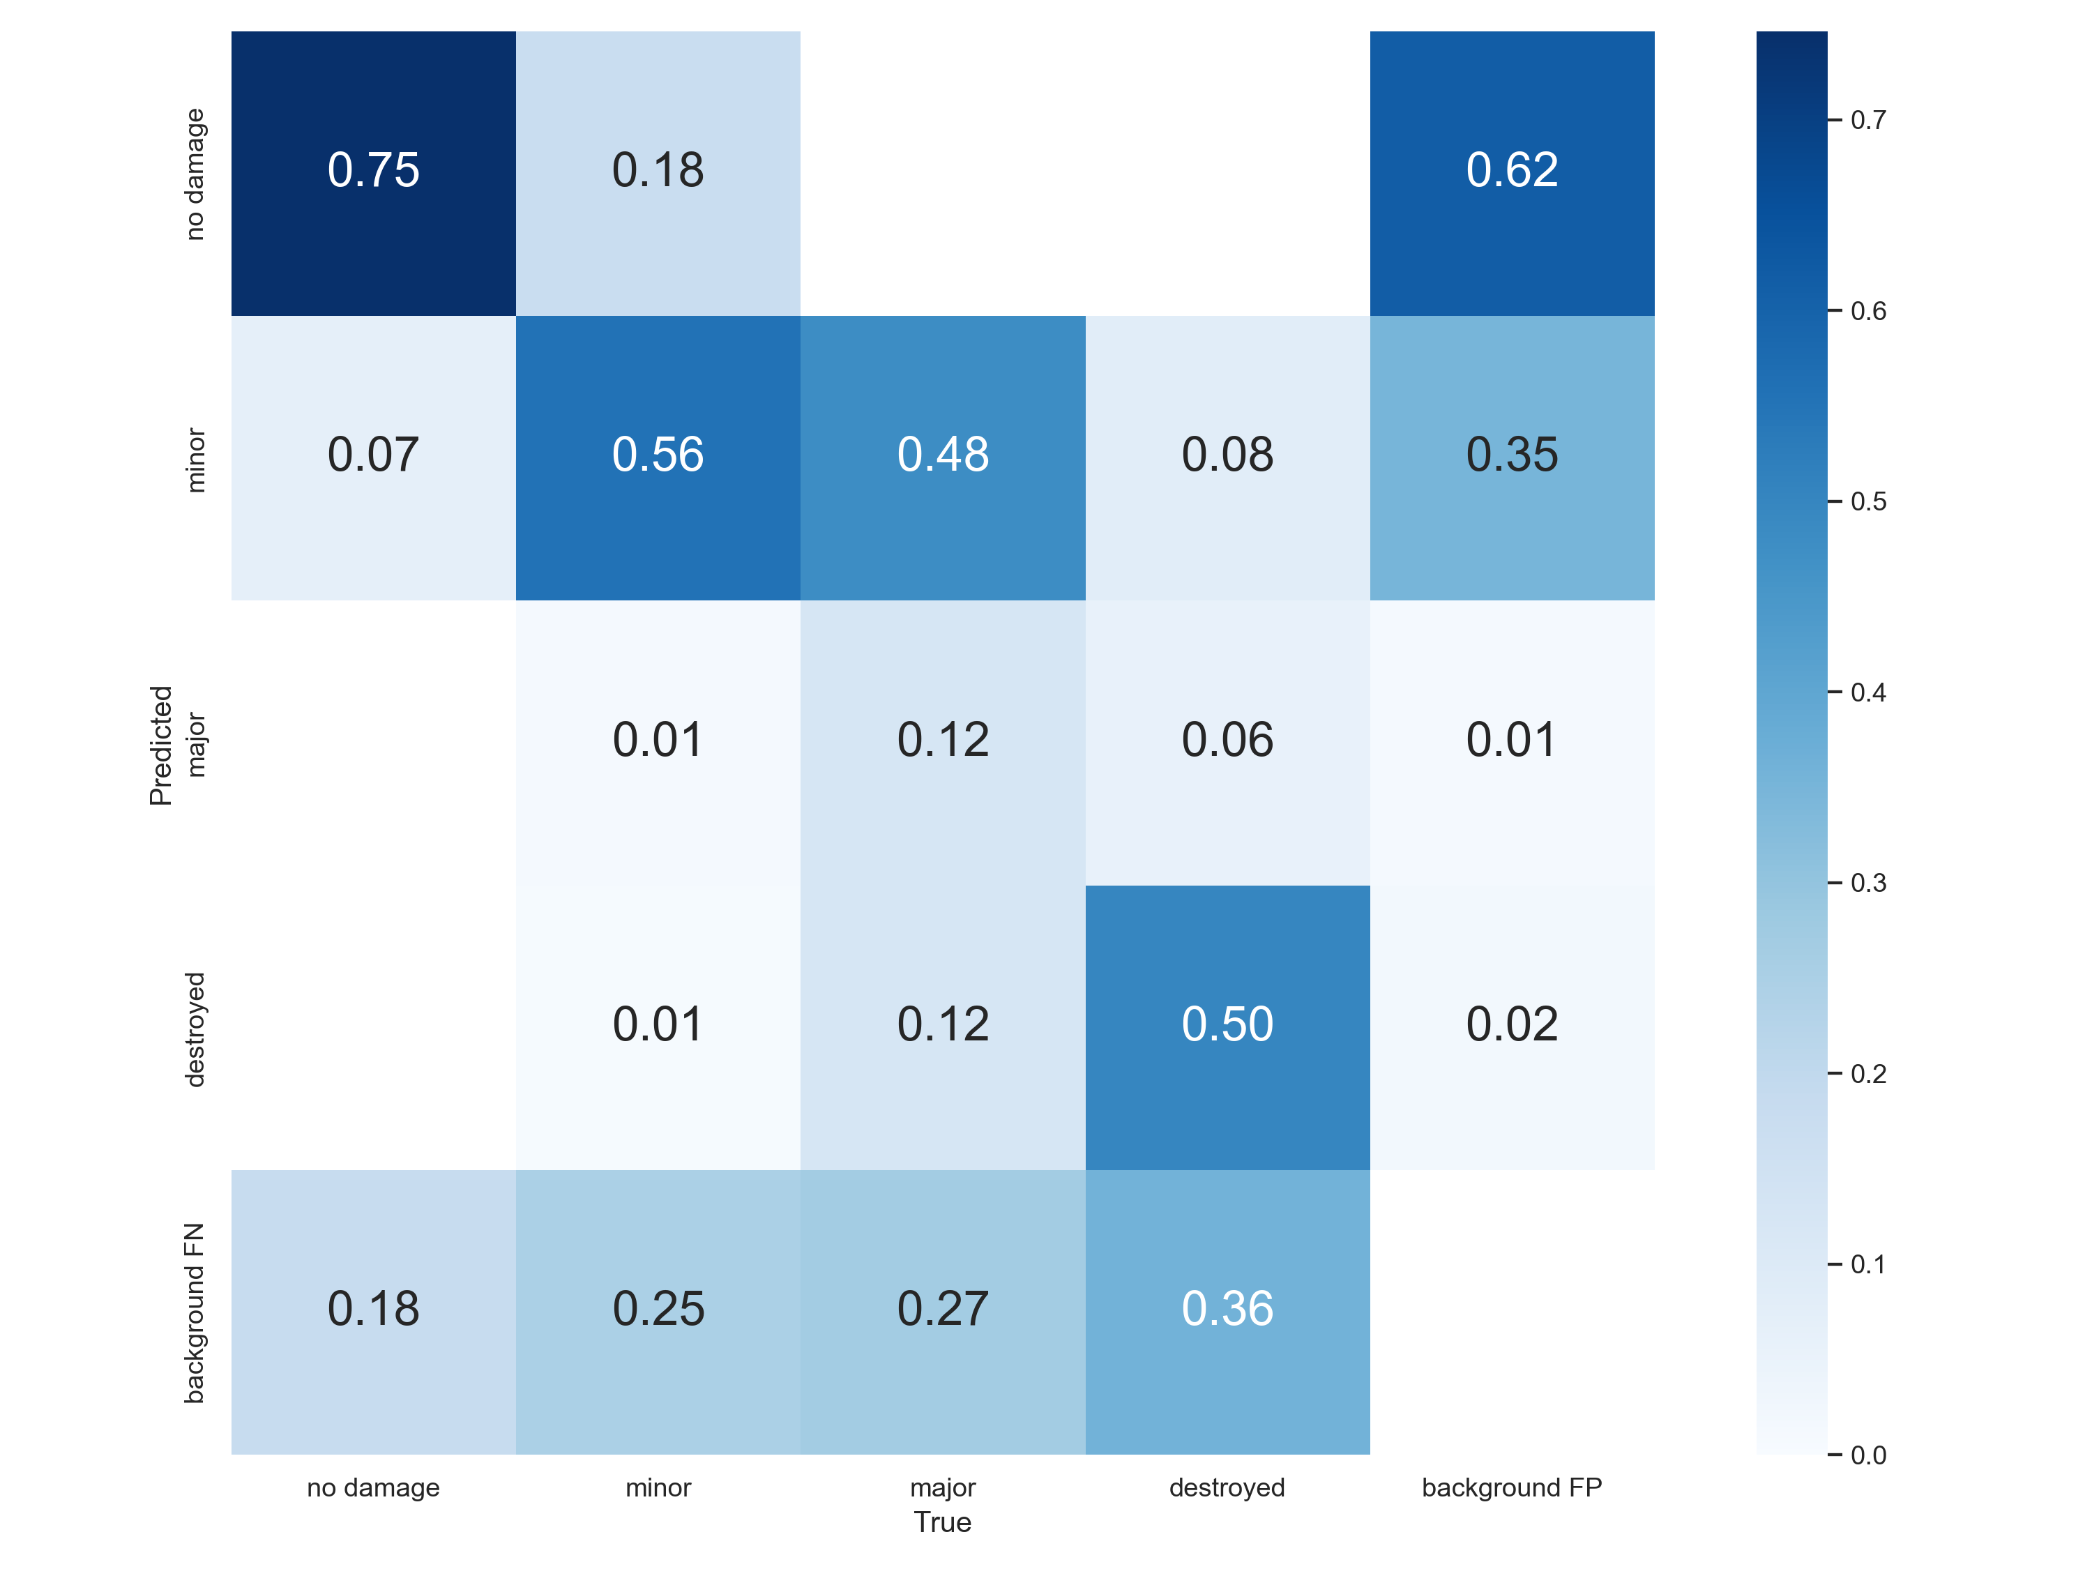
Results
YOLOv5 vs. Stacking Ensemble on test dataset
YOLOv5
(Baseline)
Stacking Ensemble
(Neural Network as meta learner)

Slide 38
Future Work

Slide 39
Future Work
Review the experiment process to find where is the problems.
Investigate alternative stacking techniques: Explore different stacking methods, architectures, or the use of additional models to enhance the overall performance and address the identified weaknesses in major damage classification.
Optimize the meta learner: Further fine-tune the meta learner's architecture and training process to improve the balance between precision and recall, as well as the mAP50 and mAP50-95 metrics.
Feature engineering: Experiment with different feature combinations or feature extraction techniques to improve the information fed into the stacking ensemble and enhance the final classification results.

Slide 40
Conclusion

Slide 41
Conclusion
The goal of this study is to perform a preliminary damage assessment on buildings captured by UAVs while focusing on using Stacking Ensemble approach to improve the classification task.
The stacking ensemble approach using YOLOv5 and Mobilenet has demonstrated improvements in precision and mAP50-95 while sacrificing recall and slightly reducing mAP50.
This approach needed to be carefully revised in order to achieve better overall performance and provide a more robust solution for post-disaster housing damage detection and classification.

Slide 42
References
Weber, Ethan, and Hassan Kané. Building Disaster Damage Assessment in Satellite Imagery with Multi-Temporal Fusion. 0 0 2004, https://arxiv.org/abs/2004.05525.
Kerle, Norman, et al. “UAV-Based Structural Damage Mapping: A Review.” MDPI, www.mdpi.com, 26 Dec. 2019, https://www.mdpi.com/2220-9964/9/1/14.
Zhu, X., Liang, J., & Hauptmann, A. (2021). Msnet: A multilevel instance segmentation network for natural disaster damage assessment in aerial videos. In Proceedings of the IEEE/CVF Winter Conference on Applications of Computer Vision (pp. 2023-2032).
Jocher, G.; Stoken, A.; Borovec, J. Ultralytic/Yolov5. Available online: https://github.com/ultralytics/yolov5.
Roboflow. (2022). Available Online https://roboflow.com/
Gupta, Gupta, R., Goodman, B., Patel, N., Hosfelt, R., Sajeev, S., Heim, E., ... & Gaston, M. (2019). Creating xBD: A dataset for assessing building damage from satellite imagery. In Proceedings of the IEEE/CVF conference on computer vision and pattern recognition workshops (pp. 10-17).
Kortmann, F., Talits, K., Warnecke, A., Meier, N., Heger, J., Drews, P., & Funk, B. The Value of Deep Learning Tools in Object Detection: YOLOv5 in a Road Damage Use Case.
A. Farhadi and J. Redmon, “Yolov3: An incremental improvement,” in Computer Vision and Pattern Recognition, 2018, pp. 1804–02 767.
Lin, T. Y., Goyal, P., Girshick, R., He, K., & Dollár, P. (2017). Focal loss for dense object detection. In Proceedings of the IEEE international conference on computer vision (pp. 2980-2988).
Kingma, D. P., & Ba, J. (2014). Adam: A method for stochastic optimization. arXiv preprint arXiv:1412.6980.
Ehrlich, D., Guo, H. D., Molch, K., Ma, J. W., & Pesaresi, M. (2009). Identifying damage caused by the 2008 Wenchuan earthquake from VHR remote sensing data. International Journal of Digital Earth, 2(4), 309-326.
Boccardo, P., & Tonolo, F. G. (2015). Remote sensing role in emergency mapping for disaster response. Geomatics, Natural Hazards and Risk, 6(3), 183-203.
Cheng, G., & Han, J. (2016). A survey on object detection in optical remote sensing images. ISPRS Journal of Photogrammetry and Remote Sensing, 117, 11-28.
Fernandez Galarreta, J., Kerle, N., & Gerke, M. (2015). UAV-based urban structural damage assessment using object-based image analysis and semantic reasoning. Natural Hazards and Earth System Sciences, 15(6), 1087-1101.

Slide 43
Q & A Thank you for your attention.

Slide 44
Background
The process for determining the nature and extent of the loss, suffering, and/or harm to the community resulting from a natural, accidental or human-caused disaster.
According to FEMA, structural loss is evaluated on 4 criteria:
Degree of Damage | Definition
No damage | no structural damage, habitable without repairs
Minor | uninhabitable, repairs can be completed in less than 30 days
Major | uninhabitable, extensive repairs required that will take more than 30 days to complete
Destroyed | total loss, permanently uninhabitable
Table 1. Definitions of four structural losses.
Notes:
https://ema.clermontcountyohio.gov/damage-assessment/

Slide 45
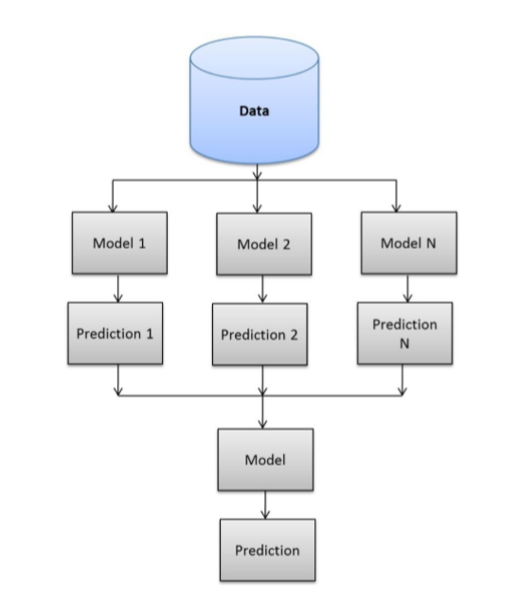
Stacking Ensemble
Background
Stacking – To train different individual models (base model) and then put the outputs into the meta learner to make better predictions.
Original data: This data is divided into n-folds and is also considered test data or training data.
Base models: These models use training data and provide compiled predictions (level-1) as an output.
Level-1 Predictions: Each base model is triggered on some training data and provides different predictions.
Meta Learner: Help to best combine the predictions of the base models. The meta-model is also known as the level-2 model.
Level-2 Prediction: The meta-model learns how to best combine the predictions of the base models and is trained on different predictions made by individual base models.
Level-1 classifier
(base models)
Level-1 predictions
Level-2 classifier
(meta learner)
Fig. 4. The structural of a stacking ensemble learning method.
Notes:
基於 YOLO model 在中間兩個分類上表現得不是很好，我們也有嘗試了許多 hyperparameters 組合來提升他的效能，可是那就是他的最好的狀況。
基於這個問題，我們想到了是否可以利用 stacking ensemble 的想法
Img Source: https://medium.com/ml-research-lab/stacking-ensemble-meta-algorithms-for-improve-predictions-f4b4cf3b9237

Slide 46
Methodology
Ground truth
★
Classification on “Major” is poor
★
Challenge:
A single model (YOLO v5) could not give us satisfying classification results on the “minor” & “major” class.
Idea: To find an addition model that can help classify “minor” and “major” better, and to alleviate the problem.
★
Prediction
★
★
Notes:
這是我從dataset 和 testing results 裡抓出來的幾個 examples，上圖是 ground truth，下圖是預測圖。
紅色星星表示房屋的類別被錯誤預測，且被低估。
在左邊這組圖中，裡面有三棟 gt 為 major 的 buildings 都被判斷成是 minor damage，右邊那組圖片中也有一棟 gt 是 destroyed 的 building 被判定成是 major damage。

