Slide 1
How to study mechanism of avalanche on reservoir bank: a retrospective study
Yihang Li, Xiangzhou Xu
School of Hydraulic Engineering, Dalian University of Technology
(xzxu@dlut.edu.cn)

Slide 2
Contents
1 Field Monitoring
2 Field Investigation
3 Field&Laboratory experiment
4 Numerical method

Slide 3
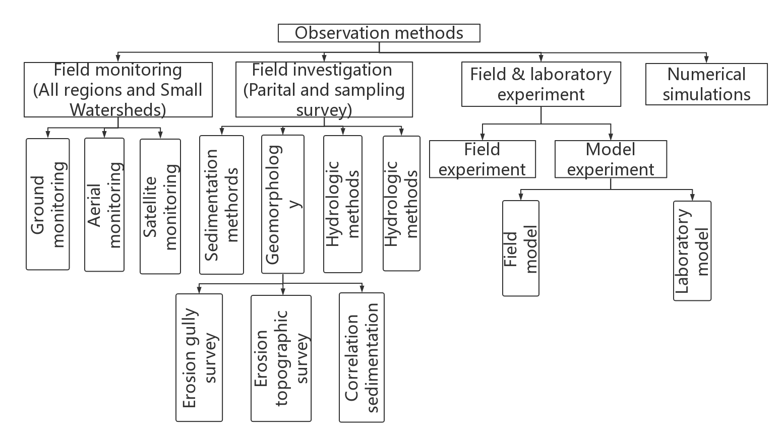
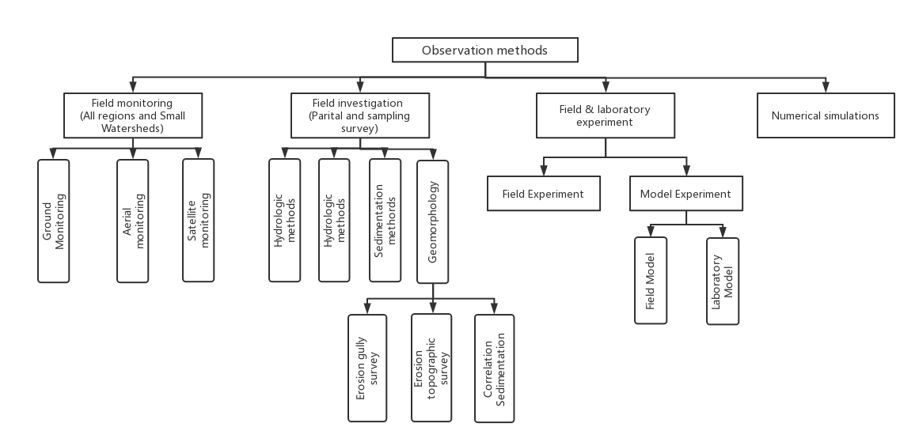
Field Monitoring:
Notes:
In this part, I will simplify introduce the field investigation method

Slide 4
Field Monitoring:
Definition:
The monitoring method is a comprehensive observation for the state of bank failure in the study area, which commonly includes ground monitoring, aerial survry and satellite monitoring.
Notes:
what is Methods and techniques to monitor soil and water conservation ？
There are Definition of Methods and techniques to monitor bank collapse
In general, soil and water conservation loss monitoring should be comprehensively used for RS, GPS, GIS, ground observation, mathematical（卖丝卖踢扣） analysis prediction of special test , prediction methods,and so on .
From this PIcture,we could know ,the Monitoring divided into Ground observation、Aerial（爱瑞） survey、Satellite monitoring and Synthesis（删特儿谁丝） method

Slide 5
Field Monitoring:
Objectives:
The purpose of dynamic moitoring of bank collapse is to timely, accurately and comprehensively reflect the ecological construction of bank collapse, the dynamics of bank failure and its development trend, which not only serves the prevention and control of bank collapse, management decision-making, but also provides the basis for national ecological construction.
Find out characteristics of bank failure
Notes:
The purpose of dynamic (代耐米克) moitoring of soil and water conservation is to timely, accurately and comprehensively reflect the ecological construction of soil and water conservation, the dynamics (代耐米克 丝)of soil and water loss and its development trend, which not only serves the prevention and control of soil and water loss, management decision-making, but also provides the basis for national ecological construction.
There are Objectives of Field Monitoring
及时、准确、全面地反映水土保持生态建设情况、水土流失动态及其发展趋势，既为水土流失防治、监督和管理决策服务，又为国家生态建设提供依据。

Slide 6
Field Monitoring:
Characteristics:
• All-sided observation
（1） Monitoring indicators can be selected from natural, economic and social aspects
（2） Reflect the bank collapse and its prevention and control from multiple angles
（3） Both high-tech and conventional investigation techniques are used to complement each other.
（4）Large scale monitoring of small watersheds
Notes:
The Characteristics (凯瑞特Ruai丝踢克 )of Field Monitoring have two points：The first point is: All-sided observation
And the all-sided observation include the following Four points: Fistly is Monitoring in di cators can be selected from natural, economic and social（搜搜） aspects
Secondly, Reflect the soil and water loss and its prevention and control from multiple angles （猫特BO安狗丝） Finally,is Both high-泰克 and conventional(肯歪森NO) investigation techniques (太克拟丝) are used to complement each other.
（3）即利用高新技术，也利用常规调查技术，互相补充。
1）可以从自然、经济和社会等多方面选择监测指标
（2）从多个角度反映水土流失及其预防和治理状况

Slide 7
Field Monitoring:
• No change to the erosion condition
（1）no change in the scale of the underlying surface
（2）The landform is not reconstructed although the border of the experimental
area should be strictly restricted in a field experiment.
• Principles for dynamical monitoring
(1) Multi-level
Multi-scale spatial process
Multi-level organization and management
Notes:
The second characteristic(凯瑞克特 Ruai 死 踢克 ) of Field Monitoring is:No change to the erosion condition
No change to the erosion condition means no change in the scale of the underlying surface
The Principles for dynamical monitoring have 5 points,Fistly is Multi-level

Slide 8
Field Monitoring:
(2) Dynamics
Continuous positioning observation
Periodic census or temporary monitoring
(3) Comprehensiveness
Direct loss & impact facts
The social, economic and other contents
(4) Standardization
relevant standards and regulationst
(5) Service
To whole society with different scales and details
Notes:
secondly is Dynamics(代 奶米克丝) Thirdly,is Comprehensiveness Fourth is Standardization(stand Z ation) finally is Service

Slide 9
Field Monitoring:
Roles monitored for bank collaps
(1) Become an important methods of bank collaps project management
(2) Provide basic data for project construction
(3) Provide scientific basis for bank collaps evaluation and decision-making
(4) Provide basis for supervision and law enforcement of bank collaps
(5) Provide a new way for bank collaps publicity
Notes:
There are Five Roles monitored for soil and water conservation, Fistly Become an important methods of soil and water conservation project management
Secondly,Provide basic data for project construction
thridly,Provide scientific basis for soil and water conservation evaluation and decision-making
Fourth,Provide basis for supervision and law enforcement of soil and water conservation
Finally,Provide a new way for soil and water conservation publicity

Slide 10
Field Monitoring:
Conclusion
Combined with ground observation, the monitoring method that plays satellite images and 3S technology has the advantages of fast speed and high degree of automation, which can quickly obtain topographic data and information on the location and scale of the occurrence of landslides in the reservoir area, and is suitable for monitoring the current situation of reservoir bank landslides in a larger scale.
Although the macroscopic monitoring means based on satellite and aerial technology can quickly make comprehensive observation of the status of the collapse of a larger area of the reservoir bank, it is affected by weather, environment and other factors, and limited by the technical characteristics of remote sensing monitoring, it is difficult to continuously monitor the occurrence and development process of the collapse of the same disaster site, which has certain limitations.

Slide 11
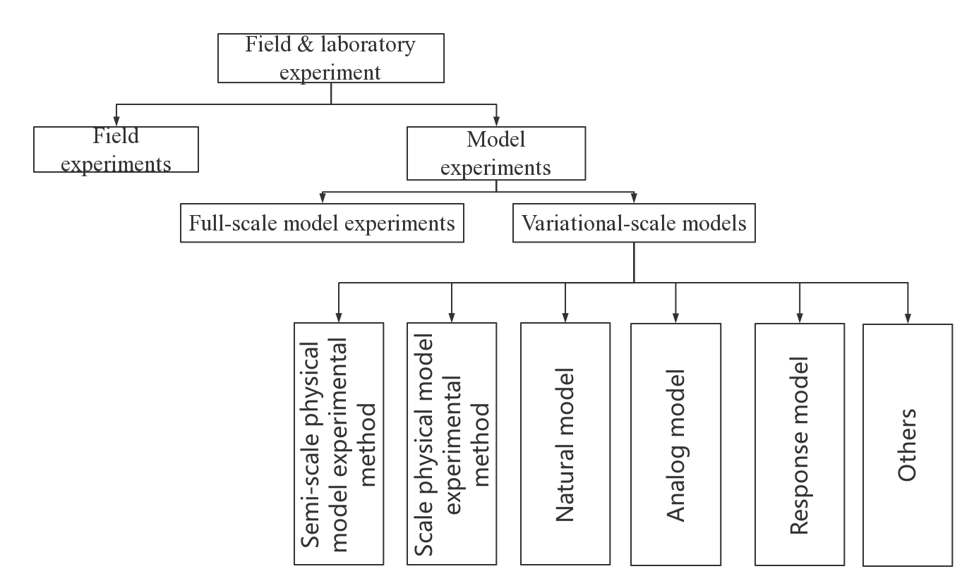
Field & laboratory experiment

Slide 12
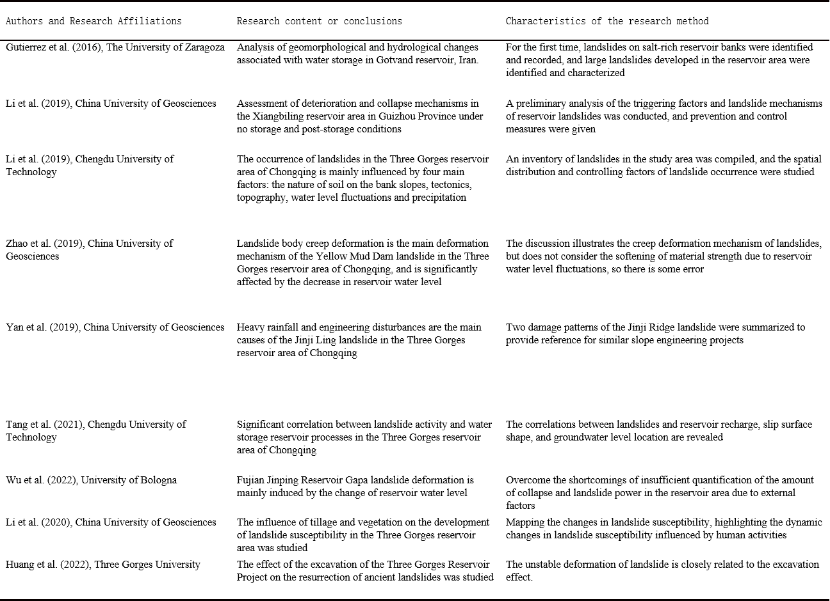
Field Investigation:
Notes:
The following is Principles for field investigation as follows

Slide 13
Field Investigation:
Conclusion
In general, the survey method is flexible and applicable to a wide range of characteristics, and can provide calibration data for bank failure monitoring and testing, and has been widely used in the study of bank deformation mechanisms. Of course, due to the topography, weather and other external conditions, the survey method cannot quickly and comprehensively obtain detailed information about the disaster in the study area, and the field survey method cannot observe the process of bank failure.
Notes:
As we can see from this Picture: The Hydrologic model divded into Empirical models and distributed（dis 吹pu 踢的） model
It should be noted that:When using this model , Precipitation, runoff and sediment yield data require accurate data.
In addition, the distributed model divded into 2 parts, from OUT OF chian and from CHina
When applying hydrological model, the basic principle of the model and whether the model has universal adaptability(鹅带波 鹅比例T) should be clear

Slide 14
Field Experiments
Definition:
Runoff and sediment distribution in a segment of the natural watershed may be conducted in an in situ test,i.e. field experiment, under natural and simulated rainfall conditions to study study the mechanism of bank collapse and the effects of management measures.
The researchers should consider the similarity of the cumulative effect while designing the downscaled model experiment for bank collapse
Characteristics of model experiment
The model experiment may be conducted in the laboratory far away from the study area, and the experimental scenario may be freely designed if needed.
The model experiment is recommended as an important supplement of the field experiment and some advantages of the experiment in the laboratory cannot be substituted with field experiments.
Notes:
Here is the definition and characristic of model experiments.
The model experiment may be conducted in the laboratory far away from the study area, and the experimental may be freely designed if needed.
The model experiment is recommended as an important supplement of the field experiment and some advantages of the experiment in the laboratory cannot be substituted with field experiments.
IT’s worth that The researchers should consider the similarity of the effect while designing the downscaled model experiment for soil conservation

Slide 15
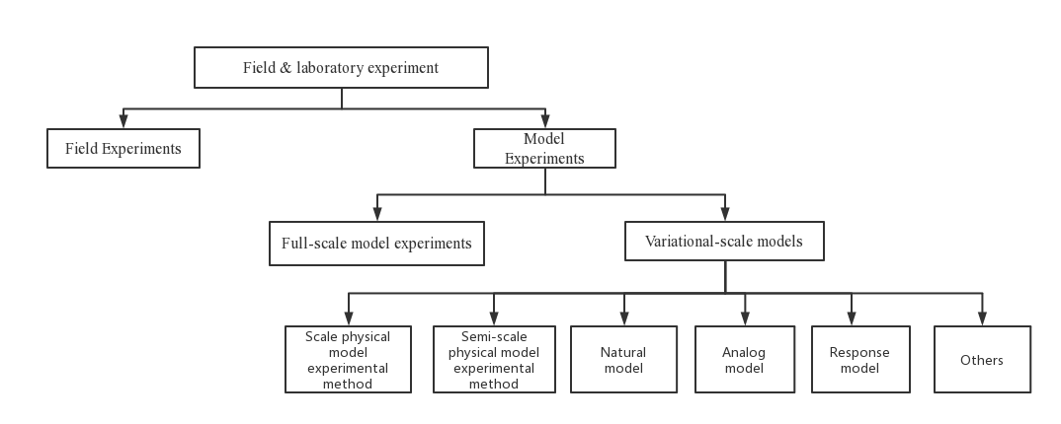
Field & laboratory experiments
Notes:
The classification(K赖C 飞kei 森） of laboratoty experiments is field experiments and Model experoments. In addition, the Model experiments include the full-scale model experiments and variational-scale models
the vartional-scale models divided into natural model、 respones model 、and so on

Slide 16
Field & laboratory experiments
Advantages:
The field experiments is to use simulation test and observation device to carry out field test or simulation test on the bank collapse process under strict boundary control conditions, in order to study the bank collapse material transport change law and collapse control method
Disadvantages:
It is difficult to make accurate observation and simulation in the field. (mainly due to environmental restrictions and inability to transport precision instruments)
Notes:
Here is the Definition of Field Experiments
AND THE Advantages of Field Experiments IS Since the field investigation does not need to reshape the underlying surface topography, that is, the underlying surface has no scale and specificity of erosion materials, so it is easy to simulate and observe the complex soil and water loss site.

Slide 17
Field & laboratory experiments
Future direction:
From the available literature, the current research results on the crumbling mechanism of reservoir banks in China are mostly about the Three Gorges reservoir area, while there are fewer experimental results on the crumbling mechanism of soil reservoir banks in other reservoir areas such as the middle reaches of the Yellow River. In fact, there are great differences in the structural characteristics of rocky bank slopes, geotechnical bank slopes and soil bank slopes.
Notes:
Of course, the Field Experiments have Disadvantages: It is difficult to make accurate observation and Simulation in the field.

Slide 18
Field & laboratory experiments
Application of the model
It should be noted that when carrying out model tests, firstly, the process of internal and external factors acting on the prototype should be clarified to highlight the problems to be studied; secondly, geological investigation of the research target is needed to understand the basic information of the material composition structure, angle and other influencing factors of the prototype bank slope in the reservoir area; finally, then the test site conditions should be considered, and the scale model should be constructed by reducing the size of the reservoir bank in an appropriate proportion according to the similarity theory, or the full-scale model should be formed by generalization based on the actual fragment of the bank slope in the reservoir area to be studied.
Notes:
The Runoff plot experiments Generally including drainage(坠内质) ditch, protection belt, community and collection facilities（fe C li 踢丝）
Observation contents including Observation of rainfall, runoff, sediment, soil nutrients(牛春丝), and so on

Slide 19
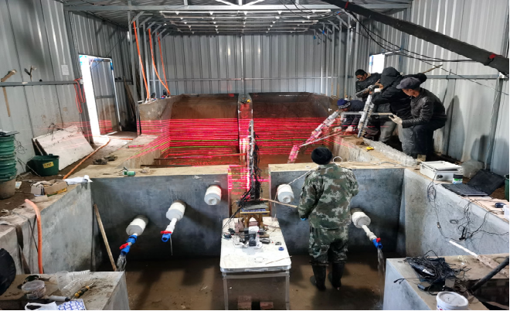
Field & laboratory experiments
Application of the model
The relationship between collapse volume and rainfall, water level and waves can be calculated through field experiments
Notes:
The Runoff plot experiments Generally including drainage(坠内质) ditch, protection belt, community and collection facilities（fe C li 踢丝）
Observation contents including Observation of rainfall, runoff, sediment, soil nutrients(牛春丝), and so on

Slide 20
Field & laboratory experiments
Conclusion
The field test method of reservoir bank collapse does not need to reshape the sub-bedding surface topography, and the relative prototype does not have the change of sub-bedding surface scale and erosion material, so it is easy to simulate and observe the complex reservoir bank collapse site.
However, the field test simulation and observation conditions are relatively rudimentary, and because the bank failure is close to the water surface, the field simulation and observation are difficult, so it has not been widely used.
Notes:
The Runoff plot experiments Generally including drainage(坠内质) ditch, protection belt, community and collection facilities（fe C li 踢丝）
Observation contents including Observation of rainfall, runoff, sediment, soil nutrients(牛春丝), and so on

Slide 21
Numerical methods
Advantages
Numerical simulation method, also called mathematical modeling method, or numerical method for short, is a mathematical method that simulates the process of bank collapse and predicts its disaster by means of numerical calculation and image display.
The numerical method can statistically analyze or predict reservoir bank failure at a more macroscopic level, and can be applied to larger scale waters without site constraints, making it a fast and low-cost scientific research method.

Slide 22
Numerical methods
Disadvantages
However, the numerical method requires detailed and accurate field observations, including geomechanical and dynamic parameters, water depth, geometry, and measurements of actual dam failure problems. In addition, the results of numerical model calculations must be verified by the results of monitoring, surveys, or tests.

Slide 23
Thanks for watching!
Please criticize and correct any shortcomings.
Notes:
Thanks for watching!
Please criticize(K 瑞踢SIZA) and correct any shortcomings.

