Slide 1
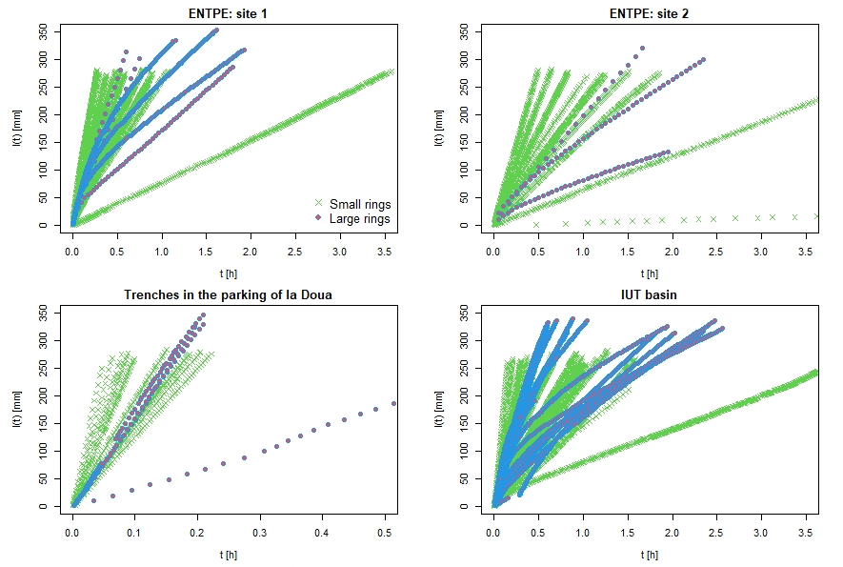
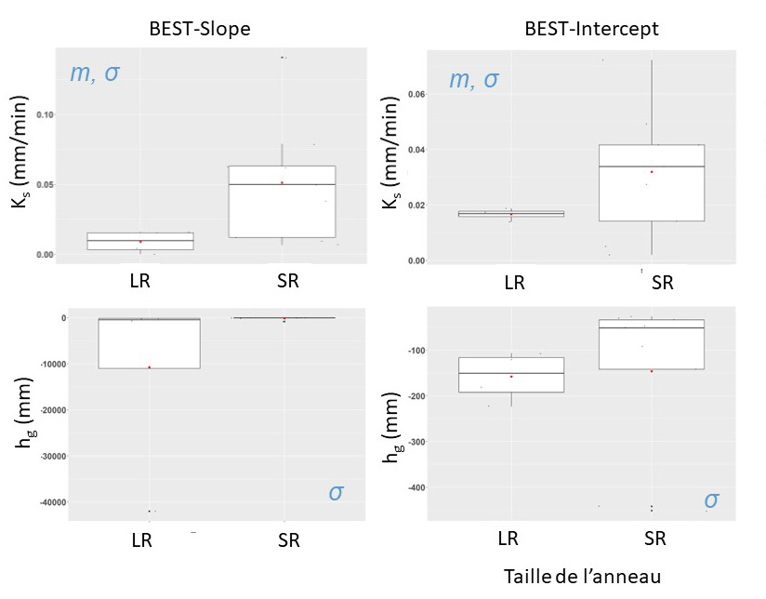
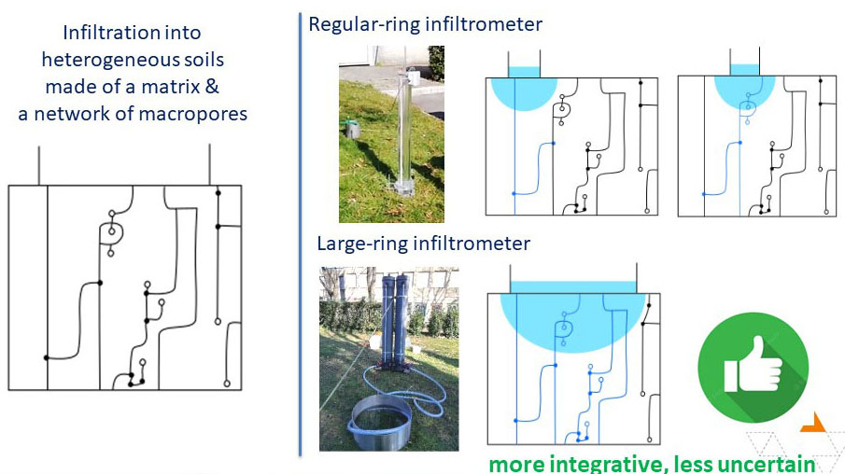
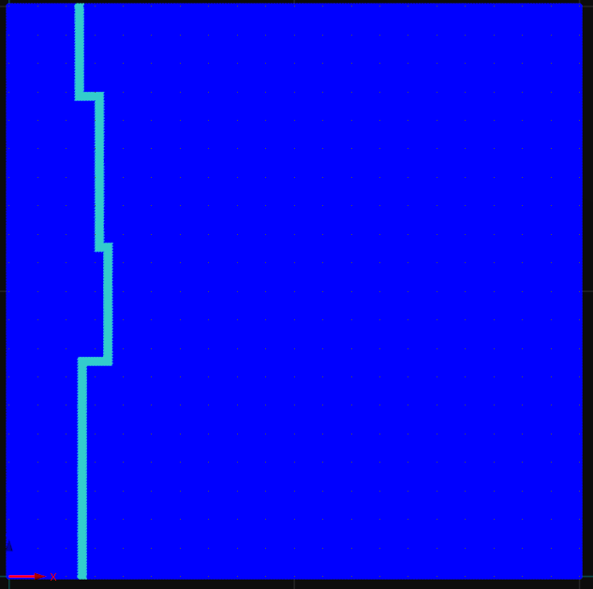
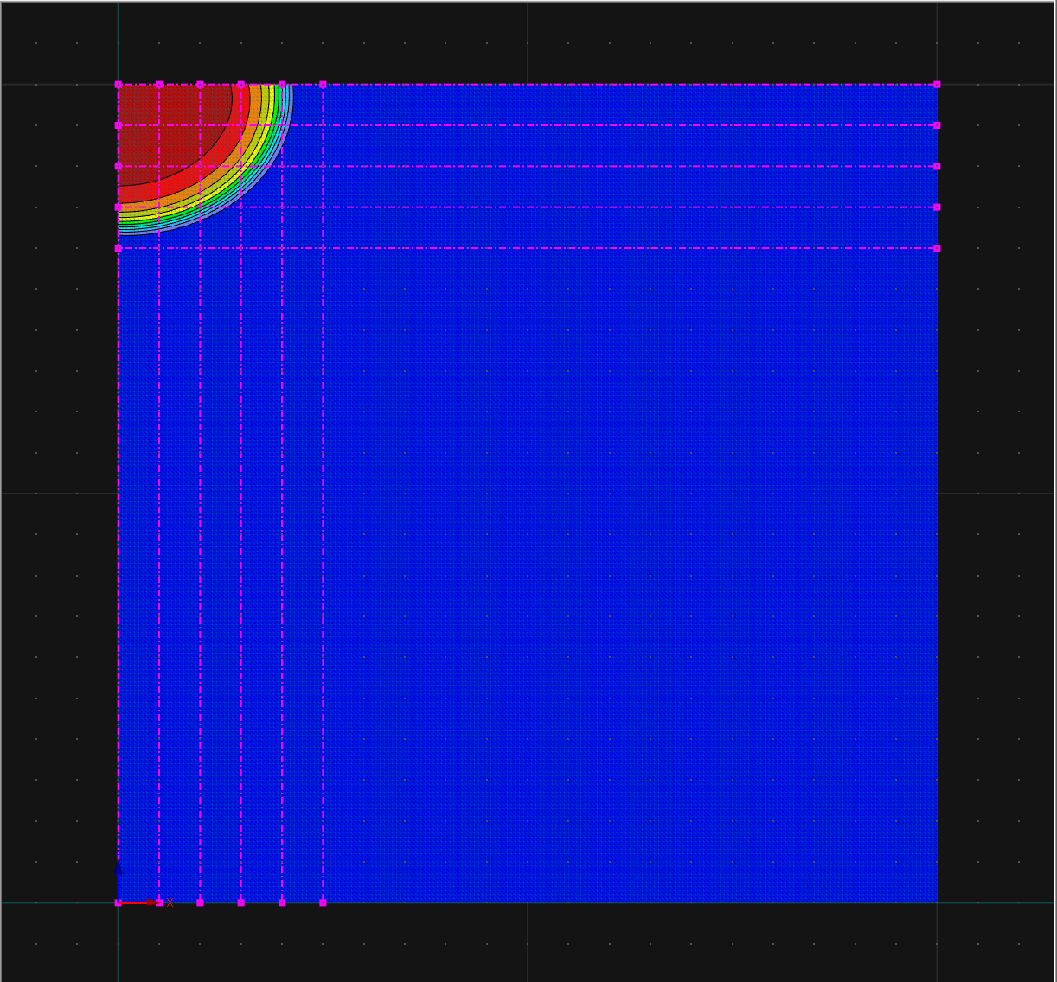
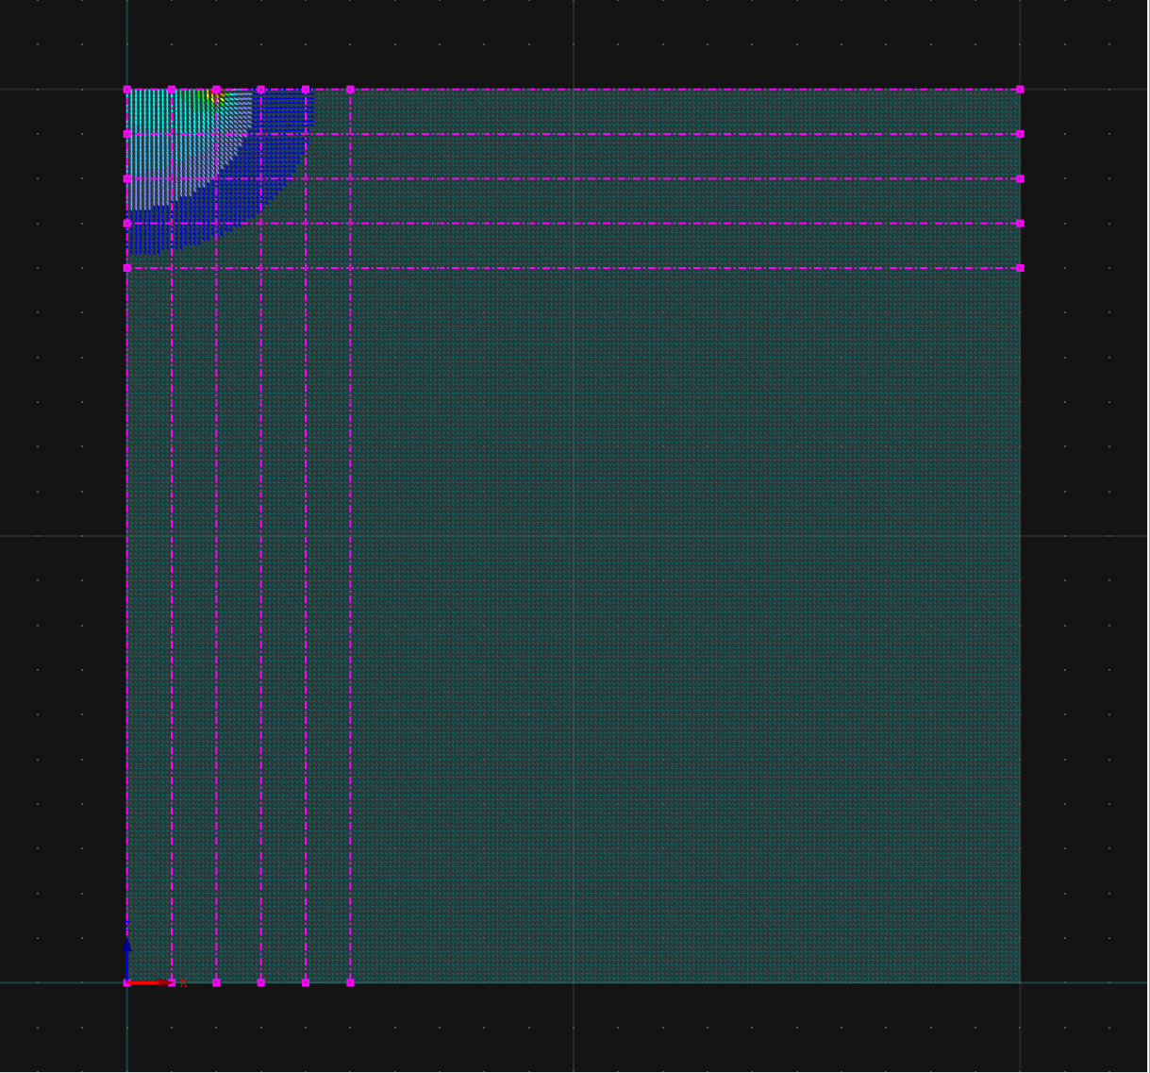
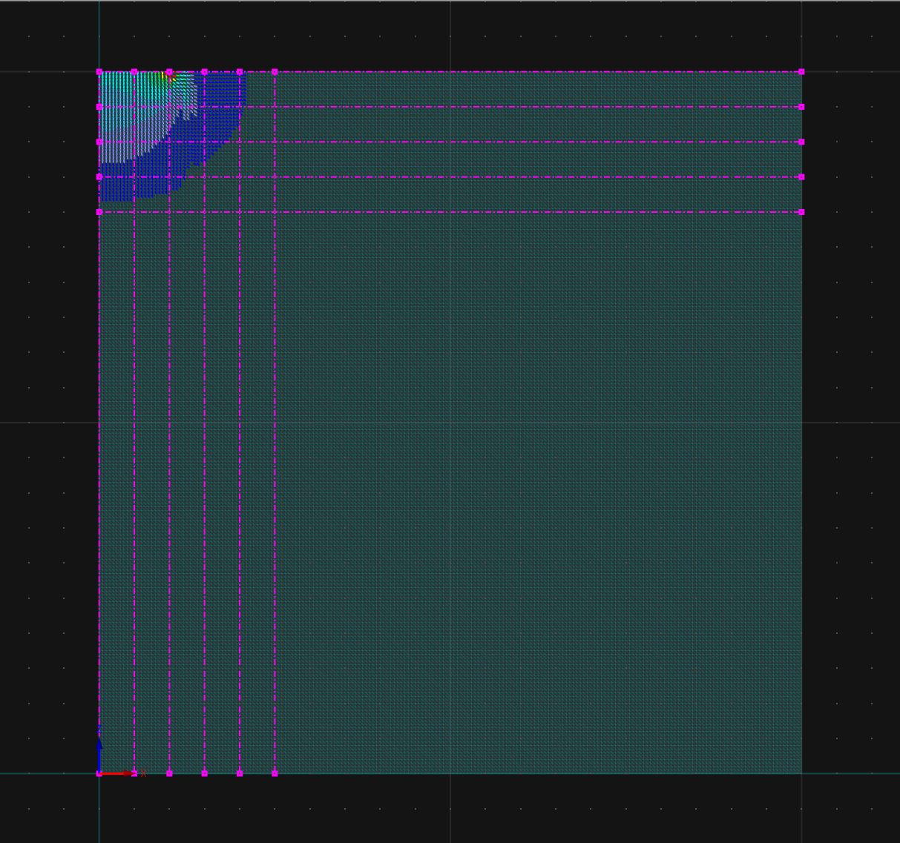
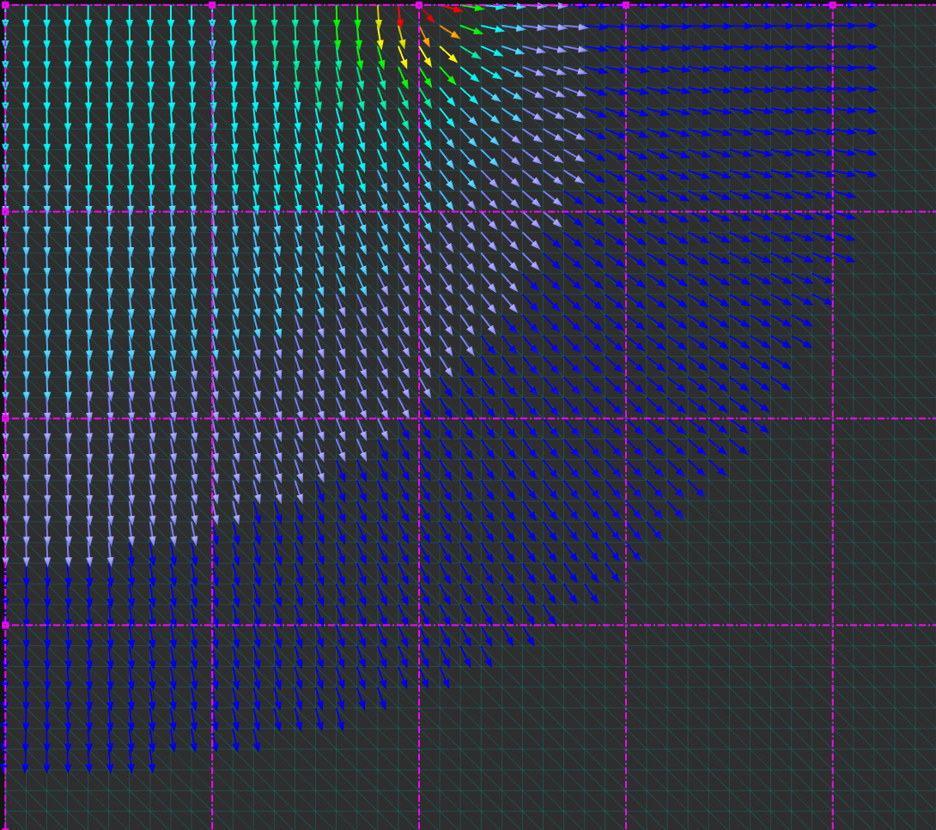
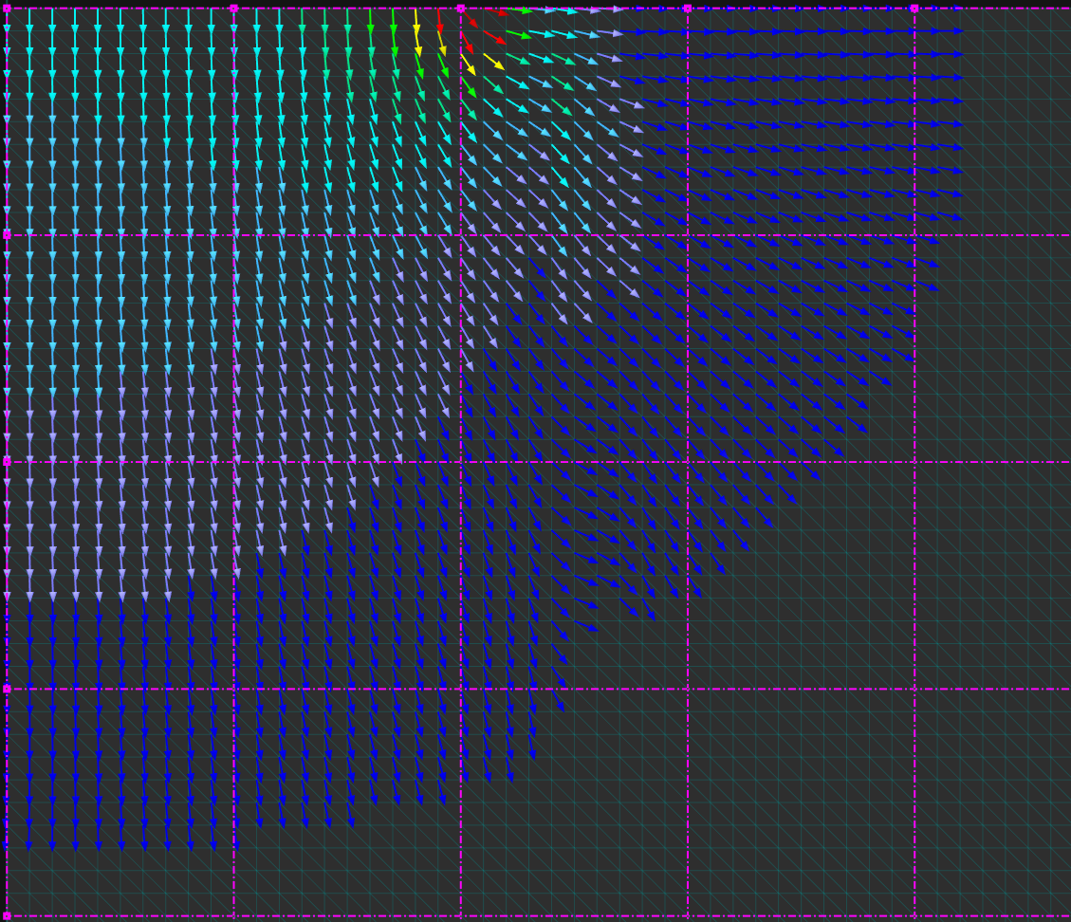
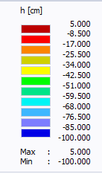
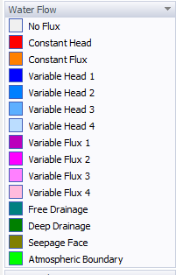
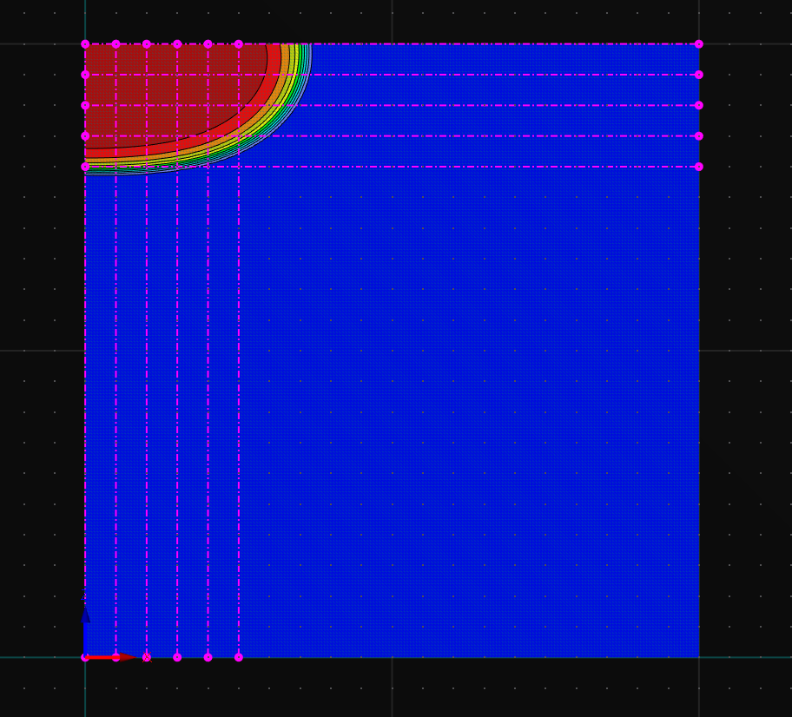
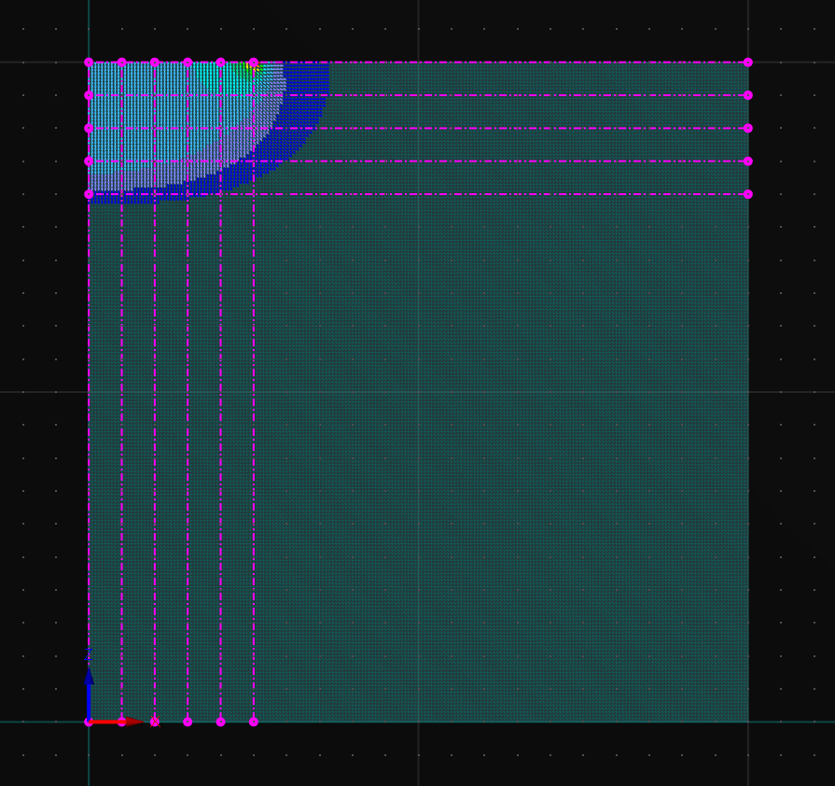
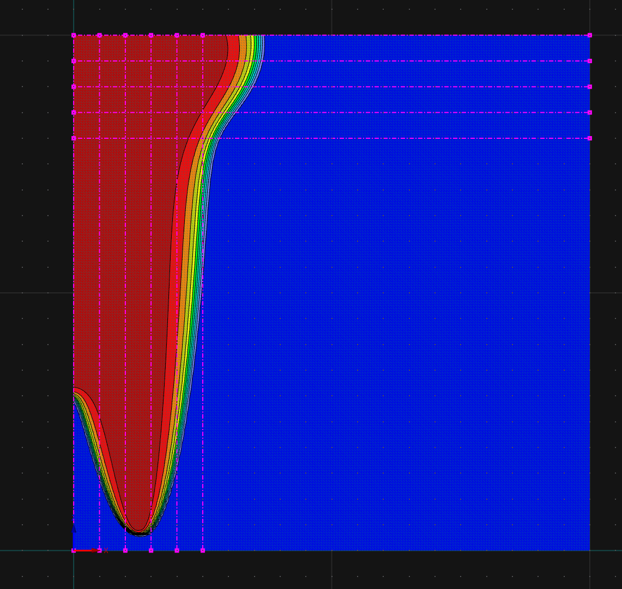
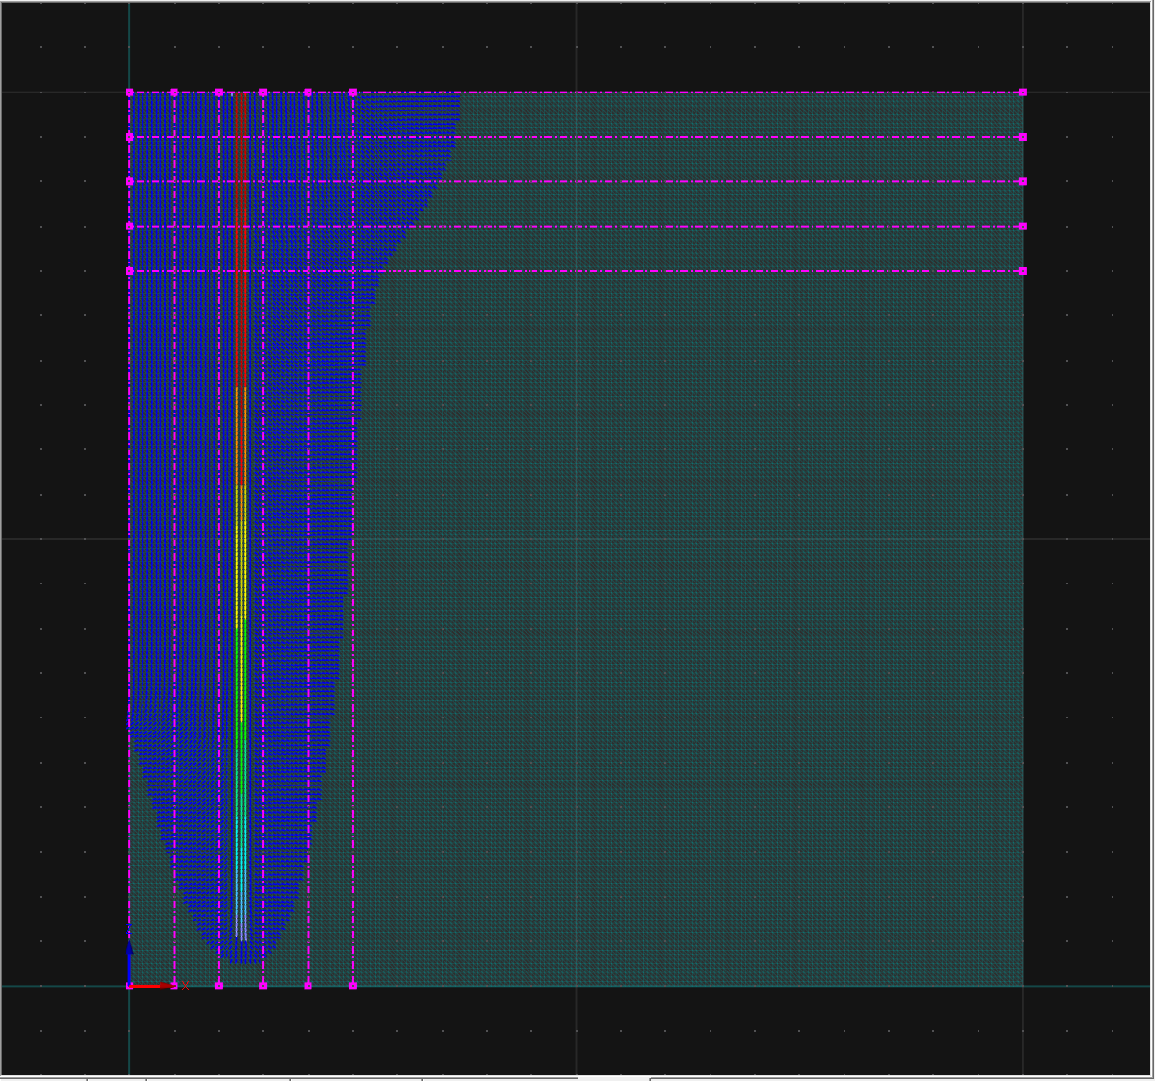
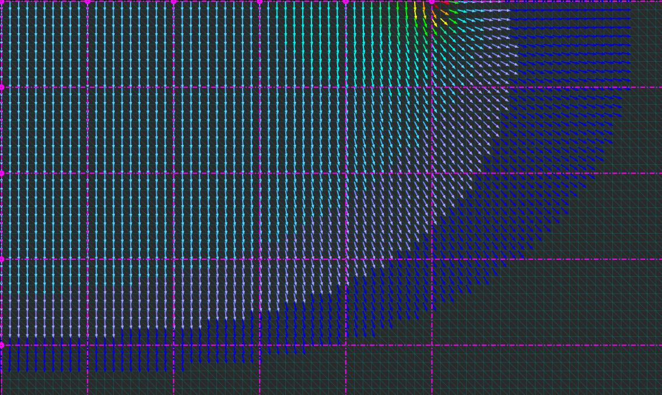
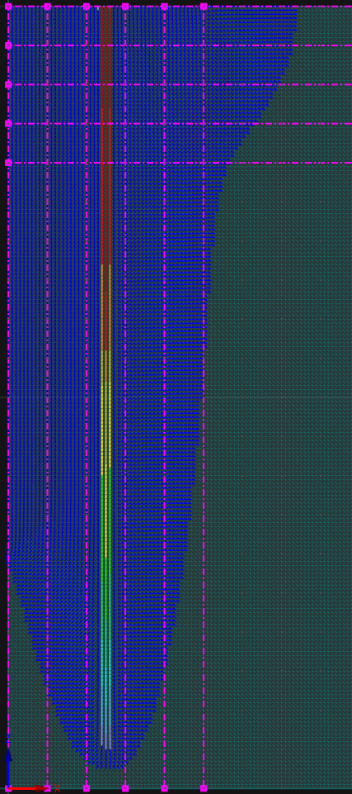
Infiltrometer ring-size effects on infiltration and macropore hydraulic activation
S. M. Saint-Louis^{1,2}, A. Traullé³, G. Fernandes¹, S. Di Prima⁴, R. Angulo-Jaramillo¹, and L. Lassabatere¹
EGU23-3409
Introduction
Modelling solute transfer
Experimental results
Climate and global changes will force cities to adapt to new drastic meteorological and hydrological conditions. Within this context, urban planning has pointed to the need to restore the natural water cycle in urban cities. Restoring the natural water cycle means promoting water infiltration in urban areas to facilitate groundwater recharge and minimize runoff at the soil surface. Several techniques were developed with this goal, including those aimed at infiltrating water in specific drainage works like sustainable urban drainage systems (SUDS). However, the management of SUDS requires monitoring their capability to infiltrate water and its permanence with time. In this study, we investigate the impact of the ring size on the results of water infiltration experiments, particularly regarding the activation of the soil macropore network and the hydraulic characterization of soils. We then performed infiltration experiments with rings of two contrasting sizes (7.5 cm versus 25 cm for the radius). BEST methods were then applied to derive the soil hydraulic parameters. Differences in estimate means and standard deviations were discussed for each hydraulic parameter. Numerical modeling was also performed using HYDRUS (Radcliffe and Simunek, 2018) with synthetic soils to explain the difference in results between ring sizes with the concept of partial activation of the macropore network depending on the ring size.
Experimental infiltration curves
Treatment with BEST method
Experimental setup and methodology
Main hypothesis of the study
Modeling synthetic cases
LR = Large Ring
SR = Small Ring
LR = Large Ring
SR = Small Ring
homogeneous soil
macropored soil
Same average between LR and SR
Standard deviations larger for SR
Smaller average for K_{s} for LR
Larger absolute value of |h_{g}| for LR
Standard deviations larger for SR
Modeling the effect of the macropore
Conclusion
(Concialdi et al., 2020)
r_{d}
r_{d}
r_{d}
r_{d}
r_{d}
r_{d}
In conclusion, we showed experimentally and numerically that the size of the ring radius s a key parameter regarding the activation of macropores. Large rings optimize the odds of sampling macropores and accounting for preferential flows. Conversely, using small rings may lead to sampling only the soil matrix and misestimating hydraulic parameters. In addition, small rings may sample contrasting conditions (matrix versus macropores only), leading to substantial variability of results. The estimated hydraulic parameters depend on the ring size regarding the hydraulic characterization of soils and the inversion of cumulative infiltrations. The use of large rings allows the sampling of a volume of soil large enough to adequately represent the soil as a whole and provide efficient hydraulic parameters.
SR = Small Ring
r_{d}
r_{d}
r_{d}
r_{d}
LR = Large Ring
Water infiltration Experiments:
SR: ring of 15 cm in diameter & ~2-3 cm of water at soil surface
LR: ring of 50 cm in diameter & ~8-10 cm of water at soil surface
Infiltration tests: Beerkan method for SR
Four experimentation sites in the Lyon area
Heterogeneous soils with macropores and lithological heterogeneity
Modeling water flow and infiltration into SR and LR devices:
Modeling water flow and infiltration for SR & LR and intermediate ring sizes
Homogeneous loamy soil versus macropored soils
Initial and boundary conditions related to Beerkan tests with the values of 5 cm of water depth at soil surface
Infiltration bulb & cumulative infiltration increased for SR
SR: small effect of the macropore
LR: very large impact of the macropore (thanks to activation)
Univ Lyon, Université Claude Bernard Lyon 1, CNRS, ENTPE, UMR 5023 LEHNA, F-69518, Vaulx-en-Velin, France, (2) Université d'Etat d'Haiti (UEH), (3) DIRE, Ministère de la Transition Ecologique, Besançon, France, (4) School of Agricultural, Forestry, Food and Environmental Sciences (SAFE), University of Basilicata, 85100 Potenza, Italy.
Concialdi P, Di Prima S, Angulo-Jaramillo R, Lassabatere L. 2019. A new acquisition system for an intensive soil hydraulic characterization. In EGU General Assembly Conference AbstractsVienna, Austria.

