Slide 1
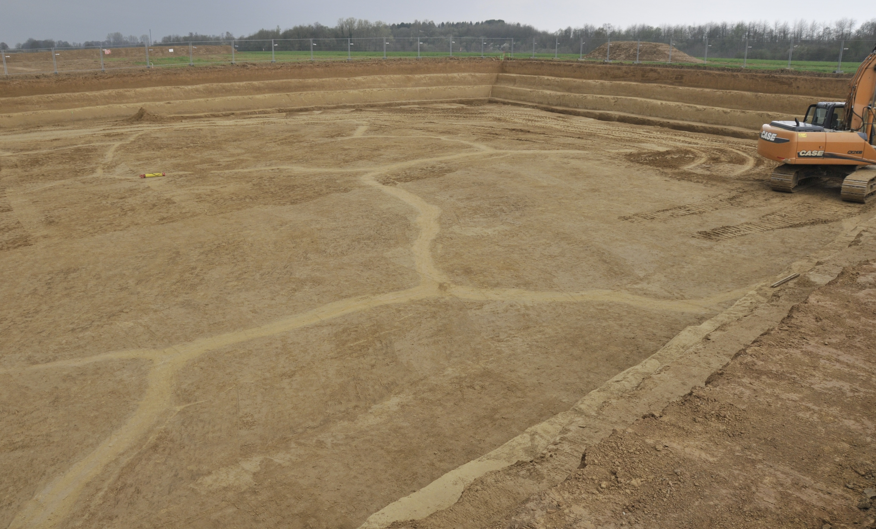






Paleodust cycle in Europe during the last climate cycle
Denis-Didier Rousseau^{1,2,3}
(denis-didier.rousseau@umontpellier.fr)
Pierre Antoine, Catherine Chauvel, Segolène Saulnier-Copard, France Lagroix, Christine Hatté, Peter Hopcroft & Markus Fuchs
Silesian University of Technology, Institute of Physics, Gliwice, Poland
University Montpellier, Geosciences, Montpellier France
Lamont-Doherty Earth Observatory of Columbia University, Palisades, NY 10964 USA
Havrincourt (Photo: P. Antoine)

Slide 2
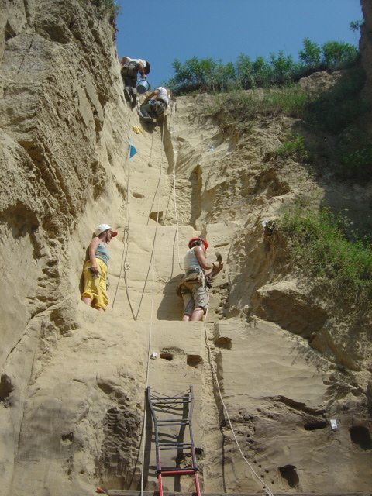
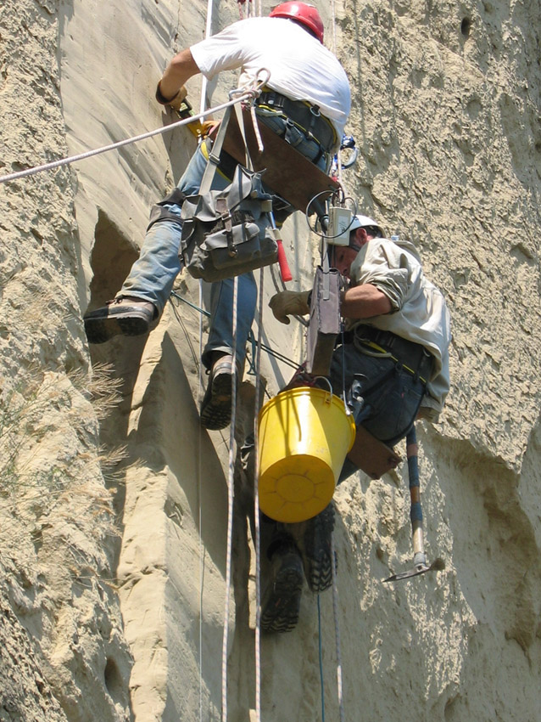
Outline
Abrupt changes in European loess sequences along 50°N
  the Nussloch Key reference sequence
  The paleosol toolkit
  Correlation with other European sequences
  Seeking the dust sources
Take home message
Acknowledgements
➔
➔
➔
➔
➔
➔
Pierre Antoine, Laboratoire de Géographie Physique, CNRS, Thiais, FR
Catherine Chauvel, Institut de Physique du Globe de Paris, CNRS, FR
Segolène Saulnier-Copard, Laboratoire de Géographie Physique, CNRS, Thiais, FR
France Lagroix, Institut de Physique du Globe de Paris, CNRS, FR
Christine Hatté, Laboratoire des Sciences du Climat et de l’Environnement, CEA, Saclay, FR
Peter Hopcroft, School of Geography, Earth & Environmental Sciences, University of Birmingham, UK
Markus Fuchs, Department of Geography, Justus Liebig University Giessen, DE
Return to Title slide
➔

Slide 3
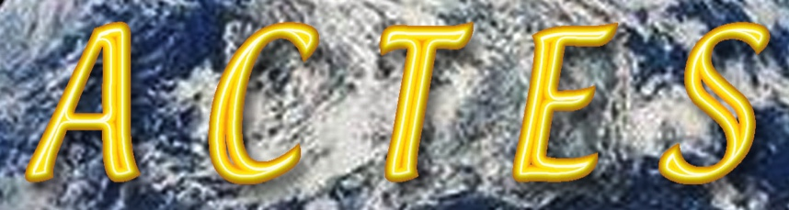
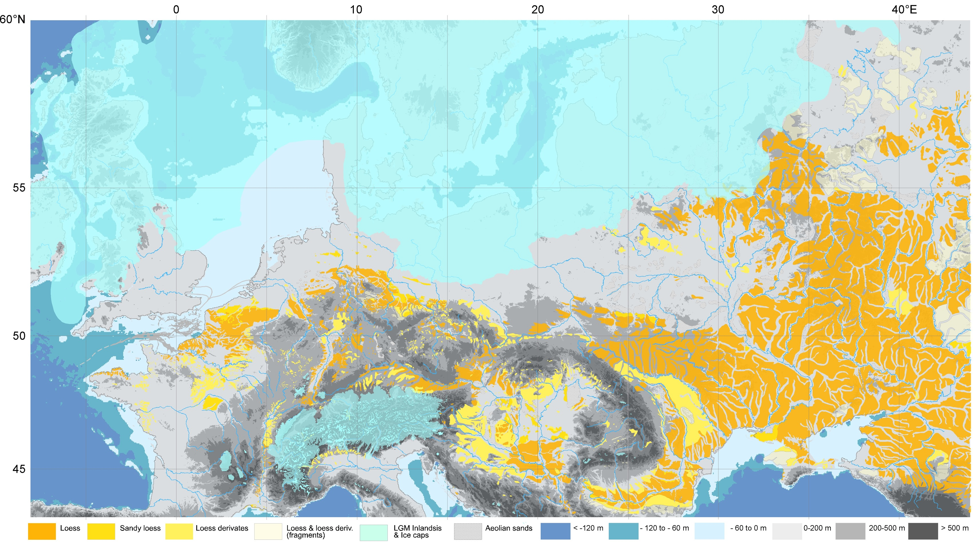
Abrupt changes in European loess sequences along 50°N
The studied sequences at high resolution
Remicourt
(BE)
Stayky
(UKR)
Dolni Vestonice
(CR)
Nussloch
(GE)
St Pierre-lès-Elbeuf
(FR)
Vyazivok
(UKR)
Achenheim
(FR)
Surduk
(SRB)
Harletz
(BGR)
Map by P Antoine modified
Return to main menu
➔

Slide 4
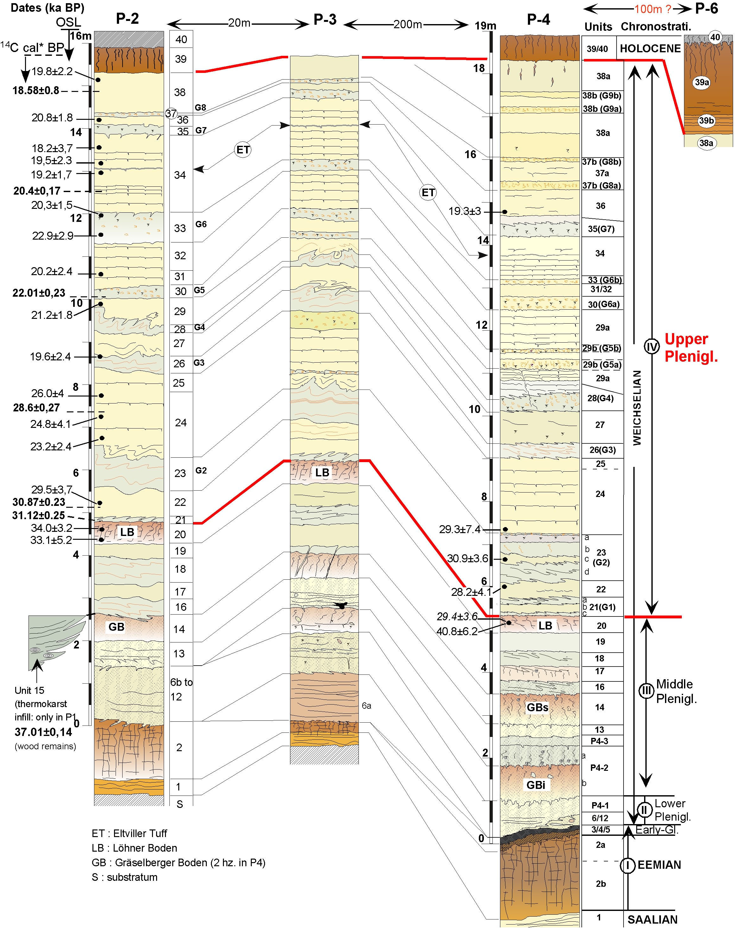
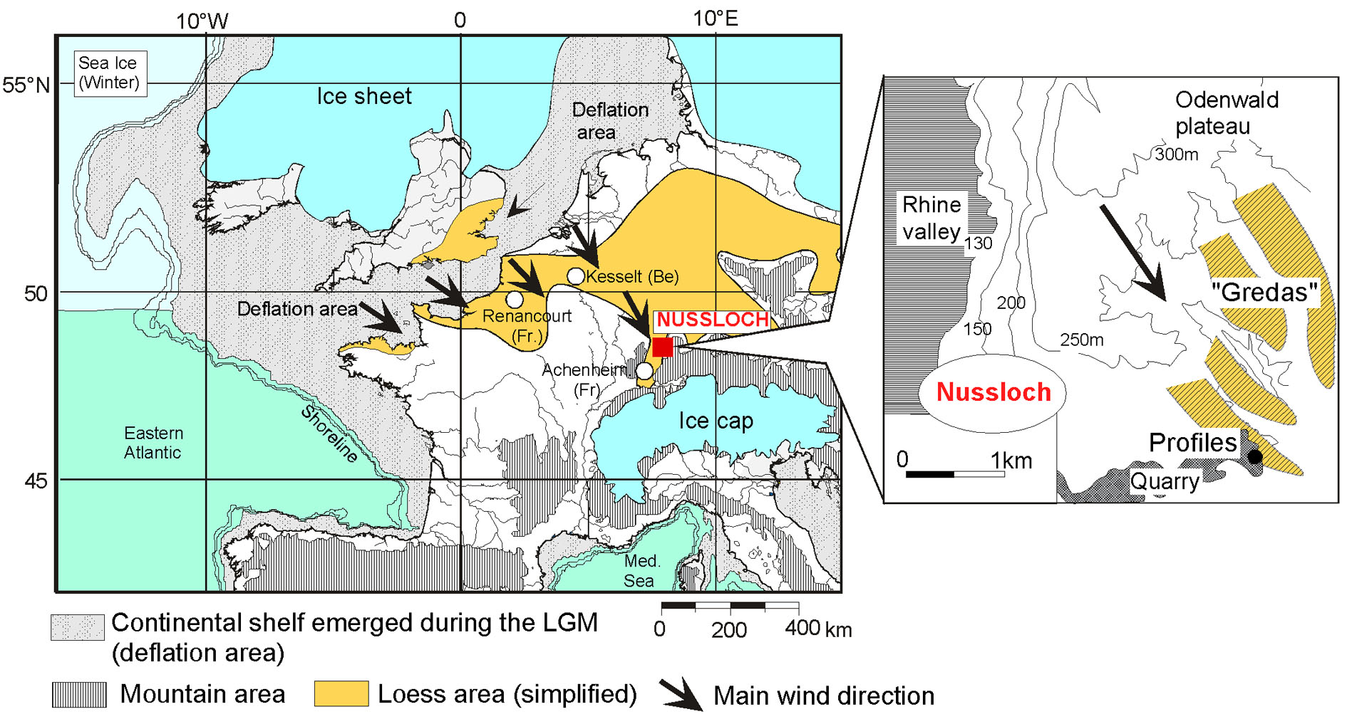
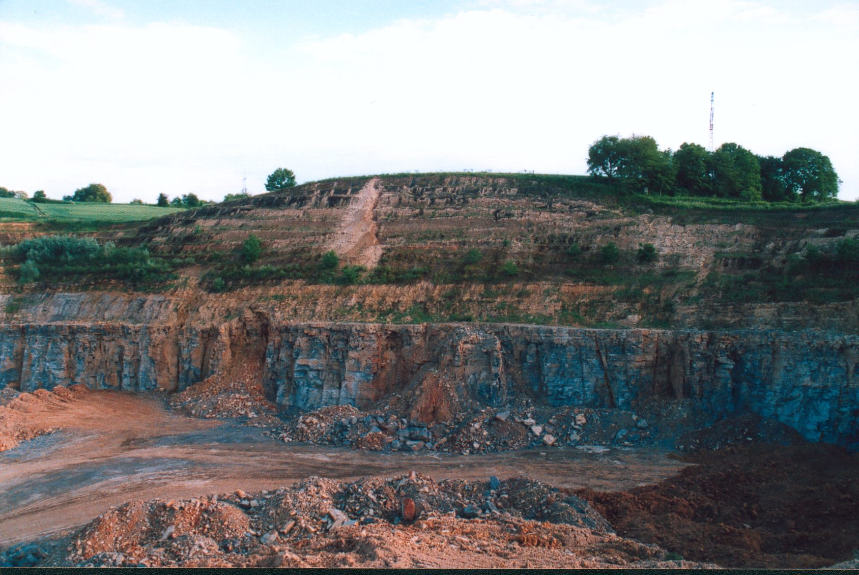
Abrupt changes in European loess sequences along 50°N
The Key sequence
Nussloch P2, P3, & P4 last climatic cycle series
P4 profile
MIS5-2
19m
55.7±12.6
MIS 7?-6
66.9±5.1
Tertiary
110±12
61.3.±9.9
Trias
122±17.8
162±15
57.0±5.7
54.2±4.2
Antoine et al. (2009, Quat. Sci. Rev.)
& Antoine et al. (2001, Quat. Int. Modified)
Return to main menu
➔

Slide 5
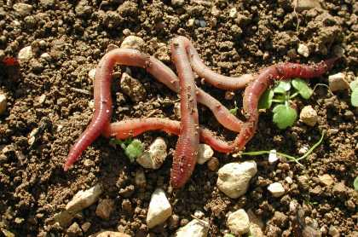

Abrupt changes in European loess sequences along 50°N
The Key sequence
Photo: Jean Meloche
Earth worm granule from Moine et al. (2017)
Moine et al. (2017, PNAS)
Return to main menu
➔

Slide 6
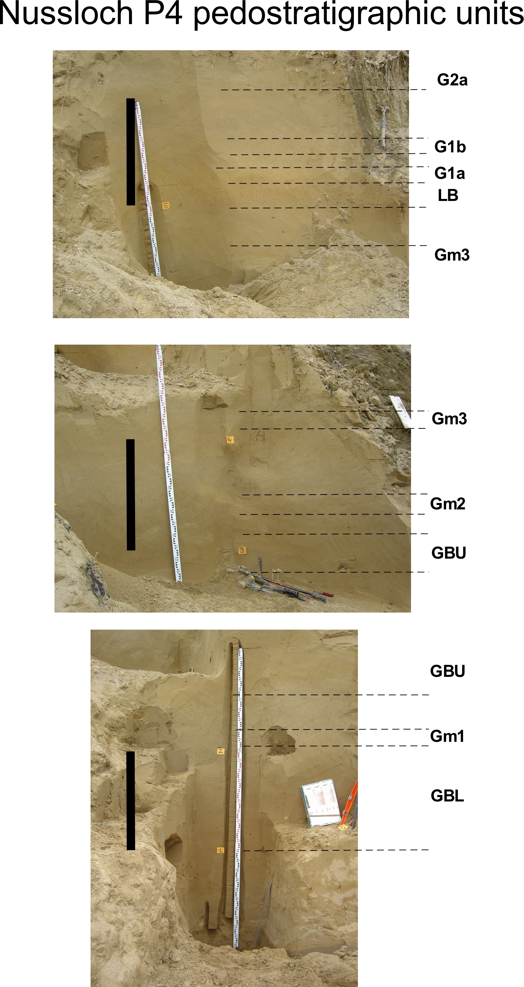
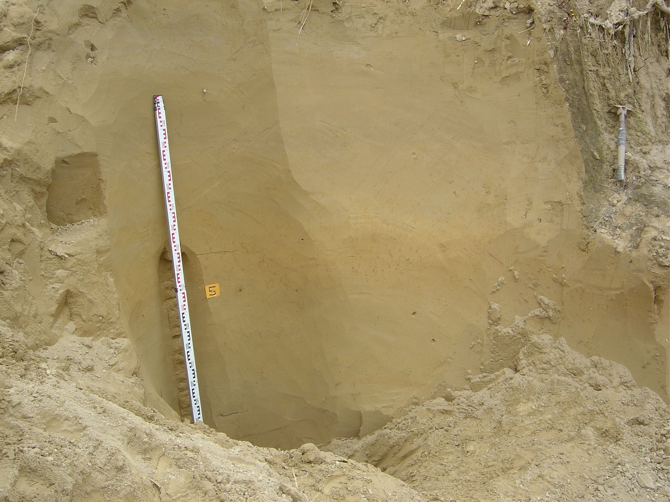
MIS (3 & 2) millennial changes in Greenland dust and European loess sequence
The paleosol toolkit
Tundra gley
1 m
Tundra gleys
Brown Arctic paleosol
Tundra gley
Tundra gley
1 m
Tundra gley
Brown Arctic paleosol
Brown Arctic paleosol
Tundra gley
1 m
Brown Arctic paleosol
Rousseau et al 2017 QSR
Return to main menu
➔

Slide 7
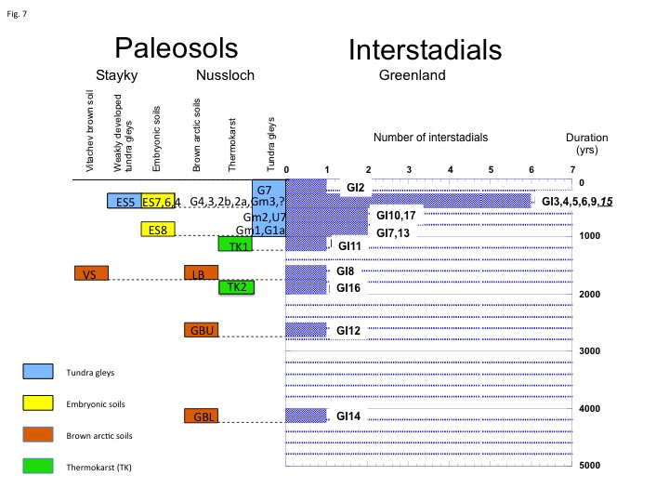
Abrupt changes in European loess sequences along 50°N
The paleosol toolkit
2 categories of paleosols corresponding to 2 different classes of duration along the 50°N transect
Rousseau et al. (2017, Quat. Sci. Rev.)
Return to main menu
➔

Slide 8
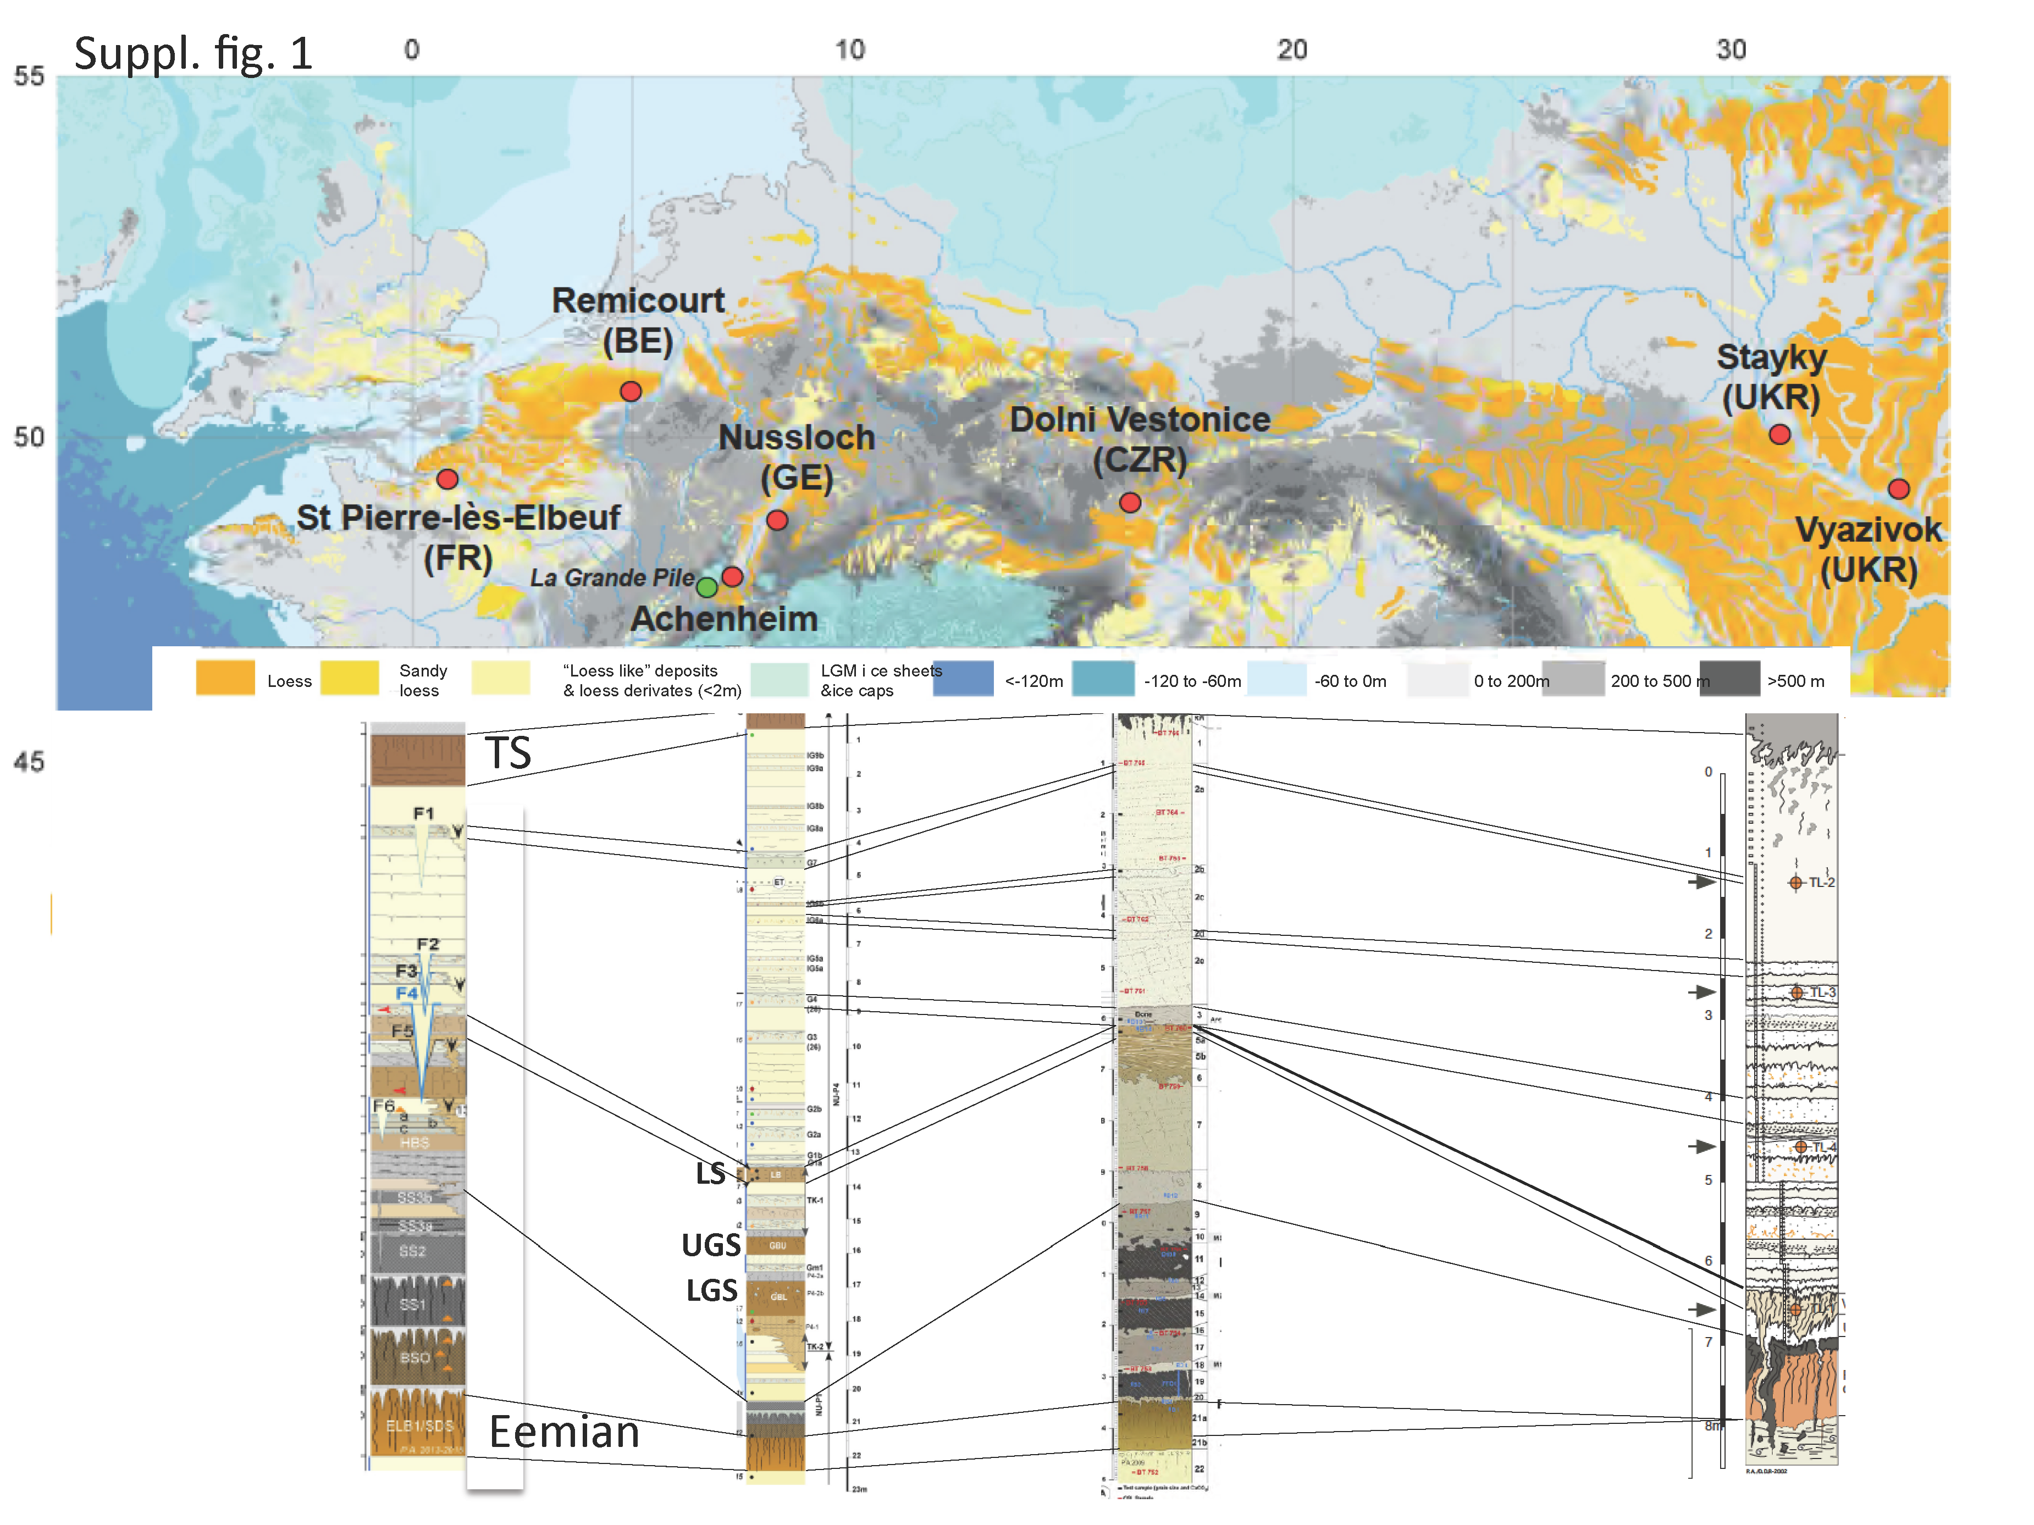
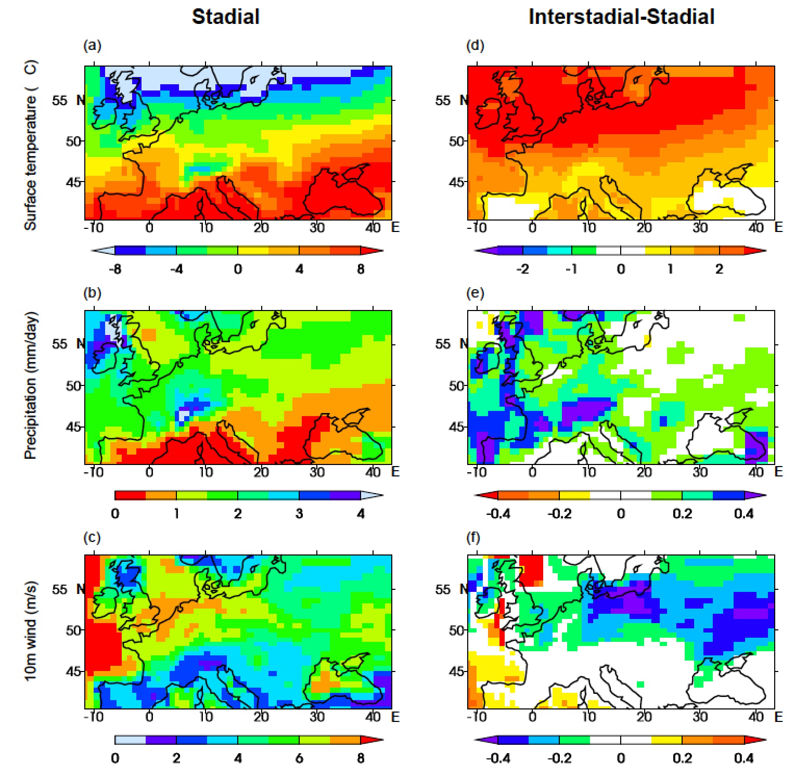
Abrupt changes in European loess sequences along 50°N
Correlations with other loess sequences at 50°N
Climate parameters over Europe during Greenland stadial (a,b,c) & comparison interstadial-stadial (d,e,f)
Rousseau et al. (2017, QSR)
Averages for the “dusty season” (Feb-June) with dust emitted and transported during stadials
Rousseau et al. (2014, GRL)
adapted from Sima et al. (2013, Clim. Past)
Return to main menu
➔

Slide 9
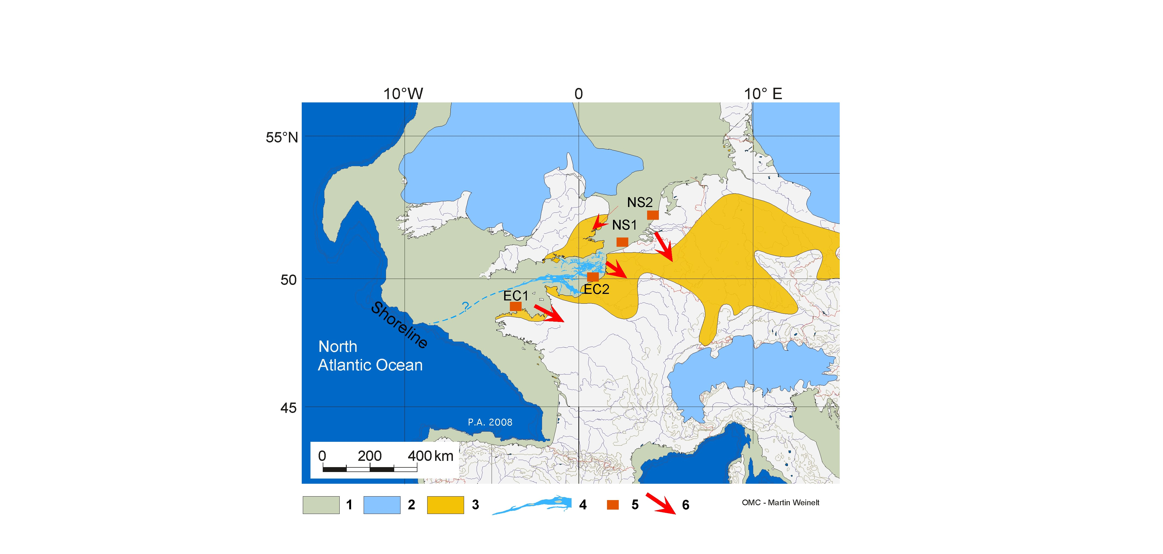
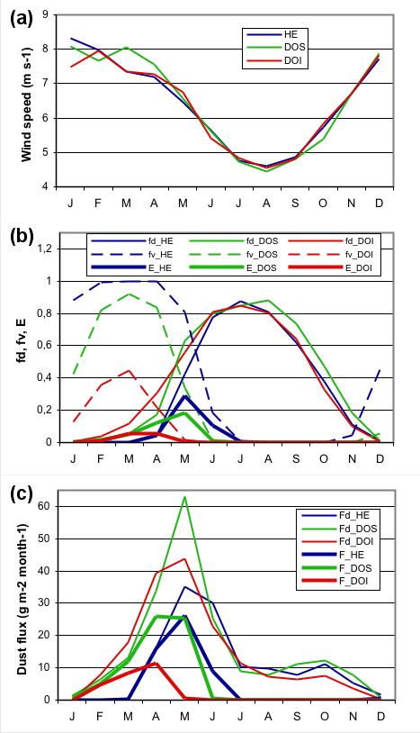
10m wind
speed
The dusty season: not winter, when wind is strongest, but roughly springtime: 3 or 4 months, after snow melts and soil dries up, but before vegetation becomes too extended. The colder the climate, the more the dusty season is shifted towards summer
Surface conditions
Annual cycles of wind speed, surface conditions (fd, fv) and dust flux
(6-hourly data from four representative grid boxes)
fd represents the snow cover and soil moisture effects
E combines soil-water and vegetation effects
fd (dry soil fraction)
fv (vegetation factor)
E erodible fraction
Dust
flux
Fd (dust flux corresponding to dry soil fraction)
F (dust flux corresponding to erodible fraction)
Sima et al., QSR, 2009
Return to main menu
➔
11/14
Notes:
The dusty season: not winter, when wind is strongest, but roughly springtime: 3 or 4 months, after snow melts and soil dries up, but before veget become too extended. The colder the climate, the more the dusty season is shifted towards summer

Slide 10
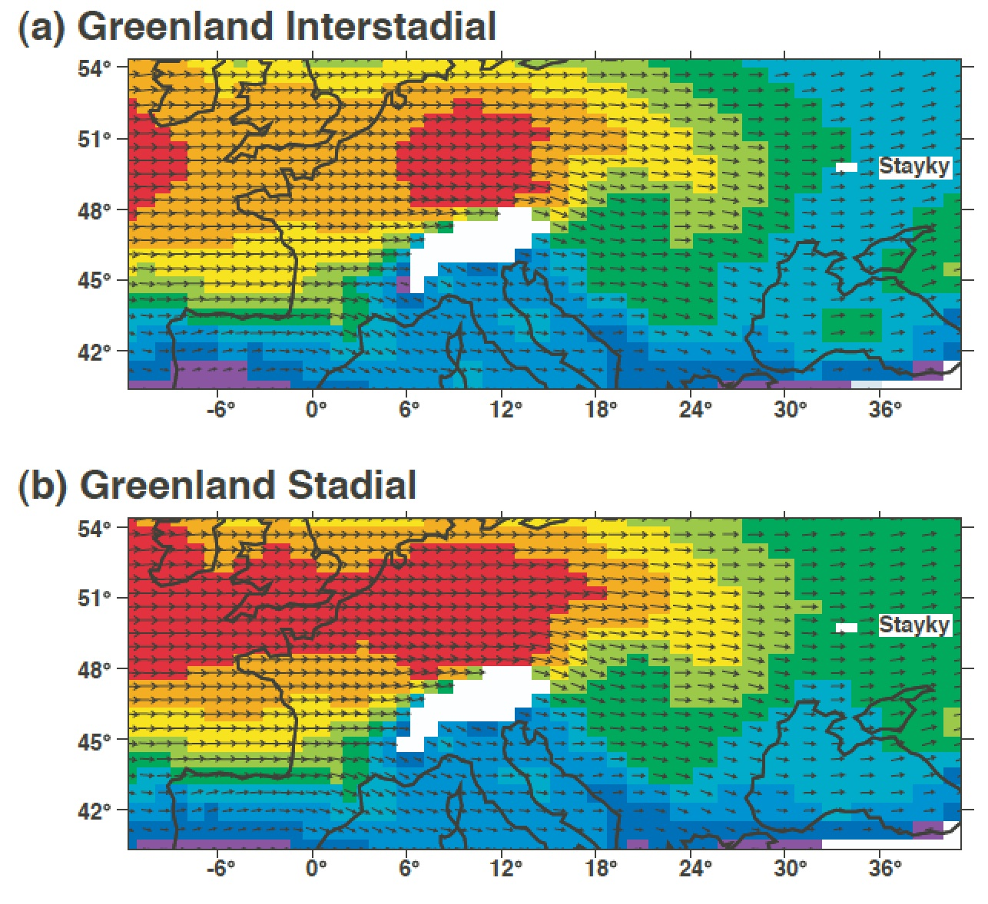
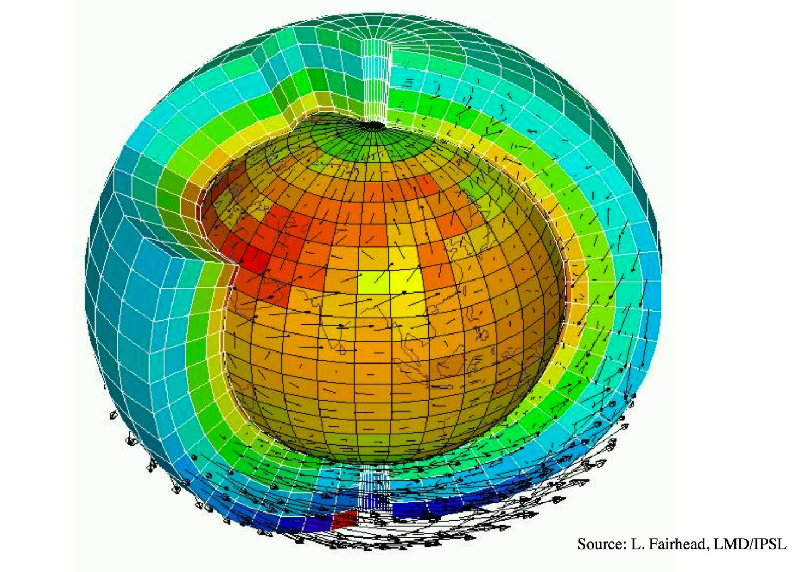
What is the next step? Earth System modeling
Average wind field at 850 hPa
Average wind field at 850 hPa in Europe at temperate latitudes for two simulated climate states associated with a Greenland
Interstadial, and a Greenland Stadial
(after Sima et al., 2009)
Rousseau et al 2011 Clim Past
Return to main menu
➔

Slide 11
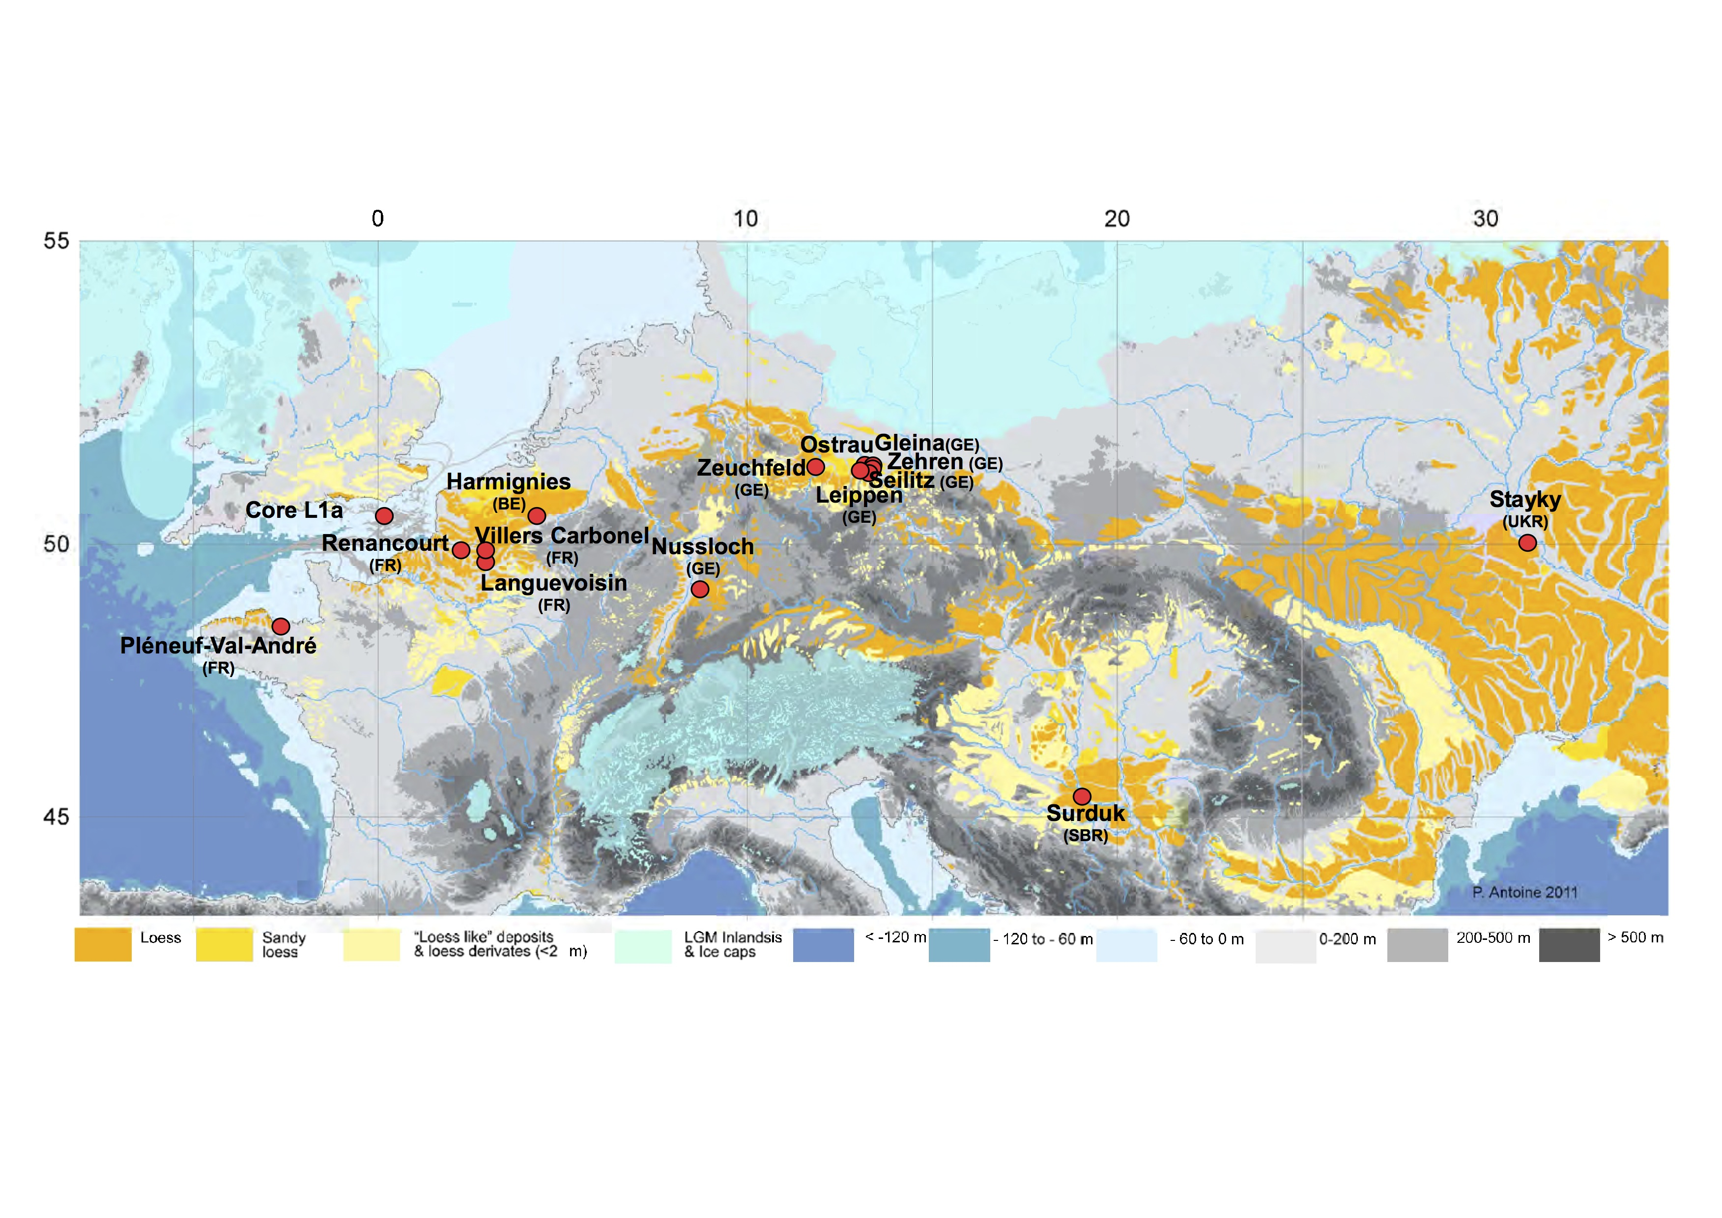
Conclusion
Search for the main dust sources and transport: combined geochemical and modeling studies
All the analyzed samples, from sites roughly located at 50°N, have the same stratigraphical position, LGM, but Nussloch samples also have a chronological distribution, from 29 ka to 18 ka
Rousseau et al. (2014, GRL )
Return to main menu
➔

Slide 12
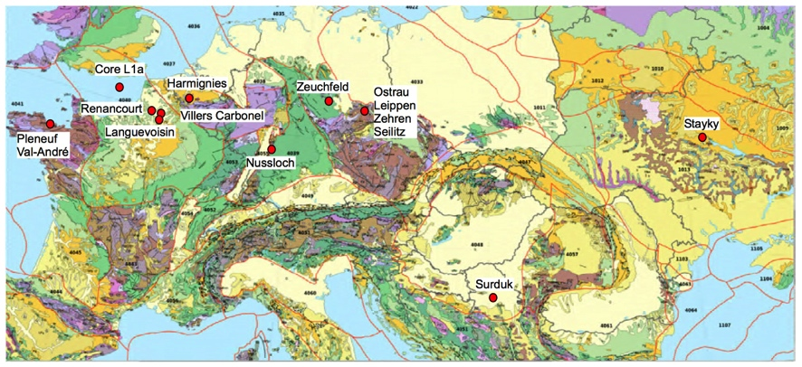
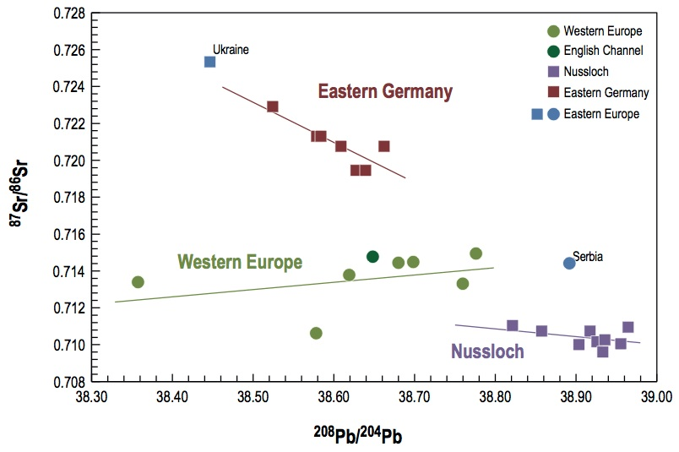
Search for the main dust sources and transport: combined geochemical and modeling studies
When combined, Sr and Pb isotopic compositions demonstrate that each individual area has its own isotopic characteristics, a feature that requires different source regions
English Channel
Rousseau et al. (2014, GRL)
Return to main menu
➔

Slide 13
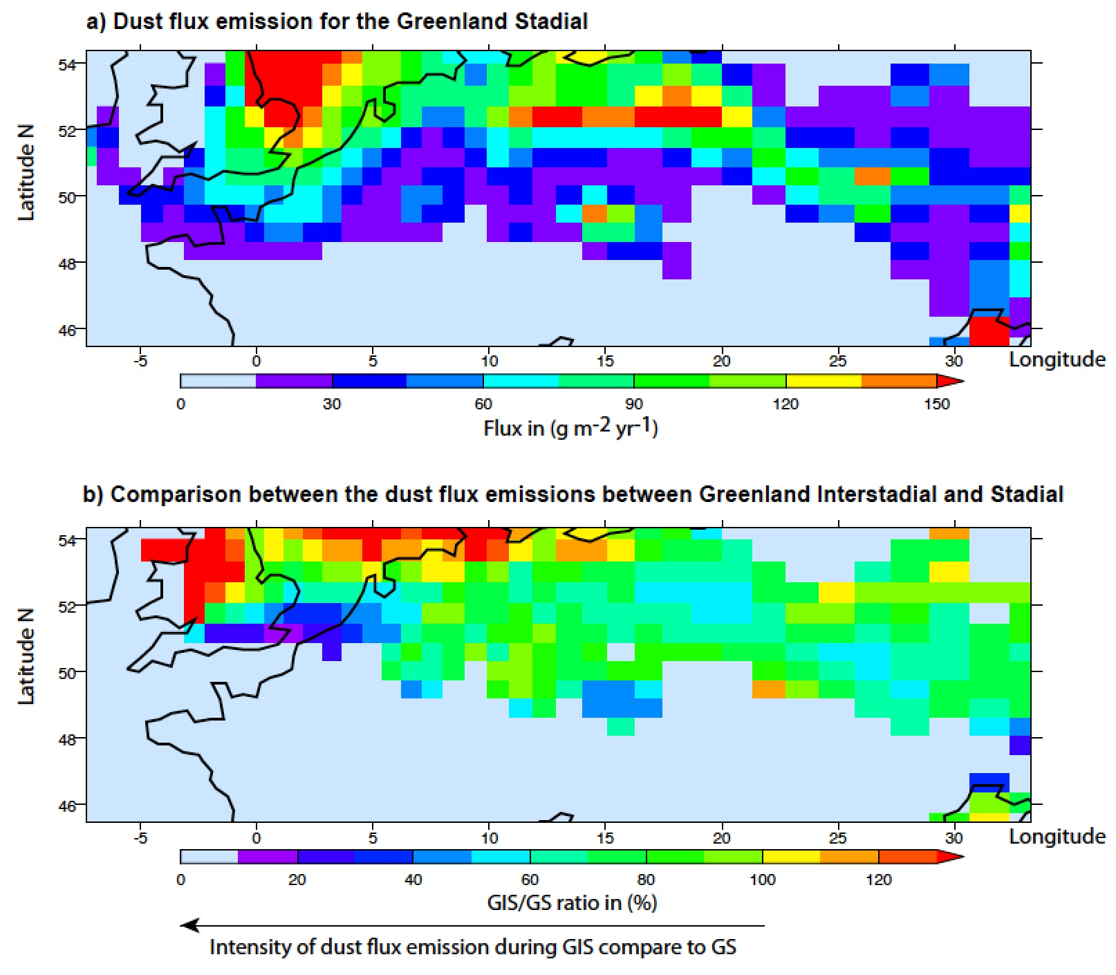
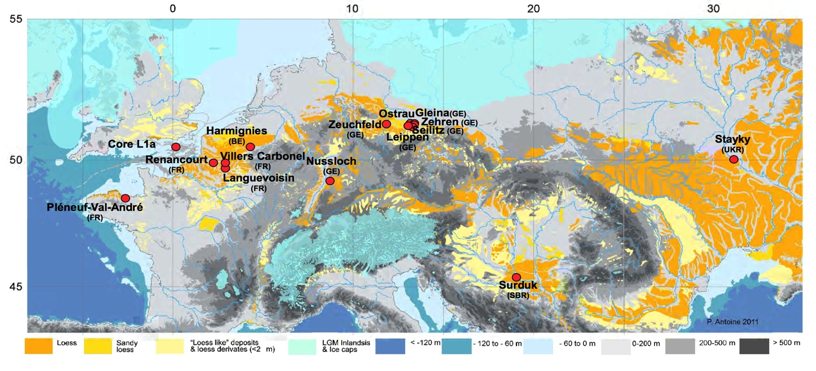
Search for the main sources and transport: combined geochemical and modeling studies
1) The deposited materials originate from relatively proximal sources, which differ between Western Europe, the Rhine Valley, East Germany, and Eastern Europe as proposed by the modeling experiment
Stayky
Nussloch
2) This implies a transport over distances of hundreds of kilometers at low elevation, probably in the atmospheric boundary layer as observed in modern major dust storms.
Nussloch
Rousseau et al. (2014, GRL)
Rousseau et al. (Clim Past 2011)
Return to main menu
➔

Slide 14
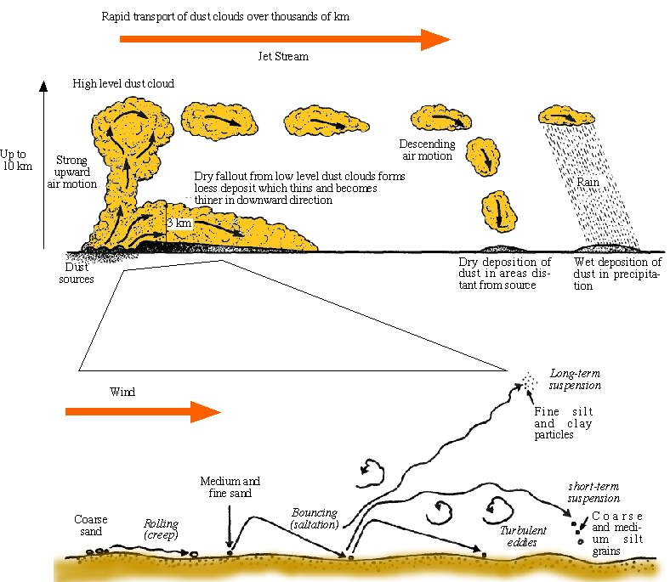
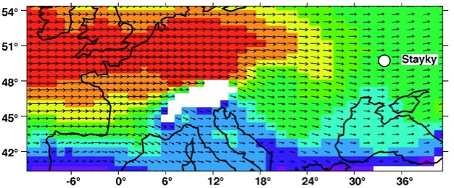
Interpreted paleodust transport
From Pye & Zhou (1989, Palaeo-3; modified)
Dust record in Greenland
Dust record in European loess sequences
Coarser
Grain size
Finer
Average annual wind speed at 850 hPa
after Sima et al. (2009, Clim. Past)
General interpretation of the dust transport
Nussloch
Return to main menu
➔

Slide 15
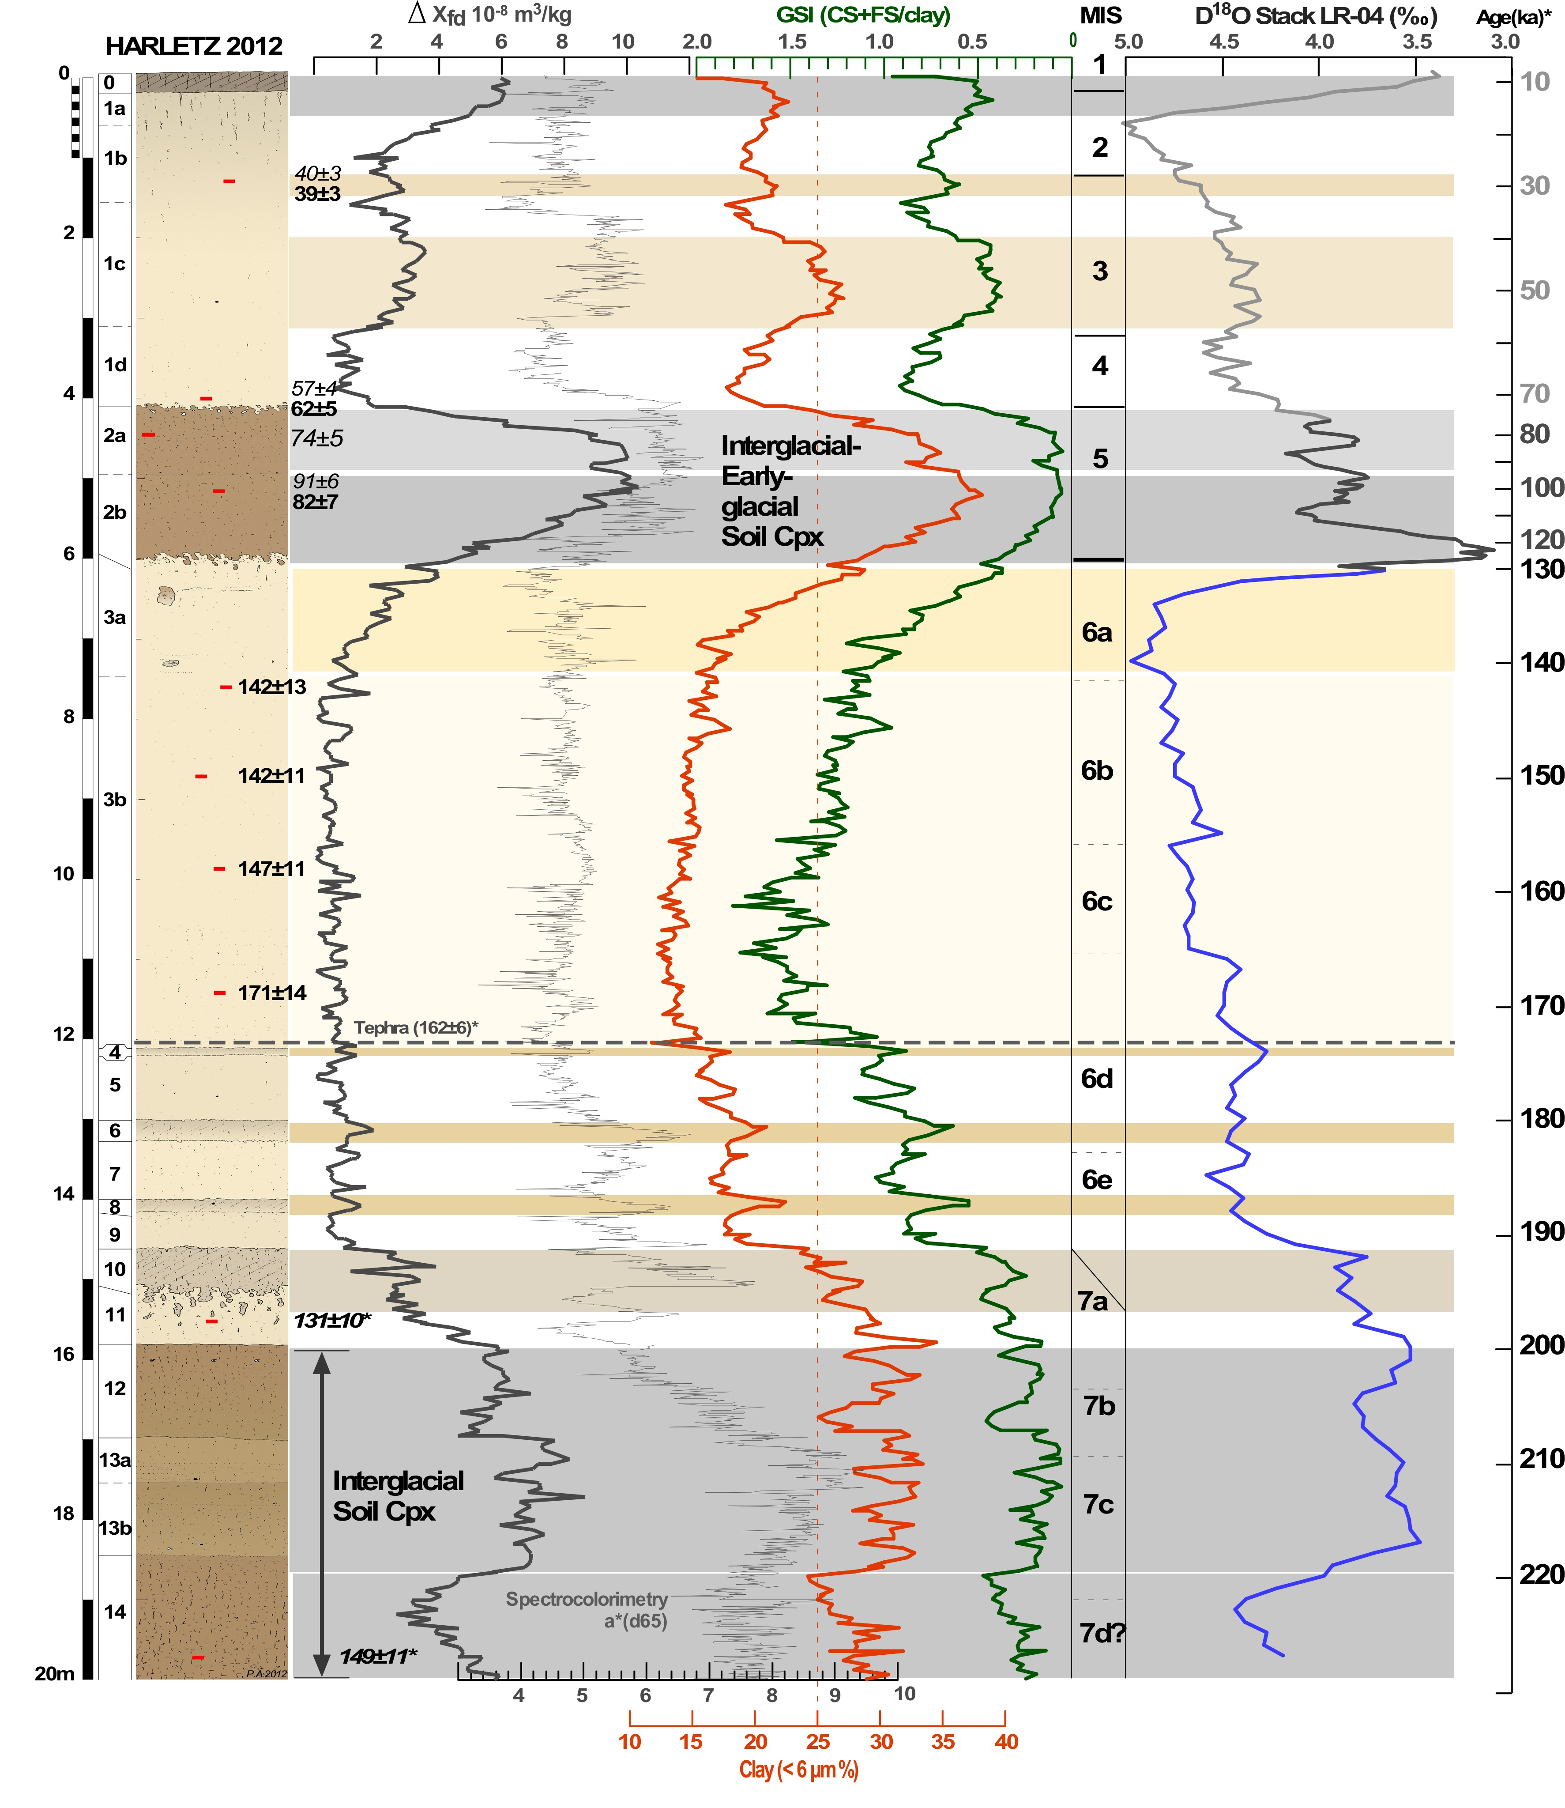
Marine
iso. strati.
Take home message: A - the last climate cycle is not unique! (1/2)
Top soil
2-4
Luminescence dates assign the lower loess deposits to MIS6, in agreement with the age of about 170 ka for the tephra layer correlated with Vrico B ignimbrite and Pitigliano tuff South of Roma recently redated from Lake Ohrid record Lleicher et al. 2016)
5
ISm
ISm
ISm
Within the MIS6 loess deposit, 5 paleosols have been observed below the tephra
They are the counterparts of those observed in the last climate cycle also in European loess sequences (see Nussloch record).
Furthermore, 5 more are described above the tephra from environmental parameters like: magnetism, clay content, grain size.
6
ISm
ISm
Tephra layer, identified by magnetism and glass shards
ISp
ISm
ISp
ISp
ISp
We have therefore identified 10 warm events interpreted as interstadials between 192 and 130ka (Rousseau et al., clim. Past, 2020)
7
Interstadials deduced from the measured parameters (ISm) and from paleosol observation (ISp).
Pedotratigraphy and variation of some parameters (from Antoine et al. QSR 2019, modified), dates from Lohmax et al. (Boreas 2019).
Return to main menu
➔

Slide 16
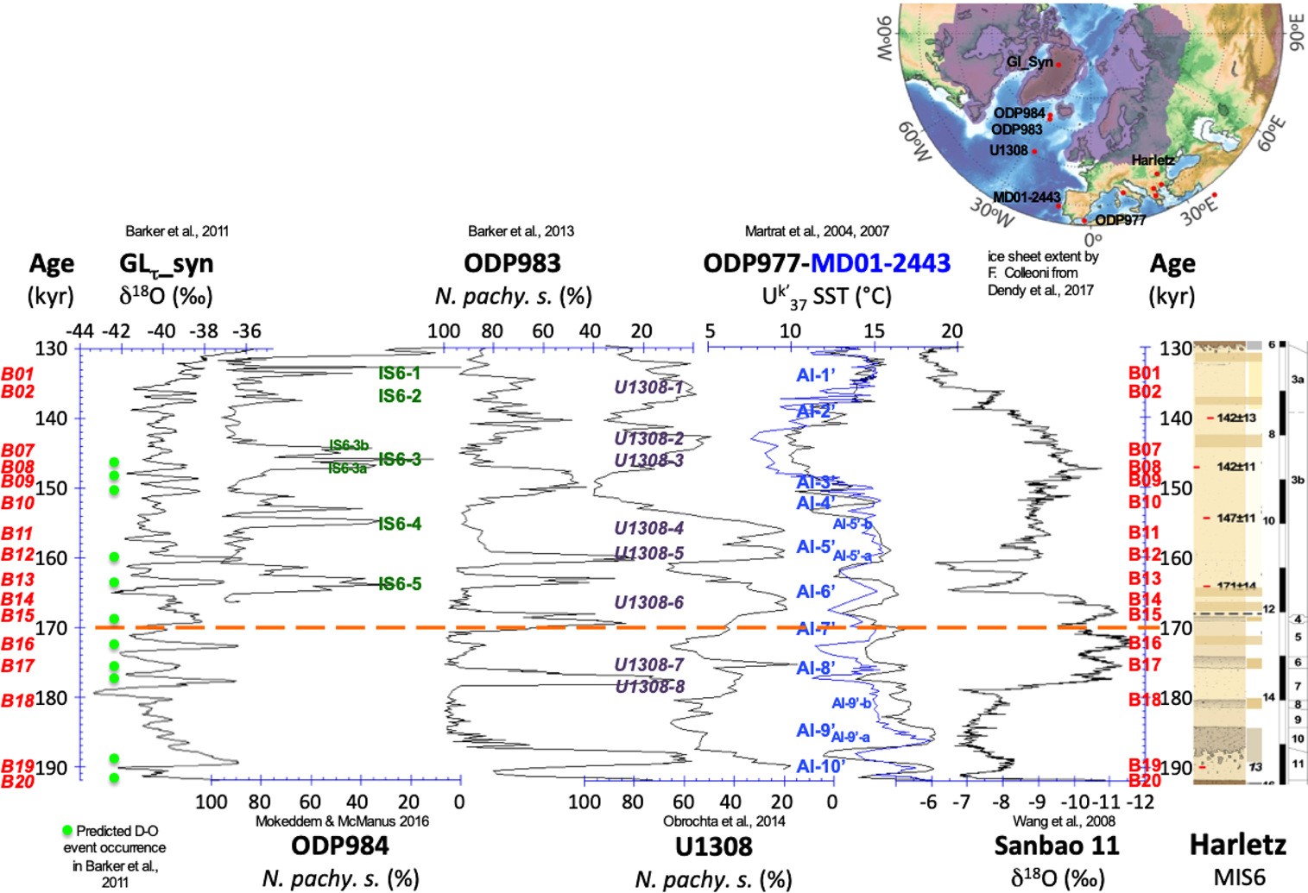
Take home message: A - the last climate cycle is not unique! (2/2)
Comparison of northern Atlantic records of MIS6: North Atlantic SST (N. pachy s) from cores ODP984, 983 & U1308), Iberian margin and Alboran Sea SST (alkenone MD01-2443, ODP 977), and Greenland synthetic δ¹⁸O . Labels of the interstadials identified in the marine and speleothem records. (Rousseau et al., Clim. Past, 2020)
Return to main menu
➔

Slide 17

Dolni Vestonice
(CZR)
DV
HV
Take home message: B - our last results show that dust transport wasn’t only regional or local
HT
NU
SU
HA
UK
ZE
Rousseau et al., unpublished
LE
OS
GE
Return to main menu
➔

Slide 18
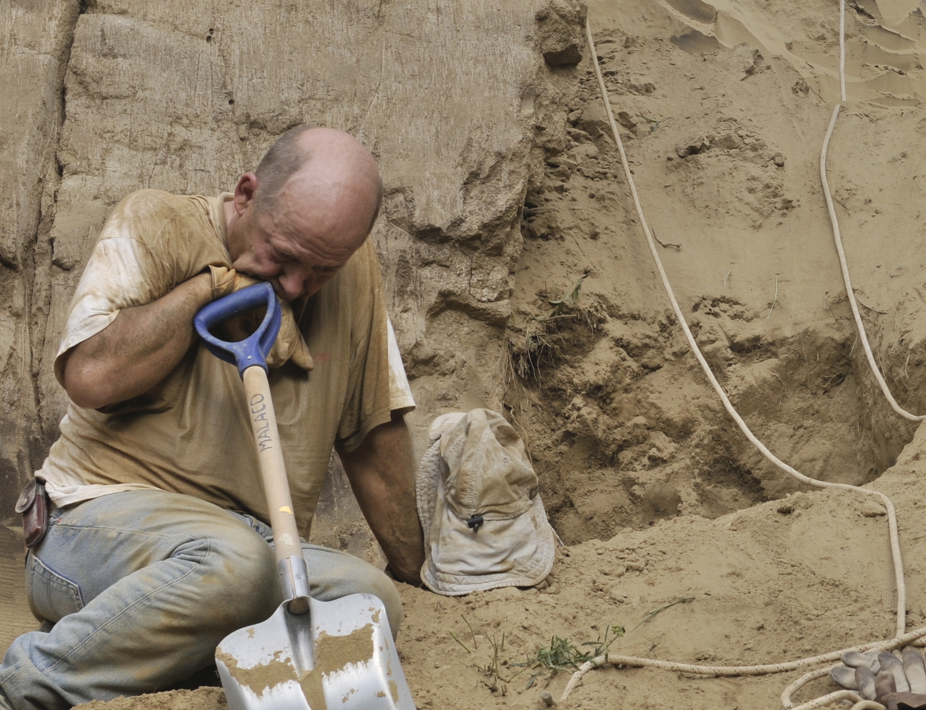



Acknowledged supports from CNRS programs and French funding agency (ANR) Blue Sky program
So stay tuned,
Thank you for your attention
Return to main menu
➔

