Slide 1
SUPPLEMENTARY MATERIAL: Quantifying sources, pathways, and controls on sediment transport dynamics in two rivers on James Ross Island, Antarctica
Christopher D. Stringer, John F. Boyle, Filip Hrbacek, Kamil Laska, Ondřej Nedělčev, Jan Kavan, Michaela Kňažková, Jonathan L. Carrivick, Duncan J. Quincey, and Daniel Nývlt
gycds@leeds.ac.uk
@sedsstringer
NERC Panorama DTP

Slide 2
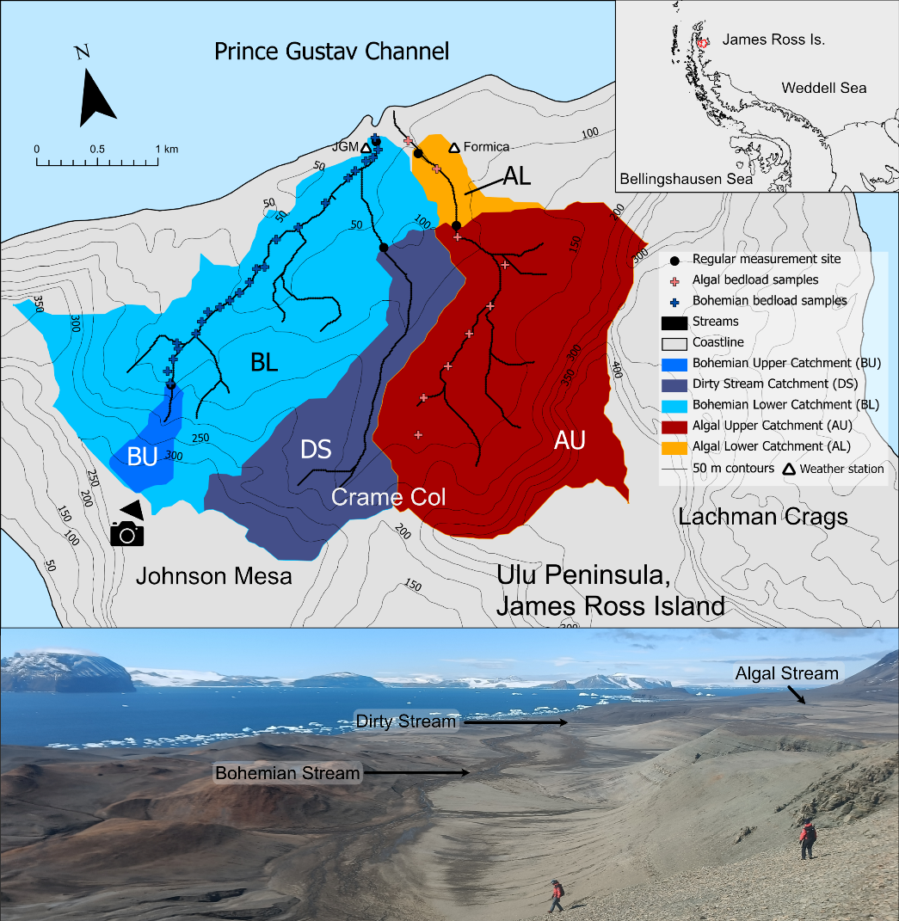
River sub-catchments
We measured suspended sediment load and discharge at five “regular measurement sites”.
These five sites were chosen to capture the water and sediment movement of the upper and lower sections of the Bohemian Stream and the Algal Stream rivers, as well as the influence of a major tributary to the Bohemian Stream; the Dirty Stream.
The lower measurement sites (Bohemian Lower: BL, and Algal Lower: AL) were placed at stable cross sections previously used for river measurements by Kavan et al. (2017) and Kavan (2021).
We also made new sampling sites in the upper reaches of the Algal Stream (Algal Upper: AU), the Bohemian Stream (Algal Lower: AL) and close to the confluence of the Bohemian and Dirty Streams (Dirty Stream: DS).
From these points, we could calculate sub-catchment extent using the Hydrology tools in ArcGIS Pro.
gycds@leeds.ac.uk
@sedsstringer
NERC Panorama DTP

Slide 3
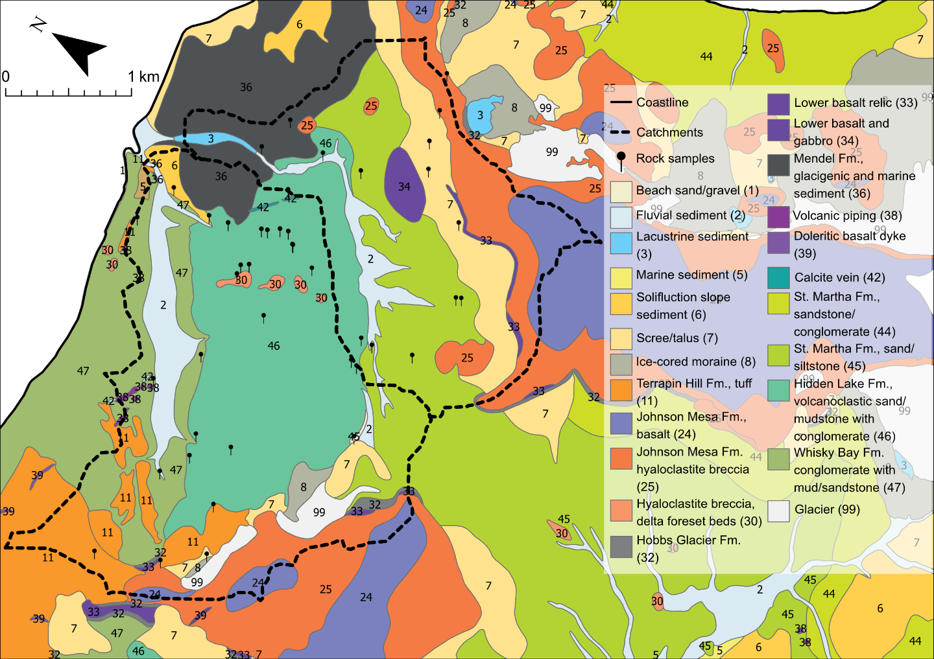
Geological map
gycds@leeds.ac.uk
@sedsstringer
NERC Panorama DTP

Slide 4
Methods: further information
We measured suspended sediment load and discharge at five “regular measurement sites”. These five sites were chosen to capture the water and sediment movement of the upper and lower sections of the Bohemian Stream and the Algal Stream rivers, as well as the influence of a major tributary to the Bohemian Stream; the Dirty Stream. We used a SonTek FlowTracker 2 handheld Acoustic Doppler Velocimeter to measure the discharge of the streams at each of our sites. Immediately after measuring discharge, we took a grab sample of water to measure suspended sediment concentration and, eventually, sediment yield. We measured discharge and suspended sediment concentration (SSC) in six-hour intervals for 24 hours every two weeks for the duration of the expedition (8 weeks total study time).
This resulted in 20 measurements from each of our sites over the course of the season, except for the Bohemian Upper site, which was frozen on two of the visits.
We collected meteorological data from two weather station: one at Mendel Station, and a smaller one situated in the Algal Lower catchment. Active layer measurements were also taken at these sites using resistance thermometers.
We took bedload samples at ~ 100 m intervals from the centre of the main channel of the Bohemian Stream. For logistical reasons, the sampling interval was ~300 m intervals along the Algal Stream. We also collected rock samples from each lithological unit in both catchments.
We sieved the bedload samples to collect the < 2 mm fraction to improve the ease with which they could be manually crushed, which we did with an agate pestle and mortar. We also crushed fissile rock samples with a pestle and mortar. For more resistant lithologies, we used a masonry drill bit with a high Moh’s hardness and collected the dust produced for analysis.
We measured the X-Ray fluorescence (XRF) with a ThermoFisher Scientific Niton XL5 Plus Handheld XRF Analyzer using the mining setting and took three 120 seconds measurements of each bedload and rock sample. We measured suspended sediment samples for 160 seconds. To calibrate the equipment and validate our readings, we measured a standard sample on any day we took a measurement.
We used a Spectral Evolution PSR+ 3500 spectrometer with a fibre optic probe to measure infrared reflectance. We measured each sample three times and also the reflectance from a white reflectance standard before every measurement to calibrate the equipment and validate our readings.
The infrared spectra were prepared for analysis by taking their first derivative (Russell et al., 2019) using SpectraGryph 1.2 and a Principal Component Analysis was conducted in the Past 4.07b statistical software for each bedload sample.
gycds@leeds.ac.uk
@sedsstringer
NERC Panorama DTP

Slide 5
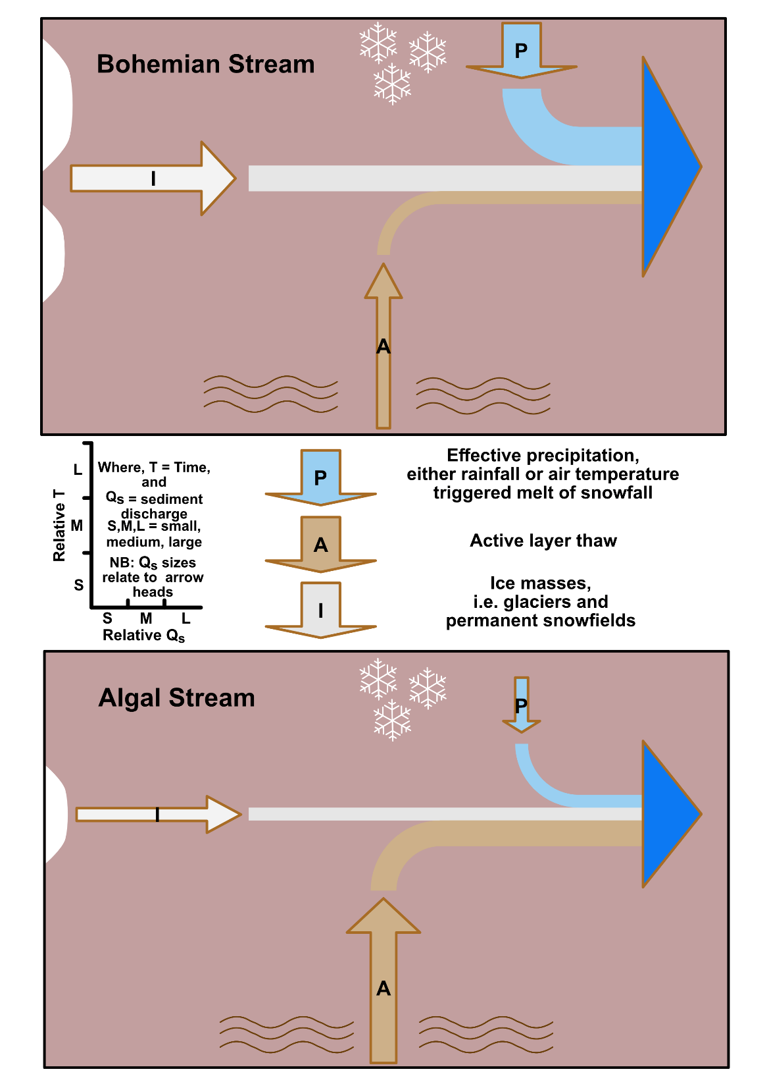
Catchment differences: a conceptual model
A conceptual model of the drivers of sediment yield variability in both catchments. NB: the ice mass arrows are oriented 90 degrees to the scale.
gycds@leeds.ac.uk
@sedsstringer
NERC Panorama DTP

Slide 6
Catchment differences: some photos
Drone images of: A) the confluence between the Bohemian Stream (main channel) and Dirty Stream and; B) the Algal Stream, with its ice cave and braiding highlighted. Note in both catchments the large areas of unconsolidated sediments on the braidplains of all three streams. A-1 shows rilling near the Bohemian Stream, A-2 shoes the confluence of the Dirty Stream with the Bohemian Stream. B-1 shows the ice cave on the Algal Stream, while B-2 shows unconsolidated sediment on an Algal Stream braidplain. Both main images were taken by MK using a DJI Mavic 2 Pro drone. Inset photos were taken by CS, except A-2, which was taken by Lucie Ráčková.
gycds@leeds.ac.uk
@sedsstringer
NERC Panorama DTP

Slide 7
Key references and further reading
Carrivick, J.L., Davies, B.J., Glasser, N.F., Nývlt, D., Hambrey, M.J., 2012. Late-Holocene changes in character and behaviour of land-terminating glaciers on James Ross Island, Antarctica. J. Glaciol. 58, 1176–1190. https://doi.org/10.3189/2012JoG11J148
Carrivick, J.L., Tweed, F.S., 2021. Deglaciation controls on sediment yield: Towards capturing spatio-temporal variability. Earth-Science Rev. 221, 103809. https://doi.org/https://doi.org/10.1016/j.earscirev.2021.103809
Cloern, J.E., 1987. Turbidity as a control on phytoplankton biomass and productivity in estuaries. Cont. Shelf Res. 7, 1367–1381. https://doi.org/10.1016/0278-4343(87)90042-2
Engel, Z., Láska, K., Nývlt, D., Stachoň, Z., 2018. Surface mass balance of small glaciers on James Ross Island, north-eastern Antarctic Peninsula, during 2009-2015. J. Glaciol. 64, 349–361. https://doi.org/10.1017/jog.2018.17
Huss, M., Hock, R., 2018. Global-scale hydrological response to future glacier mass loss. Nat. Clim. Chang. 8, 135–140. https://doi.org/10.1038/s41558-017-0049-x
Kavan, J., Ondruch, J., Nývlt, D., Hrbáček, F., Carrivick, J.L., Láska, K., 2017. Seasonal hydrological and suspended sediment transport dynamics in proglacial streams, James Ross Island, Antarctica. Geogr. Ann. Ser. A, Phys. Geogr. 99, 38–55. https://doi.org/10.1080/04353676.2016.1257914
Kavan, J., 2021. Fluvial transport in the deglaciated Antarctic catchment – Bohemian Stream, James Ross Island. Geogr. Ann. Ser. A, Phys. Geogr. 1–10. https://doi.org/10.1080/04353676.2021.2010401
Mlčoch, B., Nývlt, D., Mixa, P., 2020. Geological map of James Ross Island–Northern part 1: 25,000, Czech Geological Survey, Praha.
Overeem, I., Hudson, B.D., Syvitski, J.P.M., Mikkelsen, A.B., Hasholt, B., van den Broeke, M.R., Noël, B.P.Y., Morlighem, M., 2017. Substantial export of suspended sediment to the global oceans from glacial erosion in Greenland. Nat. Geosci. 10, 859–863. https://doi.org/10.1038/ngeo3046
Russell, F.E., Boyle, J.F., Chiverrell, R.C., 2019. NIRS quantification of lake sediment composition by multiple regression using end-member spectra. J. Paleolimnol. 62, 73–88. https://doi.org/10.1007/s10933-019-00076-2
Syvitski, J.P.M., 2002. Sediment discharge variability in Arctic rivers: implications for a warmer future. Polar Res. 21, 323–330. https://doi.org/10.3402/polar.v21i2.6494
gycds@leeds.ac.uk
@sedsstringer
NERC Panorama DTP

