Slide 1
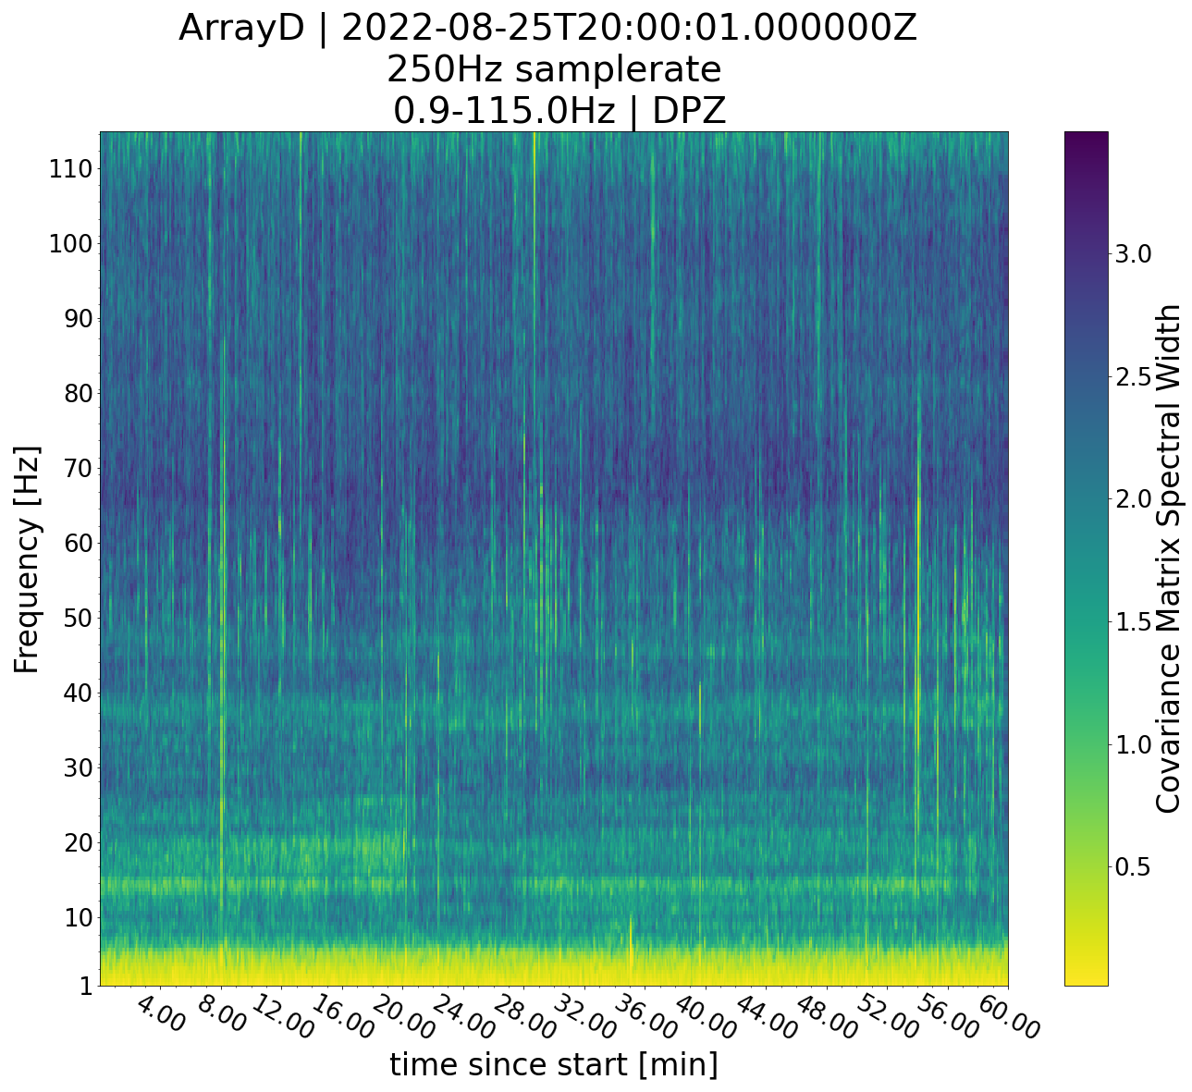
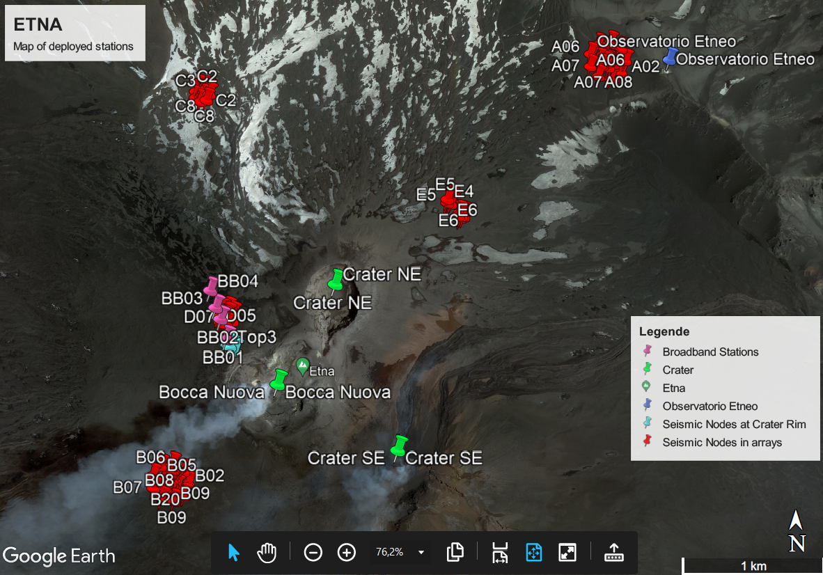
An investigation of high frequency seismic tremor on Mt Etna
This project has received funding from the European Horizon‘s 2020 research and innovation programme under Grant Agreement No 858092
Maurice Weber¹, Christopher J. Bean¹, Patrick Smith¹, Ivan Lokmer², Luciano Zuccarello^{3,4}, Silvio De Angelis^{4,3}, Vittorio Minio⁵
¹ Dublin Institute for Advanced Studies, Ireland; ² University College Dublin, Ireland; ³ Instituto Nazionale di Geofisica e Vulcanologia, Sezione di Pisa, Italy; ⁴ University of Liverpool, UK; ⁵ University of Catania, Italy
Contact: mweber@cp.dias.ie
Large deployment in summit region of Mt Etna July to September 2022
Array D
Stations Crater
?
Array B

Slide 2
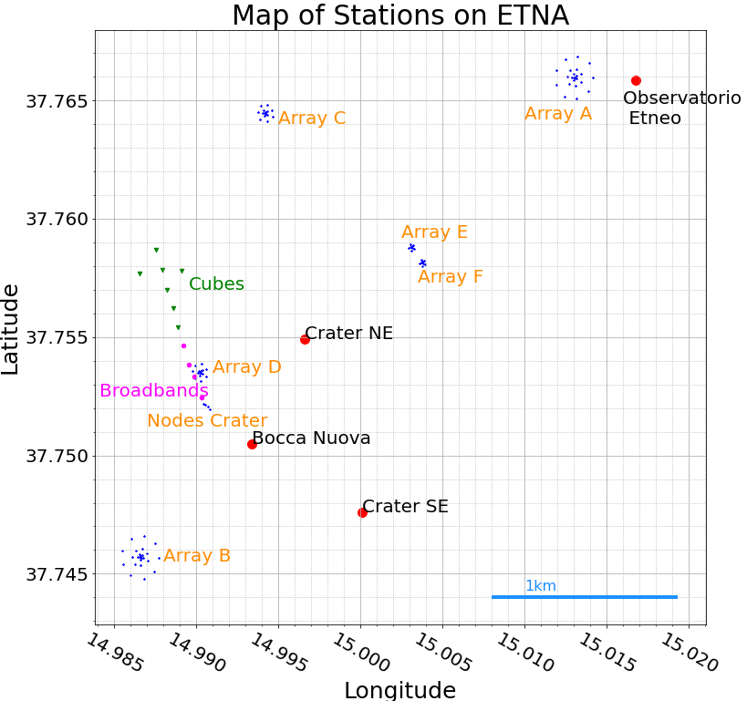
An investigation of high frequency seismic tremor on Mt Etna
This project has received funding from the European Horizon‘s 2020 research and innovation programme under Grant Agreement No 858092
Maurice Weber¹, Christopher J. Bean¹, Patrick Smith¹, Ivan Lokmer², Luciano Zuccarello^{3,4}, Silvio De Angelis^{4,3}, Vittorio Minio⁵
¹ Dublin Institute for Advanced Studies, Ireland; ² University College Dublin, Ireland; ³ Instituto Nazionale di Geofisica e Vulcanologia, Sezione di Pisa, Italy; ⁴ University of Liverpool, UK; ⁵ University of Catania, Italy
Contact: mweber@cp.dias.ie
DATA – Deployment on Mount ETNA July-September 2022
115 stations in total
6 circular arrays
250 Hz sampling rate
Profile of 15 stations including broadband and infrasound stations

Slide 3
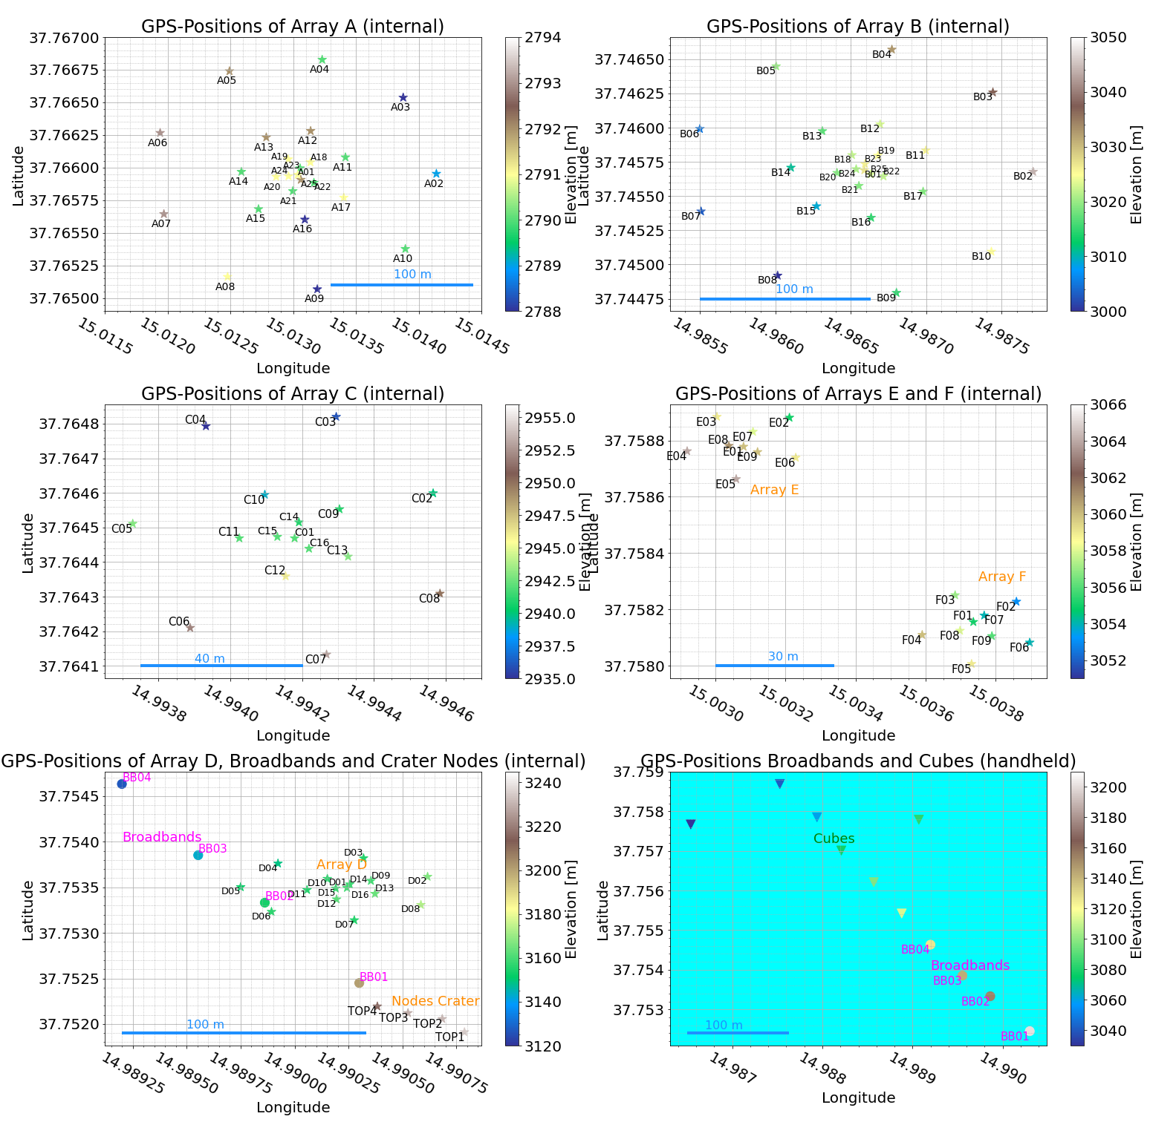
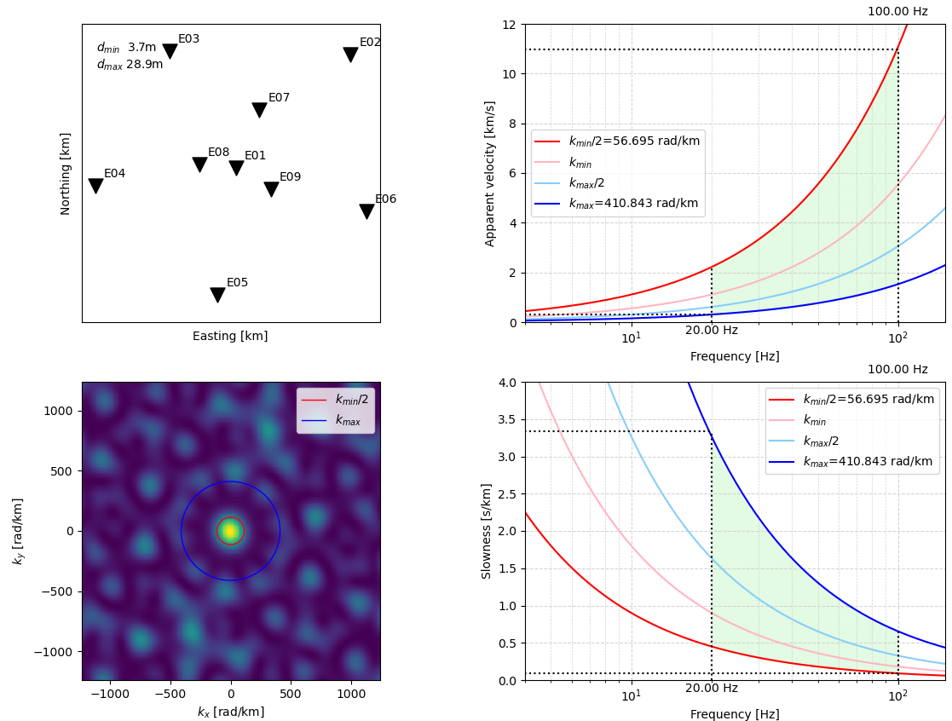
An investigation of high frequency seismic tremor on Mt Etna
This project has received funding from the European Horizon‘s 2020 research and innovation programme under Grant Agreement No 858092
Maurice Weber¹, Christopher J. Bean¹, Patrick Smith¹, Ivan Lokmer², Luciano Zuccarello^{3,4}, Silvio De Angelis^{4,3}, Vittorio Minio⁵
¹ Dublin Institute for Advanced Studies, Ireland; ² University College Dublin, Ireland; ³ Instituto Nazionale di Geofisica e Vulcanologia, Sezione di Pisa, Italy; ⁴ University of Liverpool, UK; ⁵ University of Catania, Italy
Contact: mweber@cp.dias.ie
DATA – Deployment on Mount ETNA July-September 2022
Central station
Rings of stations with increasing number of stations and radius around it
Coverage of high-frequency ranges

Slide 4
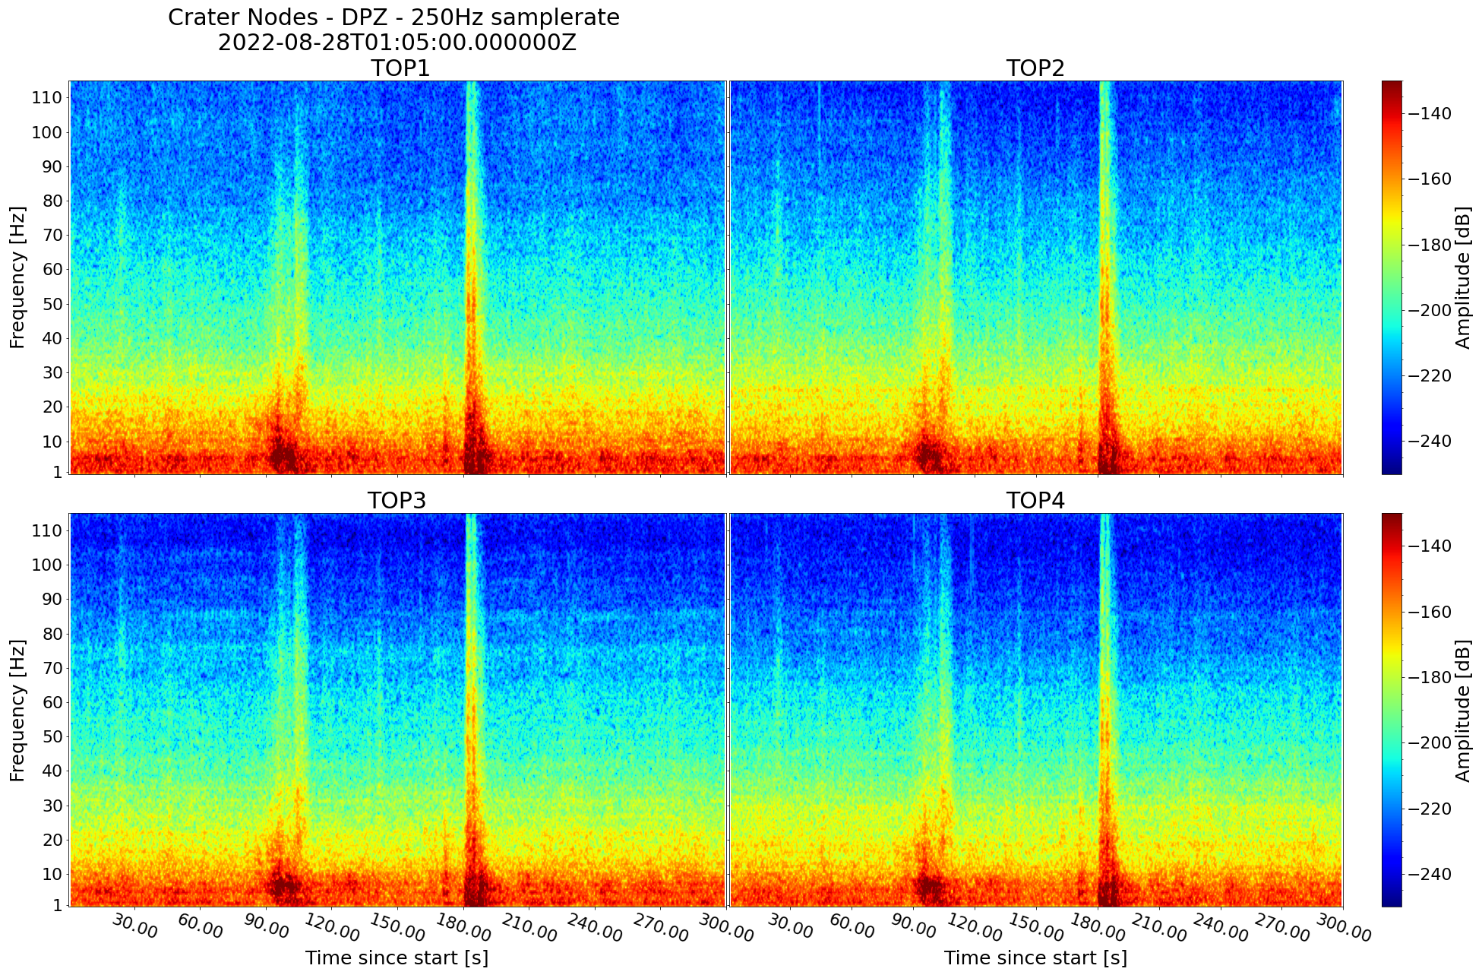
An investigation of high frequency seismic tremor on Mt Etna
This project has received funding from the European Horizon‘s 2020 research and innovation programme under Grant Agreement No 858092
Maurice Weber¹, Christopher J. Bean¹, Patrick Smith¹, Ivan Lokmer², Luciano Zuccarello^{3,4}, Silvio De Angelis^{4,3}, Vittorio Minio⁵
¹ Dublin Institute for Advanced Studies, Ireland; ² University College Dublin, Ireland; ³ Instituto Nazionale di Geofisica e Vulcanologia, Sezione di Pisa, Italy; ⁴ University of Liverpool, UK; ⁵ University of Catania, Italy
Contact: mweber@cp.dias.ie
DATA – Frequency content
4 stations near active Bocca Nuova Crater
Explosion events from crater

Slide 5
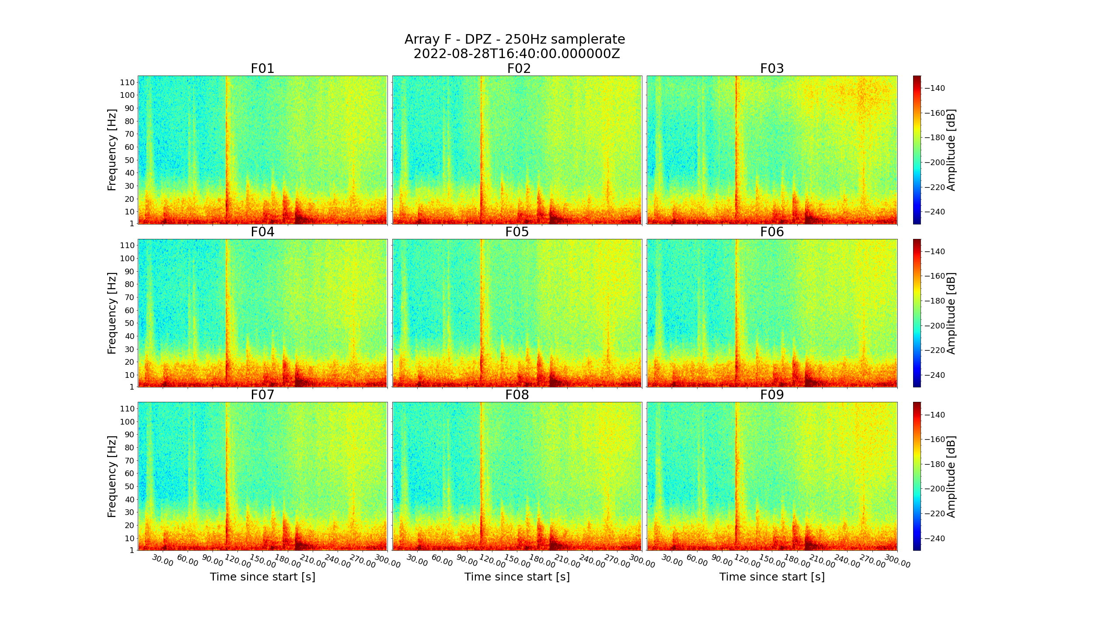
An investigation of high frequency seismic tremor on Mt Etna
This project has received funding from the European Horizon‘s 2020 research and innovation programme under Grant Agreement No 858092
Maurice Weber¹, Christopher J. Bean¹, Patrick Smith¹, Ivan Lokmer², Luciano Zuccarello^{3,4}, Silvio De Angelis^{4,3}, Vittorio Minio⁵
¹ Dublin Institute for Advanced Studies, Ireland; ² University College Dublin, Ireland; ³ Instituto Nazionale di Geofisica e Vulcanologia, Sezione di Pisa, Italy; ⁴ University of Liverpool, UK; ⁵ University of Catania, Italy
Contact: mweber@cp.dias.ie
DATA – Frequency content
Array consisting of 9 stations
Extreme high amplitude noise at very high frequencies
Maximum interstation distance about 30 m

Slide 6
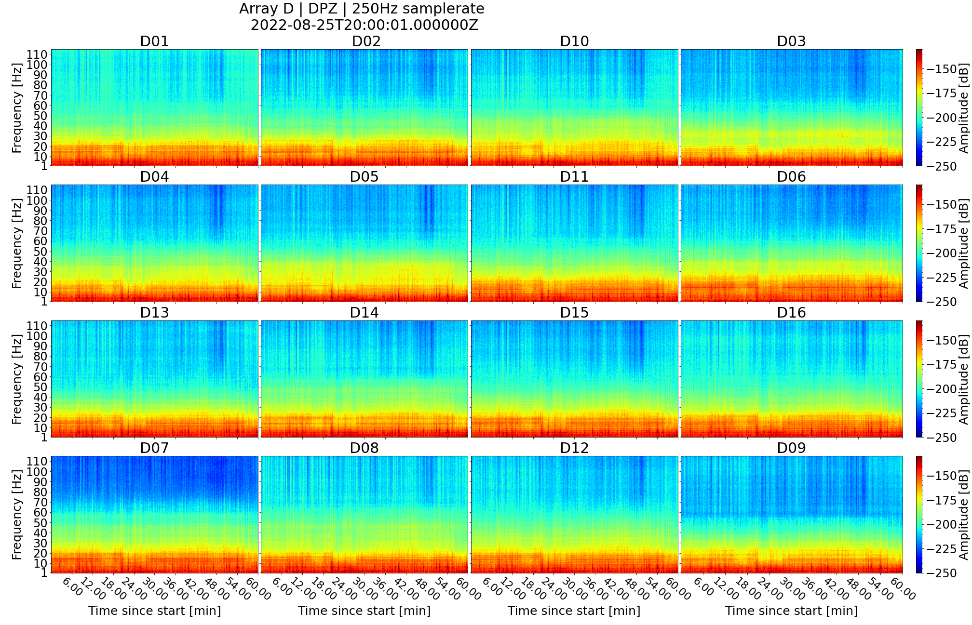
An investigation of high frequency seismic tremor on Mt Etna
This project has received funding from the European Horizon‘s 2020 research and innovation programme under Grant Agreement No 858092
Maurice Weber¹, Christopher J. Bean¹, Patrick Smith¹, Ivan Lokmer², Luciano Zuccarello^{3,4}, Silvio De Angelis^{4,3}, Vittorio Minio⁵
¹ Dublin Institute for Advanced Studies, Ireland; ² University College Dublin, Ireland; ³ Instituto Nazionale di Geofisica e Vulcanologia, Sezione di Pisa, Italy; ⁴ University of Liverpool, UK; ⁵ University of Catania, Italy
Contact: mweber@cp.dias.ie
DATA – Frequency content
Array consisting of 16 stations
Tremor episodes between 10 and 40 Hz
Maximum interstation distance about 80 m

Slide 7
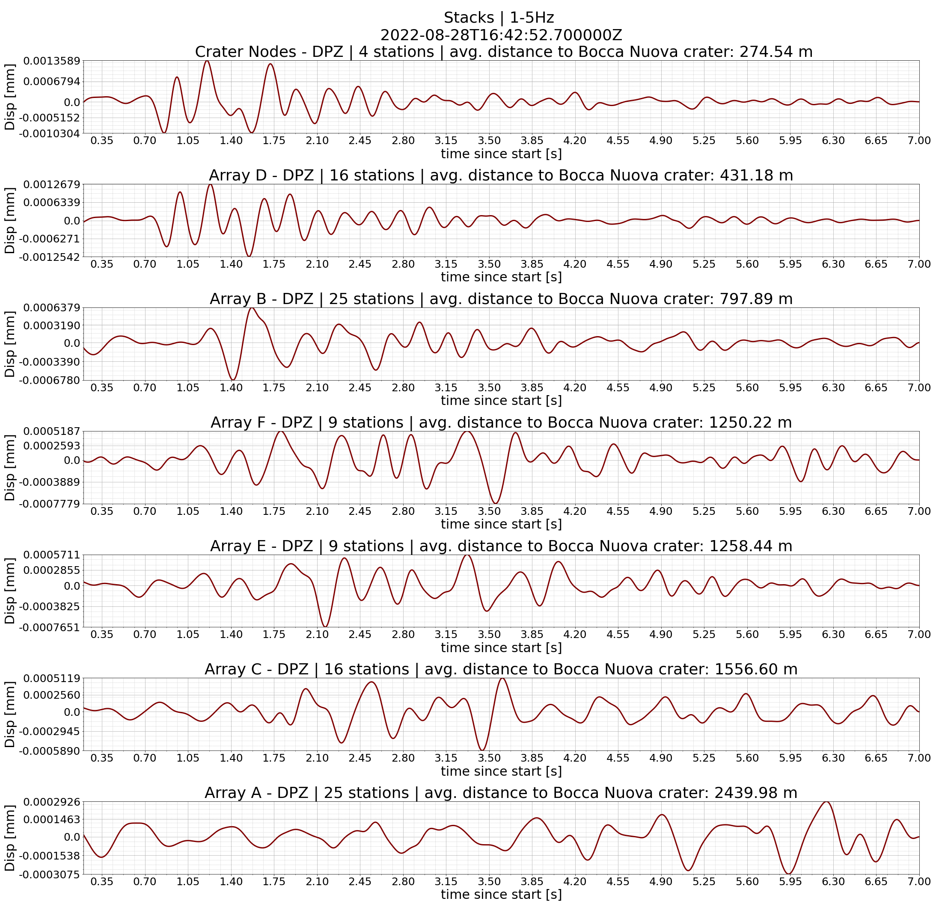
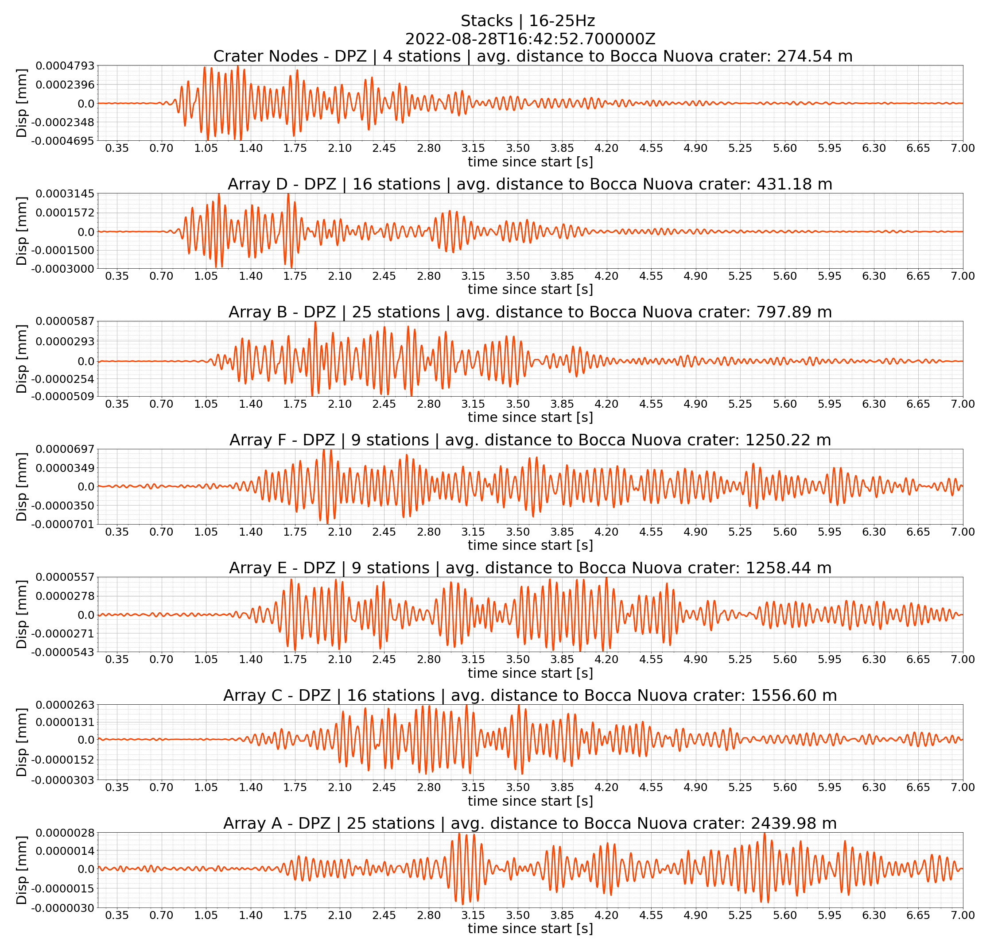
An investigation of high frequency seismic tremor on Mt Etna
This project has received funding from the European Horizon‘s 2020 research and innovation programme under Grant Agreement No 858092
Maurice Weber¹, Christopher J. Bean¹, Patrick Smith¹, Ivan Lokmer², Luciano Zuccarello^{3,4}, Silvio De Angelis^{4,3}, Vittorio Minio⁵
¹ Dublin Institute for Advanced Studies, Ireland; ² University College Dublin, Ireland; ³ Instituto Nazionale di Geofisica e Vulcanologia, Sezione di Pisa, Italy; ⁴ University of Liverpool, UK; ⁵ University of Catania, Italy
Contact: mweber@cp.dias.ie
DATA – Scattering effects on signal propagation
Signal propagation across more than 3 km of edifice
Moveout of small explosion event from Bocca Nuova nicely traceable at different frequency ranges
S/N even clearly improving moving to higher frequencies as continuous noise dominates below 5 Hz but diminishes above
Increasing distance from Bocca Nuova Crater

Slide 8
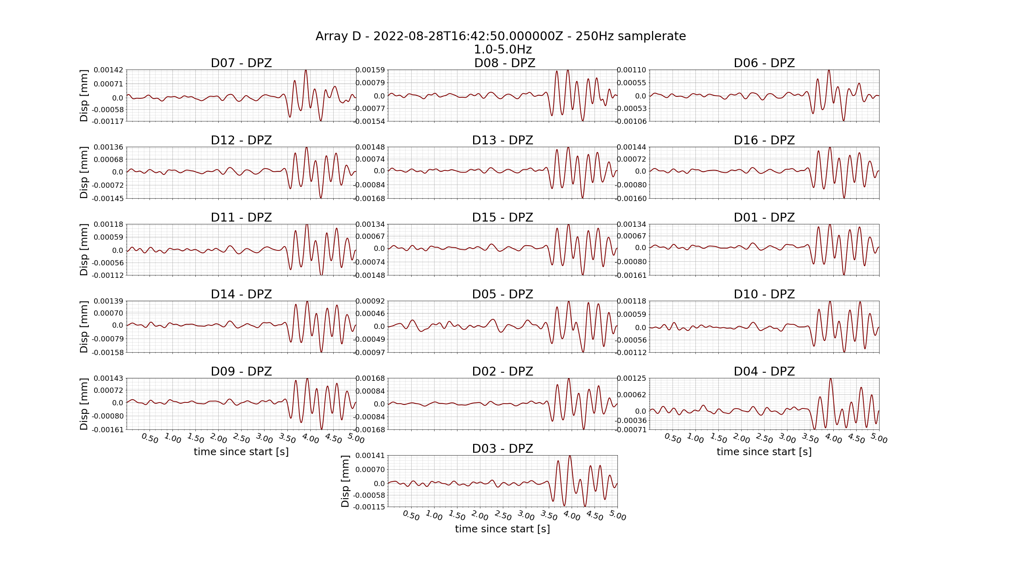
An investigation of high frequency seismic tremor on Mt Etna
This project has received funding from the European Horizon‘s 2020 research and innovation programme under Grant Agreement No 858092
Maurice Weber¹, Christopher J. Bean¹, Patrick Smith¹, Ivan Lokmer², Luciano Zuccarello^{3,4}, Silvio De Angelis^{4,3}, Vittorio Minio⁵
¹ Dublin Institute for Advanced Studies, Ireland; ² University College Dublin, Ireland; ³ Instituto Nazionale di Geofisica e Vulcanologia, Sezione di Pisa, Italy; ⁴ University of Liverpool, UK; ⁵ University of Catania, Italy
Contact: mweber@cp.dias.ie
DATA – Scattering effects on waveform coherency
Waveform changes across 80 m aperture array even at 1-5 Hz
But: very good coherency within 30 m (stations in blue box) within small area similar conditions seem present despite strongly heteorogenous medium
Especially the onset shows good coherency

Slide 9
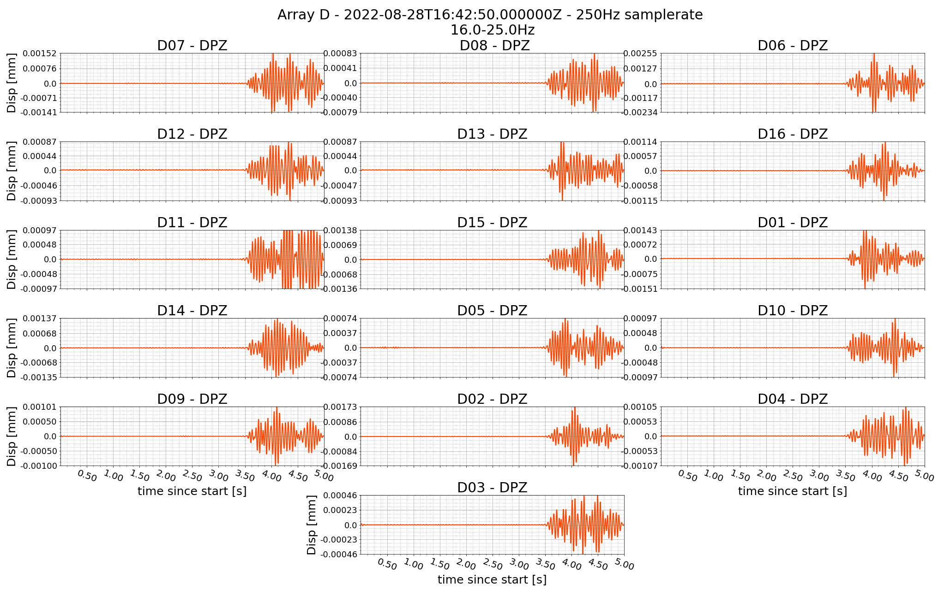
An investigation of high frequency seismic tremor on Mt Etna
This project has received funding from the European Horizon‘s 2020 research and innovation programme under Grant Agreement No 858092
Maurice Weber¹, Christopher J. Bean¹, Patrick Smith¹, Ivan Lokmer², Luciano Zuccarello^{3,4}, Silvio De Angelis^{4,3}, Vittorio Minio⁵
¹ Dublin Institute for Advanced Studies, Ireland; ² University College Dublin, Ireland; ³ Instituto Nazionale di Geofisica e Vulcanologia, Sezione di Pisa, Italy; ⁴ University of Liverpool, UK; ⁵ University of Catania, Italy
Contact: mweber@cp.dias.ie
DATA – Scattering effects on waveform coherency
Heavy scattering at 16-25 Hz visible even for stations only 5 m apart (D15 and D01)

Slide 10
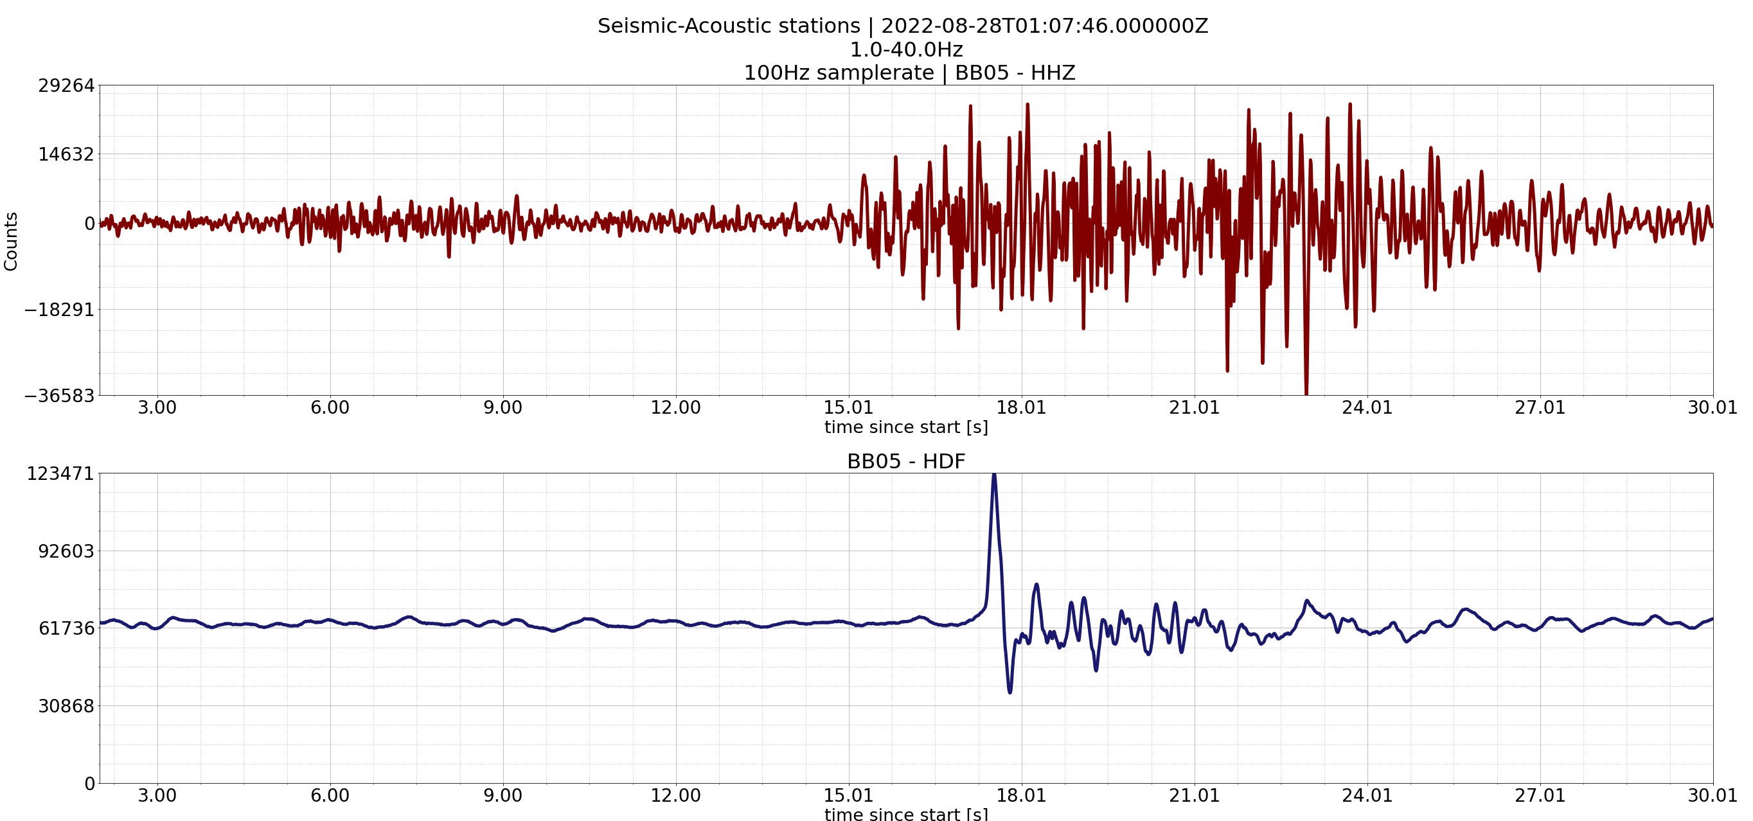
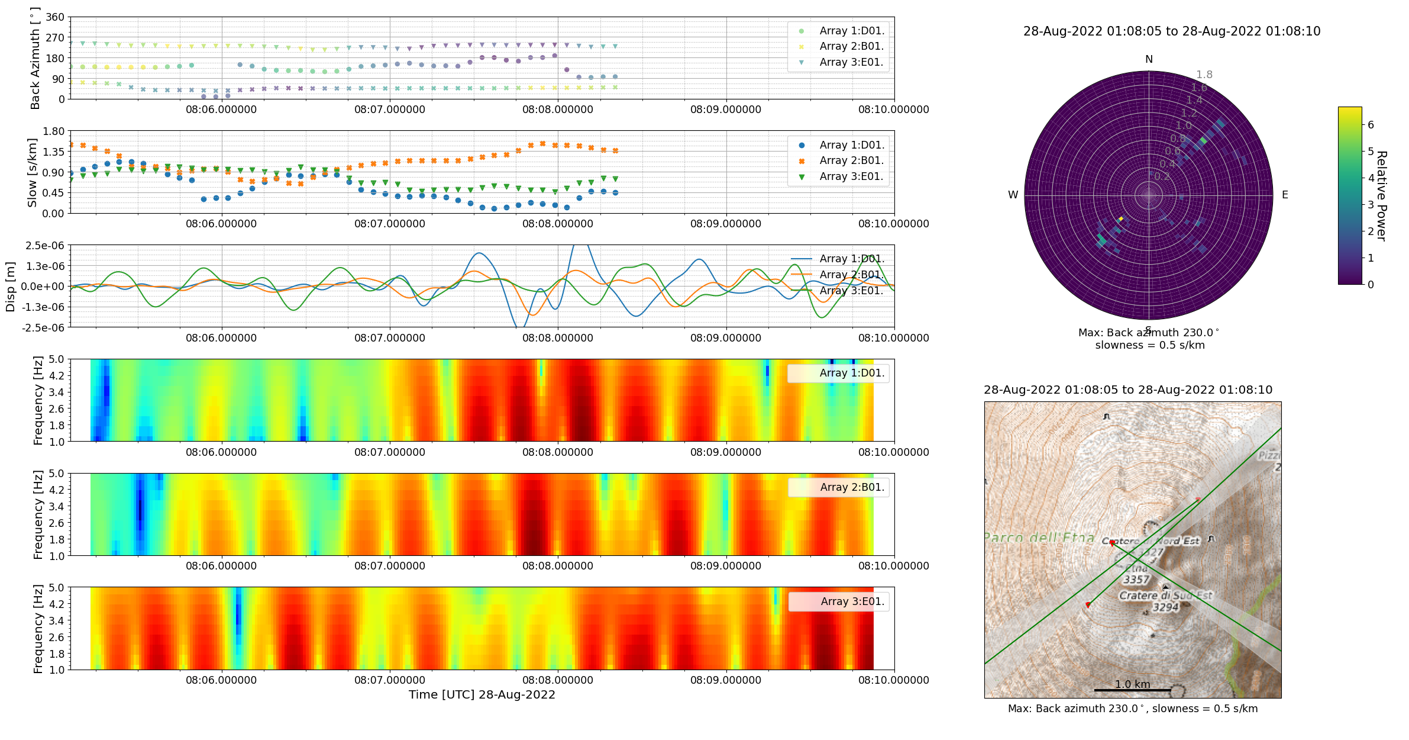
An investigation of high frequency seismic tremor on Mt Etna
This project has received funding from the European Horizon‘s 2020 research and innovation programme under Grant Agreement No 858092
Maurice Weber¹, Christopher J. Bean¹, Patrick Smith¹, Ivan Lokmer², Luciano Zuccarello^{3,4}, Silvio De Angelis^{4,3}, Vittorio Minio⁵
¹ Dublin Institute for Advanced Studies, Ireland; ² University College Dublin, Ireland; ³ Instituto Nazionale di Geofisica e Vulcanologia, Sezione di Pisa, Italy; ⁴ University of Liverpool, UK; ⁵ University of Catania, Italy
Contact: mweber@cp.dias.ie
Localisation – explosion events from Bocca Nuova
Identifying explosion events using acoustic components
Beamforming for 1-5Hz using 3 array locations
Good constraint of source location at Bocca Nuova crater
1.5 s computational window

Slide 11
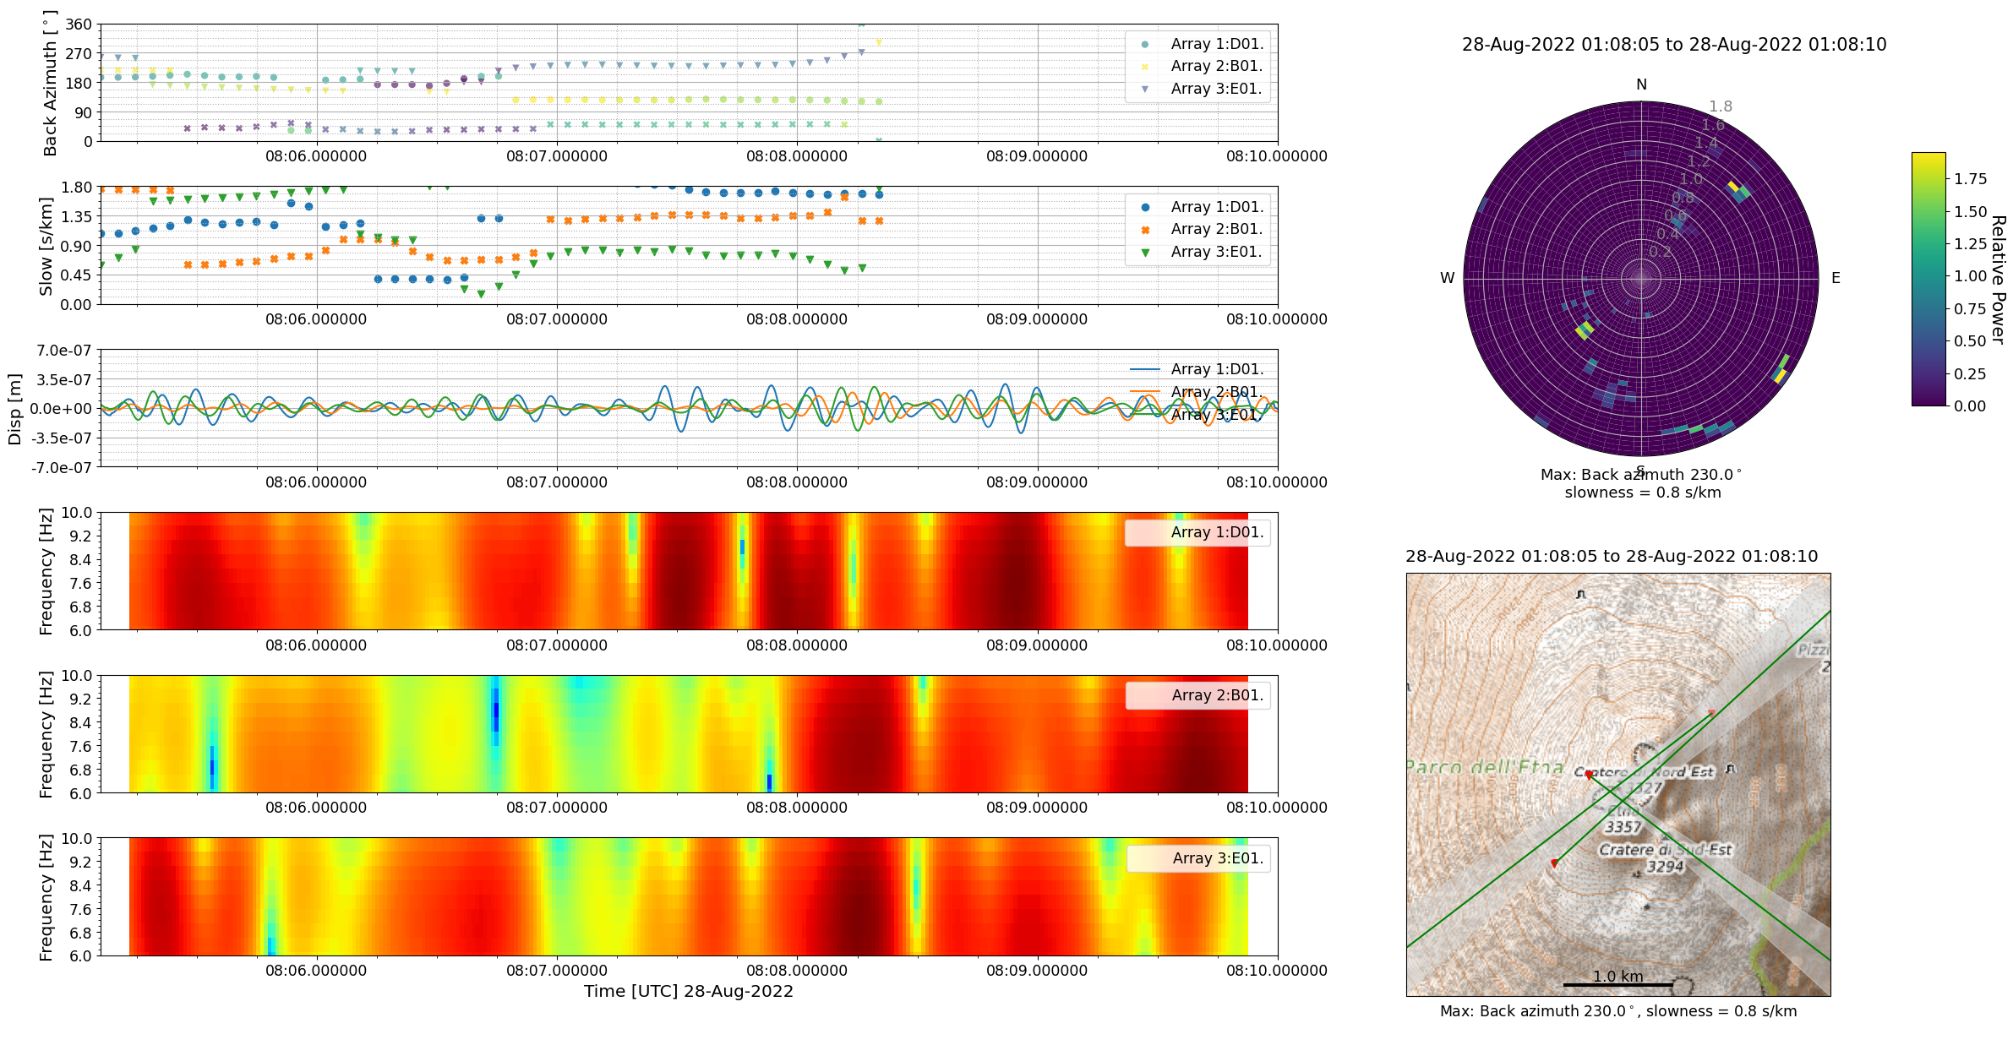
An investigation of high frequency seismic tremor on Mt Etna
This project has received funding from the European Horizon‘s 2020 research and innovation programme under Grant Agreement No 858092
Maurice Weber¹, Christopher J. Bean¹, Patrick Smith¹, Ivan Lokmer², Luciano Zuccarello^{3,4}, Silvio De Angelis^{4,3}, Vittorio Minio⁵
¹ Dublin Institute for Advanced Studies, Ireland; ² University College Dublin, Ireland; ³ Instituto Nazionale di Geofisica e Vulcanologia, Sezione di Pisa, Italy; ⁴ University of Liverpool, UK; ⁵ University of Catania, Italy
Contact: mweber@cp.dias.ie
Localisation – explosion events from Bocca Nuova
Beamforming for same event at 6-10 Hz
Increased scattering effects but still good constraint on source location
Computational window still at 1.5 s

Slide 12
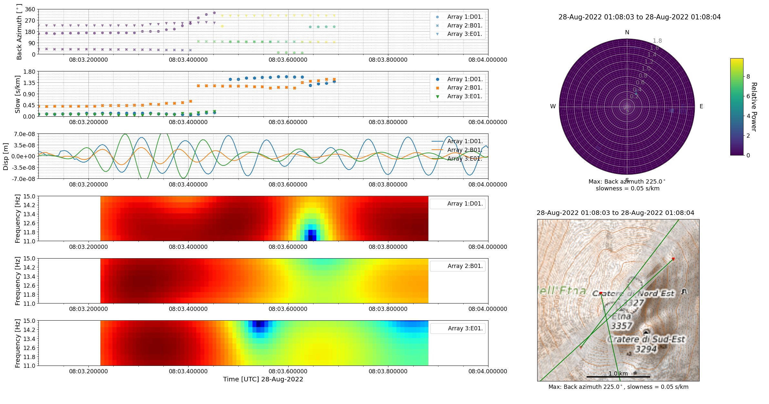
An investigation of high frequency seismic tremor on Mt Etna
This project has received funding from the European Horizon‘s 2020 research and innovation programme under Grant Agreement No 858092
Maurice Weber¹, Christopher J. Bean¹, Patrick Smith¹, Ivan Lokmer², Luciano Zuccarello^{3,4}, Silvio De Angelis^{4,3}, Vittorio Minio⁵
¹ Dublin Institute for Advanced Studies, Ireland; ² University College Dublin, Ireland; ³ Instituto Nazionale di Geofisica e Vulcanologia, Sezione di Pisa, Italy; ⁴ University of Liverpool, UK; ⁵ University of Catania, Italy
Contact: mweber@cp.dias.ie
Localisation – explosion events from Bocca Nuova
At 11-15 Hz an even shorter time window with high enough coherency has to be found to achieve good constraint on source location
Computational window now at 0.2 s

Slide 13
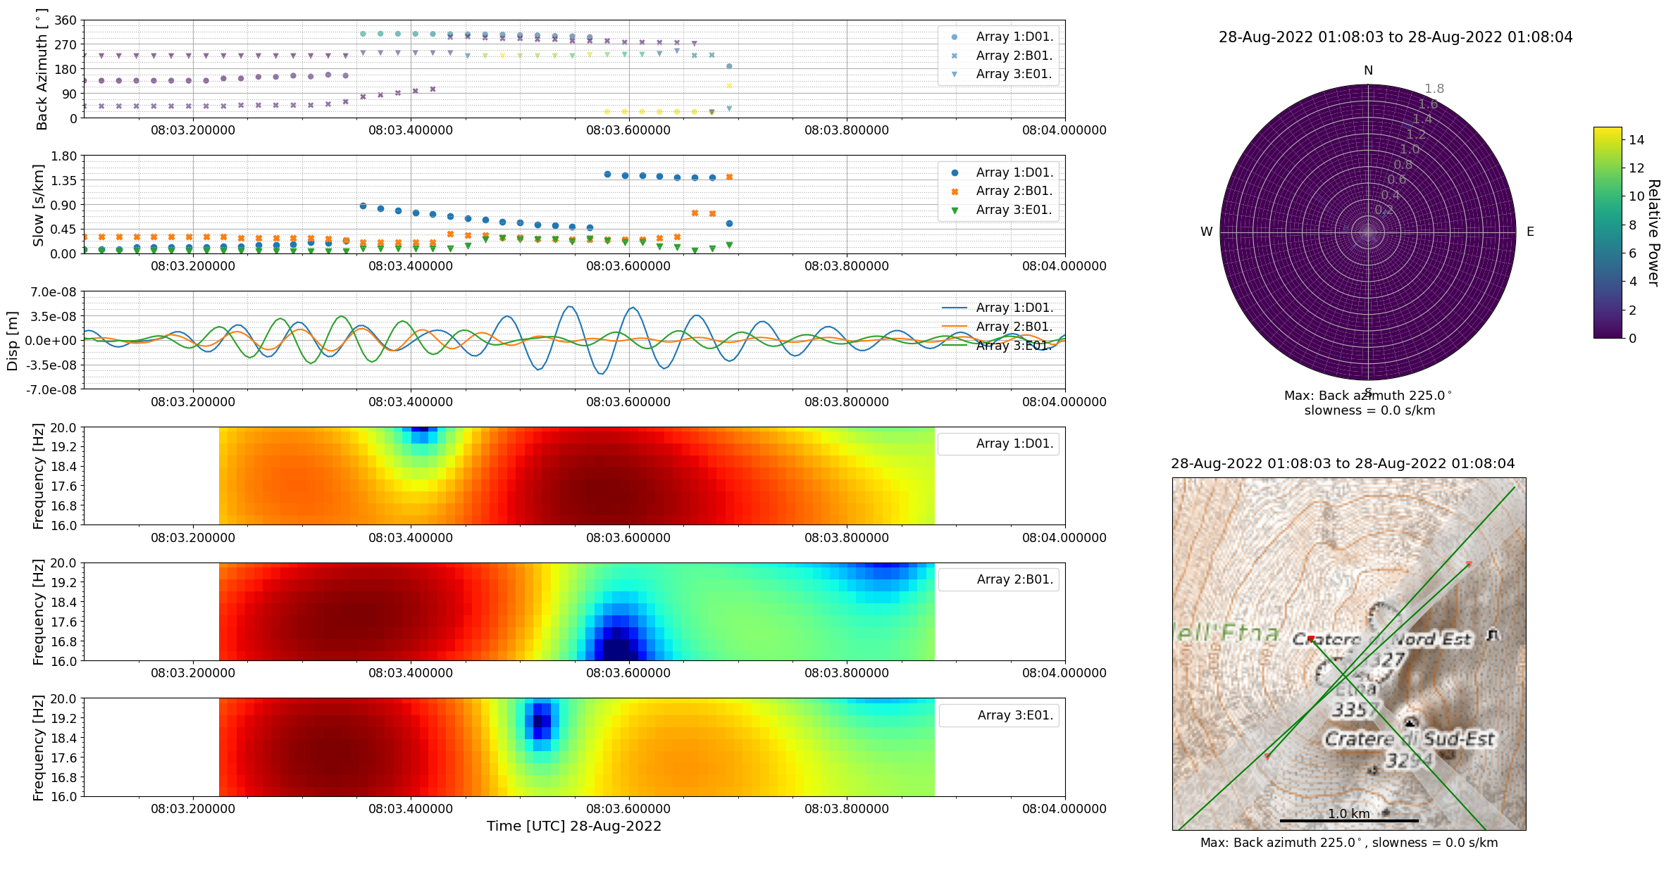
An investigation of high frequency seismic tremor on Mt Etna
This project has received funding from the European Horizon‘s 2020 research and innovation programme under Grant Agreement No 858092
Maurice Weber¹, Christopher J. Bean¹, Patrick Smith¹, Ivan Lokmer², Luciano Zuccarello^{3,4}, Silvio De Angelis^{4,3}, Vittorio Minio⁵
¹ Dublin Institute for Advanced Studies, Ireland; ² University College Dublin, Ireland; ³ Instituto Nazionale di Geofisica e Vulcanologia, Sezione di Pisa, Italy; ⁴ University of Liverpool, UK; ⁵ University of Catania, Italy
Contact: mweber@cp.dias.ie
Localisation – explosion events from Bocca Nuova
Even at up to 20 Hz a good constraint on the source location can be obtained
Keeping 0.2 s computational windows

Slide 14
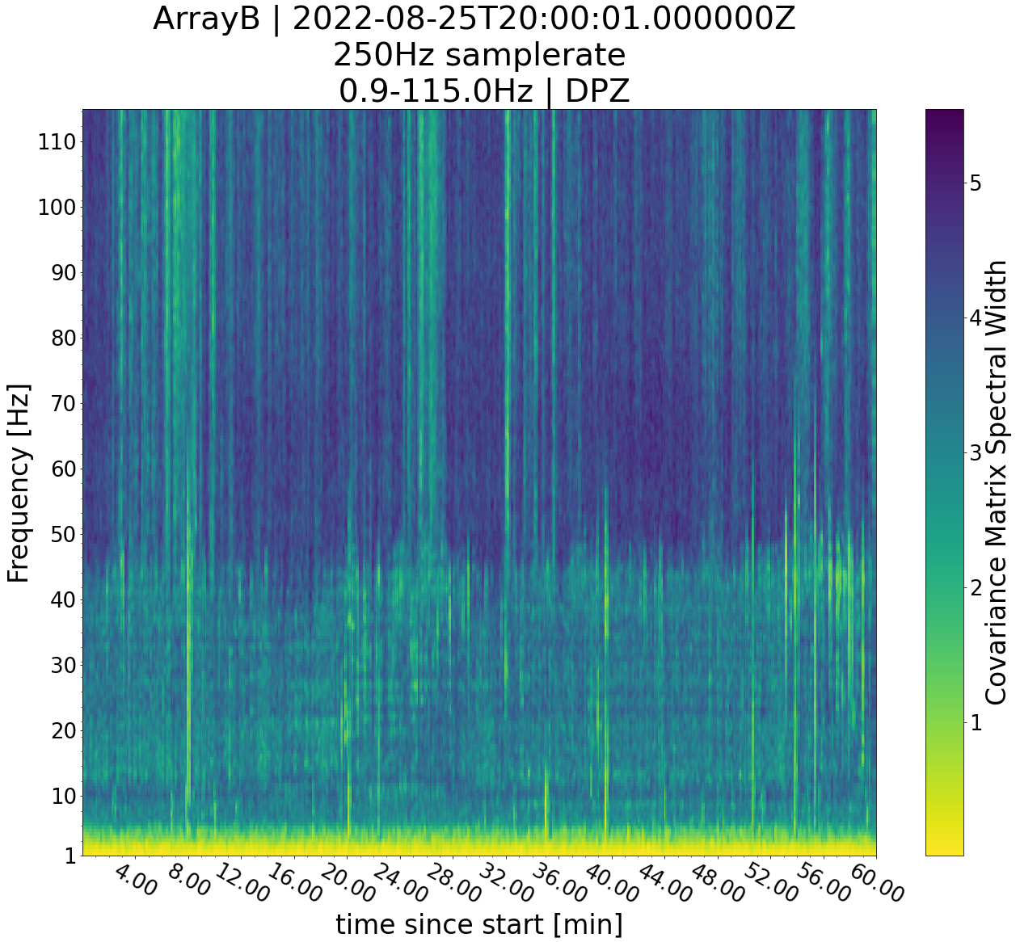
An investigation of high frequency seismic tremor on Mt Etna
This project has received funding from the European Horizon‘s 2020 research and innovation programme under Grant Agreement No 858092
Maurice Weber¹, Christopher J. Bean¹, Patrick Smith¹, Ivan Lokmer², Luciano Zuccarello^{3,4}, Silvio De Angelis^{4,3}, Vittorio Minio⁵
¹ Dublin Institute for Advanced Studies, Ireland; ² University College Dublin, Ireland; ³ Instituto Nazionale di Geofisica e Vulcanologia, Sezione di Pisa, Italy; ⁴ University of Liverpool, UK; ⁵ University of Catania, Italy
Contact: mweber@cp.dias.ie
Detection – tremor episodes
Detection of tremor bands (coherent signals on stations within array) between 10-20 Hz
Also weaker bands even between 30-40 Hz
Just about picked up on neighbouring arrays
Tremor source varies in intensity over time
Using the covseisnet tool after Soubestre et al. (2018)

Slide 15
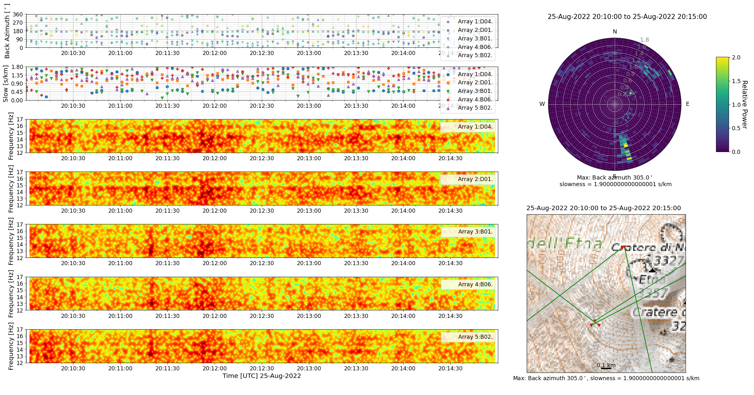
An investigation of high frequency seismic tremor on Mt Etna
This project has received funding from the European Horizon‘s 2020 research and innovation programme under Grant Agreement No 858092
Maurice Weber¹, Christopher J. Bean¹, Patrick Smith¹, Ivan Lokmer², Luciano Zuccarello^{3,4}, Silvio De Angelis^{4,3}, Vittorio Minio⁵
¹ Dublin Institute for Advanced Studies, Ireland; ² University College Dublin, Ireland; ³ Instituto Nazionale di Geofisica e Vulcanologia, Sezione di Pisa, Italy; ⁴ University of Liverpool, UK; ⁵ University of Catania, Italy
Contact: mweber@cp.dias.ie
Localisation –
tremor episodes
?
Array B
Possible source location of tremor around 15 Hz south of Bocca Nuova crater picked up at Arrays B and D
Array D
Array D
?
Array B

Slide 16
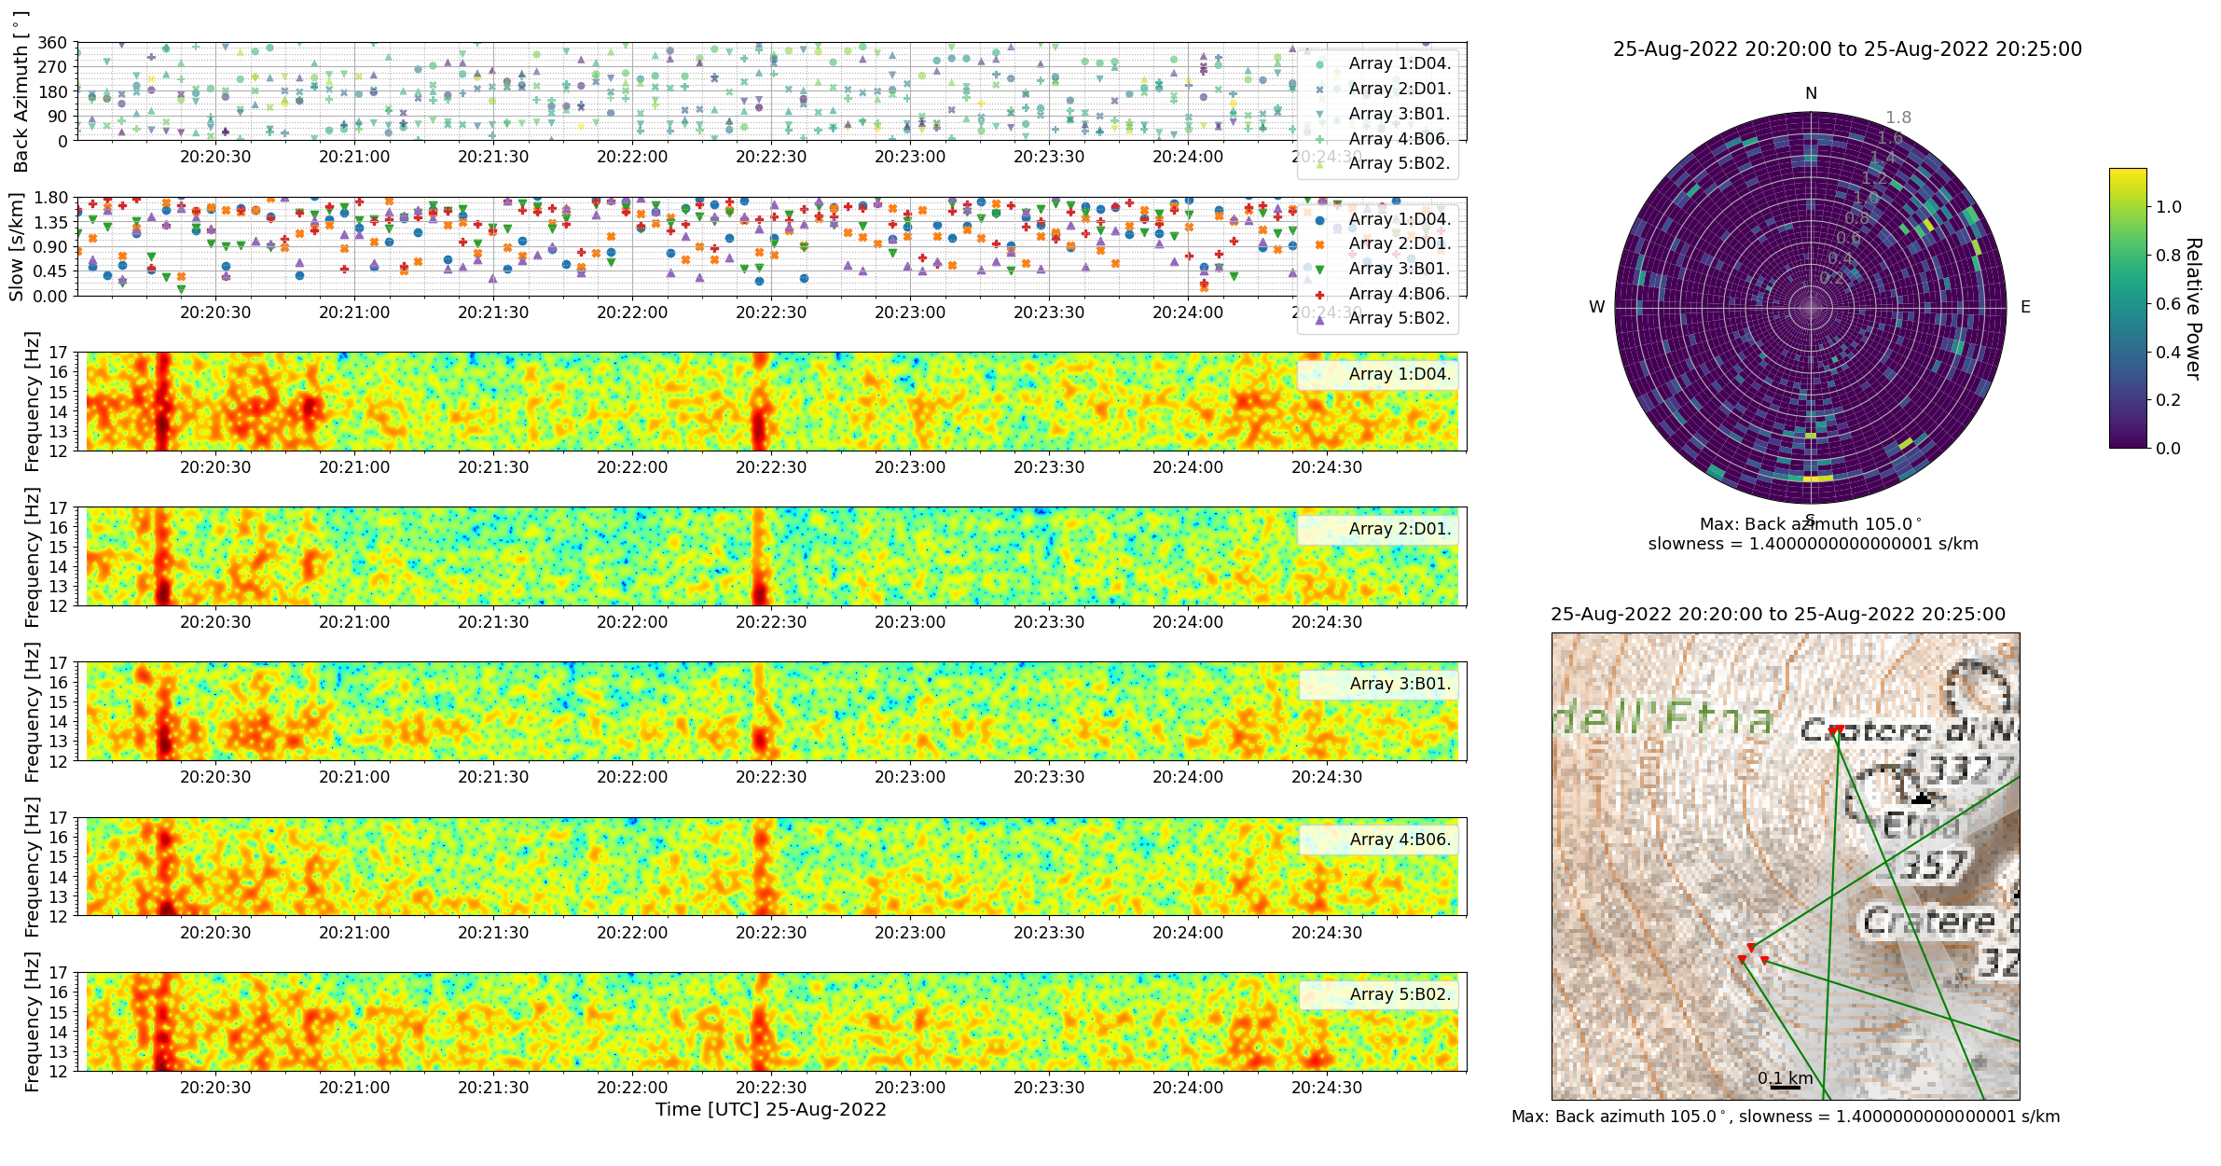
An investigation of high frequency seismic tremor on Mt Etna
This project has received funding from the European Horizon‘s 2020 research and innovation programme under Grant Agreement No 858092
Maurice Weber¹, Christopher J. Bean¹, Patrick Smith¹, Ivan Lokmer², Luciano Zuccarello^{3,4}, Silvio De Angelis^{4,3}, Vittorio Minio⁵
¹ Dublin Institute for Advanced Studies, Ireland; ² University College Dublin, Ireland; ³ Instituto Nazionale di Geofisica e Vulcanologia, Sezione di Pisa, Italy; ⁴ University of Liverpool, UK; ⁵ University of Catania, Italy
Contact: mweber@cp.dias.ie
Localisation –
tremor episodes
Decrease of intensity of tremor episode causing much more chaotic distribution of backazimuths
Array D
?
Array B

Slide 17
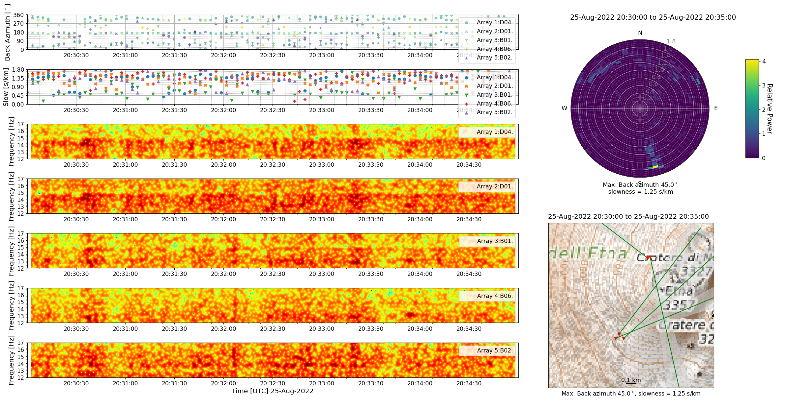
An investigation of high frequency seismic tremor on Mt Etna
This project has received funding from the European Horizon‘s 2020 research and innovation programme under Grant Agreement No 858092
Maurice Weber¹, Christopher J. Bean¹, Patrick Smith¹, Ivan Lokmer², Luciano Zuccarello^{3,4}, Silvio De Angelis^{4,3}, Vittorio Minio⁵
¹ Dublin Institute for Advanced Studies, Ireland; ² University College Dublin, Ireland; ³ Instituto Nazionale di Geofisica e Vulcanologia, Sezione di Pisa, Italy; ⁴ University of Liverpool, UK; ⁵ University of Catania, Italy
Contact: mweber@cp.dias.ie
Localisation –
tremor episodes
?
Array B
Tremor source increasing again with very similar distribution of backazimuths compared to before suggesting a similar possible source location south of Bocca Nuova
Array D
Array D
?
Array B

Slide 18
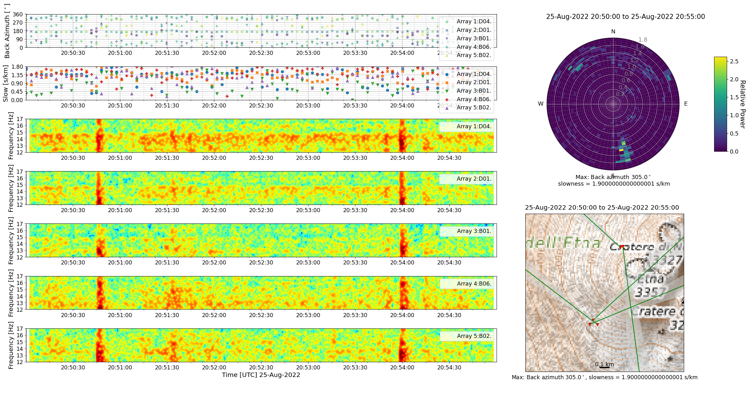
An investigation of high frequency seismic tremor on Mt Etna
This project has received funding from the European Horizon‘s 2020 research and innovation programme under Grant Agreement No 858092
Maurice Weber¹, Christopher J. Bean¹, Patrick Smith¹, Ivan Lokmer², Luciano Zuccarello^{3,4}, Silvio De Angelis^{4,3}, Vittorio Minio⁵
¹ Dublin Institute for Advanced Studies, Ireland; ² University College Dublin, Ireland; ³ Instituto Nazionale di Geofisica e Vulcanologia, Sezione di Pisa, Italy; ⁴ University of Liverpool, UK; ⁵ University of Catania, Italy
Contact: mweber@cp.dias.ie
Localisation –
tremor episodes
?
Array B
Ongoing tremor episode
Spectrograms reveal main frequency band with upper frequency of 15 Hz and a weaker band at about 16 Hz
Array B also develops a 13 Hz band
Strong vertical amplitudes mark explosion events from Bocca Nuova
Further cluster of backazimuths to the northwest?
Array D
Array D
?
Array B

Slide 19
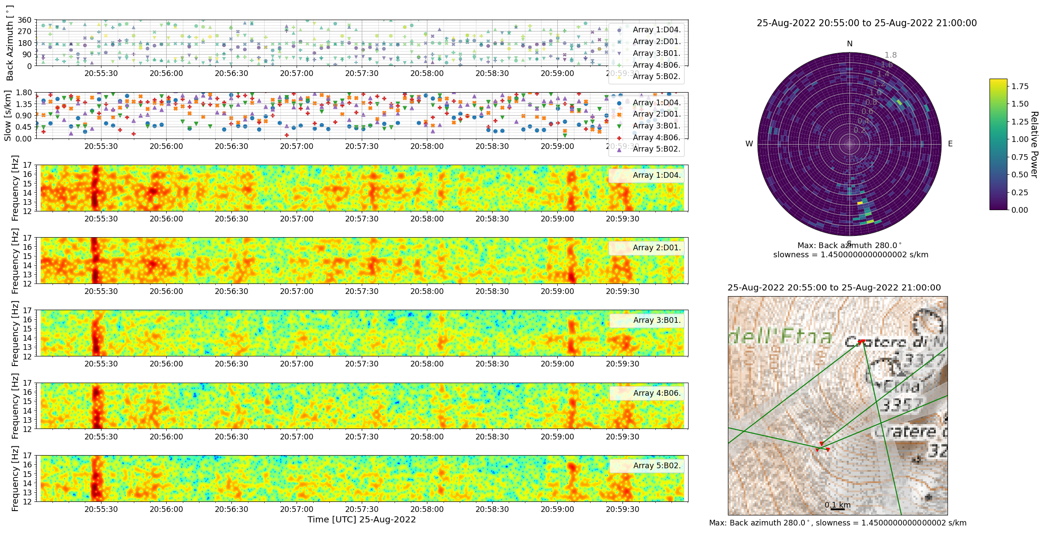
An investigation of high frequency seismic tremor on Mt Etna
This project has received funding from the European Horizon‘s 2020 research and innovation programme under Grant Agreement No 858092
Maurice Weber¹, Christopher J. Bean¹, Patrick Smith¹, Ivan Lokmer², Luciano Zuccarello^{3,4}, Silvio De Angelis^{4,3}, Vittorio Minio⁵
¹ Dublin Institute for Advanced Studies, Ireland; ² University College Dublin, Ireland; ³ Instituto Nazionale di Geofisica e Vulcanologia, Sezione di Pisa, Italy; ⁴ University of Liverpool, UK; ⁵ University of Catania, Italy
Contact: mweber@cp.dias.ie
Localisation –
tremor episodes
?
Array B
Tremor continuing with similar frequency bands as before and more explosion events in between
Array D
Array D
?
Array B

Slide 20
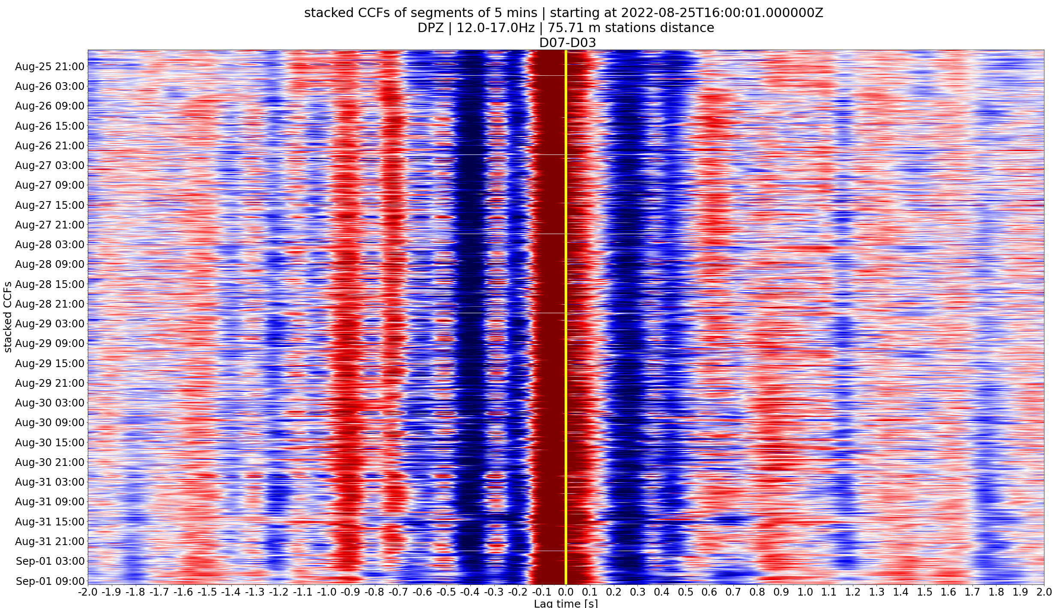
An investigation of high frequency seismic tremor on Mt Etna
This project has received funding from the European Horizon‘s 2020 research and innovation programme under Grant Agreement No 858092
Maurice Weber¹, Christopher J. Bean¹, Patrick Smith¹, Ivan Lokmer², Luciano Zuccarello^{3,4}, Silvio De Angelis^{4,3}, Vittorio Minio⁵
¹ Dublin Institute for Advanced Studies, Ireland; ² University College Dublin, Ireland; ³ Instituto Nazionale di Geofisica e Vulcanologia, Sezione di Pisa, Italy; ⁴ University of Liverpool, UK; ⁵ University of Catania, Italy
Contact: mweber@cp.dias.ie
Localisation –
tremor episodes
CCFs stacked over time for south-north orientated station pair D07-D03
Maximum of CCF clearly not at 0 s time lag
Supports southern direction of arrival at 12-17 Hz as D07 (south) is reached before D03 (north)
Lag time around -0.075 s resulting in apparent velocity of about 1000 m/s
Slightly steep angle of incidence?

Slide 21
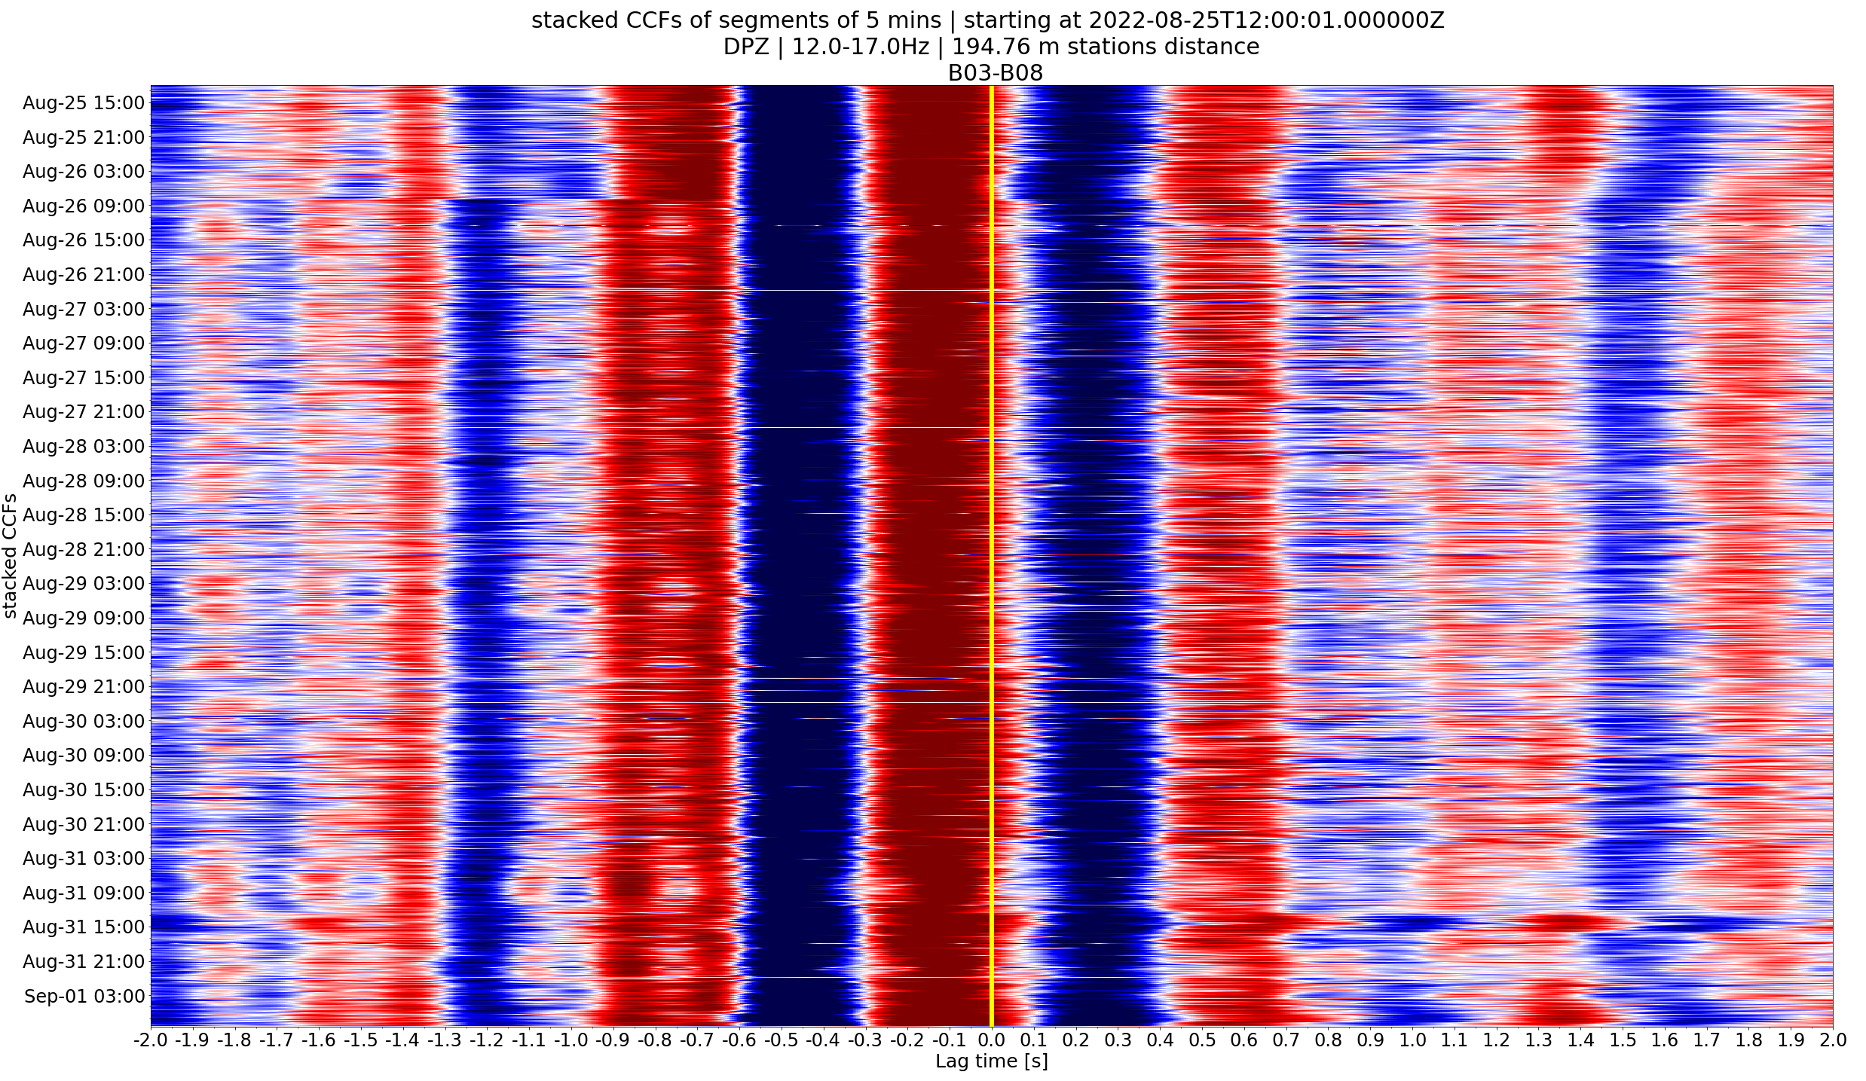
An investigation of high frequency seismic tremor on Mt Etna
This project has received funding from the European Horizon‘s 2020 research and innovation programme under Grant Agreement No 858092
Maurice Weber¹, Christopher J. Bean¹, Patrick Smith¹, Ivan Lokmer², Luciano Zuccarello^{3,4}, Silvio De Angelis^{4,3}, Vittorio Minio⁵
¹ Dublin Institute for Advanced Studies, Ireland; ² University College Dublin, Ireland; ³ Instituto Nazionale di Geofisica e Vulcanologia, Sezione di Pisa, Italy; ⁴ University of Liverpool, UK; ⁵ University of Catania, Italy
Contact: mweber@cp.dias.ie
Localisation –
tremor episodes
CCFs stacked over time for southwest-northeastern orientated station pair B03-B08
Supporting northeastern direction of arrival
Since this is also roughly the direction to the crater an offset towards negative lagtimes would have been expected here anyway
Due to much larger station distance lag time at about -1.7 s resulting in similar apparent velocity

Slide 22
An investigation of high frequency seismic tremor on Mt Etna
This project has received funding from the European Horizon‘s 2020 research and innovation programme under Grant Agreement No 858092
Maurice Weber¹, Christopher J. Bean¹, Patrick Smith¹, Ivan Lokmer², Luciano Zuccarello^{3,4}, Silvio De Angelis^{4,3}, Vittorio Minio⁵
¹ Dublin Institute for Advanced Studies, Ireland; ² University College Dublin, Ireland; ³ Instituto Nazionale di Geofisica e Vulcanologia, Sezione di Pisa, Italy; ⁴ University of Liverpool, UK; ⁵ University of Catania, Italy
Contact: mweber@cp.dias.ie
Localisation –
tremor episodes
12-17 Hz
Adding the stations up to the crater rim as input (Stations Crater)
Those stations “see” activity in Bocca Nuova Crater while beamforming for Array D and B results in previously found possible source location
Note: data from more than 2 days after early examples
Array D
Array B
Stations Crater
Array B
?
Array D
Array B
Array Crater
Array D

Slide 23
An investigation of high frequency seismic tremor on Mt Etna
This project has received funding from the European Horizon‘s 2020 research and innovation programme under Grant Agreement No 858092
Maurice Weber¹, Christopher J. Bean¹, Patrick Smith¹, Ivan Lokmer², Luciano Zuccarello^{3,4}, Silvio De Angelis^{4,3}, Vittorio Minio⁵
¹ Dublin Institute for Advanced Studies, Ireland; ² University College Dublin, Ireland; ³ Instituto Nazionale di Geofisica e Vulcanologia, Sezione di Pisa, Italy; ⁴ University of Liverpool, UK; ⁵ University of Catania, Italy
Contact: mweber@cp.dias.ie
Localisation –
tremor episodes
12-17 Hz
Adding the stations up to the crater rim as input (Array Crater)
Again those stations “see” activity in Bocca Nuova Crater while beamforming for Array D and B still results in previously found possible source location
High slownesses might correspond to Bocca Nuova activity while smaller ones could be related to possible tremor source south of Bocca Nuova matching the respective angles of beam projections (green lines)
Array D
Array B
Stations Crater
Array B
?
Array D
Array
Crater
Array B
Array D

Slide 24
An investigation of high frequency seismic tremor on Mt Etna
This project has received funding from the European Horizon‘s 2020 research and innovation programme under Grant Agreement No 858092
Maurice Weber¹, Christopher J. Bean¹, Patrick Smith¹, Ivan Lokmer², Luciano Zuccarello^{3,4}, Silvio De Angelis^{4,3}, Vittorio Minio⁵
¹ Dublin Institute for Advanced Studies, Ireland; ² University College Dublin, Ireland; ³ Instituto Nazionale di Geofisica e Vulcanologia, Sezione di Pisa, Italy; ⁴ University of Liverpool, UK; ⁵ University of Catania, Italy
Contact: mweber@cp.dias.ie
Localisation –
tremor episodes
12-17 Hz
Adding the stations up to the crater rim as input (Array Crater)
Again those stations “see” activity in Bocca Nuova Crater while beamforming for Array D and B results in previously found possible source location
High slownesses clearly seem to be related to Bocca Nuova activity seen by the stations near the crater
Array D
Stations Crater
Array B
?
Array D
Array
Crater
Array B

Slide 25
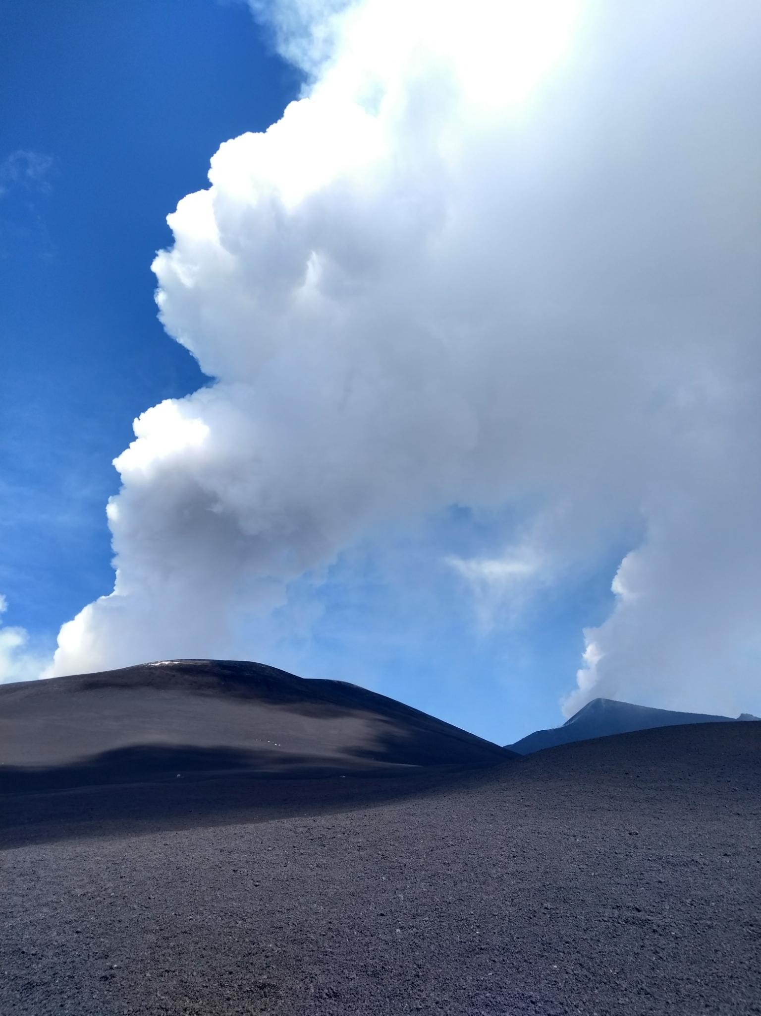
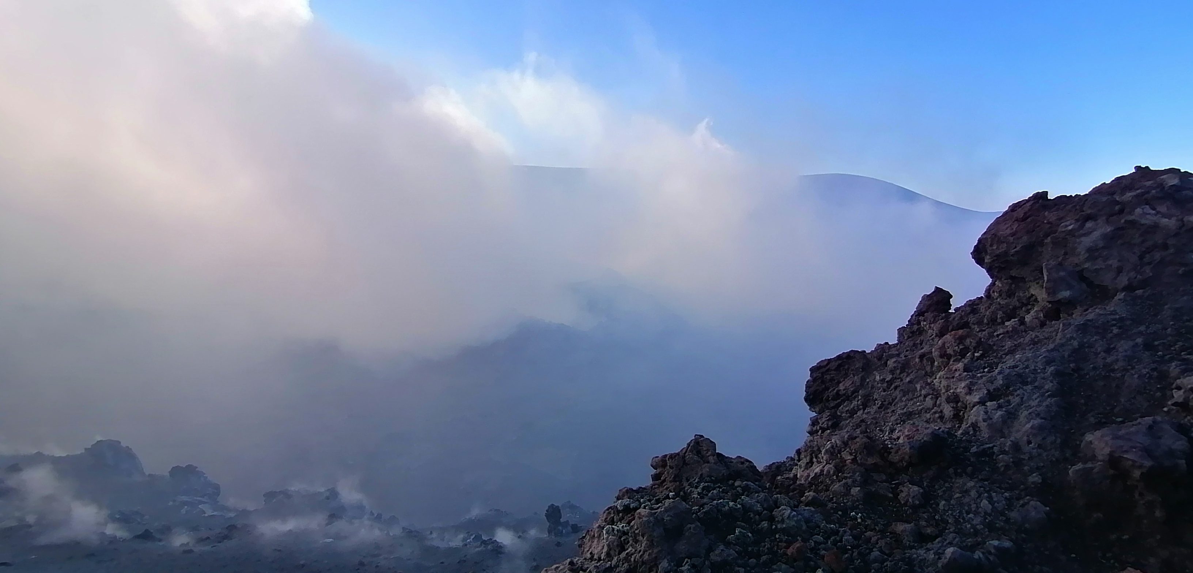
An investigation of high frequency seismic tremor on Mt Etna
This project has received funding from the European Horizon‘s 2020 research and innovation programme under Grant Agreement No 858092
Maurice Weber¹, Christopher J. Bean¹, Patrick Smith¹, Ivan Lokmer², Luciano Zuccarello^{3,4}, Silvio De Angelis^{4,3}, Vittorio Minio⁵
¹ Dublin Institute for Advanced Studies, Ireland; ² University College Dublin, Ireland; ³ Instituto Nazionale di Geofisica e Vulcanologia, Sezione di Pisa, Italy; ⁴ University of Liverpool, UK; ⁵ University of Catania, Italy
Contact: mweber@cp.dias.ie
Conclusion
Next: Running covseisnet localisation tool (source location likelihood distribution) (Soubestre et al., 2018)) to compare source location constraints to beamforming results
Despite heavy scattering constraints of source locations of tremor signals seem to be possible at higher frequencies than looked at usually
A possible tremor source (around 15 Hz) south of Bocca Nuova needs further investigation
Bocca Nuova Crater
View of Bocca Nuova (foreground) and Southeast crater (background) from southwest

