Slide 1
ERA-INTERIM
vs
ERA5
vs
ERA5-LAND
vs
STATION OBSERVATIONS

Slide 2
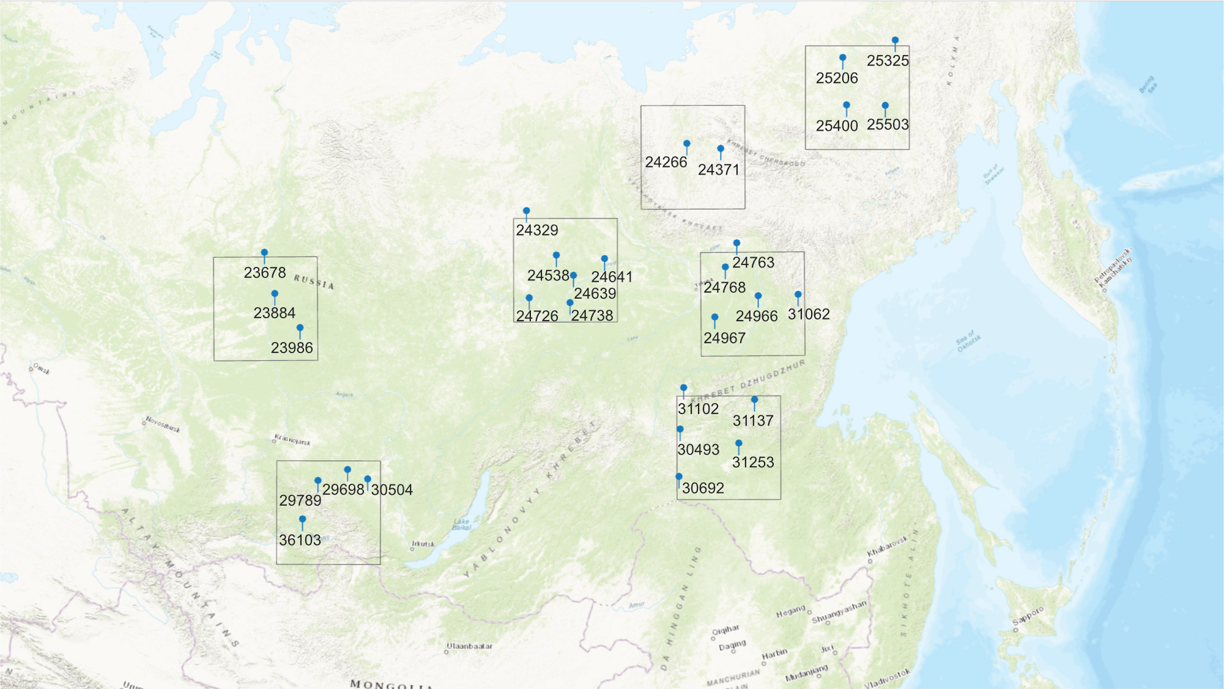

Slide 3
t2m – mean 2-metre air temperature
mx2t – maximum 2-metre air temperature
mn2t – minimum 2-metre air temperature
sd – mean snow depth
tp – total precipitation
wsp – mean wind speed

Slide 4
r – Pearson correlation coefficient
vr – variance ratio
RMSE (root-mean-square error)
Bias
Daily timescale
Seasonal trends
1979-2019

Slide 7
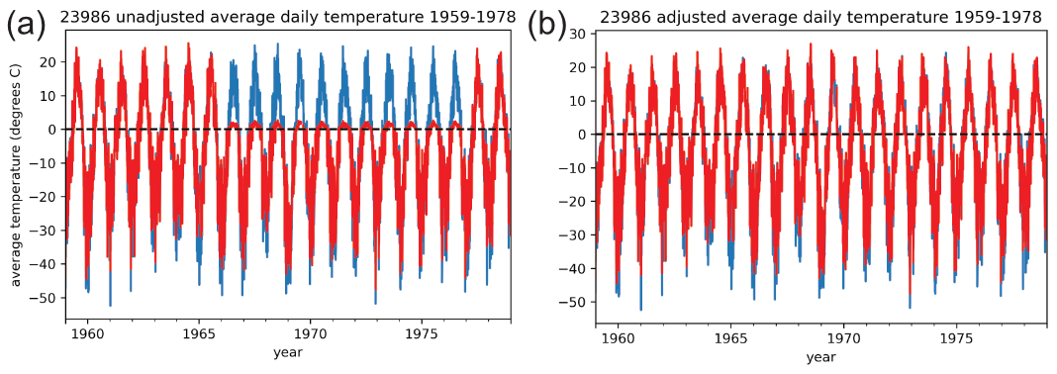

Slide 8
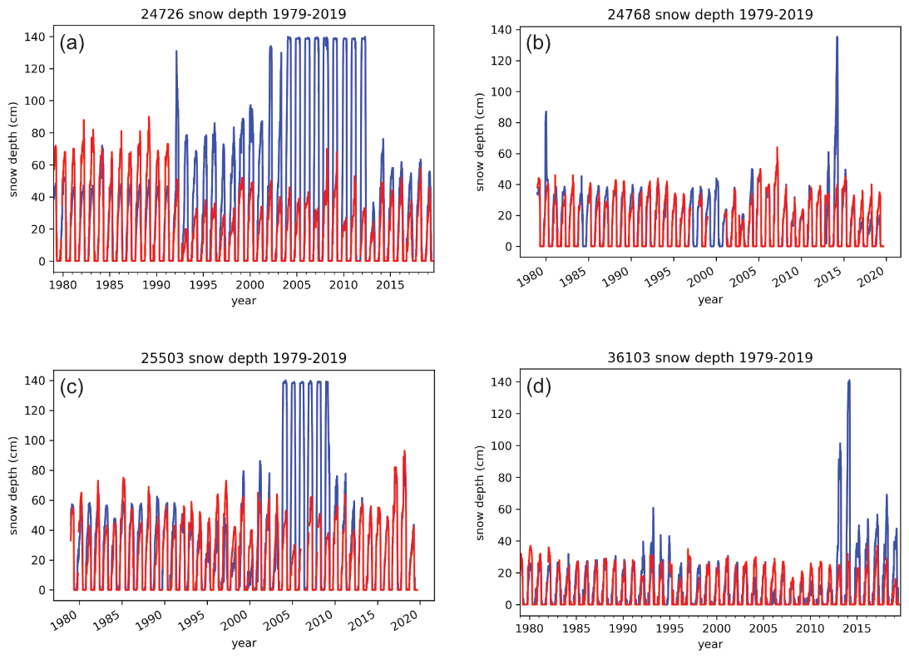

Slide 10
Evaluation of Climate Data from ECMWF Reanalyses over Siberia and the Russian Far East
Andrew Clelland^{1, 2}
Gareth Marshall¹
Robert Baxter²
PICO5.7
andell84@bas.ac.uk
1
2

Slide 11
PICO5.7

Slide 13
Evaluation of Climate Data from ECMWF Reanalyses over Siberia and the Russian Far East
Andrew Clelland^{1, 2}
Gareth Marshall¹
Robert Baxter²
1
2

Slide 14
ERA-INTERIM
vs
ERA5
vs
ERA5-LAND
vs
STATION OBSERVATIONS

Slide 16
r – Pearson correlation coefficient
vr – variance ratio
RMSE (root-mean-square error)
Bias
Daily timescale
Seasonal trends
1979-2019

Slide 17
2-metre air temperature
Snow depth (sd)
2-metre air temperature
Snow depth (sd)
Total precipitation (tp)
Wind speed (wsp)

Slide 18
Minimum
2-metre air temperature (mn2t)
Mean
2-metre air temperature (t2m)
Maximum
2-metre air temperature (mx2t)

Slide 19
t2m – Validation statistics
Reanalysis | Bias (°C) | RMSE (°C) | vr | r
ERA-Interim | -0.43 | 2.66 | 0.96 | 0.991
ERA5 | -0.18 | 2.90 | 0.98 | 0.989
ERA5-Land | -0.50 | 3.01 | 0.94 | 0.989
All reanalyses perform strongly
No significant differences between the reanalyses
Best performing studied climate variable
mx2t

Slide 20
t2m – Reanalyses vs station obs.
mx2t

Slide 21
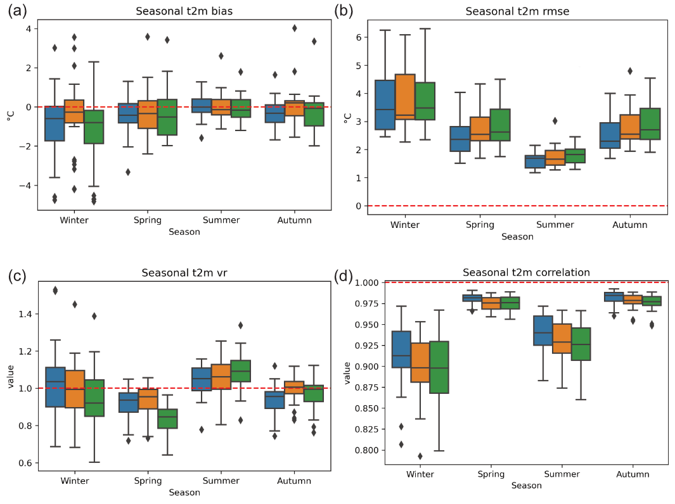
t2m – Seasonal statistics
mx2t

Slide 22
t2m – Using ERA5 (blue) to find errors from stations
Positive temperatures from station 23986 out by a factor of 10, 1966-1976
mx2t

Slide 23
mx2t – Validation statistics
All reanalyses again perform strongly
No significant differences between the reanalyses
Larger biases and RMSE values than with t2m
Reanalysis | Bias (°C) | RMSE (°C) | vr | r
ERA-Interim | 1.54 | 3.57 | 0.90 | 0.988
ERA5 | 1.53 | 3.42 | 0.93 | 0.989
ERA5-Land | 1.57 | 3.34 | 0.94 | 0.989
t2m
mn2t

Slide 24
mx2t – Reanalyses vs station obs.
t2m
mn2t

Slide 25
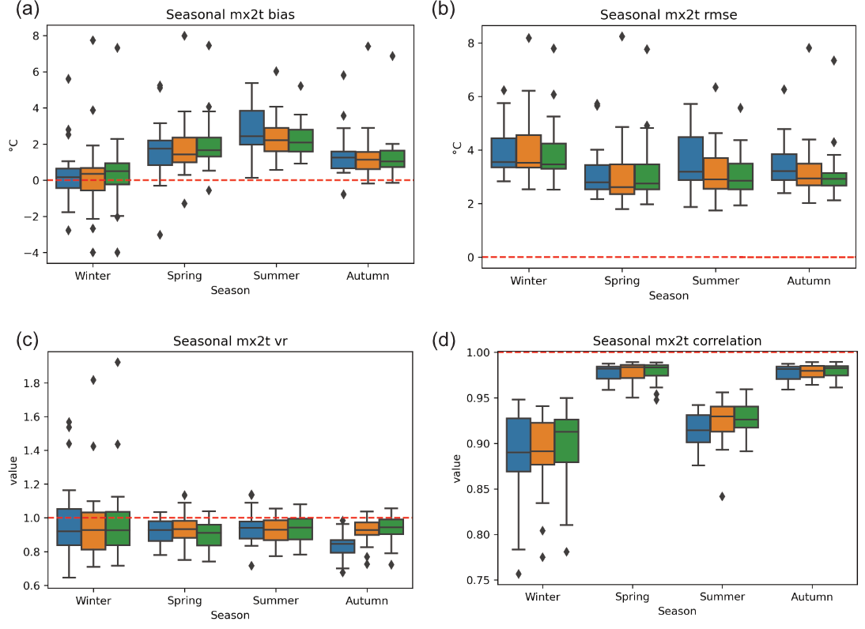
mx2t – Seasonal statistics
t2m
mn2t

Slide 26
mn2t – Validation statistics
Lower r values due to low Summer r values (average 0.66)
No significant differences between the reanalyses
Larger biases and RMSE values than with t2m and mx2t
Reanalysis | Bias (°C) | RMSE (°C) | vr | r
ERA-Interim | -2.16 | 4.89 | 0.89 | 0.972
ERA5 | -1.55 | 4.70 | 0.95 | 0.972
ERA5-Land | -1.79 | 4.69 | 0.95 | 0.973
mx2t
sd

Slide 27
mn2t – Reanalyses vs station obs.
Weaker performance at extreme low temperatures than t2m and mx2t
mx2t
sd

Slide 28
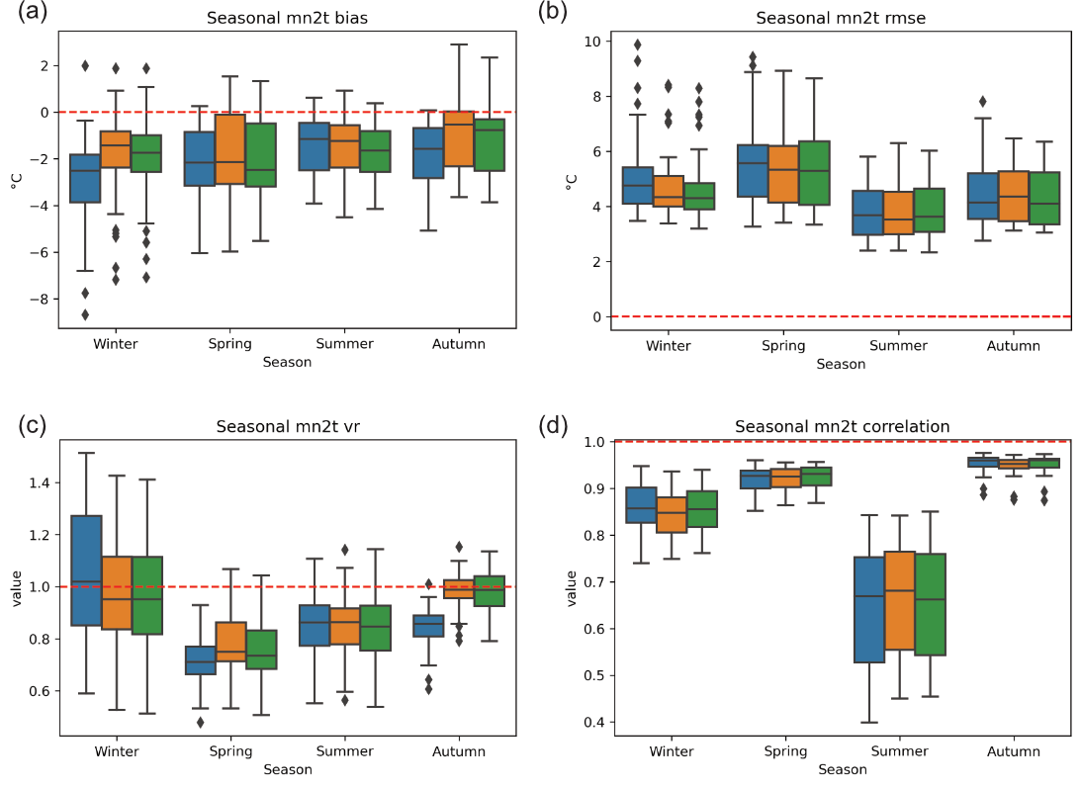
mn2t – Seasonal statistics
mx2t
sd

Slide 29
sd – Validation statistics
 | Bias (cm) |  | RMSE (cm) |  | vr |  | r
Reanalysis | 79-91 | 92-19 | 79-91 | 92-19 | 79-91 | 92-19 | 79-91 | 92-19
ERA-Interim | -1.85 | -3.15 | 10.83 | 11.76 | 1.21 | 2.37 | 0.857 | 0.868
ERA5 | -5.17 | -1.60 | 12.78 | 6.18 | 2.22 | 1.59 | 0.875 | 0.957
ERA5-Land | -7.12 | -5.73 | 14.41 | 11.79 | 2.48 | 2.13 | 0.877 | 0.923
Significant differences before and after 1992, especially in ERA5, as the data don’t assimilate before
ERA-Interim post-1992 statistics skewed by errors at some stations
mn2t
tp

Slide 30
sd – Reanalyses vs station obs.
Limit of 140 cm in ERA-Interim?
Large underestimation of extreme high snow depths
mn2t
tp

Slide 31
sd – Using station data to find errors in ERA-Interim (blue)
mn2t
tp

Slide 32
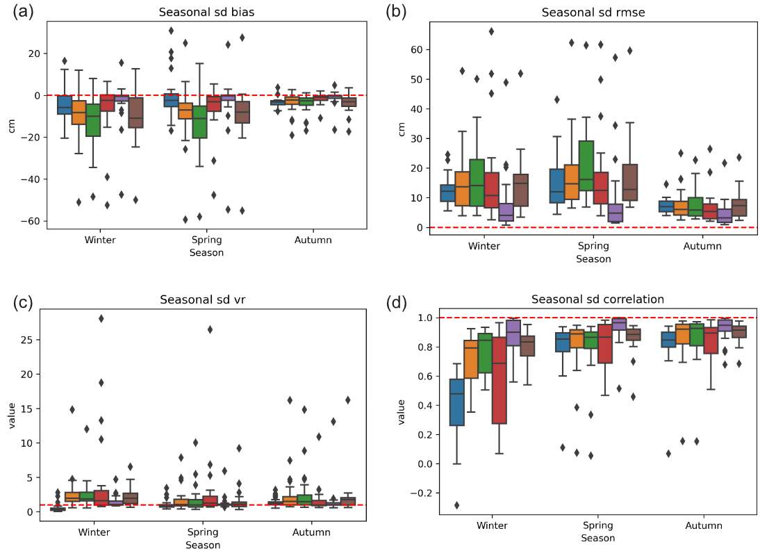
sd – Seasonal statistics (excluding Summer)
mn2t
tp

Slide 33
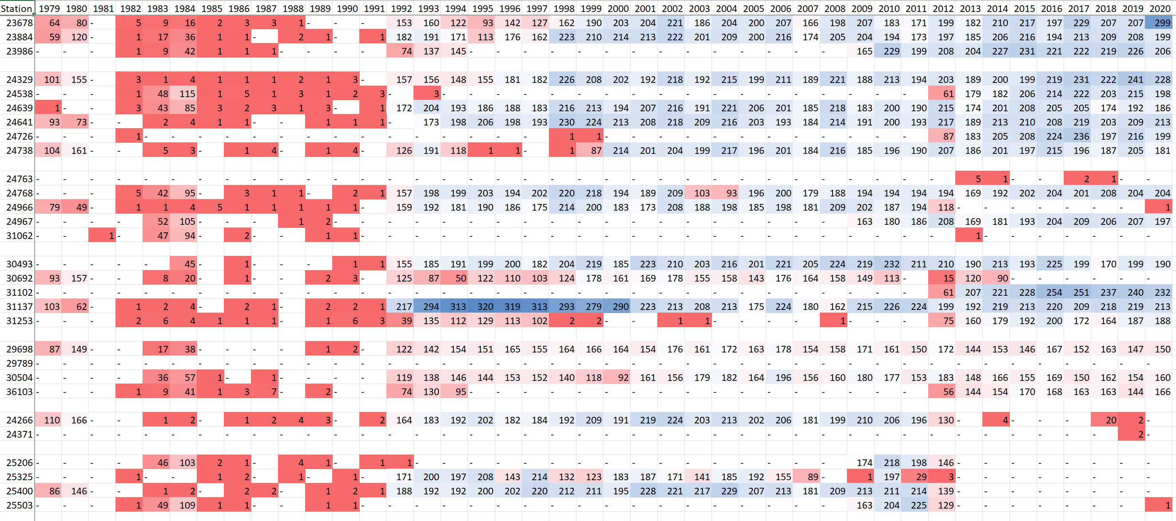
ERA5 sd assimilation values at each station
mn2t
tp

Slide 34
sd – Stations with high post-1992 assimilation counts in ERA5
ERA5 in blue
mn2t
tp

Slide 35
sd – Stations which (almost) never assimilate in ERA5
No consistency!
mn2t
tp

Slide 36
tp – Validation statistics
Reanalyses drastically underestimate station readings
ERA5 and ERA5-Land marginally better than ERA-Interim
Weakest performing studied variable
Reanalysis | Bias (mm) | RMSE (mm) | vr | r
ERA-Interim | -0.26 | 2.93 | 0.82 | 0.483
ERA5 | -0.30 | 2.97 | 0.96 | 0.501
ERA5-Land | -0.30 | 2.96 | 0.96 | 0.504
sd
wsp

Slide 37
tp – Reanalyses vs station obs.
Large underestimations, especially at extreme high precipitations
sd
wsp

Slide 38
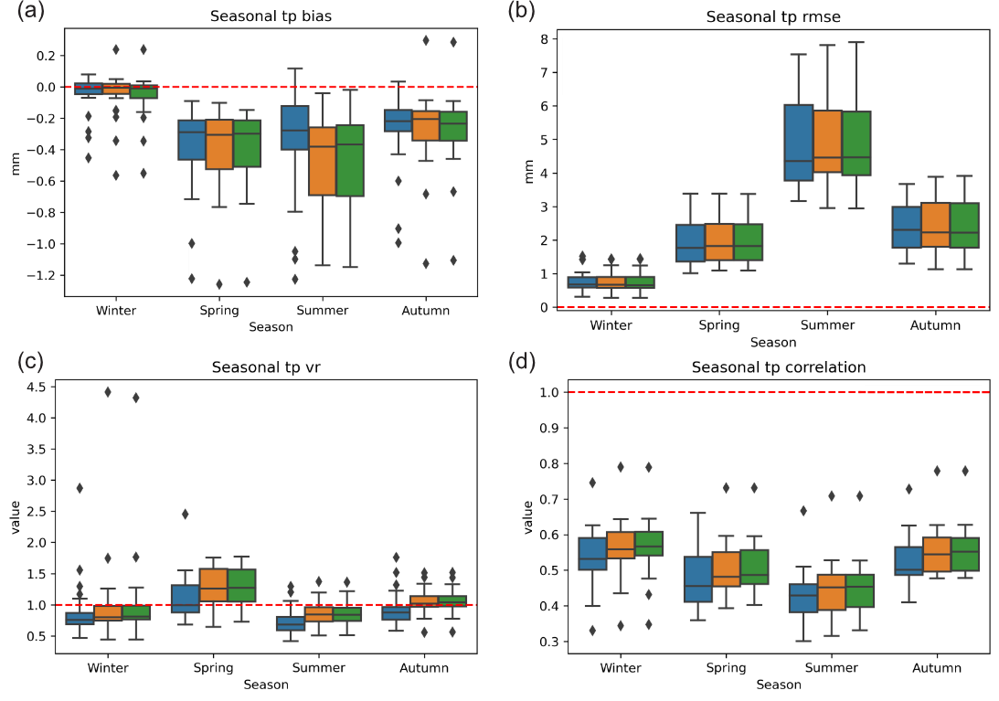
tp – Seasonal statistics
sd
wsp

Slide 39
wsp – Validation statistics
Reanalysis | Bias (ms⁻¹) | RMSE (ms⁻¹) | vr | r
ERA-Interim | -0.71 | 1.31 | 1.19 | 0.591
ERA5 | -0.46 | 1.09 | 1.01 | 0.614
ERA5-Land | 0.05 | 0.94 | 0.54 | 0.626
Reanalyses overestimate at low speeds (< 2.5 ms⁻¹) but drastically underestimate at higher speeds
Both ERA5 and ERA5-Land perform better than ERA-Interim
tp

Slide 40
wsp – Reanalyses vs station obs.
ERA5-Land best at lower speeds but ERA5 best for extreme high speeds (> 5.0 ms⁻¹)
tp

Slide 41
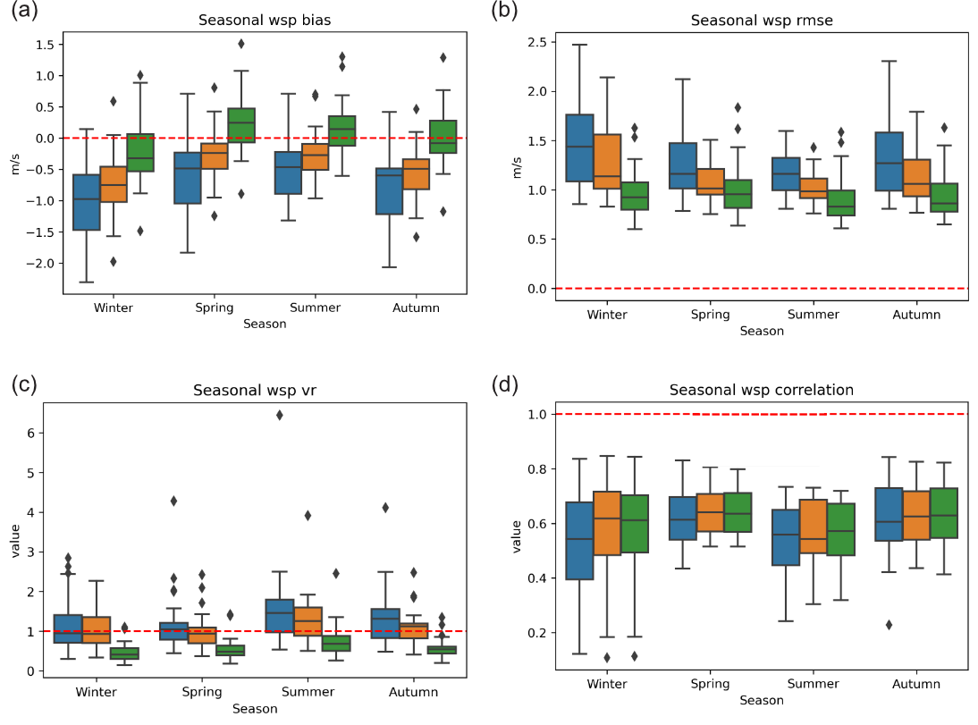
wsp – Seasonal statistics
tp

