Slide 1
Exploring the use of remotely-sensed Earth’s entropy production to reveal the ecological fitness of forests Guido J.M. Verstraeten¹ and Willem W. Verstraeten² ¹ Satakunta University of Applied Sciences, Bjorneborg-Pori, Suomi-Finland: gjmverstraeten@hotmail.nl ² KMI, Royal Meteorological Institute of Belgium, Ukkel, Belgium
Notes:
1

Slide 2
Key Notes:
Earth produced living organism to decrease its entropy production (Nobel Prize Winner Roger Penrose)
What does Remote Sensing reveal about vegetation biodiversity shift?
Which forests are the most vulnerable for Global Warming or Human Activity?
Does Earth’s Entropy Production Shift awake Planet’s ecological care for a good forest management?
An exploratory study
Notes:
2

Slide 3
Data
MODIS LST_cci : Land surface temperature from MODIS for 2002-2018 (Ghent, Veal, Perry, 2022).
See also: ESA Land Surface Temperature Climate Change Initiative (LST_cci): Land surface temperature from MODIS (Moderate resolution Infra-red Spectroradiometer) on Aqua, level 3 collated (L3C) global product (2002-2018), version 3.00
Notes:
3

Slide 4
Theoretical background
Stefan-Boltzmann radiation Law
Hubbell’s Unified Neutral Theory of Biodiversity and Biogeography
Wien radiation law abandoned (only for adiabatic processes)
Shannon Entropy Function

Slide 5
A priori terms and adopted areas
Small surface area in order to get a lognormal species distribution
Markow system and ergodic dynamics in order to apply Boltzmann’s Stosszahlansatz and equipartion law after relaxation time
June averaged monthly LST
Boreal Forest (Finland)
Deciduous Forest (Sonien Forest, Flanders)
Mediterranean Forest (Central Spain)
Rain Forest (Congo-Kinshasa)
See last slides for specific locations of the forests

Slide 6
Thermal Radiantion & Thermodynamical backround 1
Stefan –Boltzmann Law :
P (power) = A (surface) . σ . T⁴ with σ = 5.670374419 10⁻⁸ W/m²K⁴
Solar Radiation T = 5778K => Earth average temperature T=255K
λ increase => ν decrease: more photons emitted than absorbed by Earth. Consequently there is entropy production
Emitted Heat is Enthalpy: H= U + p.V & dH = TdS + Vdp (S: Entropy)
We assume constant pressure during received signals from examined Earth’s surface => dH= TdS
dS= dQ/T (dQ emitted Heat by Earth)

Slide 7
Four areas: LST data MODIS

Slide 8
Four areas

Slide 9
Thermal Radiantion & Thermodynamical backround 2
We measure the averaged June land surface temperature of the four examined areas from 2003 till 2018
ΔS/Δt = ( S_{t2} – S_{t1})/Δt
ΔS/Δt = A .σ.(T³₂₀₀₄ – T³₂₀₀₃) and so on till 2018
Time lapse: one year-entropy shift calculated over two successive measured land surface temperatures of June

Slide 10
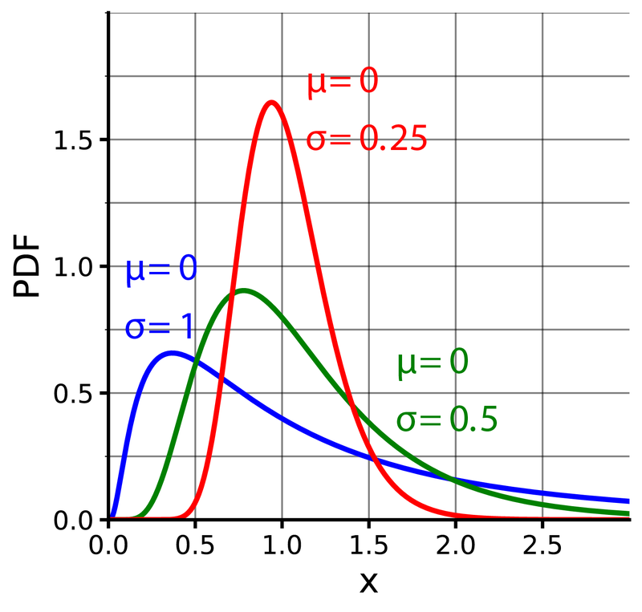
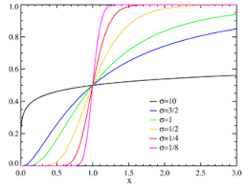
Lognormal distribution

Slide 11
Hubbell’s Neutral Theory of species abundance

Slide 12
Shifting Thermal entropy production and shifting Biodiversity
Shannon Entropy : ½ + ½ln(2πσ) + µ
µ: average
σ: standard deviation
Thermodynamic Entropy = - kb x Shannon Entropy (kb, Boltzmann constant)
ΔS/Δt = ( S_{t2} – S_{t2})/ Δt = - kb ln(σ₂/σ₁)
ΔS/Δt < 0 means σ₂ > σ₁ or increase in biodiversity
ΔS/Δt > 0 means σ₂ < σ₁ or decrease in biodiversity

Slide 13
Time Lapse of Entropy Production North Congo: Rain Forest

Slide 14
Time Lapse of Entropy Production Sonian Forest : Deciduous Forest

Slide 15
Time Lapse of Entropy Production: Comparing Subarctic and Mediterranean Forest

Slide 16
Community diversity Number Shift
Θ = 2.ρ. A_{n}. Ν
Θ: diversity number, Hubbell p. 122
ρ: species density
A_{n}: study surface area
ν (speciation) = 1 – σ₂/σ₁
θ_{i} = 1 (by normalization)
Θ_{f} = ( 1 – exp( –ΔS/kb) ).θ_{i}
ΔS: Entropy shift from 2003 till 2018, kb Boltzmann constant

Slide 17
Preliminairy conclusions 1
Within the period of 16 year due to climate change stress (Sonian deciduous Forest) and human activity (North Congo Rain Forest) the biodiversity is declining, but not statistical significant.
There is no evidence within the same period for declining biodiversity due to climatic stress and Human activity in subarctic and Mediterranean forest.

Slide 18
Preliminairy conclusions 2
The above mentioned conclusions might claim that rain forest is extremely vulnerable for unpredictable weather shifts and human activity
Further refinement is recommended to include precipitation shift and air pressure shift in the above examined areas
Refinement is also recommended for boreal forest because of small species biodiversity (binomial species abundance distribution instead of lognormal) and the Eustatic uplift of Finland (0.15 m average from 2003 till 2018)
The vegetation of Mediterranean areas is most resistant to global warming. Moreover, because the CO₂ capture of these vegetation is larger than the CO₂ capture of deciduous forests, management of the Mediterranean Forest is highly recommended
Notes:
18

Slide 19
References
Bannon, Peter.R. and Najjar, Raymond G. , Heat-Engine and Entropy-Production Analyses of the World Ocean, Journal of Geophysical Research: Oceans 10.1029/2018JC014261, 2018
Hubbell, S. P., The Unified Neutral Theopry of Biodiversity and Biogeography , Princeton University Press, 2001
Walawender, J.P et all., Land Surface Temperature Patterns in the Urban Agglomeration of Krakow (Poland) Derived from Landsat-7/ETM+ Data, Pure Appl. Geophys. 171 (2014), 913–940
Ghent, D.; Veal, K.; Perry, M. (2022): ESA Land Surface Temperature Climate Change Initiative (LST_cci): Land surface temperature from MODIS (Moderate resolution Infra-red Spectroradiometer) on Aqua, level 3 collated (L3C) global product (2002-2018), version 3.00. NERC EDS Centre for Environmental Data Analysis, 25 February 2022. doi:10.5285/6babb8d9a8d247bcb3da6aed42f4b59a. http://dx.doi.org/10.5285/6babb8d9a8d247bcb3da6aed42f4b59a

Slide 20
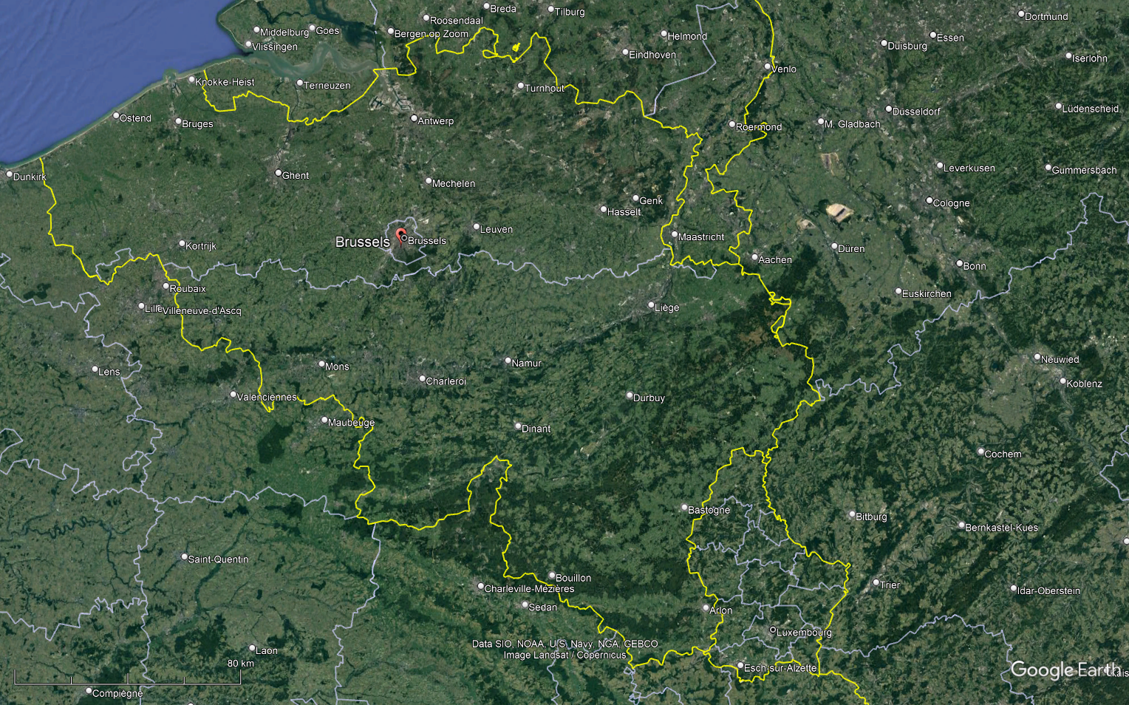
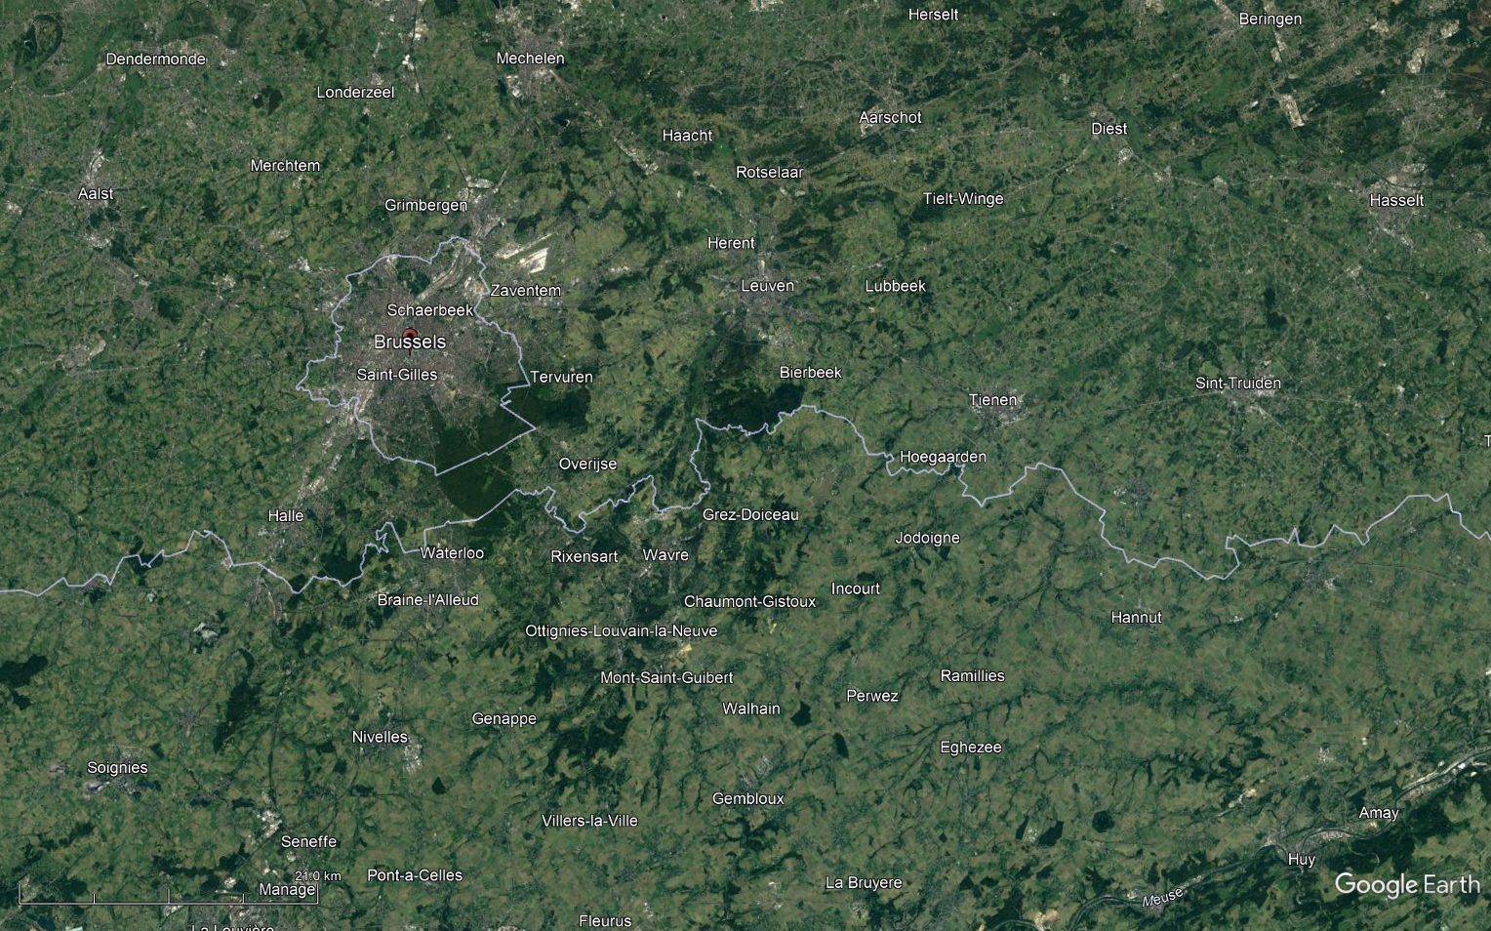
Central point:
50.7560N; 4.4787E
Sonian Forest, Belgium

Slide 21
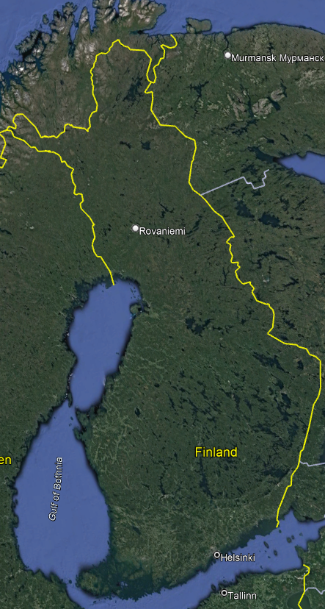
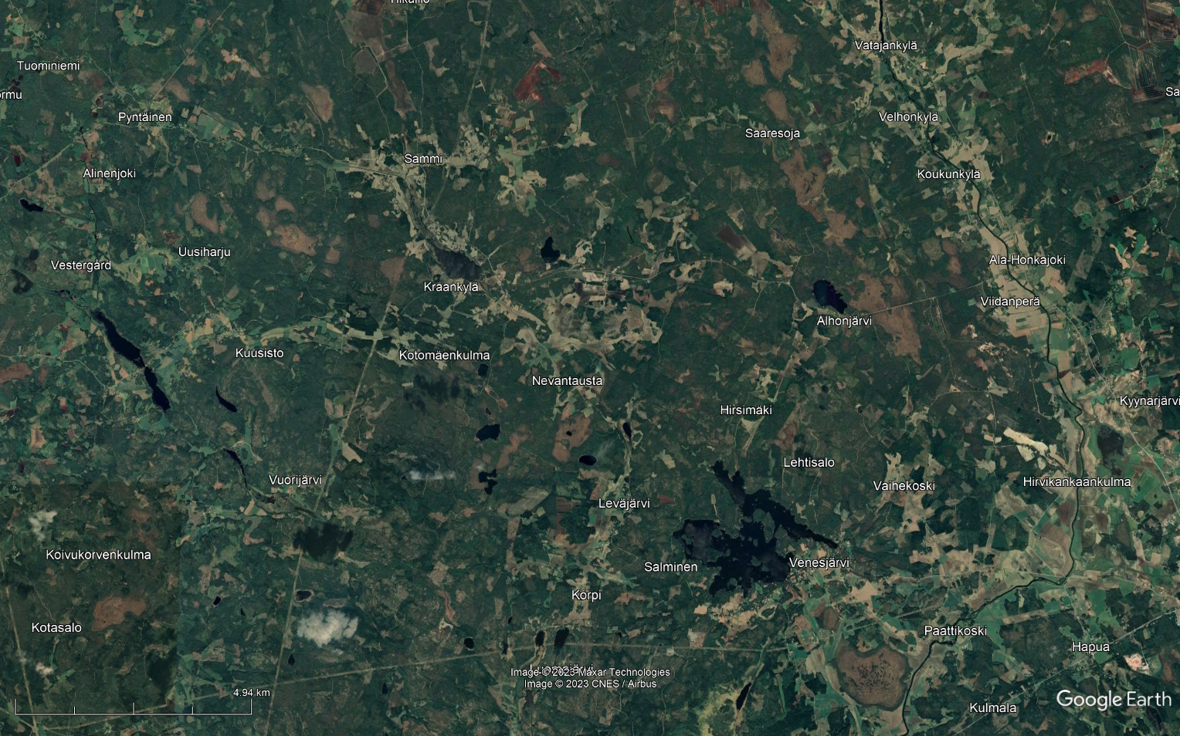
61.8796N, 21.9797E
SW Finland

Slide 22
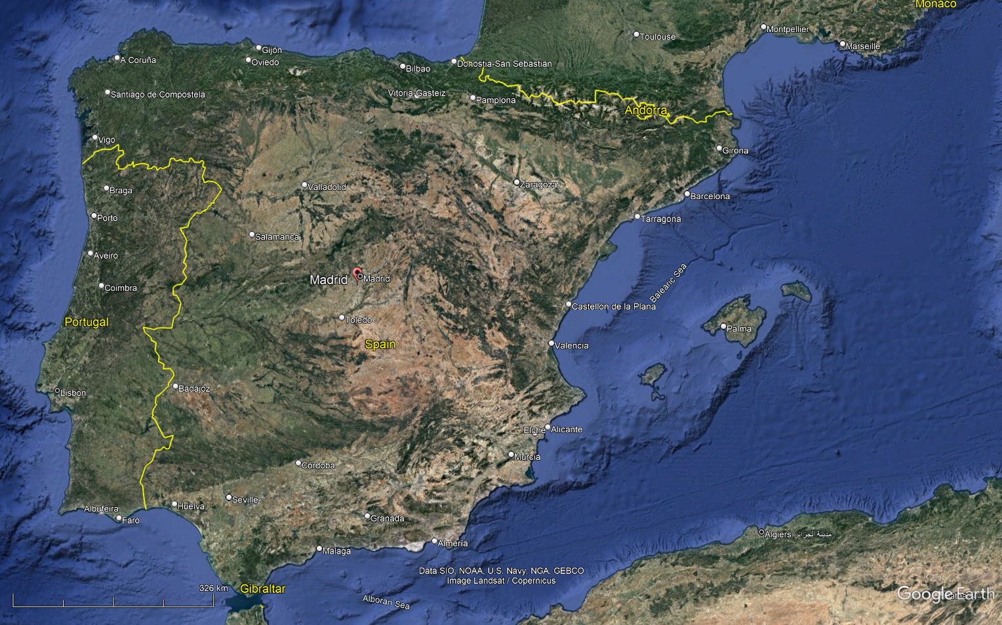
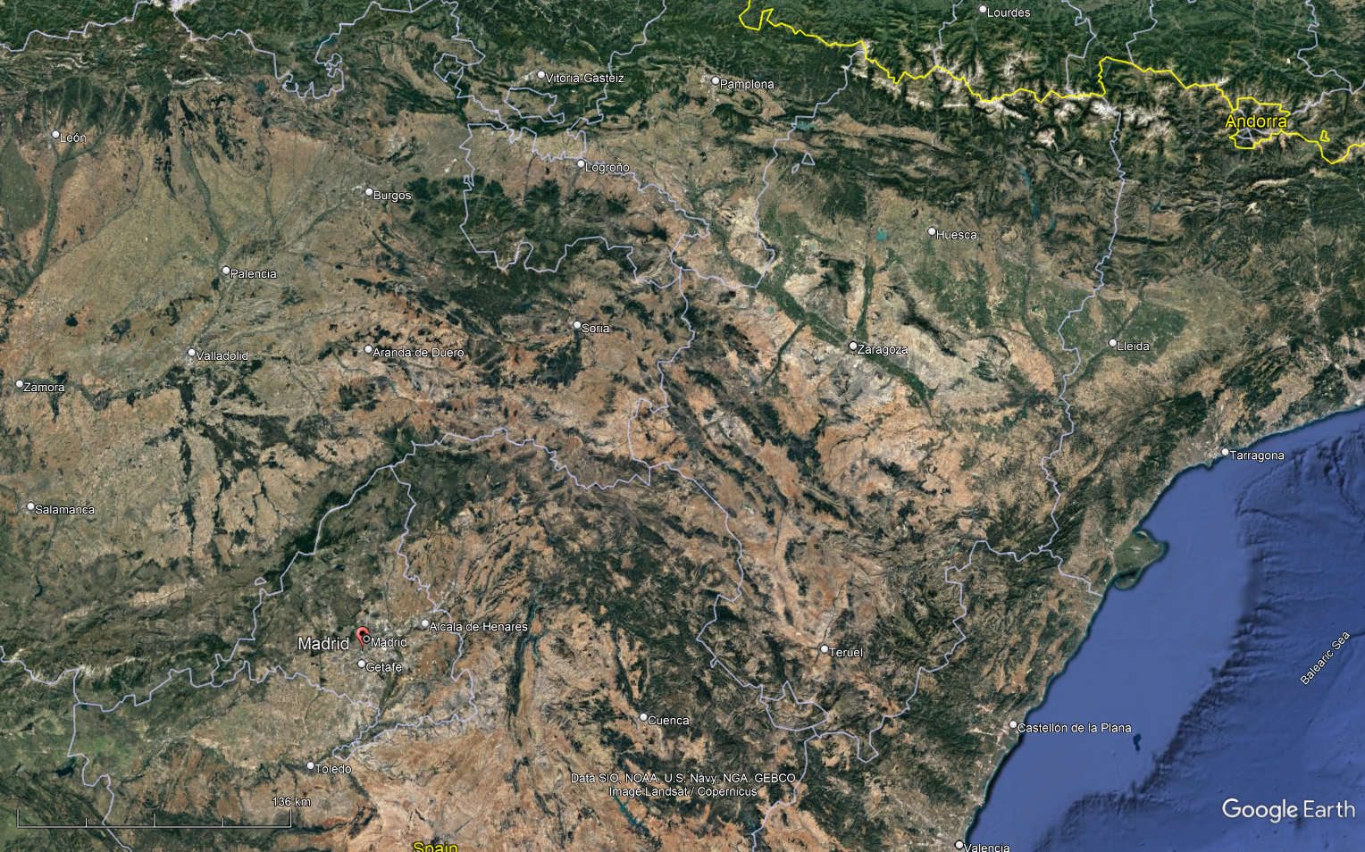
41.8744N, -2.9633
Central Spain

Slide 23
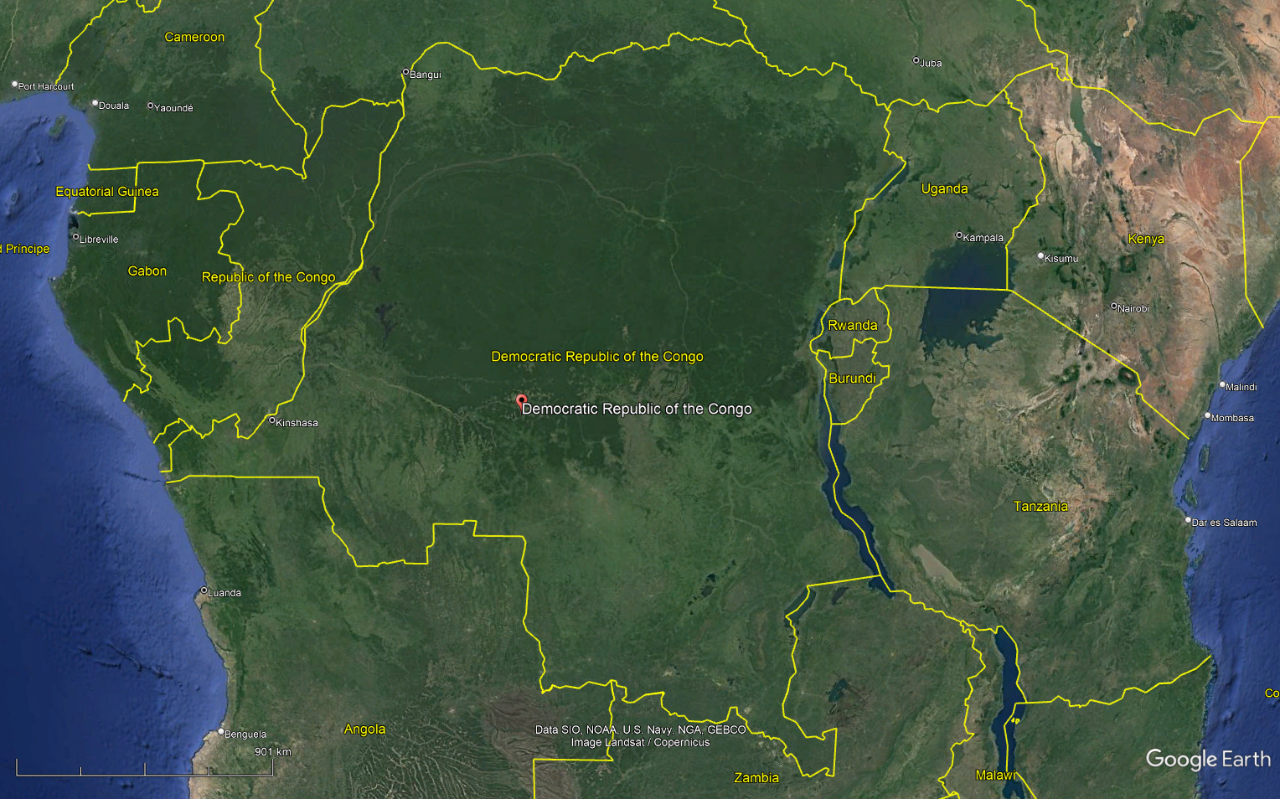
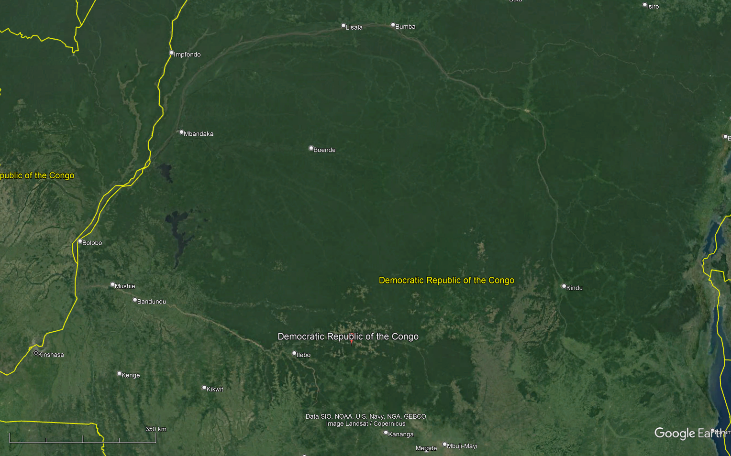
-0.4659N, 21.1822E
North Congo

