Slide 1
End to end attribution:
From hot air to environmental injustice
Michael F. Wehner
Lawrence Berkeley National Laboratory
European Geophysical Union
April 25, 2023
Supplementary information

Slide 2
US DOE Policy 411.2A
SUBJECT: SCIENTIFIC INTEGRITY
When expressing opinions on policy matters to the public and media, research personnel must make it clear when they are expressing their personal views, rather than those of the Department, the U.S. Government, or their respective institutions. Public representation of Government or DOE positions or policies must be cleared through their program management to include DOE headquarters.
In accordance with this policy, any material in this presentation should be considered the opinion of the speaker and not necessarily that of the US Dept. of Energy, the University of California or the Lawrence Berkeley National Laboratory.
Permission to record and/or distribute is granted freely.

Slide 3
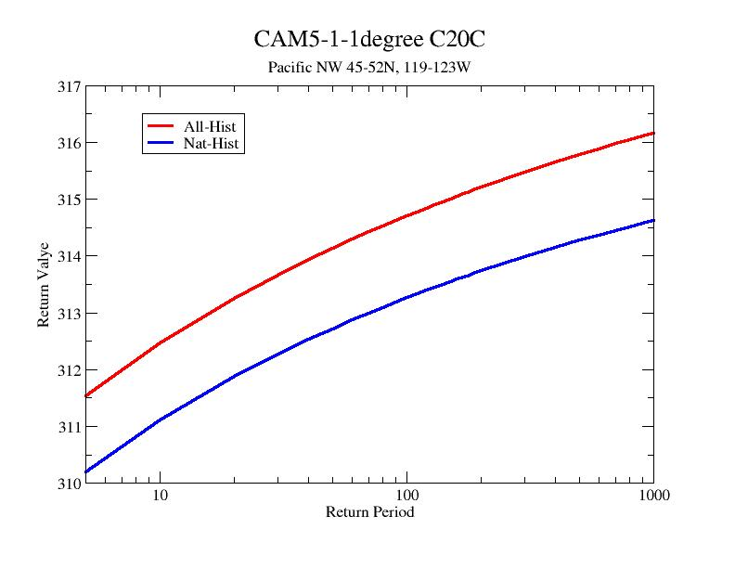
The typical weather event attribution questions:
“How has the probability of this event changed because of climate change?”
Or
“How did climate change affect the magnitude of this event?”
Public attention often focuses on the first question.
30 times more likely sounds bigger than a 2º increase.
These are two sides of the same question.
2021 Pacific Northwest heatwave.
Red: World with climate change
Blue: World without climate change
Fix the magnitude
Fix the probability.

Slide 4
Impact questions are slightly different
How much did climate change cost in this event?
How many people died because of climate change?
Or more personally,
Did climate change flood my house?
Did climate change kill my loved one?
These may or may not be tractable questions.
Fundamentally, they are linked to the change in magnitude question. (Mostly).

Slide 5
Harvey
August 2017
NOAA

Slide 6
National Hurricane Center

Slide 7
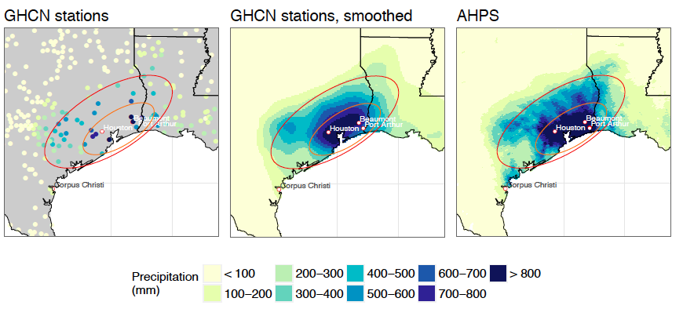
Global warming to rain
Hurricane Harvey produced copious amounts of precipitation
3 independent groups analyzed the attributable precipitation increase due to anthropogenic global warming.
All made best estimates exceeding that expected by Clausius-Clapeyron scaling (~7% from 1C of warming in the Gulf).
3 different modeling methods
3 different observational data sets
Risser & Wehner: 24%
van Oldenborg et al: 16%
Wang et al: 20%
Average ~19%
Upper bound 38%
Lower bound 7%

Slide 8
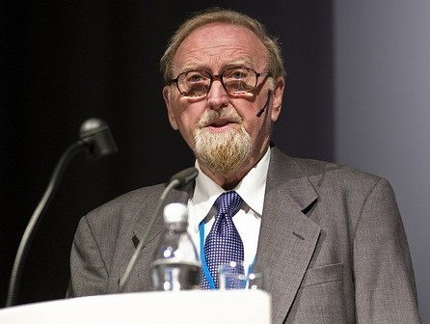
An aside: Extreme Event Attribution is causal inference.
Two complementary philosophies
Design ensembles of climate model simulations tailored to event attribution.
Actual world vs counterfactual world without human changes to the atmosphere. A direct interference.
Pearl causal inference.
Analyze observed trends with a statistical model.
Postulate a plausible cause but beware of hidden covariates.
Granger causal inference.
Prof. Judea Pearl, UCLA
Sir Clive Granger (1934-2009)

Slide 9
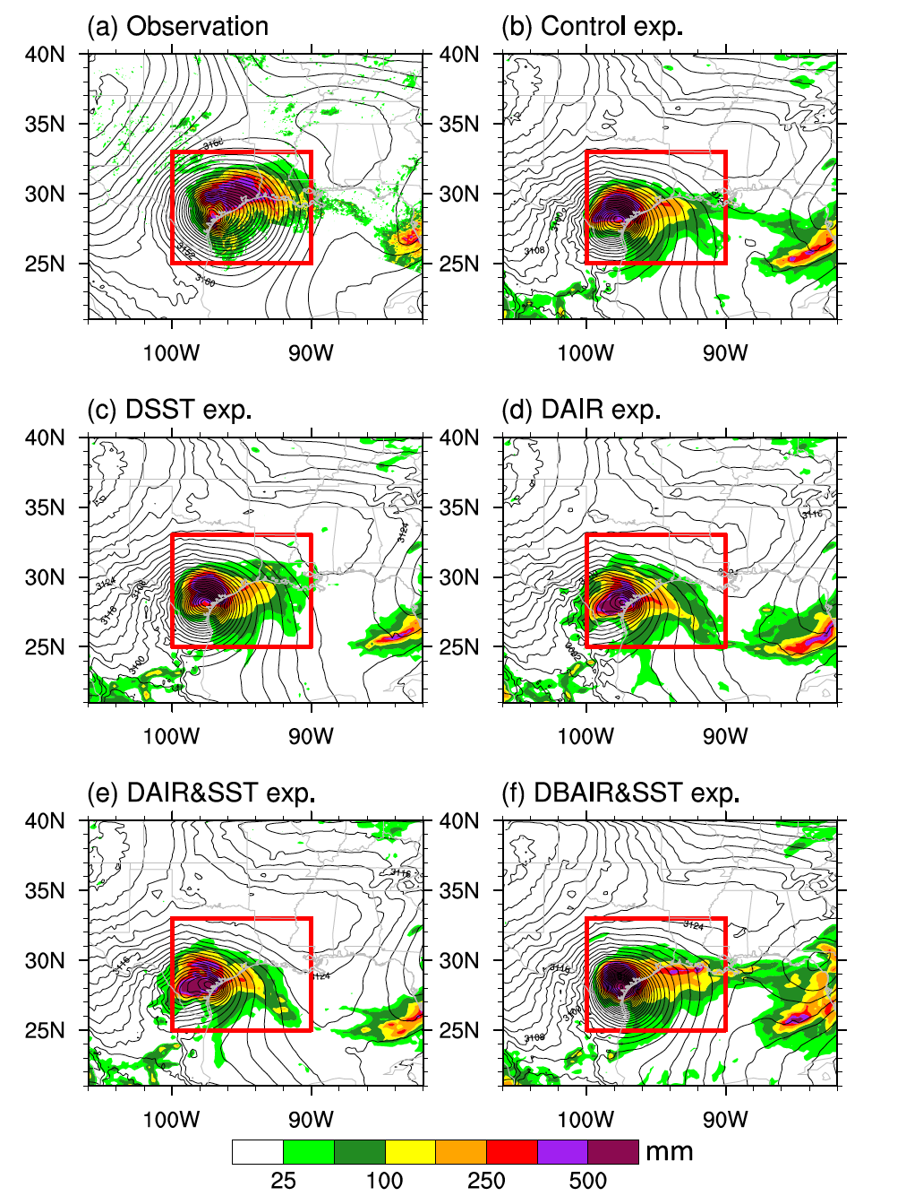
Pearl Causal inference via a storyline
Wang et al (2018)
The storm that was
WRF downscaling of the GFS initial condition data
The storm that might have been.
Same but perturbed by the CESM LE (about 1C attributable warming in the Gulf of Mexico)
Climate change increased Harvey’s precipitation by 20%
Wang et al. (2018) “Quantitative Attribution of Climate Effects on Hurricane Harvey’s Extreme Rainfall in Texas.” Environmental Research Letters 13:054014.

Slide 10
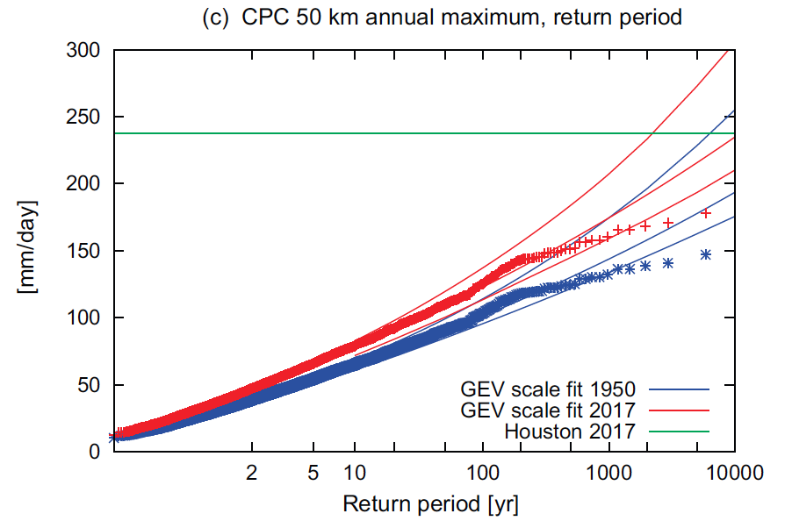
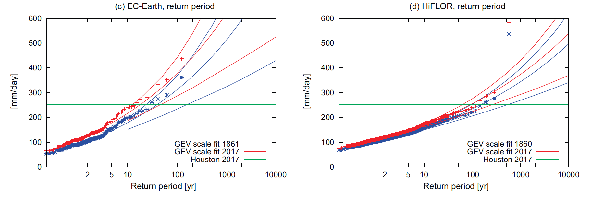
Pearl Causal inference without a storyline (“Traditional”)
van Oldenborg et al 2017
3 climate models. EC-Earth, GFDL HiFlor, HadRM3p
Ensembles of longer runs of varying length.
Harvey was not wired in by initial conditions.
Plus a GEV statistical model to estimate rarity from CPC observations.
Combined this information.
Likely range of precipitation increase of 8-19%
van Oldenborg et al. (2017). “Attribution of Extreme Rainfall from Hurricane Harvey, August 2017.” Environmental Research Letters 12:124009.

Slide 11
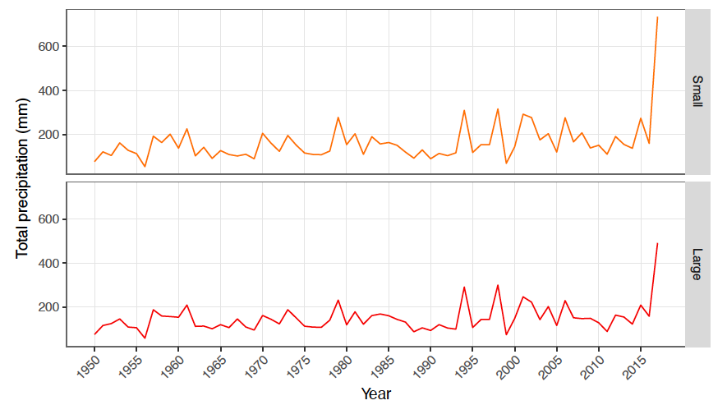
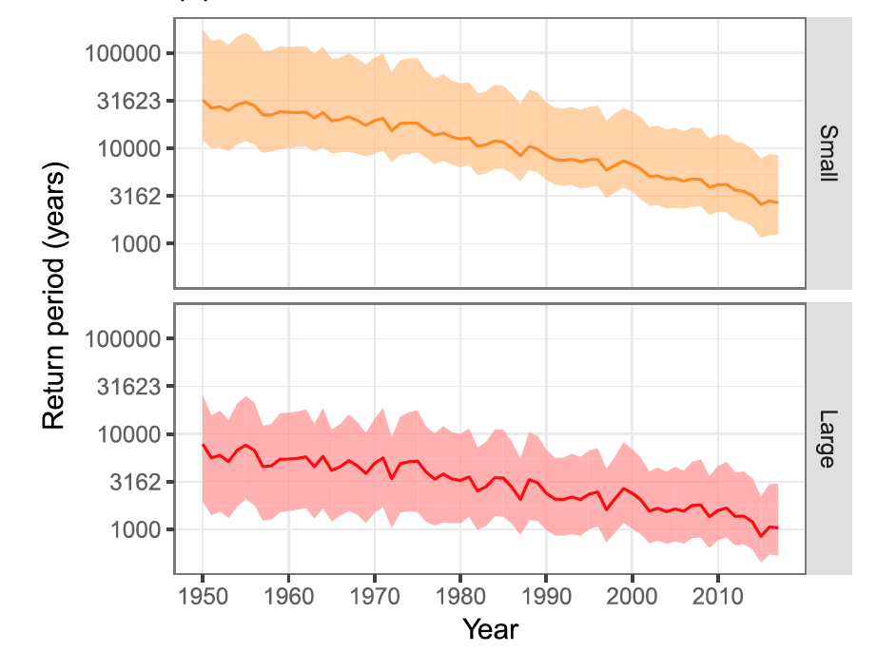
Hurricane Harvey (Risser & Wehner 2017)
1=ln(CO₂)_{t}
2=NINO3.2_{t}
Best fit, AIC

Slide 12
Hurricane Harvey (Risser & Wehner 2017)
Consider this Granger attribution statement on the change in magnitude of total Hurricane Harvey precipitation, altering the co-variates in the statistical model: A “statistical counterfactual”
Mark D. Risser and Michael F. Wehner (2017) Attributable human-induced changes in the likelihood and magnitude of the observed extreme precipitation in the Houston, Texas region during Hurricane Harvey. Geophysical Review Letters. 44, 12,457–12,464. https://doi.org/10.1002/2017GL075888

Slide 13
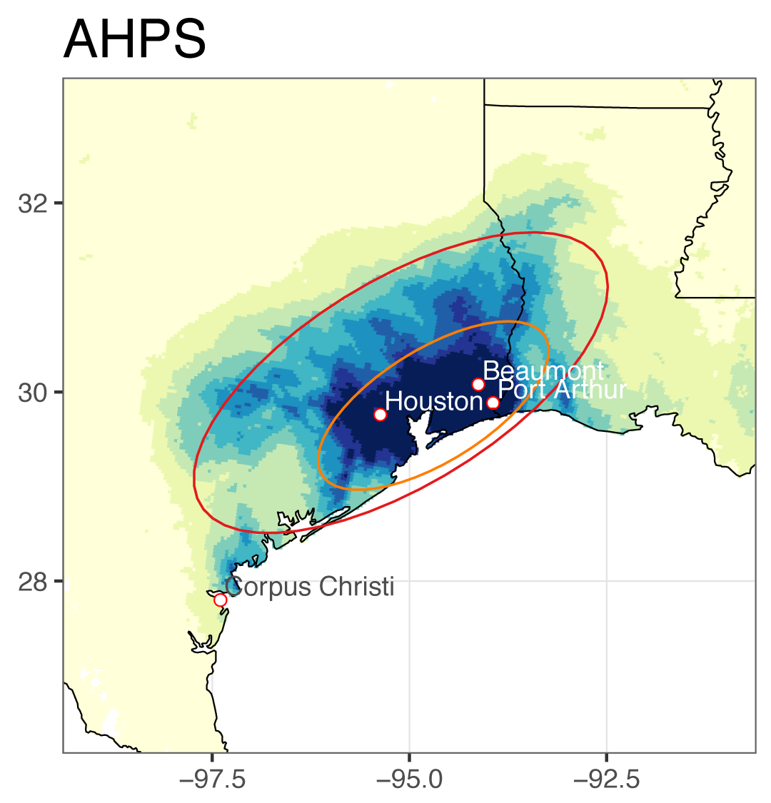
Rain to flood
How did this attributable increase in precipitation affect the flood?
Design a storyline attribution analysis of the flood. (Pearl causality)
The “flood that was”.
Fathom 30m hydraulic model driven by precipitation from the NOAA National Weather Service Advanced Hydrologic Prediction Service (AHPS)
The “flood(s) that might have been”.
Alter the rainfall uniformly by the published attribution statements.
Published ranges are 7-38% increases
e.g. Risser & Wehner’s 24% statement
Decrease observed precipitation by 1/1.24=0.81
Michael Wehner and Christopher Sampson (2021) Attributable human-induced changes in the magnitude of flooding in the Houston, Texas region during Hurricane Harvey. Climatic Change. 166, 20 https://doi.org/10.1007/s10584-021-03114-z

Slide 14
Did climate change flood my South Houston house?
Flood that was Flood that might have been
Best estimate rain increase | Best estimate flood area increase | Crude estimate attributable cost | RR
19% | 14% | US$13Bn | 4
A best estimate of the insured losses from Hurricane Harvey is US$90Bn.
“The probability of a US$90Bn hurricane loss in Texas was quadrupled due to climate change.”

Slide 15
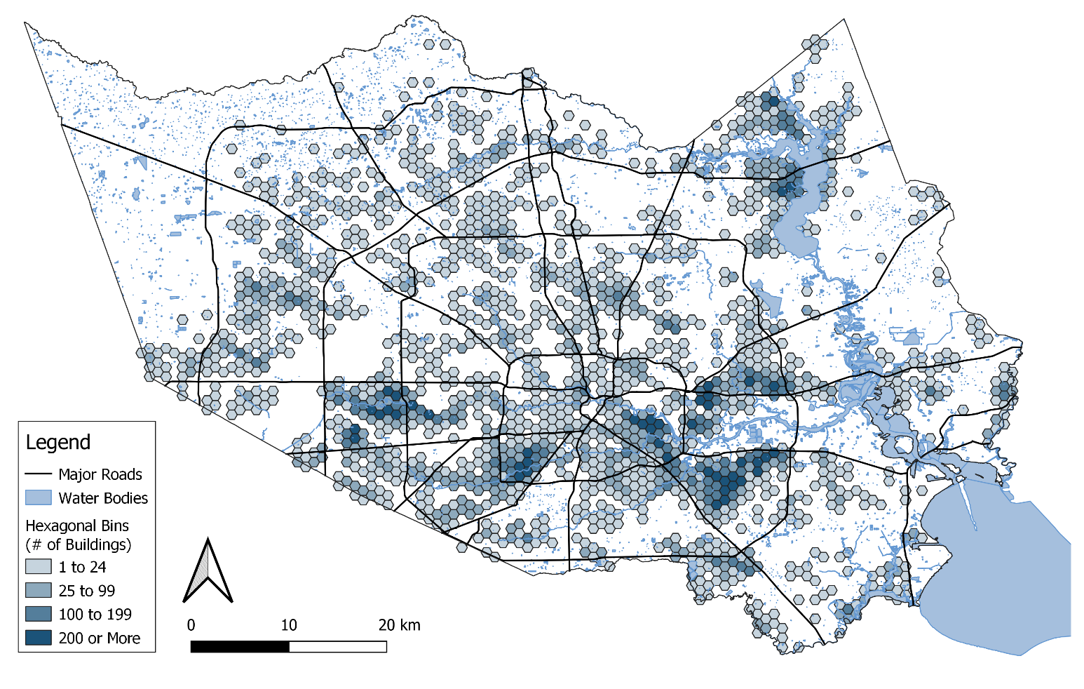
Flood to impacts
Combine the flood maps of Wehner & Sampson with real estate maps
Best estimate: 32% of flooded homes in Harris County would not have been flooded without climate change (Plausible total attributable loss = US$120Bn X .32 = US$38Bn)
36% of the population are in low income Hispanic households
but 50% of flooded properties are in these neighborhoods (Environmental injustice)
Climate change increases this proportion a little.
Kevin T. Smiley, Ilan Noy, Michael Wehner, Dave Frame, Christopher Sampson and Oliver E.Wing (2022) Social Inequalities in Climate Change-Attributed Impacts of Hurricane Harvey. Nature Communications 13, 3418 https://doi.org/10.1038/s41467-022-31056-2

Slide 16
Flood to impacts
32% of flooded homes in Harris County would not have been flooded without climate change (best estimate, 20% precipitation increase).
75% of the flooded homes were outside the Federal 100 year flood plain and thus uninsured.
NOAA estimated loss=$120Bn
Deutsche Re/Swiss Re insured loss=$90Bn
Using census data permits further socioeconomic analysis
Income & Race
Single/multi-family residence
Mobile homes

Slide 18
Socio-economic disparity
Harvey flood damages were not distributed equally across socio-economic groups.
Regardless of precipitation change estimate, low-income Hispanic communities were disproportionately affected.
In high income (white) neighborhoods, the richer you were the greater the financial damage.
In low income, Hispanic neighborhoods, the poorer you were, the greater the financial damage.
No statistical significance of income trends in non-white, non-Hispanic neighborhoods.

Slide 19
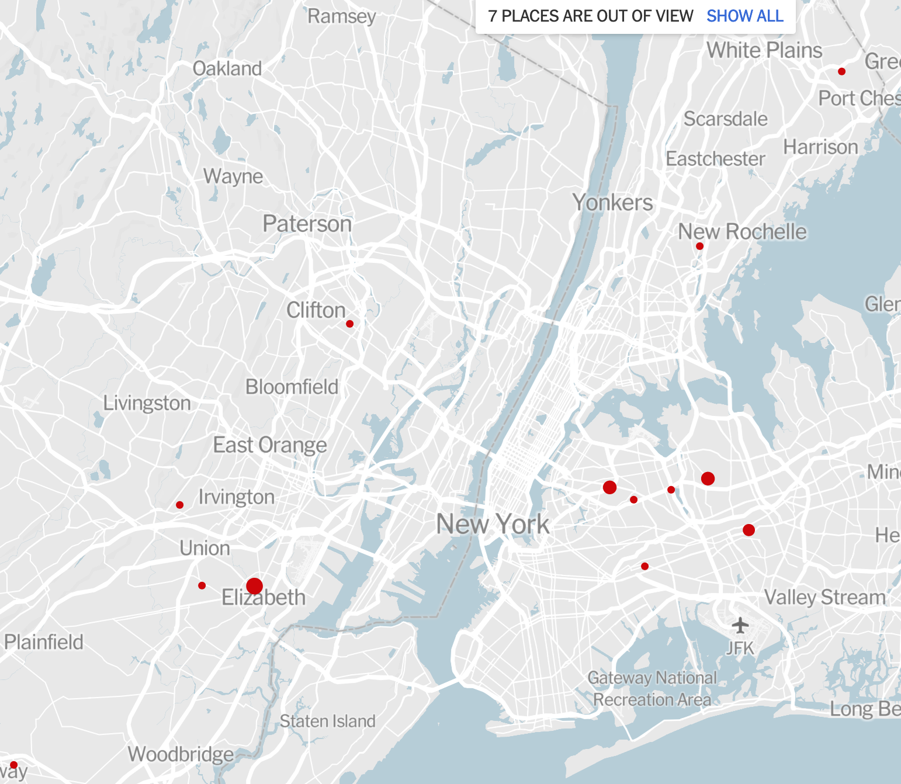
Extending to Hurricane Ida remnants
Joint work as part of the ICOM project with Michelle Li & Dave Judi (PNNL)
Hurricane Ida remnants were deadly in New York & New Jersey
New York
Complex topography of the mid-Atlantic.
Hydrologic model (not hydraulic)
RIFT
Rapid Infrastructure Flood Tool

Slide 20
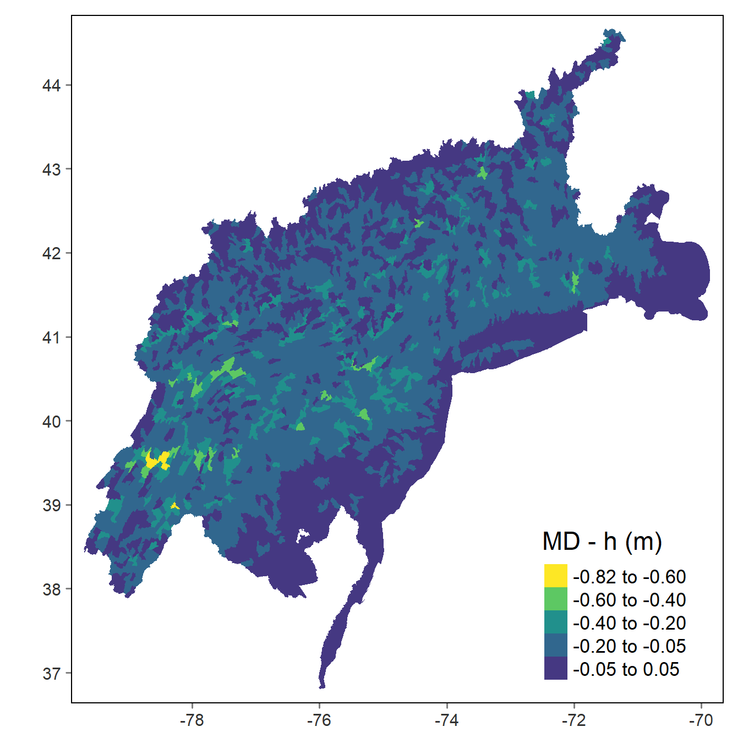
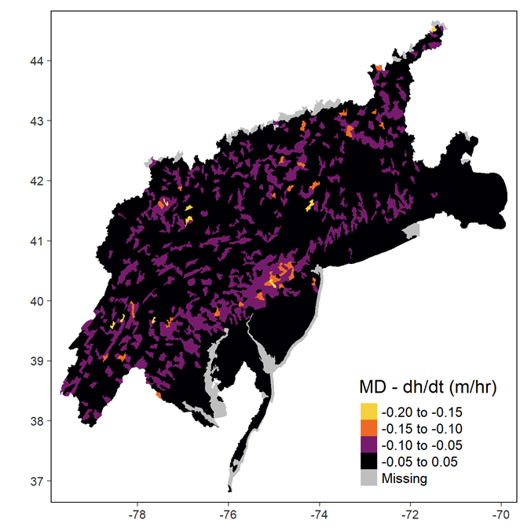
Extending to Hurricane Ida remnants
Joint work as part of the ICOM project with Michelle Li & Dave Judi (PNNL)
Hurricane Ida remnants were deadly in New York & New Jersey
Consider two plausible precipitation attribution statements: C-C and 2xCC
Xue (Michelle) Li, Michael Wehner, David Judi. Quantifying Human Effect on the Flood from the Remnants of Ida with RIFT Simulations (in preparation)

Slide 21
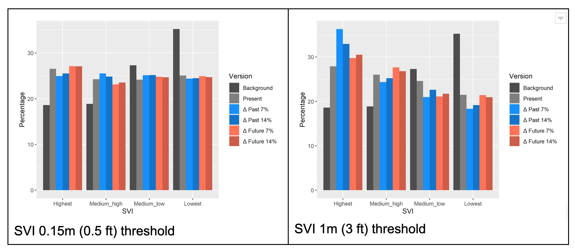
Attributable Ida social inequality
Environmental injustice exists even without climate change
Compare gray to black
Here, SVI = CDC/ATSDR Social Vulnerability Index
Climate change did not alter EJ at low flood depths (compare color to gray)
But exacerbated at deeper depths

Slide 22
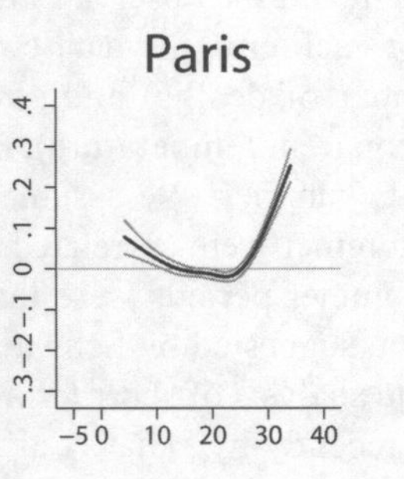
Mortality and heat: How many people died?
The effect of extreme heat increases
dramatically with temperature.
A mechanistic interpretation.
Attribute the temperature change.
Subtract from the observed temperature.
Compare mortality rate that was to the mortality rate than ”might have been”
Log Mortality rate
Temperature
Baccini et al

Slide 23
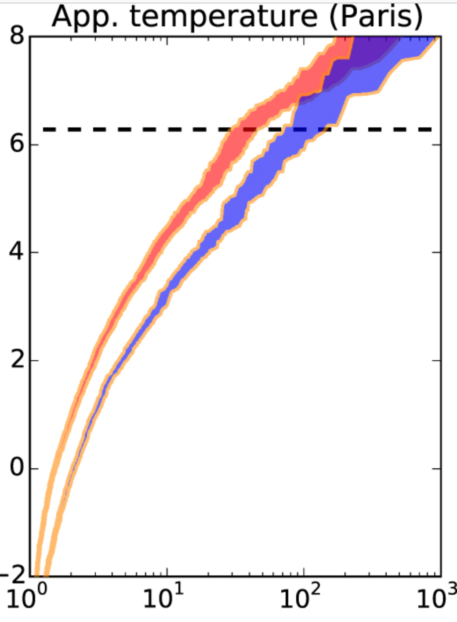
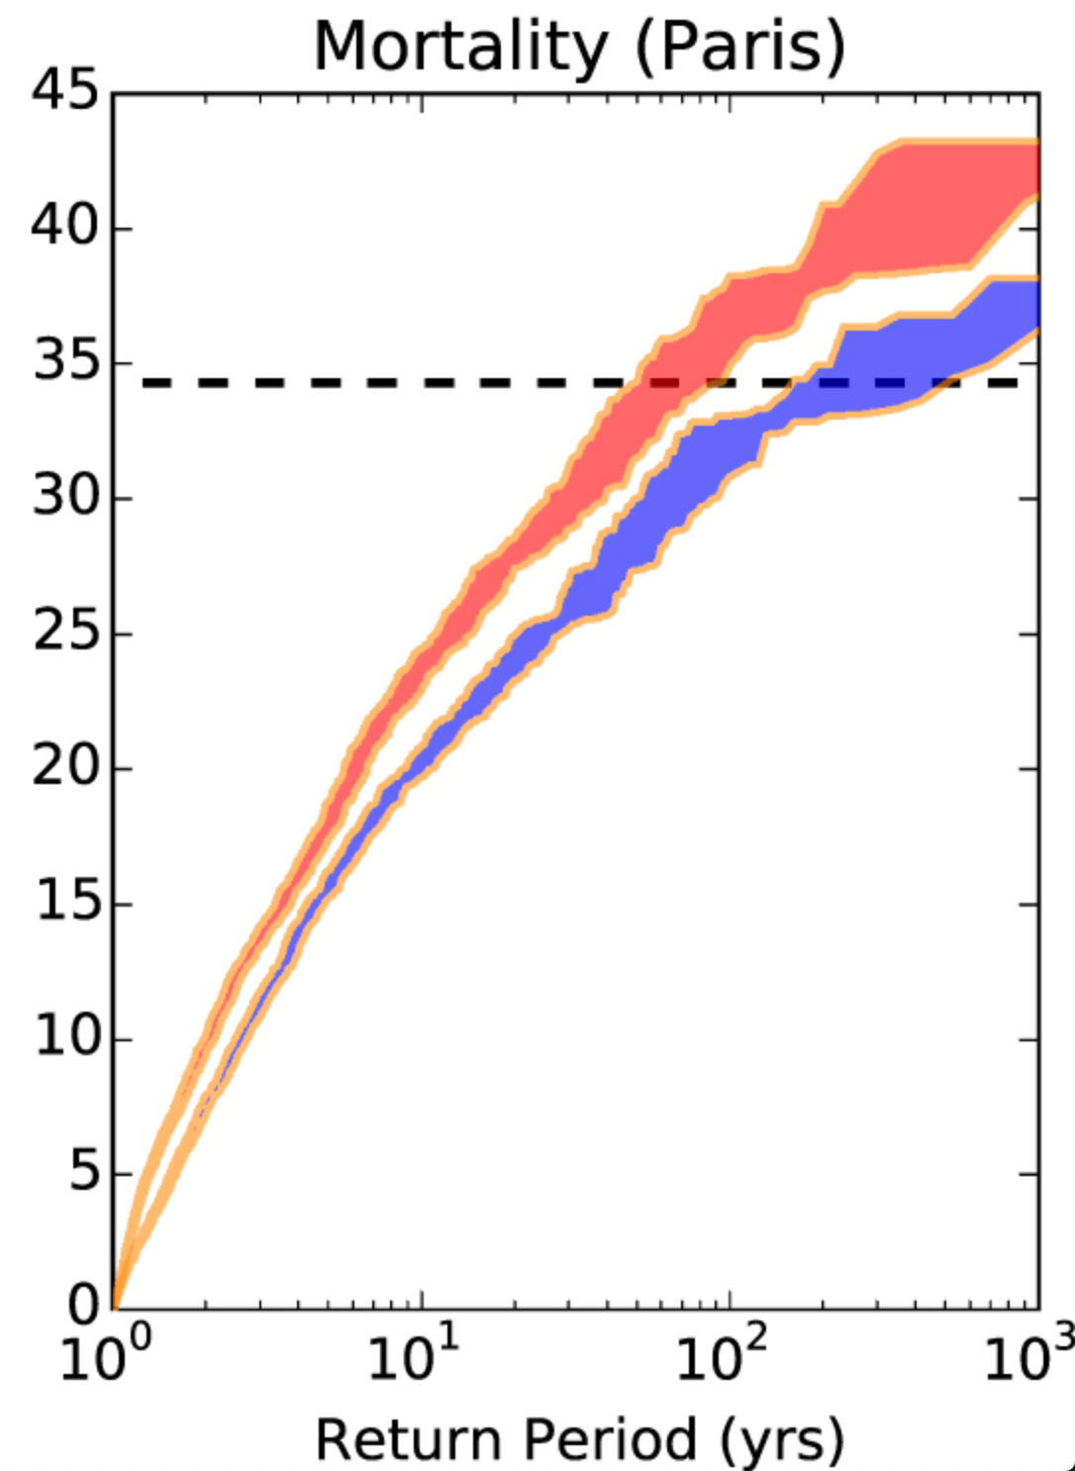
A more traditional approach (Mitchell et al.)
Use the mortality rate curve to transform temperature to death.
Pearl causality, but not a storyline.
→
The chances of the actual level of mortality due to heat was tripled because of climate change.
510 people died in Paris during the 2003 heat wave because of climate change.
As the 2003 heat wave affected 100s of millions of people across Europe, the total increase in mortality was orders of magnitude more.
Mitchell et al (2016) Attributing human mortality during extreme heat waves to anthropogenic climate change Environ. Res. Lett. 11 074006

Slide 24
End to end attribution:
Harvey:
Global warming → more rain → more flooding → more impacts
1ºC → 20% → 14% → 32%
Low income Hispanic population was disproportionately affected
~50% of the flooded homes but only 36% of the population (even without climate change)
The Harvey flood data is publicly available at https://portal.nersc.gov/cascade/Harvey/
Ida:
Best estimate: 450,000 (out of 5.4M) people flooded by climate change.
Warming exacerbated the proportion of the most vulnerable population affected by deep flooding
Least vulnerable was less affected overall.

Slide 25
Is this a quantification of environmental injustice?
Physical counterfactuals are easy to construct.
Are social counterfactuals necessary?
A difficult philosophical question.
COP27 just established a loss and damages fund.
Can storyline attribution be used to provide defensible claims by developing nations?

Slide 26
Some relevant publications
Mark D. Risser and Michael F. Wehner (2017) Attributable human-induced changes in the likelihood and magnitude of the observed extreme precipitation in the Houston, Texas region during Hurricane Harvey. Geophysical Review Letters. 44, 12,457–12,464. https://doi.org/10.1002/2017GL075888
van Oldenborg et al. (2017). “Attribution of Extreme Rainfall from Hurricane Harvey, August 2017.” Environmental Research Letters 12:124009.
Wang et al. (2018) “Quantitative Attribution of Climate Effects on Hurricane Harvey’s Extreme Rainfall in Texas.” Environmental Research Letters 13:054014.
Michael Wehner and Christopher Sampson (2021) Attributable human-induced changes in the magnitude of flooding in the Houston, Texas region during Hurricane Harvey. Climatic Change 166, 20 (2021). https://doi.org/10.1007/s10584-021-03114-z
Kevin T. Smiley, Ilan Noy, Michael Wehner, Dave Frame, Christopher Sampson and Oliver E.Wing (2022) Social Inequalities in Climate Change-Attributed Impacts of Hurricane Harvey. To appear in Nature Communications.
Baccini, Michela, et al. (2008) "Heat effects on mortality in 15 European cities." Epidemiology 711-719.
Mitchell et al (2016) Attributing human mortality during extreme heat waves to anthropogenic climate change Environ. Res. Lett. 11 074006
Perkins-Kirkpatrick, S.E., Stone, D.A., Mitchell, D.M., Rosier, S., King, A.D., Lo, Y. T. E., Pastor-Paz, J., Frame, D., Wehner, M. (2022) On the attribution of the impacts of extreme weather events to anthropogenic climate change. Environmental Research Letters 17 024009 https://iopscience.iop.org/article/10.1088/1748-9326/ac44c8

Slide 27
Thank you!
mfwehner@lbl.gov

