Slide 1
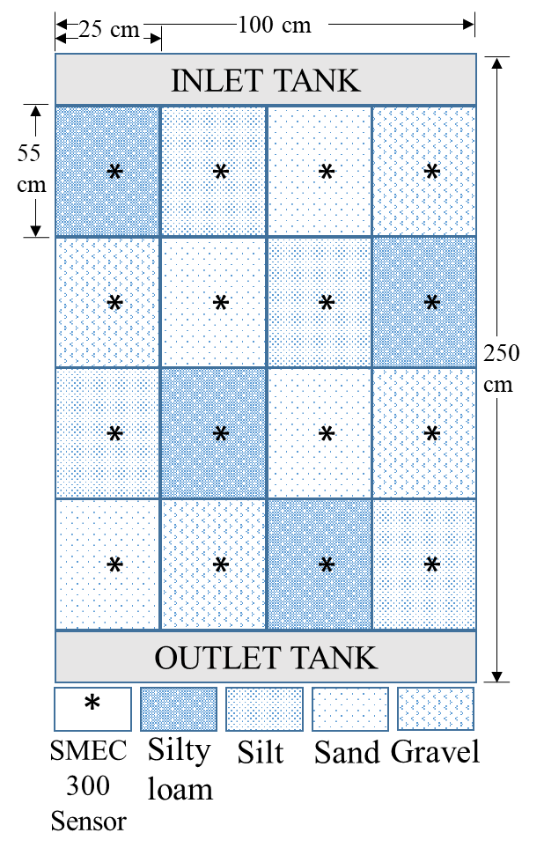
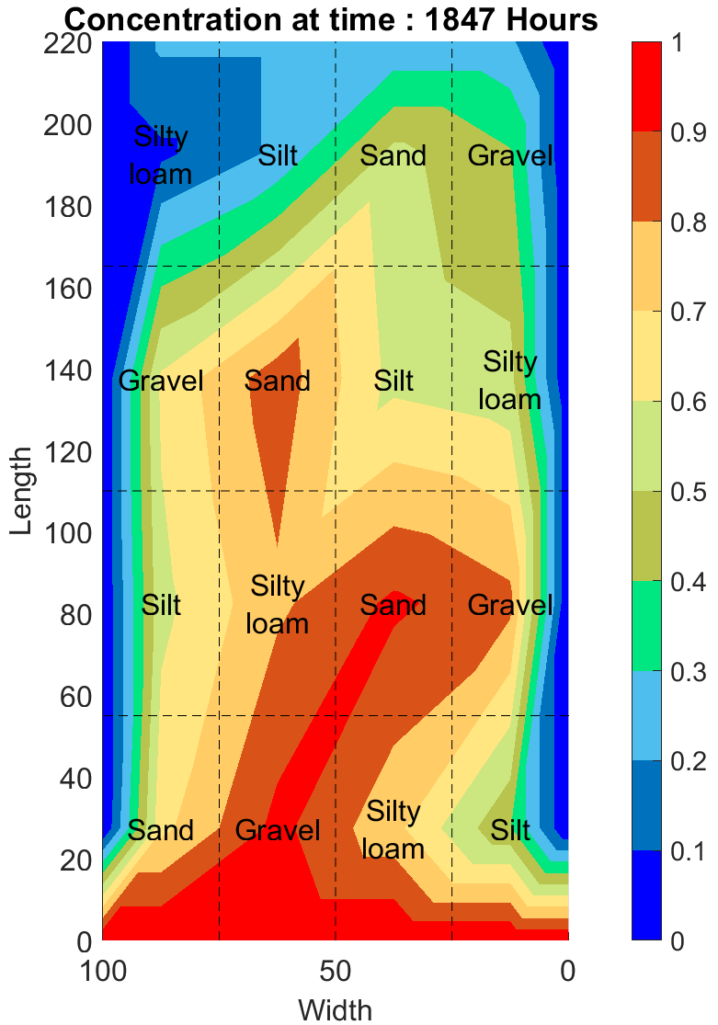
Determination of optimal number of Soil moisture and electrical
conductivity sensors deployment in field
EGU23-369
Aman Chandel and Deepak Swami
School of Civil and Environmental Engineering, Indian Institute of Technology, Mandi, India
Presenter contact: amanchandel91@gmail.com
(1) Introduction
(3) Calibration
(4)Optimum Number Determination
(5) Conclusion
Soil moisture and electrical conductivity (SMEC) sensors are capacitance-based devices developed to record the saturation levels and the concentration of mineral present in the medium on site.
Spatial and temporal record helps in efficient irrigation and fertilizer scheduling.
Three different materials are considered for the calibration purpose namely Sand, Silty loam and Silt.
Different combination of number of sensors are used to propose an optimum number of sensors required to predict best possible results in Silty loam.
Soil sample was connected to a peristaltic pump and constantly fed with known mass of water and concentration.
The SMEC sensors were tested for the temperature sensitivity in Silty loam samples completely saturated with varying concentration towards the EC and SM readings.
The perpetual concentration range was divided into three concentration ranges
Low: 0 to 100 PPM
Medium: 150 to 250 PPM
High: 500 to 1000 PPM
Soil specific calibration increases the accuracy of SMEC.
Sensitivity analysis suggests minimum of 7 sensors combination system to be deployed in field to minimize the error in soil moisture and electrical conductivity readings across the temperature and salinity ranges.
Peristaltic Pump
Water Reservoir
Weighing Balance
Weighing Balance
Weighing Balance
Data Logger
(6) Application in Heterogenous medium tank
SMEC 300
Sensor
Weighing Balance
Weighing Balance
Weighing Balance
Figure 2: Line diagram of sensor calibration setup for soil moisture
(2) SMEC Sensor
Twelve WaterScout SMEC 300 Soil Moisture Sensors have been used for calibration and sensitivity analysis.
It is a capacitance-based sensor with two electrodes which act as capacitors driven by 80 MHz oscillator frequency.
The variation of dielectric permittivity of medium quantifies the volumetric water content (VWC).
Two carbon ink electrodes are placed on the face of the sensor to provide the large contact surface area for better estimation.
Figure 3: Soil specific Soil moisture calibration with lumped calibration for all the soils
Figure 6: Plan of heterogeneous soil tank
Figure 7: Experimental data at 1847 hrs.
Figure 1: SMEC 300 Sensor
Figure 4: Electrical Conductivity calibration for Sand, Silty loam, Silt and Concatenated data
Figure 5: Temperature sensitivity of SM for varying salinity for a) 3, b) 5, c) 7 and d) 9 sensors
Figure 8: BTC at various observation nodes for the Chloride run

