Slide 1
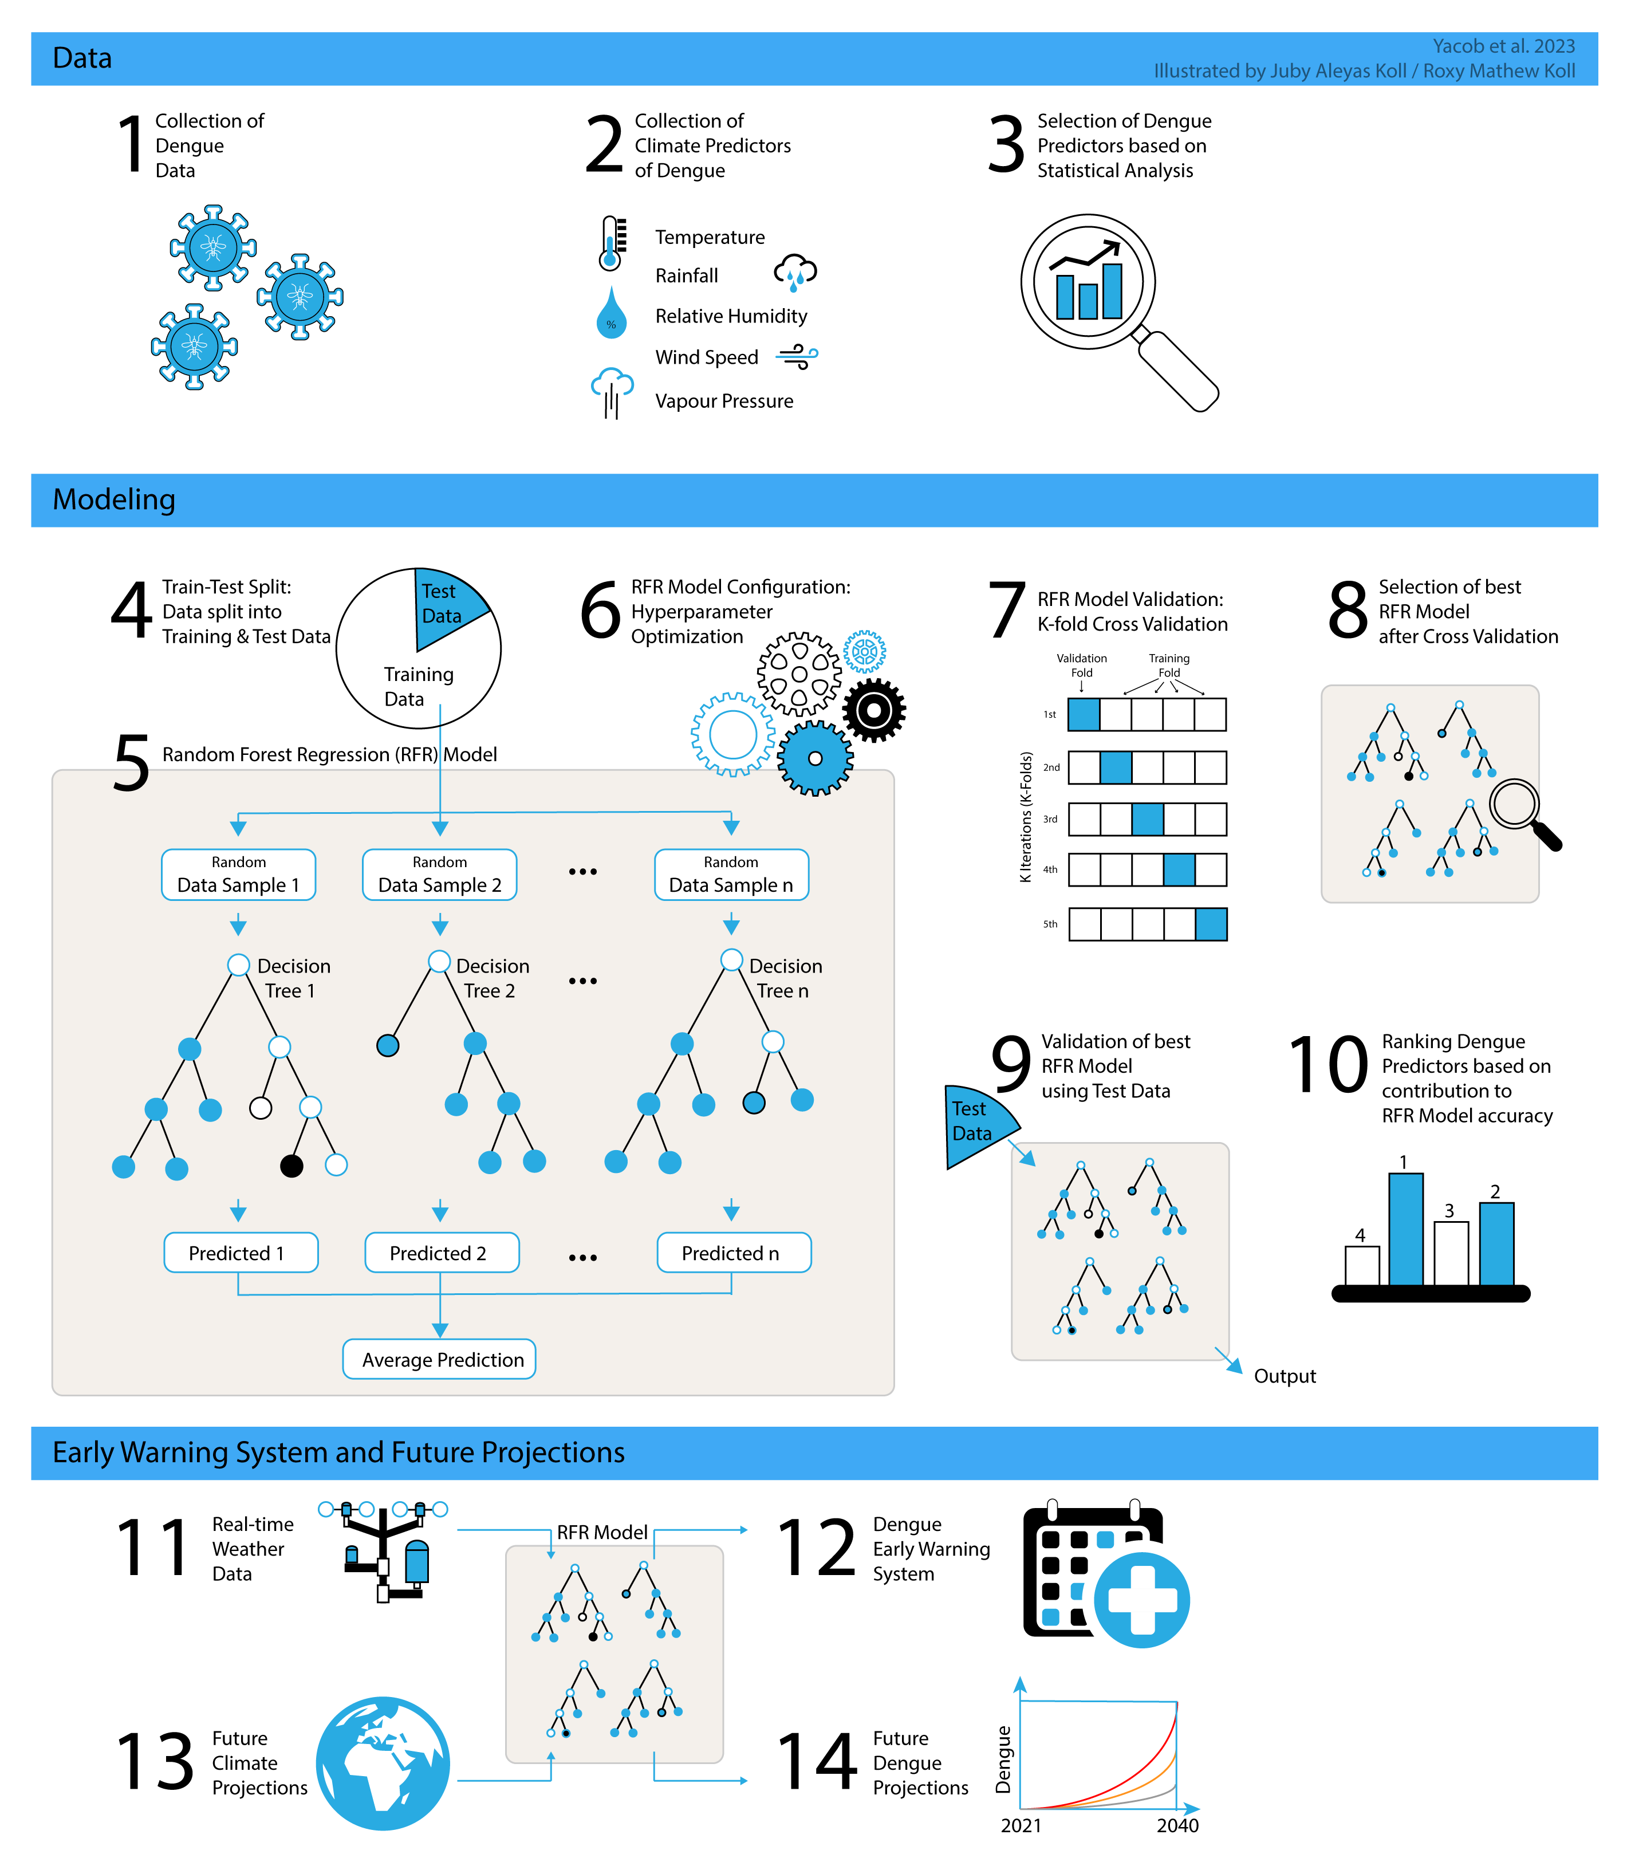
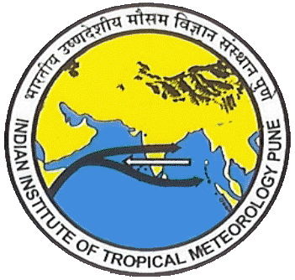
A Climate-based Dengue Early Warning System for Pune, India
Sophia Yacob^{1,2} and Roxy Mathew Koll¹
¹Centre for Climate Change Research, Indian Institute of Tropical Meteorology, Pune, India
²Department of Atmospheric and Space Sciences, Savitribai Phule Pune University, Pune, India

Slide 2
Overview
Framework of the study and data used
Introduction
Why is this study important?
3. Results
4. Summary
5. Limitations of the study and future scope
6. References
1
2
3
Climate-based dengue metric for Pune
Comparison of high and low dengue years
Lead-lag association between climate and dengue
Dengue early warning prediction model
Future projections of dengue in Pune
4
5
6

Slide 3
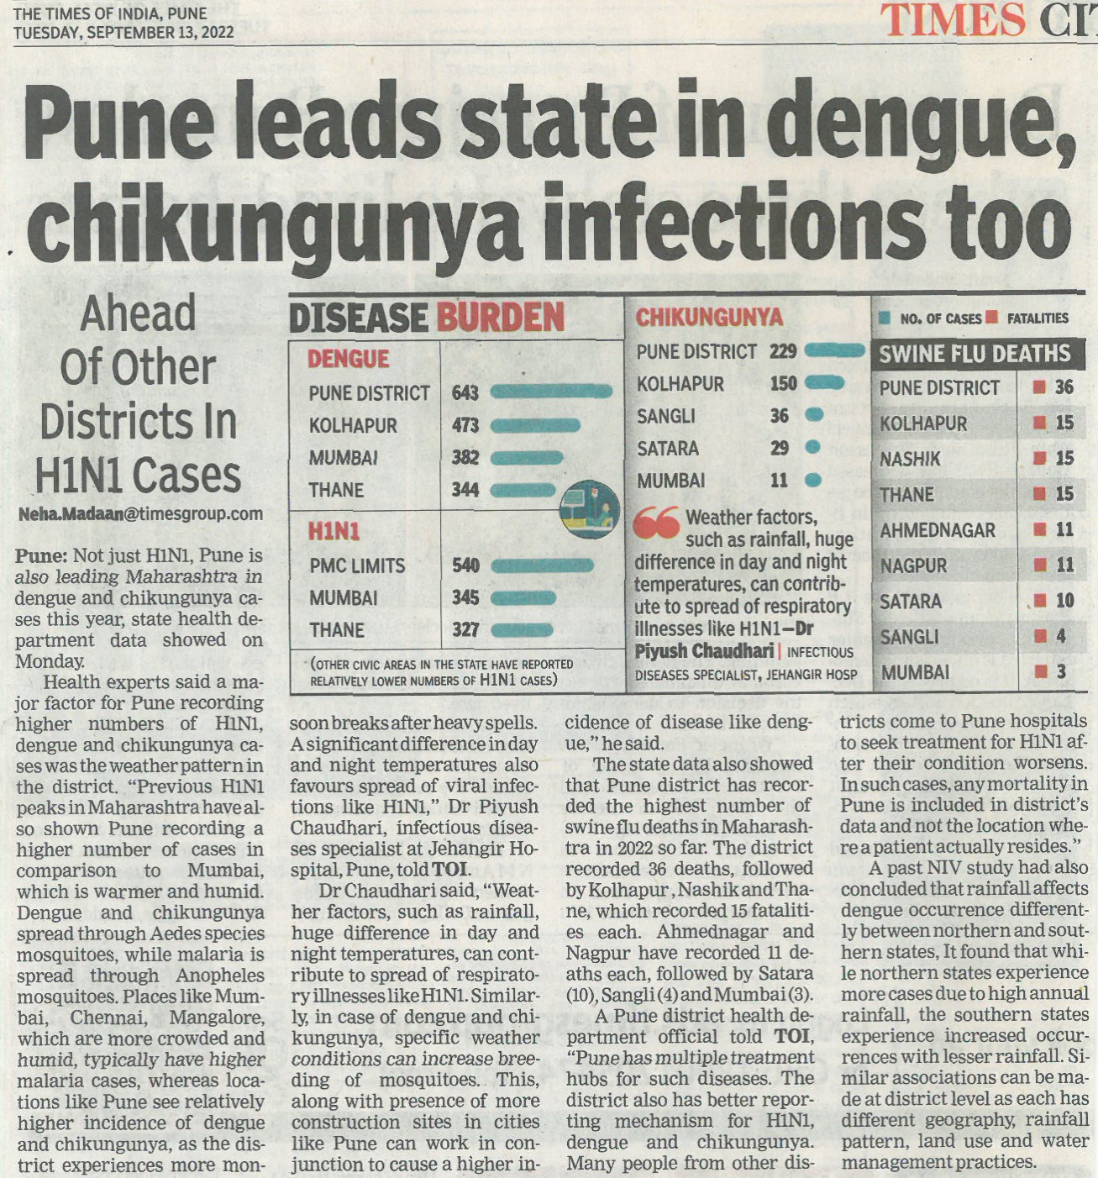
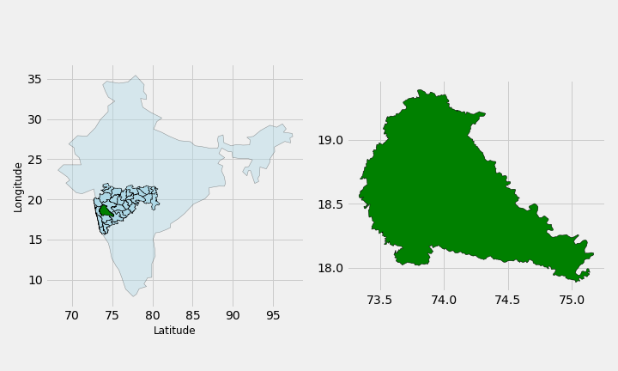
Location of the study
Study location: Pune district, India
*The political boundary depictions in these illustrative images may not be accurate or authoritative and are not endorsed by the authors
Details of the data
Dengue mortality data : Pune death registry
Meteorological data : India Meteorological department
Period : 2004-2015
Is dengue mortality data a proxy of dengue morbidity?
Newspaper report: High dengue burden in Pune
Overview

Slide 4
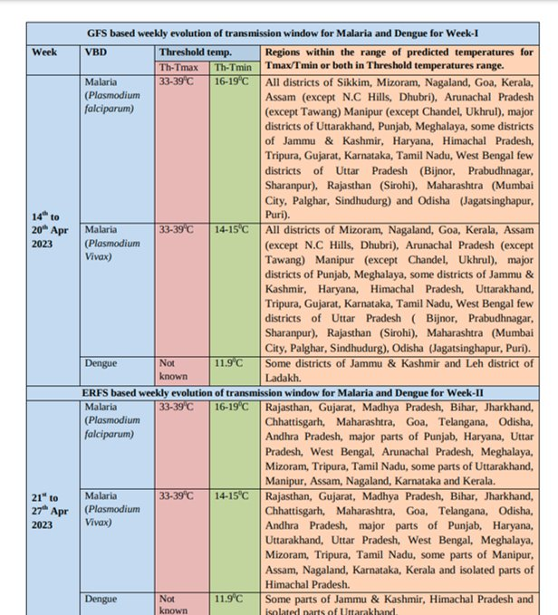
Introduction | Why is this study important ?
Dengue is a mosquito-borne viral infection found in tropical and sub-tropical climates worldwide.
Climatic factors are integral to dengue incidence (Focks et al., 1995; Gagnon et al., 2001; Hales et al., 1996).
Despite a risk of infection existing in 129 countries, 70% of the actual burden is in Asia (World Health Organization: WHO).
In India, dengue cases increased by about four times in the recent five years, from 2015 to 2020 according to NVBDCP data.
'Climate information for health’ report from IMD predict temperature windows for malaria and dengue.
Overview

Slide 5
Climate-based dengue metric for Pune
Optimal temperature count: No. of days with optimal temperatures (27–35°C) during the summer monsoon season (June to September).
Wet weeks count: No. of weeks with a minimum of 0.5 mm and a maximum of 150 mm of rainfall.
Flush count: No. of weeks with cumulative rainfall above 150 mm.
June cumulative rains: Total rainfall in the month of June.
Optimal humid days: No. of days with optimal relative humdity (60-78 %) during the summer monsoon season.
*Thresholds are based on the Pearson correlation analysis between predictor variable and dengue mortality
*all these predictors show a statistically significant (p<0.05) correlation with annual dengue mortality in Pune
Overview

Slide 6
Monsoon Intraseasonal Oscillation
Best represents the year-to-year monsoon rainfall patterns.
Obtained using band-pass filtering for (30–90) days timescale.
Active days and break days: rainfall anomalies > 0.5 standard deviations and rainfall anomalies < -0.5 standard deviations of ISMR rainfall anomaly.
Fewer active and break days lead to high dengue mortality, while more active and break days result in low dengue mortality.
Pearson correlation coefficient : r = -0.74, p <0.05
Overview

Slide 7
Comparison | High and low dengue years in Pune
 | High dengue years |  |  | Low dengue years
Year | 2010 | 2014 | 2015 | 2008 | 2011 | 2013
Deaths | 68 | 81 | 64 | 13 | 14 | 16
Total rainfall (mm) | 1247 | 1480 | 1447 | 2985 | 2305 | 2069
No. of wet weeks | 37 | 33 | 32 | 20 | 25 | 26
Flush count (> 150 mm) | 1 | 2 | 2 | 8 | 6 | 6
Sum of active and break days | 22 | 45 | 39 | 96 | 99 | 68
High dengue years: Low cumulative rains (dry)
Increased no. of wet weeks
Reduced no. of flush events
Low no. of active-break days
Low dengue years: High cumulative rains (wet)
Reduced no. of wet weeks
Increased no. of flush events
High no. of active-break days
Overview

Slide 8
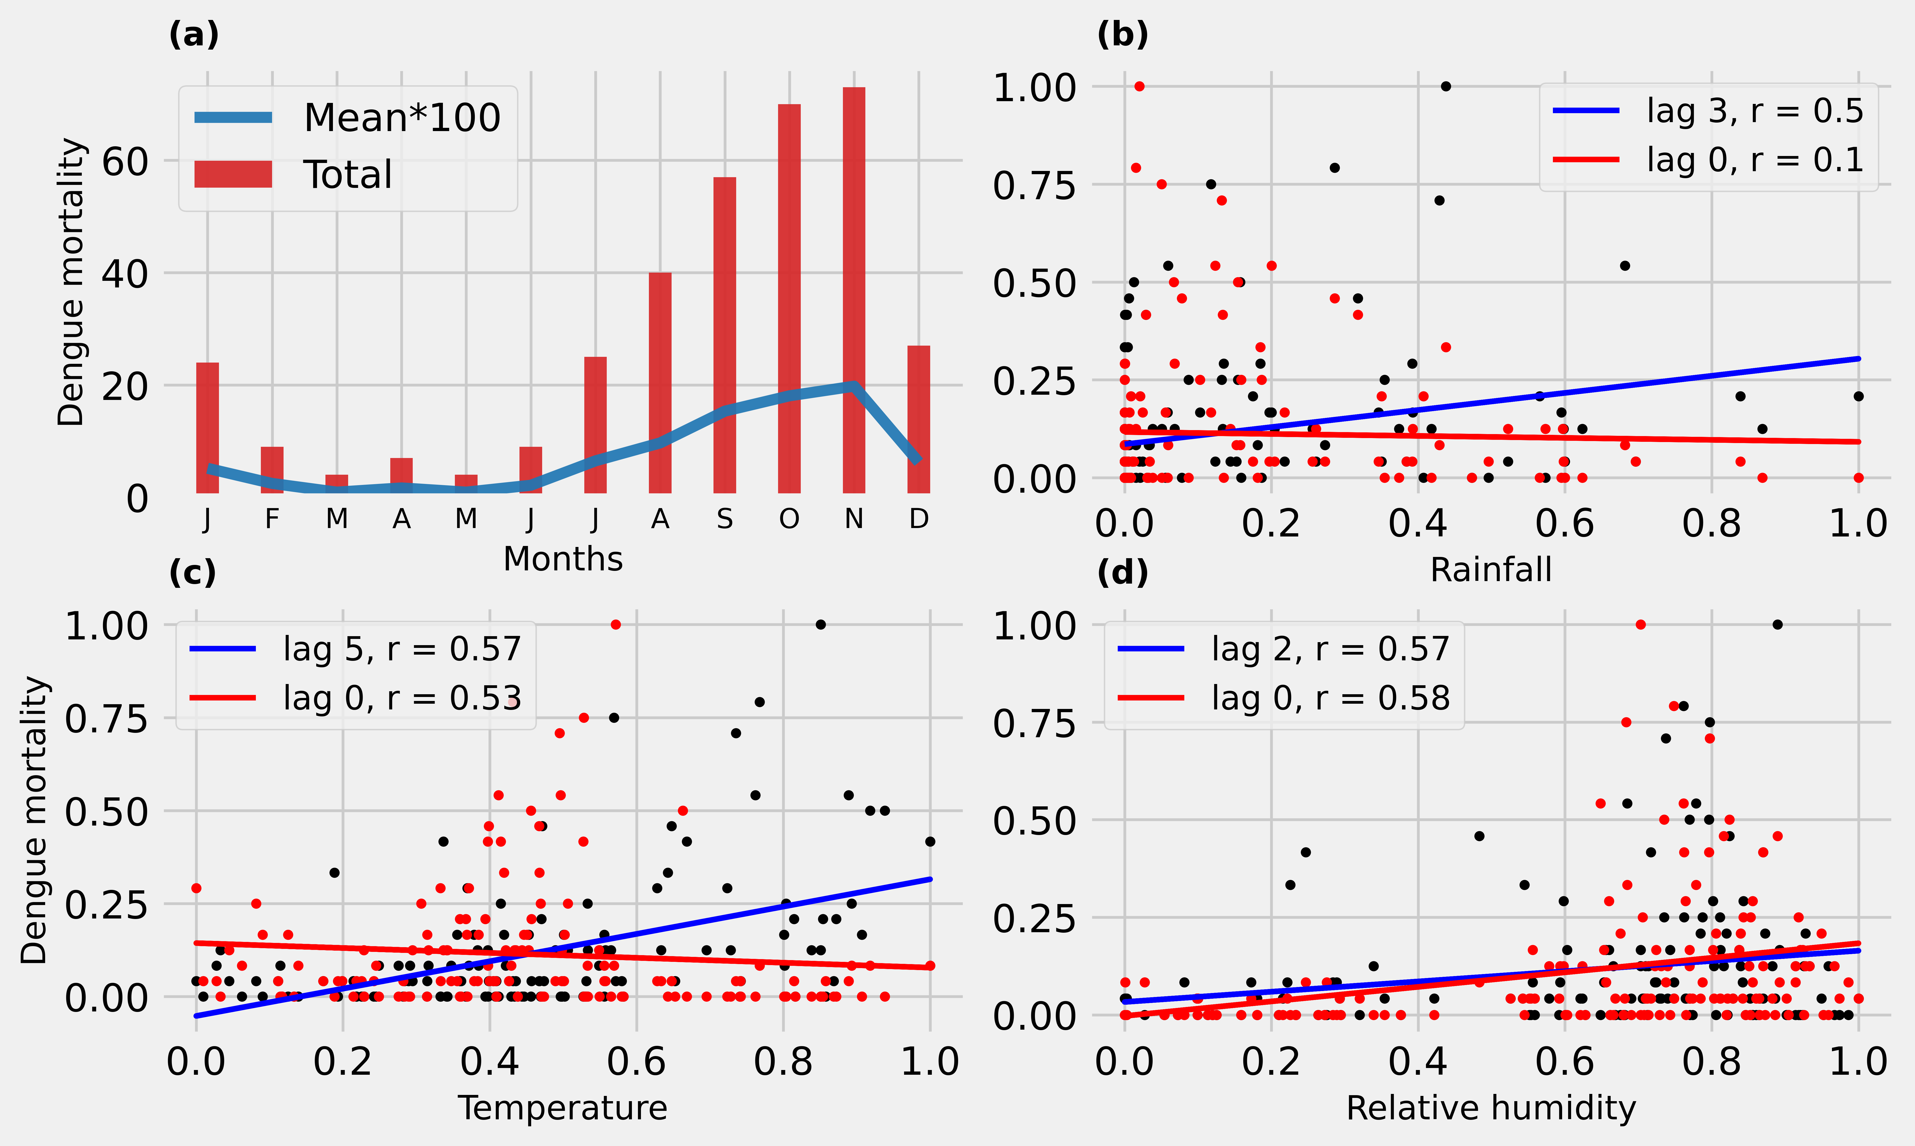
Climate-dengue associations | Seasonality & lags
Dengue seasonality: low from December to May, rises from June to peak in November.
Lag in association:
Temperature. : five months (r = 0.48)
Rainfall. : Three months (r = 0.27)
Relative humidity: Two months (r = 0.21)
*(p < 0.05)
Overview

Slide 9
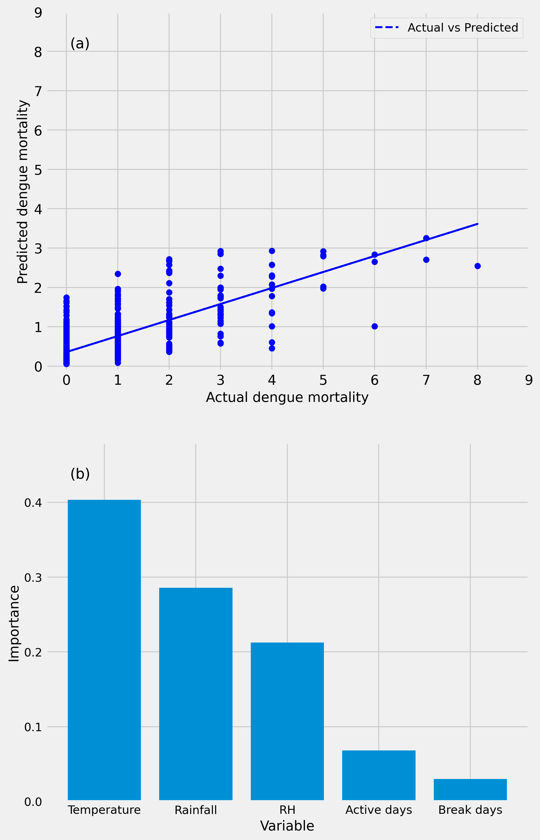
Machine learning (ML) based dengue early warning prediction model
Machine learning (ML) based dengue early warning prediction model
To extract the combined effect of meteorological predictors on dengue mortality
Machine learning algorithm : Random Forest Regression (RFR)
Environmental predictors : Mean temperature
(weekly) Cumulative rainfall
Mean relative humidity
Active and break days of monsoon
Model accuracy : Pearson correlation coefficient r = 0.77 (p < 0.05)
and a low RMSE of 1.01.
Variable importance : Temperature (41%)
Rainfall (29%)
Relative humidity (20%)
Active days (7%)
Break days (3%)
Overview

Slide 10
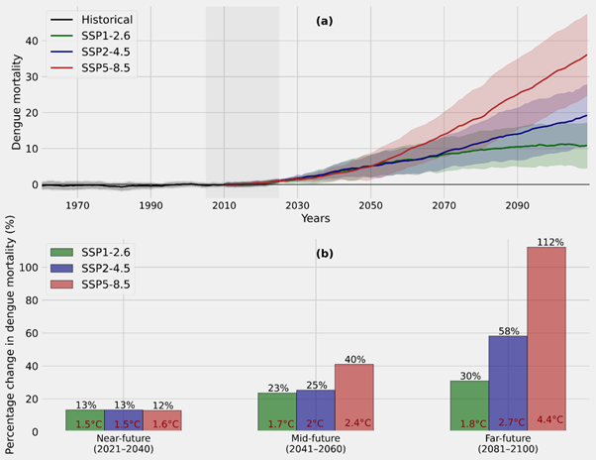
Future projections | Dengue mortality in Pune
Dengue future projections: Using RFR model and future climate projections (2020-2100) from the coupled Model Intercomparison Project Phase 6 (CMIP6)
Dengue mortalities over Pune may increase by 13% in the near-future (2021-2040) and 30-112% in the long-term (2081-2100) under different emission scenarios.
Want to know more about SSP’s?
Overview

Slide 11
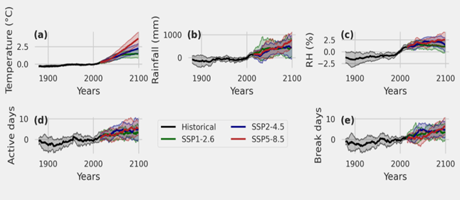
Future Projections | Environmental predictors of dengue
All environmental predictors of dengue are projected to increase in the future relative to historical levels.
Near-future (201-2040): Meteorological variables show little change relative to their reference period (1995-2015) values.
Mid-future (2041-2060) changes: Mean temperature: 1-1.5°C; cumulative rainfall: 23-27 cm; relative humidity: 0.4-1%; active-break days: 1-3 days.
Far-future (2081-2100) changes: Mean temperature: 1.2-3.5°C; rainfall: 28-65 cm; relative humidity: 0.2-1.6%; active and break days: 2-5 days.
Overview

Slide 12
Summary
Temperature, rainfall, and relative humidity have a significant effect on the dengue mortality in Pune.
Moderate rains spread in time favour an increase in dengue mortality while intermittent heavy rains with long dry periods can reduce dengue mortality.
Dengue mortality in Pune lags: temperature by five months,
rainfall by three months
relative humidity by 2 months.
Climate-based dengue early warning prediction model: Used Random forest regression algorithm.
Correlation (r = 0.77, p < 0.05)
Low root mean square error (RMSE = 1.01).
Future dengue mortality projections: Using dengue model & climate projections from CMIP6
In a changing climate, dengue mortalities over Pune are likely to increase by 13% in the near-term (2021–2040) and 30–112% in the long-term (2081–2100) under different emission scenarios.
Overview

Slide 13
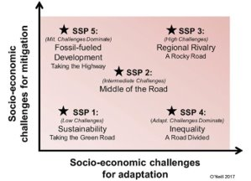
Shared Socio-economic Pathways (SSP)
Five SSPs are created, with varying assumptions about human developments including: population, education, urbanization, gross domestic product (GDP), economic growth, rate of technological developments, greenhouse gas (GHG) and aerosol emissions, energy supply and demand, land-use changes, etc.​
SSP 1: Sustainability - Taking the green road The world shifts gradually, toward a more sustainable path, emphasizing more inclusive development that respects environmental boundaries.
SSP 2: Middle of the road - The world follows a path in which social, economic, and technological trends do not shift markedly from historical patterns.
SSP 5: Fossil-fueled development - Taking the highway The push for economic and social development is coupled with the exploitation of abundant fossil fuel resources and the adoption of resource and energy intensive lifestyles around the world.​
Back

Slide 14
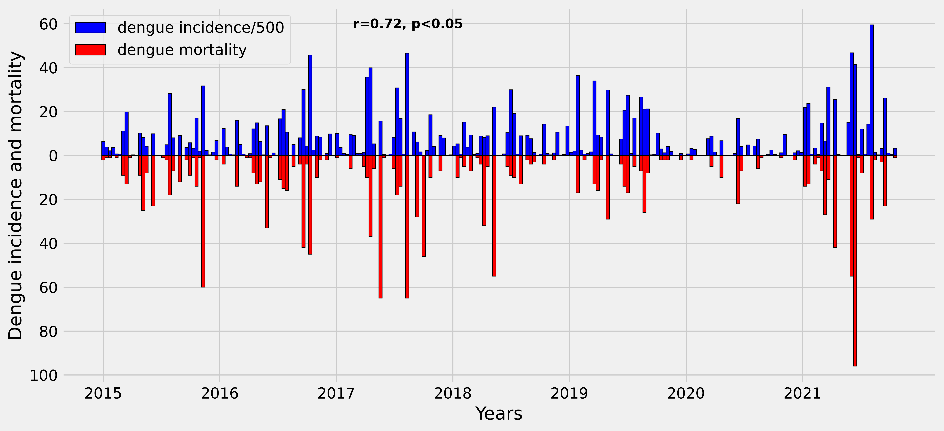
Is dengue mortality data a proxy of dengue morbidity?
Data source : National Vector Borne Diseases Control Programme (NVBDCP); available at https://nvbdcp.gov.in/
Study period : 2015-2021
Study sample : annual dengue data of thirty-five Indian states and union territories
(excluding West Bengal and Lakshadweep due to incomplete data)
Results : strong statistically significant correlation (r = 0.72, p < 0.05) between dengue cases and mortality
Conclusion : dengue mortality can be used as a proxy for dengue morbidity.
Back

Slide 15
Limitations and future scope
Limitations of the study:​
The current study is restricted to climatic factors linked to dengue.​
However, dengue mortality is also influenced by socio-economic, demographic, and geographical factors. ​
Unlike many other studies, the current study uses dengue mortality data rather than infected counts, due to unavailability of reliable dengue infection data at local level.​
Future scope:
Although this study focused specifically on dengue mortality in Pune, the overall framework of the study can be extended to other regions with dengue infections, thereby strengthening prevention strategies and policymaking to curb disease outbreaks.​
The long-term reliability of the dengue early warning prediction model can be improved by incorporating sociodemographic variables and dengue incidence data with higher spatial and temporal resolution.​
Overview

Slide 16
References
Bar-Zeev, M. (1957). The Effect of extreme Temperatures on different Stages of Aëdes aegypti (L.). Bulletin of Entomological Research, 48(3), 593–599. https://doi.org/10.1017/S0007485300002765​
Breiman, L. (2001). Random Forests. Machine Learning, 45(1), 5–32. https://doi.org/10.1023/A:1010933404324
Dhiman, R. C., Pahwa, S., Dhillon, G. P. S., & Dash, A. P. (2010). Climate change and threat of vector-borne diseases in India: Are we prepared? Parasitology Research, 106(4), 763–773. https://doi.org/10.1007/s00436-010-1767-4​
Focks, D. A., Daniels, E., Haile, D. G., Keesling, J. E., & others. (1995). A simulation model of the epidemiology of urban dengue fever: Literature analysis, model development, preliminary validation, and samples of simulation results. American Journal of Tropical Medicine and Hygiene, 53(5), 489–506.
Gagnon, A. S., Bush, A. B., & Smoyer-Tomic, K. E. (2001). Dengue epidemics and the El Niño southern oscillation. Climate Research, 19(1), 35–43.
Hales, S., Weinstein, P., & Woodward, A. (1996). Dengue fever epidemics in the South Pacific: Driven by El Niño southern oscillation? Lancet (London, England), 348(9042), 1664–1665.
Mishra, A. C., Arankalle, V. A., Gadhave, S. A., Mahadik, P. H., Shrivastava, S., Bhutkar, M., & Vaidya, V. M. (2018). Stratified sero-prevalence revealed overall high disease burden of dengue but suboptimal immunity in younger age groups in Pune, India. PLOS Neglected Tropical Diseases, 12(8), e0006657. https://doi.org/10.1371/journal.pntd.0006657​
Mutheneni, S. R., Morse, A. P., Caminade, C., & Upadhyayula, S. M. (2017). Dengue burden in India: Recent trends and importance of climatic parameters. Emerging Microbes & Infections, 6(1), 1–10.​
Shil, P., Jagtap, M., deSouza, C. R. H., Sudeep, A. B., & Awateb, P. (2020). Climate and dengue in the Pune region: Prospects for an early warning system. Dengue, 41, 49. ​
Overview

