Slide 1
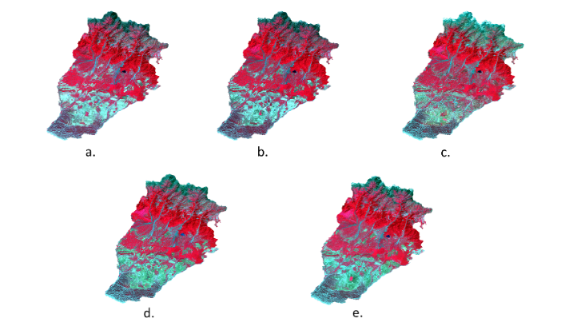
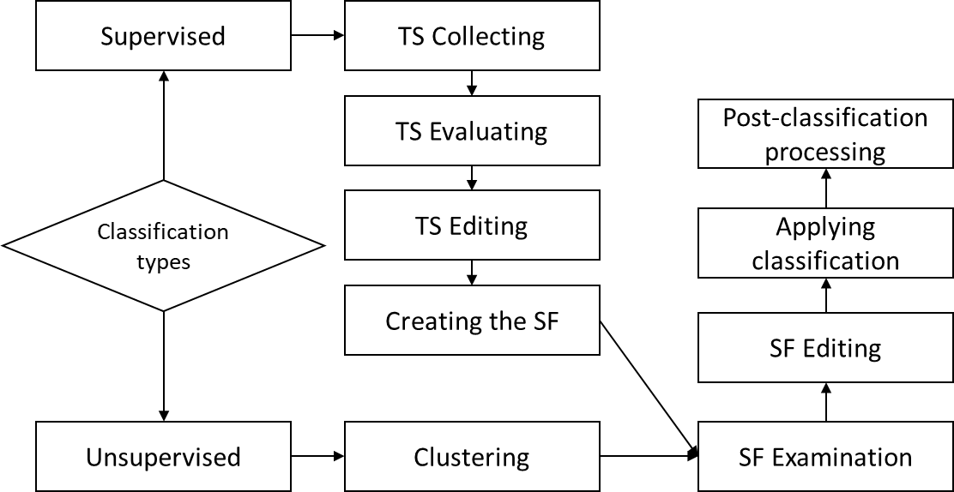
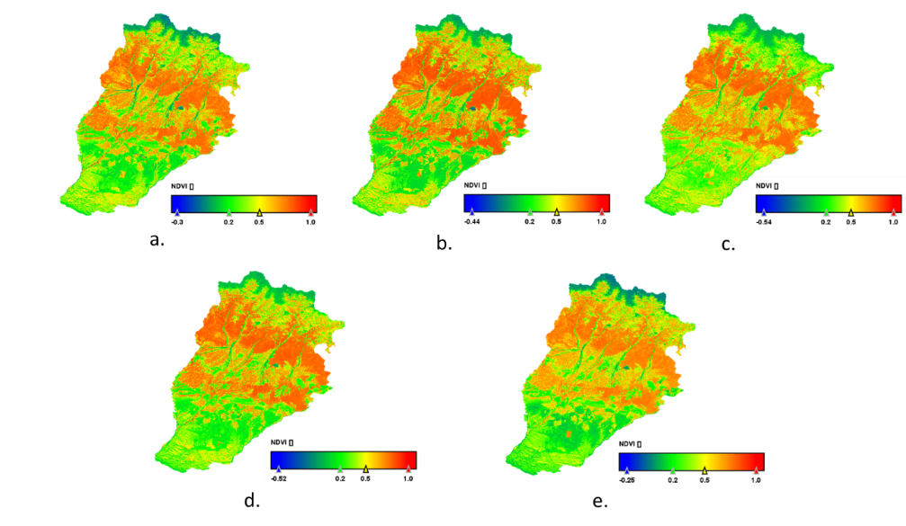
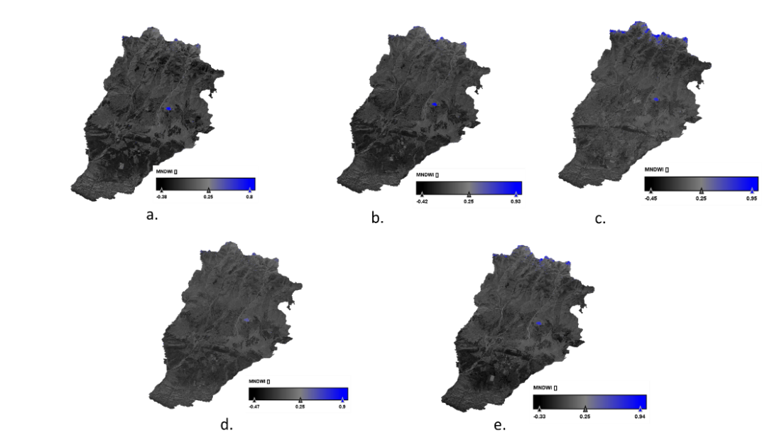
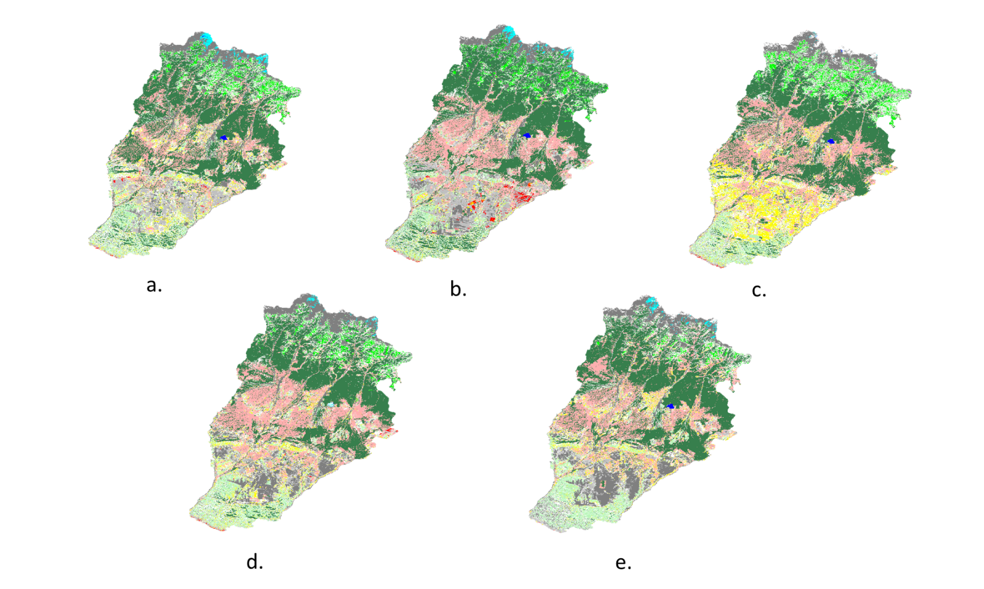
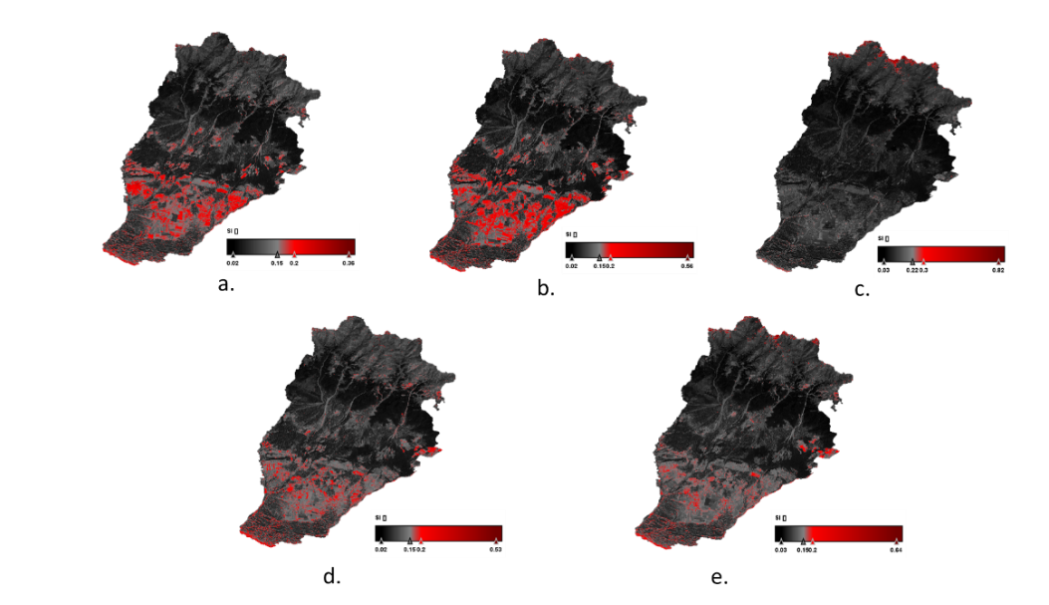
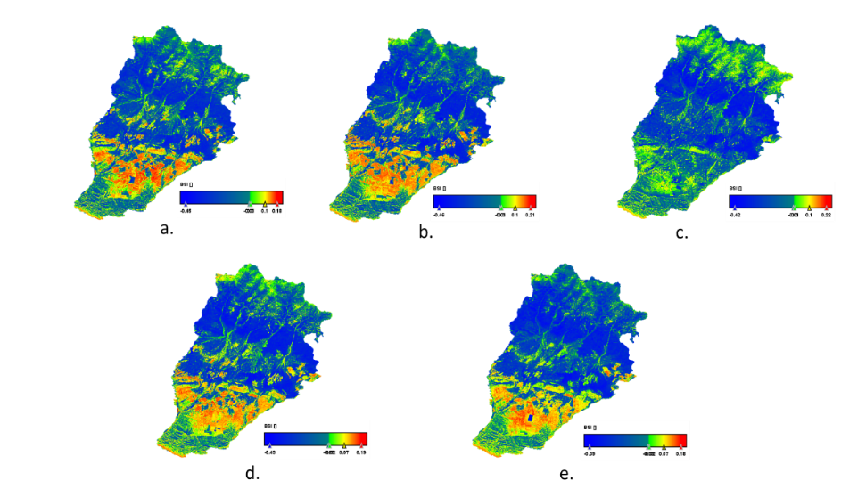
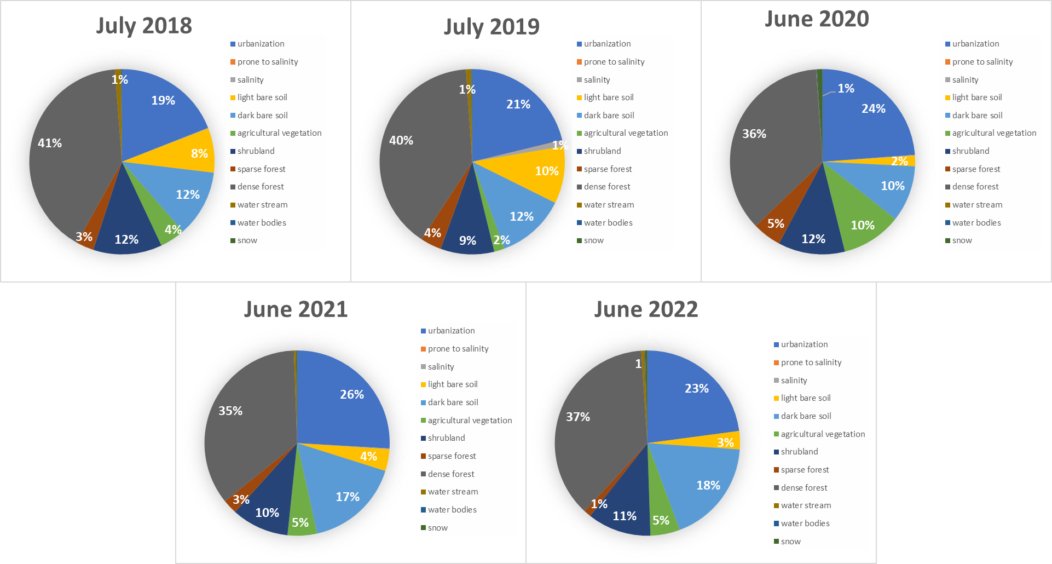
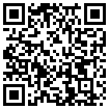
Application of Advanced Processing of the Remote Sensing Data on Landuse/Landcover Changes in Gabala, Azerbaijan
Bahruz Ahadov 1,2*, Nilufar Karimli 3,4
EGU General Assembly 2023, Vienna, Austria
Abstract
Methodology
Authors
To track global environmental change and evaluate the risk to sustainable development, analysts and decision-makers in government, civil society, finance, and industry need the fundamental geospatial data products known as Land Use and Land Cover Change (LULCC) maps. Our research studied LULCC variations in a timeframe of 5 years in the Gabala district. Sentinel 2 open-source products were used to compare and categorize the procedure over one-year time intervals. For this investigation, the discrete indexing method was developed and used. The approach we used was focused on obtaining multiple indices and using them to improve classification performance. The Normalized Difference Vegetation Index (NDVI), Modified Normalized Difference Water Index (MNDWI), Bare Soil Index (BSI), Normalized Difference Tillage Index (NDTI), and Salinity Index (SI) are the indices evaluated. The most crucial variables were determined and classified using the random forest classifier in LULCC. The Sentinel Application Platform of the European Space Agency (SNAP ESA) algorithm was used to analyse the process and performed over 90% accurate predictions when applied to the testing dataset. Results revealed that using the RS technique, time and cost-efficient analyses are possible and reliable for developing socioeconomic and ecological growth strategies.
Pre-processing
Graph Builder feature of the SNAP architecture has been used in Image pre-processing which consists of the following steps: uploading supported files, reprojecting each data using the Optical Sentinel 2 Reprojection tool, resampling each dataset, and masking out the study area.
Classification
When several georeferenced images or bands are analysed, the ones with comparable statistical characteristics in these images are grouped together using the classification technique. Image data with a specific number of thematic classes is obtained as a consequence of classification. The following diagram illustrates the process's structure:
*Bahruz Ahadov ¹, Nilufar Karimli ²
¹Ministry of Science and Education Republic of Azerbaijan. Institute of Geology and Geophysics, Baku, Azerbaijan. ahadovshao@gmail.com, (+994 557574334).
²Istanbul Technical University, Institute of Higher Education, Satellite communication and Remote Sensing MSc, Istanbul, Turkiye, karimlin19@itu.edu.tr
Fig. 1. FIR Satellite imagery band combination of the AOI: a. July 2018; b. July 2019; c. June 2020; d. June 2021; e. June 2022.
Indices
Our methodology is based on the generation of several indices such as NDVI, MNDWI, BSI, TI, and SI and their inclusion in the classification process to improve accuracy.
Normalized Difference Vegetation Index
The NDVI is a well-known and often-used remote sensing index. The NDVI is calculated using the TOA reflectance of a red band at 0.66 m and a near-infrared (NIR) band at 0.86 m (Bhandari, Kumar, & Singh, 2012). The NDVI of a heavily vegetated area will lean toward positive values, in contrast to water and built-up areas, which will be represented by near-zero or negative values. NDVI is given as orderly (Braun and Herold, 2004):
NDVI=ρ(NIR-ρRed)/(ρNIRr+ρRed)
Fig. 6. LULC classification process structure.
References
Fig. 2. NDVI visualisation of Sentinel 2: a. July 2018; b. July 2019; c. June 2020; d. June 2021; e. June 2022.
To fulfil our research perspectives, we used the SNAP architecture's Random Forest (RF) classification algorithm. The approach we used is based on the computation of several indices and their use in the classification process to improve accuracy.
Modified Normalized Difference Water Index
MNDWI can efficiently lower or even completely eliminate ground noise, plant noise, and build-up texture noise while improving open water characteristics. The area of the water samples is therefore inflated. This is such that noise from buildings can sometimes be hidden by the additional water information available on the NDWI. MNDWI improves open-water capability by utilising the green and SWIR bands.
Eric W Sanderson, Kent H Redford, Amy Vedder, Peter B Coppolillo, Sarah E Ward, (2002) A conceptual model for conservation planning based on landscape species requirements, Landscape and Urban Planning, Volume 58, Issue 1, p 41-56, ISSN 0169-2046
Lambin, E.F., Geist, H.J., & Lepers, E. (2003). Dynamics of Land-Use and Land-Cover Change in Tropical Regions
E. Erle and R. Pontius, (2007) Land-Use and Land-Cover Change, In: J. Cutler, Ed., Encyclopaedia of Earth, Cleveland, Washington DC, Environmental Information Coalition, National Council for Science and the Environment,
Joshi, P.K., Sarnam Singh, Shefali Agarwal and P.S. Roy. (2001). Land cover assessment in Jammu & Kashmir using phenology as discriminant – An approach using Wide swath satellite (IRS – WiFS). Current Science 81(4): 392-398.
Google Earth 7.3.2.5776-version, (2022) Zangilan, Geophysical layer. [Software]
Bhandari, Ashish & Kumar, Anil & Singh, G.K.. (2012). Feature Extraction using Normalized Difference Vegetation Index (NDVI): A Case Study of Jabalpur City. Procedia Technology. 6. 612–621. 10.1016/j.protcy.2012.10.074.
Braun, Matthias & Herold, Martin. (2004). Mapping imperviousness using NDVI and linear spectral unmixing of ASTER data in the Cologne-Bonn region (Germany). Proc SPIE. 5239. 274-284. 10.1117/12.510978.
Xu, H. "Modification of Normalised Difference Water Index (NDWI) to Enhance Open Water Features in Remotely Sensed Imagery." International Journal of Remote Sensing 27, No. 14 (2006): 3025-3033."
Abdellatif Dehni, Mourad Lounis, "Remote Sensing Techniques for Salt Affected Soil Mapping: Application to the Oran Region of Algeria”, Procedia Engineering, Volume 33, 2012, P 188-198, ISSN 1877-7058, https://doi.org/10.1016/j.proeng.2012.01.1193.
UNDP/GEF Project, (2013) 1375 Kura Aras MTE, April final report.
Results and Discussion
Introduction
Civilizations are continuously altering the environment to access the food, fibre, energy, and other resources that ecosystems provide. 83% of the earth's surface has been altered by human activity, either directly or indirectly (Sanderson et al., 2002). Resource availability, climatic changes, and a wide range of socioeconomic factors are all linked to these LULC variations (Lambin et al., 2003). Change is the concept LULC employs to describe the alterations that humans have wrought on the Earth's surface (Erle and Pontius, 2007). Human activities are seen as one of the most significant variables that can expedite this process, which can have a negative impact on the ecosystem's ability to sustain itself through changes in land cover and topography (Agarwal et al., 2001). In order to build policies and an appropriate management strategy based on the results acquired, it is crucial to detect any transitory changes in land use.
Fast, trustworthy, relevant, and analysable information is now easier to get due to advancements in science and space technology. Today, LULC variations are determined using Geographic Information Systems (GIS) and Remote Sensing (RS). Among the effective techniques for monitoring LULC use include RS and GIS.
Fig. 3. MDWI visualisation of Sentinel 2: a. July 2018; b. July 2019; c. June 2020; d. June 2021; e. June 2022.
Additionally, it lessens urban traits that other indicators frequently associate with open water (Xu, 2006). The MNDWI is preferable to the NDWI for enhancing and extracting water information for bodies of water dominated by background-built land areas because it can lower and even eliminate developed land noise.
MNDVI= (𝜌Green−𝜌𝑆SWIR)/(𝜌Green+ 𝜌SWIR )
Salinity index
The absence of plants may be a veiled sign that salinity is present in the soil. Poorly vegetated areas are a common characteristic of saline soils. The ratio of the red band to the near-infrared (NIR) band is known as the SI (Dehni and Lounis, 2012). The SI is determined as follows:
SI=(ρGreen*ρBlue)/2
Fig. 6. The map represents LULC results of: a. July 2018; b. July 2019; c. June 2020; d. June 2021; e. June 2022.
Based on the result of the classification, the first noticeable changes are open land and agricultural green areas. We take into account the variability of ploughing and planting strategies. Even if the urbanization rate increased at a constant rate until 2021, it decreased by 3% in 2022. Similarly, forest fund areas, which decreased until 2021, followed an increasing trend in 2022. It is also possible to see that the salinization index follows a weak trend in the area.
Fig. 4. SI visualisation of Sentinel 2: a. July 2018; b. July 2019; c. June 2020; d. June 2021; e. June 2022
Bare Soil Index
In order to determine land variances, the BSI is an index developed on blue, red, near-infrared, and short-wave infrared spectral channels. The use of these spectral channels is regulated. Blue and near-infrared spectral channels are used to detect the presence of plants, while short-wave infrared and red spectral channels are utilised to measure the mineral composition of the soil.
BSI=((ρSWIR1 + ρRed)-(ρNIR + ρBlue))/((ρSWIR1 + ρRed) + (ρNIR+ ρBlue))
Fig. 5. BSI visualisation of Sentinel 2: a. July 2018; b. July 2019; c. June 2020; d. June 2021; e. June 2022.
Fig. 7. Pie charts represent LULC results of: a. July 2018; b. July 2019; c. June 2020; d. June 2021; e. June 2022.

