Slide 1
Non-linear intensification of monsoon low-pressure systems by the BSISO
Kieran M R Hunt and Andrew Turner

Slide 2
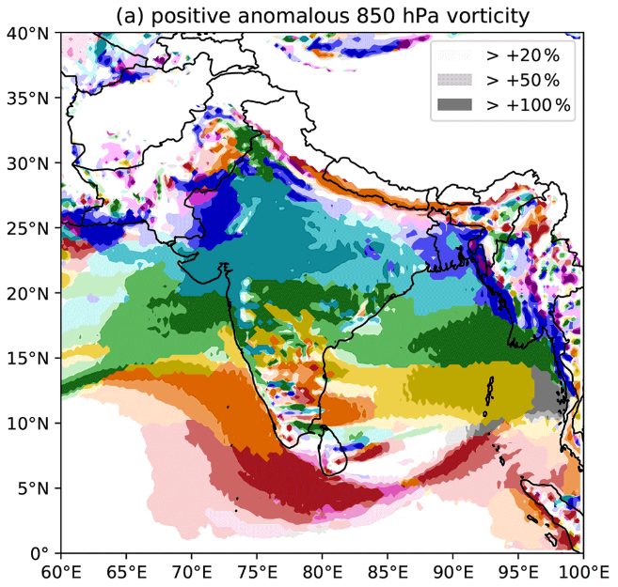
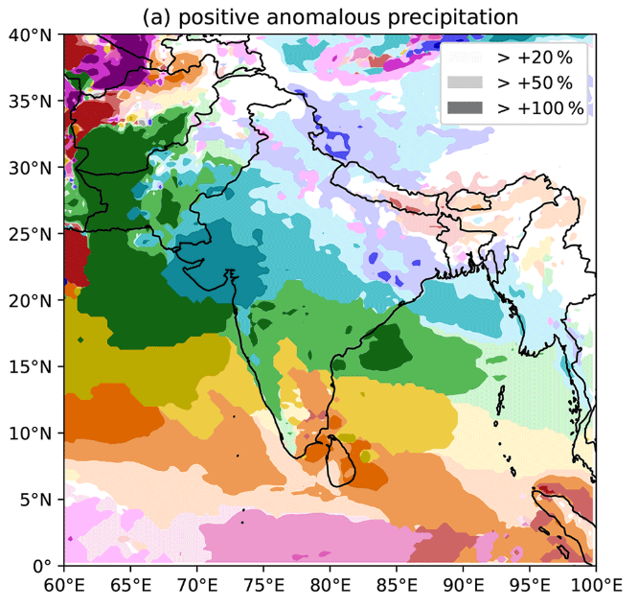
Introduction
523 LPSs June-Sep 1979-2018
Ignore “phase 0”
Slight phase lag between different BSISO responses

Slide 3
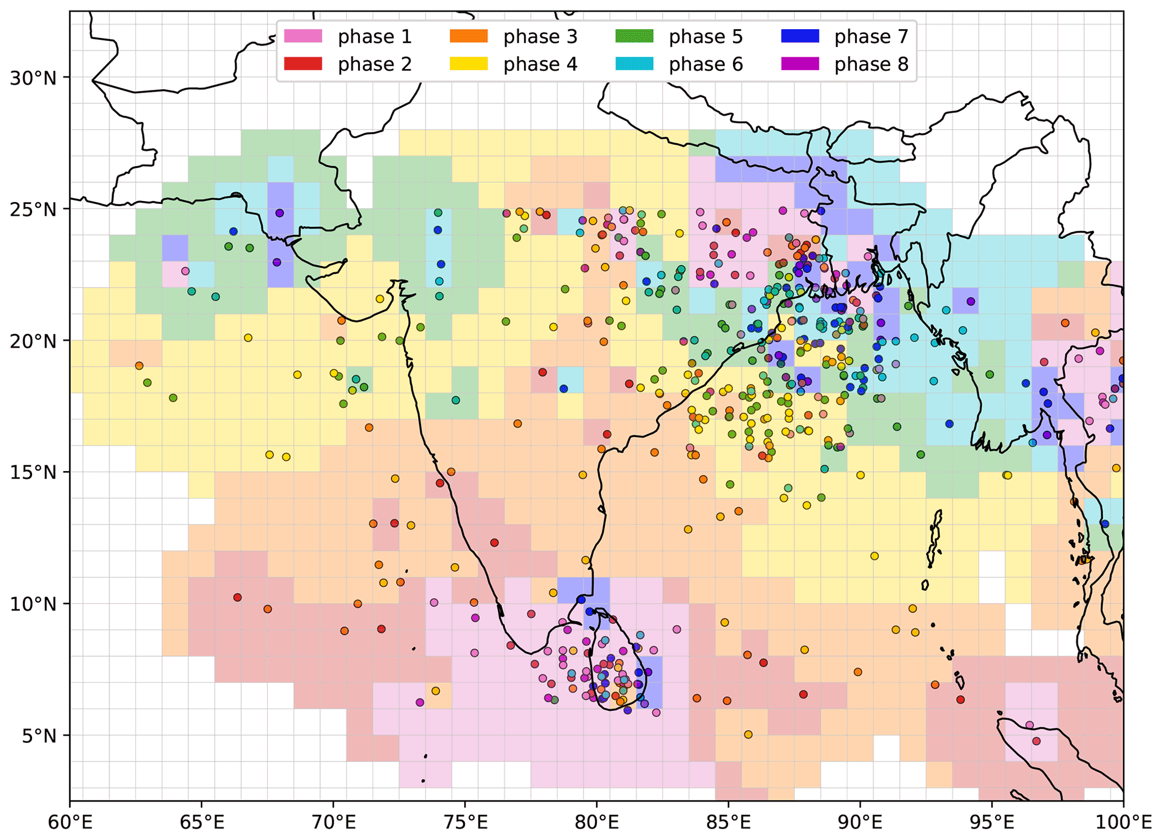
LPS genesis
Genesis points of LPS coloured by BSISO phase
Mean phase approximated by background gridded field
Lags anomalous vorticity by about half a phase
Ignore genesis points where BSISO phase is not well defined (~41%)
For dynamical consistency, will look only at LPSs north of 15°N

Slide 4
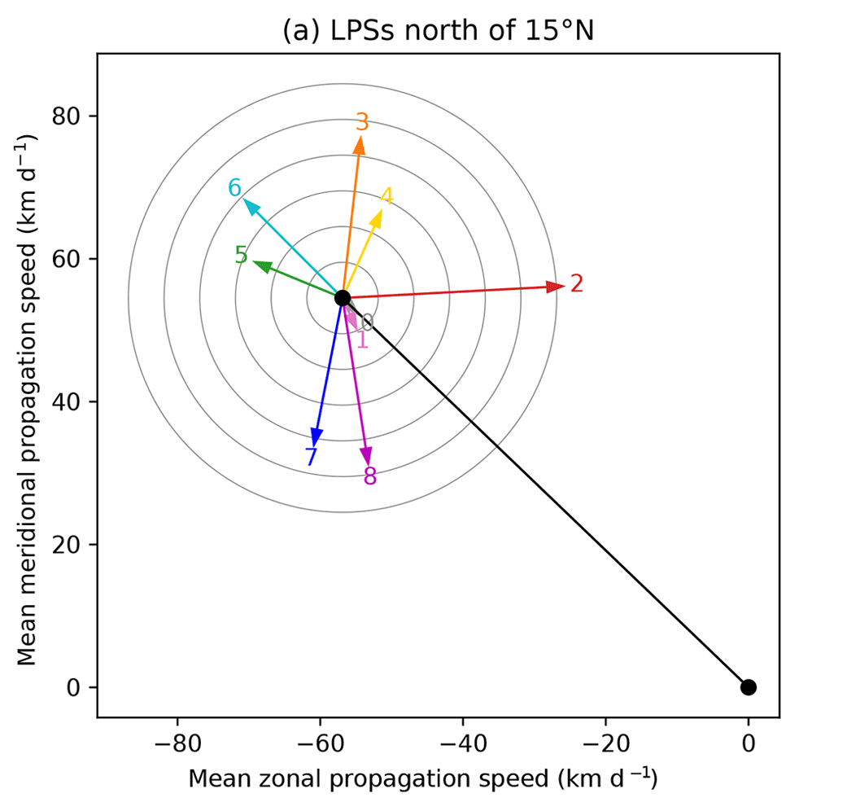
LPS propagation
Black line shows average LPS propagation vector (northwestward at ~100 km per day)
Coloured lines show anomalous propagation for each BSISO phase
During phases 5 and 6, LPSs propagate ~20% faster
During phase 2, LPSs propagate ~20% slower

Slide 5
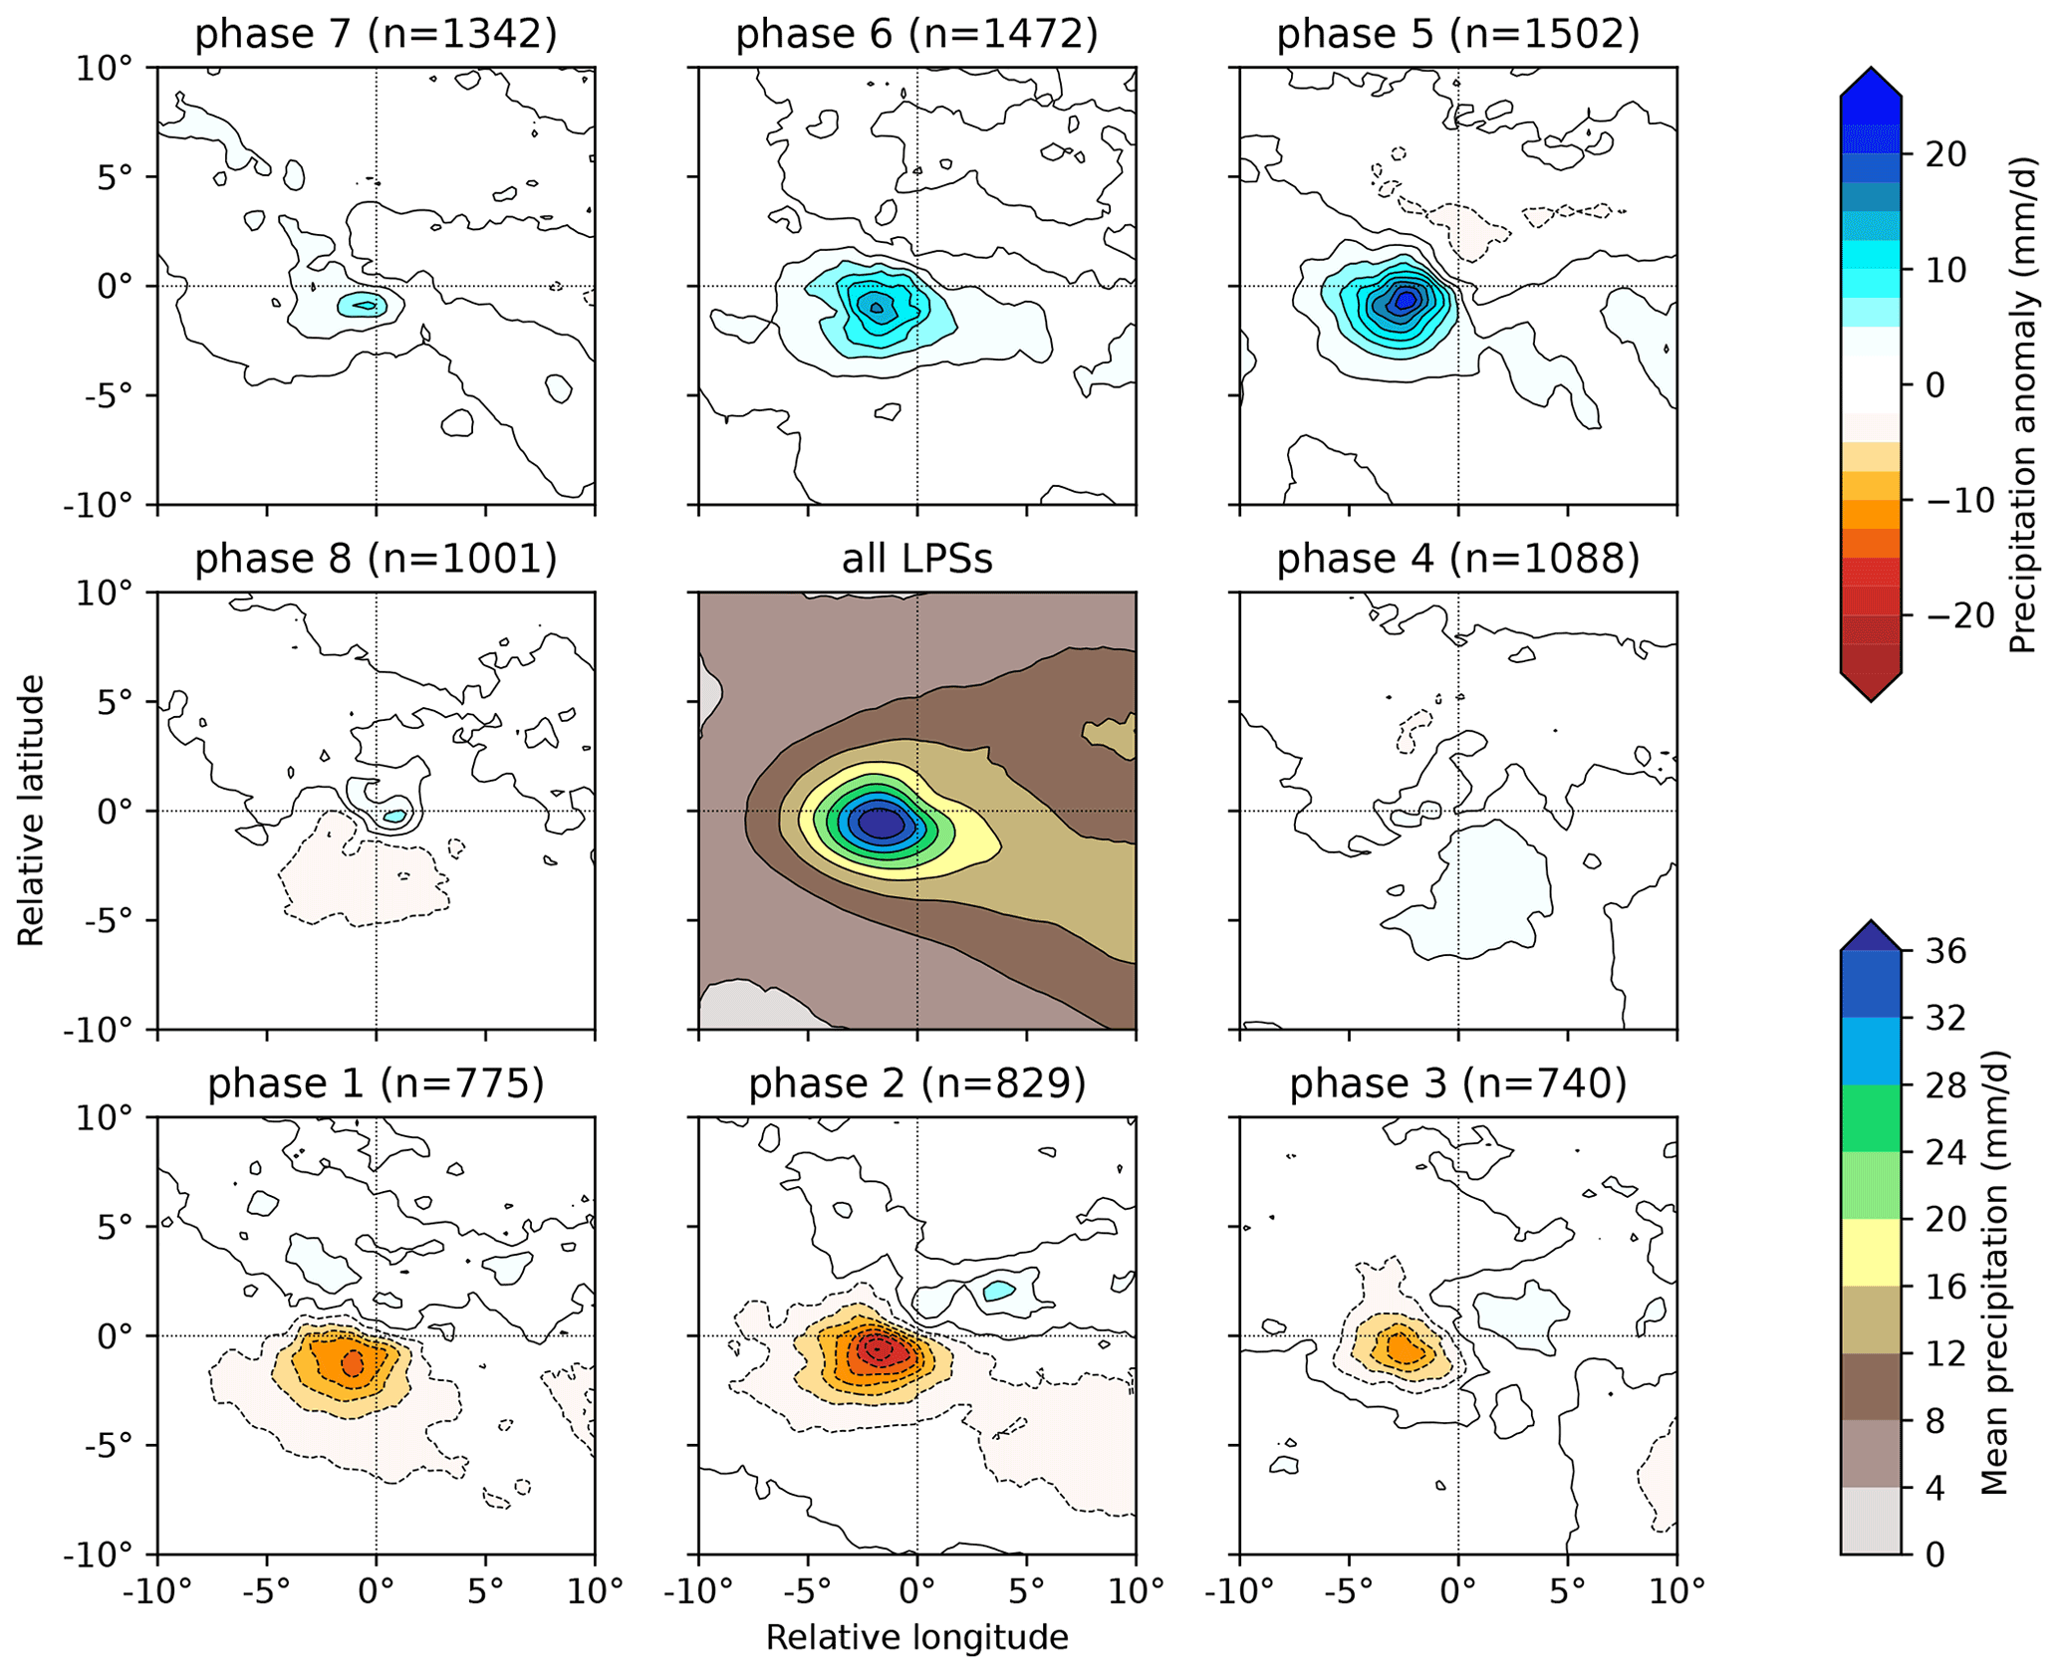
LPS precipitation
Centre panel shows system-centred mean precipitation for all LPSs
Panels around edge show anomaly to mean for each BSISO phase
Biggest changes in phase 5 (+51%) and phase 2 (-39%)
For simplicity, will now look only at these two phases

Slide 6
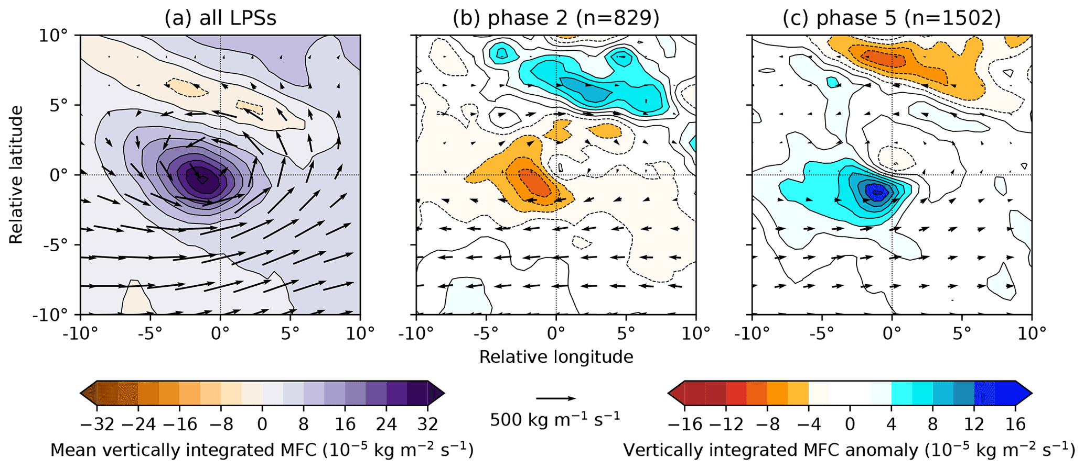
Where does the extra precipitation come from?
Changes in precipitation well matched by composite vertically integrated moisture flux convergence
This is easier to diagnose

Slide 7
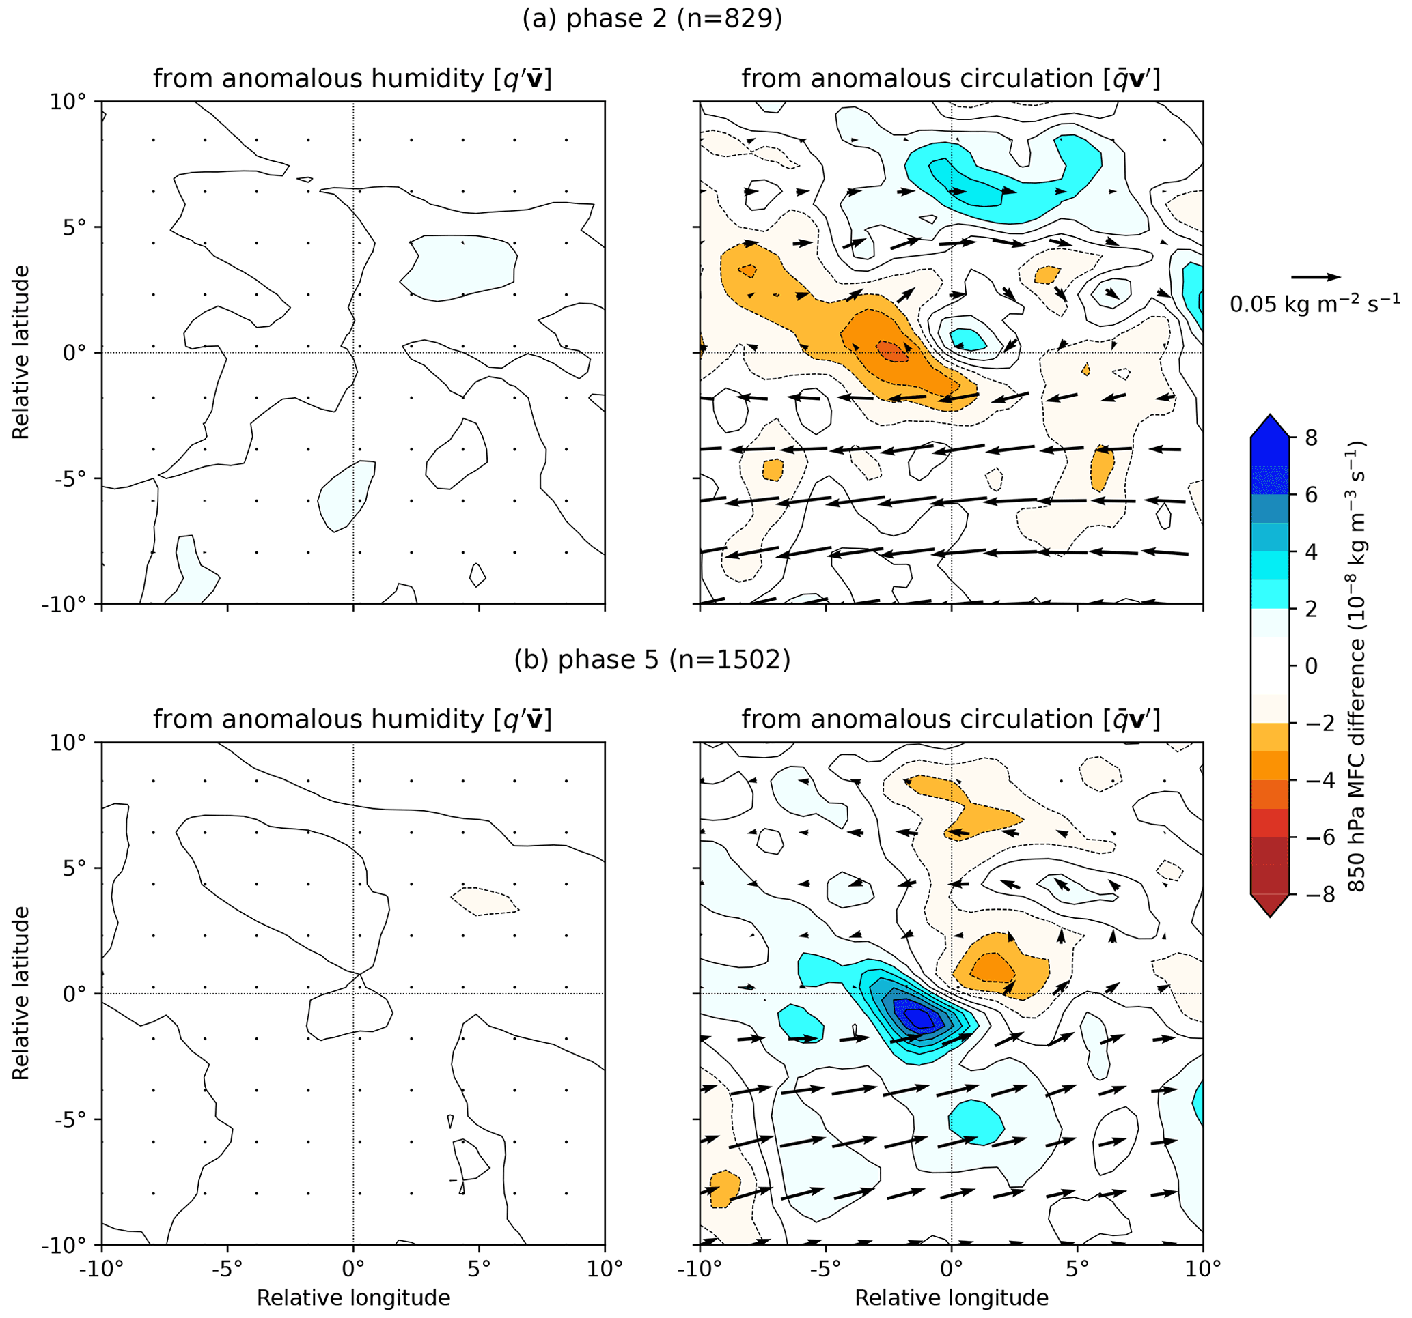
Where does the extra precipitation come from?
Linearisation shows us that almost all the change comes from anomalous circulation, not moisture
But could moisture play an indirect role?

Slide 8
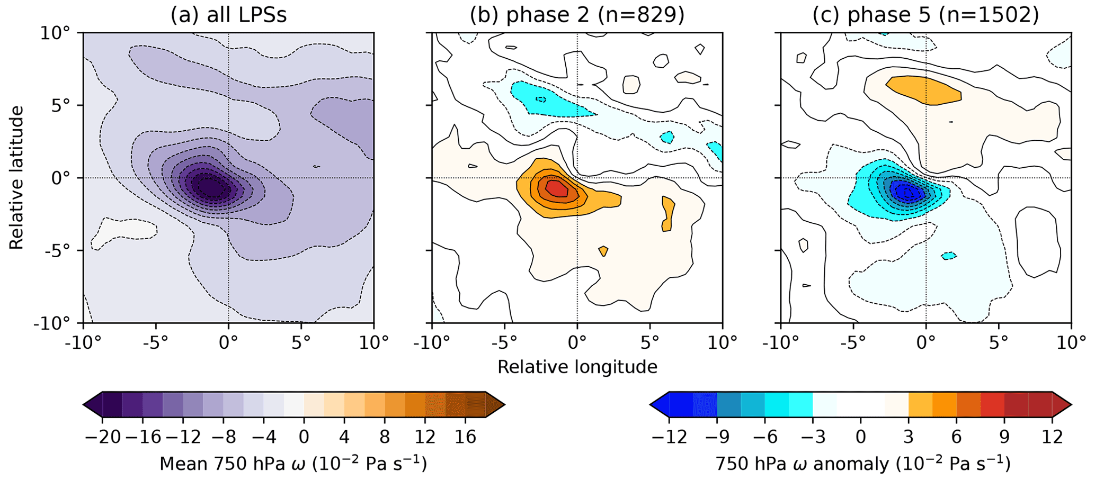
What causes the dynamical adjustment?
Mass continuity means that low-level omega approximates VIMFC very closely
Means we can use QG theory

Slide 9
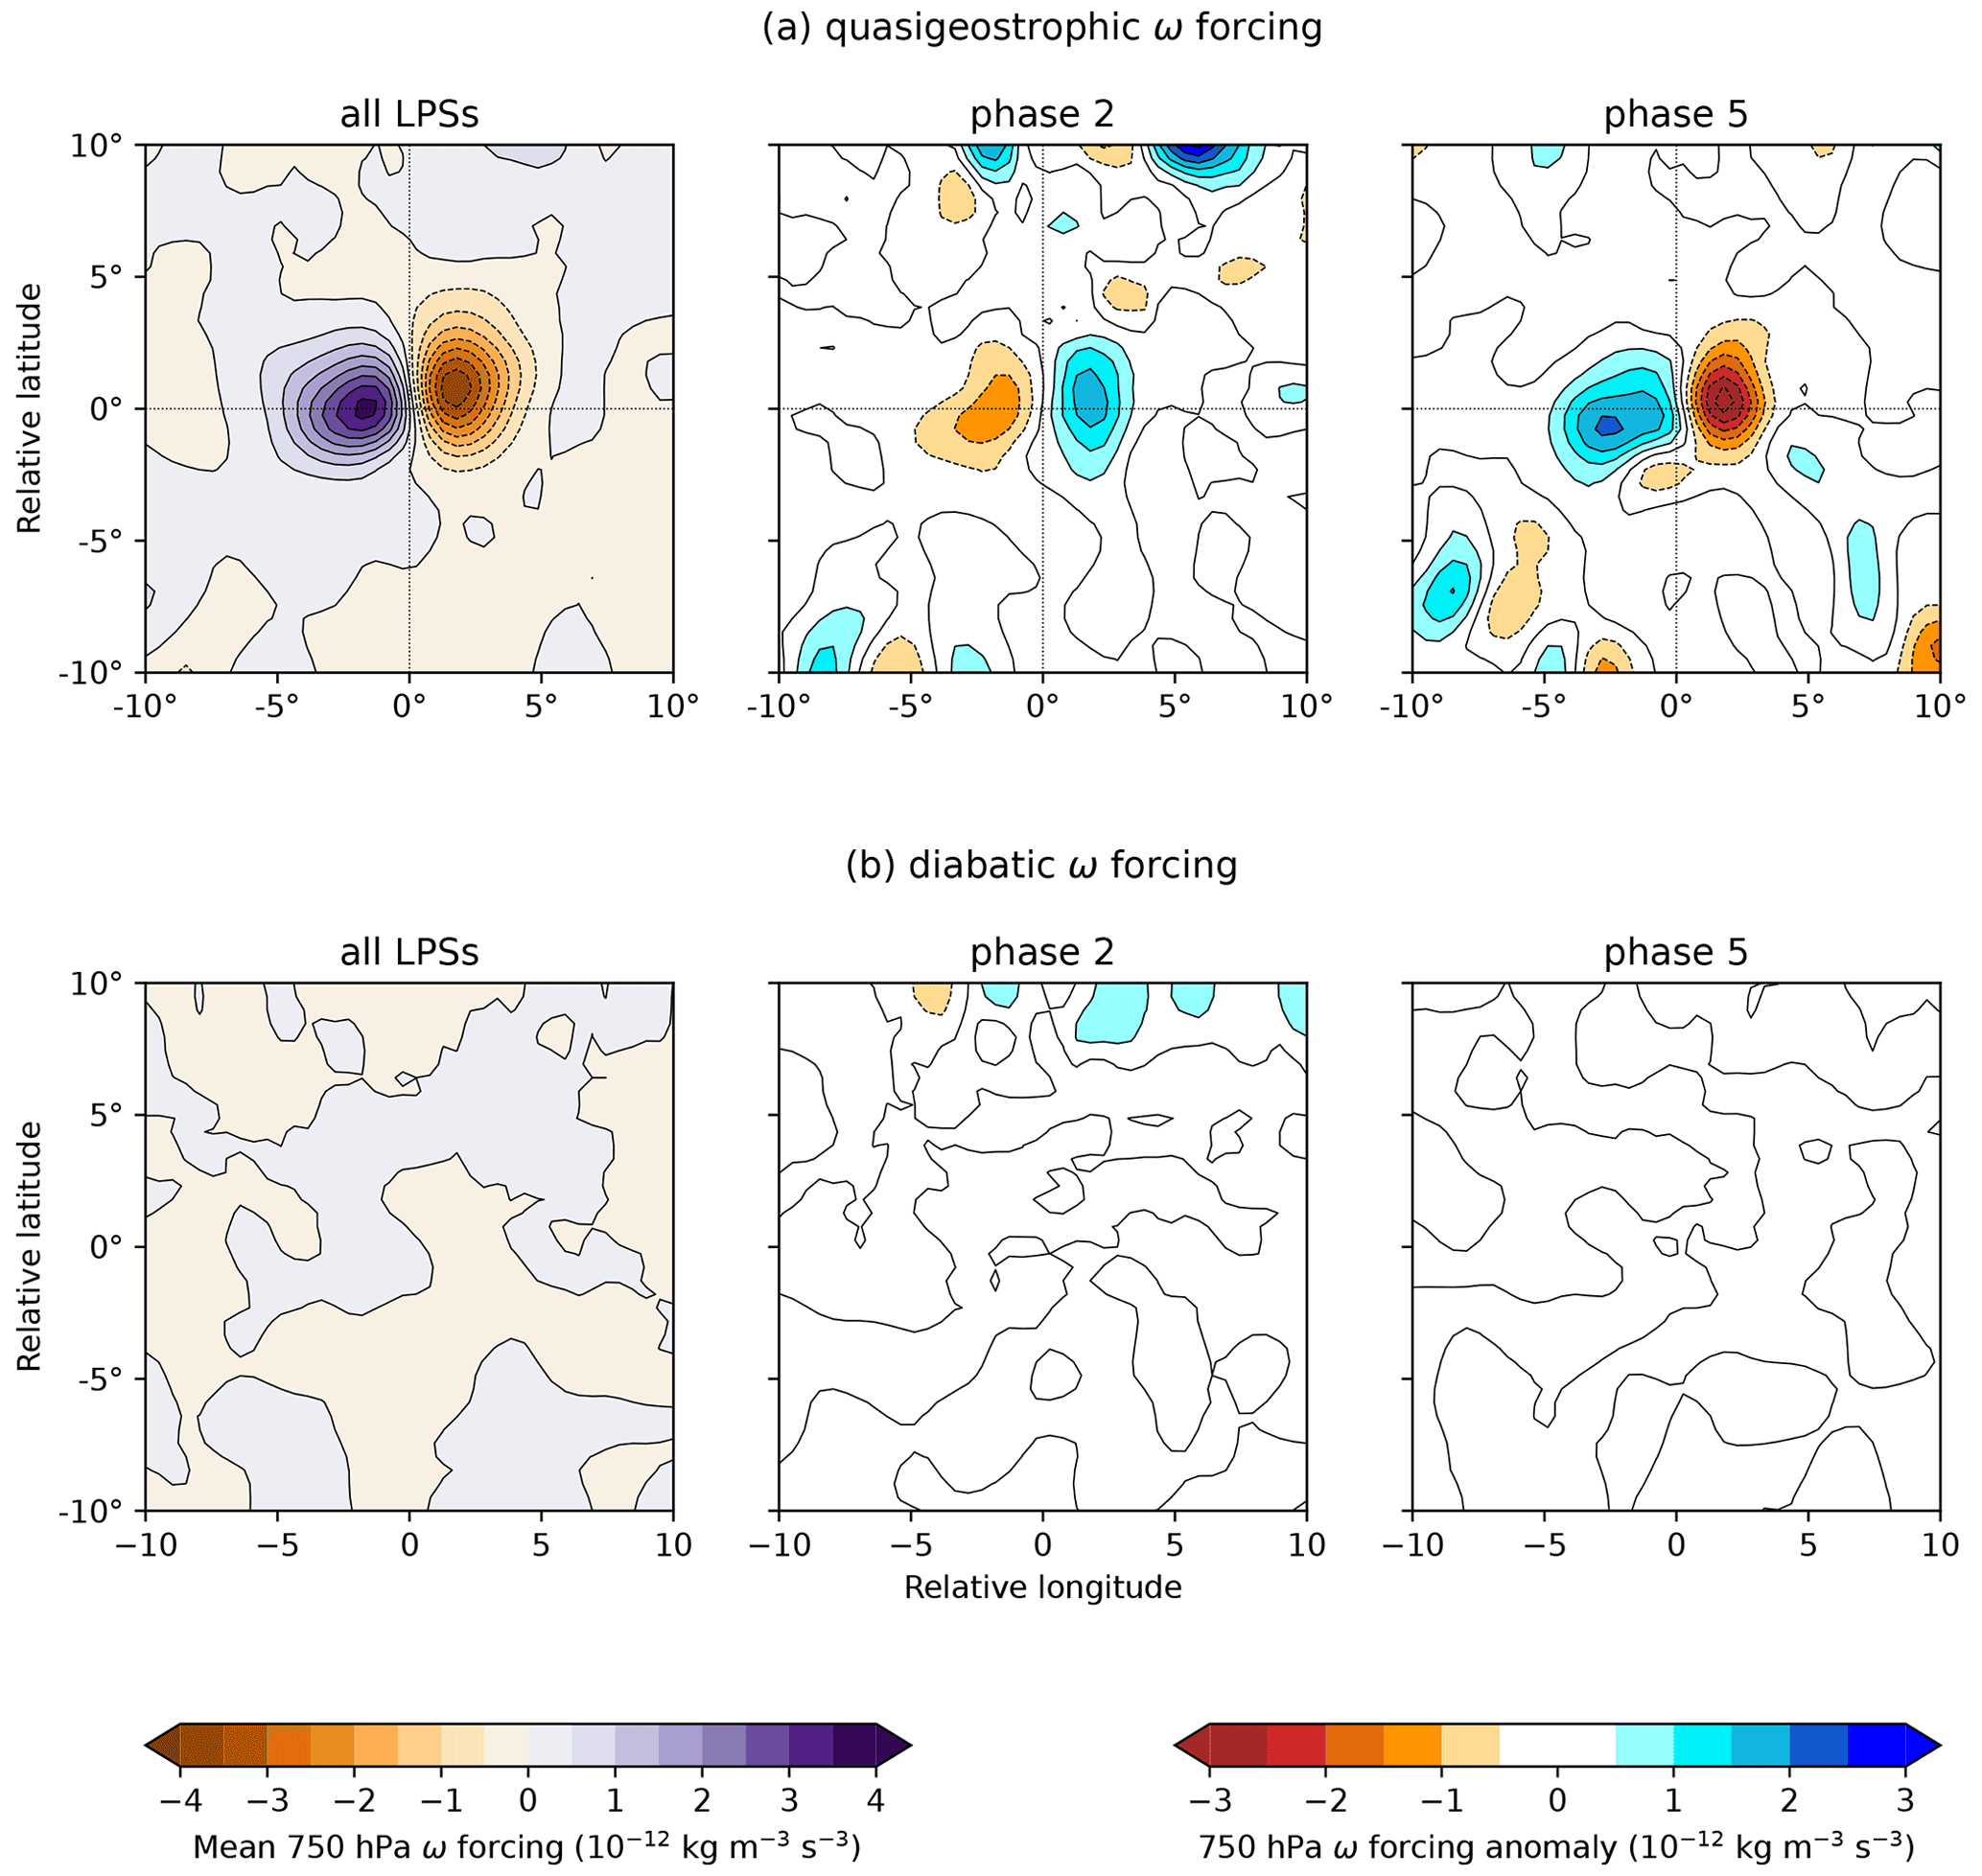
What causes the dynamical adjustment?
Anomalous latent heating has negligible effect on dynamics

Slide 10
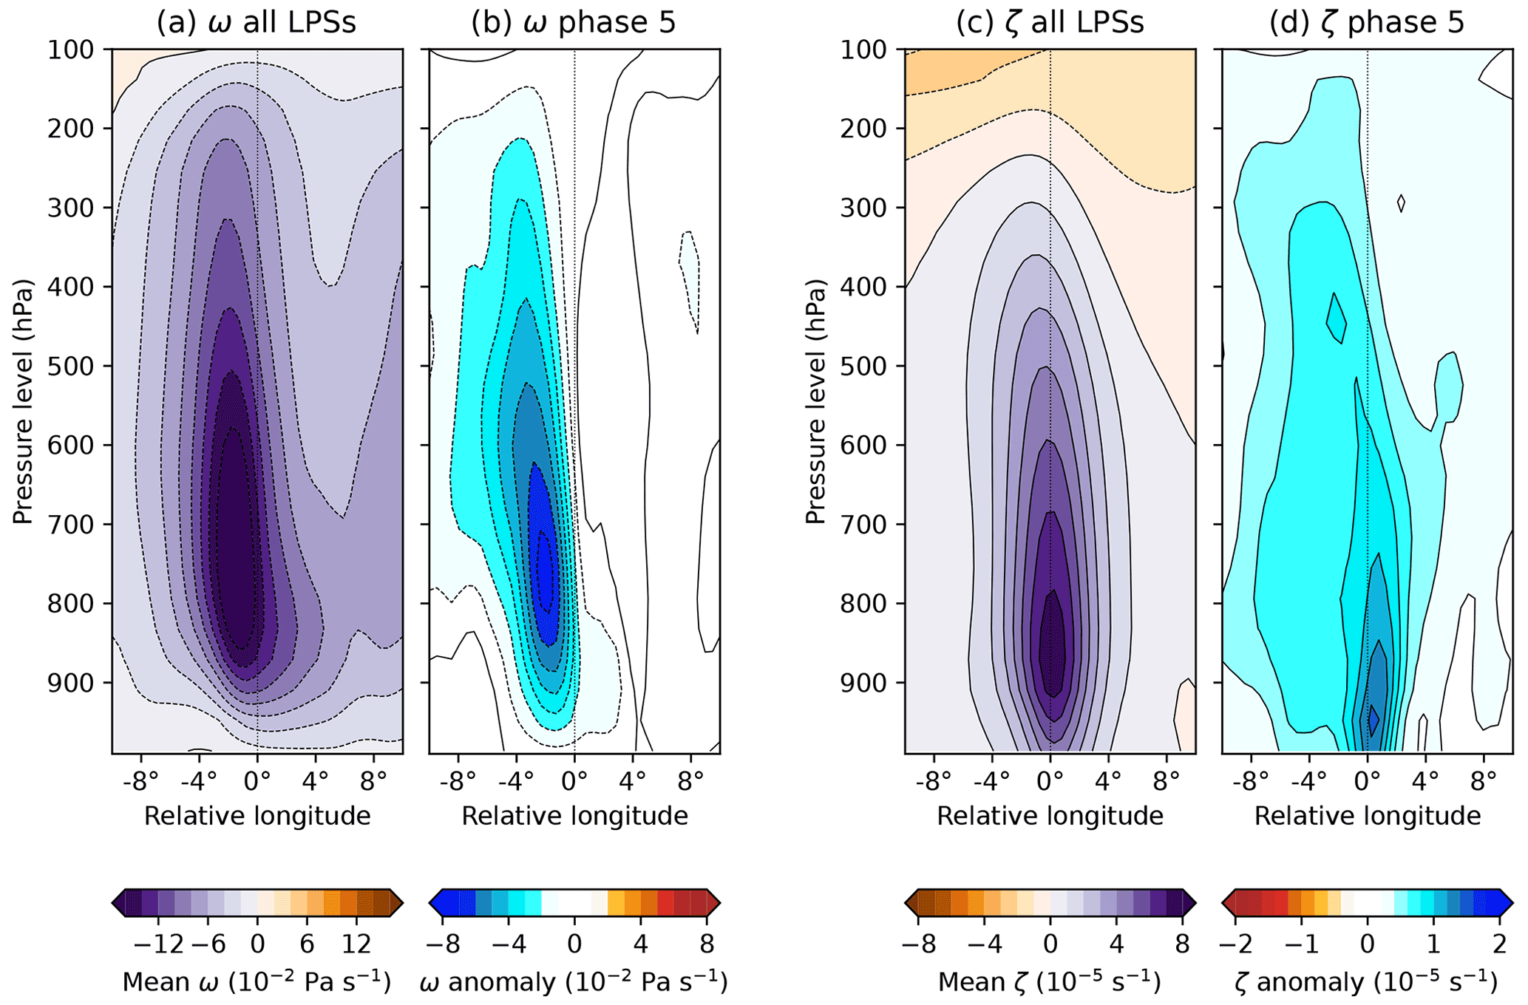
Title
Changes in omega largely follow the mean
Supported by earlier “linear” QG theory
But changes in vorticity do not follow the mean → linear theory is incomplete

Slide 11
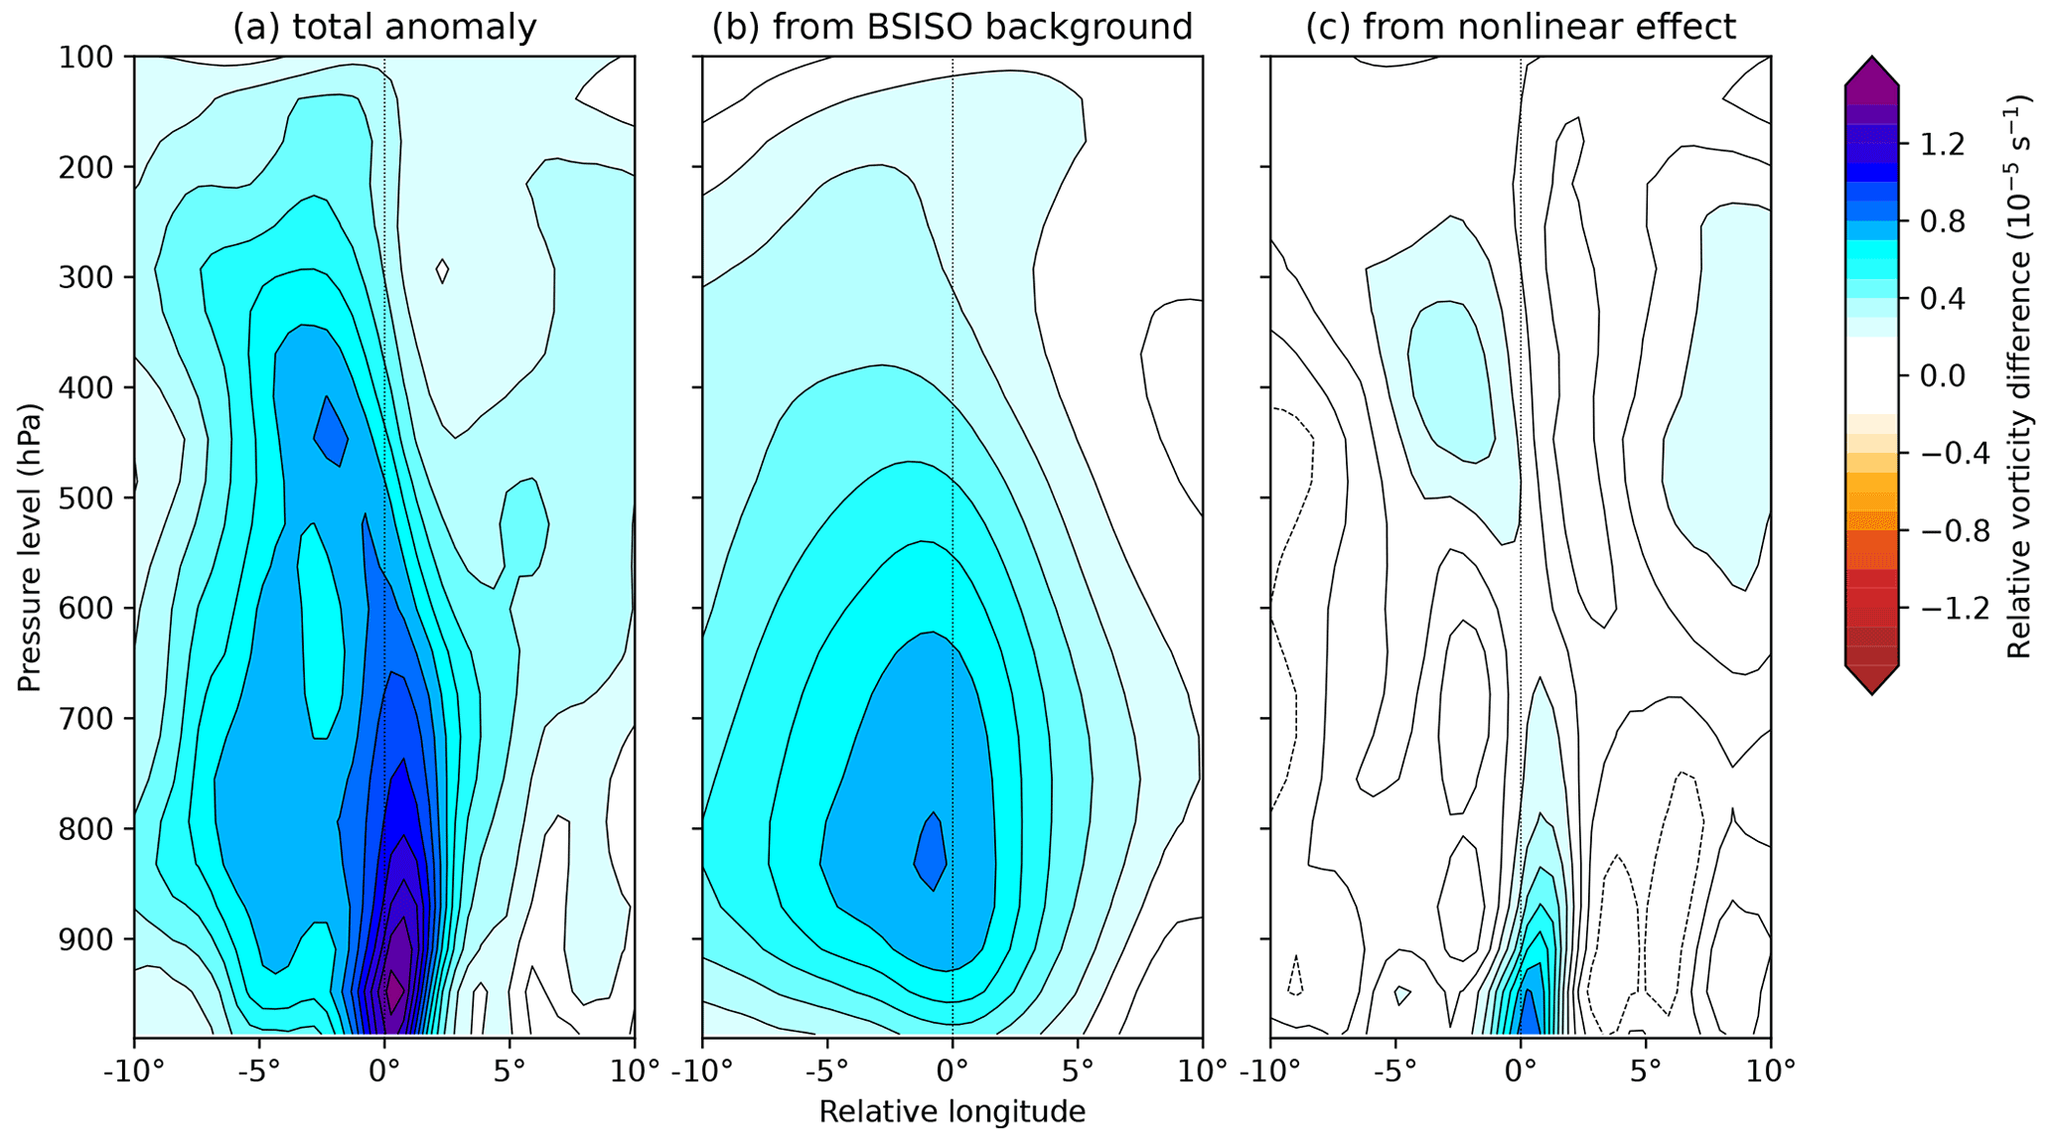
The trick: separating linear and nonlinear
Sample BSISO climatology to compute linear addition term
Residual term strong but largely confined to boundary layer
Increased moist barotropic instability?
Increased frictional convergence?

Slide 12
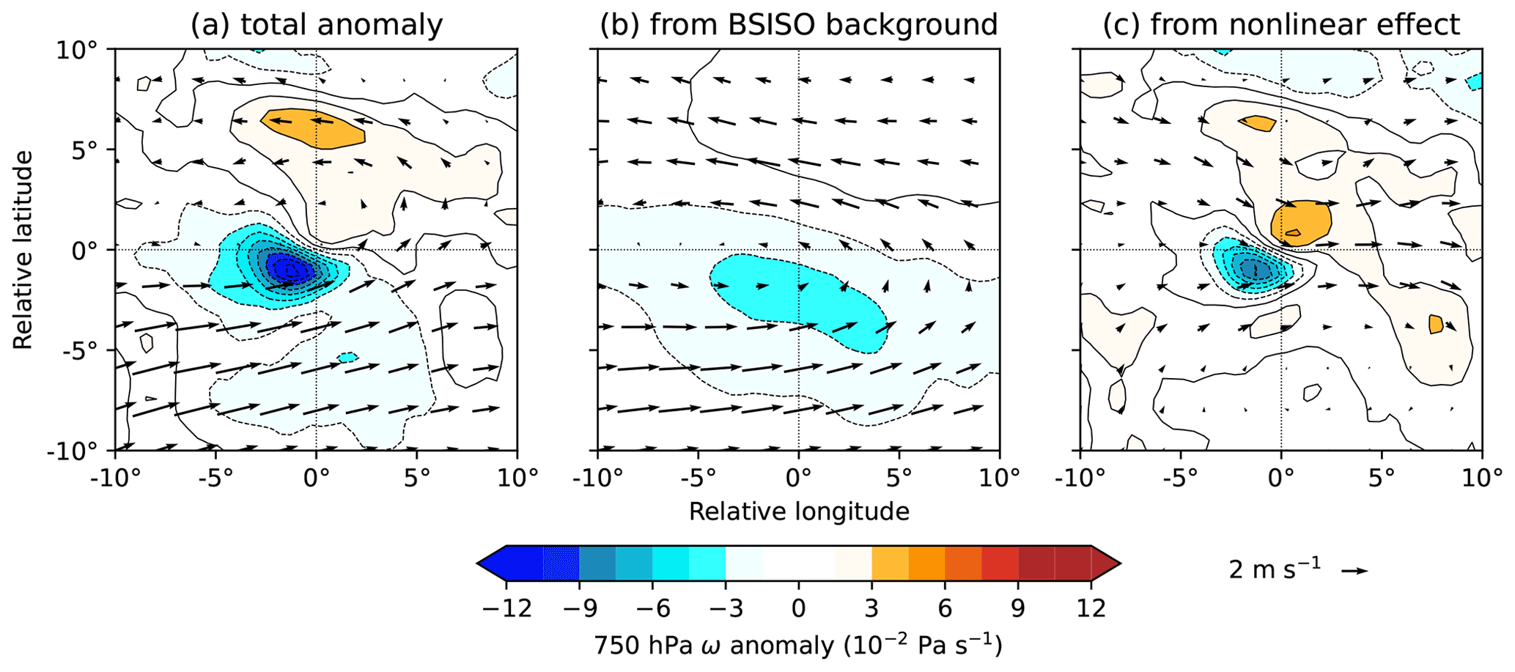
The nonlinear interaction
BSISO supplies only weak anomalous uplift
Rest comes from nonlinear interaction
Anomalous winds show LPS is extracting energy from anomalous barotropic instability

Slide 13
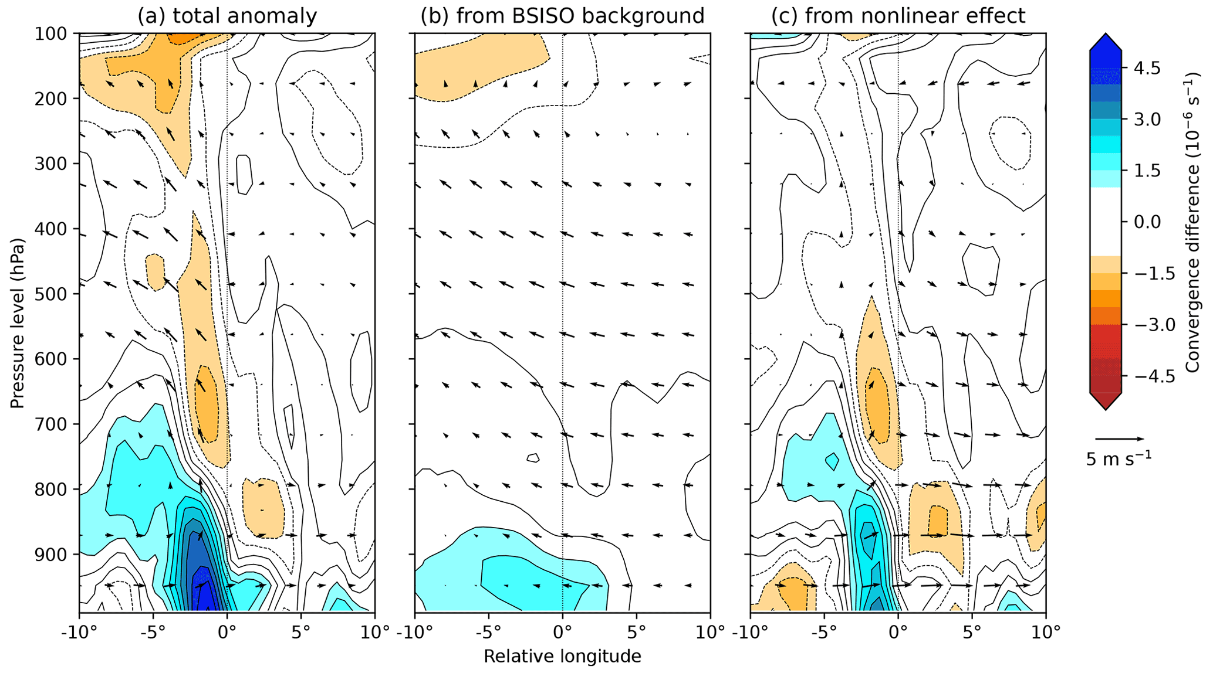
The nonlinear interaction
Barotropic instability cannot explain the PBL maximum since it scales with mean vorticity
But frictional convergence can…
So both processes important
barotropic instability
frictional convergence

Slide 14
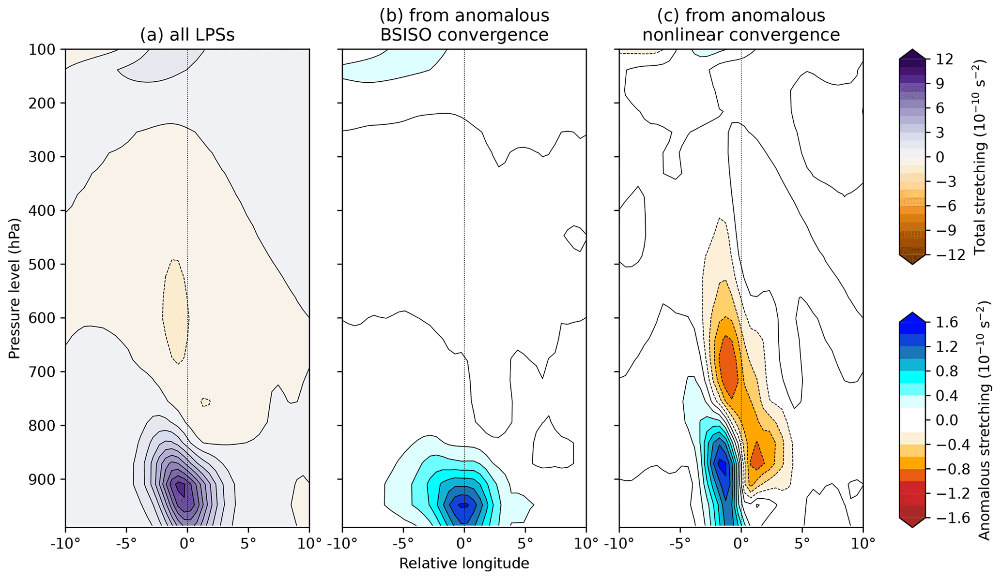
Wrapping it all together
Vortex stretching from BSISO alone intensifies the LPS
Vortex stretching from the nonlinear term makes it propagate faster

Slide 15
Conclusions
BSISO significantly affects LPS genesis, propagation, intensity, and precipitation
LPSs over north/central India produce 50% more rain and travel 20% more quickly in phase 5
Phase 2 roughly equal and opposite
Changes driven by underlying dynamics of BSISO, rather than anomalous moisture
But effect of BSISO not linear! In modifying LPS, nonlinear effects from barotropic instability and frictional convergence come into play
Ultimately, linear BSISO contribution affects LPS intensity, nonlinear contributions affect LPS speed

