Slide 1
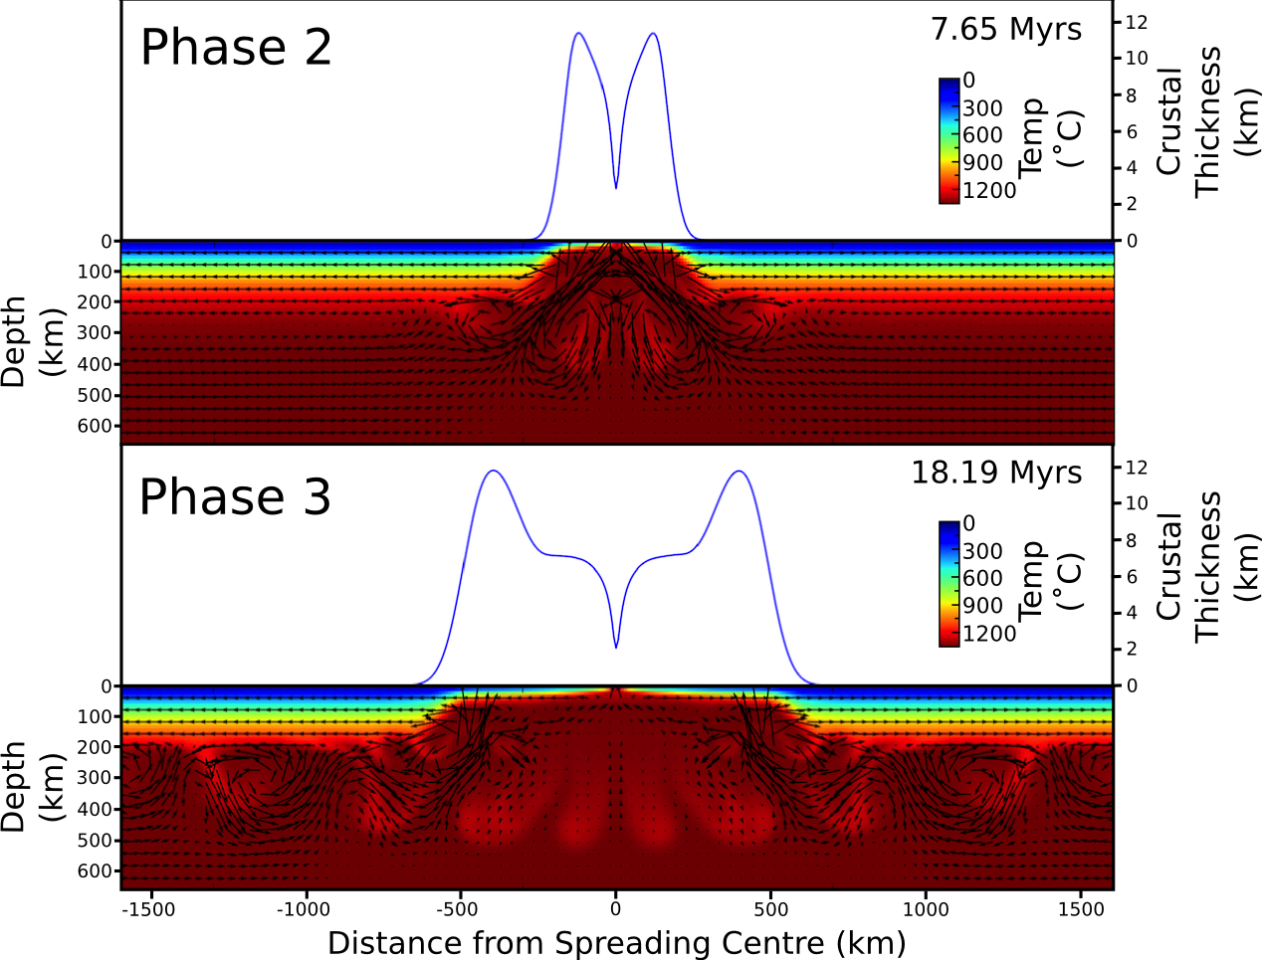
Downwelling dense mantle residues and hotspot magmatism
Jordan Phethean, Martha Papadopoulou, Alex Peace, Jeroen van Hunen

Slide 2
Mantle density changes during melting: Chemical Buoyancy

Slide 3
Mantle density changes during melting: Chemical Buoyancy

Slide 4
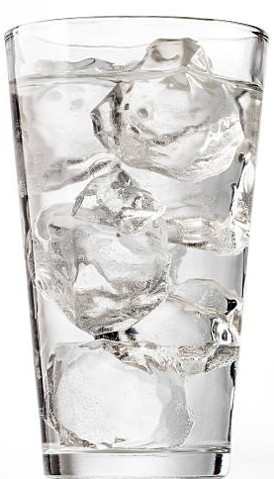
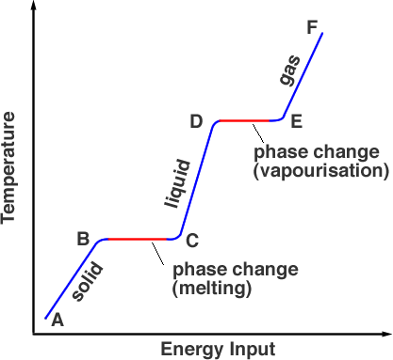
Mantle density changes during melting: Latent heat of melting

Slide 5
Mantle density changes during melting: Thermal expansion/contraction
Yao et al., 2018

Slide 6
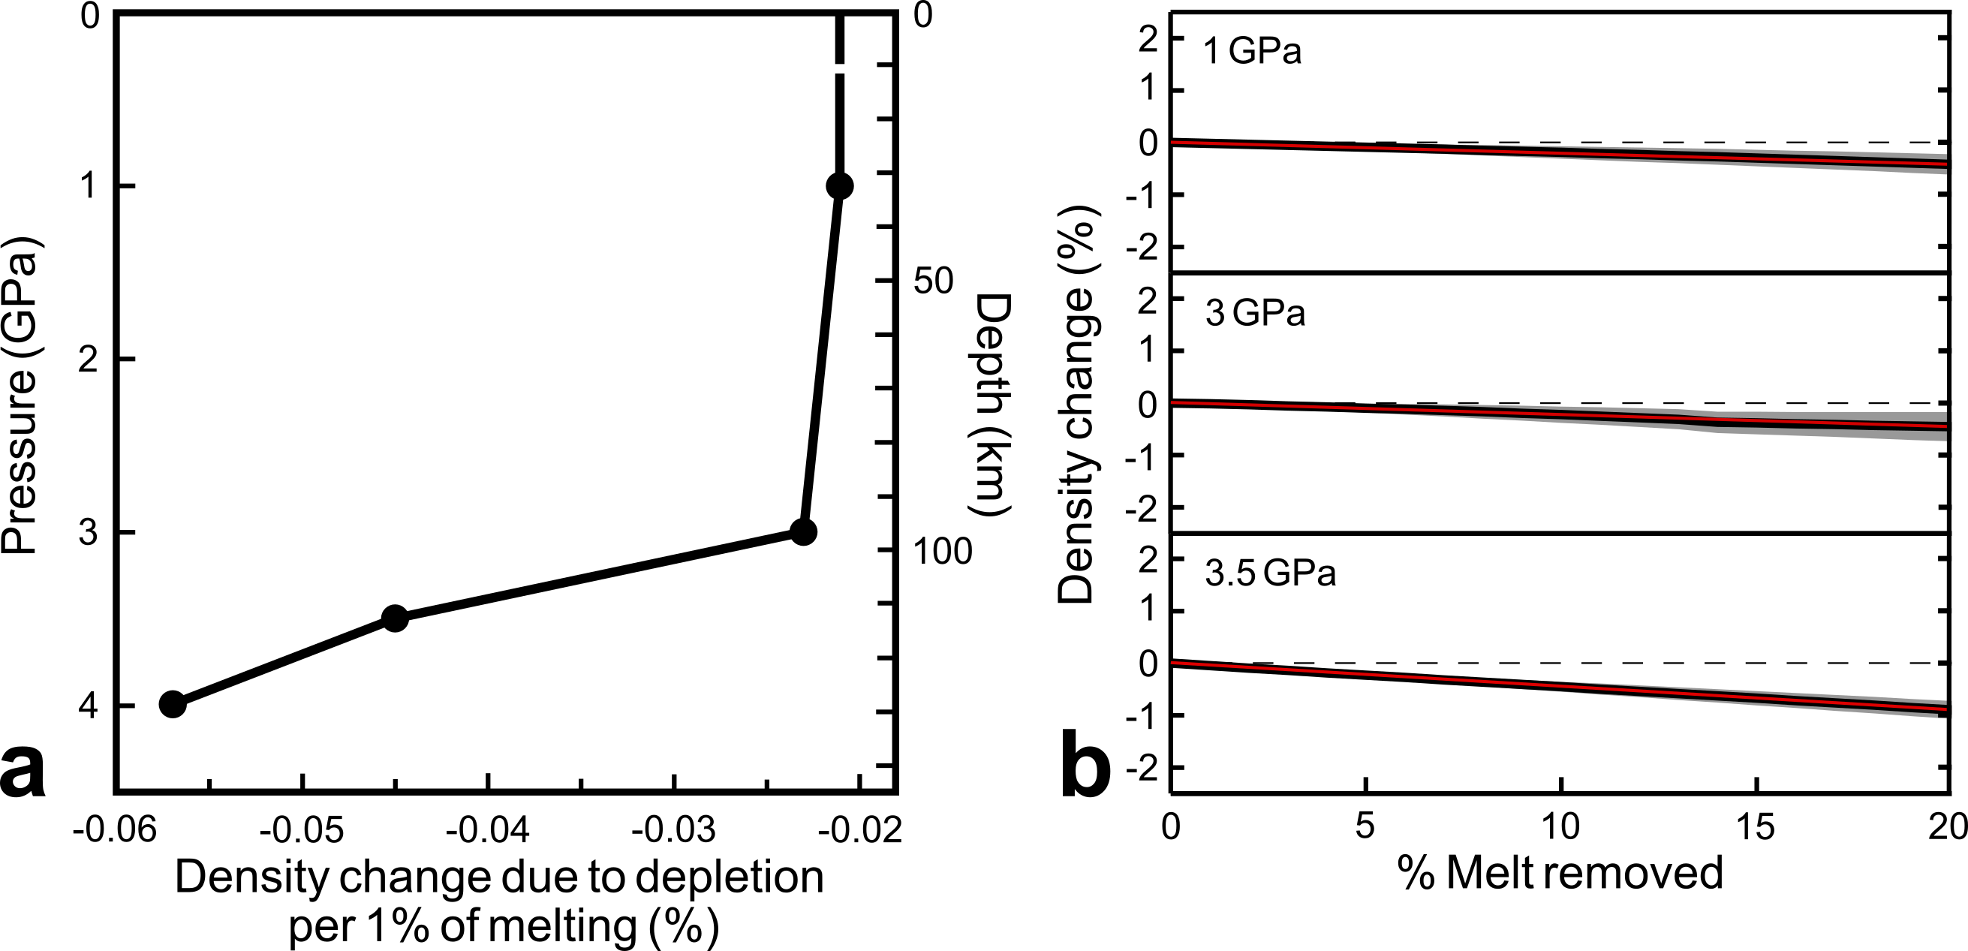
Chemical Depletion buoyancy
Phethean et al., 2022; Schutt and Lesher, 2006

Slide 7
Thermal contraction
Katsura et al., 2010; Kojitani and Akaogi (1997); Phethean et al., 2022; Phethean et al., in prep

Slide 8
Overall residue density change
Phethean et al., 2022; Phethean et al., in prep

Slide 9
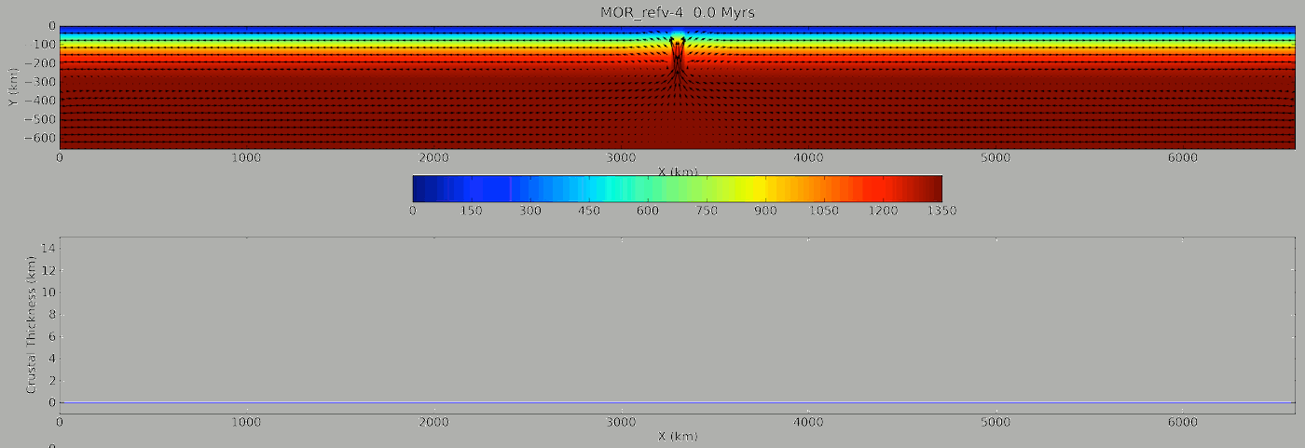
Numerical modelling
Phethean et al., in Prep
Notes:
The inversion of mantle convection beneath the spreading centre pulls more asthenospheric material through the melting window to produce a period of excess melting.

Slide 10
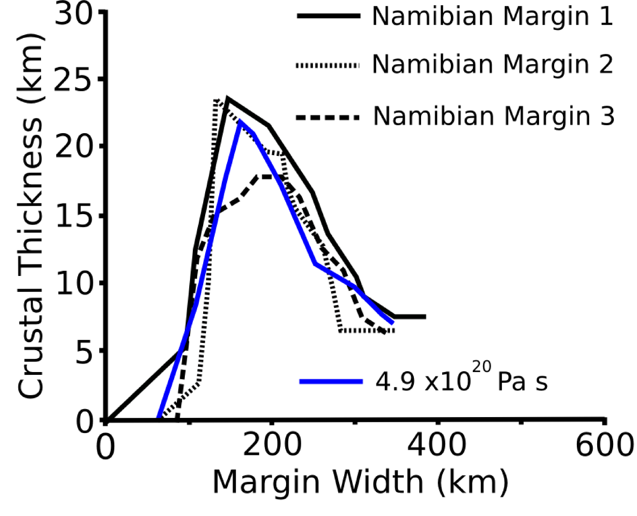
Comparison to observations
Geoffroy, 2005; Phethean et al., in prep

Slide 11
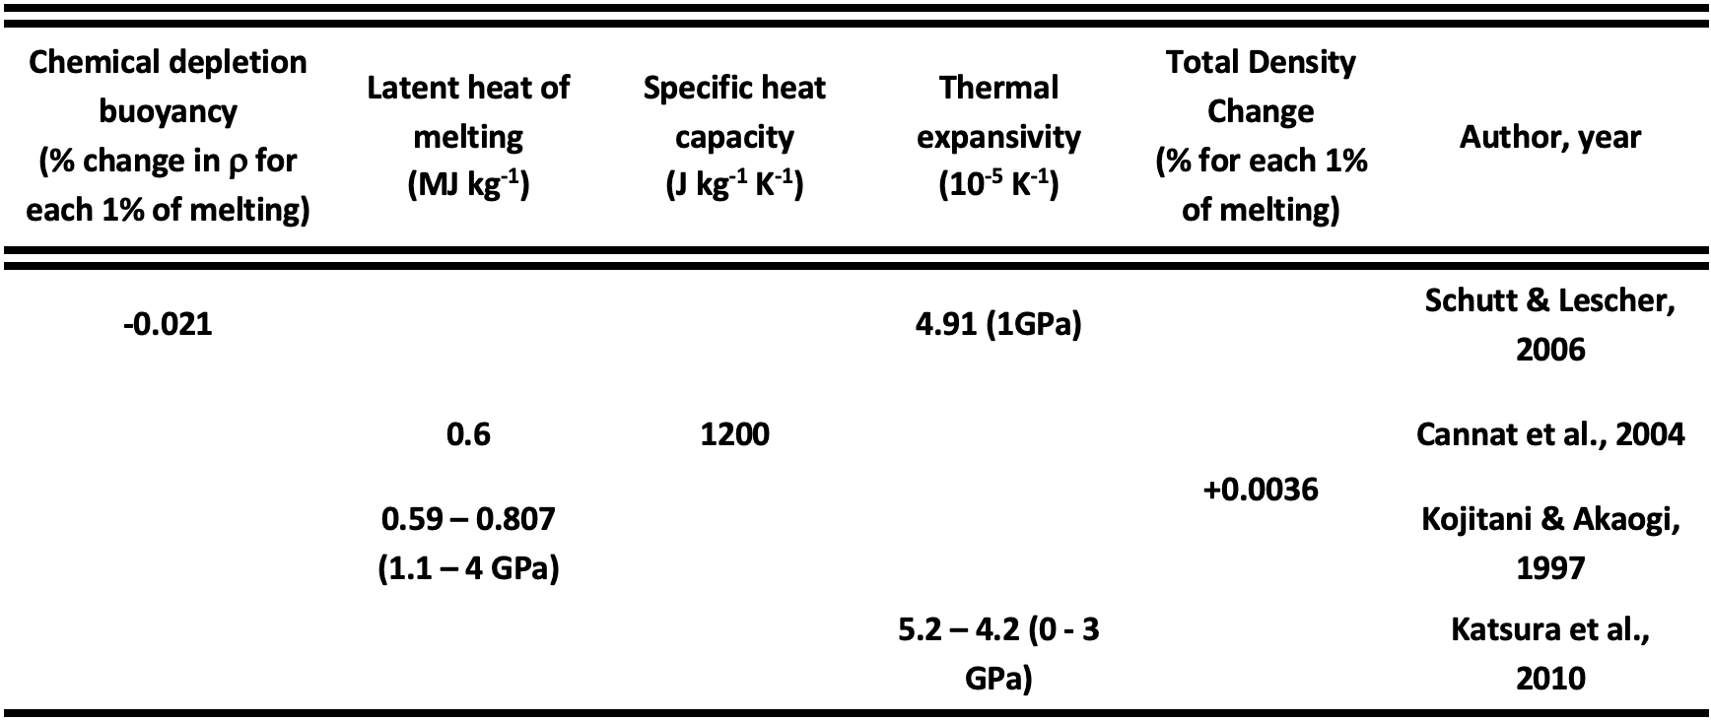
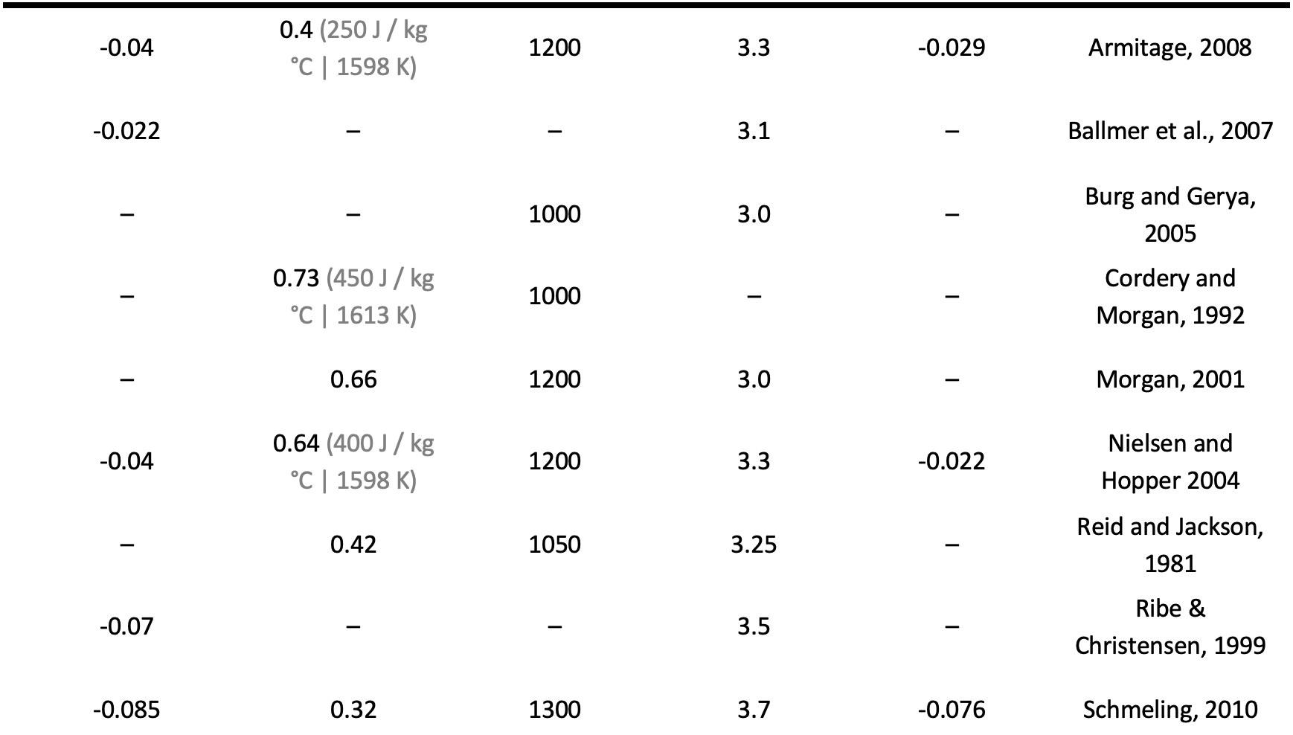

Slide 12
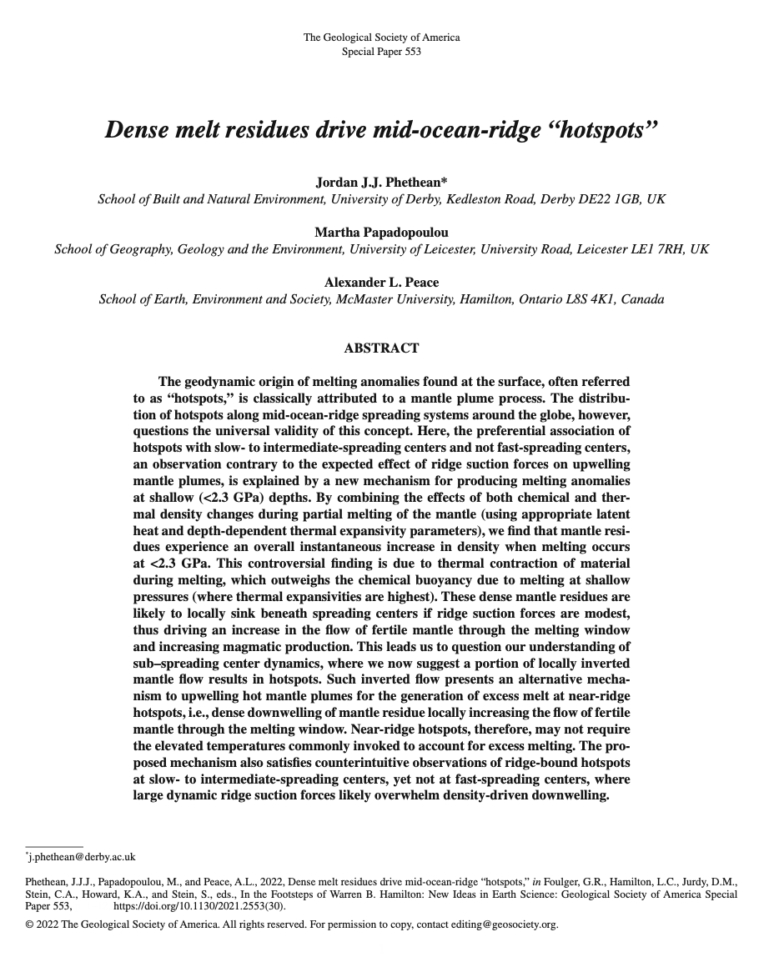
Thank you Any questions?

