Slide 1
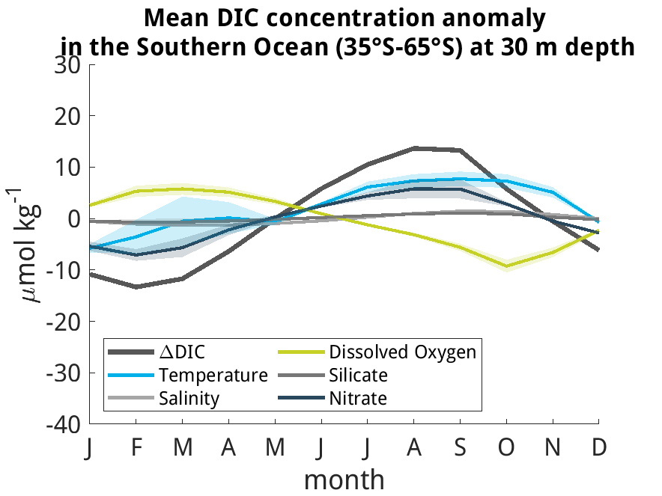
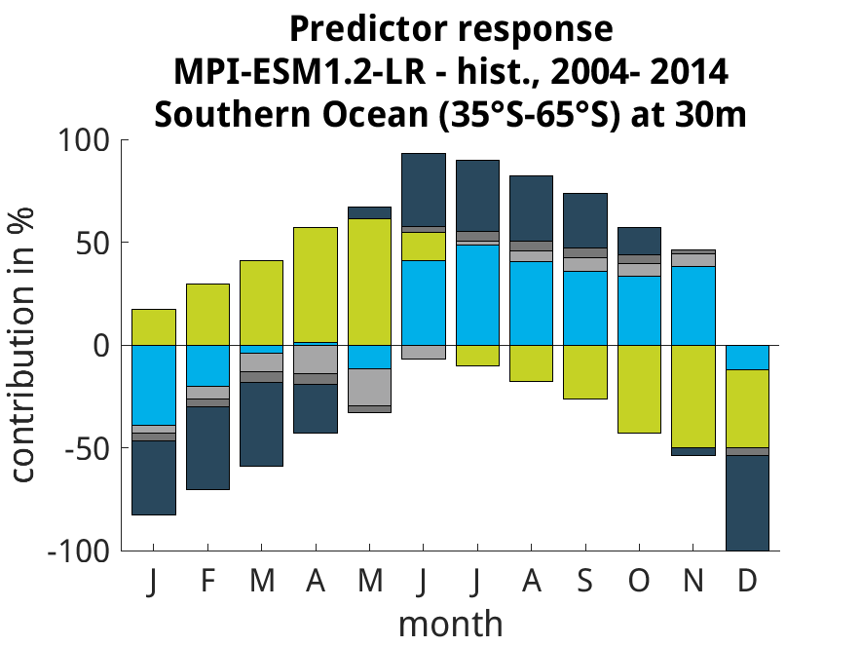
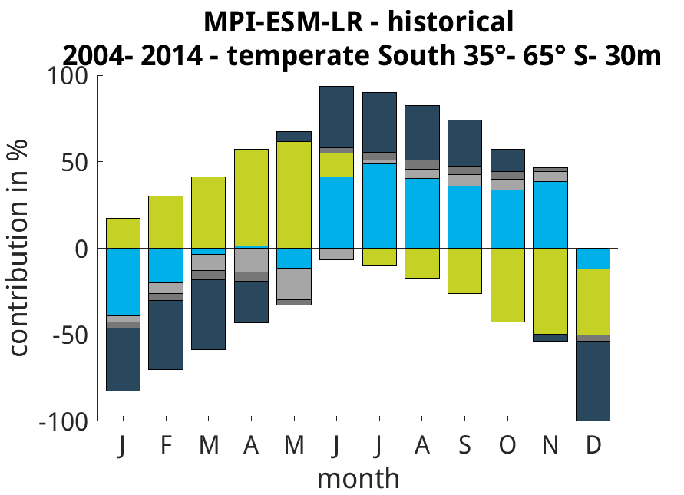
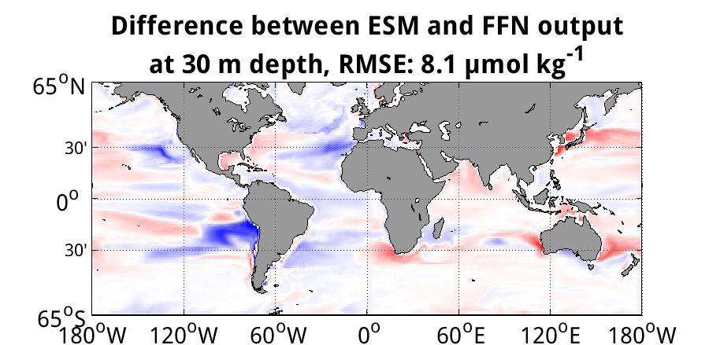
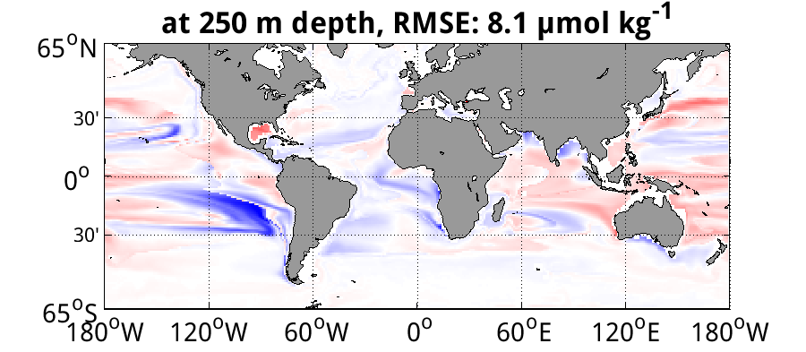
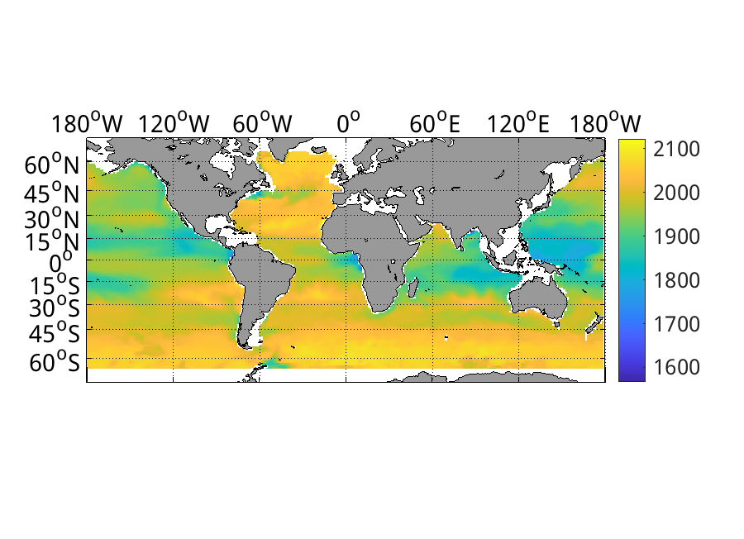
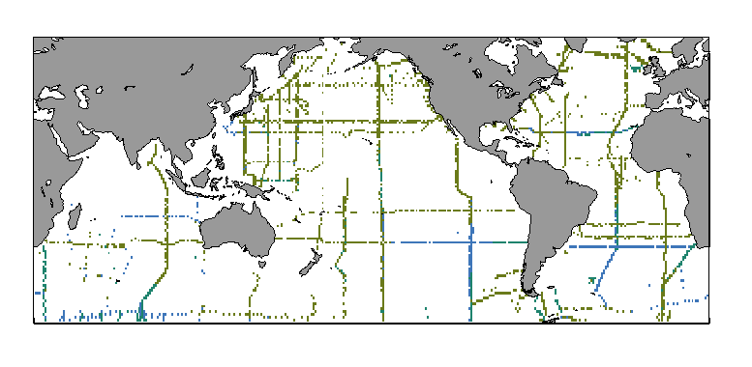
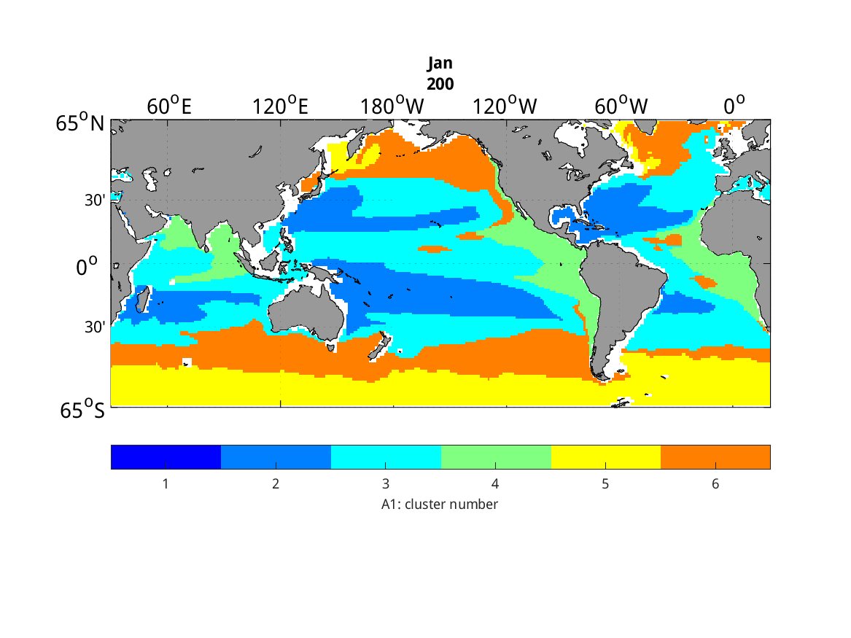
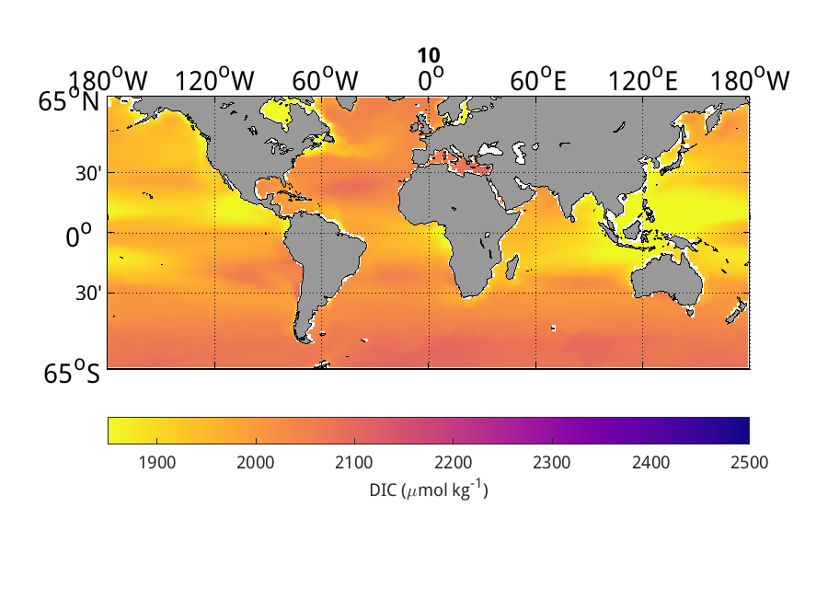
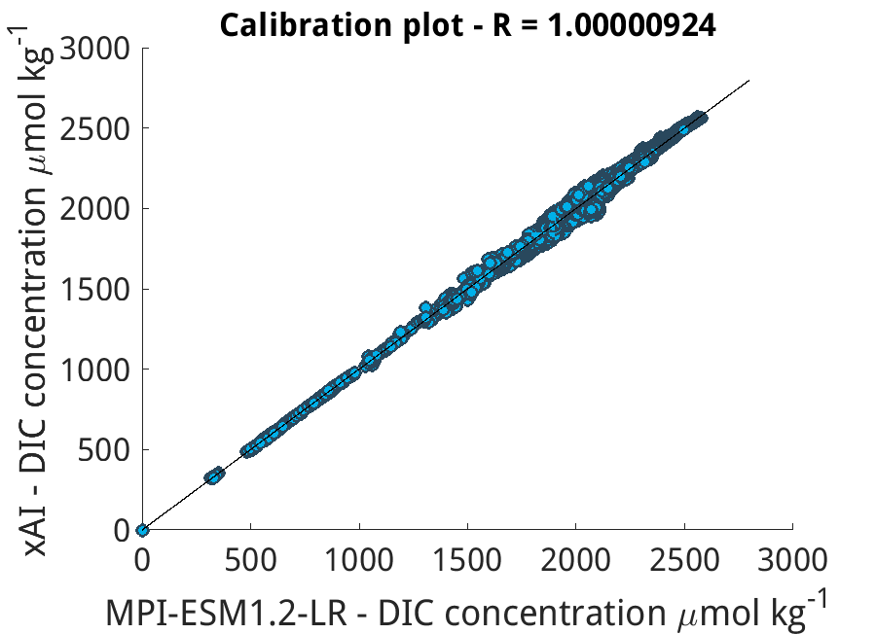
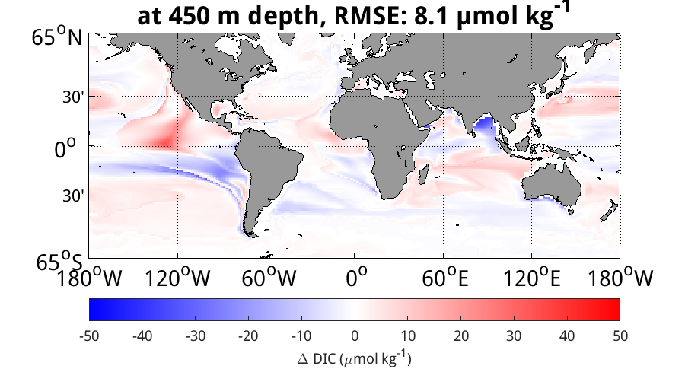
Explainable AI for evaluating seasonality of the oceanic carbon cycle in CMIP6 ESMs
Paul Heubel^{1,3}, Lydi Keppler², and Tatiana Ilyina³
¹Institute of Oceanography CEN, University Hamburg, Hamburg, Germany (paul.heubel@mpimet.mpg.de), ²Scripps Institution of Oceanography, UCSD, USA, ³Max-Planck-Institute for Meteorology, Hamburg, Germany
Motivation – CMIP6 models disagree on phase and magnitude of dissolved inorganic carbon (DIC) seasonal cycle
To estimate the future of the ocean carbon sink potential Earth System Models (ESMs) incorporate carbon cycles^{[1]}. Although the seasonal cycle of surface DIC is the main driver of variability in most basins, it is insufficiently represented in many CMIP6 models^{[2]}. We develop a diagnostical framework to quantify the importance of predictors on DIC seasonality by applying an explainable machine learning (xAI) approach. Our chosen predictors are related to physical processes (T & S) as well as biogeochemistry (O₂,Si & NO₃).
Research question – Which modelled variables (drivers) contribute to the DIC seasonal cycle mismatch in CMIP6 model climates?
Here emphasized along MPI-ESM1.2-LR historical run^{[9,10]} in important carbon sink region – the Southern Ocean^{[1]}.
Key - points
NO₃ and T drive seasonal cycle of DIC concentration in Southern Ocean in MPI-ESM-LR model climate
Dissolved O2 counteracts DIC changes
Our xAI framework shows sufficient skill in surface layer – RMSE < 10 µmol kg⁻¹
within reach: Comparison with obs. run and other models now possible
validation via comparison to random forest approach (linear)
Key - Points
NO₃ and T are the main statistical drivers of DIC in the Southern Ocean in this MPI-ESM-LR run.
S and Si are less important drivers.
Our xAI framework shows sufficient skill in surface layer – RMSE < 10 µmol kg⁻¹
Coming soon: Comparison with observations run and other models now possible
Validation via comparison to random forest approach (linear)
Figure 1: Left: Mean seasonal cycle of DIC, and the contribution of each of the 5 predictors (T, S, O2, Si, NO3) to the seasonal cycle, i.e. the seasonal response function. Thick line: mean; shading: standard deviation of a 10-member ensemble (boot-strapping approach). Right: Stacked bars - relative contribution of the 5 predictors (cf. left legend) on the seasonal cycle of DIC for each month. Both left and right are estimated by training the FFN multiple times, where for each run, only one of the 5 predictors is used (following Gevrey et al. (2003)^{[4]}).
Background
CMIP6 (Coupled Model Intercomparison Project Phase 6)
Facilitates standardized multi-model comparison^{[12]}.
With our evaluation, we adress a related Grand Challenge on Carbon Feedbacks by WCRP, aiming to constrain carbon sink durability and persistence under anthropogenic forcing (rising and falling GHG concentrations)^{[1]}.
Inorganic carbon chemistry and neural networks
The seasonal cycle of DIC is driven by temperature, salinity, and biological production (observable e.g., through O₂, Si, and NO₃)^{[3]}. Here, we consider the statistical drivers of DIC in CMIP6 models and compare the findings to observations. We use the neural network as a regression machine to determine the statistical drivers^{[4]}. As the relationships are non-linear we use a neural network and not a linear regression.
This will help inform us on how to improve the seasonal cycle in CMIP models, which will improve climate projections^{[2]}.
Observational Datasets: GLODAPv2.2019^{[11]}, Argo float data^{[6]}, World Ocean Atlas 2018^{[7]}
Model: 1°x 1°4-D (lat, lon, 31 depth-lev, time) fields from MPI-ESM-LR historical run^{[9,10]} (interactive cycle, emission driven, prognostic).
Methodology
MOBO-DIC
Keppler et al. (2020)^{[3]} applied 2-step cluster (SOM, Kohonen,1989^{[5]}) – feed-forward neural network (FFN, Landschützer et al., 2014^{[8]}) approach for observation extrapolation (4D-field MOBO-DIC^{[3]}).
We are shedding light into the black box by looking at the statistical drivers and apply it for CMIP6 ESM evaluation.
xAI – open the feed forward neural network
Based on Gevrey et al. (2003)^{[4]}, we extrapolate DIC incorporating only seasonality of predictor of interest. Remaining predictors are kept constant in time. 𝞓DIC is residual of run with & without sensitivity experiment (seasonal response function).
Training/ Test: (80/20%) at observational coordinates in space and time.
Validation: Model field and application to observational MOBO-DIC climatology.
Evaluation of xAI
RMSE of less than 10 µmol kg⁻¹
Comparison of full model field with xAI output shows small errors in Southern Ocean for all depths (< 500 m), i.e. predictions here are most accurate.
A simple calibration plot in figure 3 (bottom) emphasizes the global accuracy of our model, i.e. showing a correlation coefficent of R² ≈ 1.
Figure 3: Right: Bias plot of xAI DIC field in comparison to MPI-ESM1.2-LR historical run for 3 depth levels (30m, 250m, 450m).
Left: Calibration plot of xAI DIC surface field (<500m) in comparison to MPI-ESM1.2-LR field, temporal mean of all months for all lat, lon, lev.
T, S, O₂, Si, NO₃
& DIC
Cluster subsampled field
Apply FFN to clusters Bootstrap to estimate uncertainty of the method
References:
[1] Ilyina, T. and Friedlingstein, P. (2016). Biogeochemical Cycles and Climate Change. White Paper on WCRP Grand Challenge. World Climate Research Programme, https://www.wcrp-climate.org/gc-carbon-feedbacks
[2] Nevison, C. D., Manizza, M., Keeling, R. F., Stephens, B. B., Bent, J. D., Dunne, J., Ilyina, T., Long, M., Resplandy, L., Tjiputra, J., & Yukimoto, S. (2016). Evaluating CMIP5 ocean biogeochemistry and Southern Ocean carbon uptake using atmospheric potential oxygen: Present-day performance and future projection. Geophysical Research Letters, 43, 2077– 2085. doi.org/10.1002/2015GL067584
[3] Keppler, L., Landschützer, P., Gruber, N., Lauvset, S. K., & Stemmler, I. (2020). Seasonal carbon dynamics in the near-global ocean. Global Biogeochemical Cycles, 34, e2020GB006571. doi.org/10.1029/2020GB006571
[4] Gevrey, M., Dimopoulos, I., Lek, S., Review and comparison of methods to study the contribution of variables in artificial neural network models, Ecological Modelling, 160, 3, 2003, doi.org/10.1016/S0304-3800(02)00257-0
[5] Kohonen, T. (2001). Self-organizing maps, Springer Series in Information Sciences. Berlin, Heidelberg: Springer.
[6] Roemmich, D., & Gilson, J. (2009). The 2004-2008 mean and annual cycle of temperature, salinity, and steric height in the global ocean from the Argo program. Progress in Oceanography, 82(2), 81– 100. https://doi.org/10.1016/j.pocean.2009.03.004
[7] Garcia, H. E., Boyer, T. P., Baranova, O. K., Locarnini, R. A., Mishonov, A. V., Paver, C. R., Seidov, D., Weathers, K. W., Zweng, M. M., Grodsky, A., & Smolyar, I. V. (2019). World ocean atlas 2018: Product documentation.
[8] Landschützer, P., Gruber, N., Bakker, D. C. E., & Schuster, U. (2014). Recent variability of the global ocean carbon sink. Global Biogeochemical Cycles, 28, 927– 949. https://doi.org/10.1002/2014GB004853
[9] Ilyina, T., Six, K. D., Segschneider, J., Maier Reimer, E., Li, H., & Nez Riboni, I. (2013). Global ocean biogeochemistry model HAMOCC: Model architecture and performance as component of the MPI-Earth system model in different CMIP5 experimental realizations. Journal of Advances in Modeling Earth Systems, 5, 287– 315. https://doi.org/10.1029/2012MS000178
[10] Wieners, K.-H., Giorgetta, M., Jungclaus, J., Reick, C., Esch, M., Bittner, M., Legutke, S., Schupfner, Martin; Wachsmann, F., Gayler, V., Haak, H., de Vrese, P., Raddatz, T., Mauritsen, T., von Storch, J.-S., Behrens, J., Brovkin, V., Claussen, M., Crueger, T., Fast, I., Fiedler, S., Hagemann, S., Hohenegger, C., Jahns, T., Kloster, S., Kinne, S., Lasslop, G., Kornblueh, L., Marotzke, J., Matei, D., Meraner, K., Mikolajewicz, U., Modali, K., Müller, W., Nabel, J., Notz, D., Peters-von Gehlen, K., Pincus, R., Pohlmann, H., Pongratz, J., Rast, S., Schmidt, H., Schnur, R., Schulzweida, U., Six, K., Stevens, B., Voigt, A., Roeckner, E. (2019). MPI-M MPI-ESM1.2-LR model output prepared for CMIP6 CMIP historical. Version YYYYMMDD[1].Earth System Grid Federation. https://doi.org/10.22033/ESGF/CMIP6.6595
[11] Olsen, A., R. M. Key, S. van Heuven, S. K. Lauvset, A. Velo, X. Lin, C. Schirnick, A. Kozyr, T. Tanhua, M. Hoppema, S. Jutterström, R. Steinfeldt, E. Jeansson, M. Ishii, F. F. Pérez and T. Suzuki. The Global Ocean Data Analysis Project version 2 (GLODAPv2) – an internally consistent data product for the world ocean, Earth Syst. Sci. Data, 8, 297–323, 2016, doi:10.5194/essd-8-297-2016.
[12] Eyring, V., Bony, S., Meehl, G. A., Senior, C. A., Stevens, B., Stouffer, R. J., and Taylor, K. E.: Overview of the Coupled Model Intercomparison Project Phase 6 (CMIP6) experimental design and organization, Geosci. Model Dev., 9, 1937-1958, doi:10.5194/gmd-9-1937-2016, 2016.
Acknowledgements: This projectreceives funding from the European Union’s Horizon 2020 research and innovation programme under grant agreement No. 101003536 (ESM2025–Earth System Models for the Future). The methodology and data presented in this study is also analyzed for a thesis toward completion of the Masters of Ocean and Climate Physics with the Universität Hamburg in association with the Max Planck Institute for Meteorology.

