Slide 1
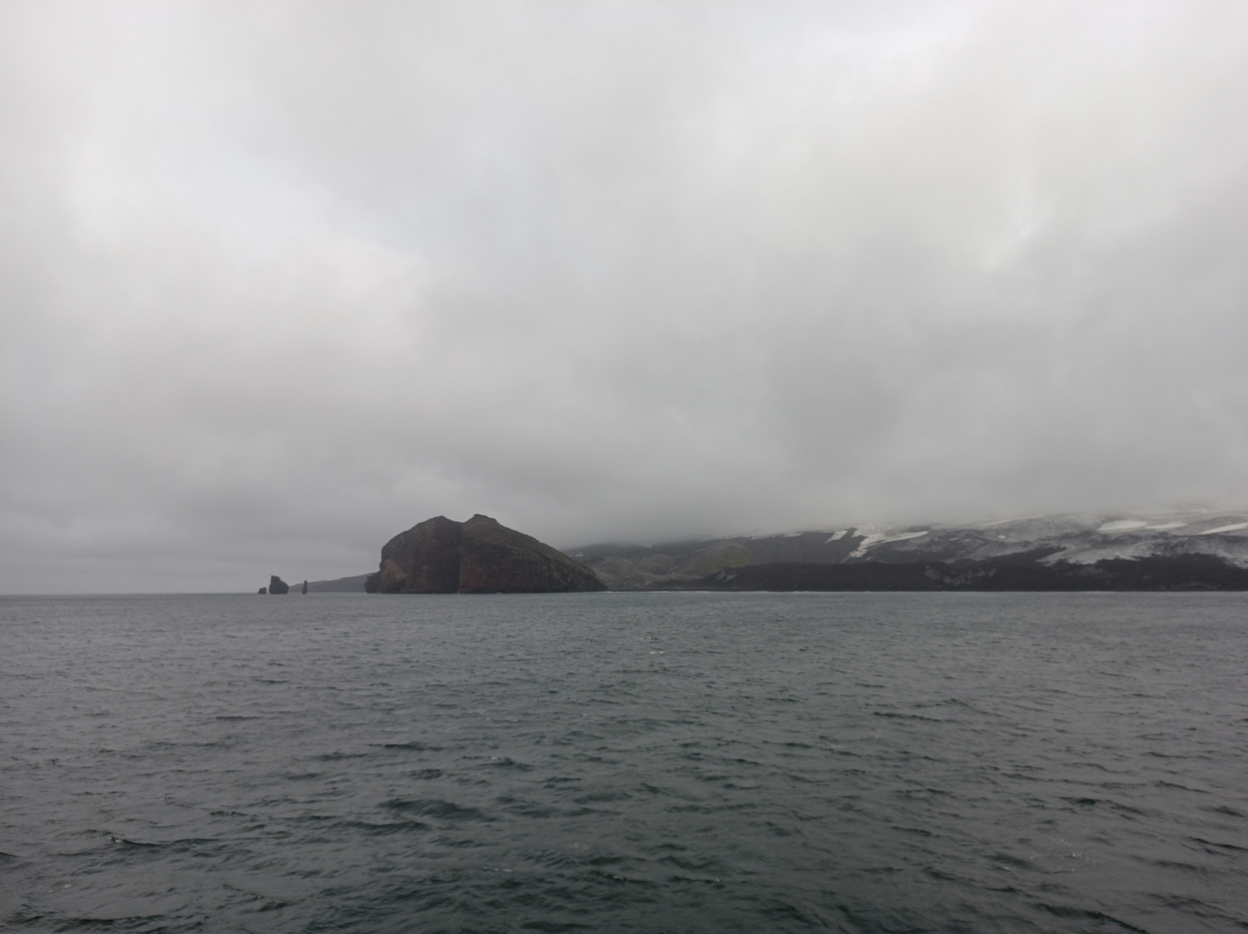
Noble gas geochemistry to explore the sources of magma feeding the Antarctic submarine volcanism in Bransfield Strait (NW Antarctica)
A. Polo Sánchez⁽¹⁾, A. Caracausi^{(1,2)}, A. M. Álvarez-Valero⁽¹⁾, A. Geyer⁽³⁾, L. Insiga⁽⁴⁾
(1)
(2)
(3)
(4)

Slide 2
Summary
Bransfield Strait. Why and how to study it?
Sample Location
Noble Gas Analysis
Helium Isotopic Ratios (³He/⁴He)
Argon Isotopic Ratios (⁴⁰Ar/³⁶Ar)
Main findings and way forward
Summary
EGU General Assembly 2023. GMPV 7.5. 25th April 2023
1/9

Slide 3
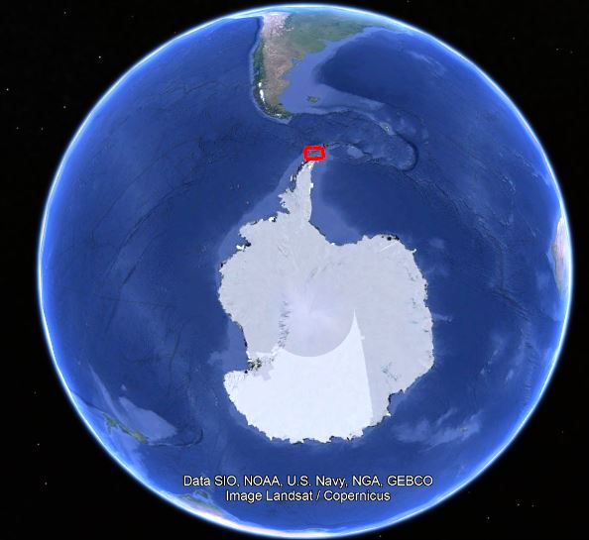
Bransfield Strait. Why and how to study it?
Back-arc basin associated to the subduction between the Phoenix and the Antarctica plates
One of the scarce accessible places to study Antarctic volcanism
It hosts several submarine volcanoes (e.g. Three Sisters, Orca) and two subaerial ones (Deception and Bridgeman Islands)
Deception Island is one of the most active volcanoes in Antarctica (Geyer et al., 2019)
Orca suffered a seismic unrest associated to magma ascent in 2020 (Cesca et al., 2022)
Noble gases preserved in inclusions are excellent tools to understand magma sources and magma ascent
Bransfield Strait. Why and how to study it?
EGU General Assembly 2023. GMPV 7.5. 25th April 2023
2/9

Slide 4
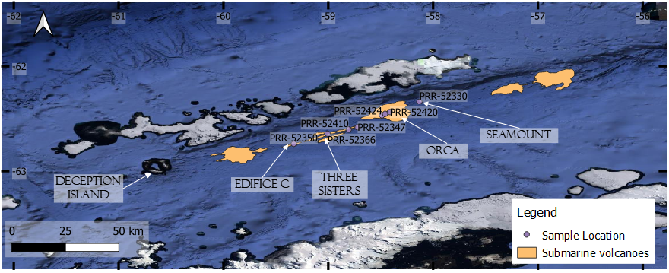
Sample Location
Samples from the Polar Rock Repository with support from the U.S National Science Foundation, under Cooperative Agreement OPP-1643713.
Sample Location
EGU General Assembly 2023. GMPV 7.5. 25th April 2023
3/9

Slide 5
Noble Gas Analysis
1 g of clean olivine phenocryst or glass shards. Depending on the most abundant phase of the sample
Crushed in one-single step through a hydraulic press
The released gas is conducted in ultra high-vacuum purification line (10⁻⁹ bar)
The purification line retains the rest of the gases and separates Helium (He), Neon (Ne) and Argon (Ar)
Helium, Neon and Argon are sent into their respective mass spectrometers
Noble Gas Analysis
EGU General Assembly 2023. GMPV 7.5. 25th April 2023
4/9

Slide 6
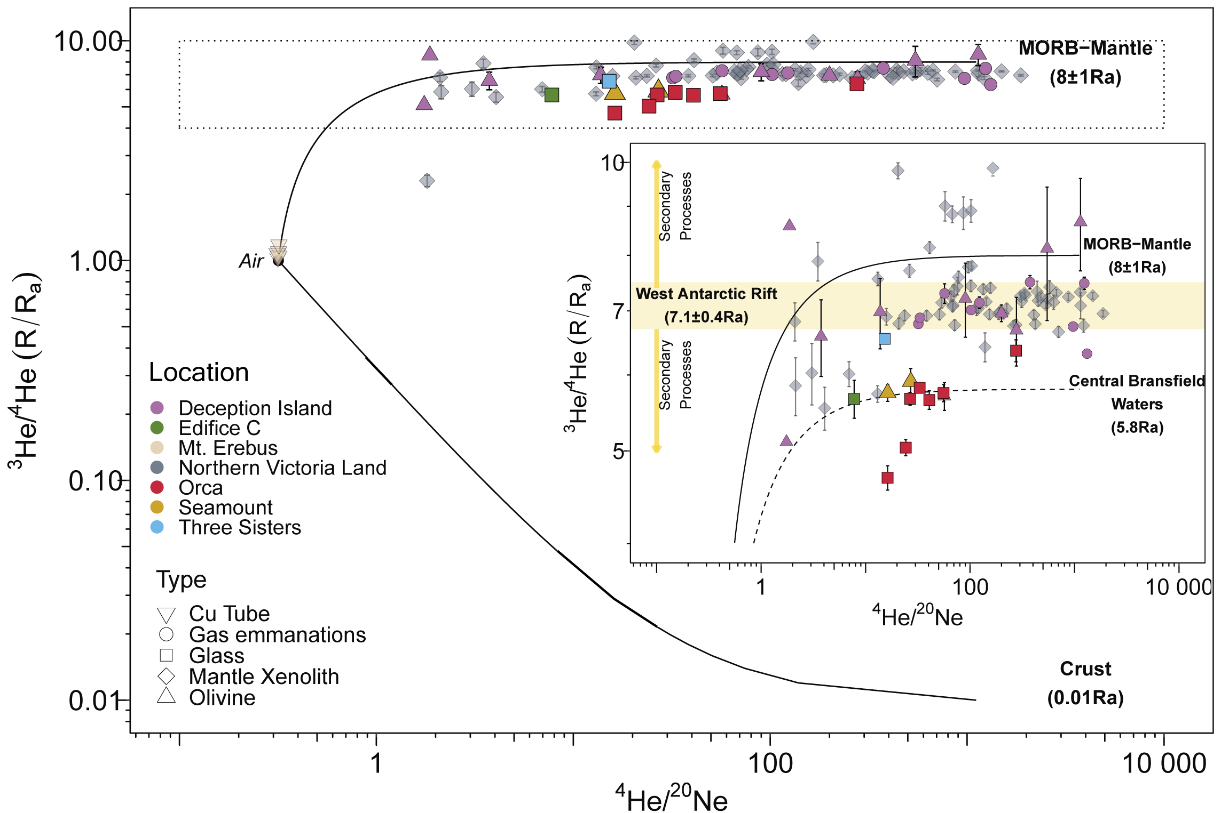
Helium Isotopic Ratios (³He/⁴He)
4.6 to 6.5 R_{a}
Homogeneity along 70 km
Deception Island values are close to MORB values (8±1 R_{a})
R_{a} = ³He/⁴He normalized to the atmospheric value (1,38 x 10⁻⁶)
Deception Island data from Álvarez-Valero et al., (2022). Central Bransfield Waters from Schlosser et al., (1988). West Antarctic Rift from Correale et al., (2019). Mt. Erebus data from Ilanko et al., (2019)
Helium Isotopic Ratios (³He/⁴He)
EGU General Assembly 2023. GMPV 7.5. 25th April 2023
5/9

Slide 7
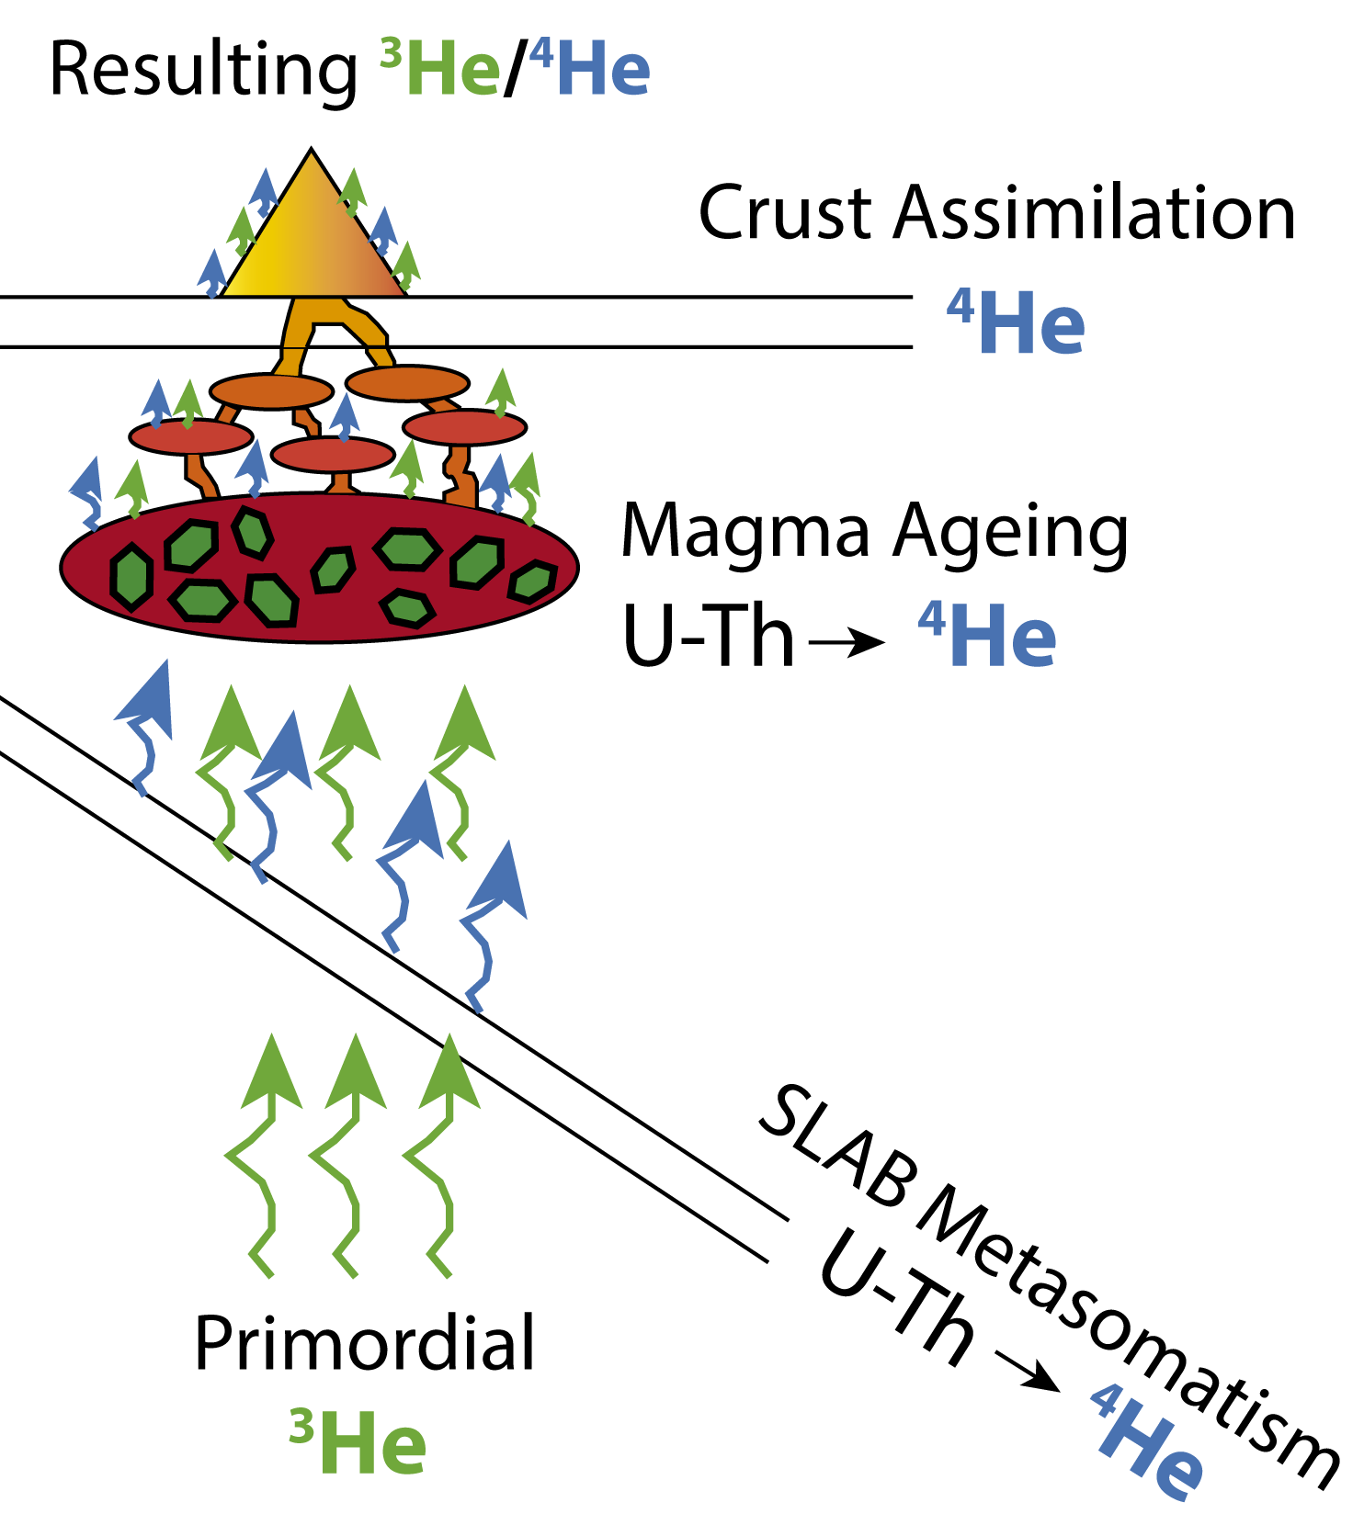
4.6 to 6.5 R_{a}
Homogeneity along 70 km
Three Possibilities
Magma Ageing in the chamber
Crust assimilation
Subducting Plate (SLAB) Metasomatism
The homogeneity rules out Magma Ageing. The different volcanoes should give different ratios in this case
The crust is very thin beneath these volcanoes (Li et al., 2021)
SLAB metasomatism. More significant than in Deception Island
Helium Isotopic Ratios (³He/⁴He)
EGU General Assembly 2023. GMPV 7.5. 25th April 2023
6/9

Slide 8
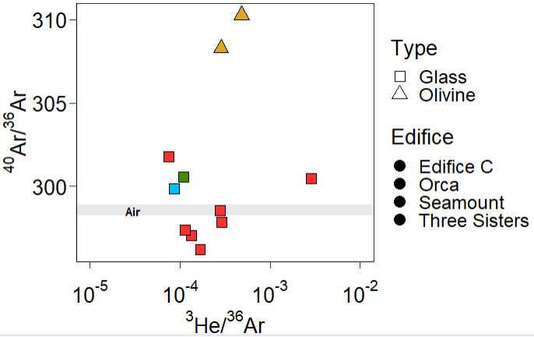
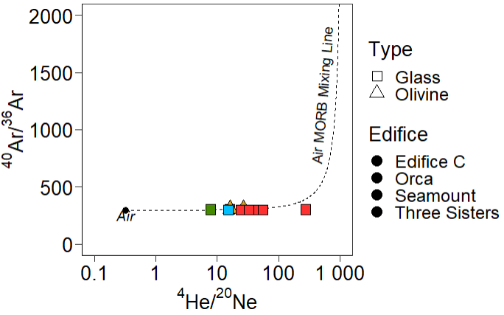
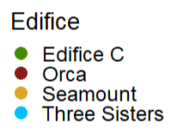
Argon Isotopic Ratios (⁴⁰Ar/³⁶Ar)
MORB ⁴⁰Ar/³⁶Ar >40000
Olivine
Glass
⁴⁰Ar/³⁶Ar close or below the atmospheric value (298.56±0.31; Lee et al., 2006)
Olivines are less atmospheric than glass shards
Argon Isotopic Ratios (⁴⁰Ar/³⁶Ar)
EGU General Assembly 2023. GMPV 7.5. 25th April 2023
7/9

Slide 9
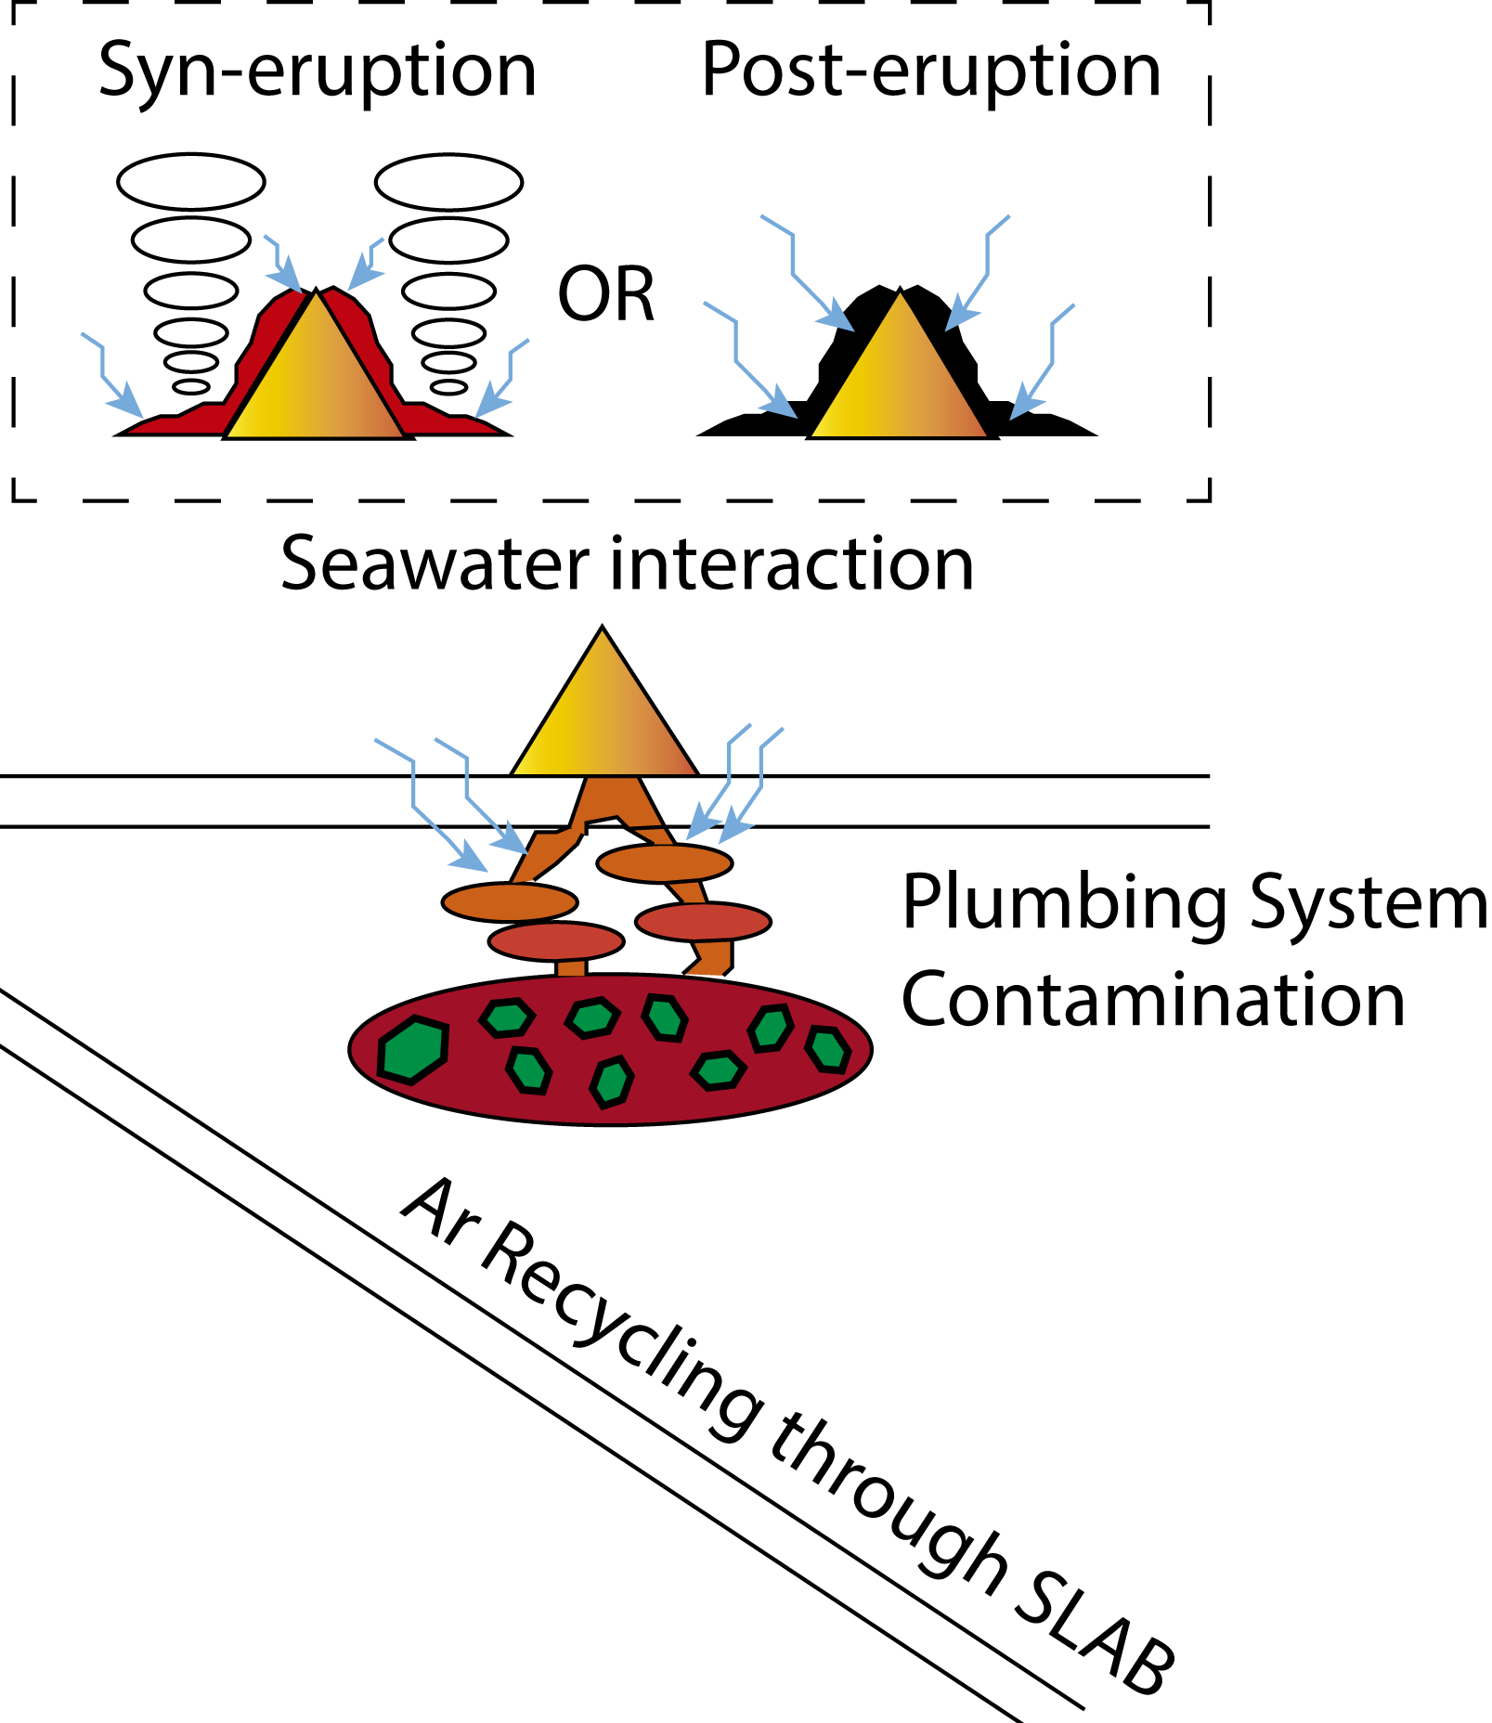
Olivines are only a little bit less atmospheric than glass shards (air contamination)
In submarine volcanoes, air contamination is supposed to be insignificant
Possible Scenarios
Ar is dense enough to be retained in the atmosphere and dense enough to be recycled through SLAB
Plumbing System Contamination
Seawater Interaction at the surface
We need other criteria to determine where the contamination took place
Argon Isotopic Ratios (⁴⁰Ar/³⁶Ar)
EGU General Assembly 2023. GMPV 7.5. 25th April 2023
8/9

Slide 10
Main findings and way forward
Helium values:
Subduction-related processes at the magma source
Stronger at the submarine volcanoes (Edifice C, Three Sisters, Orca, Seamount), than in Deception Island
Argon values:
Air Contamination through SLAB metasomatism, at the plumbing system or by seawater interaction at the surface
Precise when the contamination took place (On-going)
Petrologic criteria
δ¹⁸O and δD analysis
Main findings and way forward
EGU General Assembly 2023. GMPV 7.5. 25th April 2023
9/9

Slide 11
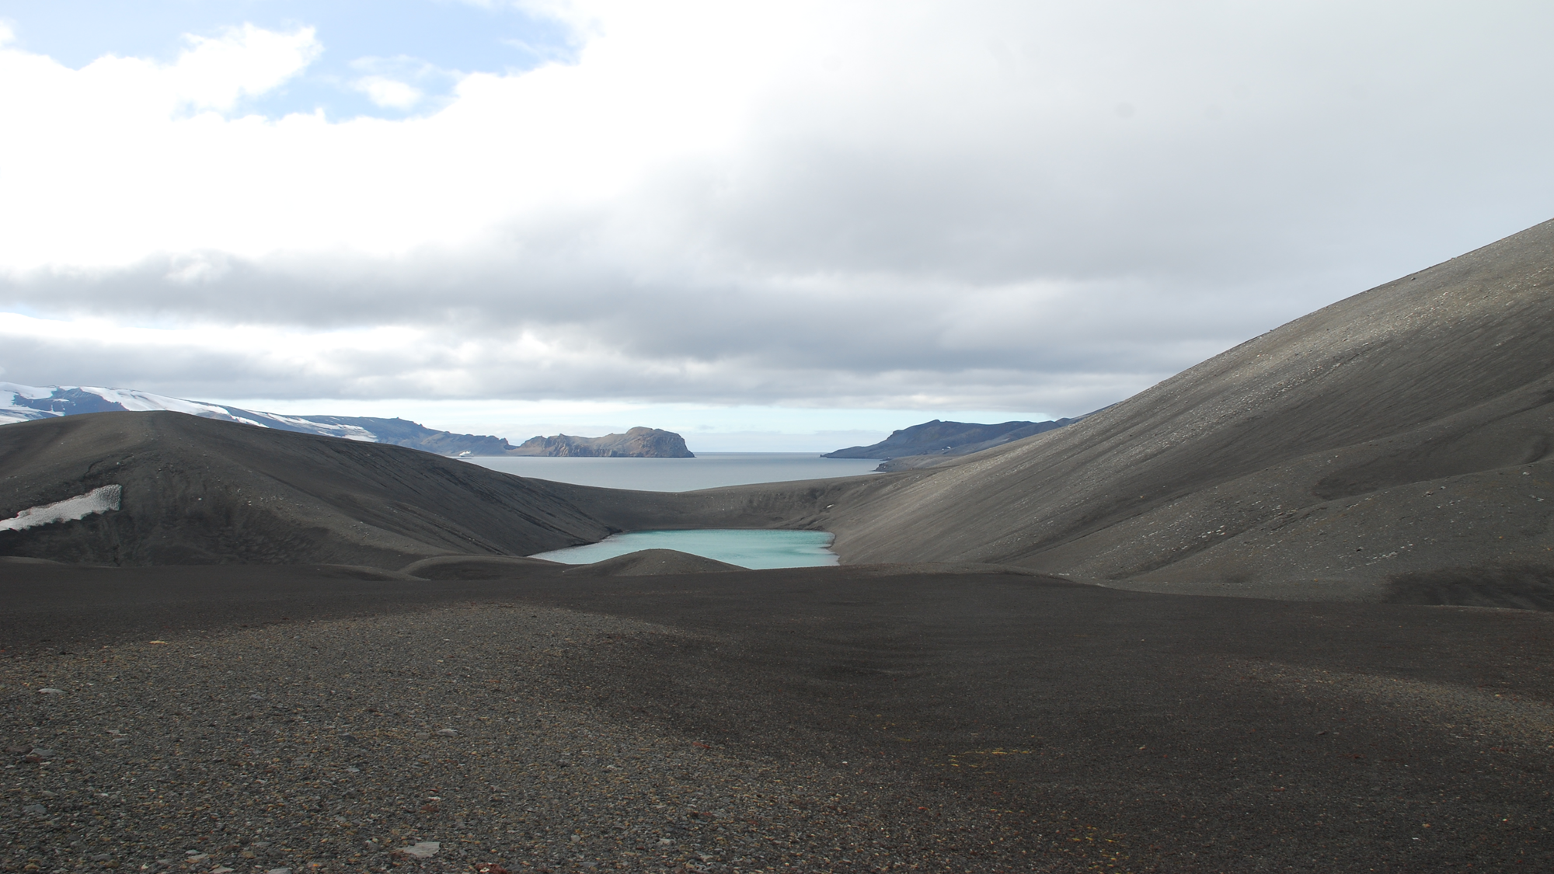
Thank you!
Contact:
apolosanchez@usal.es
Deception Island. Picture taken by A. M. Álvarez Valero (2018)

Slide 12
References
Álvarez-Valero. A. M, Sumino. H, Caracausi. A, Polo Sánchez. A, Burgess. R, Geyer. A, Lozano-Rodríguez. J. A, Albert. H, Aulinas. M, Núñez-Guerrero. E (2022). Noble gas isotopes reveal massive degassing-derived eruptions at Deception Island (Antarctica) and current high levels of activity at Deception Island (Antarctica). Scientific Reports, 12, 19557.
Cesca, S., Sugan, M., Rudzinski, Ł., Vajedian, S., Niemz, P., Plank, S., Petersen, G., Deng, Z., Rivalta, E., Vuan, A., Plasencia Linares, M, P., Heimann, S., & Dahm, T. (2022). Massive earthquake swarm driven by magmatic intrusion at the Bransfield Strait, Antarctica. Communications Earth & Environment, 3(1), 1-11.
Correale, A., Pelorosso, B., Rizzo, A. L., Coltorti, M., Italiano, F., Bonadiman, C., & Giacomoni, P. P. (2019). The nature of the West Antarctic Rift System as revealed by noble gases in mantle minerals. Chemical Geology, 524, 104-118.
Geyer, A., Álvarez-Valero, A. M., Gisbert, G., Aulinas, M., Hernández-Barreña, D., Lobo, A., & Martí, J. (2019). Deciphering the evolution of Deception Island’s magmatic system. Scientific Reports, 9(1), 1-14.
Ilanko, T., Fischer, T. P., Kyle, P., Curtis, A., Lee, H., & Sano, Y. (2019). Modification of fumarolic gases by the ice-covered edifice of Erebus volcano, Antarctica. Journal of Volcanology and Geothermal Research, 381, 119-139.
Lee, J. Y., Marti, K., Severinghaus, J. P., Kawamura, K., Yoo, H. S., Lee, J. B., & Kim, J. S. (2006). A redetermination of the isotopic abundances of atmospheric Ar. Geochimica et Cosmochimica Acta, 70(17), 4507-4512.
Li, W., Yuan, X., Heit, B., Schmidt‐Aursch, M. C., Almendros, J., Geissler, W. H., & Chen, Y. (2021). Back‐arc extension of the Central Bransfield Basin induced by ridge–trench collision: Implications from ambient noise tomography and stress field inversion. Geophysical Research Letters, 48(21), e2021GL095032.
Schlosser, P., Suess, E., Bayer, R., & Rhein, M. (1988). 3He in the Bransfield Strait waters: indication for local injection from back-arc rifting. Deep Sea Research Part A. Oceanographic Research Papers, 35(12), 1919-1935.

