Slide 1
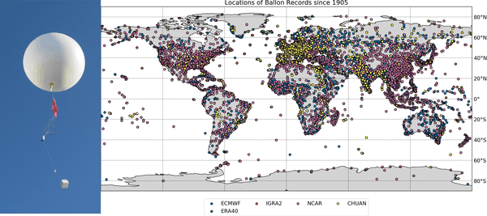




Reducing biases and representation errors in the global historical upper-air network for ERA6 leopold.haimberger@univie.ac.at
L Haimberger, F. Ambrogi,
U. Voggenberger

Slide 2
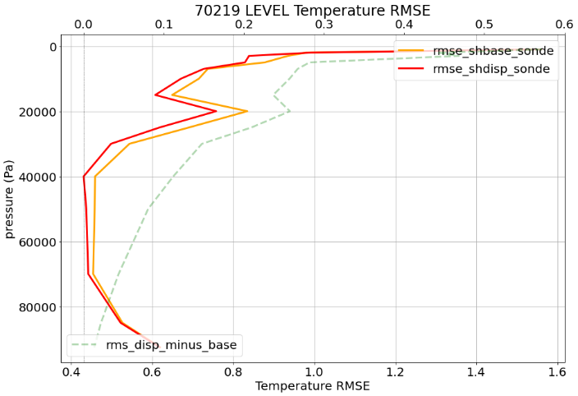
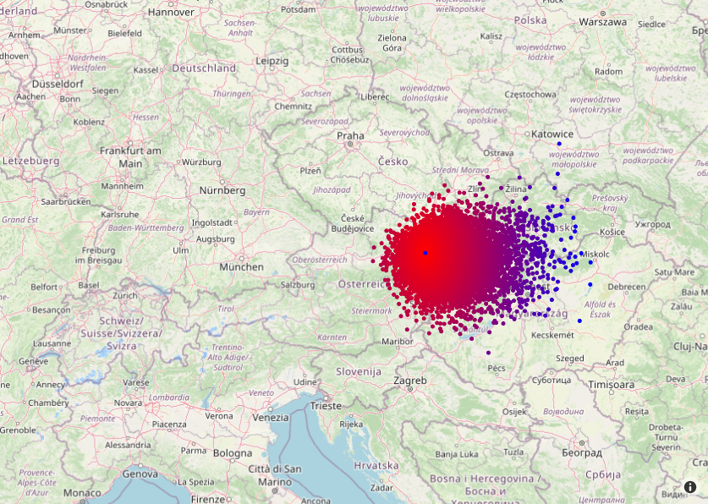
Displacement from observed wind profile
We prepare historical upper air data for assimilation in ERA6
Displacement of balloons can be calculated from observed winds
Taking it into account improves fit to ERA5
Displacements Vienna 2020

Slide 3
Reducing biases and representation errors in the global historical insitu upper-air network for ERA6 leopold.haimberger@univie.ac.at
L Haimberger, F. Ambrogi,
U. Voggenberger

Slide 4
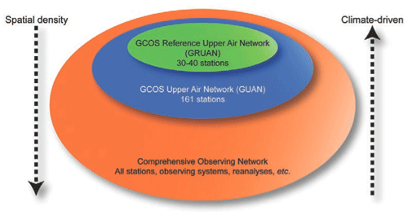
Motivation
Radiosondes anchor reanalyses in pre-satellite period
  Bias adjustment is essential
  Metrological standards met only for fraction of data,
  if at all.
Recent Activities
  Improve lat/lon/release time data
  Improve metadata (e.g. instrument change timing) via ERA5 bg departure statistics
  Model balloon drift from ascent data to improve location
  Homogeneity adjustment software (RAOBCORE/RICH, Haimberger et al. 2012) completely rewritten in python
  Support test assimilation in preparation of ERA6
Plans
  Publish data via Copernicus “insitu-comprehensive-upper-air-observation-network”
  Support production of ERA6
  Defensible error assessment, particularly for systematic errors for all stations
  Thorough comparison with independent satellite data

Slide 5
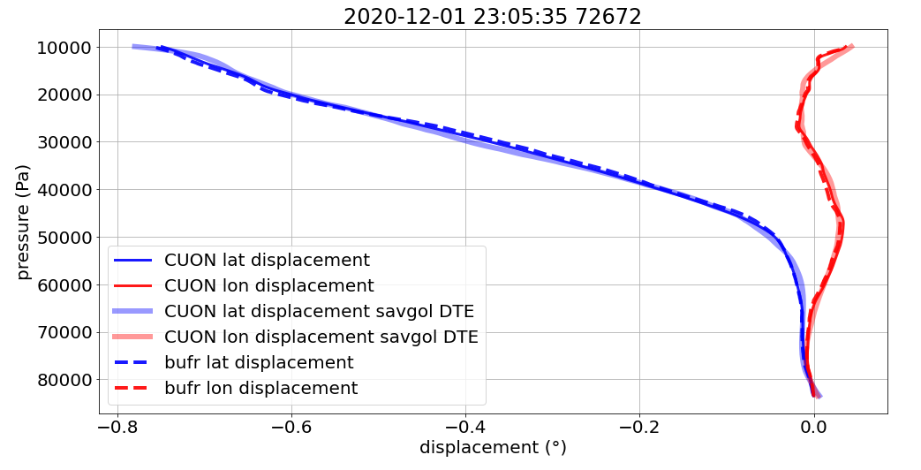
Displacement from observed wind profile
Displacement of balloon can be calculated from observed winds
Very good agreement with displacements from GPS measurements
Example displacement for one ascent
Displacements Vienna 2020
~80km

Slide 6
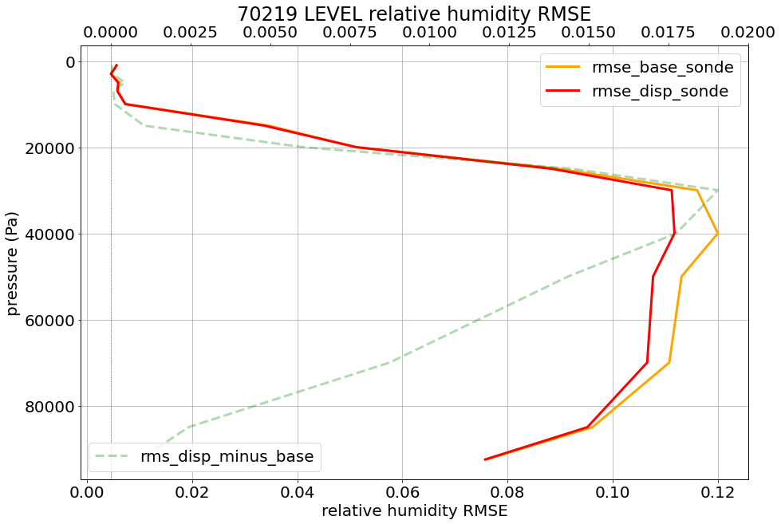
Benefit of accurate location
Smaller RMS of offline calculated background departures from ERA5
  Clear benefit for all measured variables
Effort to determine also exact release time, not nominal ascent time
Shown are statistics over year 2020
Expect better fit also when comparing with GNSS-RO retrievals

Slide 7
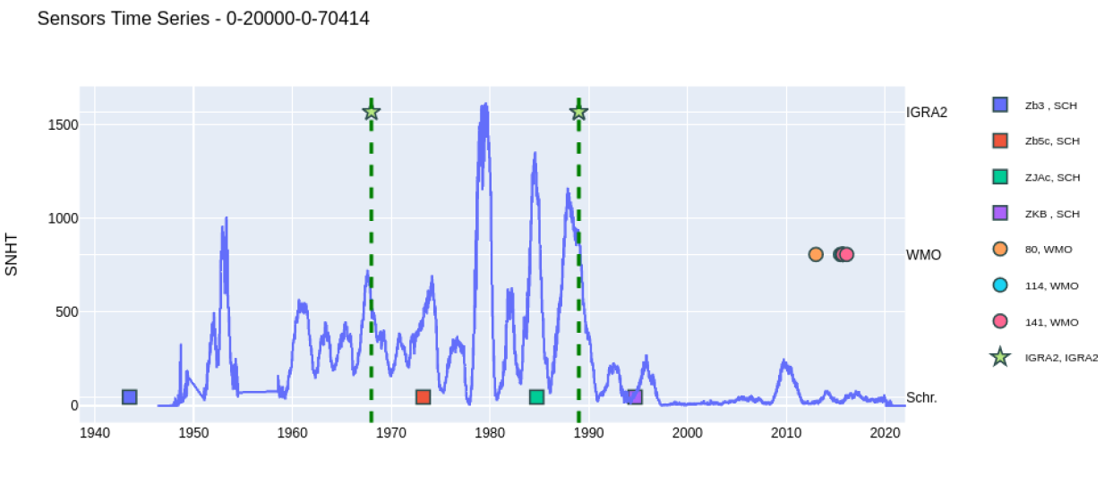
Analysis of Metadata
Metadata from IGRA, S. Schroeder (TAMU) and WMO BUFR codes
Complementary, incomplete, SNHT statistics help finding time of breaks
Shemya, Alaska
IGRA
SNHT statistic
BUFR
Schroeder

Slide 8
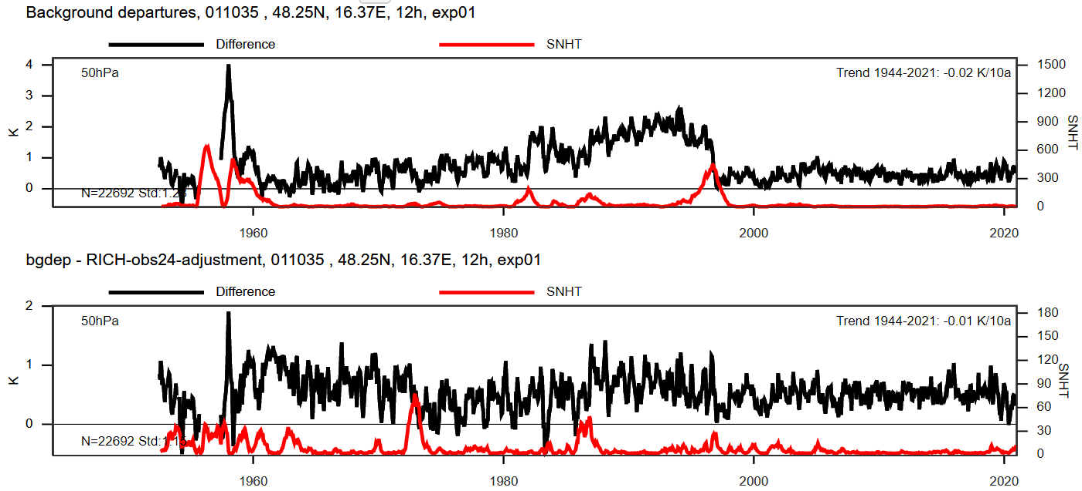
Revised homogeneity adjustment method
Updated RAOBCORE-RICH
  RAOBCORE uses ERA5 as reference for break detection/adjustments
  RICH uses neighbouring radiosondesas reference for adjustments
Rewritten in python
Revised handling of data gaps, usage of sparse data
obs-bg, Vienna 12GMT
RICH-adjusted obs-bg

Slide 9
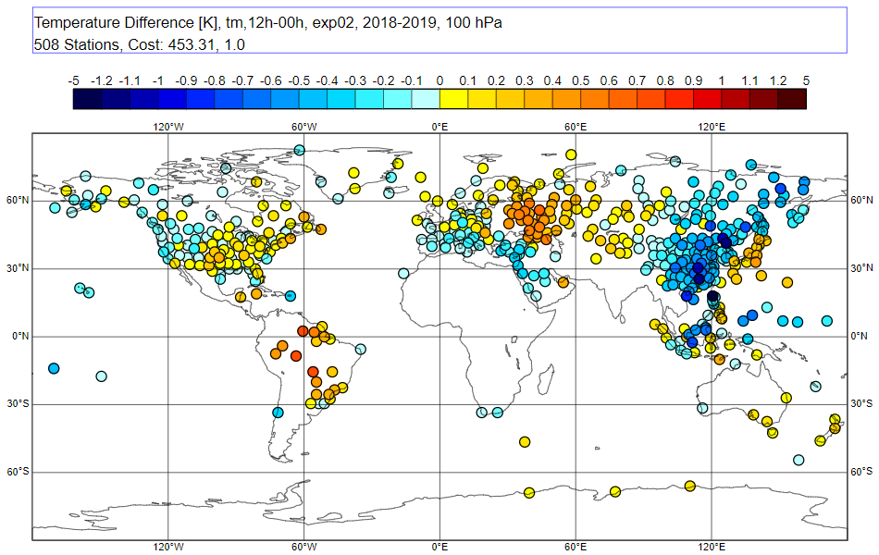
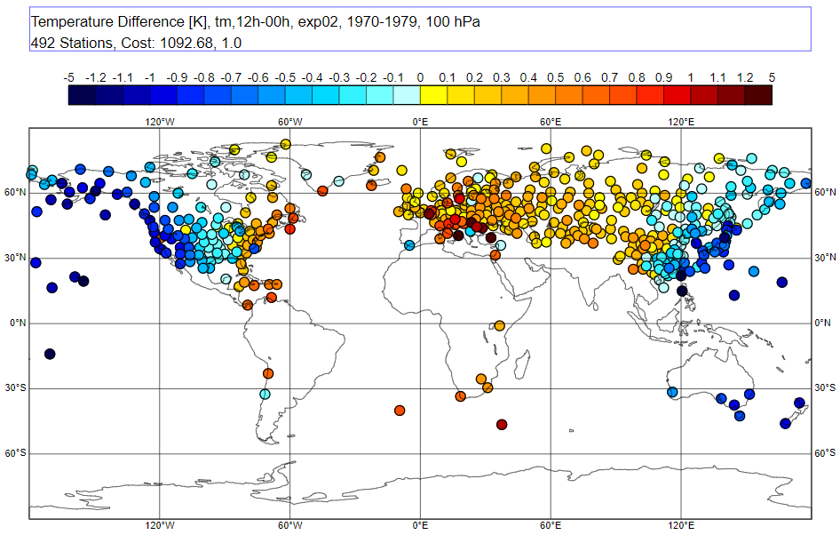
12GMT-00GMT Differences
Some 12GMT-00GMT differences still too large 2018-2019
Large radiation errors in the 1970s
2018-2019
1970-1979

Slide 10
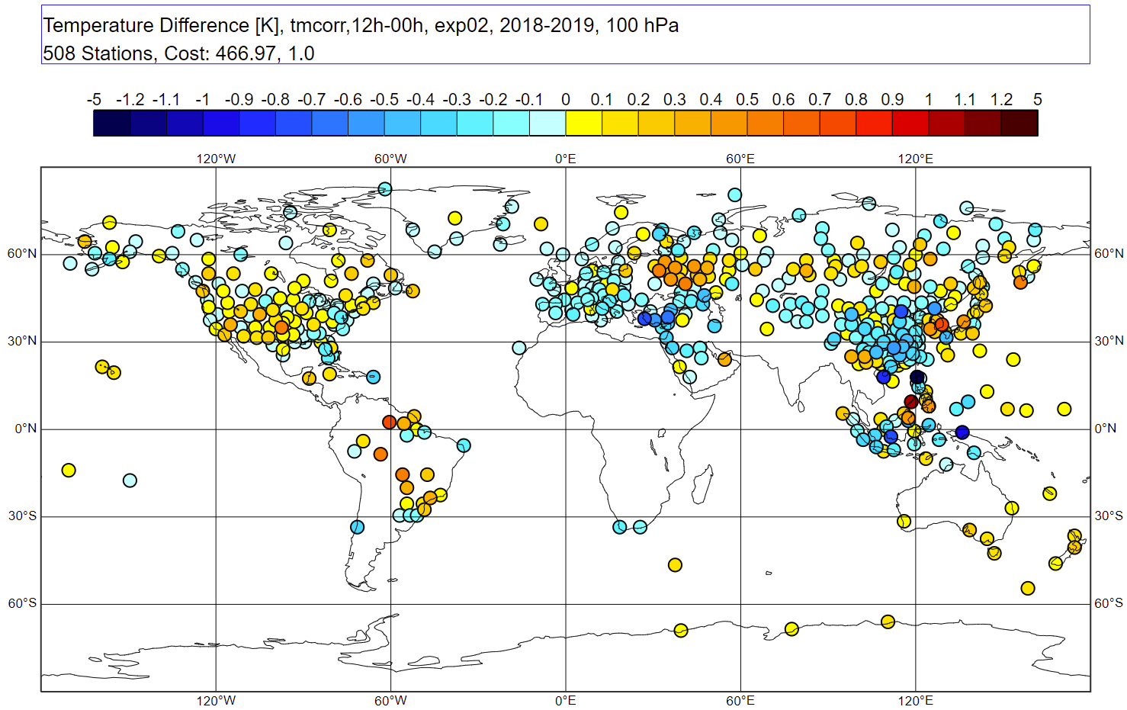
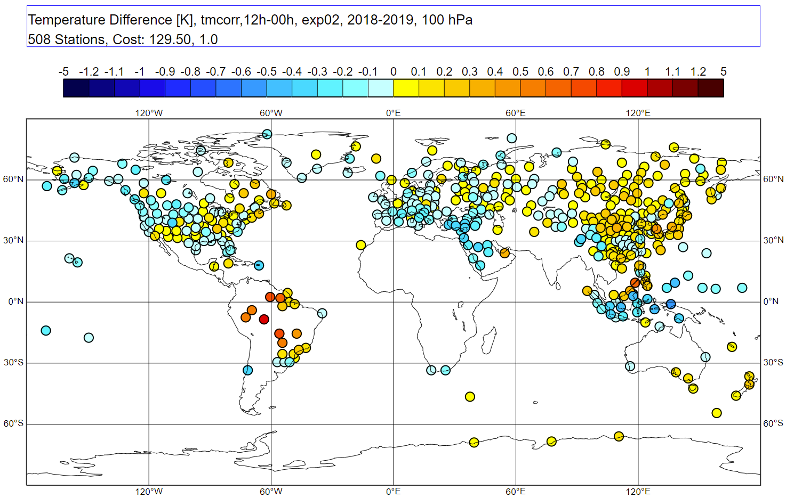
Adjusted 12GMT-00GMT difference, 2018-2019
Left: Adjusted differences ERA5 operational BC only
Right: Leave RS92, RS41 unchanged, compare their ERA5 bg departures with neighboring other stations, adjust the other stations.

Slide 11
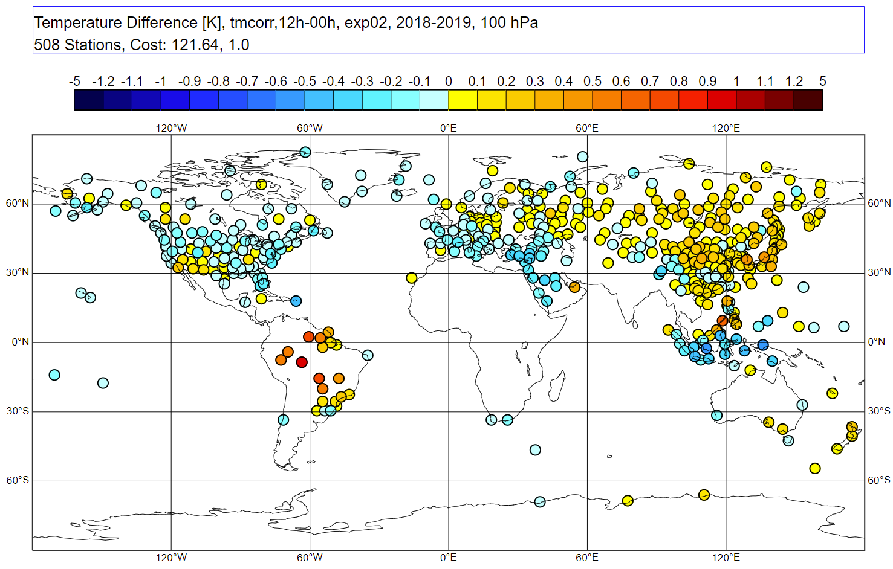
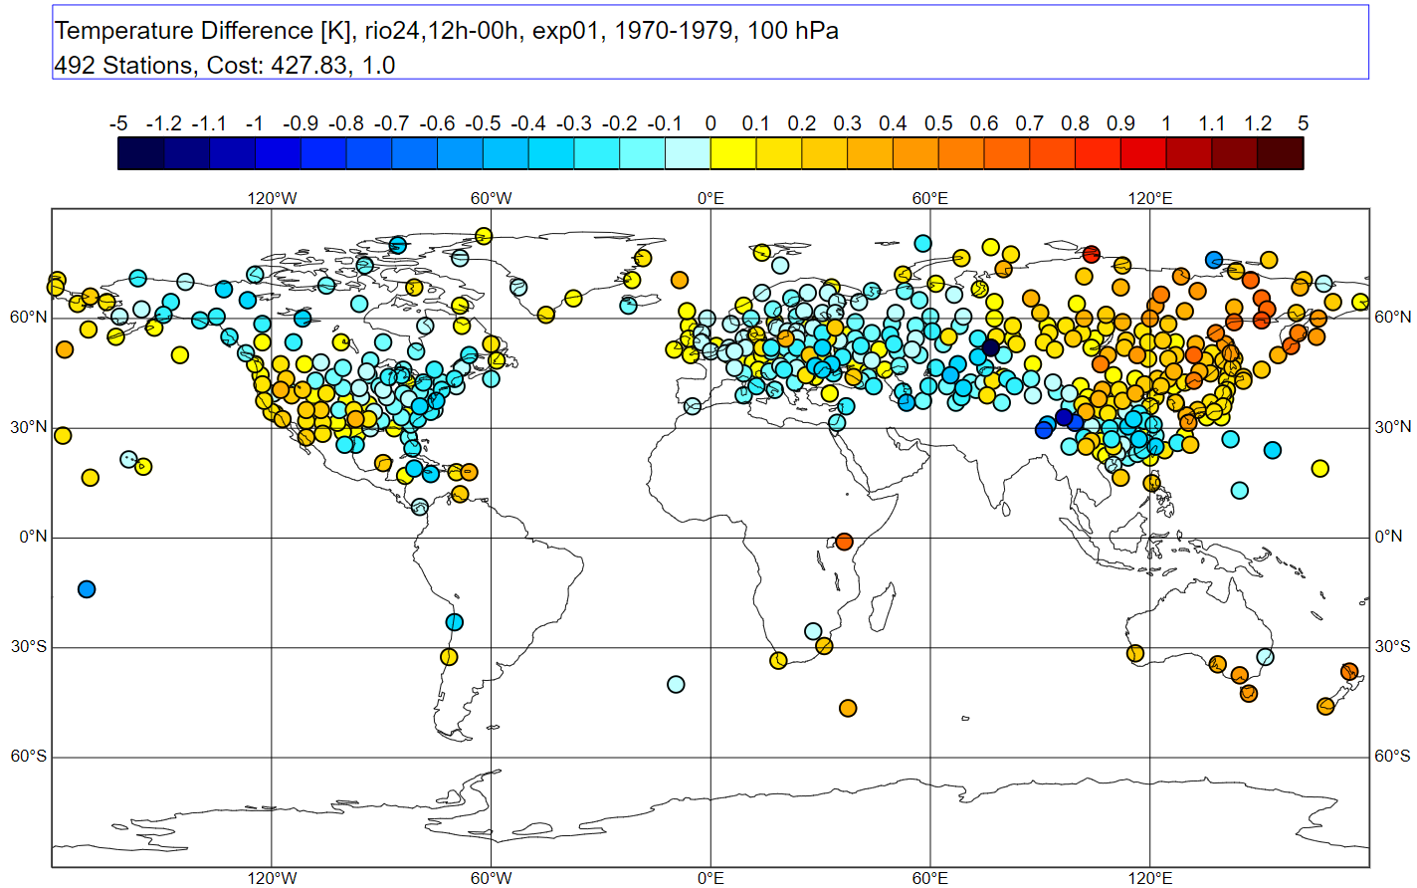
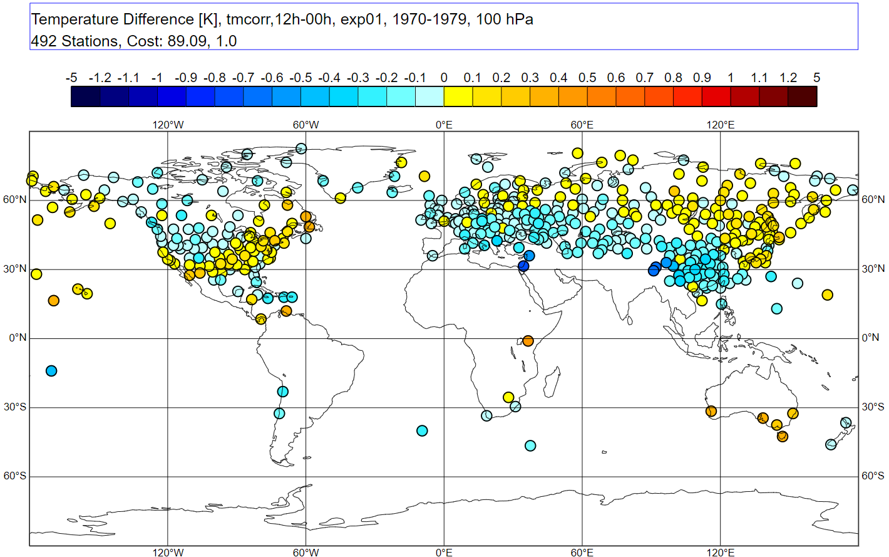
Combined ERA5 BC, neighbours, homogenization with RAOBCORE
ERA5 operational BC for RS92,41, other stations as above
Positive Effect sustained back to 1960s and 1970s
TODO: Check consistency of ERA5 BC with GRUAN
2018-2019
1970-1979
RICH

Slide 12
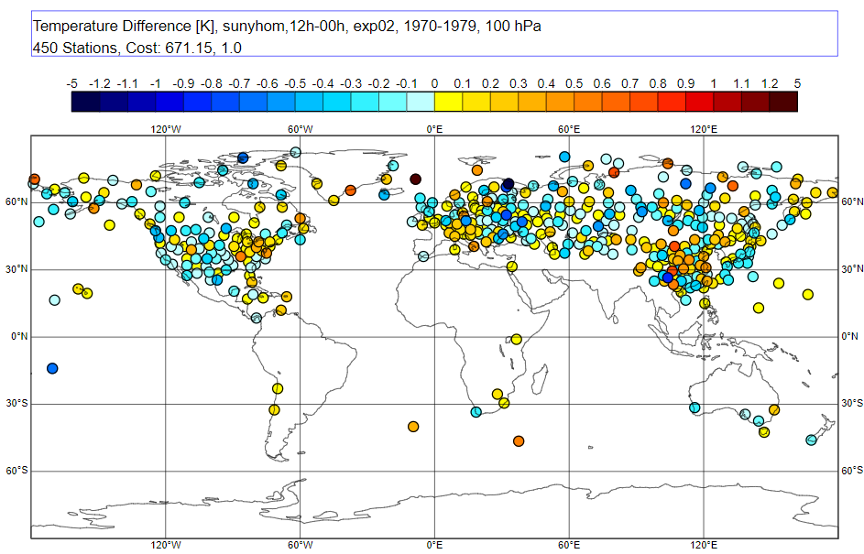
Improved Day-Night Differences
Notable improvement compared to Zhou et al. 2021,
prior RAOBCORE/RICH versions
1970-1979
1970-1979
RAOBCORE
Zhou et al. 2021, JC

Slide 13
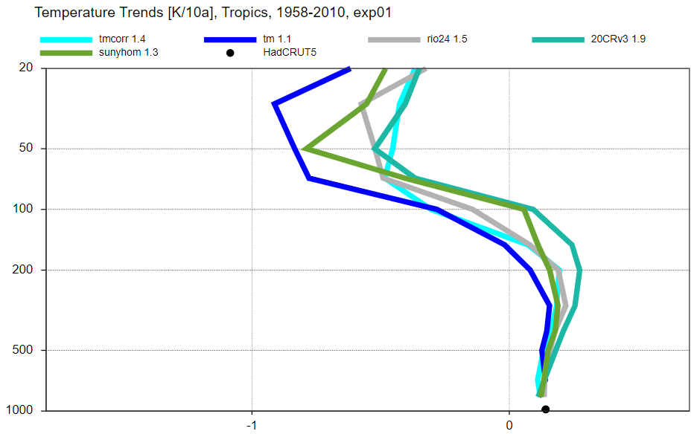
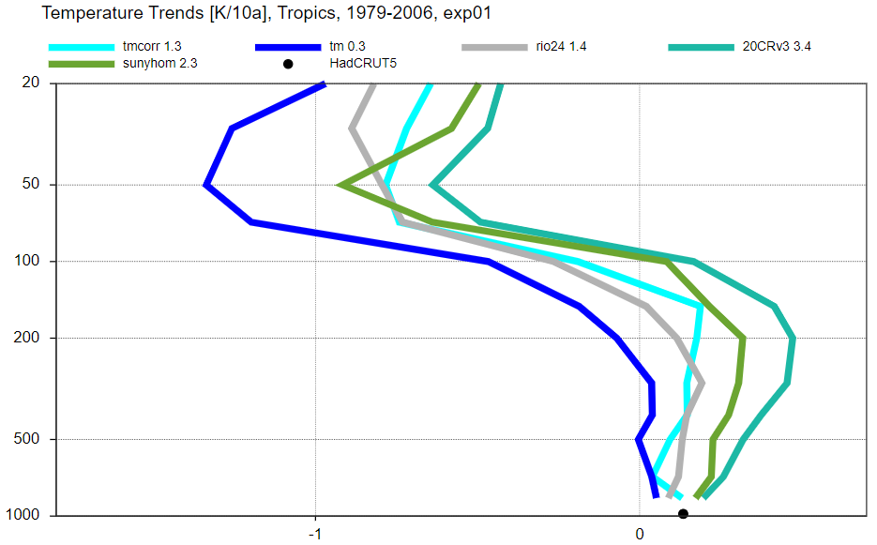
Tropical Temperature Trends – some preliminary results
RAOBCORE
Zhou et al.
RAW
RICH
20CRv3
20yr T-Trend (20N-20S) Amplification Factor
1958-2021
RAOBCORE
Zhou et al.
RAW
RICH
20CRv3
1979-2006

Slide 14
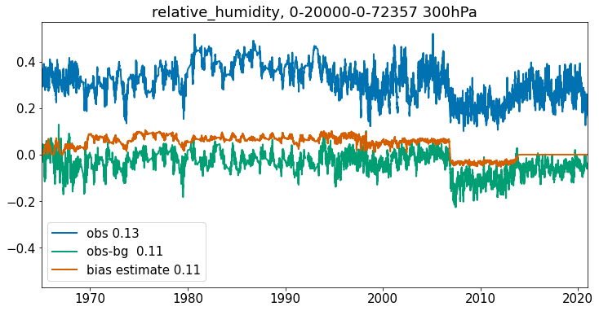
Humidity adjustments
Use quantile matching, modified ERA5 relative humidity as reference, back to 1973
Adjustment performed on relative humidity

Slide 15
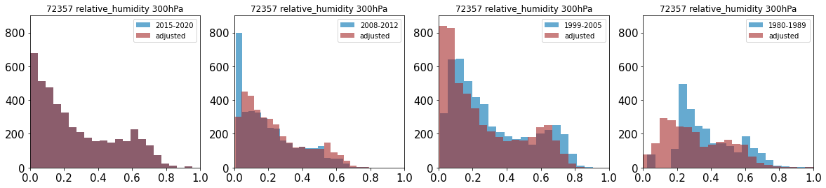
Humidity adjustments
Distribution change in relative humidity
More very dry values after adjustments
Figure 14: Histograms of relative humidity at station Norman (OK, 72357) at 300 hPa for different time intervals.
Blue=unadjusted, brown=adjusted, semi-transparent colours are used. Number of valid observations differ in intervals.
(From Copernicus technical document)

Slide 16
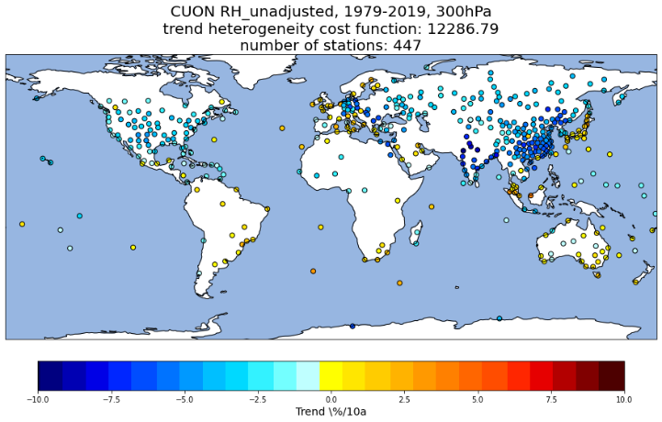
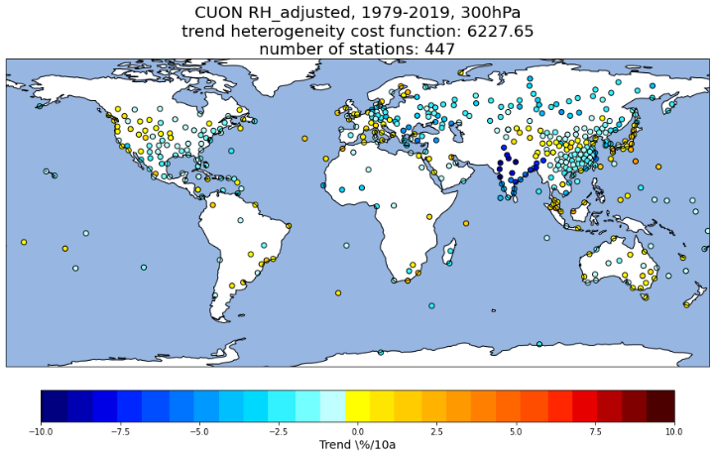
Humidity adjustments
Large impact on humidity trends
Drying biases over US, China substantially reduced
Vaisala RS80, RS90 dry bias in early 2000s – reduced as well

Slide 17
Summary
Balloon displacements should definitely be taken into account for historical ascents – clearly reduce representation errors
New RAOBCORE and RICH bias adjustments lead to substantially reduced 12GMT-00GMT differences, also for short time series.
Adjustment of short series essential to avoid competition of biased with adjusted observations
Humidity adjustments reduce large known biases and lead to spatially more homogeneous trend picture, need further validation
Trend amplification in tropics well reproduced, stable amplification

Slide 18
Next steps
Thorough comparison with reprocessed SAT radiances, GNSS RO data, demostrate consistency before ERA6 test assimilations start in 2023
Sensitivity experiments using other reanalyses as background
For ERA6:
  Optimally combine RHARM (Madonna et al. 2021) with RAOBCORE/RICH adjustments
  Make use of metadata as much as possible
  Check and harmonize available ascents prior to 1940
Adjustments available also for wind, not covered here.
Compare adjustments and error characterization with RHARM

Slide 19
References
Haimberger, L., C. Tavolato, and S. Sperka, 2012: Homogenization of the Global Radiosonde Temperature Dataset through Combined Comparison with Reanalysis Background Series and Neighboring Stations. J. Climate, 25, 8108–8131, https://doi.org/10.1175/JCLI-D-11-00668.1.
Madonna, F., Tramutola, E., SY, S., Serva, F., Proto, M., Rosoldi, M., et al. (2022). The new Radiosounding HARMonization (RHARM) data set of homogenized radiosounding temperature, humidity, and wind profiles with uncertainties. Journal of Geophysical Research: Atmospheres, 127, e2021JD035220. https://doi.org/10.1029/2021JD035220
Zhou, C., J. Wang, A. Dai, and P. W. Thorne, 2021: A New Approach to Homogenize Global Subdaily Radiosonde Temperature Data from 1958 to 2018. J. Climate, 34, 1163–1183, https://doi.org/10.1175/JCLI-D-20-0352.1.

