Slide 1
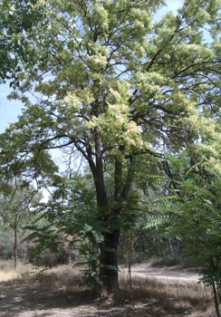
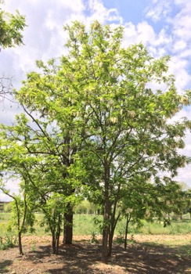
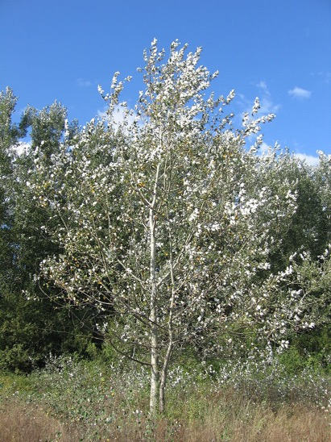
Exotic invasive trees affect germination and growth of understory plants via soil modifications
Silvia Medina-Villar^{1,2,3}, Ana de Torre-Sáez², Antonio Manuel Montoya-Ruíz², Paloma de las Heras Puñal², M. Esther Pérez-Corona²
¹Department of Natural Sciences, Saint Luis University, Avenida del Valle, 34, 28003 Madrid,Spain.
²Department of Biodiversity, Ecology and Evolution, Complutense University of Madrid, José Antonio Novais, 12, 28040 Madrid, Spain
³Center for Biotechnology and Plant Genomics, Parque Científico y Tecnológico, INIA-UPM Campus de Montegancedo, Ctra, M-40, km 38, 28223, Madrid, Spain
Introduction
Results and discussion
The mechanisms by which two of the most hamful invasive trees in Spain (Ailanthus altissima and Robinia pseudoacacia) impact native plants are uncertain.
Emergence speed
Exotic invasive trees
Native tree
a)
b)
AC AC AC
Aa Pa Rp
AC AC AC
Aa Pa Rp
Ailanthus altissima (Aa)
Robinia pseudoacacia (Rp)
Populus alba (Pa)
Plant biomass (aboveground)
c)
d)
Effects on:
via soil modifications?
“Effects as compared to the effect produced by the native tree as control”
AC AC AC
Aa Pa Rp
AC AC AC
Aa Pa Rp
Emergence speed
Plant biomass
Trifolium repens
Dactylis glomerata
AC
AC
AC
AC
AC
AC
Understory plants
Fig. 1. Emergence speed and plant biomass of Trifolium repens and Dactylis glomerata in presence of soils collected under the canopy of different trees: exotic (Aa and Rp) and native (Pa) and supplemented or not with AC.
Experimental design
AC: Activated Carbon, able to trap phytotoxic (allelopathic) compounds
Independently of the addition of AC, compared to native soils, those of the exotic invasive trees negatively affected the target species. The emergence speed of T. repens was affected by both exotic soils (Fig. 1a). The emergence speed of D. glomerata and the biomass of T. repens was lower in A. altissima soils than in native soils (Fig. 1b and c). Our results showed that the effects produced by the exotic trees may be attributed to changes in soil properties, but not to the release of phytotoxic compounds. This study contributes to understand the mechanisms of impact of two aggressive invasive trees on native plant communities.
AC
AC
AC
AC
AC
AC
Soil samples collected under the canopies of the different tree species:
Aa: orange; Rp: pink; Pa: green

