Slide 1




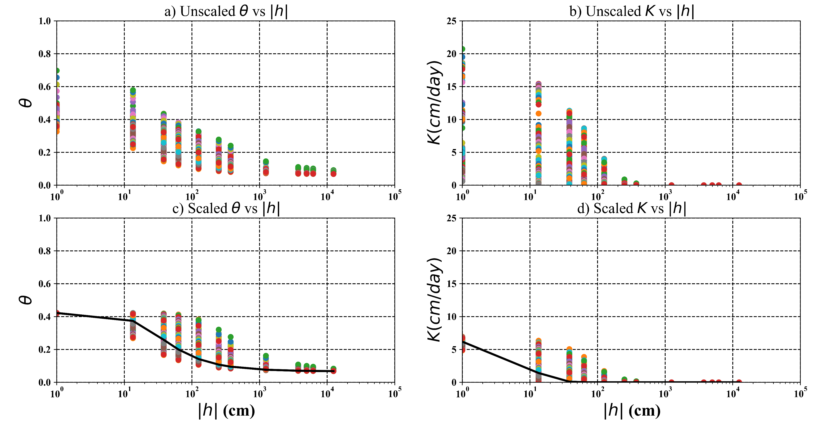
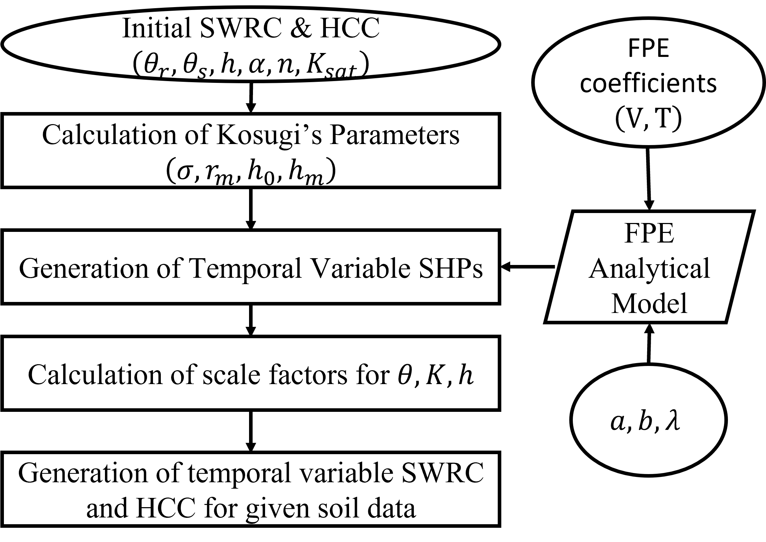

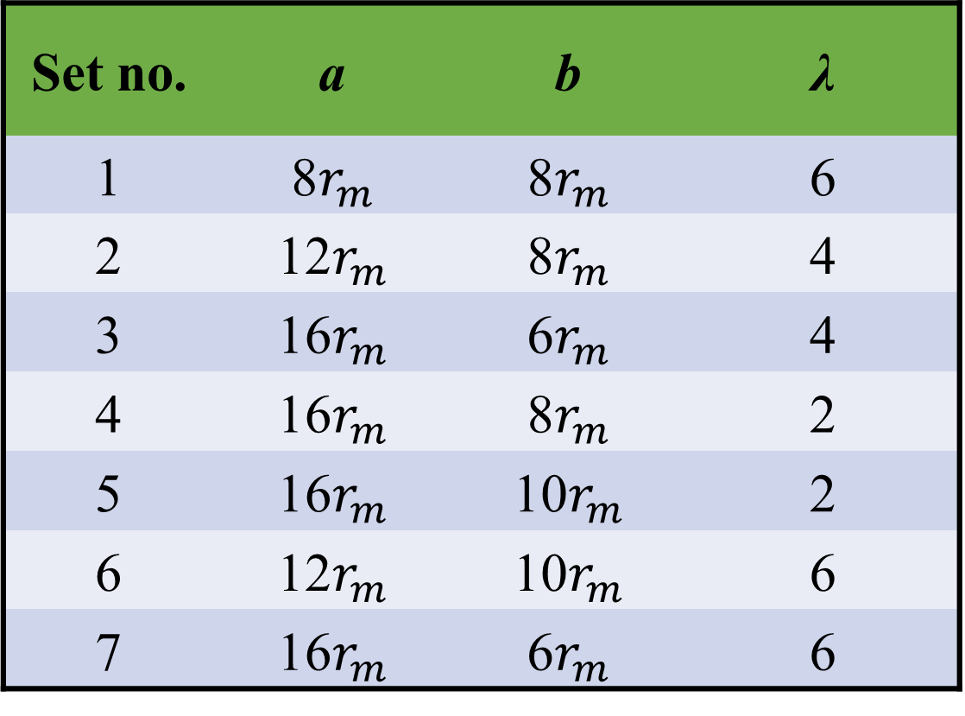
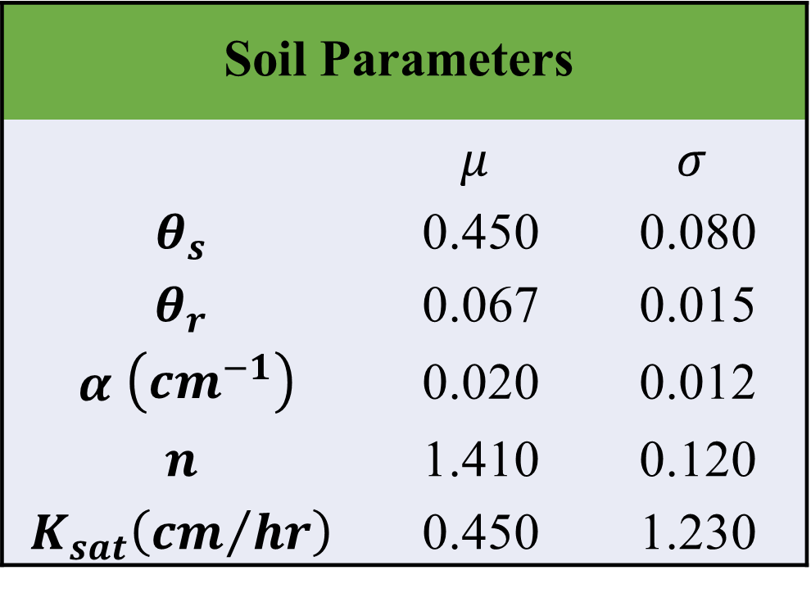
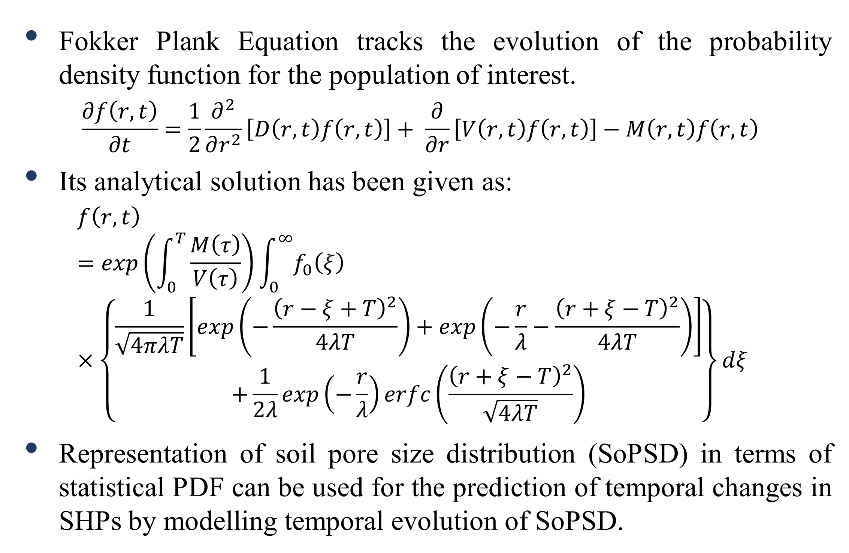
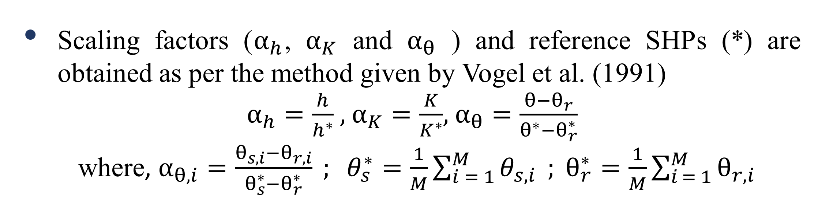
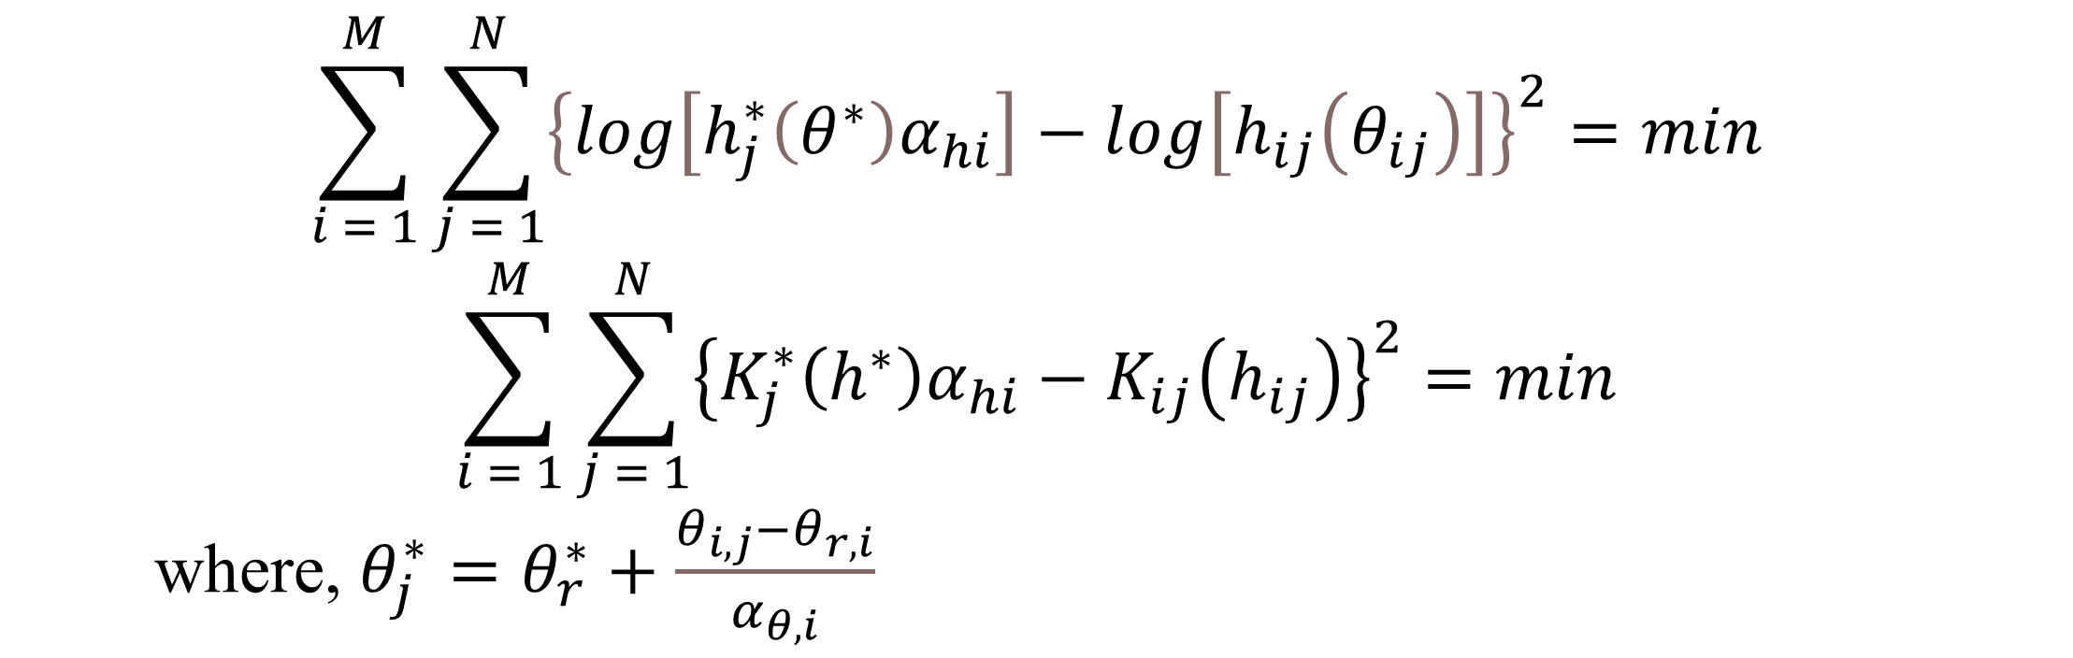
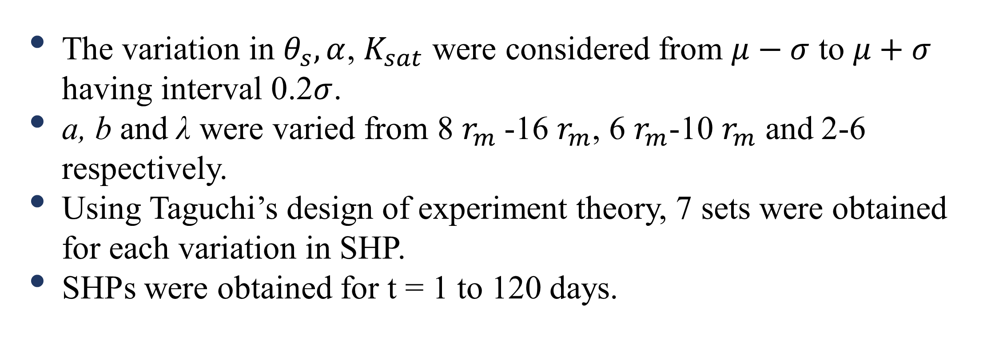
Use of Scaling to Describe Temporal Variability in Soil Hydraulic Properties
Saurabh Kumar¹ and Richa Ojha¹
¹Department of Civil Engineering, Indian Institute of Technology Kanpur, Kanpur, India, 208016 email: saurk@iitk.ac.in; richao@iitk.c.in
EGU23-4060
EGU General Assembly 2023, Vienna Austria
1. Introduction
4. Results and Discussion
  Accurate knowledge of Soil hydraulic properties (𝜃(ℎ), 𝐾(ℎ)) is necessary for reliable modelling of water fluxes and solute transport in unsaturated soils.
  Natural and human factors affect the soil structure resulting in spatio-temporal variability of SHPs (Chandrasekhar et al., 2018; Nikodem et al., 2021).
  Limited attempts have been made to model temporal variation of SHPs (Chandrasekhar et al., 2018).
  Scaling methods based on similar media concept have the potential to model the spatio-temporal variation of vadose zone processes while accounting for natural variability.
  In this study, we attempted to develop a reference SWRC and HCC for a synthetically generated field data and estimated scaling factors to characterize the temporal variation of SHPs based on the functional normalization approach as given by Vogel et al. (1991).
$$\sum_{i = 1}^{M}{\sum_{j = 1}^{N}{{\left\{log\left[h_{j}^{∗}\left(θ^{∗}\right)α_{hi}\right]−log\left[h_{ij}\left(θ_{ij}\right)\right]\right\}}^{2}}}=min$$
$$\sum_{i = 1}^{M}{\sum_{j = 1}^{N}{{\left\{K_{j}^{∗}\left(h^{∗}\right)α_{hi}−K_{ij}\left(h_{ij}\right)\right\}}^{2}}}=min$$
where, $θ_{j}^{∗}=θ_{r}^{∗}+\frac{θ_{i,j}−θ_{r,i}}{α_{θ,i}}$
3. Methodology
Figure 1: Comparison of scaled and unscaled SWRC and HCC for silt loam soil, circles represents the SHPs while line represents the reference SWRC and HCC
2.1 Theory
  Fokker Plank Equation tracks the evolution of the probability density function for the population of interest.
  $$\frac{∂f\left(r,t\right)}{∂t}=\frac{1}{2}\frac{∂^{2}}{∂r^{2}}\left[D\left(r,t\right)f\left(r,t\right)\right]+ \frac{∂}{∂r}\left[V\left(r,t\right)f\left(r,t\right)\right]−M\left(r,t\right)f\left(r,t\right)$$
  Its analytical solution has been given as:
  $$f\left(r,t\right) =exp\left(\int_{0}^{T}{\frac{M\left(τ\right)}{V\left(τ\right)}}\right)\int_{0}^{∞}{f_{0}\left(ξ\right)} ×\left\{\begin{aligned}\frac{1}{\sqrt{4πλT}}\left[exp\left(−\frac{{\left(r−ξ+T\right)}^{2}}{4λT}\right)+exp\left(−\frac{r}{λ}−\frac{{\left(r+ξ−T\right)}^{2}}{4λT}\right)\right] \\ +\frac{1}{2λ}exp\left(−\frac{r}{λ}\right)erfc\left(\frac{{\left(r+ξ−T\right)}^{2}}{\sqrt{4λT}}\right)\end{aligned}\right\}dξ$$
  Representation of soil pore size distribution (SoPSD) in terms of statistical PDF can be used for the prediction of temporal changes in SHPs by modelling temporal evolution of SoPSD.
Methodology followed in this study
Figure 2: Variation of scale factors with time
Table 2: Variation of Drift Parameters of FPE analytical Model
5. Conclusion
Table 1: van Genuchten parameter for silt loam (Carsel and Parrish,1988)
Scaling was performed by combining multiple sets of SHPs at different timesteps.
Reference SHPs and scale factors as proposed by Vogel et al. (1991) can be useful to characterize soil temporal variability.
Inclusion of temporal variability of SHPs leads to ease in computation and characterization of variability in SHPs.
Variability in scale factors decreases with time.
$$\text{Soil} \text{Parameters}$$
 | $$μ$$ | $$σ$$
$$θ_{s}$$ | 0.450 | 0.080
$$θ_{r}$$ | 0.067 | 0.015
$α$ $\left({cm}^{−1}\right)$ | 0.020 | 0.012
$$n$$ | 1.410 | 0.120
$$K_{sat}\left({cm}/{hr}\right)$$ | 0.450 | 1.230
Set no. | a | b | λ
1 | 8$r_{m}$ | 8$r_{m}$ | 6
2 | 12$r_{m}$ | 8$r_{m}$ | 4
3 | 16$r_{m}$ | 6$r_{m}$ | 4
4 | 16$r_{m}$ | 8$r_{m}$ | 2
5 | 16$r_{m}$ | 10$r_{m}$ | 2
6 | 12$r_{m}$ | 10$r_{m}$ | 6
7 | 16$r_{m}$ | 6$r_{m}$ | 6
Acknowledgment
2.2. Temporal Scaling of SWRC and HCC
The authors would like to thank the financial support from Science and Engineering Research Board, Government of India, for the project titled “Temporal Variability of Soil Hydraulic Properties in Agricultural field” through project no. CRG/2021/003340.
The variation in $θ_{s}, α$, $K_{sat}$ were considered from $μ−σ$ to $μ+σ$ having interval 0.2$σ$.
a, b and λ were varied from 8 $r_{m}$-16 $r_{m}$, 6 $r_{m}$-10 $r_{m}$ and 2-6 respectively.
Using Taguchi’s design of experiment theory, 7 sets were obtained for each variation in SHP.
SHPs were obtained for t = 1 to 120 days.
References
Scaling factors ($α_{h}$, $α_{K}$ and $α_{θ}$ ) and reference SHPs (*) are obtained as per the method given by Vogel et al. (1991)
$α_{h}=\frac{h}{h^{∗}}$ , $α_{K}=\frac{K}{K^{∗}}$, $α_{θ}=\frac{θ−θ_{r}}{θ^{∗}−θ_{r}^{∗}}$
where, $α_{θ,i}=\frac{θ_{s,i}−θ_{r,i}}{θ_{s}^{∗}−θ_{r}^{∗}} ; θ_{s}^{∗}=\frac{1}{M}\sum_{i = 1}^{M}{θ_{s,i}} ; θ_{r}^{∗}=\frac{1}{M}\sum_{i = 1}^{M}{θ_{r,i}}$
Carsel, R. F., & Parrish, R. S. (1988). Developing joint probability distributions of soil water retention characteristics. Water resources research, 24(5), 755-769.
Chandrasekhar, P., Kreiselmeier, J., Schwen, A., Weninger, T., Julich, S., Feger, K. H., & Schwärzel, K. (2019). Modeling the evolution of soil structural pore space in agricultural soils following tillage. Geoderma, 353, 401-414.
Nikodem, A., Kodešová, R., Fér, M., & Klement, A. (2021). Using scaling factors for characterizing spatial and temporal variability of soil hydraulic properties of topsoils in areas heavily affected by soil erosion. Journal of Hydrology, 593, 125897.
Vogel, T., Cislerova, M., & Hopmans, J. W. (1991). Porous media with linearly variable hydraulic properties. Water Resources Research, 27(10), 2735-2741.

