Slide 1
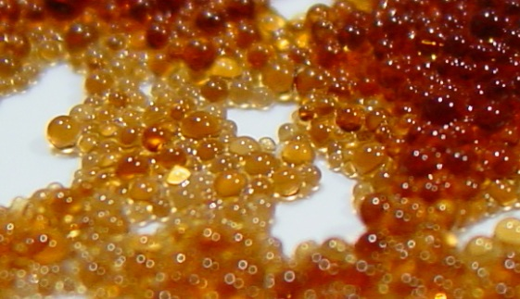
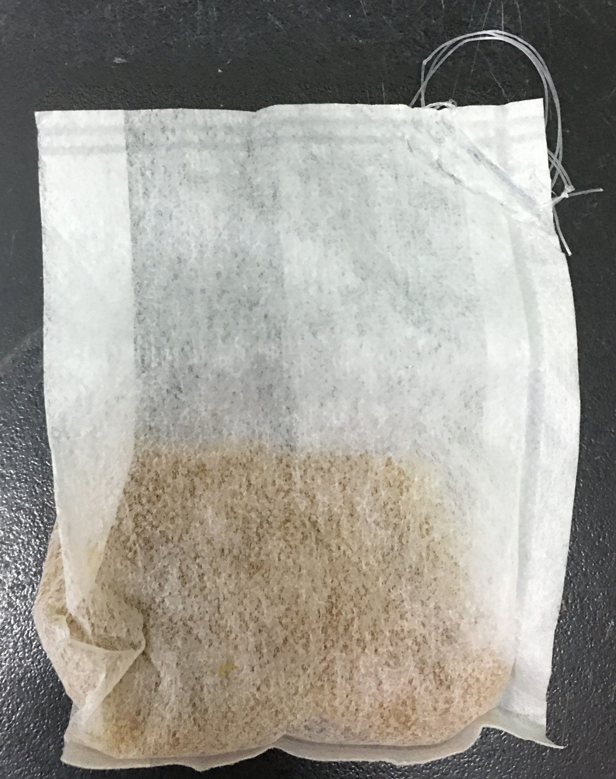
Methods - ion-exchange resin
Mechanism
Heavy metal elements have larger affinity to resin bead
Characteristics
High exchange capacity and efficiency of aborbing heavy metal elements
River water
Cation exchange resin
Metal ion
Mobile ion
(ion bond with resin)
https://en.wikipedia.org/wiki/Ion-exchange_resin
Modified from (Skipton et al., 2008)
Notes:
表達重金屬元素的親和力高，所以會跑到樹枝上，所以樹枝才
有高親和力為什麼
用樹枝優勢是什麼，用他的目的是什麼
半徑比較大、假樹大為什麼親和力大？
由於樹脂吸留離子主要是靠靜電引力，因此，樹脂對離子的親和力的大小就決定於水合離子的大小和電荷數的多少。例如： 、 ， 的水合離子電荷數相同，水合離子半徑依次減小，樹脂對這些離子的引力就依次增強，因此親和力依次增強。
http://dardel.info/IX/resin_structure.html#other 這個網頁有滿多樹脂的知識
https://www.lenntech.com/Data-sheets/Ion-Exchange-for-Dummies-RH.pdf 把離子交換的機制講得很簡單
查一下樹枝再多大的濃度下多久會達到飽和

Slide 2
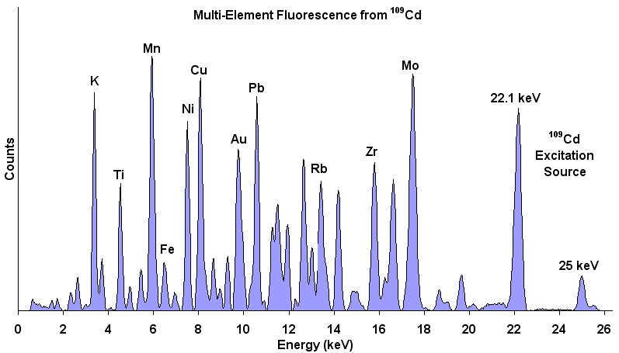
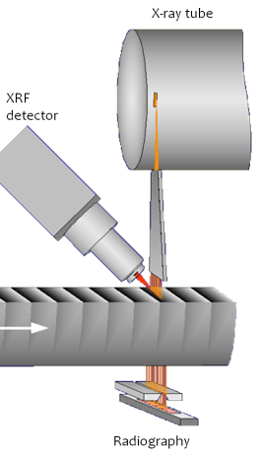
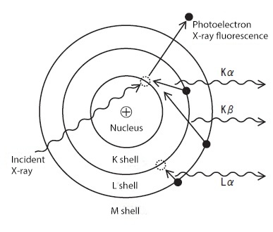
Methods - Itrax XRF-CS
Measuring elements
Fe, Mn, Zn, Cu, Cr, Cd, Ni, Hg, As
Advantages
Short analysis time, low-cost
Mechanism
https://www.spec2000.net/00-login-1.htm
https://www.matsusada.com/column/words-xrf.html
Notes:
https://www.olympus-ims.com/en/insight/understanding-x-ray-fluorescence-how-does-xrf-work/ 這個原理講的滿簡單的
https://www.matsusada.com/column/words-xrf.html
要講一下怎麼裝填這個樹脂樣本
講他的優點跟他是幹嘛的
Incident X-ray radiation to create the excitation of inner atomic shell electrons; outer shell electrons filled the vacancies and emitted characteristic X-ray radiation (Brouwer, 2006; Weltje et al., 2008; Panchuk et al., 2018)

Slide 3
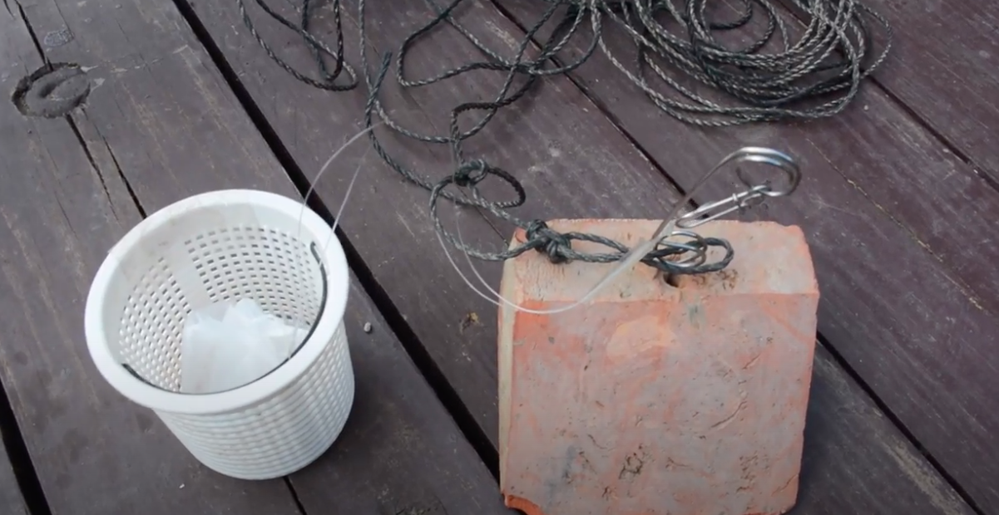
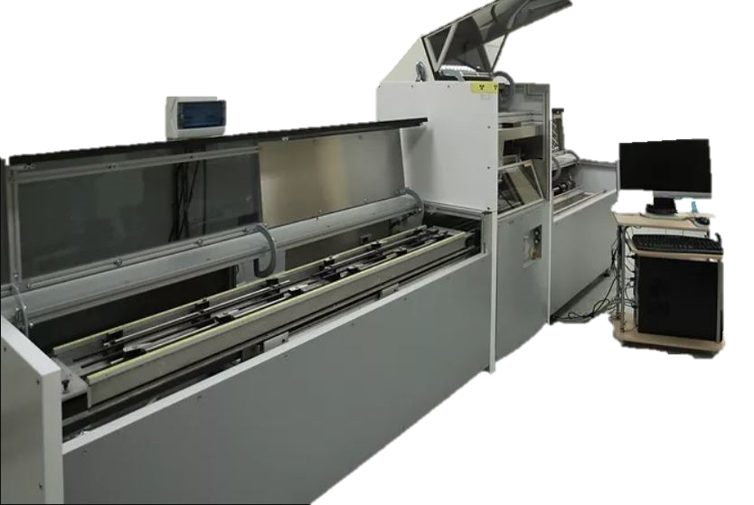
Workflow
One week…
8
6
5
7
Resin sachet setup
One week…
XRF-CS
Detect!!
3
2
4
Fishing bait snap-connector
Resin sachet
6
5
4
3
Anchor
2
1
Basket
(Modified from Huang et al., 2019; Shih et al., 2019)
Notes:
優勢沒有達到短時間監控的目標，因為採樣時間隔太久
As one of the receiving-phase materi- als, ion-exchange resin has been developed as an economically feasible method for extracting heavy metals in wastewaters over the past decades, even at low concentration effluents
overcome these restrictions.
Therefore, this study has developed a cost-effective, readily-deployable ion-exchange resin sachet as the integrating passive sampler. Multiple samplers can be easily installed and left for suitable times depending on the motivation of the monitoring program. The sensitive and non-destructive XRF-CS can therefore fulfill the demand to quantitatively assess heavy metal concentrations of the resin samples in a fast and economical manner, which allows for archiving samples of potential legal significance

