Slide 1
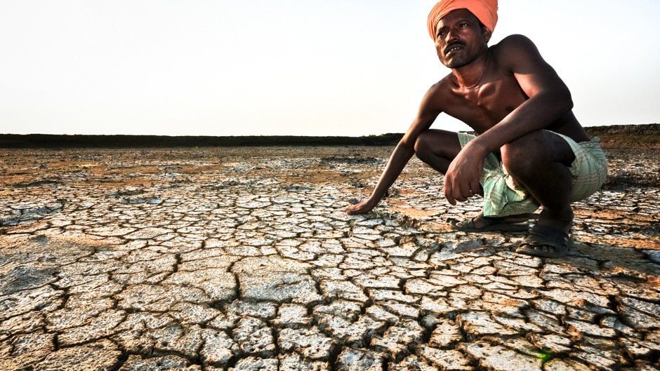
Simulating the effects of sea level rise and soil salinization on migration and adaptation in coastal Mozambique
Photo: IRRI
Kushagra Pandey, Jens de Bruijn, Hans de Moel, and Jeroen Aerts

Slide 2
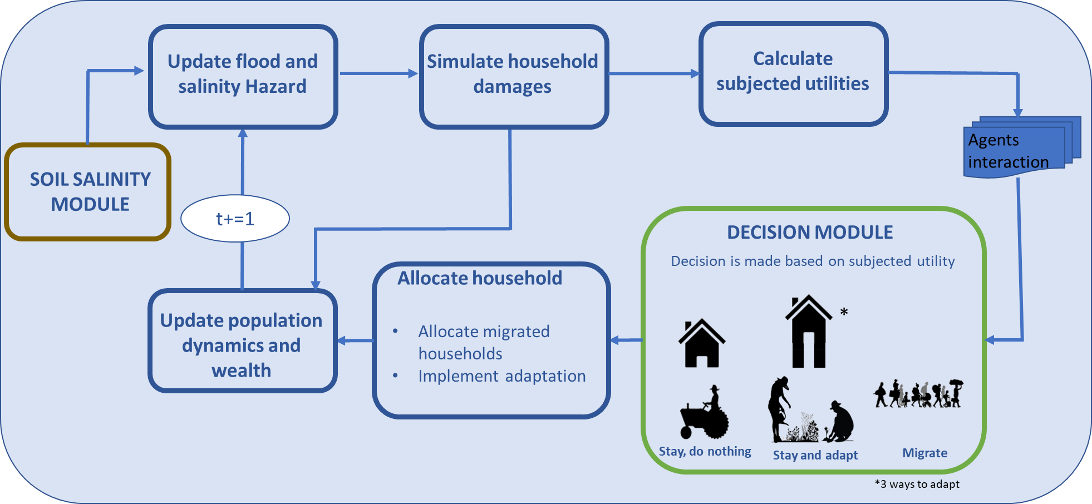
Modelling framework

Slide 3
Decision Module
$$DEU_{1}= \int_{p_{i}}^{p_{I}}{β_{t} ∗p∗U \left(\sum_{t=0}^{T}{\frac{W_{t}+A_{x,t}+{Inc}_{x,t}−D_{x,t,i} }{{\left(1+r\right)}^{t}}}\right)dp }$$ (To stay and do nothing)
$$DEU_{2}= \int_{p_{i}}^{p_{I}}{β_{t} ∗p_{i}∗U \left(\sum_{t=0}^{T}{\frac{W_{t}+A_{x,t}+{Inc}_{x,t}−D_{x,t,i}^{adapt} −C_{t}^{adapt}}{{\left(1+r\right)}^{t}}}\right)dp }$$ (Stay while adapting)
$$DEU_{3}=U\left(\sum_{t=0}^{T}{\frac{W_{t}+A_{y,t}+{Inc}_{y,t}−C_{y,t}^{migration}}{{\left(1+r\right)}^{t}}}\right)$$ (Migrate)
$, U\left(x\right)=\frac{x^{1−σ}}{1−σ}$ ,
$β_{t}=c∗{1.6}^{−d∗t}$+0.01
, $C_{annual}^{building}={(C}_{0}^{building}+C_{0}^{farm})∗\frac{r∗{\left(1+r\right)}^{n}}{{\left(1+r\right)}^{n}−1},$
$C_{0}^{farm}=f(P_{0},α, crop)$
$${, C}_{y}^{migration}=\frac{2∗C^{fixed}}{1+e^{−0.05∗{dist}_{xy}}}$$
References:
[1]Ruig, L. T. de, Haer, T., Moel, H. de, Orton, P., Botzen, W. J. W., & Aerts, J. C. J. H. (2022). An agent-based model for evaluating reforms of the National Flood Insurance Program: A benchmarked model applied to Jamaica Bay, NYC. Risk Analysis. https://doi.org/10.1111/RISA.13905
[2]Tierolf, L., Haer, T., Botzen, W.J.W. et al. A coupled agent-based model for France for simulating adaptation and migration decisions under future coastal flood risk. Sci Rep 13, 4176 (2023). https://doi.org/10.1038/s41598-023-31351-y
Notes:
Alpha- penetration coeffcienct

Slide 4
Soil Salinity Module
SOIL MODULE
Geo-physical parameters as [2,3]
Geo-physical parameters
Sample upper depth
Sample lower depth
WRB
Clay content
Elevation
Slope
Field capacity
Wilting point
Effective plant rooting depth
dryssª
wetss^{b}
evspsbl^{c}
Pr-fre^{d}
Pr-int^{e}
Sea Level Rise scenarios
Distance to coast
RCP and SSP scenarios
Sector Vector Machine(SVM) regression
Simulated soil salinity maps
a Five-year moving average of daily dry deposition rate of sea salts.
b Five-year moving average of daily wet deposition rate of sea salts.
c Five-year moving average of daily evapotranspiration.
d Five-year moving average of annual precipitation frequency.
e Five-year moving average of annual precipitation intensity
References:
[1]FAO, I., & ISRIC, I. (2012). Jrc: Harmonized world soil database (version 1.2). FAO, Rome, Italy and IIASA, Laxenburg, Austria.
[2]Hassani, A., Azapagic, A. & Shokri, N. Predicting long-term dynamics of soil salinity and sodicity on a global scale. Proc. Natl Acad. Sci. USA 117, 33017–33027 (2020).
[3]Hassani A, Azapagic A, Shokri N. Global predictions of primary soil salinization under changing climate in the 21st century. Nat Commun. 2021 Nov 18;12(1):6663. doi: 10.1038/s41467-021-26907-3. PMID: 34795219; PMCID: PMC8602669.

Slide 5
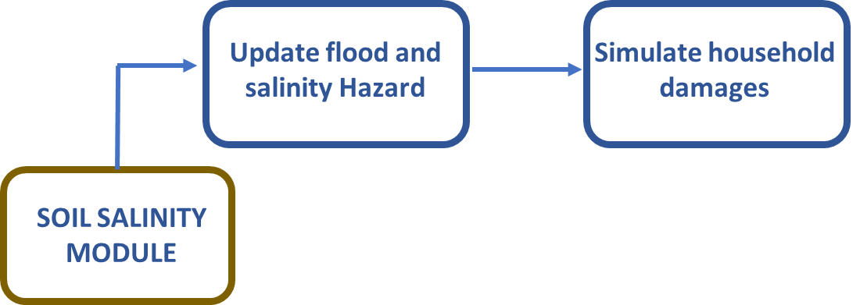
Risk and Damage module
$D_{flood}=f\left(C_{d},WL\right)∗D_{max⁡}\left[2\right]\left[3\right]$
$D_{farm}=Y_{r}∗Y∗P_{cr}∗A, Yr=f\left(SL, crop\right)$
Simulate salinity levels(SL) under RCP scenarios
water levels(WL) interpolated based on inundation maps[1]
References:
[1] Ward, P. J. et al. Aqueduct Floods Methodology. World Resources Institute https://www.wri.org/research/aqueduct-floods-methodology (2020).
[2] Huizinga, J., De Moel, H. & Szewczyk, W. Global flood depth-damage functions: Methodology and the database with guidelines. https://publications.jrc.ec.europa.eu/repository/handle/111111111/45730 (2017).
[3] Aerts, J. C. J. H. & Botzen, W. J. Flood-resilient waterfront development in New York City: Bridging flood insurance, building codes, and flood zoning. Ann. N. Y. Acad. Sci. 1227, 1–82 (2011).

Slide 6
Results

Slide 7
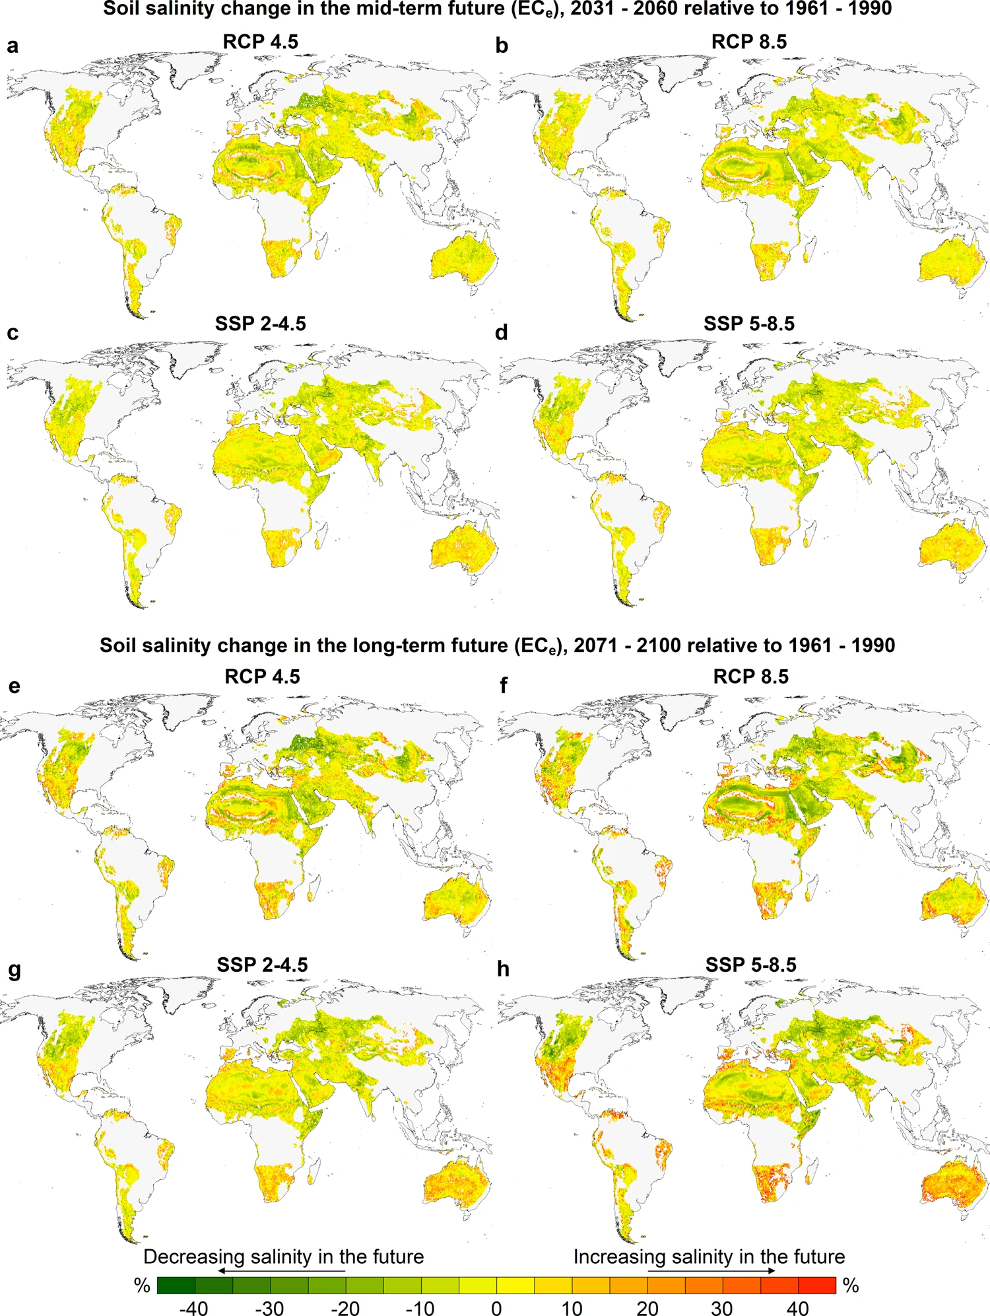
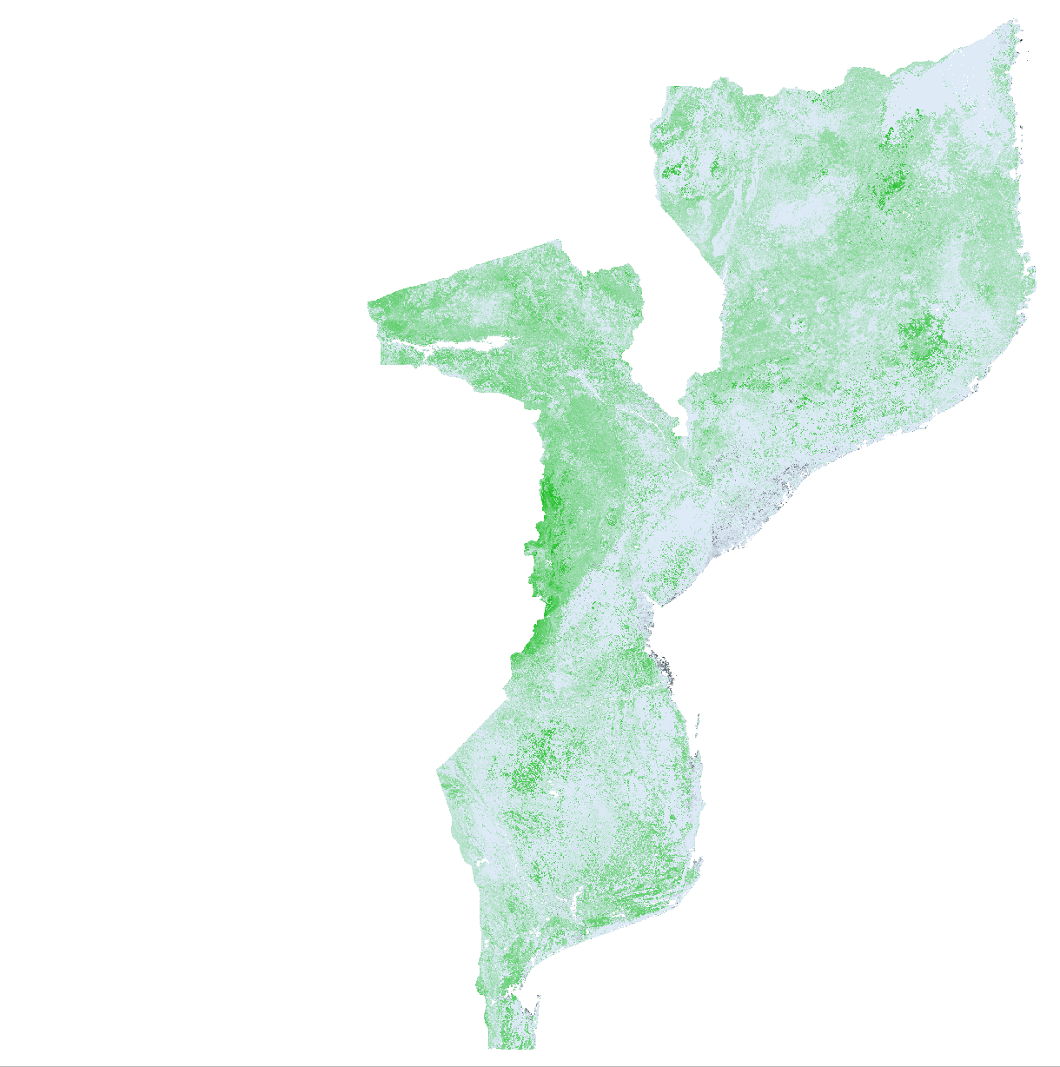
Salinity maps
Simulated soil salinity(dSm⁻¹(*10⁻⁵)
(Hassani et al, 2021)

Slide 8
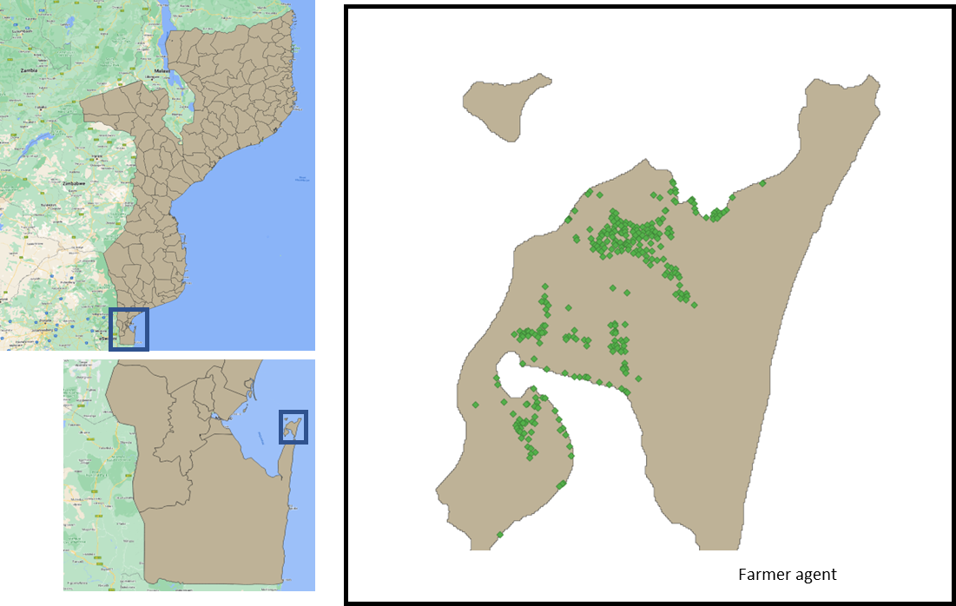
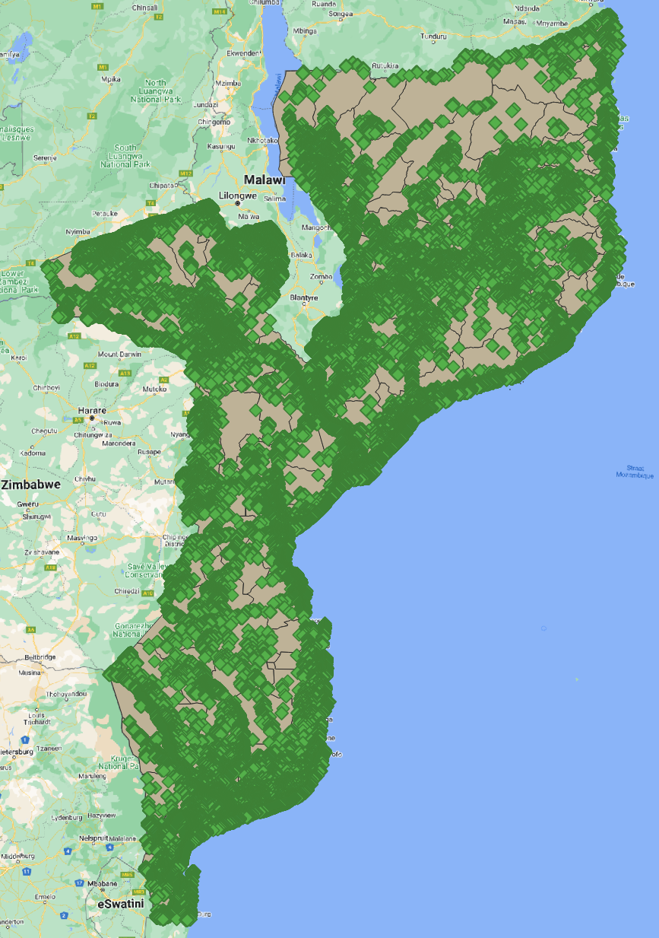
Farmland maps
Farm lands are simulated using global cropland model[1]
References:
[1] P. Potapov, S. Turubanova, M.C. Hansen, A. Tyukavina, V. Zalles, A. Khan, X.-P. Song, A. Pickens, Q. Shen, J. Cortez. (2021) Global maps of cropland extent and change show accelerated cropland expansion in the twenty-first century. Nature Food. https://doi.org/10.1038/s43016-021-00429-z

Slide 9
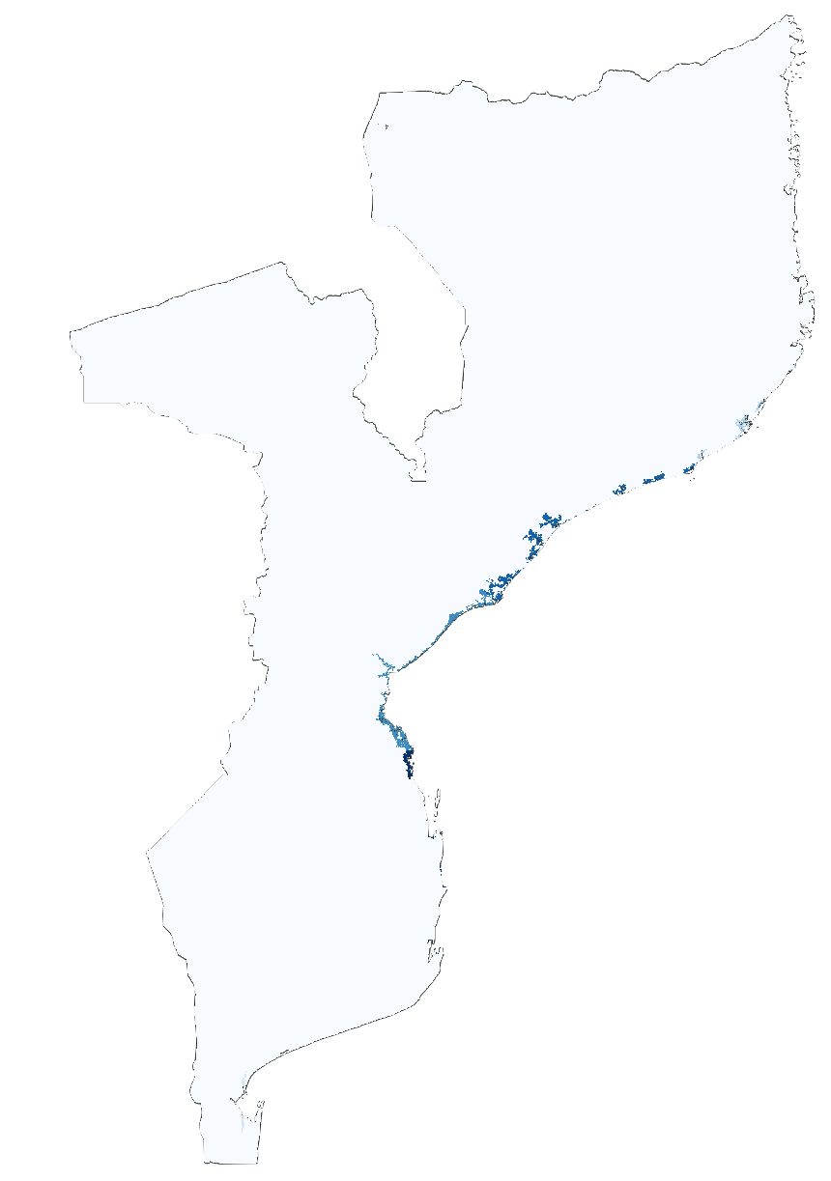
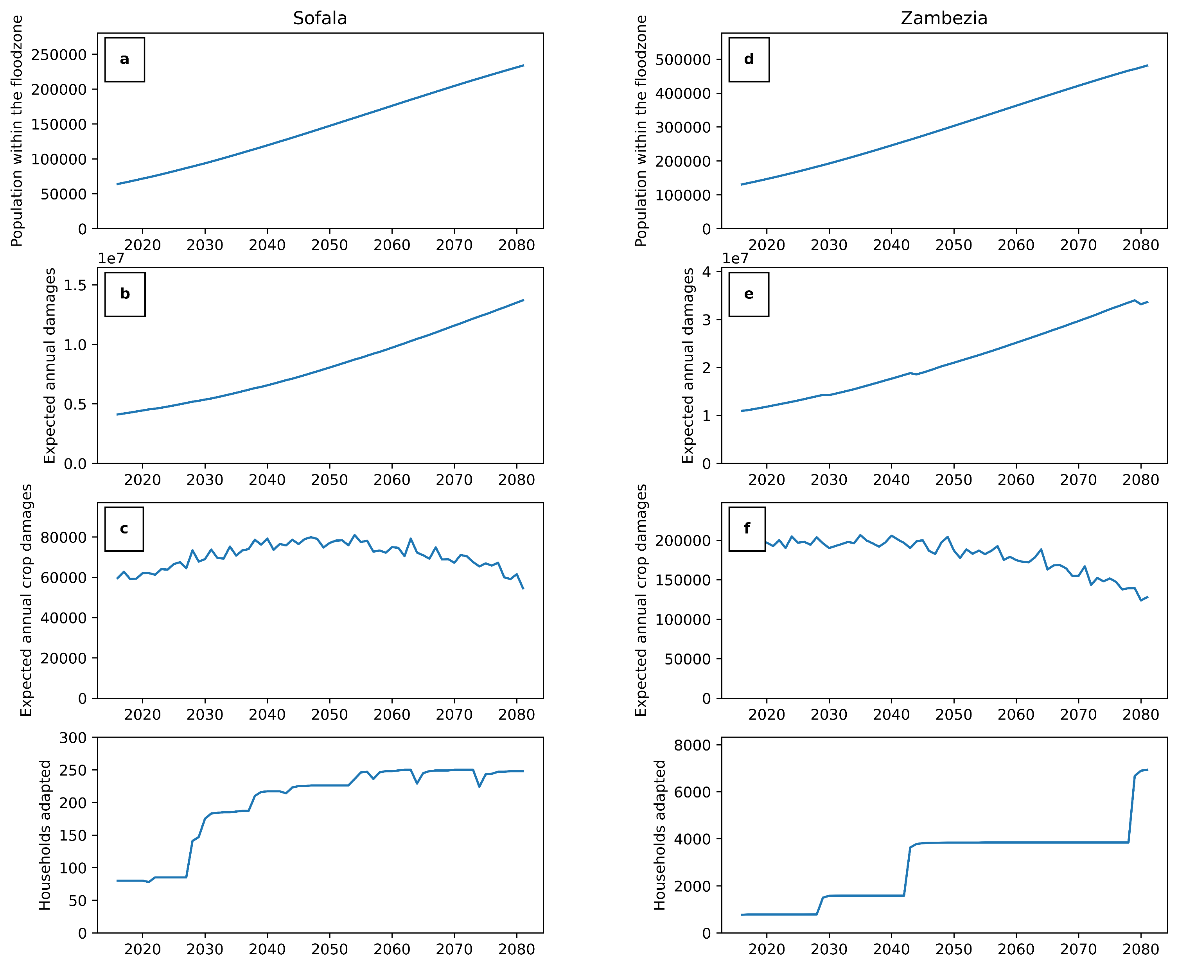
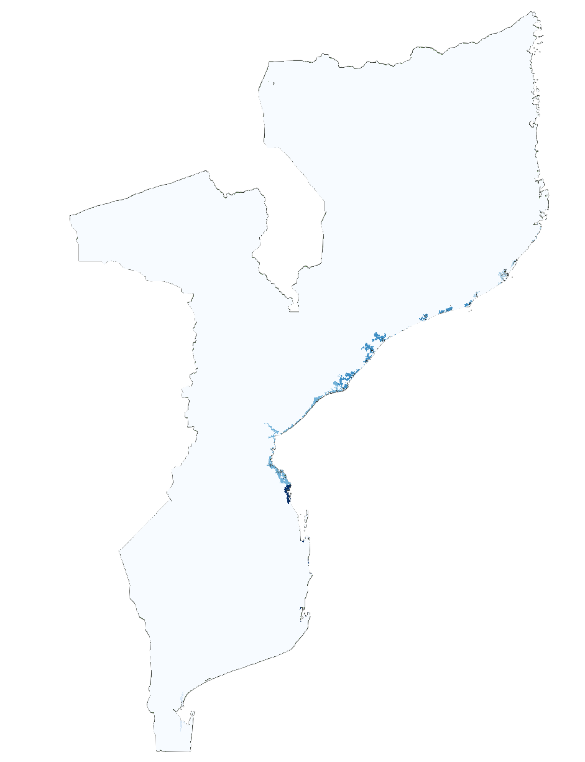
Model output
Zambezia flood plain
Maputo
a.)2050
b.)2080
Expected crop damage per no. of household involved in simulation (x10³ euro/household)

Slide 10
Further important notes
$C^{fixed}:$ Kennan, J. & Walker, J. R. The effect of expected income on individual migration decisions. Econometrica 79, 211–251 (2011)
$Yr=f\left(SL, crop\right):$Maas, E. v, & Hoffman, G. J. (1977). Crop salt tolerance—current assessment. Journal of the Irrigation and Drainage Division, 103(2), 115–134.
Crop data:FAO(2002) Annex 1. Crop salt tolerance data. Annex 1. https://www.fao.org/3/y4263e/y4263e0e.htm#bm14
SCAN ME
Contact
k.pandey@vu.nl
Link to abstract

Slide 11
Contact and future research
COASTMOVE: A global agent-based model to simulate effects of sea level rise and soil salinization on coastal adaptation and migration
Simulating heterogeneity of global adaptation methods
Further references:
Duijndam, S. J., Botzen, W. J., Hagedoorn, L. C., & Aerts, J. C. (2022). Anticipating sea‐level rise and human migration: A review of empirical evidence and avenues for future research. Wiley Interdisciplinary Reviews: Climate Change, 13(1), e747.
Aerts, J. C. J. H. (2020). Integrating agent-based approaches with flood risk models: A review and perspective. Water Security, 11, 100076.
Ruig, L. T. de, Haer, T., Moel, H. de, Orton, P., Botzen, W. J. W., & Aerts, J. C. J. H. (2022). An agent-based model for evaluating reforms of the National Flood Insurance Program: A benchmarked model applied to Jamaica Bay, NYC. Risk Analysis. https://doi.org/10.1111/RISA.13905
Tierolf, L., Haer, T., Botzen, W.J.W. et al. A coupled agent-based model for France for simulating adaptation and migration decisions under future coastal flood risk. Sci Rep 13, 4176 (2023). https://doi.org/10.1038/s41598-023-31351-y
SCAN ME
Link to abstract
Contact
k.pandey@vu.nl

