Slide 1
Aerosol–cloud interaction in atmospheric chemistry model GRAPES_Meso5.1/CUACE
and its impacts on mesoscale numerical weather prediction under haze pollution conditions in Jing–Jin–Ji in China
Wenjie Zhang, Hong Wang, Xiaoye Zhang, Liping Huang, Yue Peng, Zhaodong Liu,
Xiao Zhang, and Huizheng Che
https://doi.org/10.5194/acp-22-15207-2022

Slide 2
Motivation
The role of aerosol-cloud interaction (ACI) in operational numerical weather prediction (NWP) models is less considered compared with climate models
Our aim is to investigate the impact of ACI on the mesoscale NWP under haze pollution conditions
ACI
ACI
Numerical weather prediction
Climate projection
Days, weeks
Seasonal, decadal and centennial
https://doi.org/10.5194/acp-22-15207-2022

Slide 3
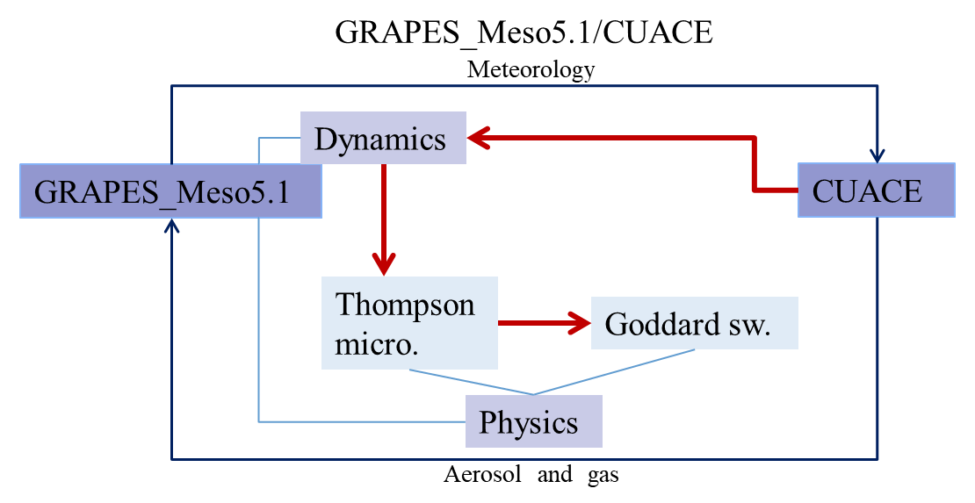
Implementation of ACI in GRAPES_Meso5.1/CUACE
Water-friendly aerosol
WFA
Cloud water and ice effective radius
Rc,Ri
Diagram of aerosol–cloud interaction in the model
https://doi.org/10.5194/acp-22-15207-2022

Slide 4
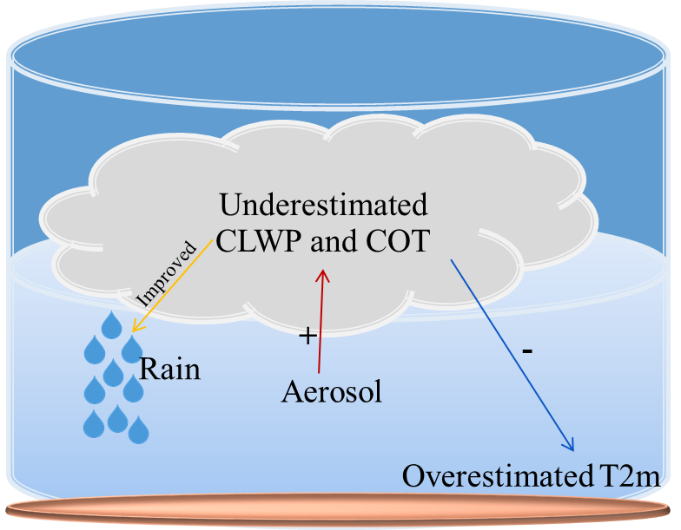
The impact of ACI on the mesoscale numerical weather prediction
ACI increases underestimated cloud liquid water path (CLWP) and optical thickness (COT)
Cooling in temperature at 2 m (T2m) is closer to observations
Improve the magnitude and spatial distribution of precipitation
Low-cloud
Haze pollution conditions
Diagram of ACI effect on NWP
https://doi.org/10.5194/acp-22-15207-2022

Slide 5
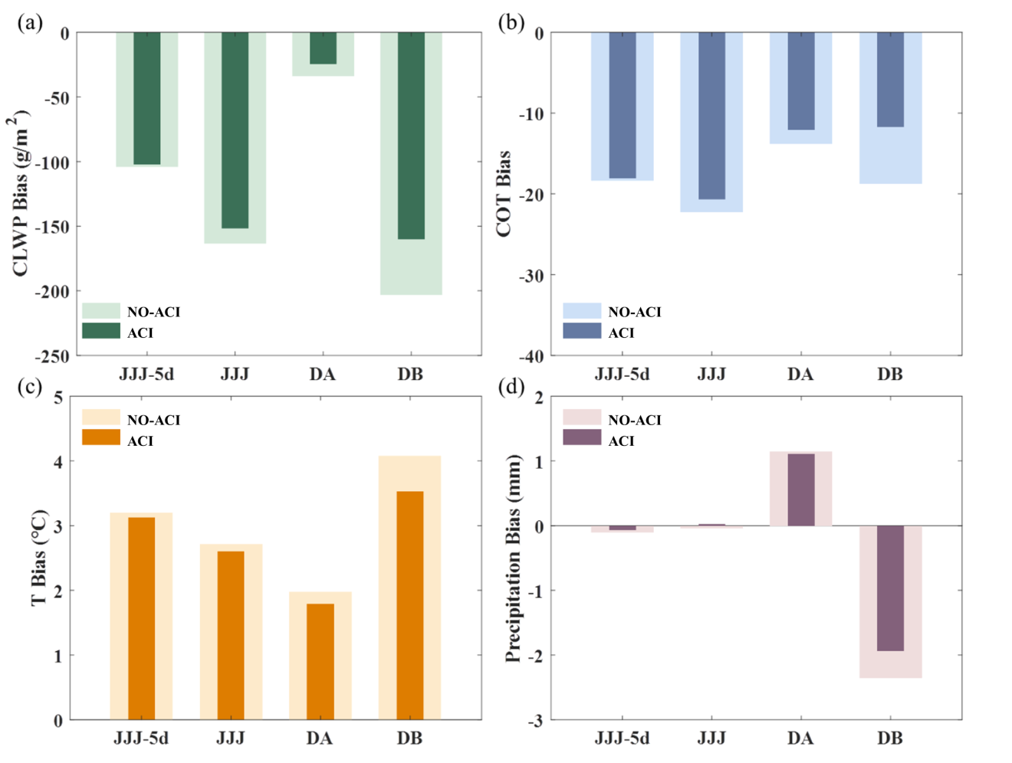
The significant variations of ACI effect in time and space
Comparison of bias by NO-ACI and ACI
ACI’s improvement varies significantly in different time periods and regions
Improvement depends more on cloud water content than on aerosol concentration
https://doi.org/10.5194/acp-22-15207-2022
JJJ-5d: whole period JJJ: cloudy time DA: more polluted region DB: less polluted region

Slide 6
Summary
The ACI is first implemented in GRAPES_Meso5.1/CUACE by allowing for real-time aerosol activation in the Thompson cloud micro-physics scheme
ACI increases underestimated CLWP and COT, further reducing the bias of T2m and improving the magnitude and spatial distribution of precipitation
ACI’s improvement varied significantly in different time periods and regions, depending more on cloud water content than on aerosol concentration
https://doi.org/10.5194/acp-22-15207-2022

Slide 7
Thank you for listening!
More details are in the published article:
Zhang, W., Wang, H., Zhang, X., Huang, L., Peng, Y., Liu, Z., Zhang, X., and Che, H.: Aerosol–cloud interaction in the atmospheric chemistry model GRAPES_Meso5.1/CUACE and its impacts on mesoscale numerical weather prediction under haze pollution conditions in Jing–Jin–Ji in China, Atmos. Chem. Phys., 22, 15207–15221, https://doi.org/10.5194/acp-22-15207-2022, 2022.
Any question please contact: 20113020027@fudan.edu.cn
https://doi.org/10.5194/acp-22-15207-2022

