Slide 1
Institutional impacts on the evolution of the Yellow River, China: a perspective from socio-hydrological modelling
Lecturer: Shuang Song
PhD. Candidate in Geography
Notes:
Hello everyone, I'm pleased to present my research titled "Institutional impacts on the evolution of the Yellow River, China"

Slide 2
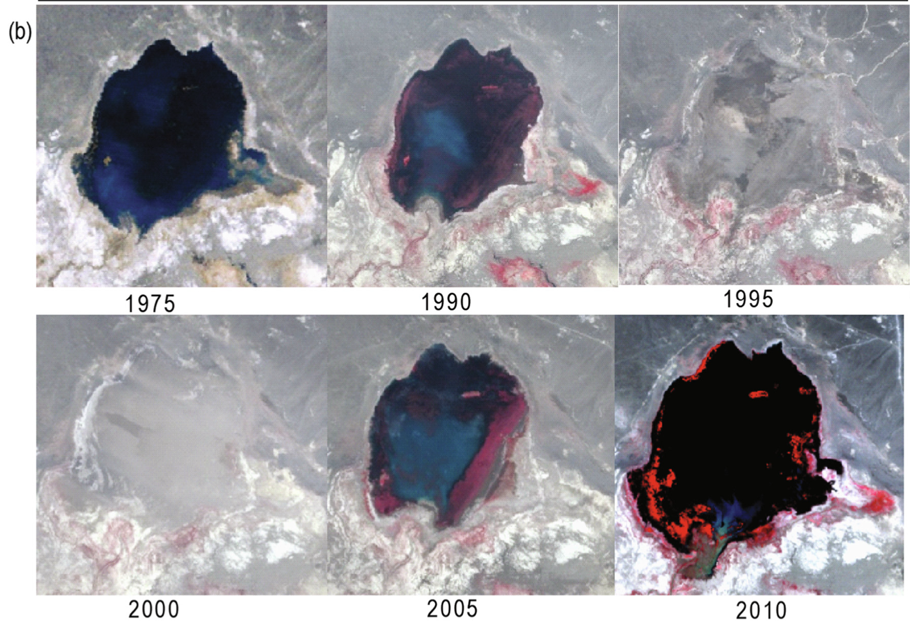
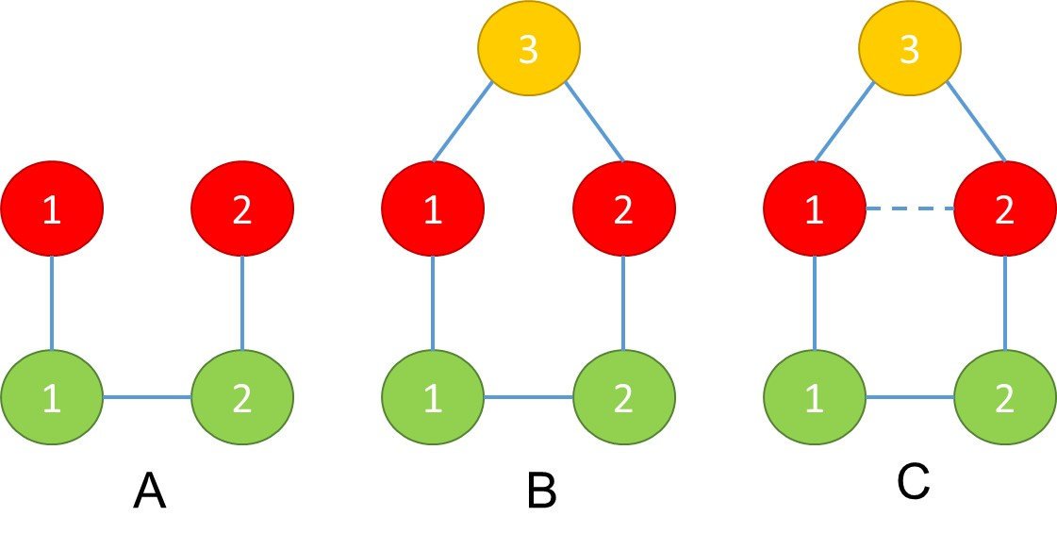
Theory Background
Part 1: Background
Structural changes
Interactions
Governance System (GS)
Actors
(A)
Matched structure
Resource Units
(RU)
Resource System
(RS)
Institutional change
Social-ecological system (SES)
Mismatched structure
Adapted from Ostrom et al., 2008 Science
Wang et al., 2019 Science Bulletin
Bodin et al., 2017, Science
Social-ecological systems (SES)
Institutional shifts
Notes:
The evolution here means the co-evolution between a river and human because they are intertwined as a social-ecological system (SES). The interactions can be broken or reframed by institutional shifts. Sometimes this leads to effectiveness and sustainability.

Slide 3
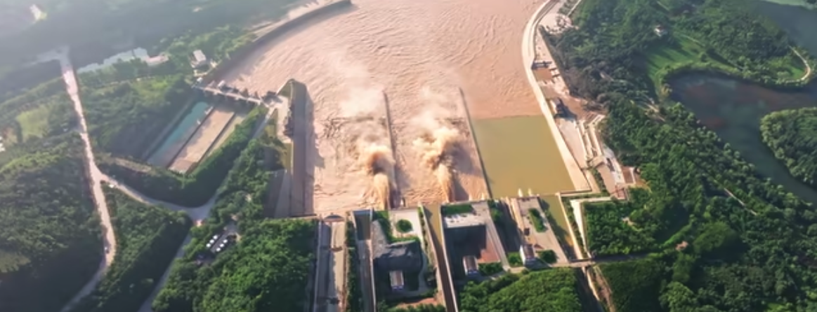
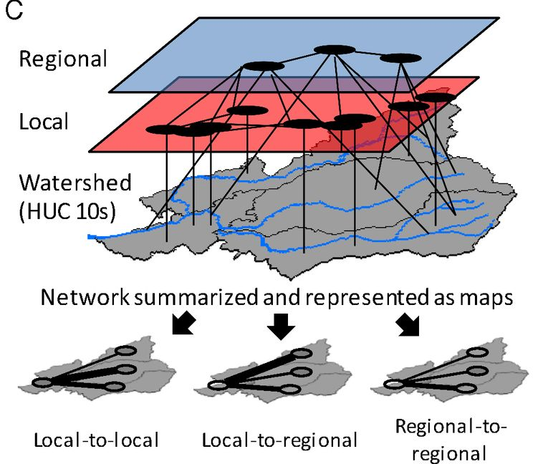
Institution Background
Part 1: Background
Drying-up Yellow River
Regulated Yellow River
Two water allocation policies
Began to dry up
The last drying-up
Institutional shift (1987)
Institutional shift (1998)
Connecting structure
License
Measuring
Measuring
Freely take water
shrink water usage into given quotas
no longer have authorities to take water by themselves
Notes:
Ok, lets look at the Yellow River case, the cradle of Chinese civilization.
As we can see from this graph it began to dry up in 1972 because of excessive water use.
Therefore, two water allocation policies were proposed to address this crisis.
Before 1987, all regions along the river were able to freely take water.
After the first institutional shift. Regions were asked to shrink their water usage into given quotas.
However, this policy not only failed but also made the crises even worse.
Then, after the second institutional shift in 1998, the above quotas became compulsory for the regions because they no longer have authorities to take water by themselves.
In line with the expectation, the drying-up crisis was resolved almost immediately as a consequence.

Slide 4
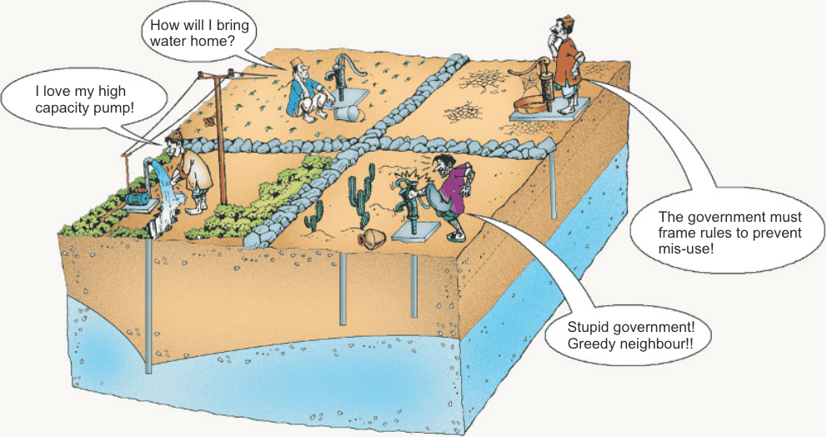
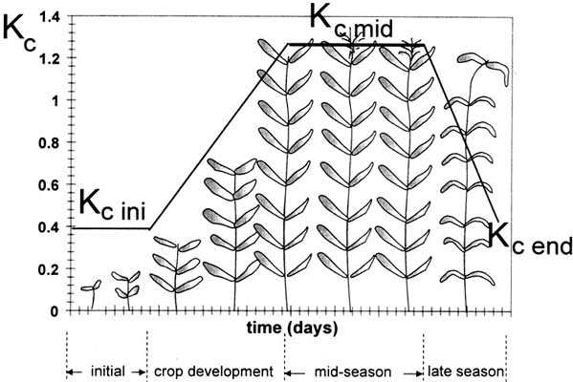
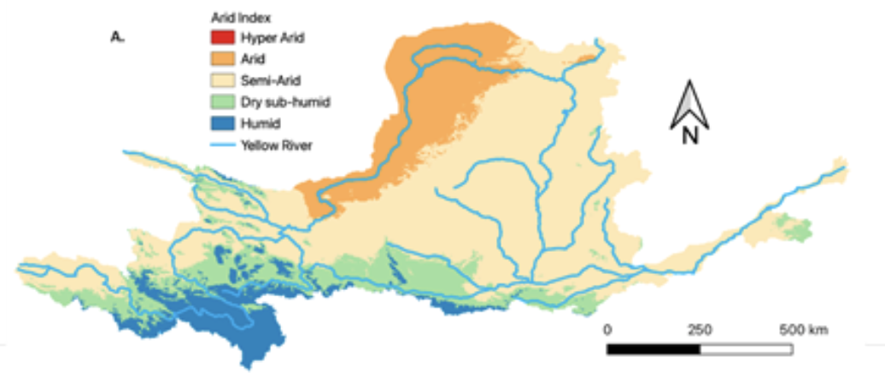
Agent-based socio-hydrological model
Part2: approach
Social system
Breach
Social norm
Castilla-Rho et al., Nature Human Behavior, 2017
Castilla-Rho et al., Global Environmental Change, 2019
Quota
Actual
Max
Overdraw water or not?...
Ecosystem
WHY water users behaved so different to response the two institutional shifts?
FAO56., Allen 1998
FAO56, Penman eq.
Notes:
Why water users in these regions behaved so different to response the 2 institutional shifts? An agent-based social-hydrological model can bring us some insights.

Slide 5
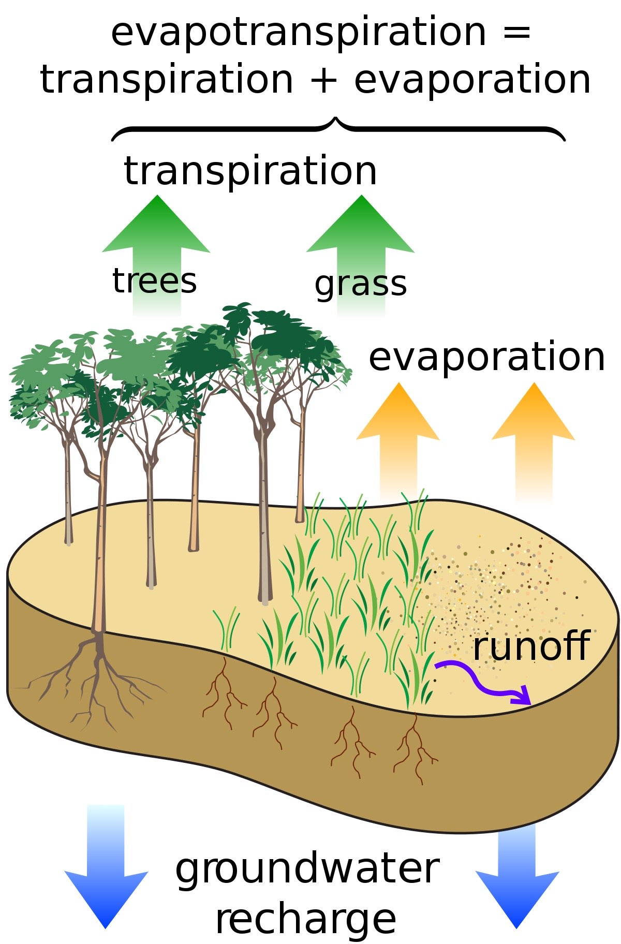
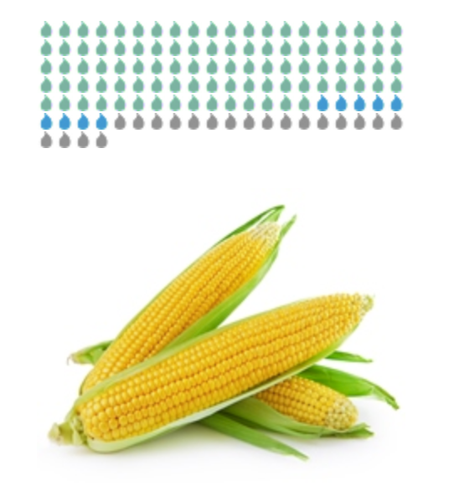
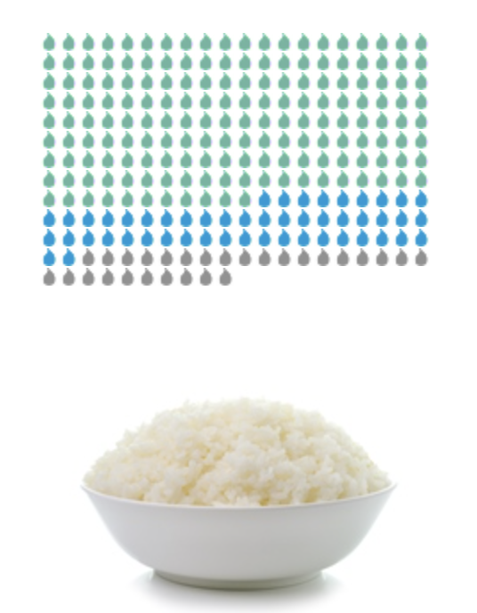
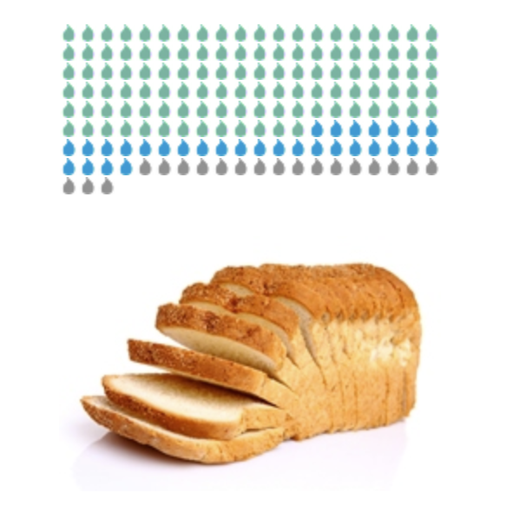
Model diagram
Part2: approach
Obey the quota policy?
Water allocation scheme
A.
Precipitation
B.
Surface water withdraw (cheap)
I need water!
Water demands
Groundwater withdraw (expensive)
C.
Irrigating water
Maize
Rice
Wheat
Based on crop water requirements, water allocation quotas, and over-extraction decisions, the actual irrigation water sources are divided into surface/groundwater.
By considering evapotranspiration and precipitation for three types of staple crops, the FAO56 single-coeffcient crop model estimates the net water demand.
According to the net water demand of crops, surface water quotas are allocated among agents within a specific administrative region.
Notes:
As I don’t have enough time to dive into the details. The core of this model is that agents estimate their water demands and then decide if breach the quota or not.

Slide 6
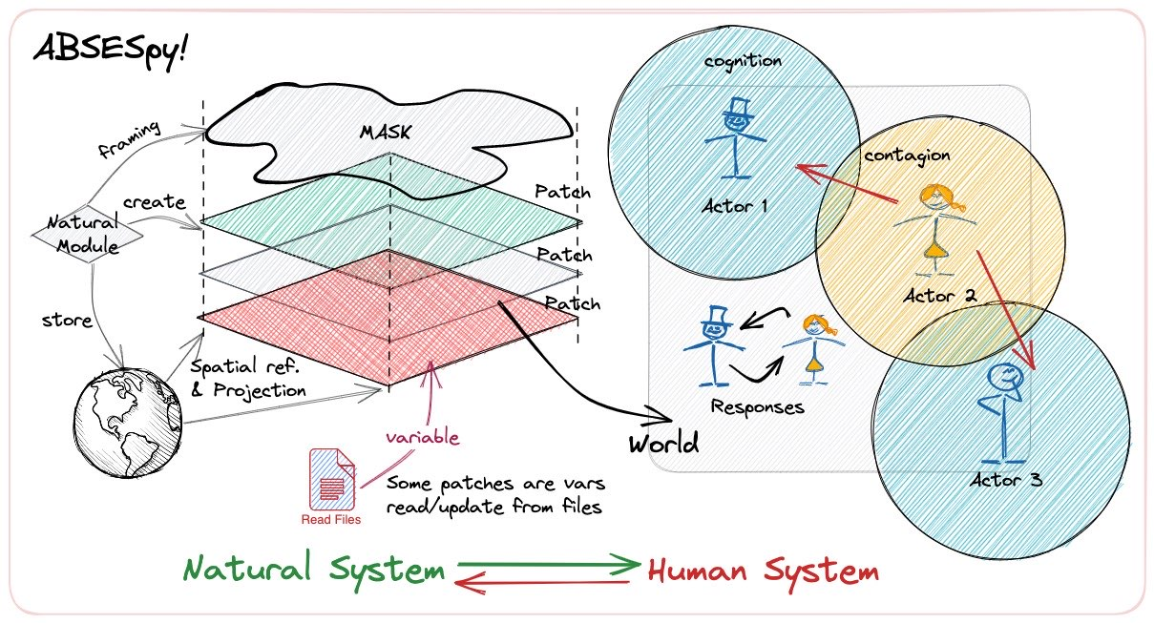
Modelling framework
Part2: approach
Agent-based social-ecological systems modelling framework for integrating modules.
GitHub: https://github.com/SongshGeo/ABSESpy
Document: https://songshgeo.github.io/ABSESpy/
Notes:
To complete this model, I developed some of its more general functions into an open-source Python package.

Slide 7
Modelling Process
Part2: approach
Update climate data
Random distribution
Update crops
Update agents attr
Randomly connecting
b/v decision
Update quota
Cooperate?
Agent (farmer) 1
< b1?
Update decision
Update scores
Social norm?
D
C
Evaluating mutually
<v2 ?
Agent (farmer)2
Precipitation
Grid_1 += 1
Group_2 += 1
Update cognition
No:
Yes
Surface water
Gain payoff
Update decisions
Max?
Over-quota water use
Contagion of decision
S_max?
No
Mutation?
Learning
Calculate water uses
Yes
Groundwater use
Mutation
Update randomly 5%
b1 = b_max
v1 = v_max
Notes:
Next, I used an agent-based model to analyze why the policy between 1987 and 1998 had such a stimulating effect on water use.
This model is quite complex, and we can discuss it in detail later if you are interested.

Slide 8
Main Results
Part3: Results
Between 1987 and 1998, the water usage of the 50% of agents with lower surface water extraction remained relatively stable, while the water usage of the 50% of entities with higher water extraction increased.
Institutional shift in 1987 stimulated water users to over-use water from the YR.
Notes:
Our model combines human behavior with a crop irrigation model, to demonstrate that agents overdraw surface water resources by widespread violation of quotas after the ‘water allocation scheme (as a response to the policy shock).
Few provinces over-withdraw groundwater after surface water quota is fully fixed after United Basin Regulation in 1998 (as another response to the policy shock).
I can do even more scenario experiments by using this model for simulating in the future…

Slide 9
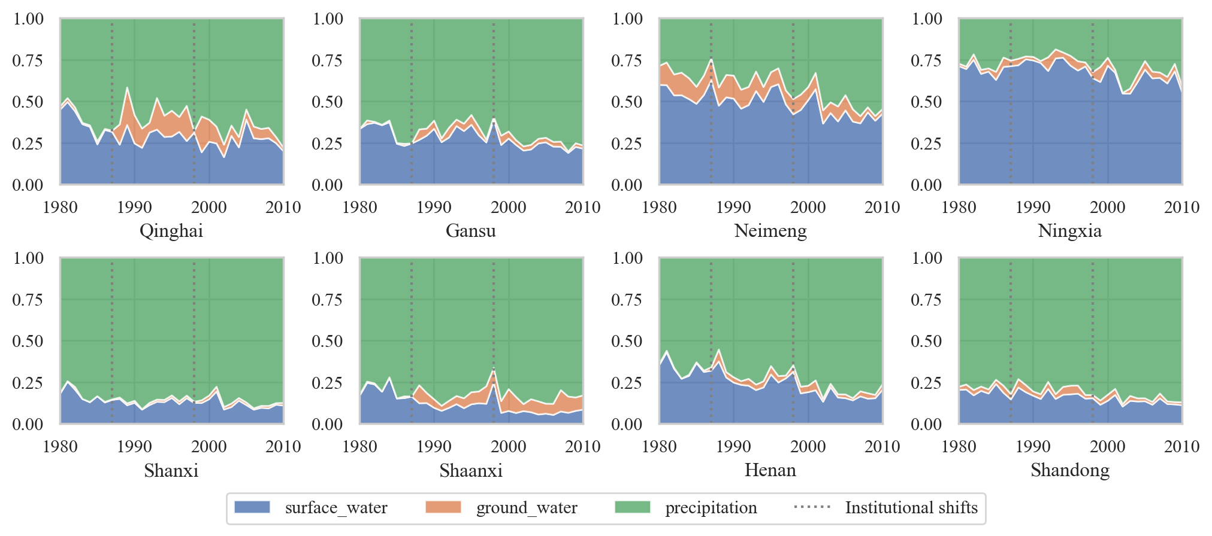
Main Results
Part3: Results
Institutional effect
Provinces maintain a continuous decline in the proportion of blue water use (surface & ground water). Policy impact on the blue/green water ratio is not significant. Only a few provinces have abrupt changes (e.g., Shaanxi).
Success of the compulsory quotas in 1998 was a result of the water-saving reforms.
Notes:
Our model combines human behavior with a crop irrigation model, to demonstrate that agents overdraw surface water resources by widespread violation of quotas after the ‘water allocation scheme (as a response to the policy shock).
Few provinces over-withdraw groundwater after surface water quota is fully fixed after United Basin Regulation in 1998 (as another response to the policy shock).
I can do even more scenario experiments by using this model for simulating in the future…

Slide 10
Summary
Part4: Summary
Drying-up Yellow River
Regulated Yellow River
The most severe drying-up
First drying-up
The last drying-up
Water Allocation Scheme (1987)
United Basin Regulation (1998)
Institutional shift in 1987 stimulated water users to over-use water from the YR.
Success of the compulsory quotas in 1998 was a result of the water-saving reforms.
Notes:
We have two take home messages based on our results:
(1) Institutional shift in 1987 stimulated water users to over-use water from the YR.
(2) Success of the compulsory quotas in 1998 was mainly because of the water-saving reforms.

Slide 11
Lecturer: Shuang Song
Ph. D. candidate in Geography

