Slide 1
Water-Energy-Food Nexus Analysis at Basin Level to Improve the Resources Availability and Accessibility Sources
Krishna Mondal
Agricultural & Food Engineering Department,
Indian Institute of Technology Kharagpur
krishnamondal160@gmail.com
(Co-Authors: Prof. Chandranath Chatterjee, Prof. Rajendra Singh)

Slide 2
OUTLINE
Introduction
Objectives
Methodology
Study area
Modelling Framework
Data
Results
Conclusions
References
Outline

Slide 3
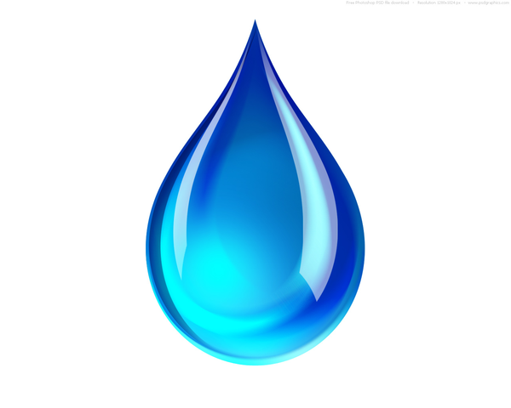
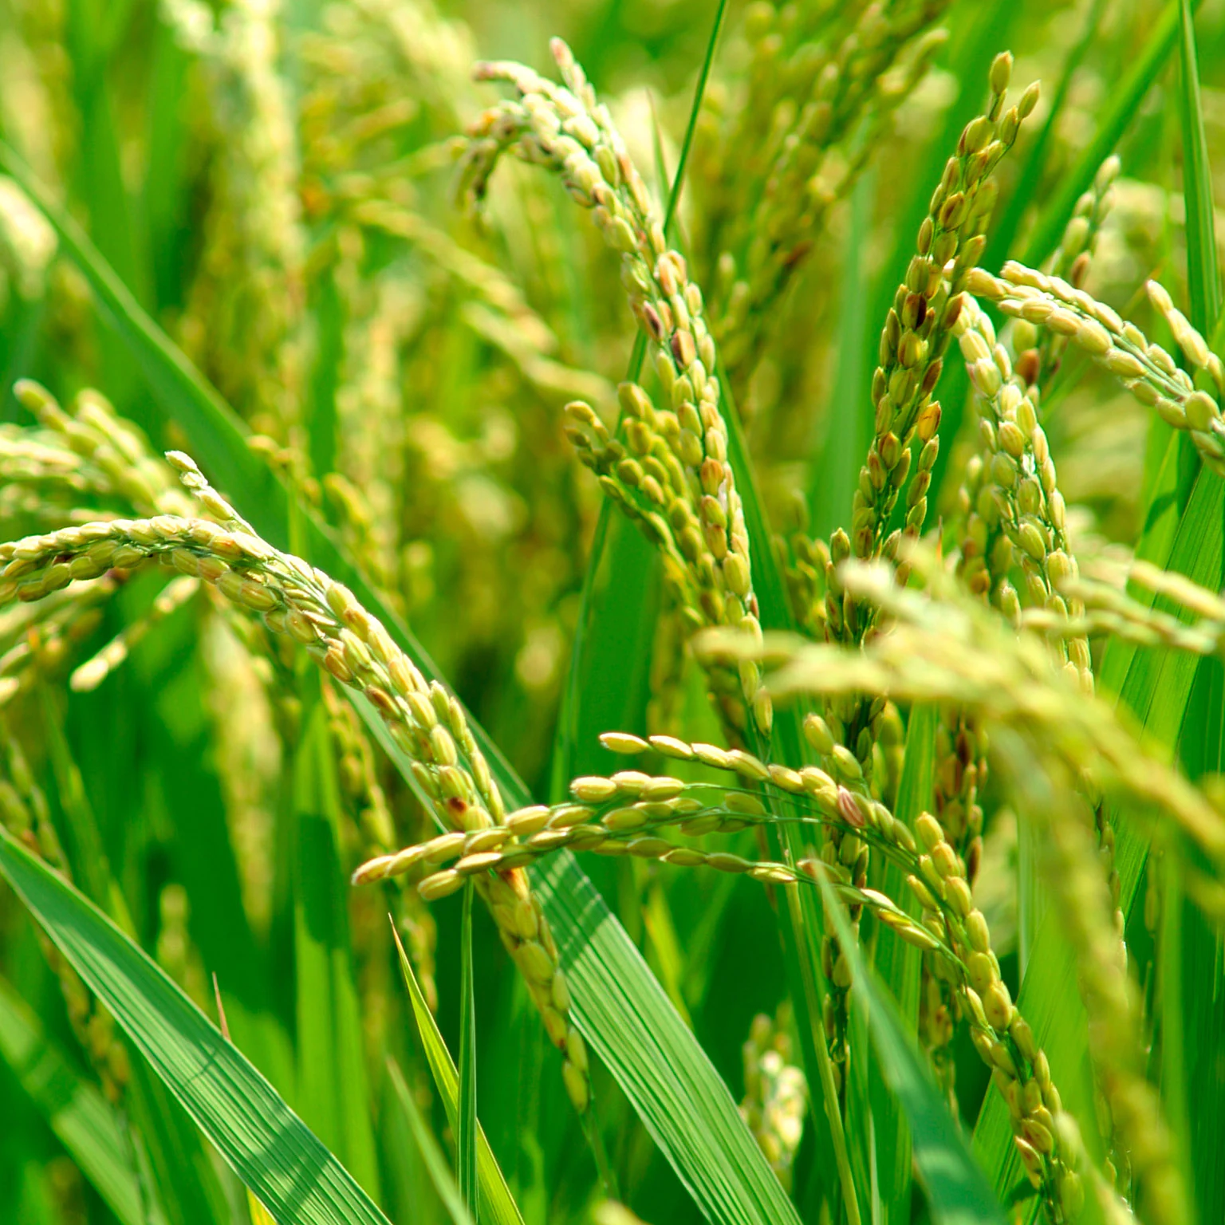
Water Energy Food-Nexus
Water
Pumping
Hydro Energy
Thermal Energy
Irrigation
Virtual Water
Water Quality
Background
Interconnection
WEF-Nexus
Cooking
Food Processing
Bioenergy
Energy
Food

Slide 4
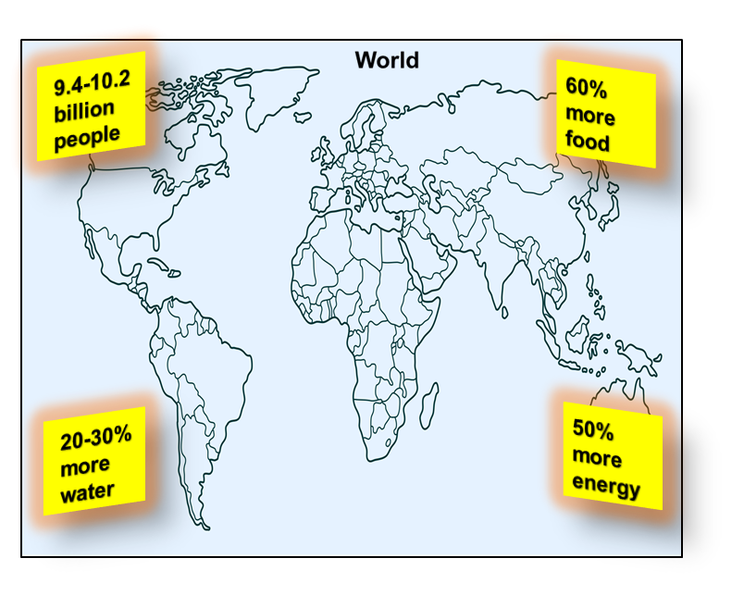
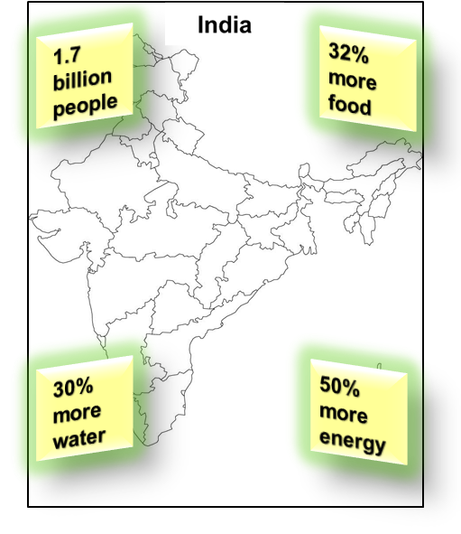
Current & Future Challenges
Population Growth
2050 Challenges
Unmet Demand (India)
91 million people have no access to basic water supply
Background
Changes in Consumption Pattern
Increasing Demand
13% household have no access to electricity
189.2 million people are undernourished
Economic Development

Slide 5
Current & Future Challenges
Need for
a
SYSTEMETIC WEF-NEXUS APPROACH
Background

Slide 6
WEF Nexus Tools/Models
46 WEF Nexus Tools/Models
Developed between 2009-2021
61% Unreachable to the intended users
70% Lack key capabilities like GIS integration and scale transferability
Only 28% have been applied by multiple-users
Motivation

Slide 7
WEF Nexus Tools/Models
Scope to develop a Robust WEF-NexusTool
Multi-Scale Flexibility/Transferability
GIS Interface
Adaptability across Users and Uses
Motivation
Objectives
To develop a distributed water-energy-food nexus model for analysing WEF security at the basin (or any chosen) scale
To test the performance of the developed model in the Kangsabati river basin, India

Slide 8
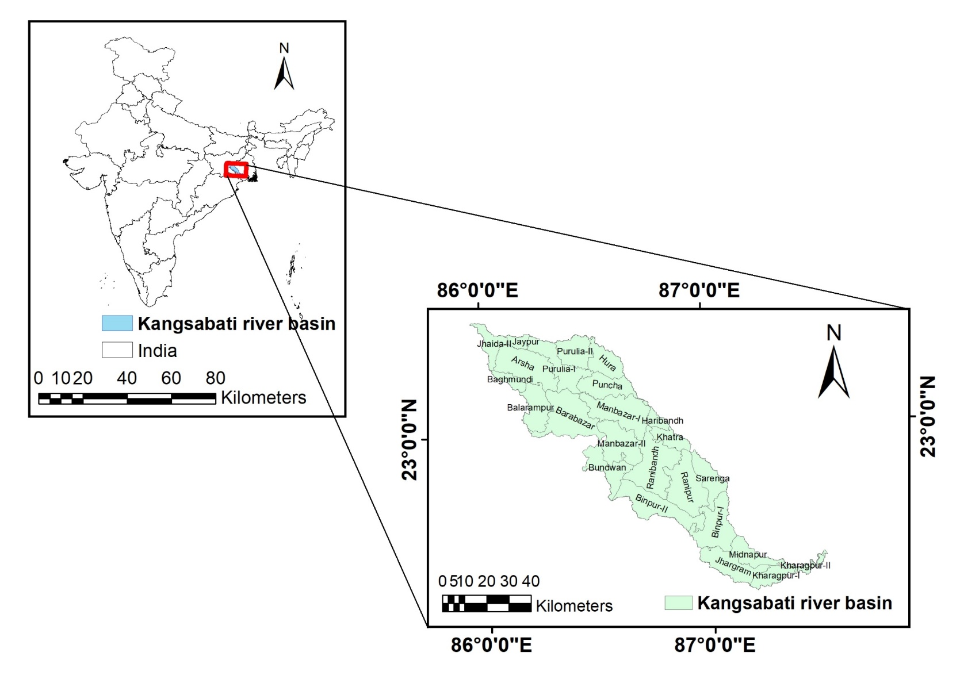
Study area
Location:
87°32´ E and 85°57´ E;
22°18´ N and 23°28´ N
Area: 5796 km²
Annual mean rainfall: 1400mm
Min temperature: 13.5ºC
Max temperature: 43.2ºC
Districts: 4 (Purulia, Bankura, West Midnapore, Jhargram)
Blocks (micro administrative units): 24
Cities/Towns: Purulia, Mukutmanipur, Raipur, Midnapore, Kharagpur
Methodology

Slide 9
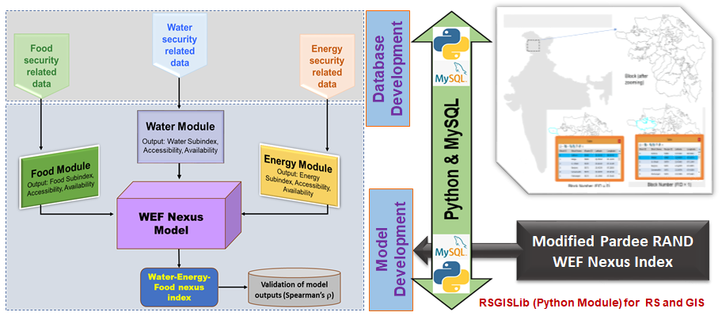
Model Framework
Methodology

Slide 10
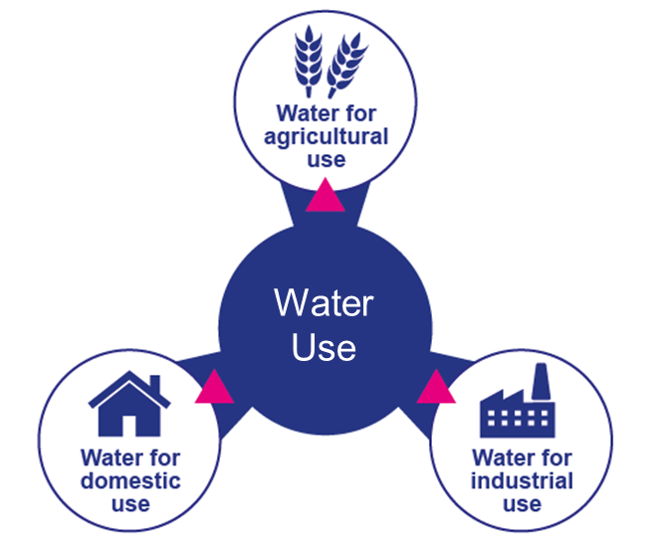
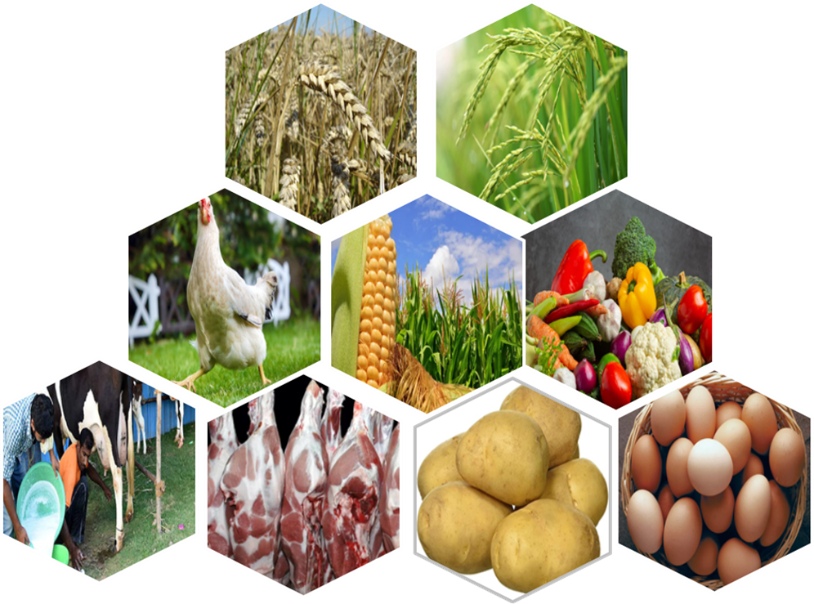
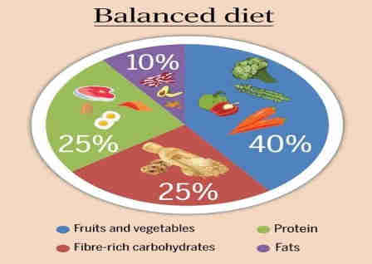
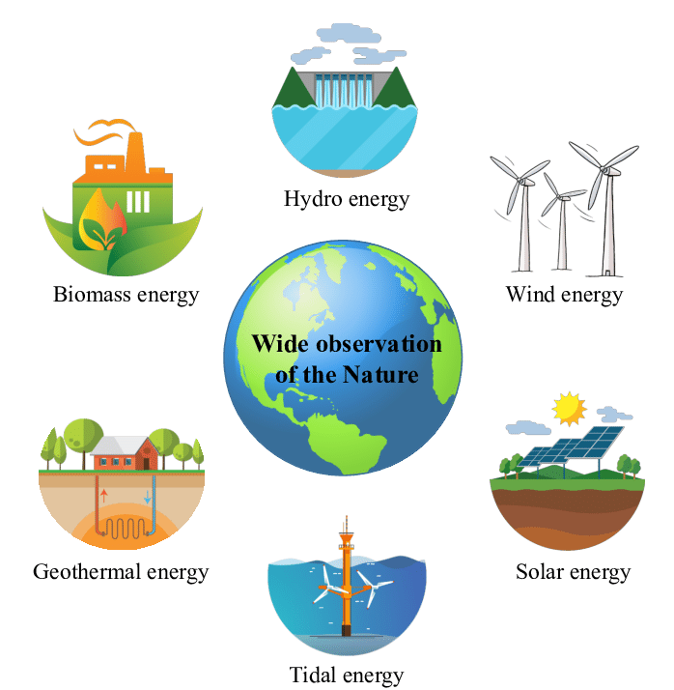
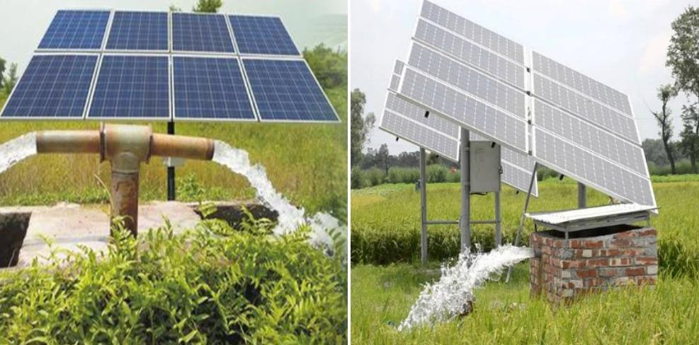
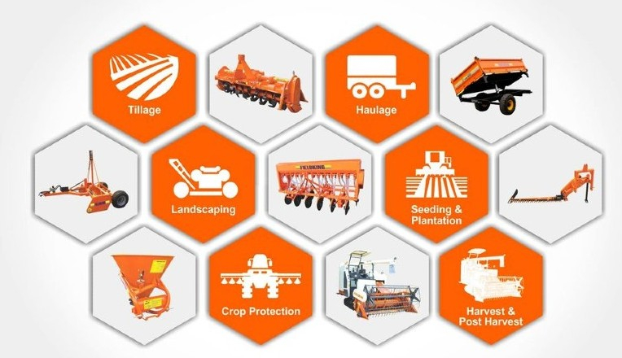
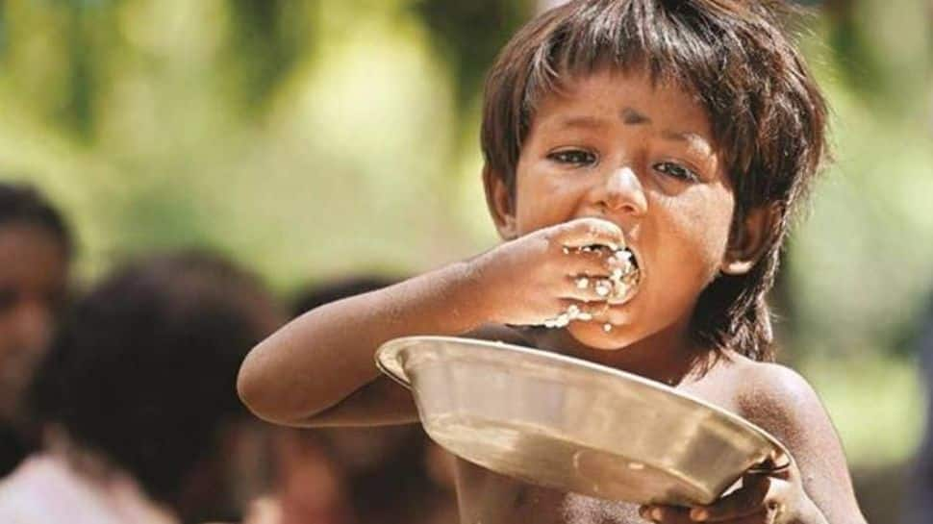
Modifications in Pardee RAND approach
Willis et al., 2016
Model Development
Methodology
Water balance equation to calculate total water availability
Sector-wise water requirement and use
Major types of food production
Dietary requirement for different age groups
Renewal energy sources
Solar lift irrigation
Farmers having access to modern farm equipment
Hunger Index

Slide 11
Modifications in Pardee RAND approach
Model Development
Sector | Security Indicators | Equation | Variable definition (unit)
Water | Water Availability ($WAv$) | ($WAv$) = $\frac{wavi}{wreq}$ = $\frac{A (P−ETF∗P)}{\begin{aligned}{WR}_{d}+{WR}_{cp}+{WR}_{ch}+{WR}_{m}+{WR}_{ml} \\ +{WR}_{e}\end{aligned}}$ ETF = ET/P, ET is calculated using the Hargreaves equation | $wavi$: water available (m³) $wreq$: water requirement (m³) A: geographical area (ha) P: precipitation (mm) ETF: evapotranspiration factor ${WR}_{d},{WR}_{cp},{WR}_{ch},{WR}_{m},{WR}_{ml},{WR}_{e}$: water required for domestic purposes, crop production, chicken, meat production, milk production, egg production, respectively (m³)
 | Water Accessibility ($WAc$) | $$WAc=\sqrt[2]{\text{PDS}∗{FSW}_{I}}$$ | PDS: % population having access to sufficient water for drinking and sanitation FSW_{I}: % farmer having access to sufficient water for irrigation
 | Water Sub-index (WSI) | $WSI$ = $\sqrt[2]{WAv ∗ WAc}$ | $WAv$: water availability (ratio) $WAc$: water accessibility (ratio)
Energy | Energy Availability ($EAv$) | $\frac{Eavi}{Ereq}$ = $\frac{\text{TES}\text{ + 0.28 (}\text{ME}\text{ + }\text{HLE}\text{)}}{{ER}_{d}+{ER}_{cp}+{ER}_{ch}+{ER}_{m}+{ER}_{ml}+{ER}_{e}}$ TES = TE+SE+HE+WE | $Eavi$: energy available (kwh) $Ereq:$ energy requirement (kwh) TES: total electricity supply (kwh) TE, SE, HE, WE: thermal, solar, hydropower, wind energy, respectively (kwh) ME: machinery energy (MJ) HLE: human labour energy (MJ) ${ER}_{d},{ER}_{cp},{ER}_{ch},{ER}_{m},{ER}_{ml},{ER}_{e}$: energy required for domestic purpose, crop production, chicken production, meat production, milk production, egg production, respectively (kwh)
Methodology
Introduction

Slide 12
Modifications in Pardee RAND approach
Model Development
Sector | Security Indicators | Equation | Variable definition (unit)
Energy | Energy Accessibility ($EAc$) | $$EAc=\sqrt[4]{P_{e}{+H}_{mf}{+F}_{fe}{+F}_{sei}}$$ | P_{e}: % population having access to electricity for household H_{mf}: % household having access to modern fuel F_{fe}: % farmers having access to modern farm equipment F_{sei}: % farmer having access to sufficient electricity for irrigation
 | Energy Sub-index (ESI) | $$ESI=\sqrt[2]{EAv∗EAc}$$ | $EAv$: energy availability (ratio) $EAc$: energy accessibility (ratio)
Food | Food Availability ($FAv$) | $\frac{Favi}{Freq}$ = $\frac{C_{p}{+F}_{p}{+M}_{p}{+Ml}_{p}{+E}_{p}}{\sum_{i}{{DR}_{i}∗{Pop}_{i}}}$ | $Favi$: food availability (ton) $Freq$: food requirement (ton) C_{p}, F_{p}, M_{p}, Ml_{p}, E_{p}: crop production, fish production, meat production, egg production, respectively (ton) DR: dietary requirement (kg/year) Pop: population i: different age group
 | Food Accessibility ($FAc$) | $$FAc=\sqrt[2]{\text{(1/}\text{FPLI}\text{)}∗\text{(1−}\text{HI}\text{)}}$$ | FPLI: Food price level index (ratio) HI: Hunger index (ratio)
 | Food Sub-index ($FSI$) | $$FSI=\sqrt[2]{FAv ∗ FAc}$$ | $FAv$: food availability (ratio) $FAc$: food accessibility (ratio)
WEF | Water-Energy-Food Nexus Index | WEFNI = $\sqrt[3]{WSI∗ESI∗FSI}$ | WSI: Water Sub-index ESI: Energy Sub-index FSI: Food Sub-index
Methodology
Introduction

Slide 13
Data
Data used for WEF Nexus model simulation (2011)
Data sets | Data information | Sources
Energy Security | Population having access to electricity connection in their house Total number of households; Households that have LPG connection Total electricity supply (thermal, solar, bio and hydro) (kwh) Number of solar and lift irrigation pumps, number of tractors, agriculture worker Energy requirement for per unit crop, chicken or meat, egg, milk, electricity production (kwh/ton) | West Bengal (WB) Census report 2011; Government of WB 2011
Food Security | Agriculture area, aquaculture area (ha) Total number of farmers, number of farmers having access to modern farm equipment Number of farmers who benefited per solar and lift irrigation pump Cropping intensity, crop productivity (ton/ha) of different crops (paddy, wheat, maize, potato) Dietary requirement/per capita of different age groups (kg/year) Total meat, egg, and milk production (ton/year) Fish production per unit aquaculture area (kg/ha) Number of the population under different age groups Hunger index, food price level index | Government of WB 2011b, WB Census report 2011, Global Hunger Index 2011, CEIC India data
Water Security | Crop water productivity (kg/m³) of different crops (paddy, wheat, maize, potato) Water requirement/capita for domestic purposes (lit/day) Water requirement for per unit production of chicken or meat, egg, milk, electricity (m³/ton) Population having access to sufficient water for domestic purposes Annual groundwater storage and draft (m³) Geographical area (ha), rainfall and evapotranspiration (mm) | WHO 2003, Government of WB 2011c, WB Census report 2011, India WRIS, NABARD 2018, CAG, 2020
Methodology

Slide 14
GUI of Developed WEF Nexus model
Results
(a) Start Window

Slide 15
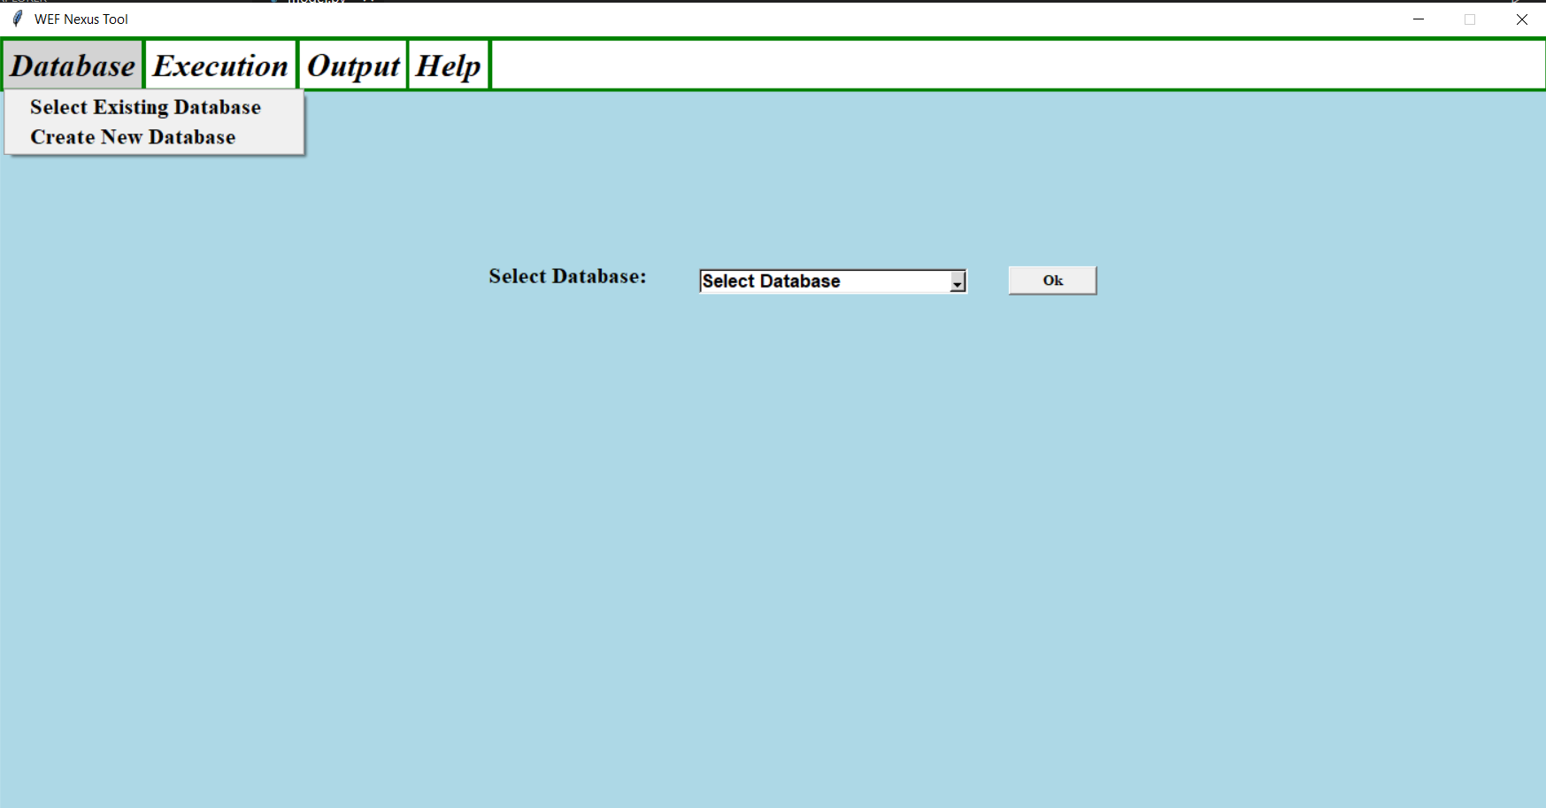
GUI of Developed WEF Nexus model
Results
(b) Database Window

Slide 16
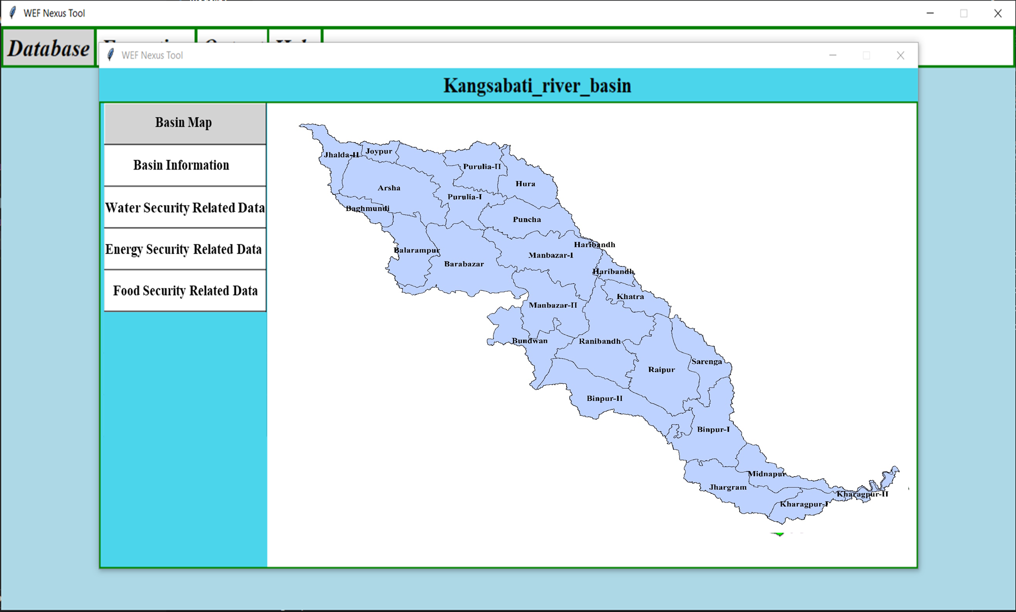
GUI of Developed WEF Nexus model
Results
(c) Existing Database

Slide 17
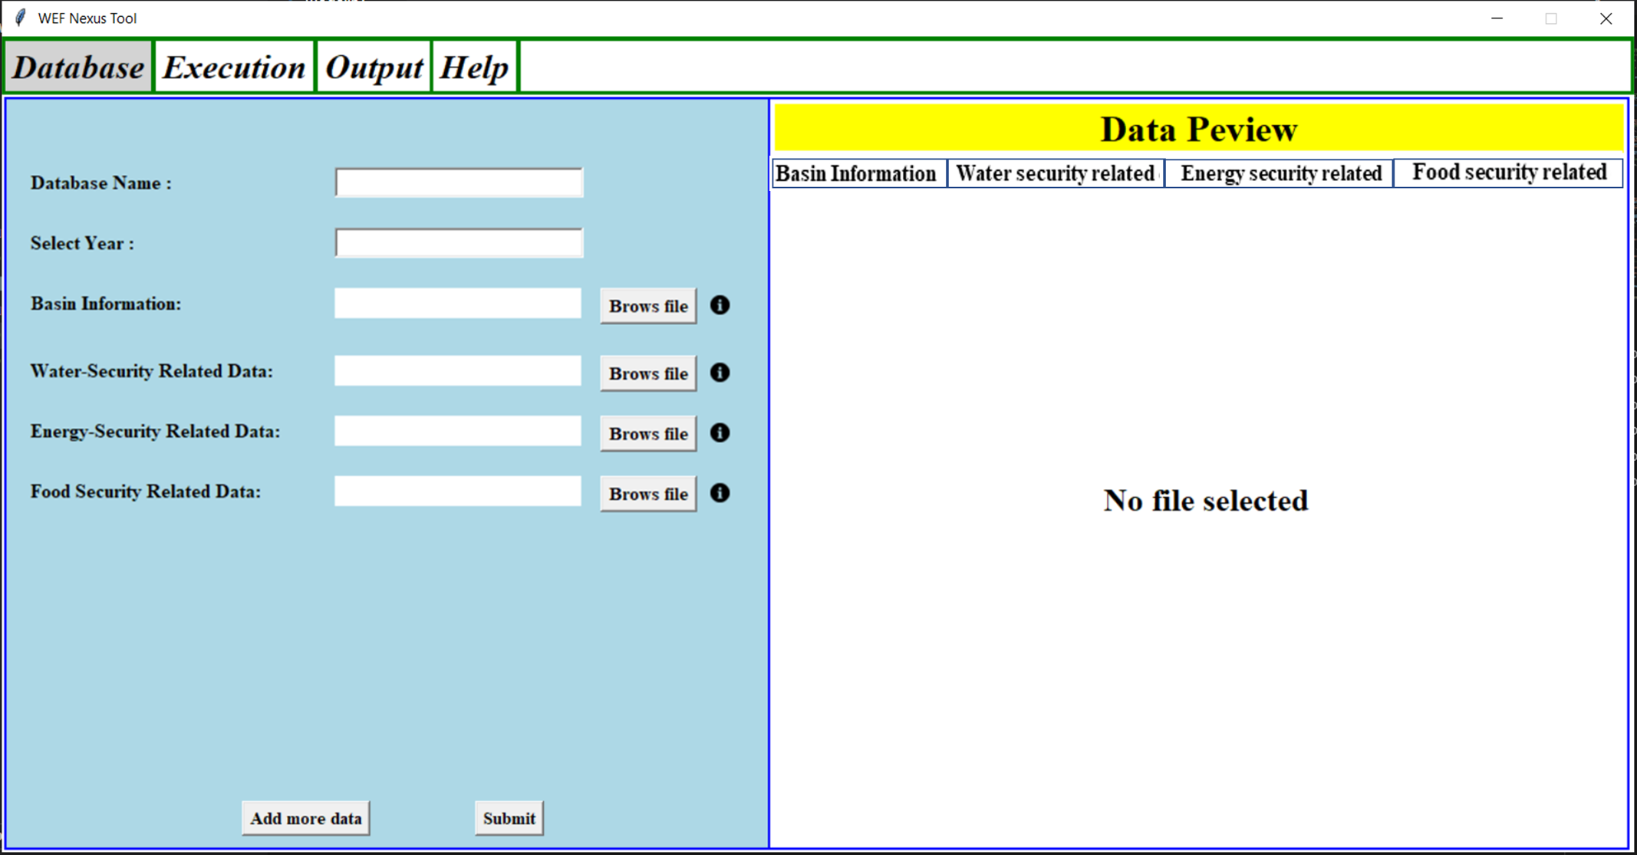
GUI of Developed WEF Nexus model
Data Preview
Results
(d) Create new database

Slide 18
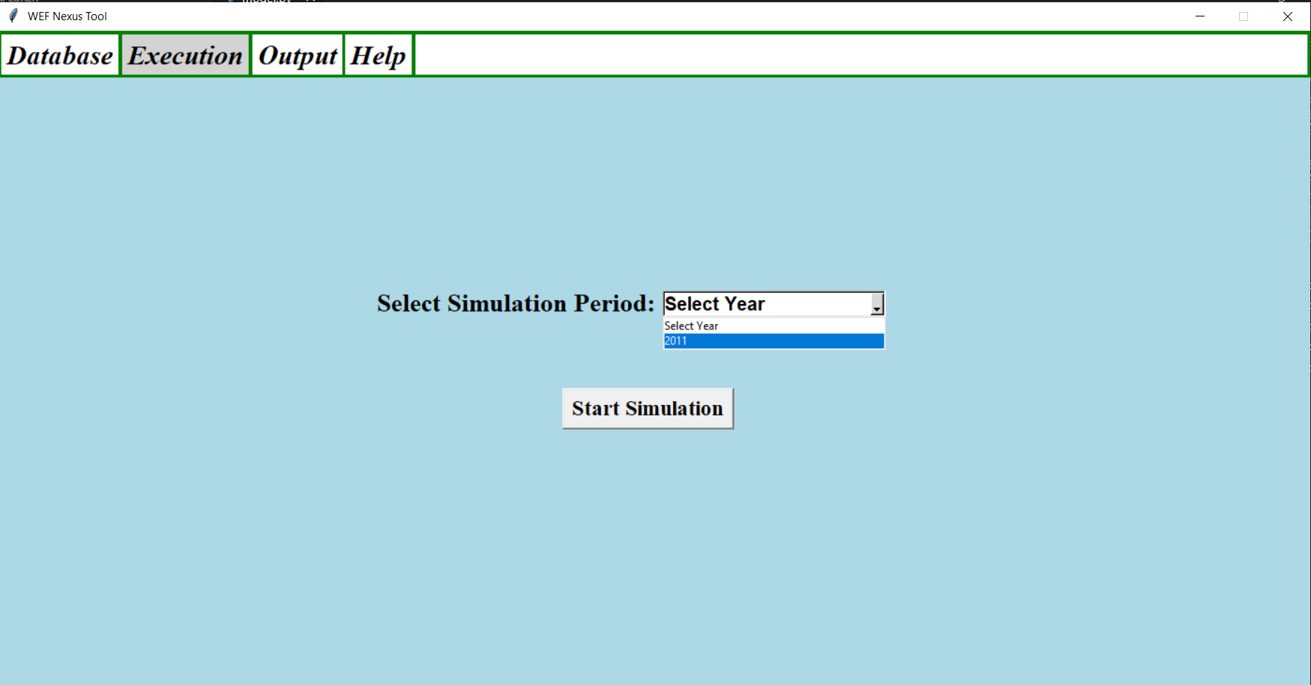
GUI of Developed WEF Nexus model
Results
(e) Execution Window

Slide 19
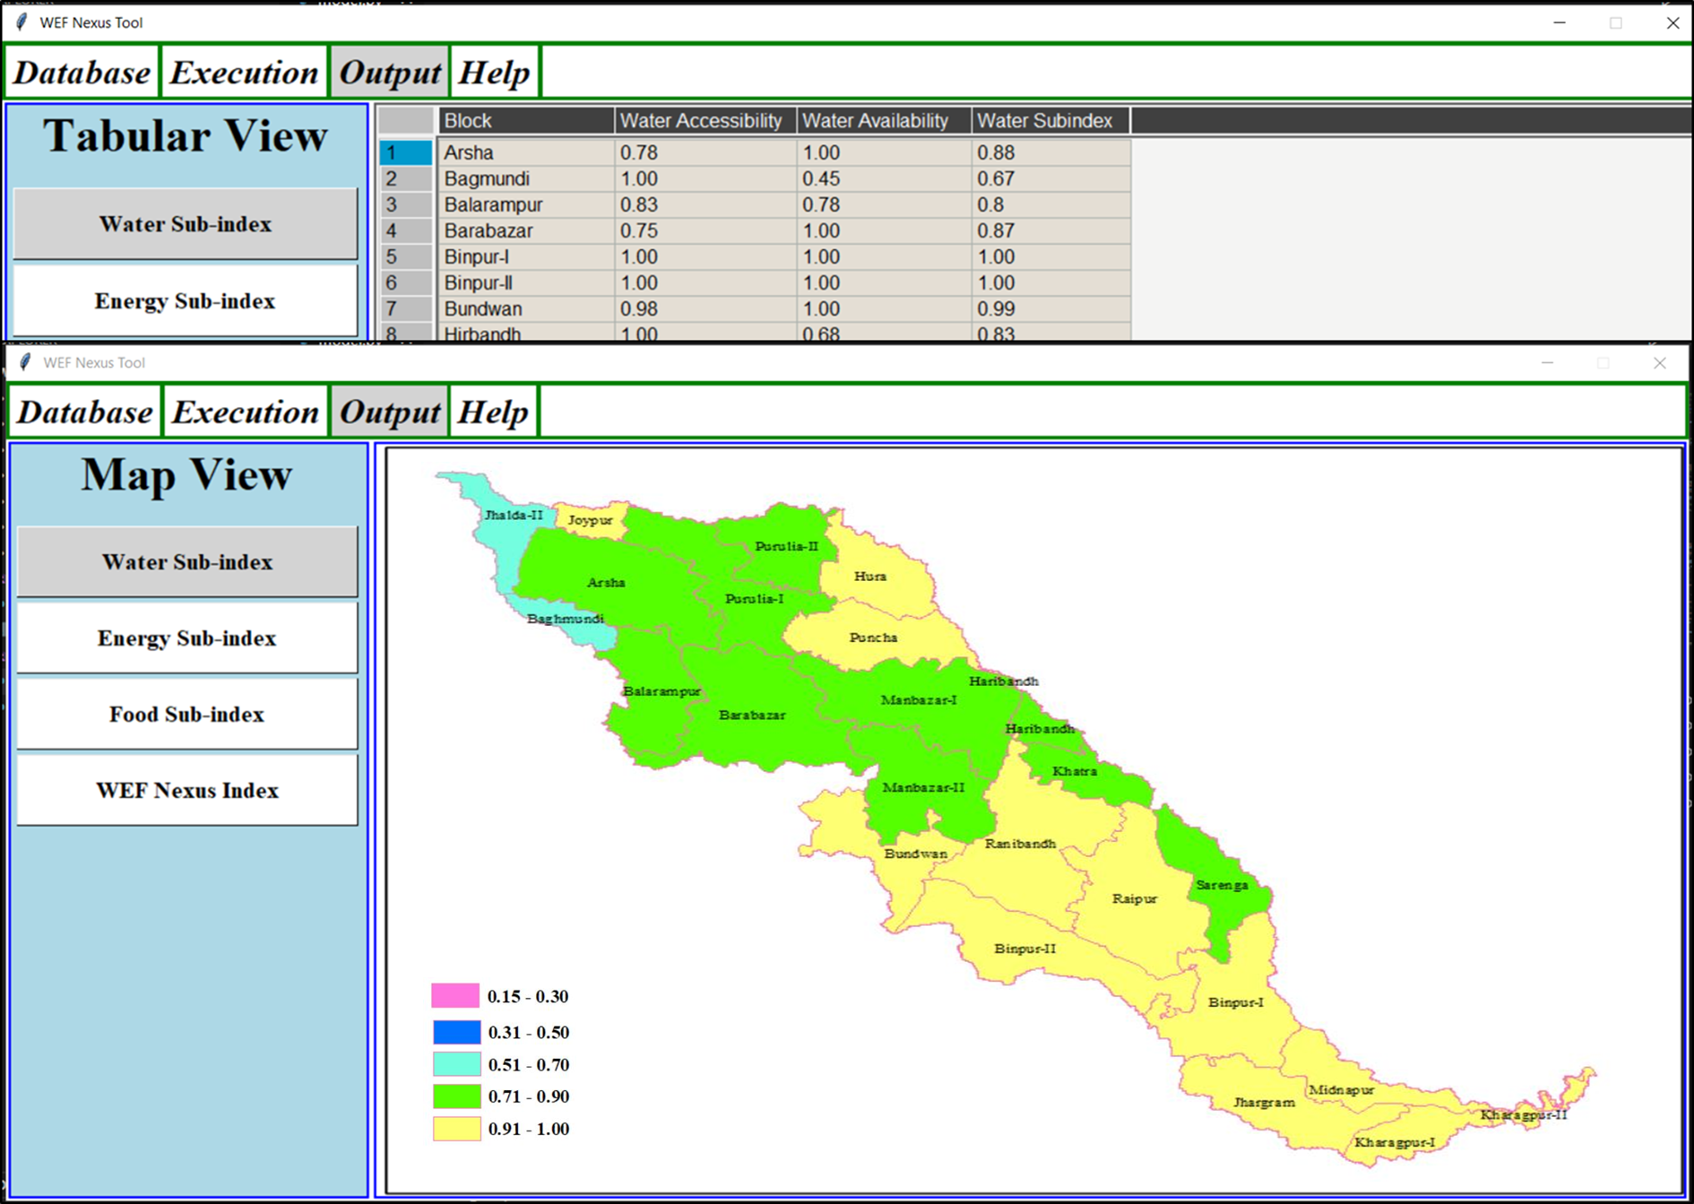
GUI of Developed WEF Nexus model
Results
(f) Output Window

Slide 20
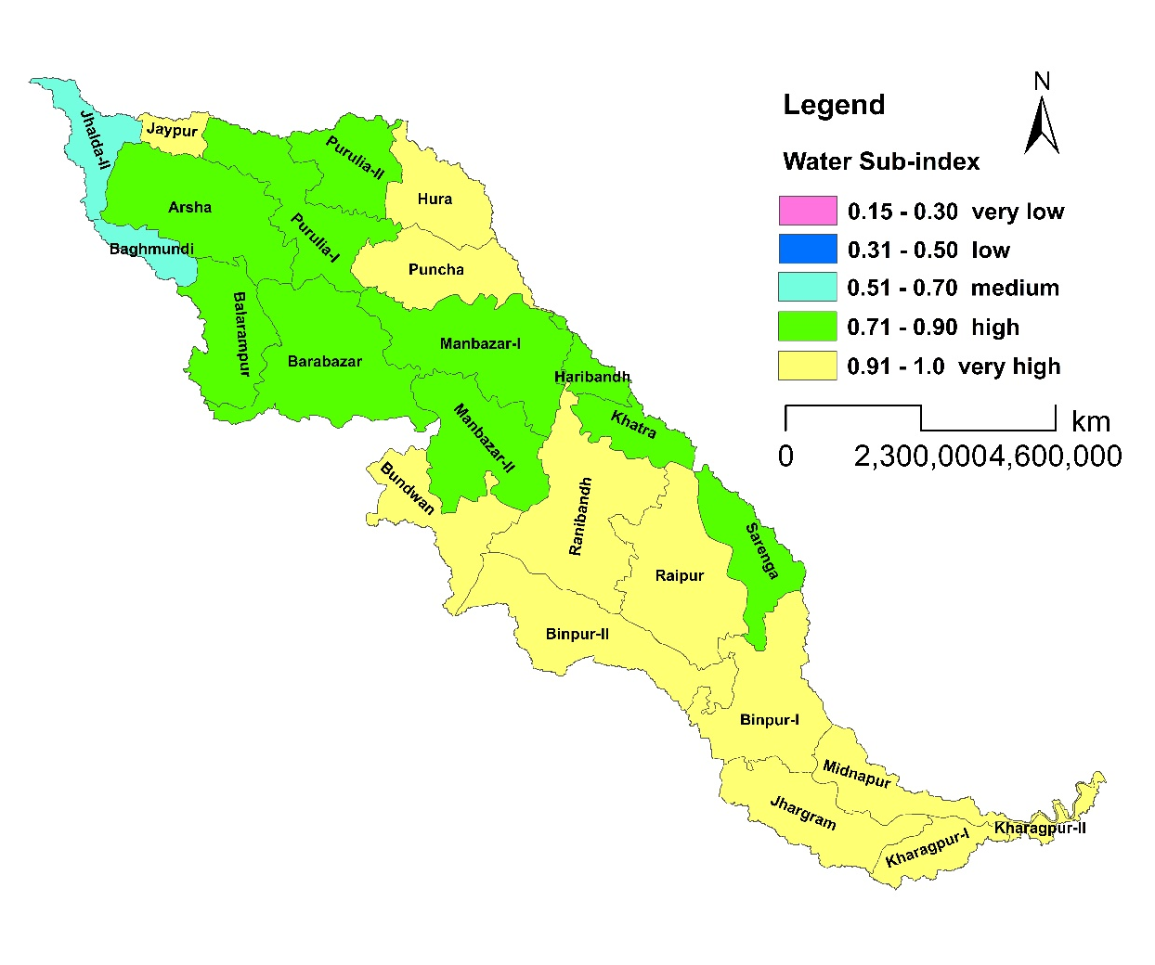
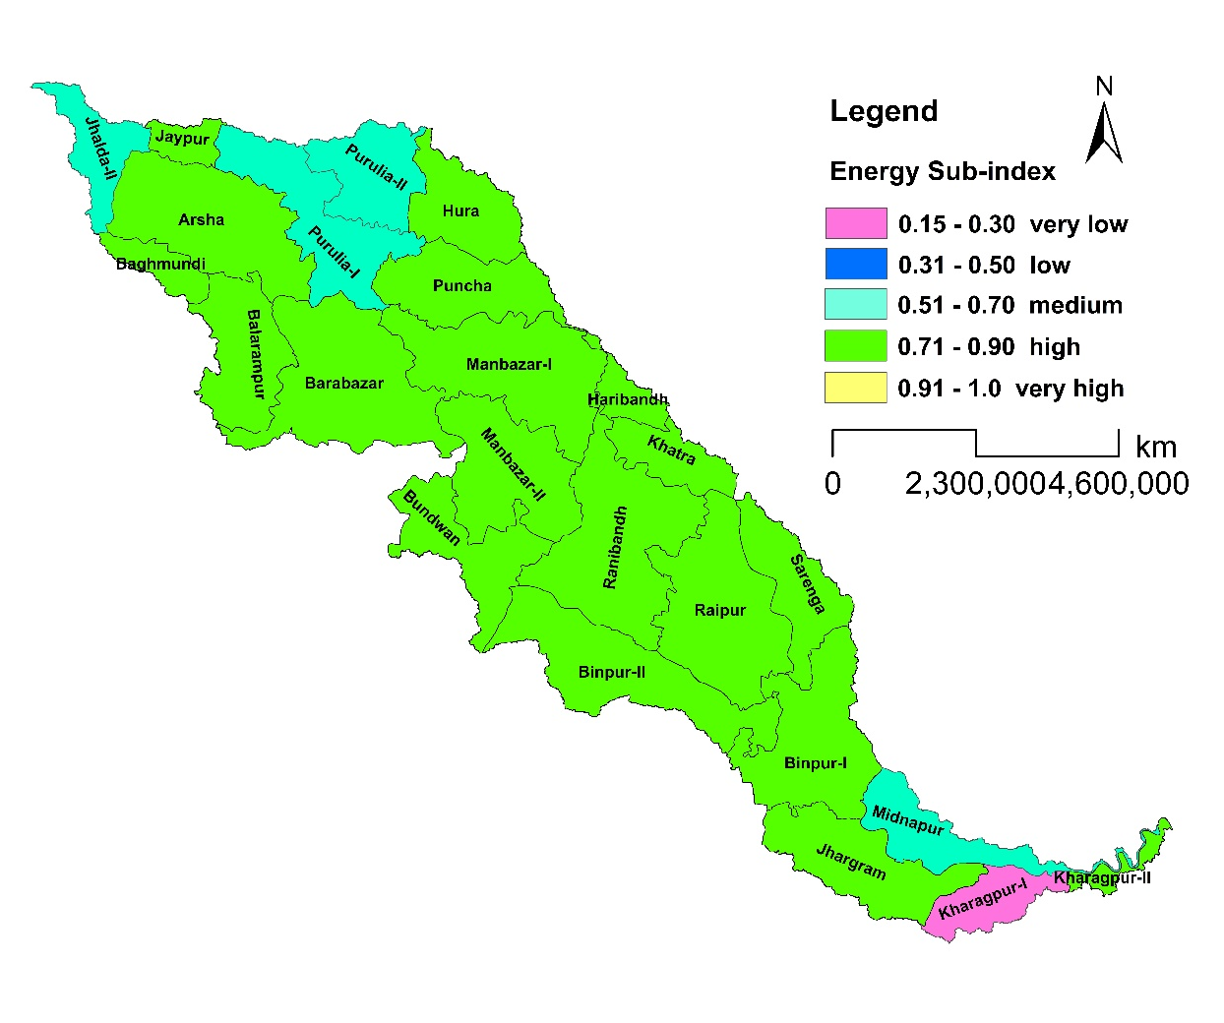
WEF Nexus Indices in Kangsabati River Basin
Results
Water Sub-index varies from medium to very high
92% blocks have a high to very high WSI
Energy sub-index varies from very low to high
79% blocks have a high ESI

Slide 21
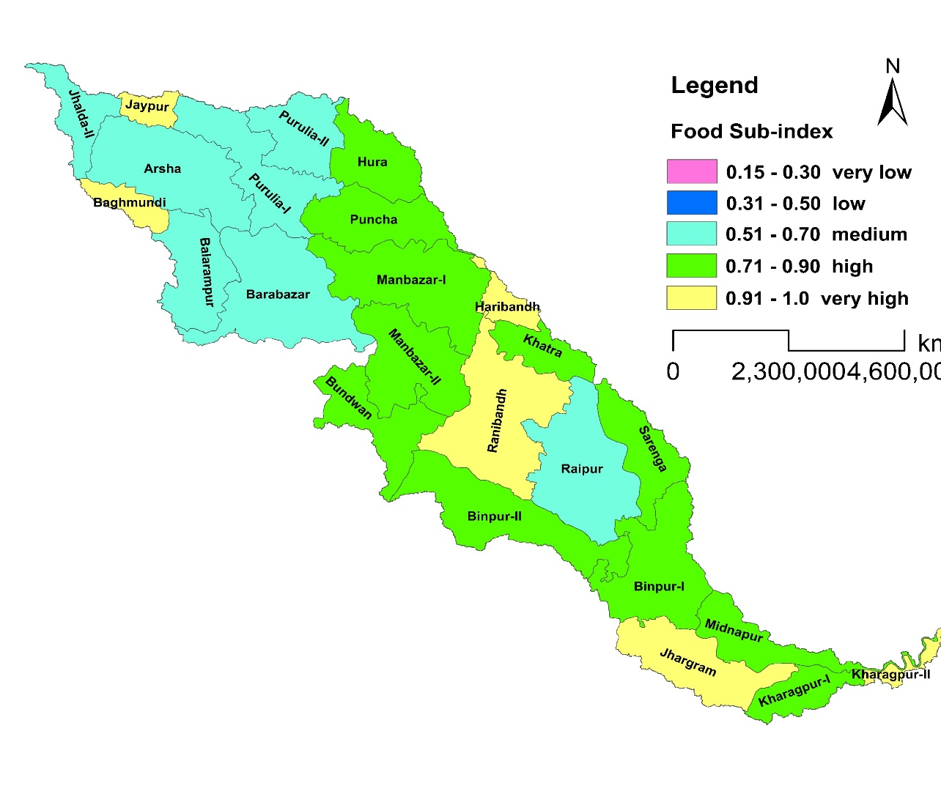
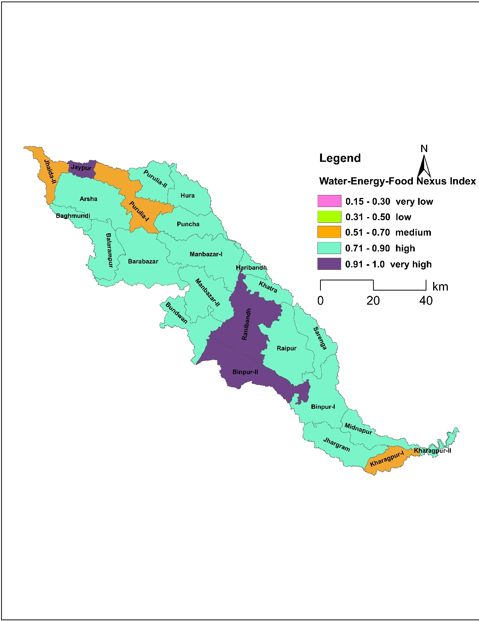
WEF Nexus Indices in Kangsabati River Basin
Results
Food Sub-index also varies from medium to very high
70% blocks have a high to very high FSI
75% blocks have a high to very high WEFNI
Since all blocks have water, energy and food sub-indices greater than 0.50, it shows that the blocks are on the path to achieving WEF security

Slide 22
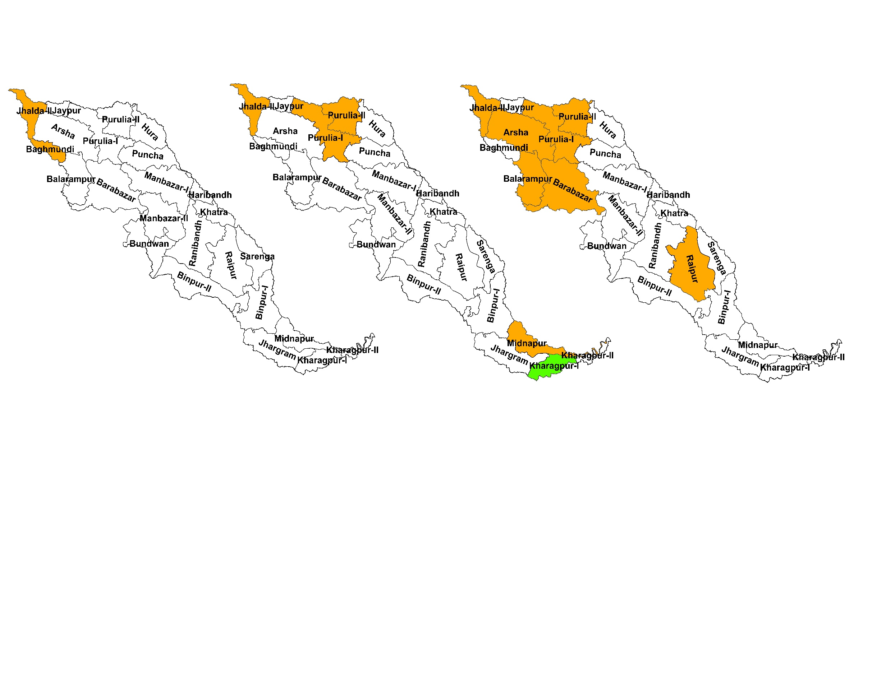
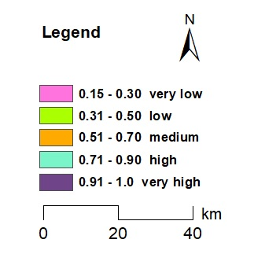
Policy Intervention Needs
Water
Sub-index
Energy
Sub-index
Food
Sub-index
Results
Water-Energy-Food
Energy-Food
Energy
Food

Slide 23
Conclusions
The developed model analyses water, energy and food security by generating WEF sub-indices and nexus index
The water, energy and food sub-indices, and WEF nexus index show that the Kangsabati basin is on the path to achieve WEF security
Basin-scale WEF management will ensure better management of WEF resources holistically and equitably
Future work involves developing a policy analysis module to analyse the impact of policy changes on the WEF sufficiency in a basin
Conclusions

Slide 24
References
Taguta, C., Senzanje, A., Kiala, Z., Malota, M. and Mabhaudhi, T. (2022) Water-energy-food nexus tools in theory and practice: a systematic review. Frontiers in Water, 1-4.
Willis, H.H., Geoves, D.G., Ringel, J.S., Mao, Z., Efron, S. and Abbott, M. (2016) Developing the Pardee RAND food-energy-water security index. pp 72, RAND Corporation, Santa Monica, Calif. https://doi.org/10.7249/TL165.
References

Slide 25
Contact Details
Krishna Mondal
Research scholar
Agricultural and Food Engineering department
IIT Kharagpur, India
Email: krishnamondal160@gmail.com
Whatsapp No: +91-9093724146
Contact Details

