Slide 1
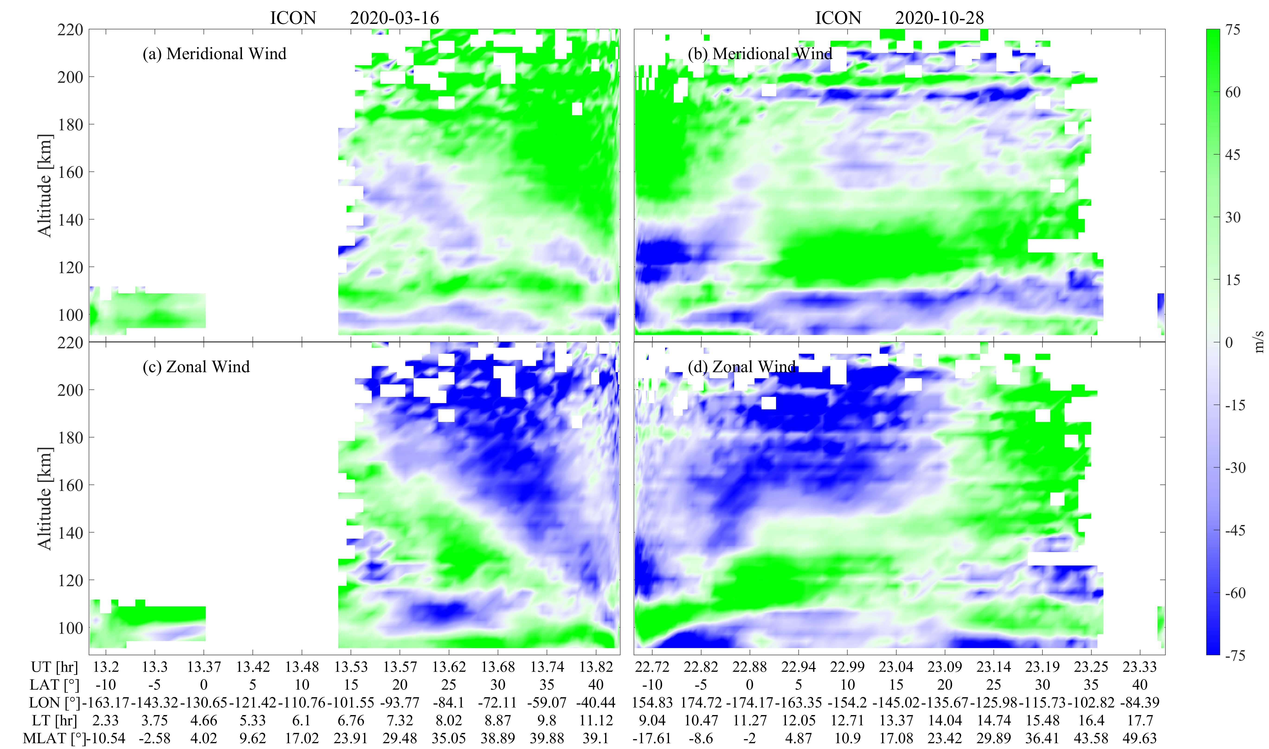
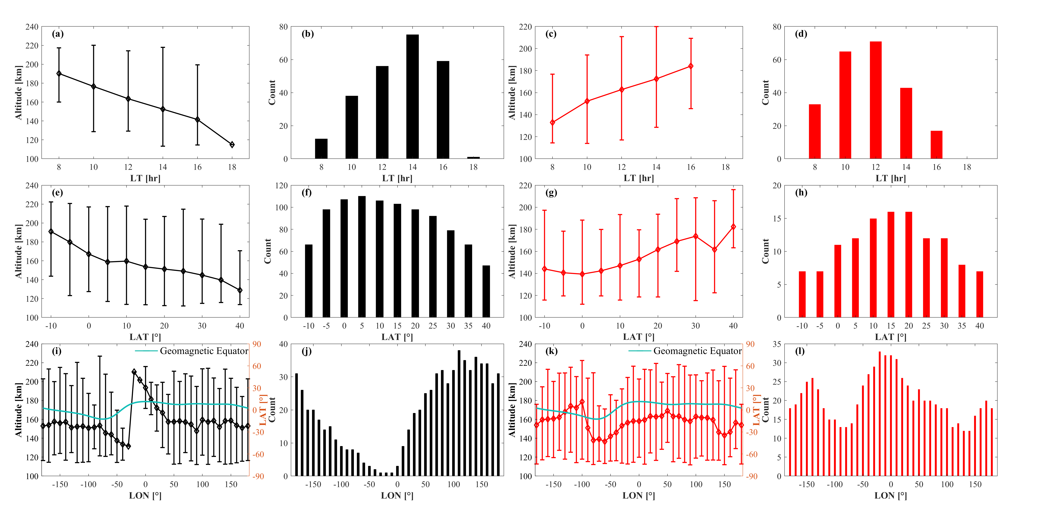
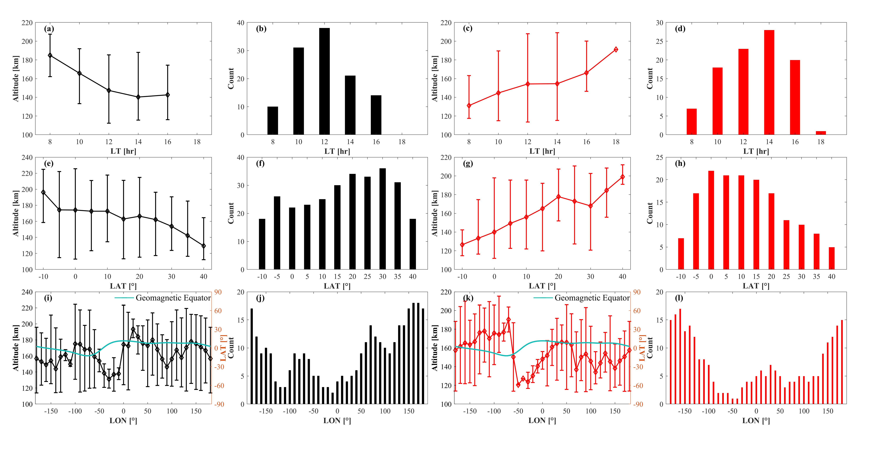
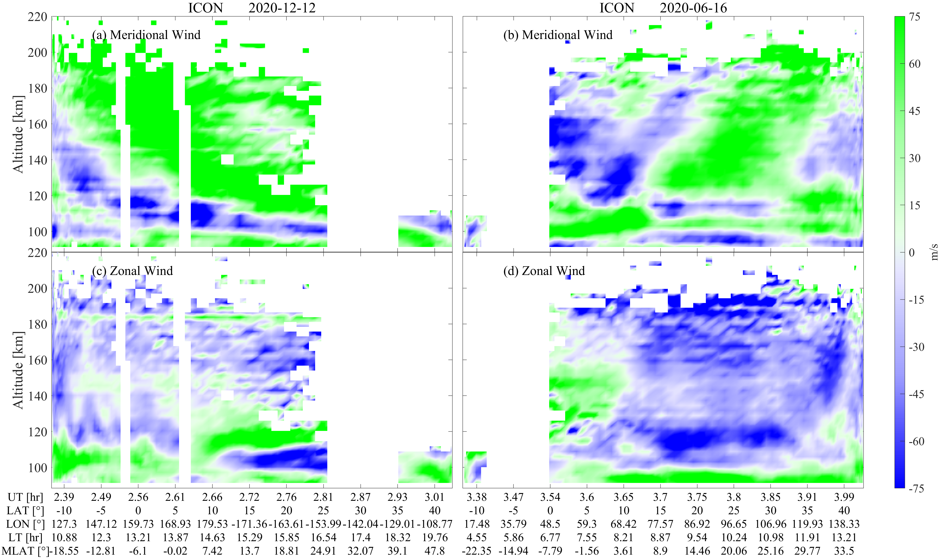
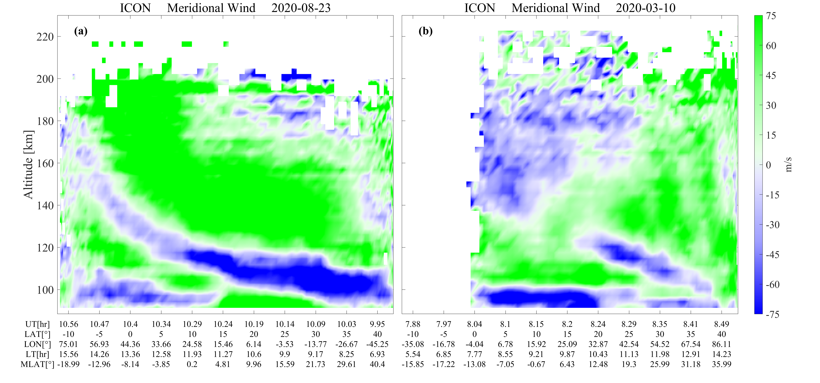
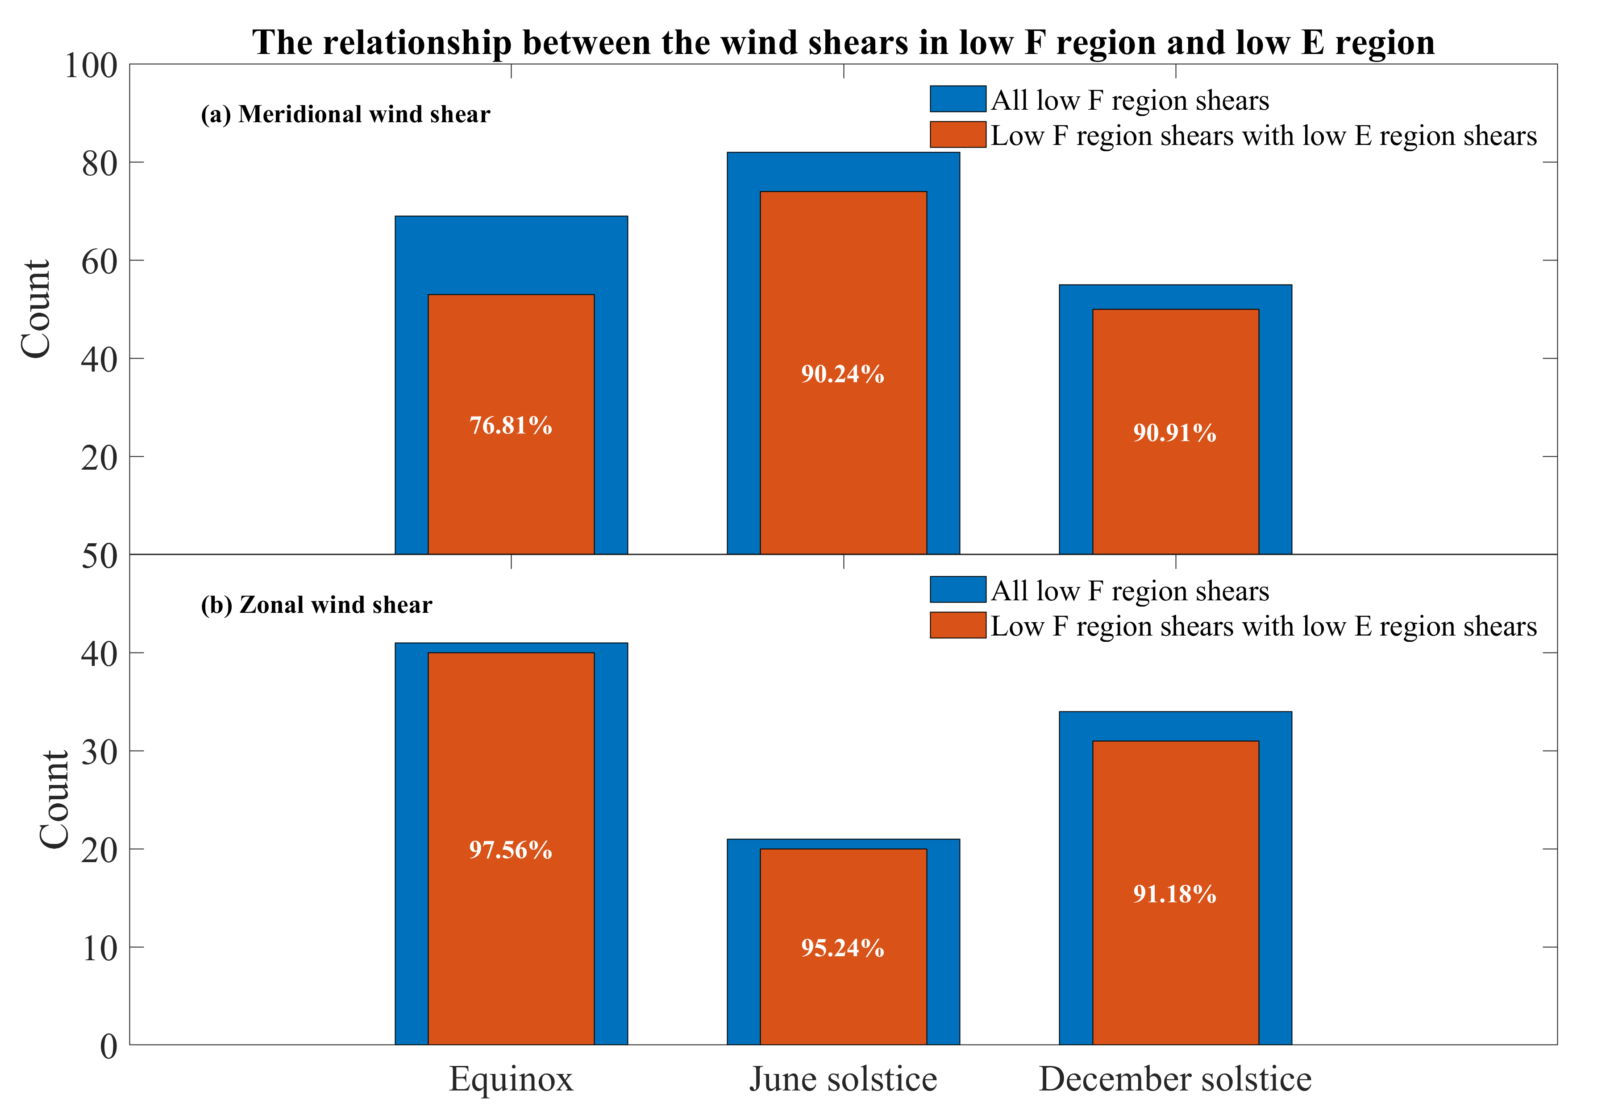
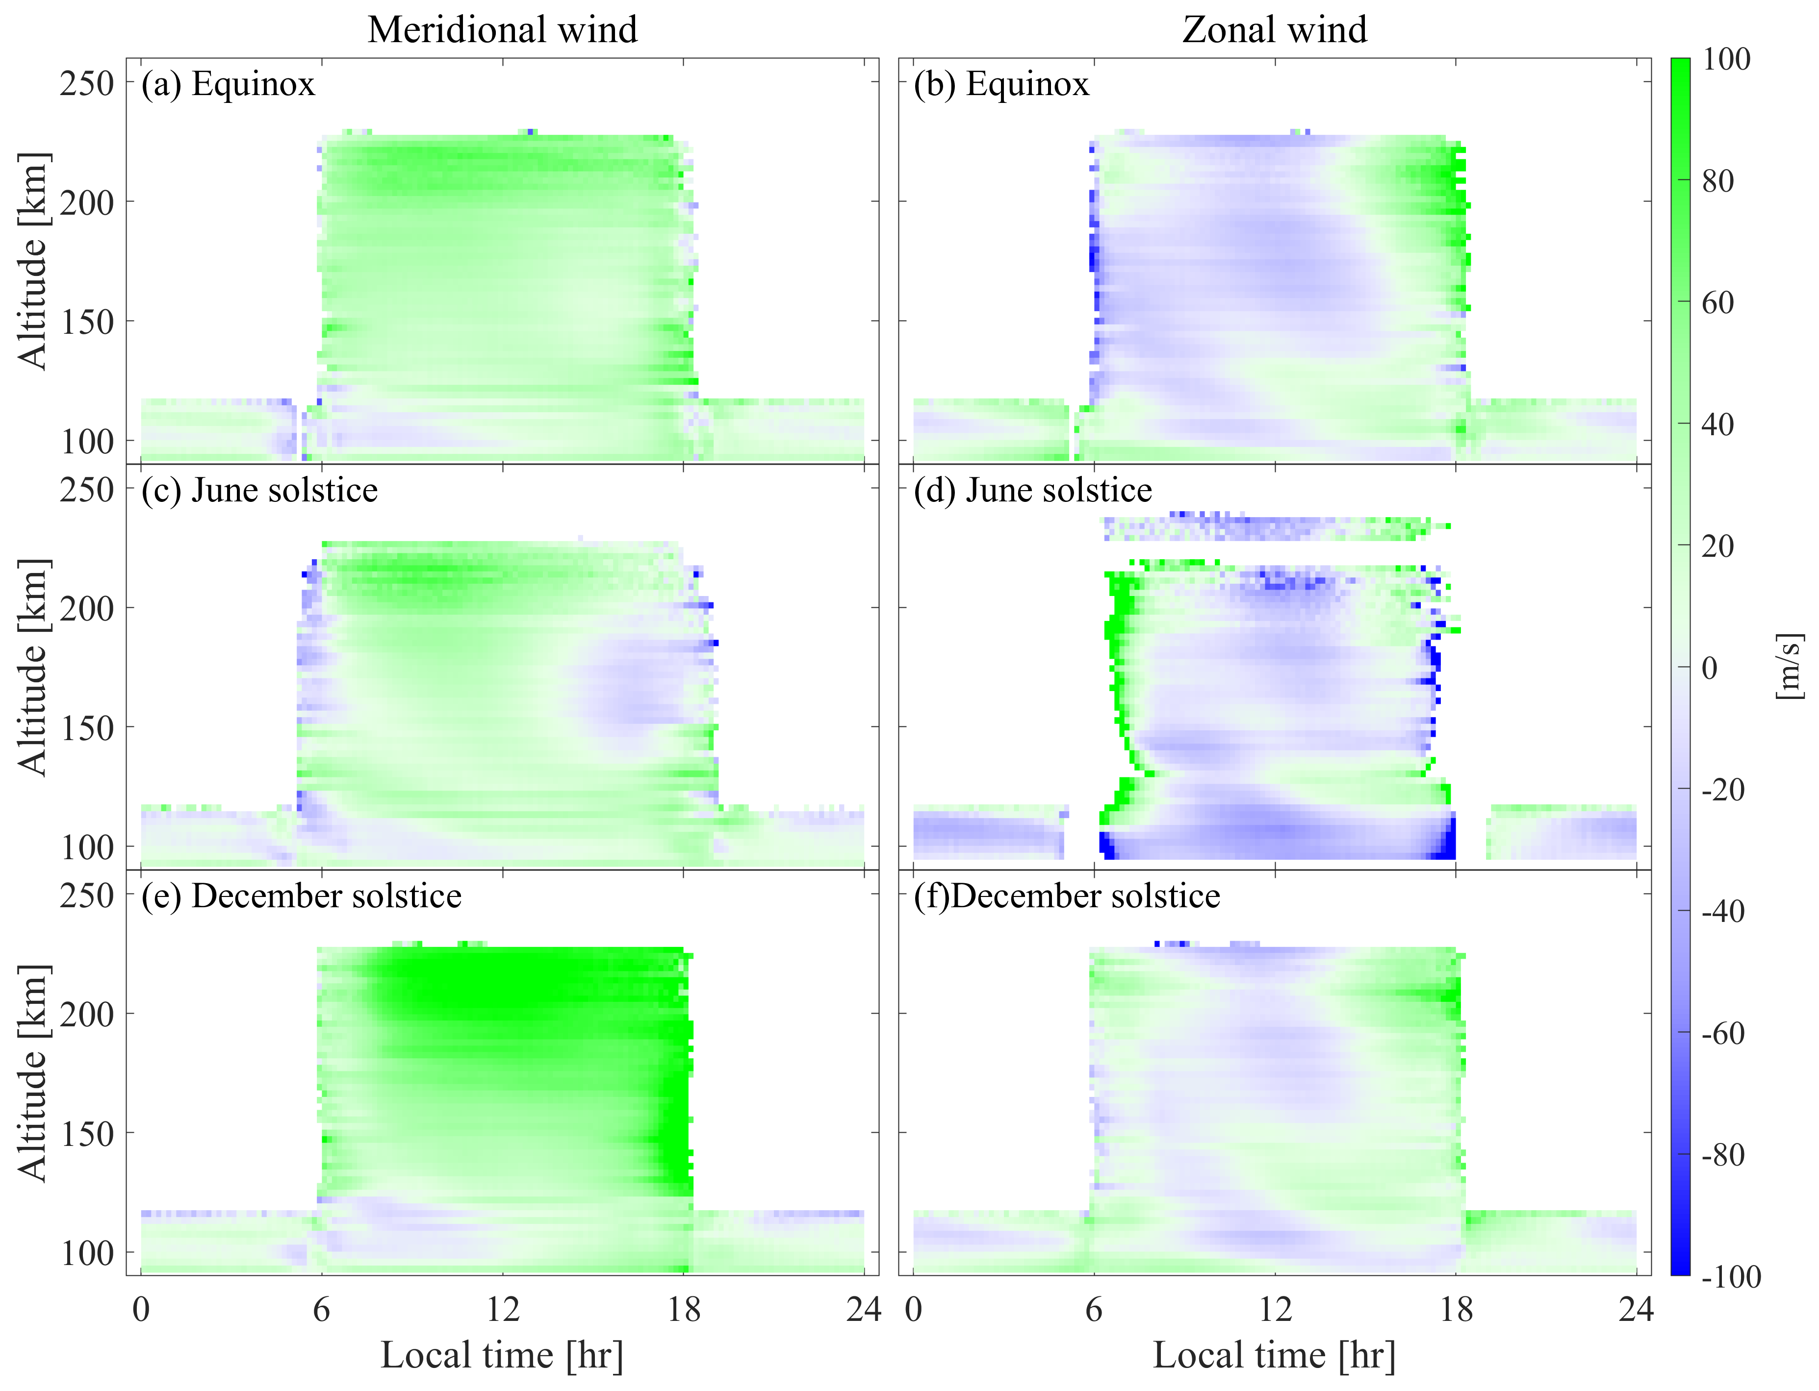
Dayside vertical wind reversal at transition altitude from E to F regions observed by the ICON satellite
Yuyang Huang¹, Chao Xiong^{1,2}, Jiawei Wu¹, Claudia Stolle³, Fengjue Wang¹, Yuhao Zheng¹, Chunyu Xu¹, Yang Hu¹, Simin Wang¹
1. Department of Space Physics, School of Electronic Information, Wuhan University, Wuhan, China.
2. Hubei Luojia Laboratory, Wuhan, China.
3. Leibniz Institute of Atmospheric Physics at the University of Rostock, Kühlungsborn, Germany.
EGU23-4285
INTRODUCTION
RESULTS
Statistics Results
Neutral wind takes a significant role in the ionospheric electrodynamics at the middle and low latitudes. So far, most previous studies focused on the variations of horizontal winds, while very few studies have investigated the vertical structures of neutral winds. Vertical structures of neutral winds also play an important role on electrodynamic processes of ionosphere. Yamazaki et al. (2022) provided direct evidence that the vertical shears play a significant role for causing Es.
The Michelson Interferometer for Global High-Resolution Thermospheric Imaging (MIGHTI) on board the ICON provides a good opportunity to measure the vertical wind variations. Different from England et al. (2022) who investigate the vertical wind shears at low E region (from 100 km to 130 km), in this study we focus on the wind reversal due to vertical shears at the transition altitude from E to F regions, from 120 km to 220 km.
Examples of wind reversal due to large vertical shears
Meridional wind
Zonal wind
Altitude [km]
Type I
Type II
Left two columns (Type I) Right two columns (Type II)
Two types of wind reversal due to vertical wind shear depend on local time (first line), geographic latitude (second line), geographic longitude (third line).
Both types occur at 120~220 km altitude and the deviations of mean altitude are over 50 km.
The mean altitudes of wind reversal due to vertical wind shear vary by over 20 km or even larger at longitude dependence
DATA
Type I
Ionospheric Connection Explorer (ICON)
Type II
Orbital altitude：About 593 km
Time range：2019.12-2022.02
Launch time：10th October 2019
Orbit inclination：About 27°
Measurements：The Michelson Interferometer for Global High-Resolution Thermospheric Imaging (MIGHTI)
Measurements altitude: ~90-310 km for Green (557.7 nm) emissions and ~150-310 km for Red (630.0 nm) emissions
Time range：2019.12-2022.02
Relation between the vertical shears of the meridional and zonal winds at low F region altitude
RESULTS
Two events of wind reversal due to vertical wind shear from meridional and zonal wind.
Types I: wind reversal at higher altitudes occurring at earlier LT
Types II: wind reversal at higher altitudes occurring at later LT
Averaged diurnal variation
Northward wind dominant during the daytime at all altitudes.
Northward wind during December solstice is larger than other season, as southward wind during June solstice does.
Westward wind dominates the most of day tine.
Vertical wind shears are observed the whole year.
There are two types of spatial pattern between E and F regions.
Close relation between E and F region wind reversal due to vertical wind shears.
Influence of geomagnetic and solar activity
COLCULSION
Wind reversal occurs mostly (about 75%) during magnetic quiet periods with Kp less than 2 Geomagnetic activity rarely affects the vertical wind shears.
Occurrence of vertical wind shears keeps declining with the increase of solar F10.7 flux (F10.7<100 sfu).
Fewer observations with F10.7 >100 sfu, influencing the reliability of solar flux dependence of vertical shears with high solar flux.
Clear wind reversals due to large vertical shears were identified in the meridional and zonal components of ICON wind observations.
The wind reversal of both meridional and zonal winds show two types of altitude variations on local time and latitude.
For most orbits with wind reversal identified at low F region, there are wind reversals simultaneously observed at low E region.

