Slide 1
Ali Salem Yasir Abduljaleel
Assessing the impact of climate change scenario for simulating nonstationary rainfall intensity and duration

Slide 2
Introduction
Heavy precipitation events is expected to increase in frequency and intensity in most regions under the ongoing climate change
Changes in climate conditions observed over the last few decades are considered to be responsible for most of the dramatic modifications in both the magnitude and frequency of extreme storm events
Floods have been worsen by the inadequacy of the existing critical stormwater systems in most regions

Slide 3
Problem Statement
Because of the lack of observational data, flood events in a specific region are commonly estimated using the storm data, and hydrologic modeling. Consequently, studies of extreme rainfall events have great relevance for the understanding of the hydrology of flooding in a given area. The high‐quality rainfall information is essential for successful flood modeling.

Slide 4
Main objectives
To examine the impacts of climate change on the precipitation patterns and extremes across the Cedar River Watershed in the Pacific Northwest under the Shared Socio-economic Scenario (SSP-585) obtained from CMIP6 models

Slide 6
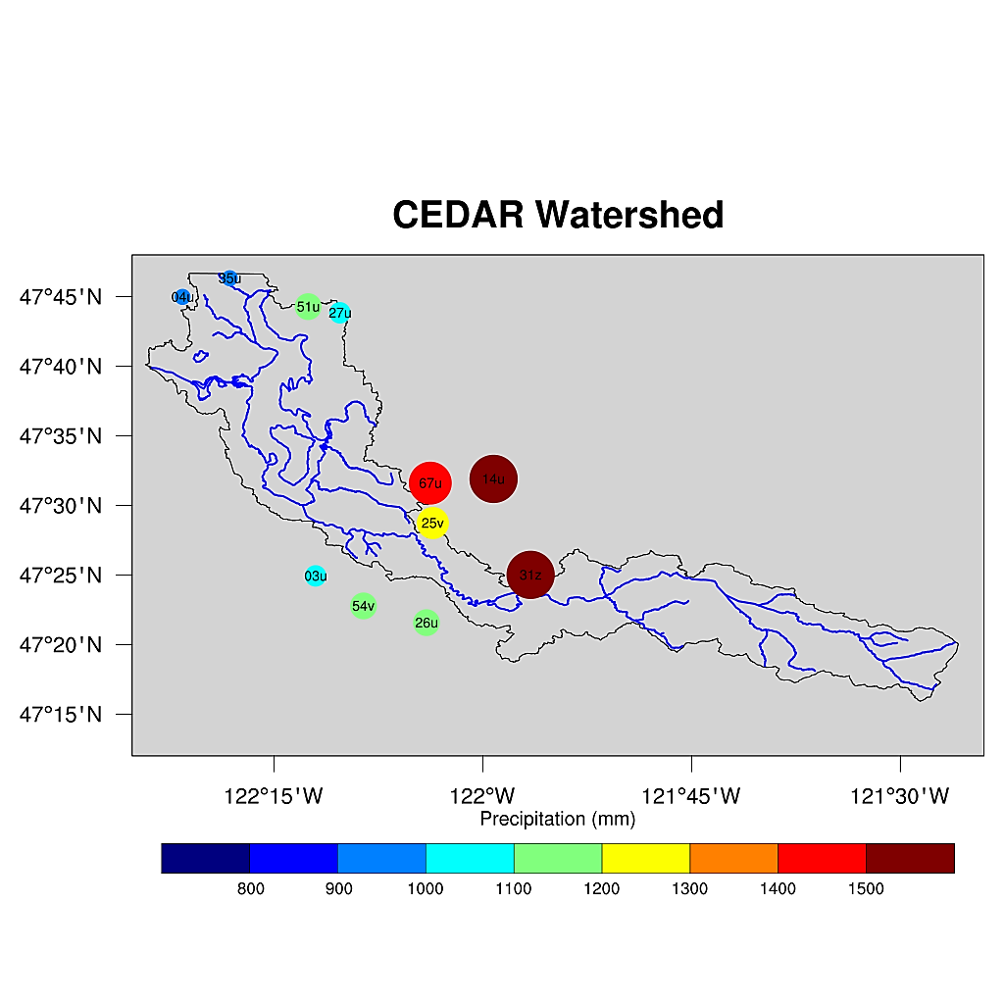
Case study
Cedar Watershed

Slide 7
Methodology
Socio-economic processes
Impacts
Climate
RCPs
SSPs
Climate
Socioeconomic Processes
Exposure
Natural variability
Socioeconomic Pathways
Vulnerability
Risk
Adaptation & mitigation Actions
Anthropogenic Climate change
Hazard
Governance
Emissions & land use change

Slide 8
Results

Slide 9
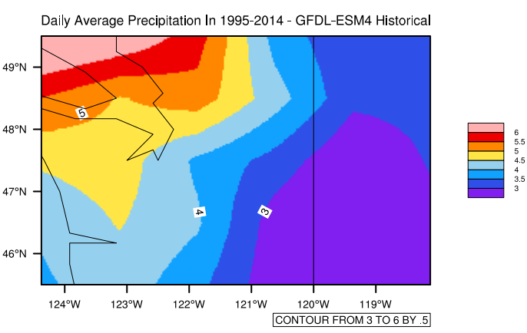
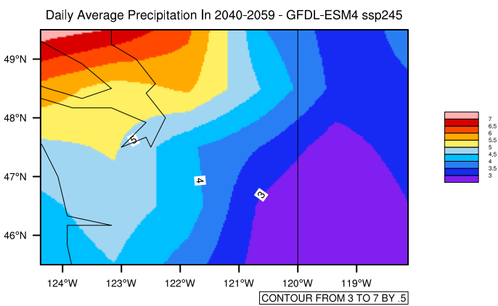
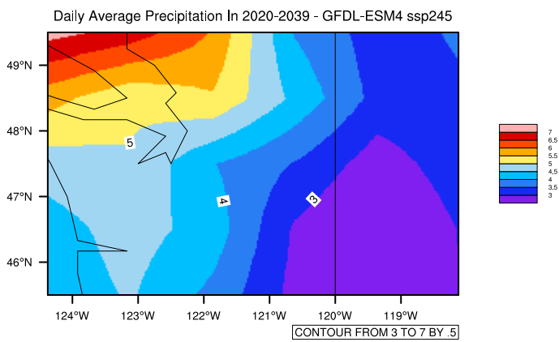
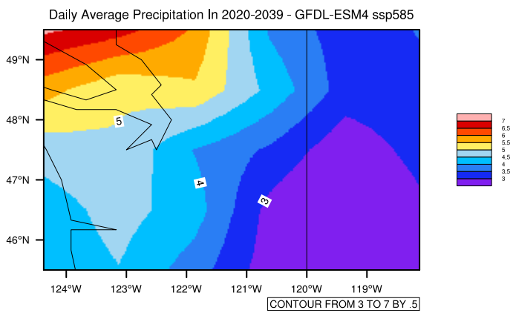
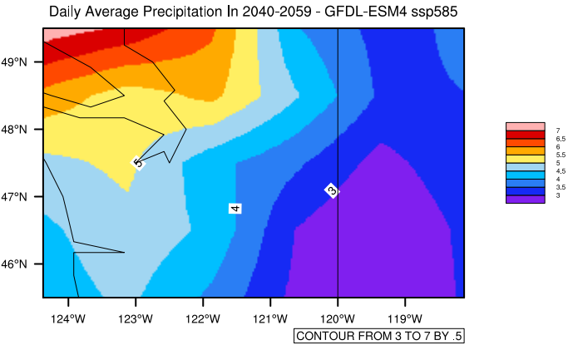
Analyzing the historical and future precipitation’s values
at the historical period, the most amount of precipitation over 1994-2014 has occurred in the north-east of WA. Whereas, as presented for 2020-2039, and 2040-2059 the maximum border of rainfall will reach 7 mm, and we can also see that the different levels of average precipitation value will higher than the historical period around 1mm.

Slide 10
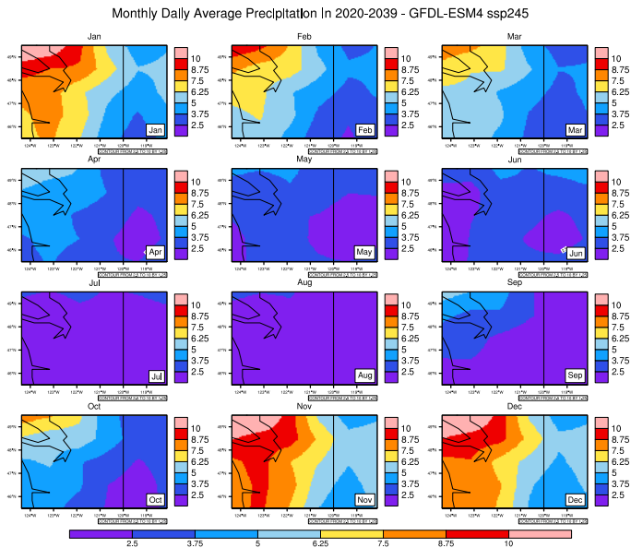
The amount of monthly average daily precipitation (mm) in future (2020-2039) period with GFDL CMIP6 model, under SSP245 scenario
the “Monthly average daily precipitation” with the GFDL model during historical (1995-2014) and future (2020-2039 and 2040-2059) periods under SSP245 scenario has been depicted. In Apr to Sep, there are no significant changes in the precipitation amount on the historical period in comparison with the future period. Whereas, there are substantial changes for Jan to Mar and Oct to Dec. in the historical period vs. future periods (2020-2039 and 2040-2059).

Slide 11
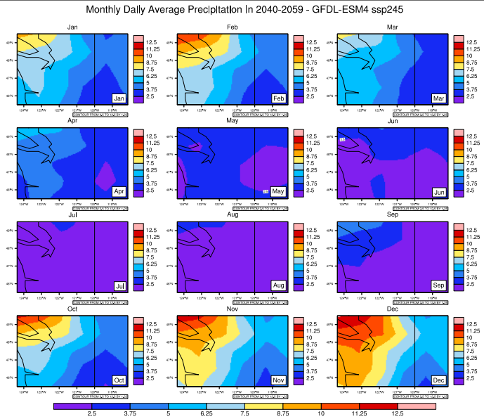
The amount of monthly average daily precipitation (mm) in future (2040-2059) period with GFDL CMIP6 model, under SSP245 scenario

Slide 12
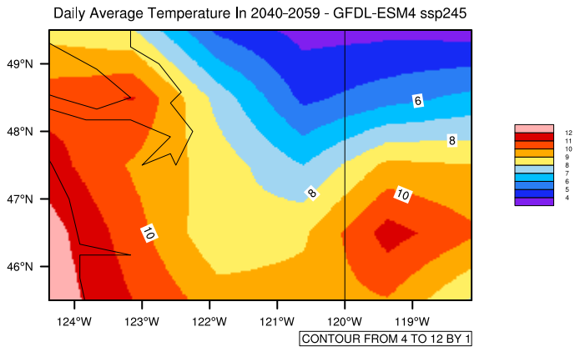
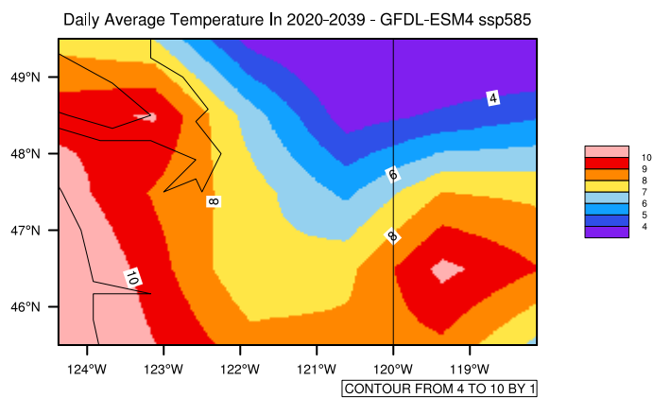
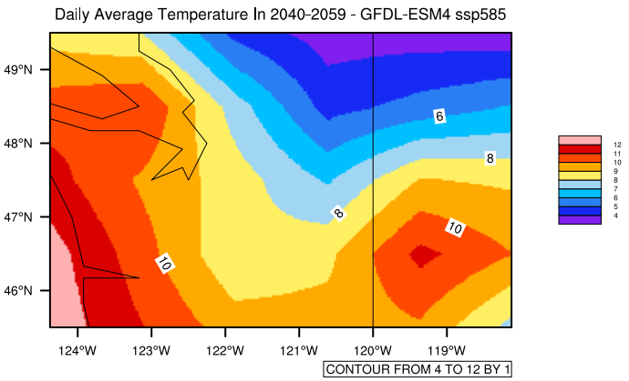
At the historical period, the most amount of temperature over 1994-2014 has occurred in the South-West of WA. Whereas, as presented for 2020-2039, and 2040-2059 the maximum border of precipitation will reach 12ºC, and we can also see that the different levels of average temperature value will higher than the historical period around 1 to 2 ºC. Also, there are significant changes for central states in the historical period in comparison with the future one

Slide 13
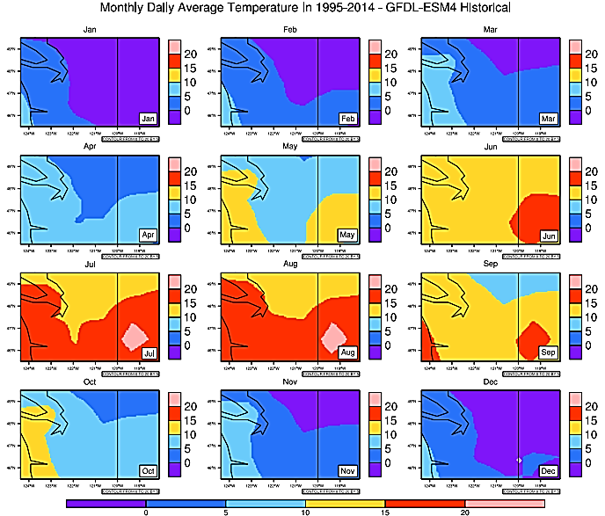
the “Monthly average daily temperature” with the GFDL model during historical (1995-2014) and future (2020-2039 and 2040-2059) periods under SSP245 scenario has been drawn. As you can see in these maps since all of them depicted on monthly scales, so there are small changes when we compare the historical period vs. future ones.

Slide 14
Conclusion:
This study examines the impacts of climate change on the precipitation patterns and extremes across the Cedar River Watershed.
Two global climate models (GCMs), namely MIROC6 and CMCC-ESM2, are considered in this study
The results indicate that the storm intensities increase (ranging from 2.5% to 30%) over the future periods for all selected return periods, with relatively larger increase for higher return periods i.e., 50-year and 100-year storms.

Slide 15
Thanks for your attention!
Questions

