Slide 1
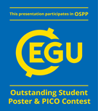
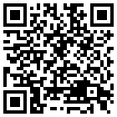
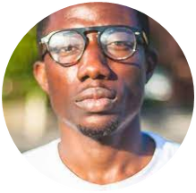
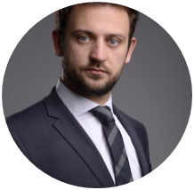
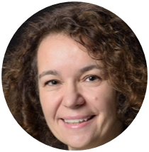
Towards a sustainable utilization of the global hydrological research software WaterGAP
Emmanuel Nyenah
(Goethe University Frankfurt)
Dr. Robert Reinecke
(University of Postdam)
Prof. Dr. Petra Döll
(Goethe University Frankfurt)
27th April 2023
Session ESSI3.6 – Collaborative Science Through Free and Open Source Software Tools and Frameworks in Earth sciences (Geo, Weather, Climate)

Slide 2
Summary
Motivation
Sustainable research software is software that: [1] is maintainable, [2] is extensible, [3] is flexible (adapts to user requirements), [4] has a defined software architecture, [5] is testable, [6] has a comprehensive in-code and external documentation, and [7] is accessible (the software is licensed as Open Source with a digital object identifier (DOI) for proper attribution).
WaterGAP has been developed and modified for about 30 years by researchers with little to no training in software development resulting in software with over thousand lines of code, little modularity and documentation.
Goal
Reprogram WaterGAP in Python, applying best practices to meet sustainability requirements while maintaining computational performance.
Applied Best Practices
Challenges & lesson learned
Agile
Understanding legacy code needs time and effort .
Getting functional user stories is hard.
Packages are available for improving the computational performance of Python.
APPLY PROJECT MANAGEMENT
PRACTICES
CONSIDER
SOFTWARE ARCHITECTURE, LANGUAGE &
VERSION CONTROL
MAKE INTERNAL AND EXTERNAL DOCUMENTATION COMPREHENSIBLE
APPLY DESIGN PATTERNS AND QUALITY CONTROL
nyenah@em.uni-frankfurt.de

Slide 3
Motivation
WaterGAP Development Progression:
Very low comment density
WaterGAP 2.2e has 83 files ranging from 1 to 4000+ source lines of code
Home
nyenah@em.uni-frankfurt.de

Slide 4
Project Goals
Modular
Usable & Testable
Rewrite WaterGAP with a modular structure.
Usable by WaterGAP community. Software components can be tested
Modern Language
Flexible, Extensible & Maintainable
Use Python as it is more readable than C++
Easily change resolution. New features can be added in the future and are easily repairable
Documentation
Open source
Provide comprehensive
documentation
Open source with a License
and a DOI for proper attribution
Home
nyenah@em.uni-frankfurt.de
Notes:
Now there Is funding to rewrite waterGAP to a more sustainable software.

Slide 5
Agile Project Management
1 big task remaining:
Implementing human water abstraction in the model
Home
nyenah@em.uni-frankfurt.de

Slide 6
Software Architecture, Language & Version Control
Architecture
Language
Legacy code
C++
New Code
Python
Version Control
Model controller View (MVC)
Model: Manages data and logic (hydrological processes)
Controller: Controls the data flow into model
View: Visualizes output data in desired format.
GNU Lesser General Public License v3.0
Home
nyenah@em.uni-frankfurt.de

Slide 7
Comprehensive External & Internal Documentation
New Documentation
Comment Density
Model Version | Comment Density (%)
ReWaterGAP | 35.3
2.2e | 27.6
Automated with GitHub workflow
Home
nyenah@em.uni-frankfurt.de

Slide 8
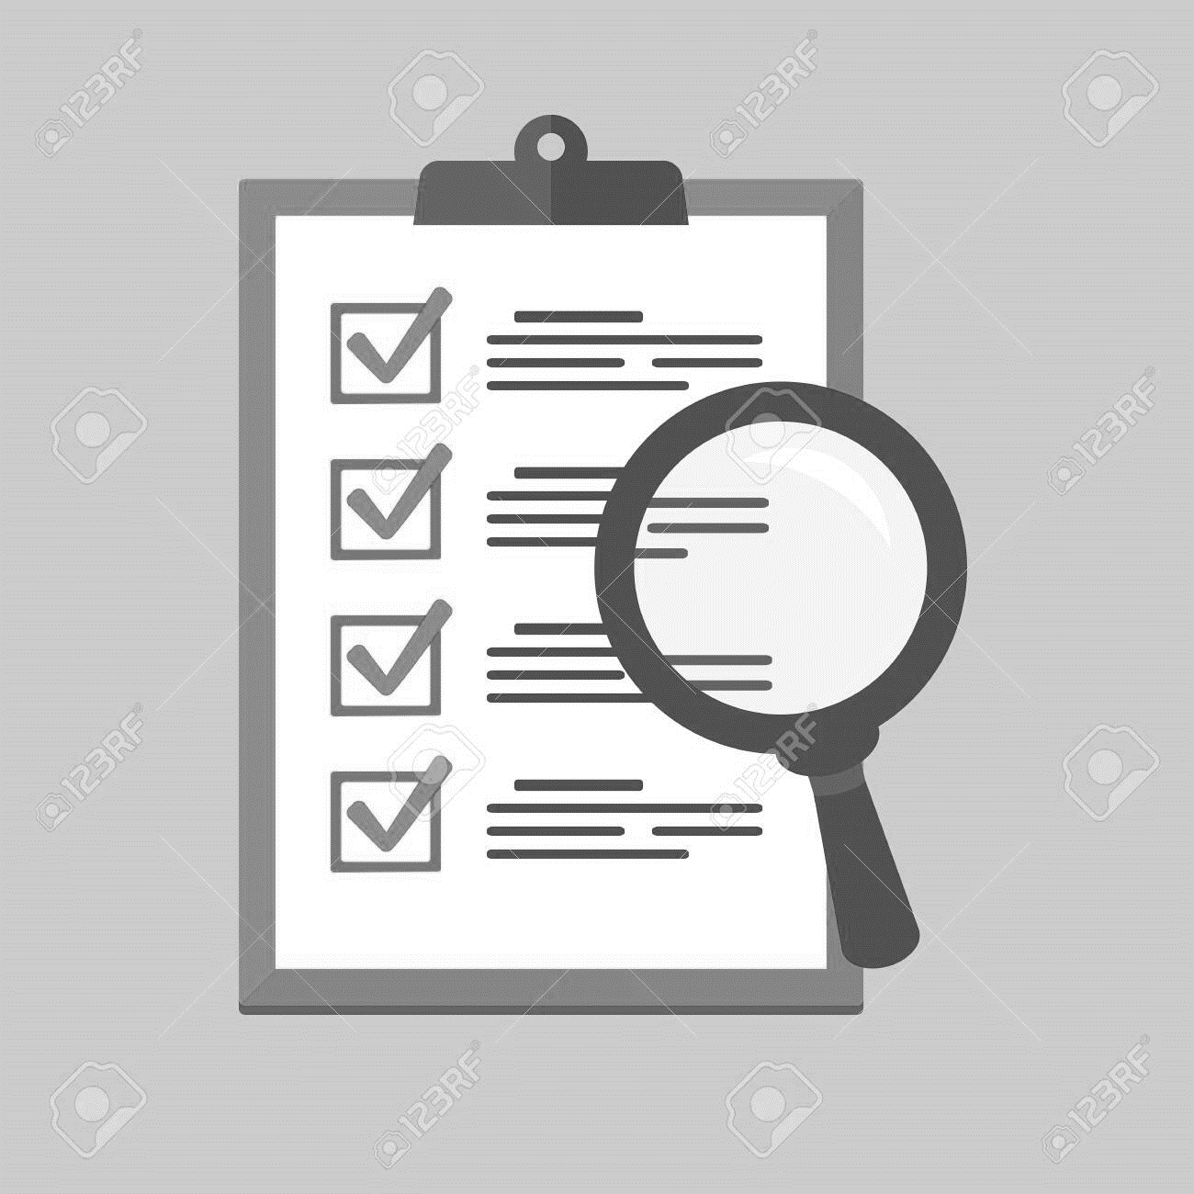
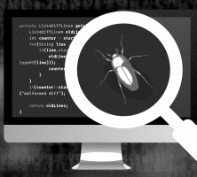
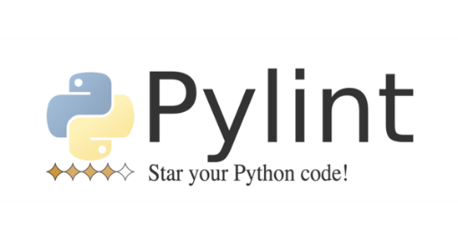
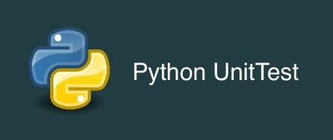
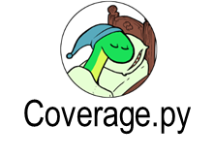
Design Principles & Quality Control
Quality checks
Design Patterns
Design patterns are ready-to-use solutions to recurring software design problems.
Apply design patterns if required.
e.g. Factory Method , Façade, etc . https://refactoring.guru/design-patterns/catalog
Internal and external review:
Check code quality
Linting:
Analyzing code for issues such as style deviations and unsafe constructs.
Testing
Home
nyenah@em.uni-frankfurt.de
Notes:
After a module is developed it goes through internal review processes to check code quality and comprehension.
We use code quality control tools such as
-Linter (put right definition here)
_testing (Here we test the components of the software to see if they are functioning as intended.
-coverage tools: provides a score to check which part of our code was accessed by the written test. ( The end is to make sure that all part of the codes are tested)

Slide 9
Challenges & Lesson Learned
Challenge | Lesson learned
Getting functional user stories | Requires iteration
Improving computational performance | Packages are available (eg. Numba)
Knowledge of two languages (C++ & Python)
Model outputs similarity | There will be some differences (new user stories and model processes)
Understanding legacy or complex scientific code | Needs time and effort
Home
nyenah@em.uni-frankfurt.de

Slide 10
User Stories
A user story is an informal, general explanation of a software feature written from the perspective of the end user or customer. The purpose of a user story is to articulate what the software should and should not do.
https://www.atlassian.com/agile/project-management/user-stories
Example user stories
Home
nyenah@em.uni-frankfurt.de

Slide 11
Performance and Interface
Performance
Interface
Model Version | Runtime per year (mins) | Remarks
ReWaterGAP | 8-9 | You can only get reasonable runtime with performance improving packages.
2.2e | 4-6 | Written in C++
Home
nyenah@em.uni-frankfurt.de

Slide 12
What is WaterGAP?
WaterGAP is a global hydrological model that quantifies human use of groundwater and surface water as well as water flows and water storage and thus water resources on all land areas of the Earth. It is also used to access climate change impacts on these natural resources
https://gmd.copernicus.org/articles/14/1037/2021/
Home
nyenah@em.uni-frankfurt.de

