Slide 1
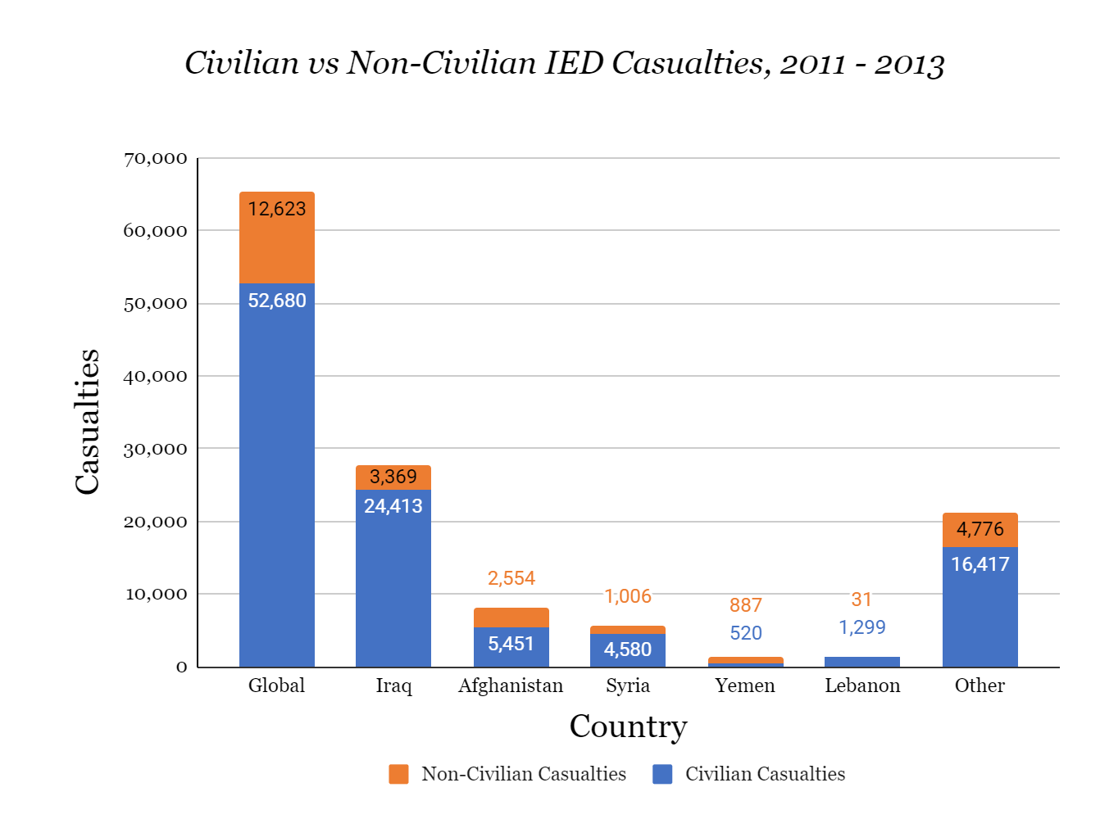
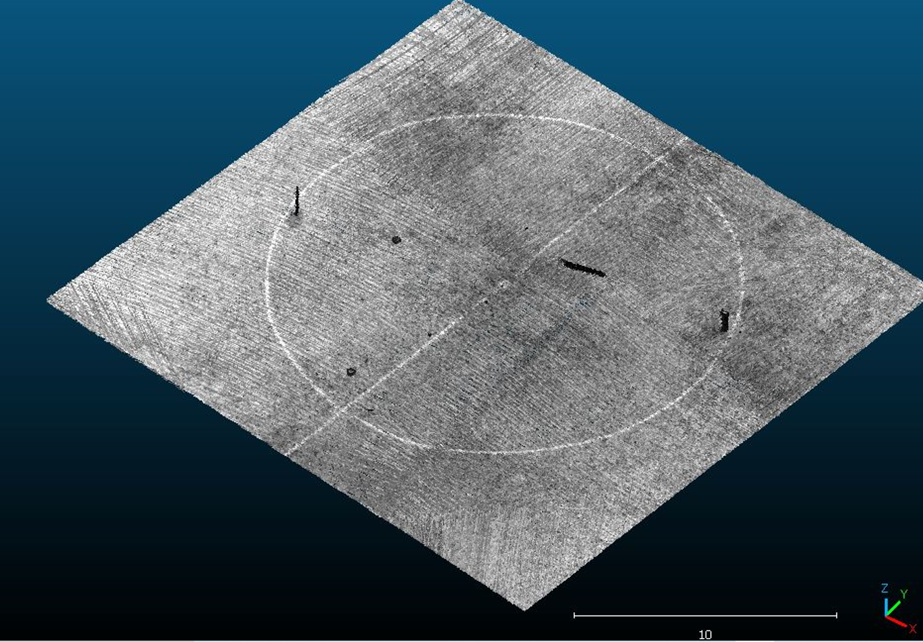
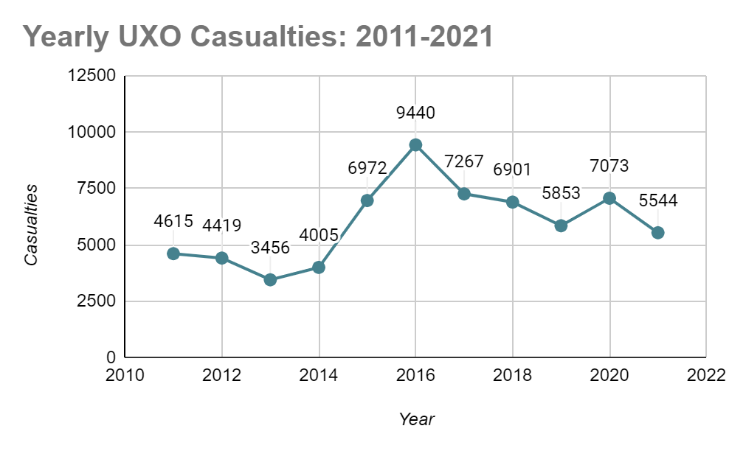
Novel Drone Technology mixed with LIDAR and HSI shows promising results toward locating UXOs
Drones paired with Hyperspectral Imaging and LIDAR to locate Unexploded Ordinances
A. Restrepo, A. Labnine, R. DiMatteo, C. Edwards, L. Quinto, M. Tuohy, A. Nikulin, and T. S. de Smet
1. INTRODUCTION
3. RESULTS
Unexploded Ordinances (UXOs): explosives that do not detonate and are a common byproduct of war.
Improvised Explosive Device (IED): modified UXOs used to create bombs
Relevant Areas: Ukraine, Middle East, Cambodia
Our Research: detecting common UXOs used by the Russian military - a mix of landmines and rockets.
Figure 1: worldwide IED casualty statistics from 2011-2013 broken down by country
LIDAR DATA (3d point cloud)
Anti-personnel Mines:
VPMA-3 PFM-1
Figure 2: global UXO casualties from 2011 to 2021
HSI DATA (High Resolution Scan)
TM-62 Anti-Vehicle Mine
2. METHODS
Place 3 MBRL rockets, 2 TFM-62, 3 VPMA-3, 18 PFM-1 mines in a 75m area.
Perform successive 10 meter high flights using a DJI Phantom drone paired with HSI and LIDAR sensors.
Process LIDAR data by denoising and converting to a point cloud
Process the HSI using Harris Geospatial ENVI software
2m
Multi-barrel Rocket
4. CONCLUSIONS
HSI shows a clear differentiation between all UXOs and the environment, while LIDAR was able to locate MBRL rockets and TM-62 landmines. To improve accuracy and efficiency processing techniques like algorithms, alternative data processing workflows and sub-pixel techniques could be tested. Data acquisition parameters may also be further refined.
REFERENCES
ABSTRACT

