Slide 1
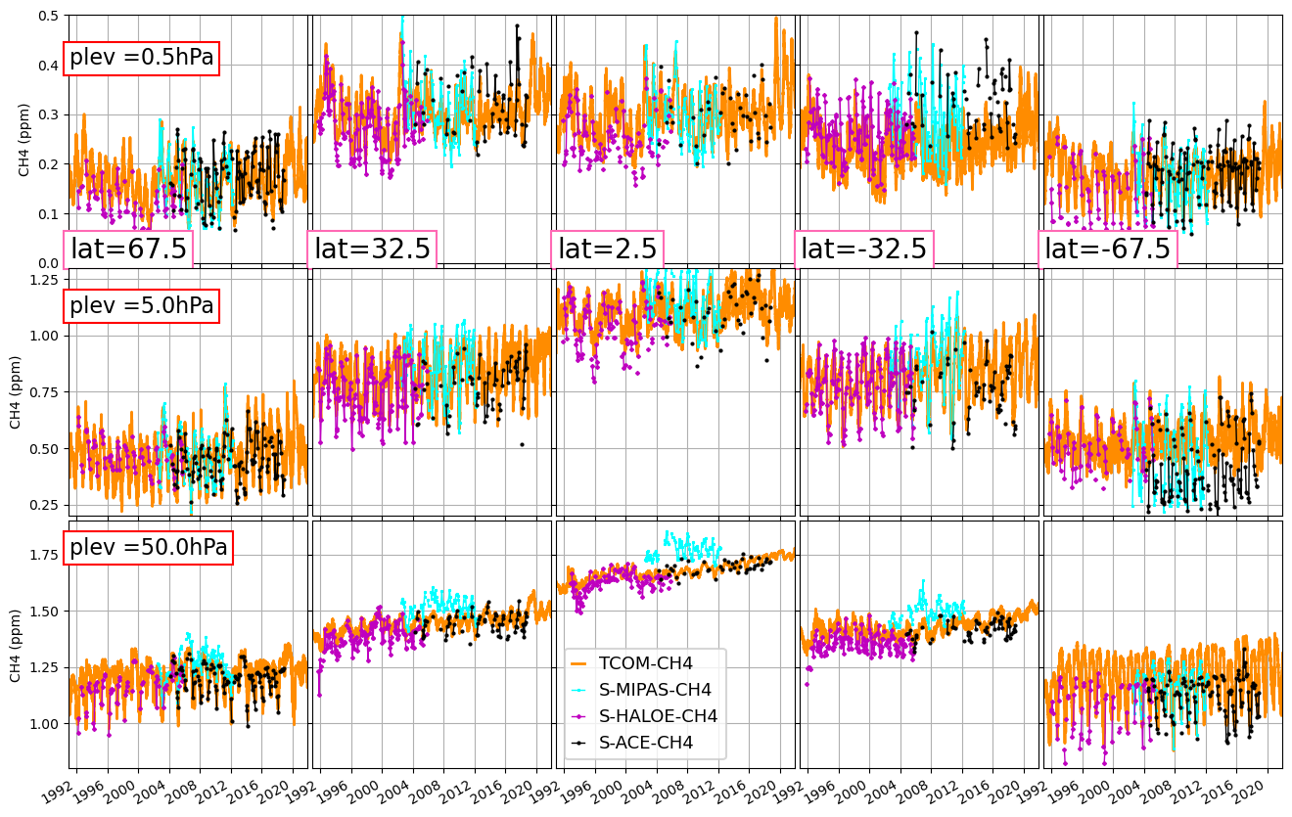
Using machine-learning to construct long-term gap-free stratospheric profile data sets based on TOMCAT CTM & Occultation Measurements (TCOM)
Sandip Dhomse & Martyn Chipperfield (Uni-Leeds, UK)
s.s.dhomse@leeds.ac.uk
All the chemical models have biases (parametrisations)
Satellite measurements are sporadic & cover shorter time periods
Machine learning is used to estimate correction
Chemical model output + ML estimated biases
Preprint : https://doi.org/10.5194/essd-2023-47, in review, 2023
CH4- https://doi.org/10.5281/zenodo.7293740
N2O - https://doi.org/10.5281/zenodo.7386001
HCl -https://doi.org/10.5281/zenodo.7608194
HF - https://doi.org/10.5281/zenodo.7607564
O3 - https://doi.org/10.5281/zenodo.7833154
Usage: e.g. evaluate strat. chemistry/dynamics, retrieval algorithms
CH4
Fig: TCOM-CH4 – comparison with SPARC dataset

Slide 2
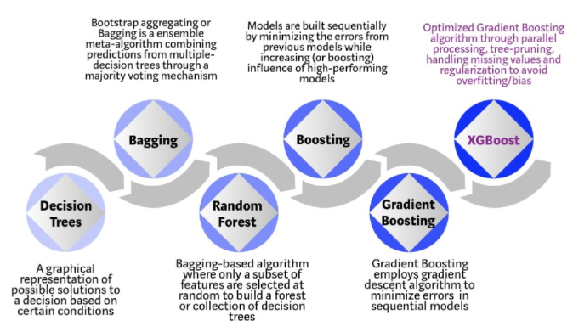
XGBoost- Supervised machine learning

Slide 3
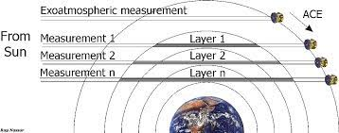
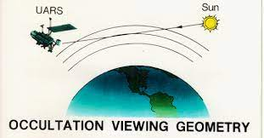
Satellite Data : HALOE (1991-2005) & ACE-FTS (2004—present)
Solar Occultation instruments provide about 30 profiles/day (15 sunrise & 15 sunset)

Slide 4
Methodology
TOMCAT CTM simulation (forced with ERA5)
Calculate differences w.r.t. satellite data at each 1 km vertical level
Divide global measurements in 5 lat bins (poles, mid-latitudes and tropics)
Calculate diff. w.r.t. satellite data at each 1 km vertical resolution
Train XGBoost regression model for each level and latitude bin
There are 13 explanatory variables in the XGBoost – mostly TOMCAT tracers
Once trained, XGBoost is used to estimate biases in daily profiles that are added back in CTM output
70% - training, 30% testing, 2019-2021 - evaluation
dCH4 = CH4+ N2O+ O3+ H2O+ HCl+ HNO3+ NO2+ ClONO2+ HF + potential vorticity +temp + date + latitude

Slide 5
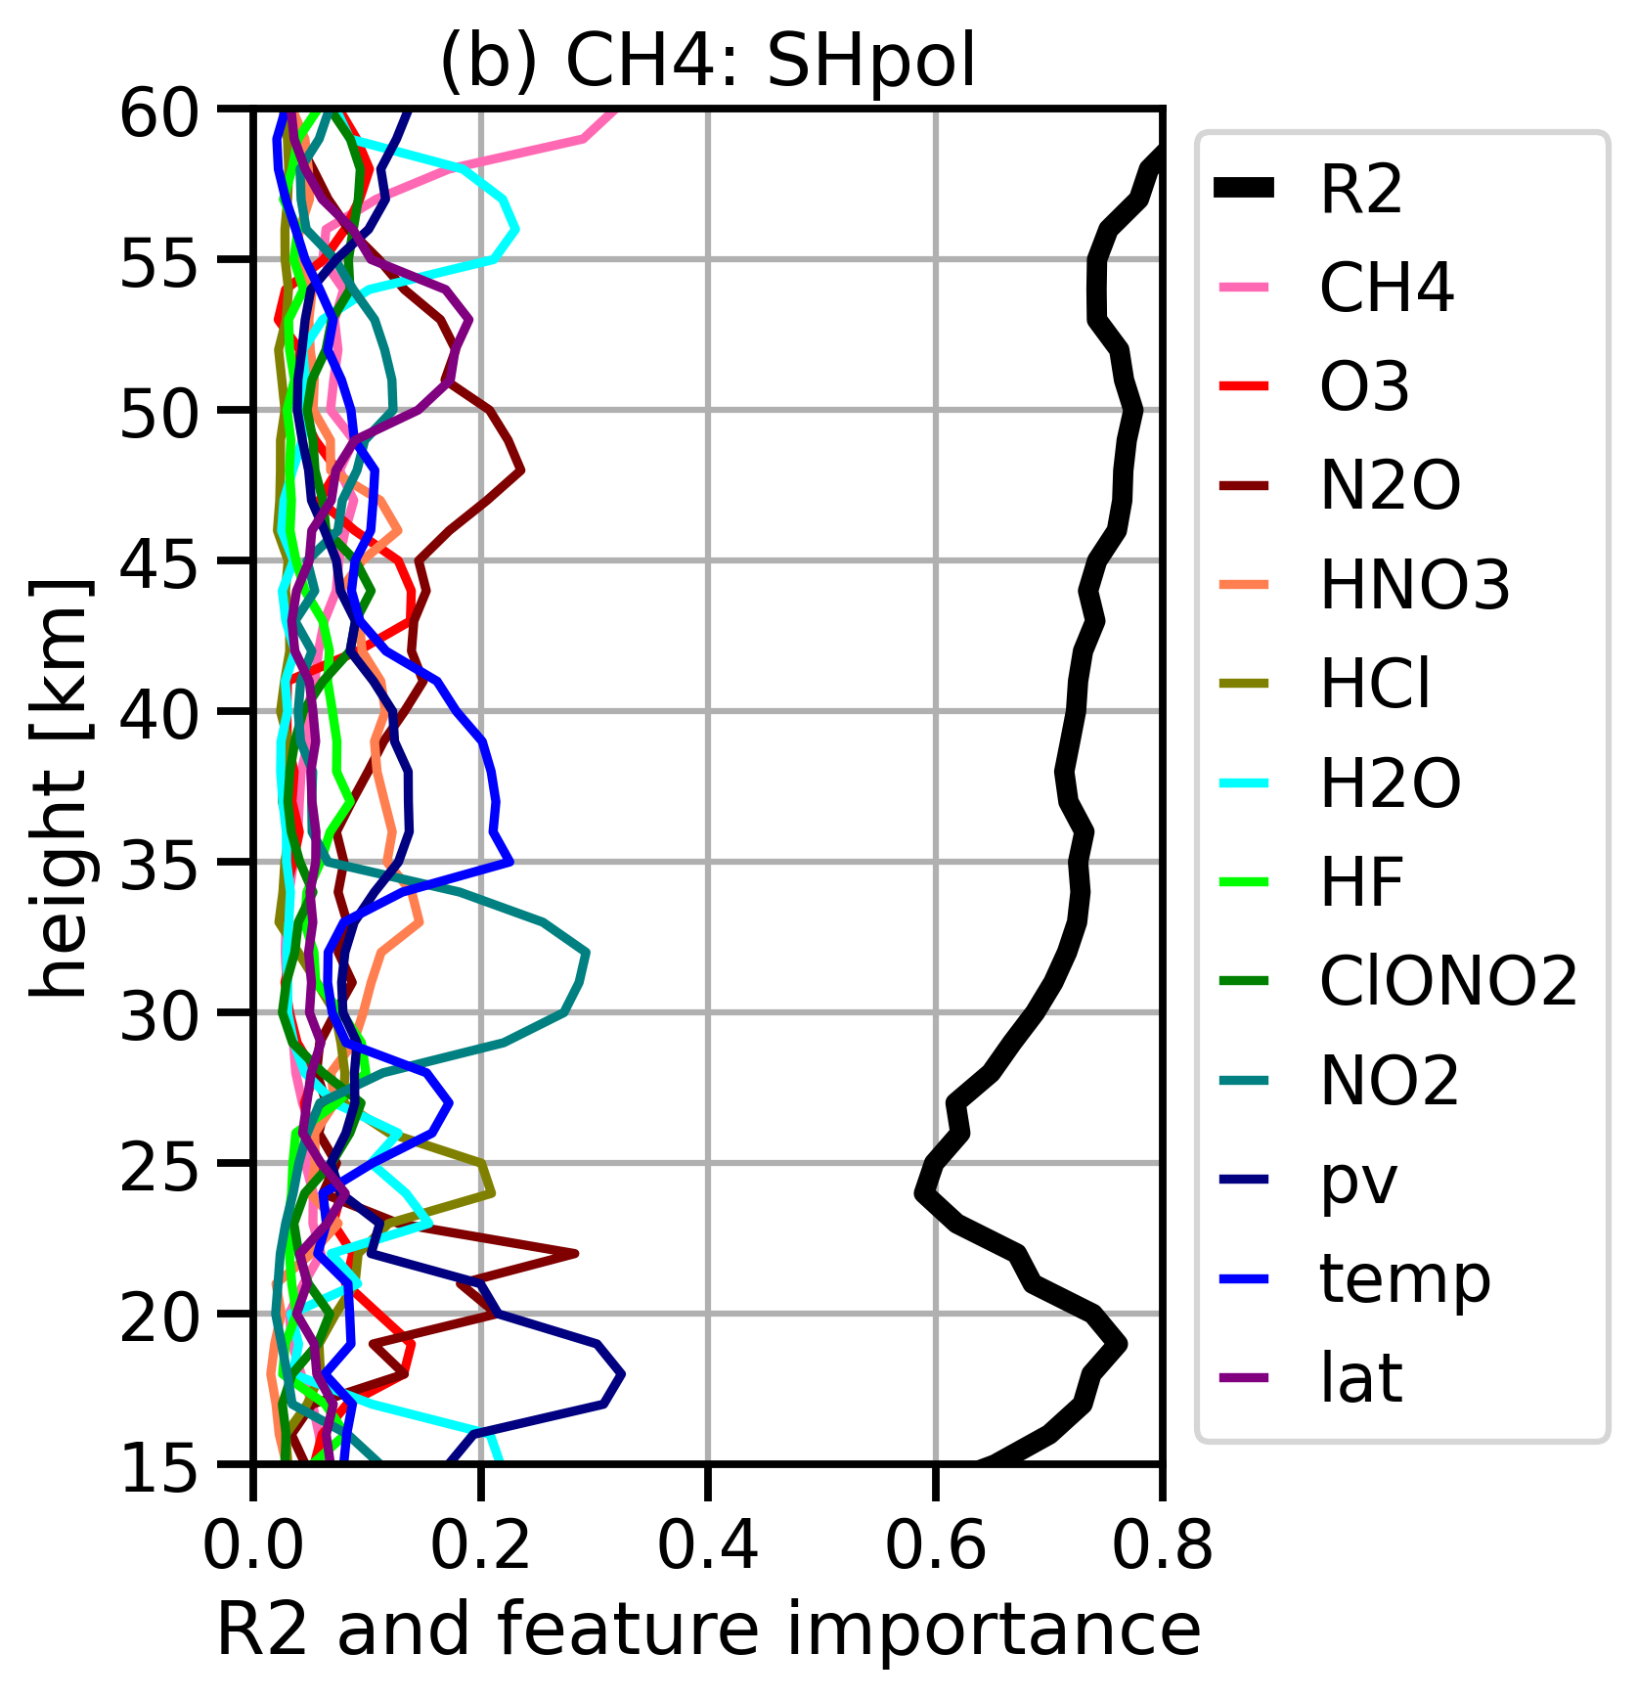
Example: CH4 – SH pol
XGBoost performance and feature importance's for SHpol
70% - training
30 % - testing

Slide 6
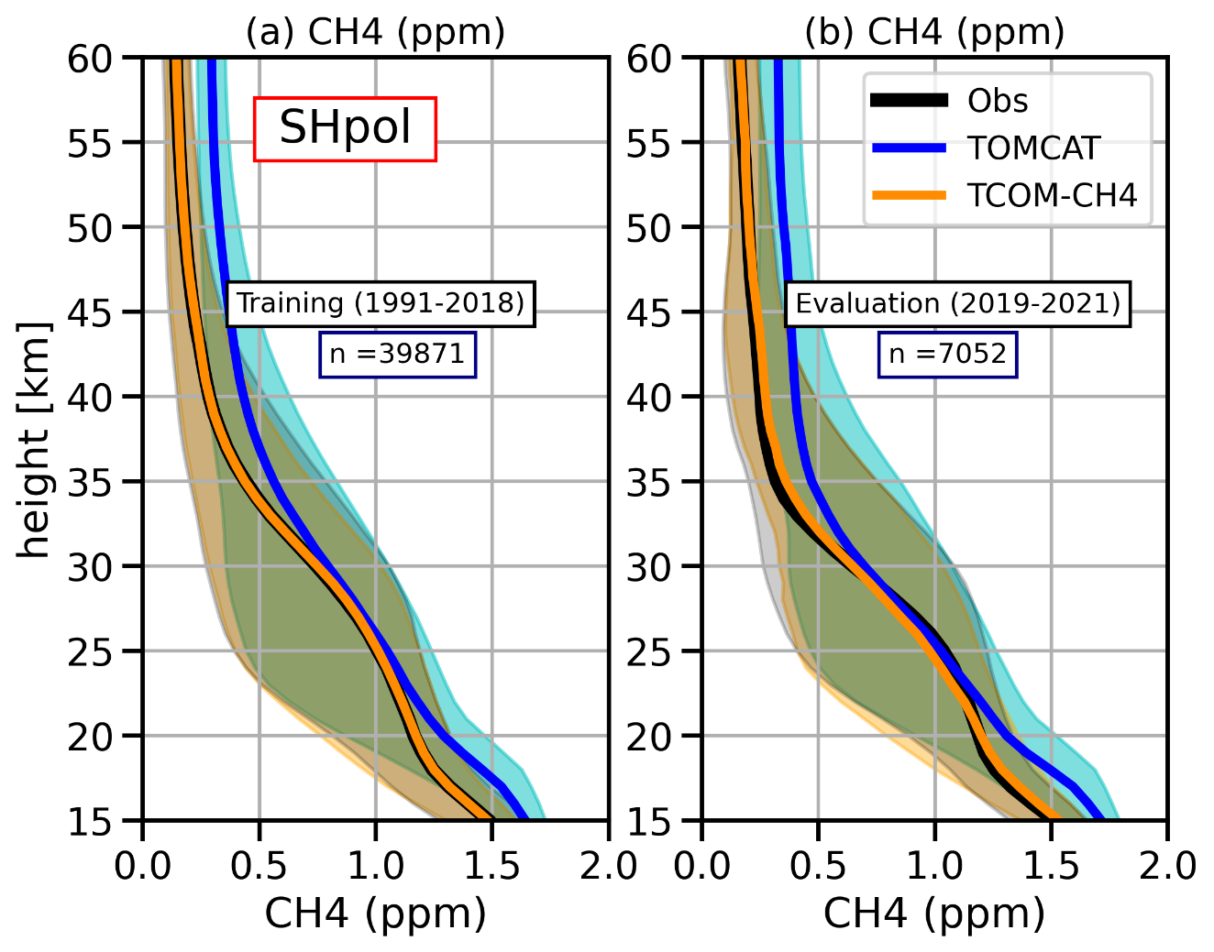
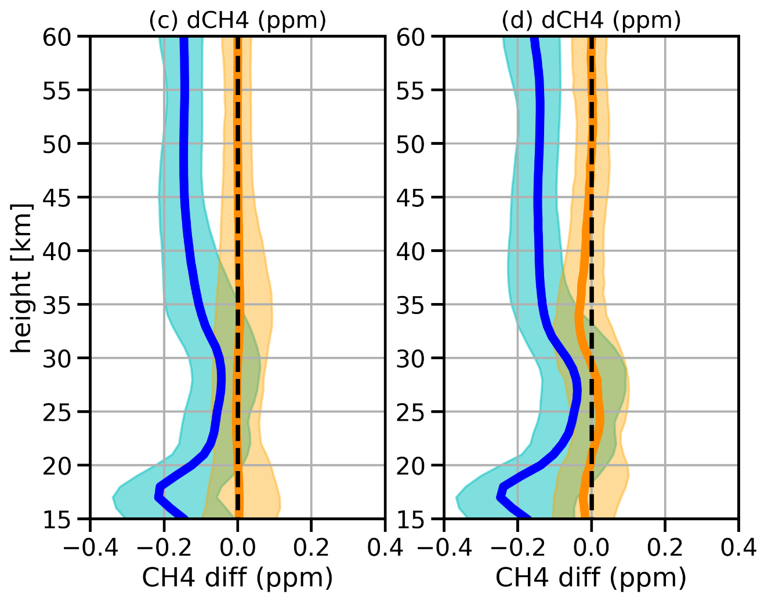
Example: CH4 – SH pol
Profile Comparison
Differences in ppm

Slide 7
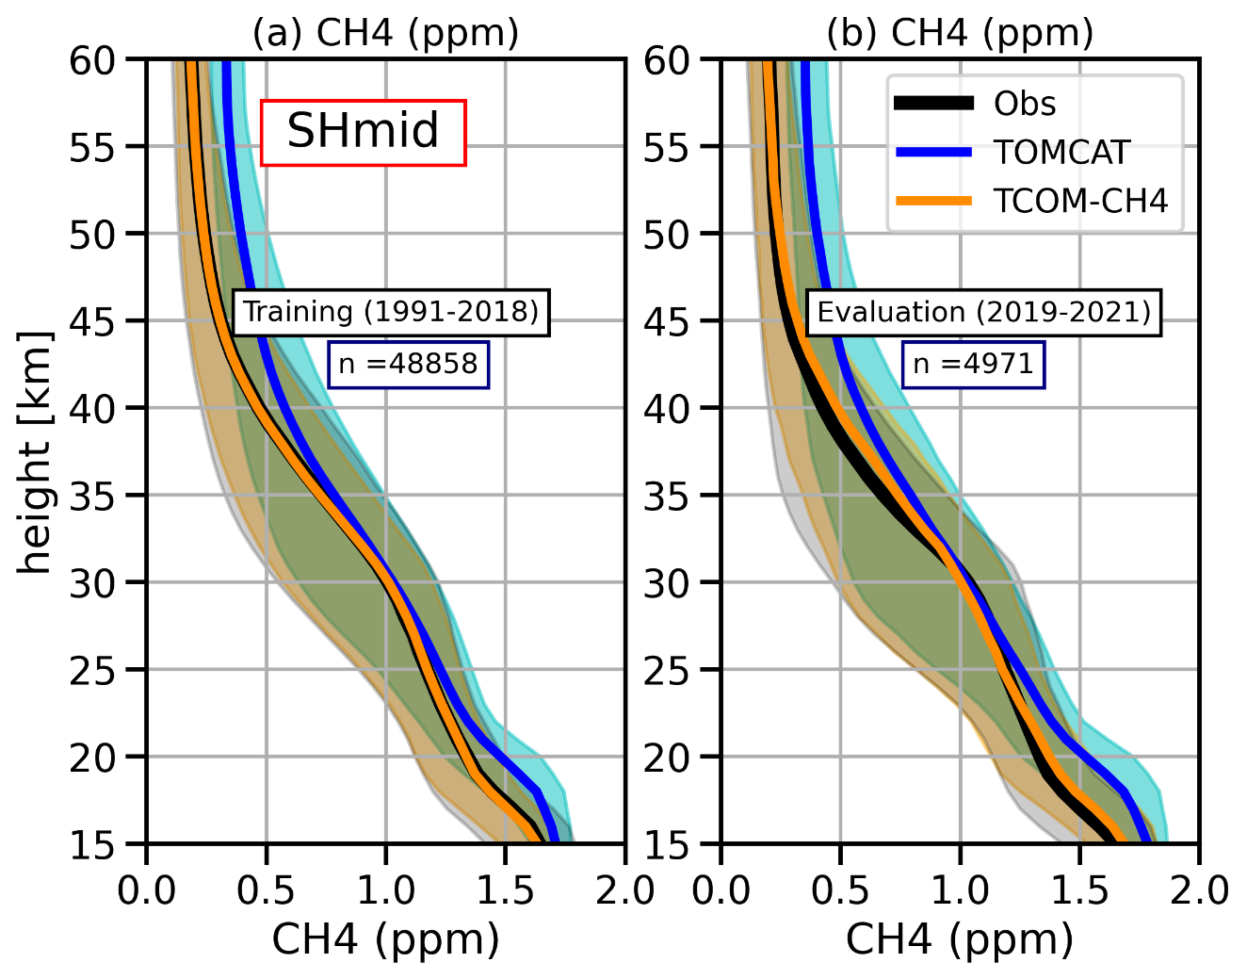
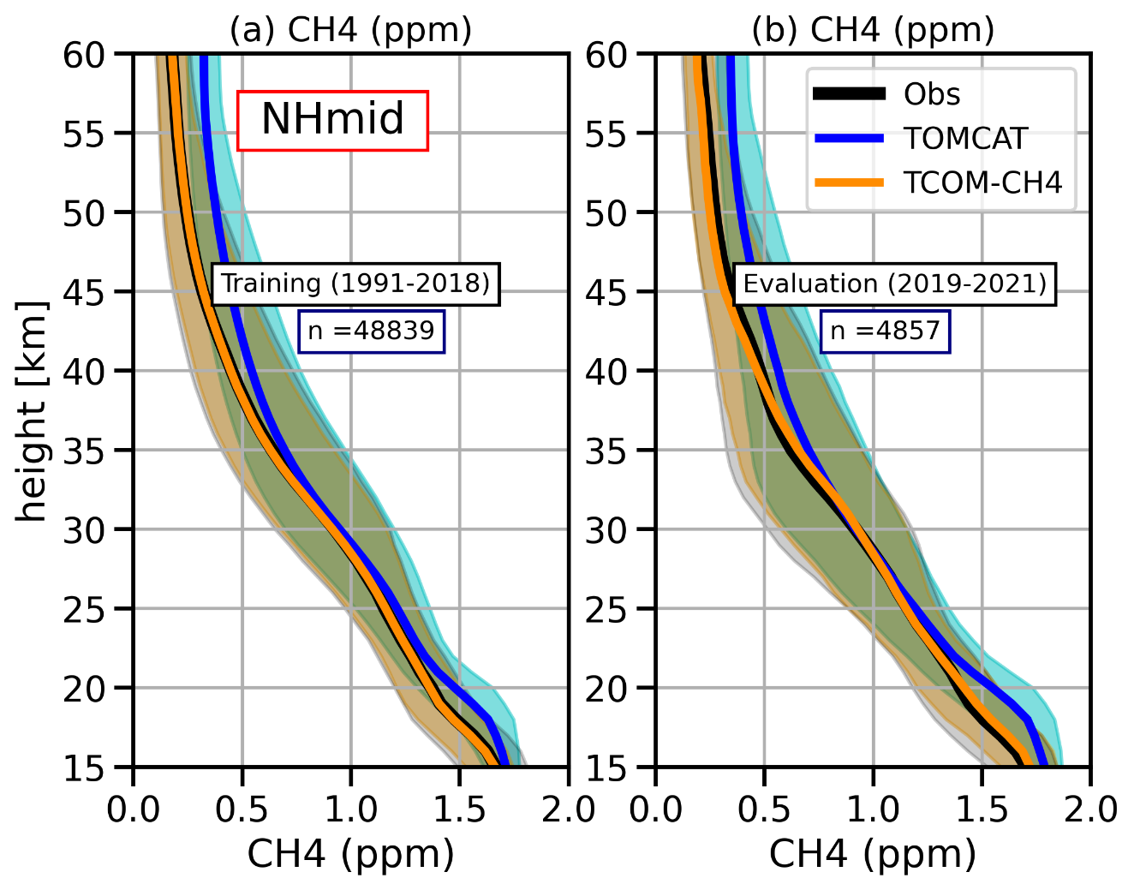
Example: CH4 – mid-lat
Profile Comparison

Slide 8
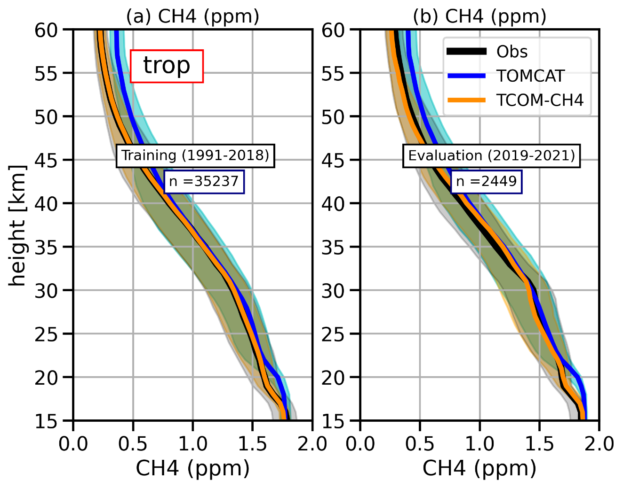
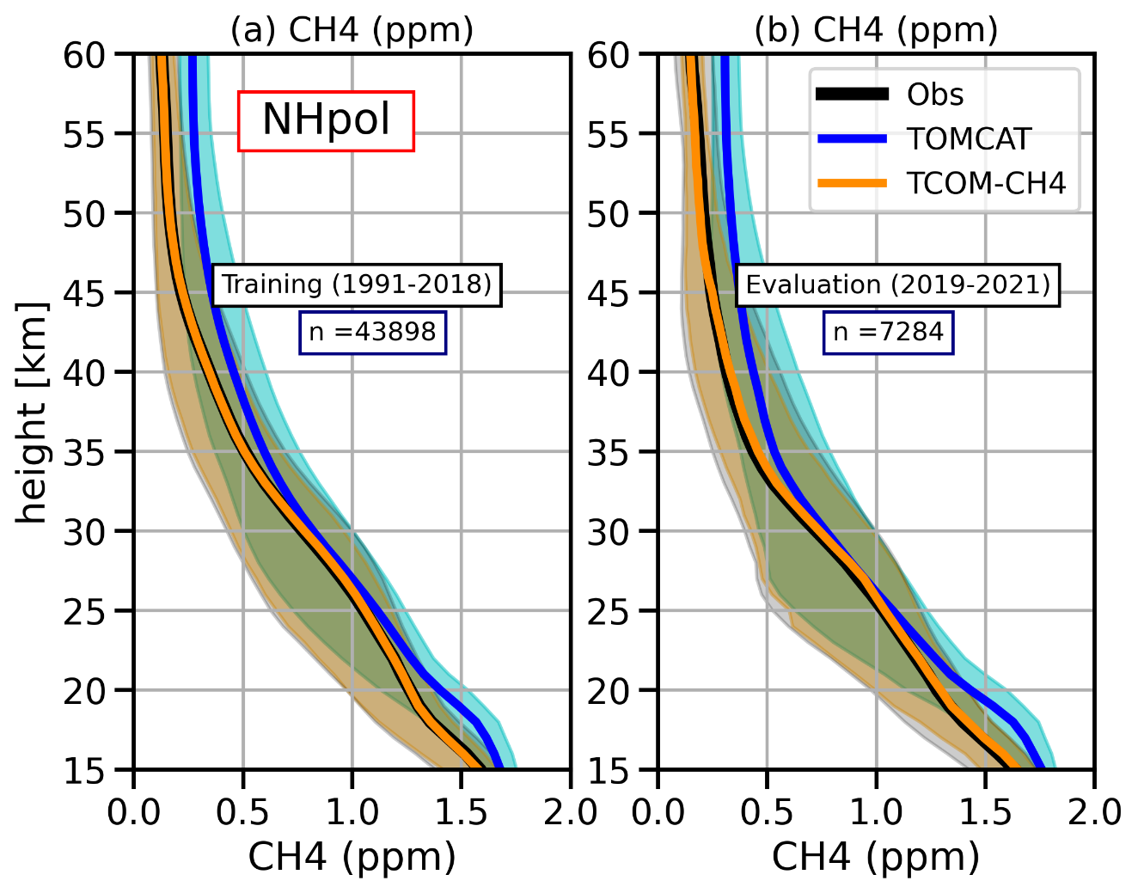
Example: CH4 – tropics & NHPol
Profile Comparison

Slide 9
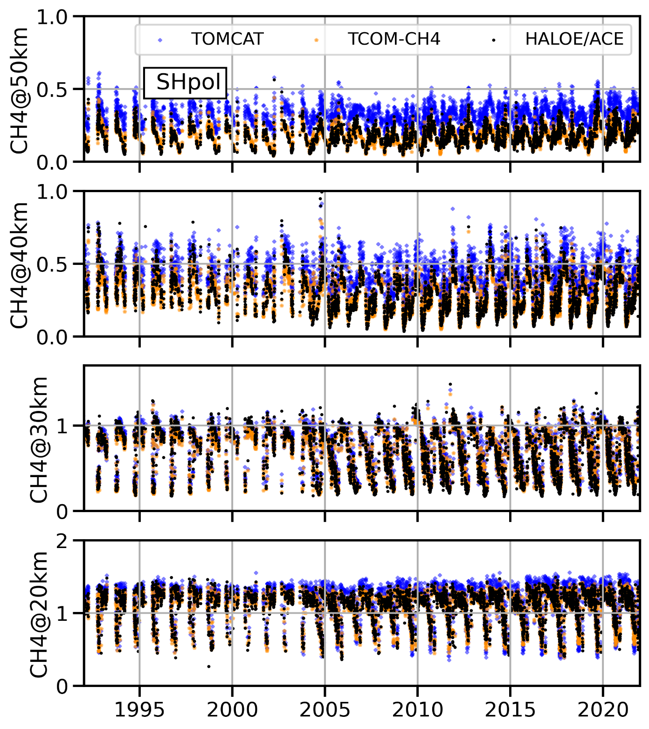
Comparison with ACE/HALOE measurements (SHpol)
50km
40km
30km
No clear long-term trends
20km
Only 10% points are plotted

Slide 10
Comparison with SPARC CH4 data (Hegglin et al., 2021)

Slide 11
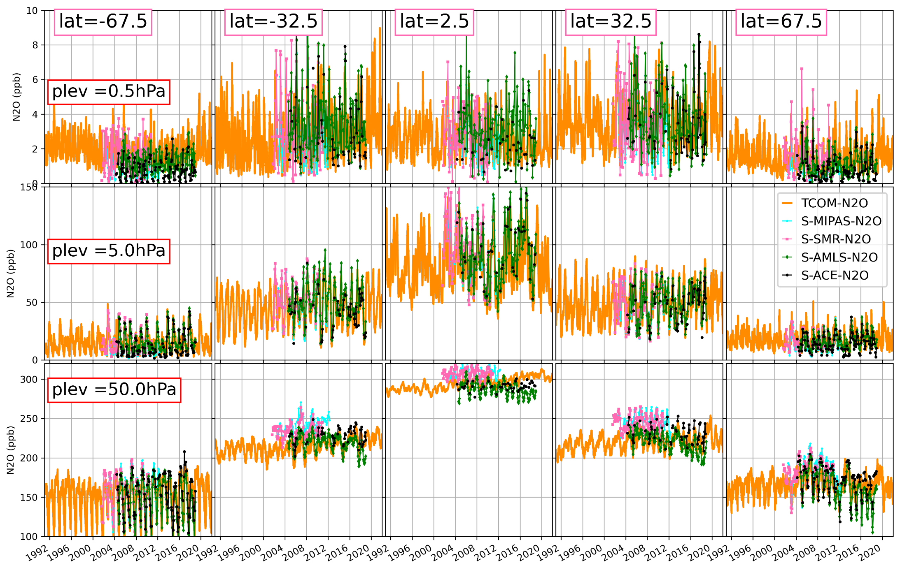
Comparison with SPARC N2O data (Hegglin et al., 2021)

Slide 12
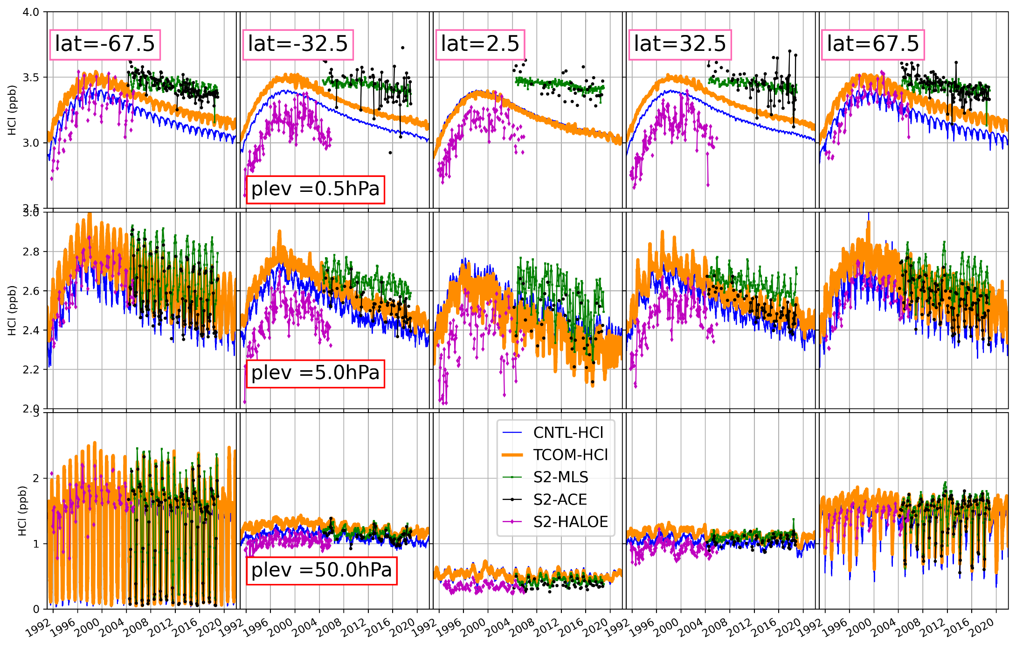
Comparison with SPARC HCl data (Hegglin et al., 2021)

Slide 13
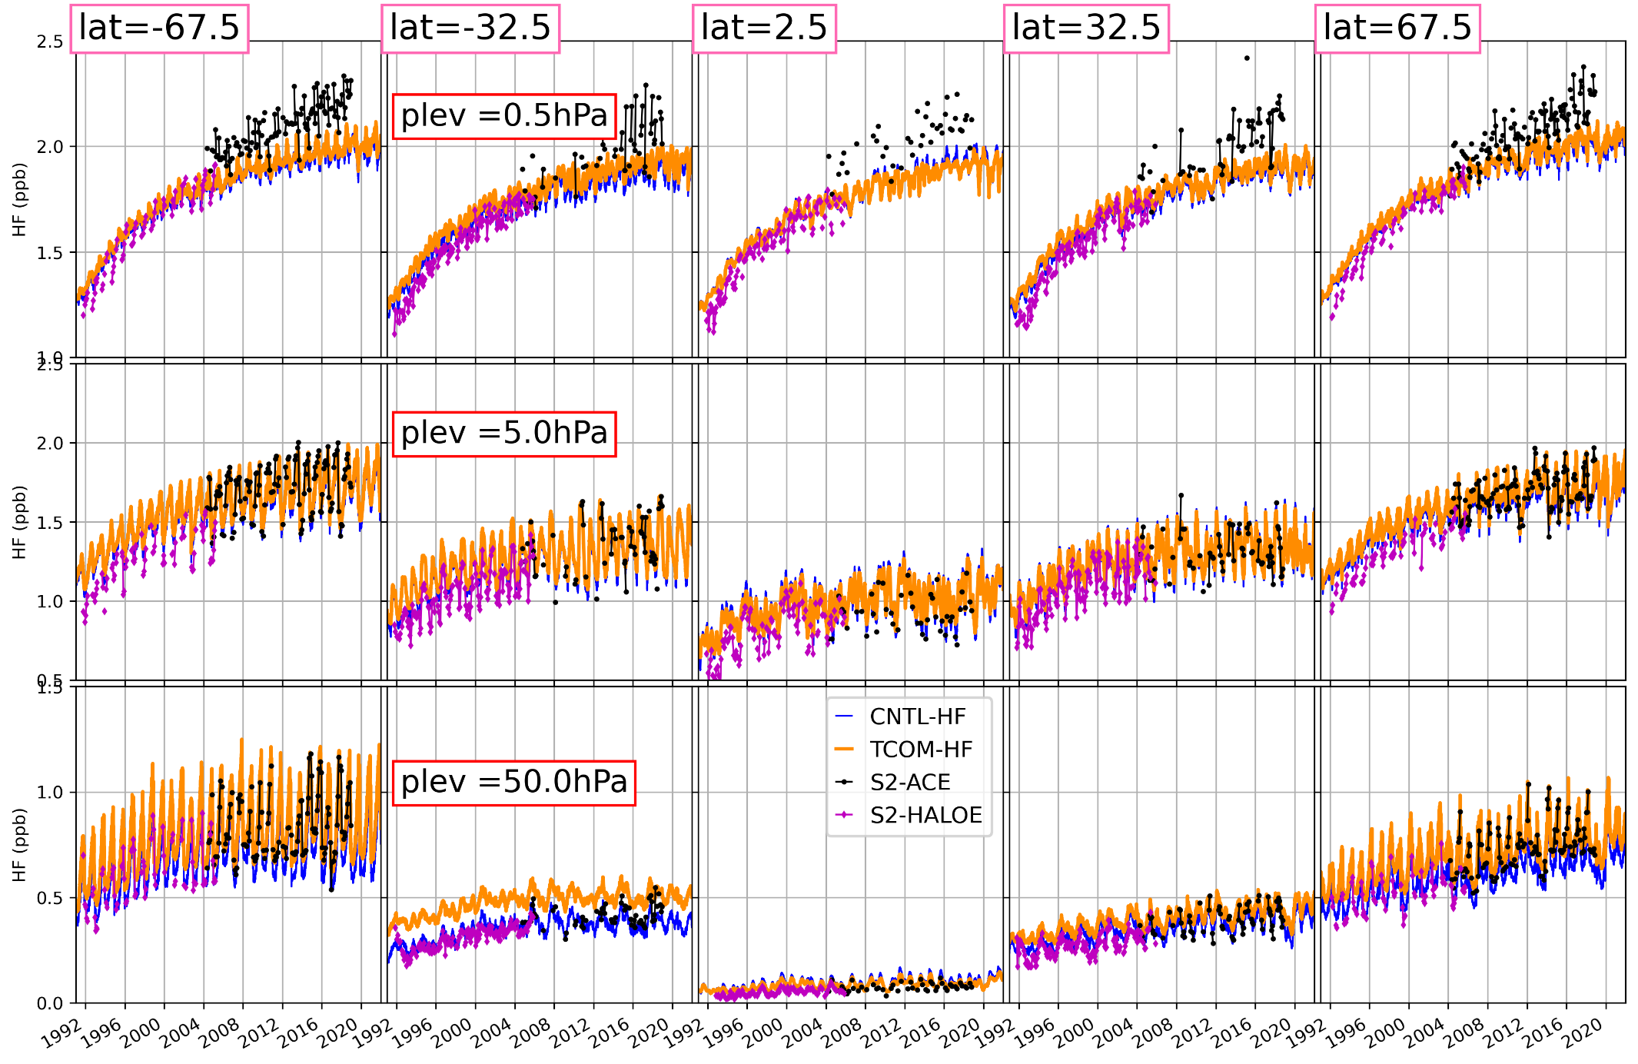
Comparison with SPARC HF data (Hegglin et al., 2021)

Slide 14
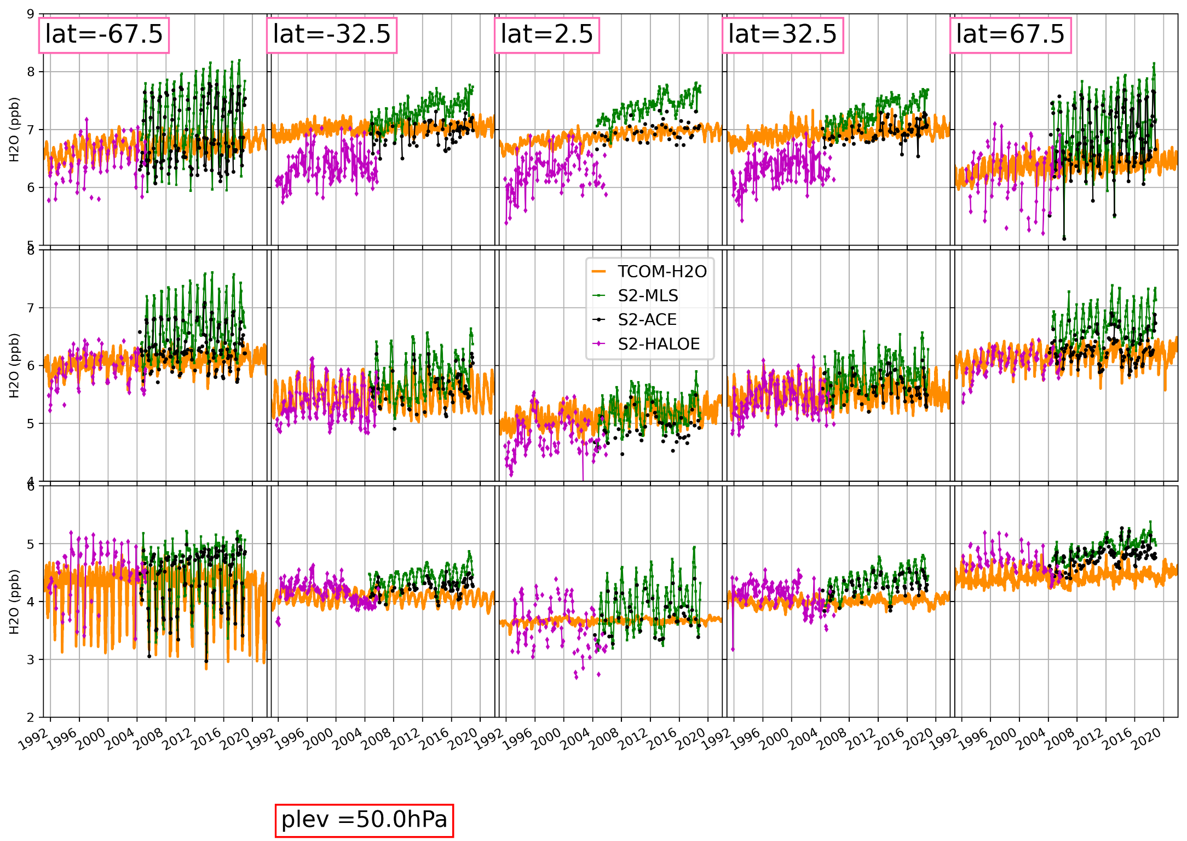
Comparison with SPARC H2O data (Hegglin et al., 2021)

Slide 15
Summary &Outlook
There are very few long-term data sets for the stratospheric species
We use machine learning algorithm to estimate biases chemical model output w.r.t. occultation instrument measurements
Bias corrected daily-global zonal mean gap-free data at 1 km vertical resolution (15-60~km) is released on zenodo
Manuscript https://doi.org/10.5194/essd-2023-47, in review, 2023
CH4- https://doi.org/10.5281/zenodo.7293740
N2O - https://doi.org/10.5281/zenodo.7386001
HCl -https://doi.org/10.5281/zenodo.7608194
HF - https://doi.org/10.5281/zenodo.7607564
O3 - https://doi.org/10.5281/zenodo.7833154
Daily 3D data is available on request (s.s.dhomse@leeds.ac.uk)

