Slide 1
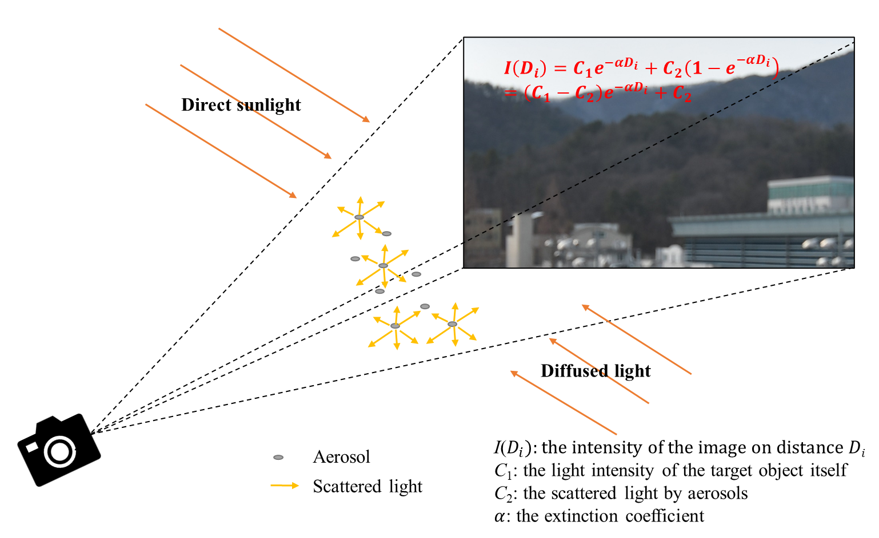
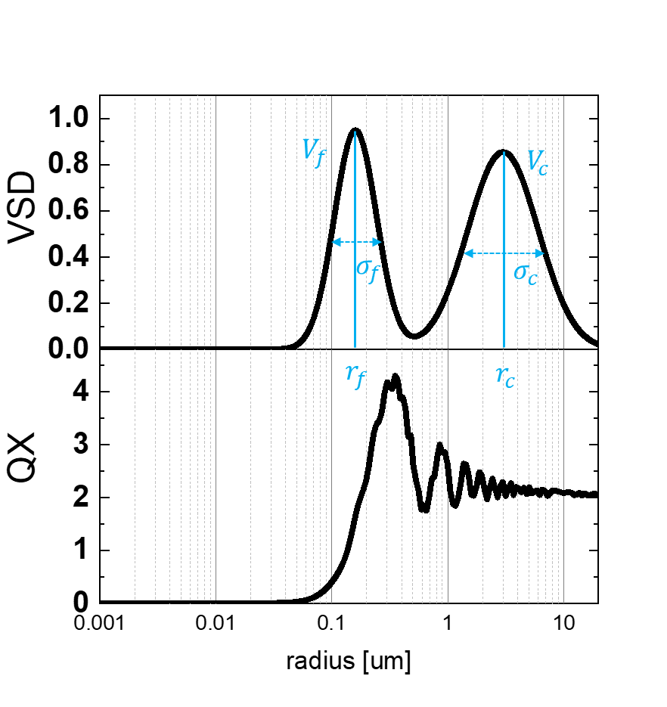
Estimation on refractive index of ambient aerosols as fine- and coarse-mode volume size distribution
Ju-seon Shin, Juhyeon Sim, Dukhyun Kim¹ and Youngmin Noh
Abstract
Division of Earth Environmental System Science, Pukyong National University, Busan, Republic of Korea
⁽¹⁾ School of Basic Science, Hanbat National University, Daejeon, Republic of Korea
Presentation Link:
Introduction
Results
Importance of Refractive index (RI) - RI has information on aerosol optical properties like shape and size - cause making errors on direct aerosol radiative forcing (DARF) and climate change models
Limitation on existing methods - Chemical method: collaborate known RI of chemical species and their volume ratio - Optical method: based on Mie theory using measure Extinction coefficient and size distribution → Measurement and analysis process takes much time, so it’s difficult to apply for long-term or real-time measurement
Site1: Port area (Yongdang/Busan/Korea)
Site2: Small industrial and residential area (Gimhae-si/Gyeongsangnam-do/Korea)
0.80 ± 0.58 ${μm}^{3}{cm}^{−3}$
4.73 ± 1.52 ${μm}^{3}{cm}^{−3}$
Mass | Slope | R²
PM₁₀ | 0.73 | 0.75
PM_{2.5} | 0.92 | 0.91
PM₁ | 0.99 | 0.98
0.11 ± 0.03$μm$
1.92 ± 0.10 $μm$
1.37 ± 0.05
Wavelength | Slope | R²
R | 0.89 | 0.76
G | 1.11 | 0.84
B | 1.12 | 0.84
Method
Size and PM mass concentration from OPC
Extinction coefficient from camera analysis on different wavelength
Retrieve the real part of RI based on the Mie theory
Figure1. Retrieved volume size distribution
from mass (site1)
Figure2. PM mass, Extinction coefficient and retrieved the real part of RI (site1)
Figure3. Validation of VSD parameters and retrieved RI
(site1)
0.69 ± 0.53 ${μm}^{3}{cm}^{−3}$
4.83 ± 1.31 ${μm}^{3}{cm}^{−3}$
Mass | Slope | R²
PM₁₀ | 0.73 | 0.85
PM_{2.5} | 0.93 | 0.93
PM₁ | 0.99 | 0.96
0.11 ± 0.0$2 μm$
1.94 ± 0.11 $μm$
$$\frac{dV(r)}{dlog(r)}=\sum_{k=f,c}{\frac{V_{k}}{\sqrt{2π}(\log\left(σ_{k}\right))}e^{−\frac{{(\log\left(r_{k}\right)−\log\left(r\right))}^{2}}{2{(logσ_{k})}^{2}}}}$$
1.37 ± 0.07
Wavelength | Slope | R²
R | 0.62 | 0.41
G | 0.80 | 0.56
B | 0.92 | 0.67
$V_{f} and V_{c} :$Volume of fine/coarse peak
$r_{f} and r_{c} :$Median radius of fine/coarse peak
$σ_{f} and σ_{c}:$Width of fine/coarse peak
Figure4. Retrieved volume size distribution
from mass (site2)
Figure5. PM mass, Extinction coefficient and retrieved the real part of RI (site2)
Figure6. Validation of VSD parameters and retrieved RI (site2)
$$α\left(λ,m\right)=\int_{0}^{∞}{Q\left(λ,r,m\right)πr^{2}N\left(r\right)dr}$$
$$=\int_{0}^{∞}{Q\left(λ,r,m\right)\frac{3}{4}\frac{1}{r}V\left(r\right)dr }$$
Conclusion
Fundings & Contacts
The real part of RI is an important parameter related to aerosol properties.
We tried to retrieve the real part of RI using OPC mass concentration and extinction coefficient measured by camera image.
The retrieval of RI is possible if we know the size information and have extinction coefficients on different wavelengths.
The research should proceed further, considering aerosol types and meteorological conditions. If we successfully retrieve RI in this way, we could apply this method to long-term measurement and climate models.
This work was supported by the Agency for Defense Development by the Korean Government(UI220035ZD)
Author contact
Juseon Shin: juseonshin@pukyong.ac.kr
$α$: Extinction coefficient
$$Q:Extinction efficiency$$
$$r:radius$$
$$m:refarctive index$$
QX: Extinction efficiency (depending on real part of RI)

