Slide 1
Efficient software for sediment yield minimization by afforestation
Grethell Castillo Reyes^{1,2}, René Estrella³, Karen Gabriels², Jos Van Orshoven², Floris Abrams², Dirk Roose²
¹University of Informatic Sciences, Cuba (gcreyes@uci.cu)
²KU Leuven, Belgium
³University of Cuenca, Ecuador
Home
Overview
Motivation
Implementation
Results

Slide 2
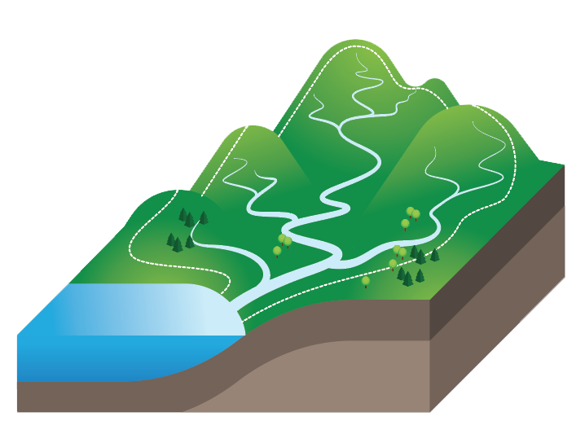
Overview
✓
Afforestation can reduce the outflow of sediment in a river catchment
✓
✓
Spatial interaction
Changes in a location have impact on neighboring locations
CAMF Software for
Minimizing Sediment Yield
?
Where to Afforest?
Iterative process to select the optimal sites
Home
Overview
Motivation
Implementation
Results

Slide 3
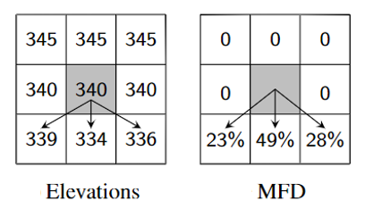
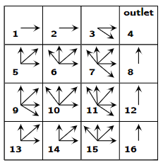
Motivation
Traverse a large fraction of cells requires high computational cost.
Execution time prohibitively expensive for large geo-databases.
Adaptations to the algorithm to reduce the computational cost
graph
Home
Overview
Motivation
Implementation
Results

Slide 4
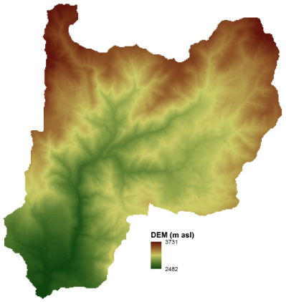
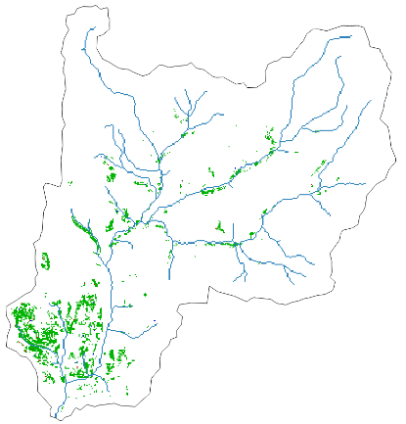
Implementation & Results
1
2
3
Parallelization for multi-core processors
Reduce the number of iterations
Reduce the cost of an iteration
Preserving spatial interaction.
Accelerated version can be four orders of magnitude faster than the original.
Loss in solution quality is negligible.
Home
Overview
Motivation
Implementation
Results

Slide 5
Efficient software for sediment yield minimization by afforestation
Grethell Castillo Reyes^{1,2}, René Estrella³, Karen Gabriels², Jos Van Orshoven², Floris Abrams², Dirk Roose²
¹University of Informatic Sciences, Cuba (gcreyes@uci.cu); ²KU Leuven, Belgium; ³University of Cuenca, Ecuador
Home
Go to the main page and section menu
Overview
General problem statement. Optimization problem in presence of spatial interaction
Home
Motivation
Computational cost of iterative processes in raster databases
Overview
Motivation
Implementation
A-CAMF: Computational cost reduction versus loss of accuracy.
Results
Case study. Concluding results
Implementation
Results

Slide 6
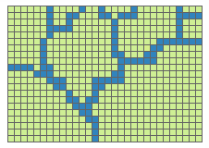
Overview
✓
CAMF Method for
Minimizing Sediment Yield
Afforestation can reduce the outflow of sediment in a river catchment
Reforest n cells
Raster inputs:
Elevation and land use data
Annual sediment produced locally before and after afforestation
✓
✓
Spatial interaction
Changes in a location have impact on neighboring locations
For each candidate cell not yet afforested
Tentatively afforestation of the cell
?
Compute Sediment Accumulation matrix
No
Where to Afforest?
Compute Sediment Yield Reduction SYR at outlet and select cells with highest SRY
Goal is reached?
Yes
Home
Overview
Motivation
Implementation
Results

Slide 7
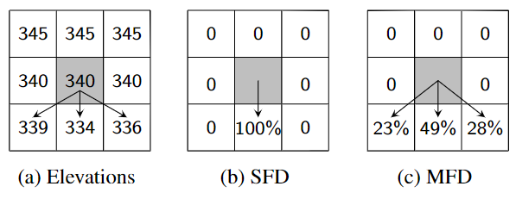
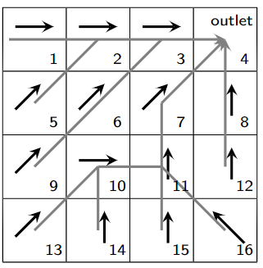
Motivation
MFD increases relationships among cells.
Computational cost of one iteration of CAMF-MFD:
100 x CAMF-SFD.
Execution time prohibitively expensive for large geo-databases.
Adaptations to the algorithm to reduce the computational cost
Spatial
interaction
tree
graph
Home
Overview
Motivation
Implementation
Results

Slide 8
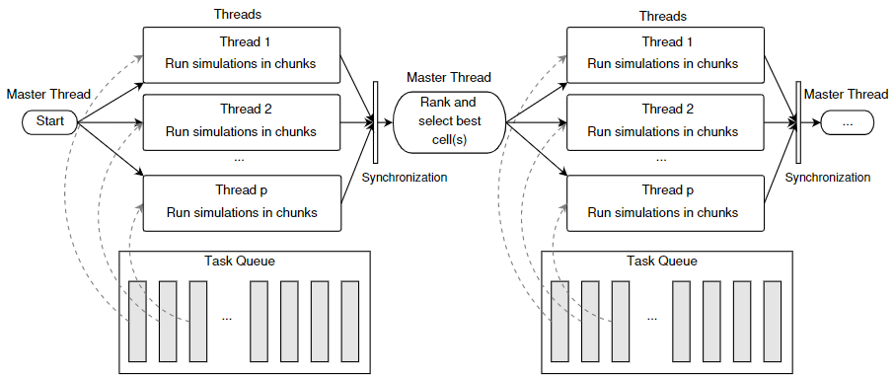
Implementation
In each iteration:
Tentatively afforest each candidate cell.
Independent calculations.
Can be done in parallel.
Open Multi-Processing (OpenMP) directives are used.
Dynamic scheduling to minimize load imbalance.
Figure. Representation of the parallel execution of the first iterations, using p threads and dynamic load balancing in A-CAMF.
Home
Overview
Motivation
Implementation
Results

Slide 9
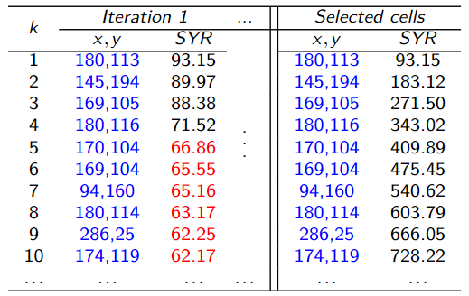
Implementation
Selection of several cells per iteration:
Spatial interaction: select one cell per iteration; re-compute ranking in every iteration.
More than one cell with the same maximum reduction of sediment at the outlet, is exceptional.
User-defined threshold to select several cells in an iteration.
Home
Overview
Motivation
Implementation
Results

Slide 10
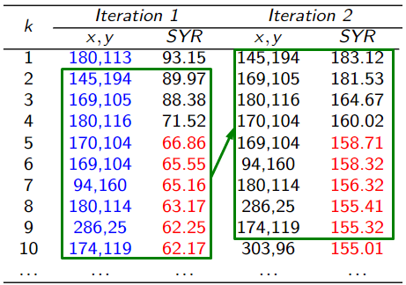
Implementation
Re-using the ranking:
In subsequent iterations the top of the ranking cells consists of (almost) the same cells.
A-CAMF only calculates the complete ranking every K iterations.
In intermediate iterations it computes only the effect of afforesting a cell for the cells in the “top N” of the complete ranking.
A tuning process was implemented, aiming at a compromise between accuracy and computational cost.
Home
Overview
Motivation
Implementation
Results

Slide 11
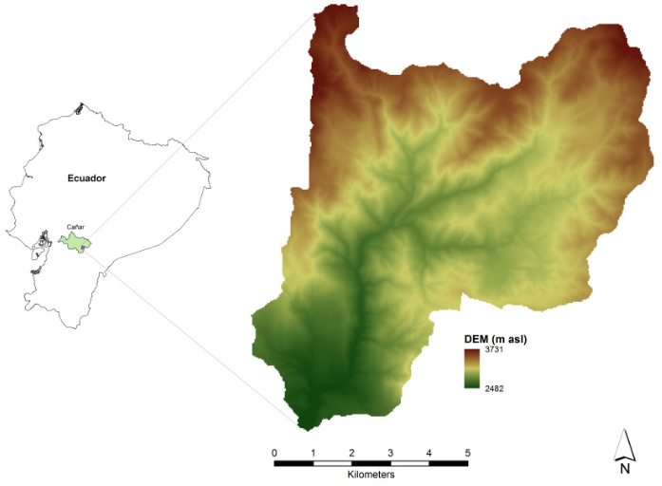
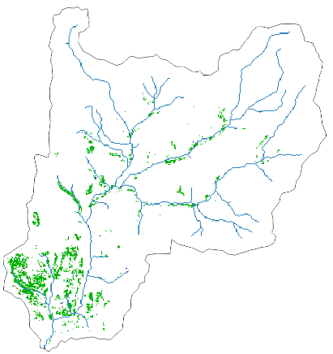
Results
Figure. Spatial coincidence of the afforested cells by CAMF-MDF and A-CAMF. Afforestation of 10% of the candidate cells in the Tabacay catchment when both algorithmic accelerations are active with T=0.1, K = 20 and N = 1500.
Figure. Digital Elevation Model of the Tabacay catchment and its location in Ecuador. It consists of 355 x 356 cells of 30m x 30m.
Home
Overview
Motivation
Implementation
Results

Slide 12
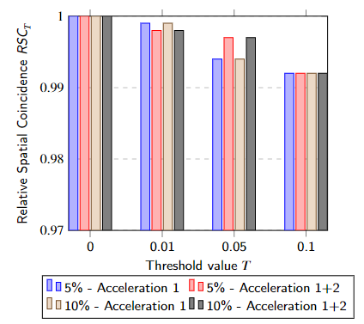
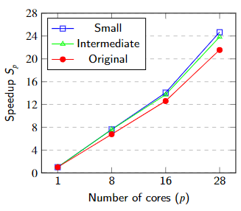
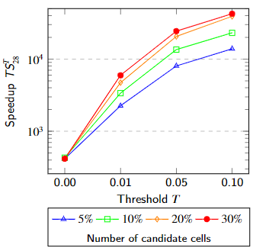
Results
Figure. Speedup $S_{p}$ of CAMF-MFD (one iteration) for the Tabacay data-sets. Small: 1/16 of the original data-set; Intermediate: 1/4 of the original data-set.
Figure. Relative Spatial Coincidence after afforesting 5% and 10% of the candidate cells with A-CAMF. K = 20 and N = 1 500.
Figure. Total speedup ${TS}_{p}$of A-CAMF. K = 20 and N = 1500.
Executing A-CAMF on many cores, with well-chosen parameters can be four orders of magnitude faster than the original sequential CAMF.
Including timings of the tuning process A-CAMF is substantially faster (with a factor > 100) than executing CAMF.
Home
Overview
Motivation
Implementation
Results

Slide 13
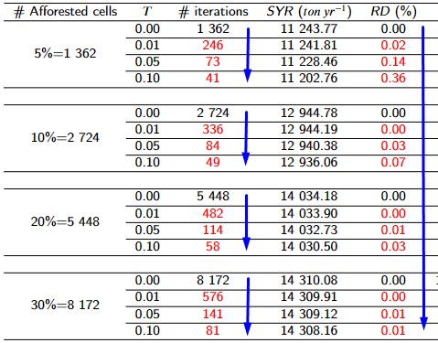
Results
Table. Performance of A-CAMF when K=20, N=1500. T: threshold value; RD: relative difference between the results of CAMF-MFD and A-CAMF (%); # afforested cells: 5%, 10%, 20% and 30% of the candidate cells.
For the current test case:
The number of iterations and the runtime can be reduced by a factor up to 100, while the effect on the solution quality is negligible.
Relative difference between results of CAMF and A-CAMF decreases when the number of selected cells increases.
Home
Overview
Motivation
Implementation
Results

Slide 14
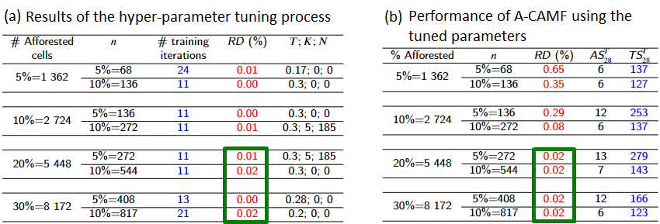
Results
Table. Results of the hyper-parameter tuning process, with RD_{MAX}=0.02; T_{MAX}=0.3; K_{MAX}=50; T_{STEP}=0.01; K_{STEP}=5.
For the current test case:
When 20% and 30% of the cells are afforested, the predicted RD (a) is nearly equal to the actual RD (b), indicating that the SYR computed by A-CAMF with the tuned parameters is sufficiently accurate.
When 5% and 10% of the cells are afforested, the large difference between RD indicates that the small number of cells n used in the tuning process is not sufficient to tune the parameters.
Executing the tuning procedure and subsequently A-CAMF is substantially faster (with a factor > 100) than executing CAMF.
Home
Overview
Motivation
Implementation
Results

Slide 15
Efficient software for sediment yield minimization by afforestation
Grethell Castillo Reyes^{1,2}, René Estrella³, Karen Gabriels², Jos Van Orshoven², Floris Abrams², Dirk Roose²
¹University of Informatic Sciences, Cuba (gcreyes@uci.cu); ²KU Leuven, Belgium; ³University of Cuenca, Ecuador
Home
Go to the main page and section menu
Overview
General problem statement. Optimization problem in presence of spatial interaction
Home
Motivation
Computational cost of iterative processes in raster databases
Overview
Motivation
Implementation
A-CAMF: Computational cost reduction versus loss of accuracy.
Results
Case study. Concluding results
Implementation
Results

