Slide 1
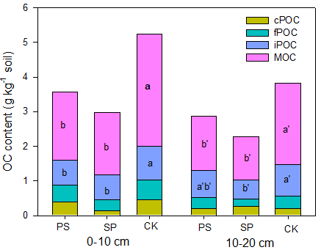
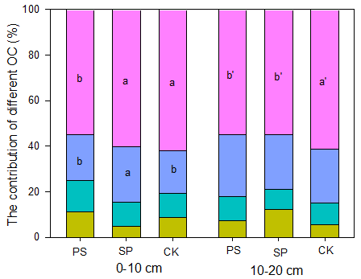
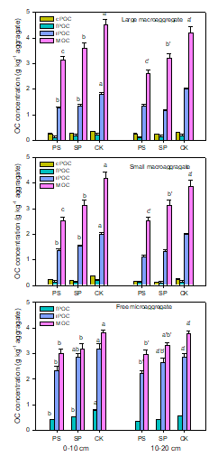
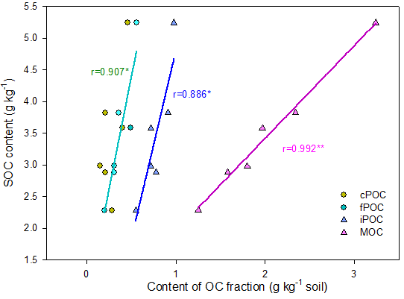
Afforestation with Caragana korshinskii enhances the quantity and stability of soil organic carbon in the northern Loess Plateau, China
Chi Tianqi¹, Li Yangyang²*, Zhang Xiaoping²
(1 College of Forestry, Northwest A&F University, Yangling Shaanxi 712100, China; 2 State Key Laboratory of Soil Erosion and Dryland Farming, Institute of Soil and Water Conservation, Northwest A&F University, Yangling Shaanxi 712100, China)
Backgrounds: The northern Loess Plateau, China is an eco-environment fragile zone with the most serious soil and water loss in the world. Hence, soil face the direct threat of texture coarsening, fertility decline and loss of microbial biodiversity, etc. Selecting rational afforestation species will be beneficial for the maintenance and improvement of soil structure and function in this area. Populus simoni (PS, tree), Caragana korshinskii (CK, shrub) and Salix psammophila (SP, shrub) are major perennial woody plants for afforestation in this region, but it is not clear how long-term plantation of these plants affect the quantity and stability of soil organic carbon (SOC) and whether the afforestation species are sustainable for soil resources.
Methods: Wet sieving method (Aggregates),
physico-chemical methods (OC fractions)
(a)
Fig.3 Concentration of cPOC, fPOC, iPOC and MOC for large macroaggregate (a), small macroaggregate
(b) and free microaggregate (c)
(b)
Fig.4 Content and the contributions of different organic carbon fractions
(c)
Fig.5 Relationship between content of organic carbon fractions and SOC
Fig.1 SOC content in two soil depths of three stands
(a)
(b)
Results and conclusions
SOC content for CK stands increased significantly compared to PS and SP stands.
The <0.25 mm microaggregate content accounted for more than 74% for three stands, CK stands had higher free microaggregate during both depths and higher small macroaggregate at 0-10 cm compared to PS and SP stands, MWD for CK stands were also significantly higher.
CK stand had higher protected C content than the other two stands，protected C content was significantly positively correlated with the SOC across treatments.
long-term C. korshinskii planation can increase the quantity and stability of SOC via increasing the content of protected C.
Fig.2 The mass distribution of soil aggregates and silt+clay (a) and mean weight diameter of the soils (b)

