Slide 1


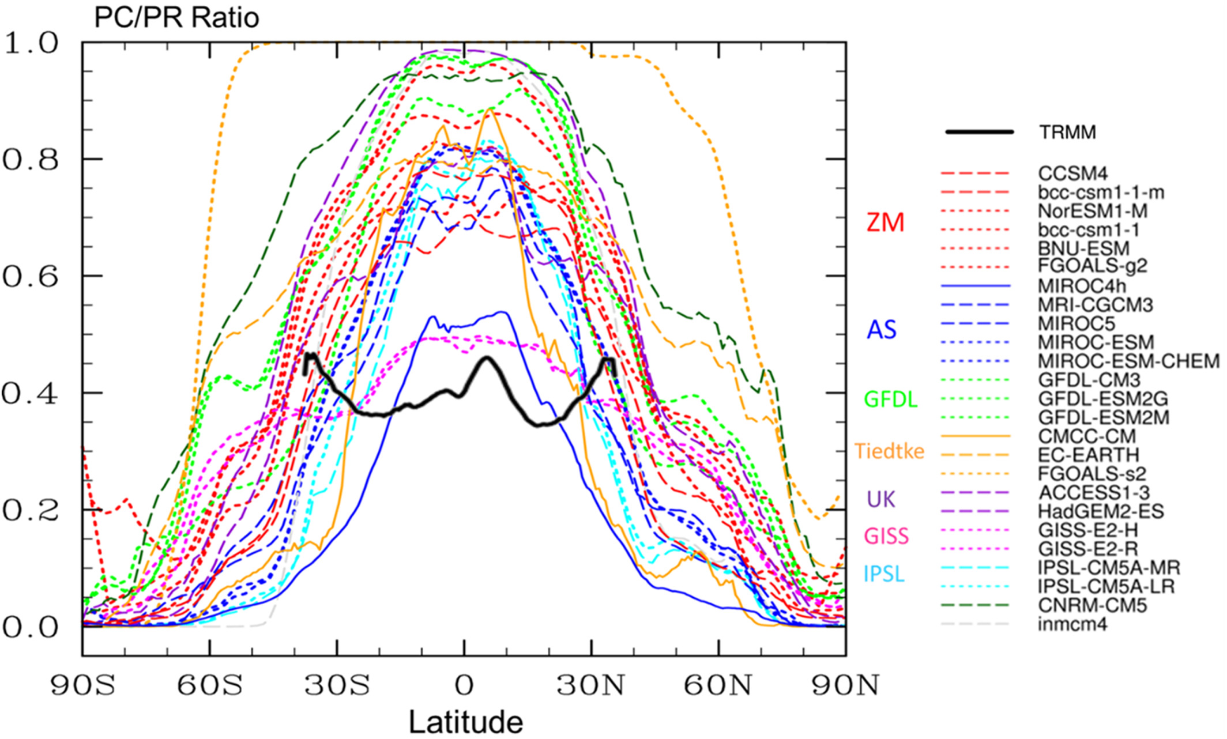
Impact of parameterized convection on the storm track and jet stream response to global warming: implications for mechanisms of the future poleward shift
Benny Keller, Chaim I. Garfinkel, Ian White, Martin Jucker, Edwin Gerber
1. Introduction and Conclusions
3. What mechanisms are consistent with the sensitivity of the jet shift to the convection scheme?
Which forcings and processes govern the projected future poleward shift of the midlatitude circulation and subtropical drying?
Is the poleward shift sensitive to the convective parameterization, which is poorly constrained and still under development in models?
Tools:
An intermediate-complexity moist general circulation model (MiMA) with realistic radiation (Garfinkel et al 2020; Jucker and Gerber 2017).
We have performed simulations with 1x CO₂ and 4x CO₂ with all eight possible combinations of the three different parameter settings of the convection scheme: (1) shallow convection on/off; (2) critical relative humidity for the profile relaxed back towards (0.7 or 0.8); (3) whether precipitation should be proportional to CAPE or not
For simplicity, two configurations are known as convection promoted and convection inhibited by changing the Betts Miller tuning parameters to mimic the defaults of Jucker and Gerber 2017 and Frierson et al 2007 respectively. (Promoted: critical relative humidity of 0.7 and shallow convection turned on; Inhibited: critical relative humidity of 0.8 and shallow convection turned off).
Main conclusions:
The jet shift is robust only for the convection inhibited setting (box 2), possibly explaining for some of the intermodel spread in CMIP.
The following mechanisms cannot account for the dependence of the poleward shift on the convective scheme settings: raised tropopause height, tropical upper tropospheric warming or diabatic heating, Arctic amplification, increased subtropical lapse rate, shift towards longer wavelength, moist static energy poleward flux, shift towards faster phase speeds, eddy feedback strength. In other words, these factors change similarly both in promoted and inhibited, and thus cannot explain the lack of a jet response in promoted. These mechanisms are therefore not necessary for the poleward shift (box 3)
The following mechanisms are consistent with the poleward shift: changes in eddy momentum flux convergence, changes in diabatic heating in the subpolar mid- and lower-troposphere.
Temperature response to increased CO₂ [K]
convection promoted
convection inhibited
Reject these mechanisms:
Tropical upper tropospheric warming
Tropopause height lapse rate increase
Arctic amplification
Jet latitude
Asterisks mark tropopause in
1x and 4x CO₂
Shading marks response to higher CO₂
If a mechanisms is equally present or even more strongly present in the convection promoted run but nonetheless the jet doesn’t shift poleward, then this mechanism is at most of secondary importance.
All mechanisms based on the zonally symmetric temperature response are of secondary importance at most.
These configurations span the range of the ration of large-scale to convective precipitation evident in CMIP models (Chen et al 2021)
Total diabatic heating response to increased CO₂[K/day], radiation+latent
convection promoted
convection inhibited
Black/magenta contours mark climatology
Shading marks response to higher CO₂
K/day
All runs have tropical upper tropospheric warming and subtropical cooling (though relative contributions of radiation, convective heating, and large scale heating differs). So tropical upper tropospheric heating seems less important
They differ in the subpolar diabatic heating well poleward of the jet latitude, and for reasons discussed in the paper this appears to be related to the jet shift.
U’V’ at 272hPa, decomposed by phase speed [m²s⁻² ∆c⁻¹ ]
Climatological jet
Shift towards
faster phase speeds
This shift is present
regardless
of whether jet shifts
polewards
convection promoted
convection inhibited
climatology
Response to CO₂
2. Zonal Wind response to 4xCO2
Jet response
DJF Zonal Wind average [m/s]
Eddy fluxes decomposed by wavenumber
convection promoted
convection inhibited
m/s
convection promoted
Shading marks response to higher CO₂
Black contours mark climatology
Asterisks and gray contours mark 1x CO₂ climatology
Colored shading and red and blue contours
mark jet response
convection inhibited
Subtropical acceleration in lowermost stratosphere evident in all configurations, however near-surface response depends on convective parameterization.
Qualitatively different hydroclimate responses as well.
Shift towards longer wavelength
Regardless of whether jet shifts polewards, eddy activity moves to longer wavelengths

