Slide 1
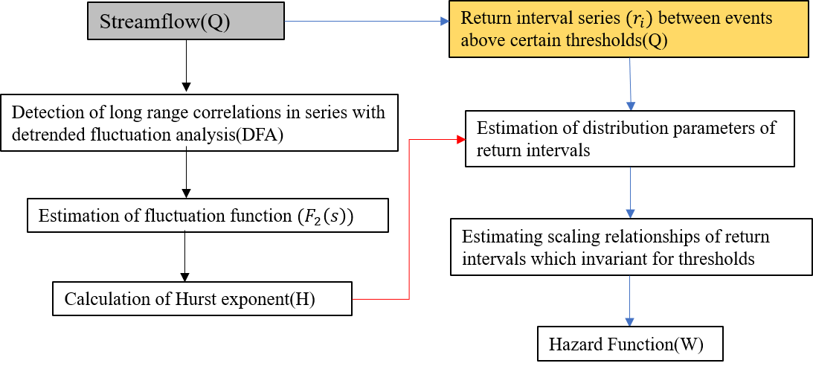
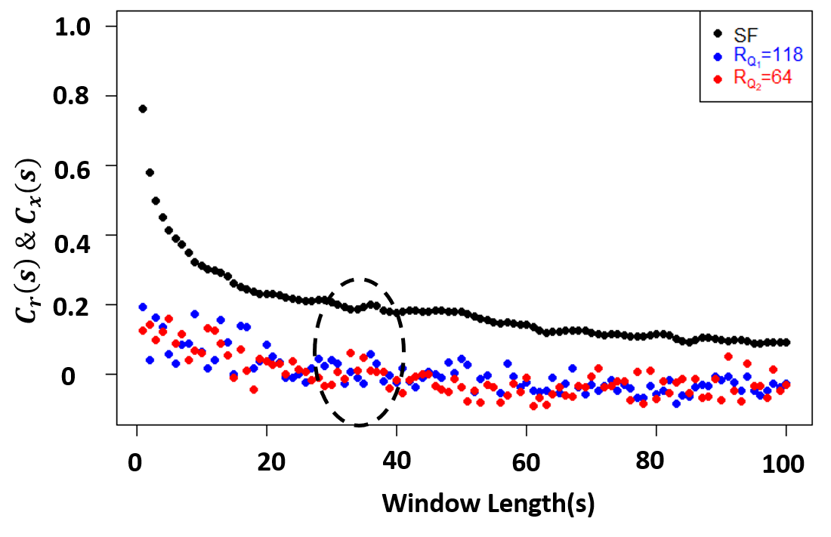
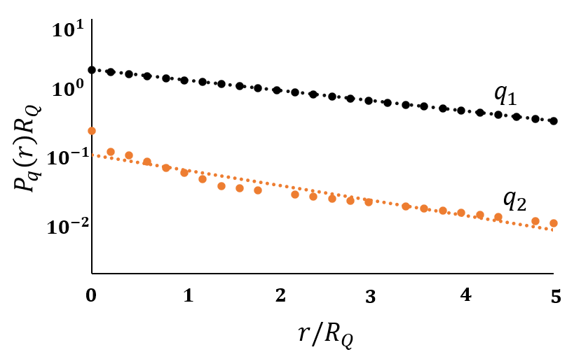
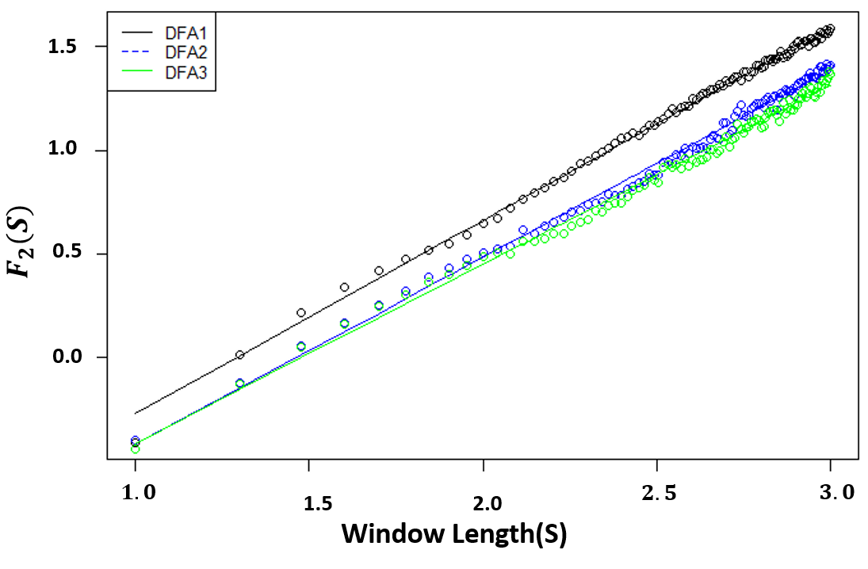
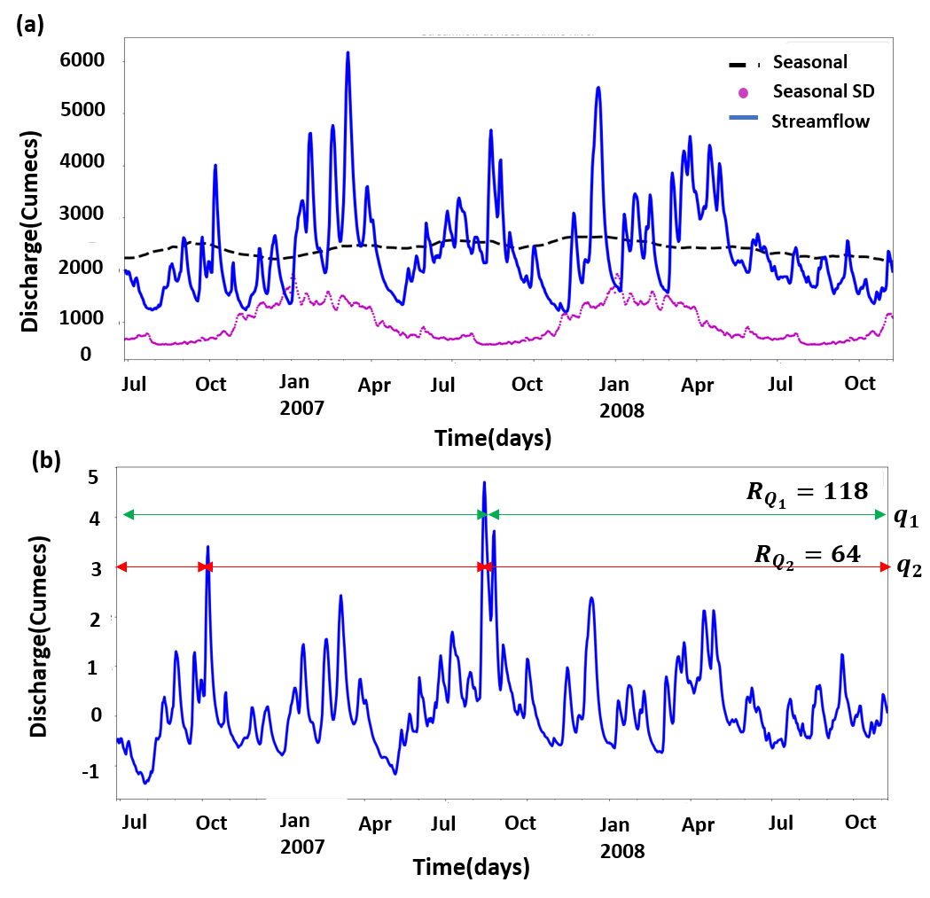
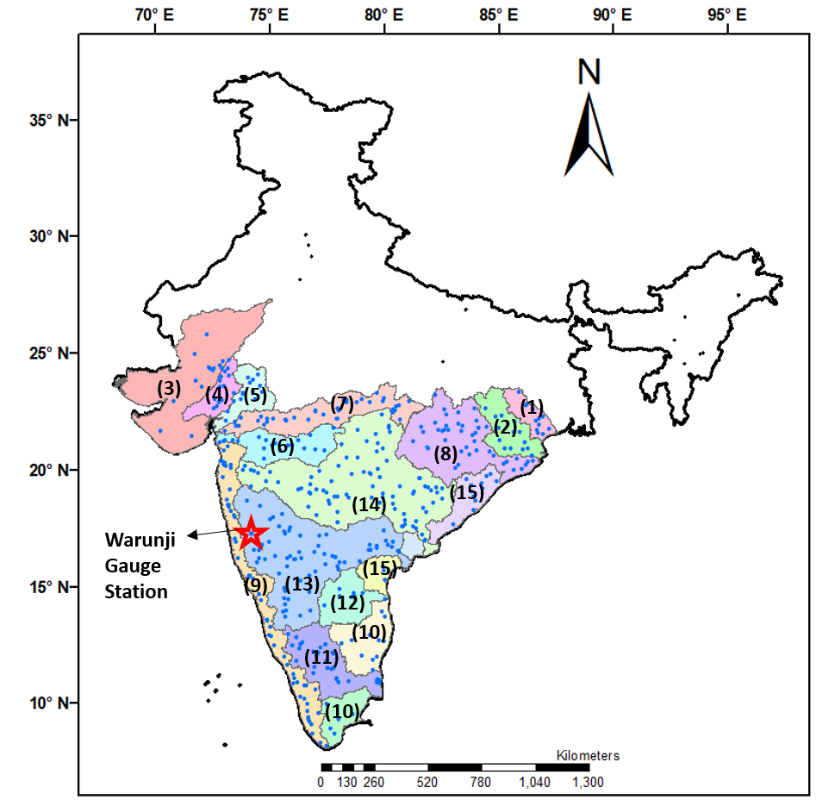
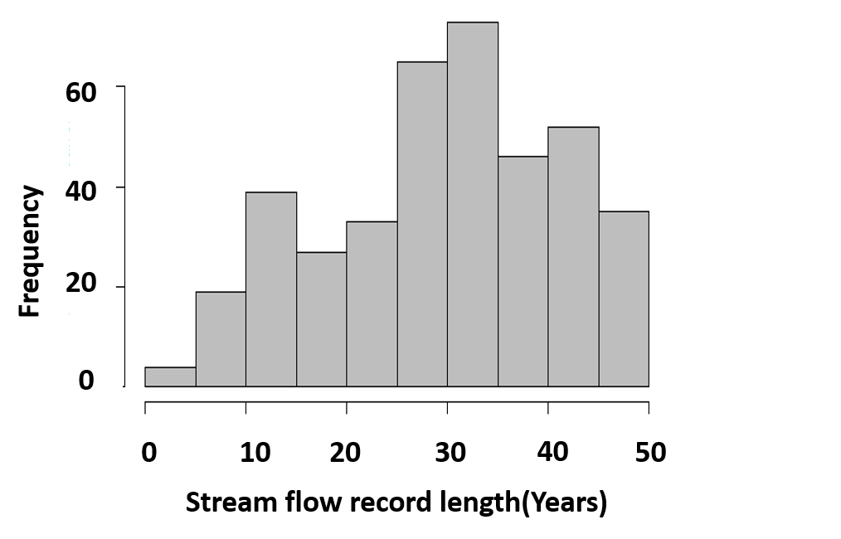
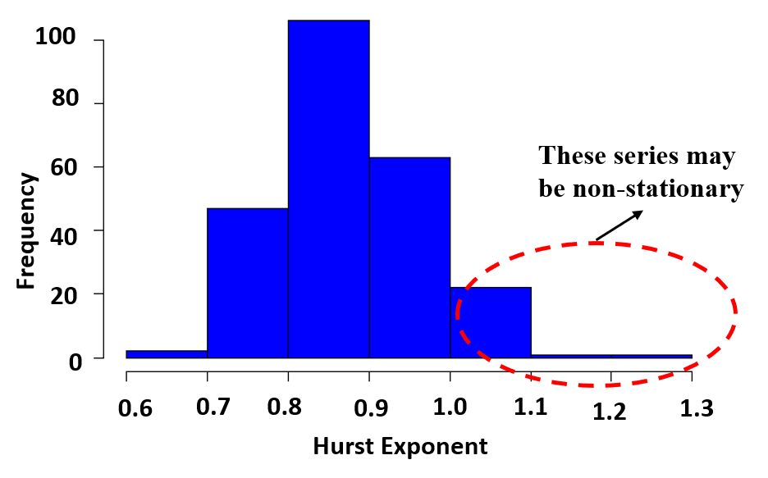
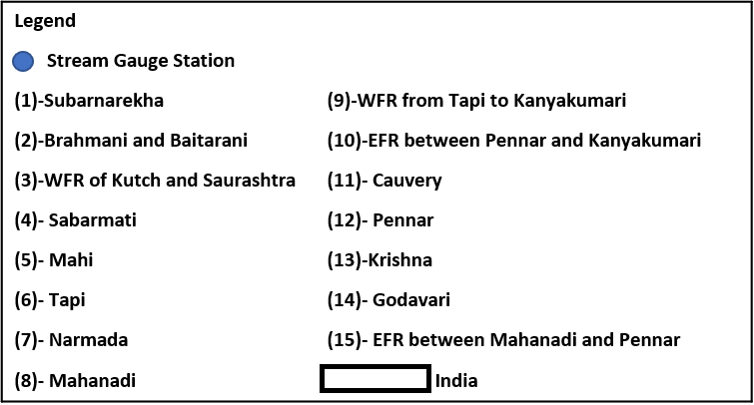
Towards Temporal Scaling Laws for the Risk Analysis of Rare Flood Events
Kanneganti Bhargav Kumar¹ and Pradeep P Mujumdar^{1,2}
¹Department of Civil Engineering, Indian Institute of Science, Bengaluru, India (kannegantibhargavkumar@gmail.com)
²Interdisciplinary Centre for Water Research, Indian Institute of Science, Bengaluru, India
INTRODUCTION
METHODOLOGY
RESULTS
Extreme flood events are rare but catastrophic and have tremendous adverse impacts on human lives and the economy.
To estimate the extreme quantiles of flood risk, traditional methods depend on historical data recorded at gauge stations, assuming that they capture a spectrum of extreme flood magnitudes.
However, the available gauge station record lengths are often small for several gauge stations, and these records are less likely to capture the full range of likely flood magnitudes.
Therefore, there is a need to develop methods that can better extrapolate the dynamics of large and rare events from historical data containing only small but frequent fluctuations.
Step -3
Long term memory implies slowly decaying auto correlation function(like shown in Figure 6) that decays by a power law i.e., $C_{x}\left(S\right)\sim S^{−γ}.$In this case, the intervals between events are likely to be long term correlated with same exponent as the original record.
The presence of long term memory in series significantly alter the occurrence of extreme events.
Step -4
Step-1
Step -5
Step -5
Step -2
Step -5
Figure 6: Autocorrelation functions(ACFs) $C_{x}\left(s\right)$ of the original data and $C_{r}(s)$ of the return interval series for $R_{q_{1}}$= 118 (blue circles) and $R_{q_{2}}$=64(red circles).The ACFs of both original data and return interval series are characterised by the same exponent $γ=−0.3$ for long time scales.
OBJECTIVES
Future step
Perform detrended fluctuation analysis to understand the long term correlations in streamflow series.
Estimation of probability distribution function of return intervals to understand occurrence of each extreme return intervals.
Estimation of threshold invariant scaling laws to extrapolate the risk to large to rare events.
RESULTS
The distribution $P_{q}\left(r\right)$ of the return intervals, for $γ=0.3$ and for two thresholds as a function of $r/R_{q}$, where $R_{q}$ is the mean return interval is shown in Figure 7.
The $P_{q}\left(r\right)R_{q}$ is only function of ratio $r/R_{q}$ , this scaling is important, since it allows us to extrapolate the behaviour at very large $q$ values from the behaviour at small$q$values that are not rare.
The framework is implemented at all gauge stations of study region, but for the purpose of illustration, results at Warunji station in Krishna basin, India are presented.
Figure 7: Distribution of $P_{q}\left(r\right)$ of the return intervals $r$ of the thresholds $q_{1}=3.0 (R_{q}=$64 , black colour), $4.0 (R_{q}=$118 , orange colour) for streamflow data at warunji, Krishna basin, India. The slope of the both lines are same indicating a threshold invariant relation between return levels of events.
STUDY AREA AND DATASETS
Step-1
Step-3
CONCLUSIONS
It is observed that return intervals are long term correlated with same exponent $(γ)$ as original record for long time scales.
This may indicate large and small return intervals are not arranged in random fashion but are expected to form clusters.
The streamflow series show that the Hurst exponent values of 35 streamflow series greater than 1.0 which indicates hydrologic processes in these catchments are non-stationary.
A threshold invariant scaling relationships are observed for the return intervals of extreme events in the study regions. These relationships can be helpful in extrapolating the risk associated with rare events at a specific site.
Figure 2: Histogram of streamflow records length(years) in study region.
Figure 4:Double logarithmic plots of the fluctuation functions $F_{2}(S)$ versus window length(S) obtained from $DFA1−DFA3.$
Step-2
Step -4
The distribution of return intervals is
Figure 5: (a) Discharge of the Krishna river at Warunji gauge station (from 1 July 2006 until 31 October 2007).The seasonal trend(black line) and the seasonal standard deviation (magenta dotted line). (b) Corresponding detrended dataset. The horizontal lines in the detrended records refer to two thresholds $q_{1}$ and $q_{2}$, with return periods $R_{q}$ of 64 and 118 days, respectively.
$$P_{q}\left(r\right)=\frac{a_{γ}}{R_{q}}\exp\left[−b_{γ}{\left(\frac{r}{R_{q}}\right)}^{γ}\right]$$
ACKNOWLEDGEMENTS
The first author acknowledges the financial support received through the Prime Ministers' Research Fellowship (ID no: 0200367), The Ministry of Education, Government of India. This work was partially funded by the project, “Advanced Hydrologic Research and Knowledge Dissemination” sponsored by the Ministry of Earth Sciences, Government of India (Project No. MOES/PAMC/H&C/41/2013-PC-II). The second author acknowledges the support received through the J.C. Bose Fellowship (grant number JCB/2018/000031).
Figure 1: Geographical extent of the study region, and streamflow gauge locations in peninsular India.
Figure 3: Histogram of the Hurst exponent(H) for 242 daily discharge series of peninsular India.
Where, $γ=2−2×H$
$$a_{γ}=\frac{γΓ\left(\frac{2}{γ}\right)}{Γ^{2}\left(\frac{1}{γ}\right)};b_{γ}=\frac{Γ(\frac{2}{γ})}{Γ(\frac{1}{γ})};Γ is gamma function.$$

