Slide 1
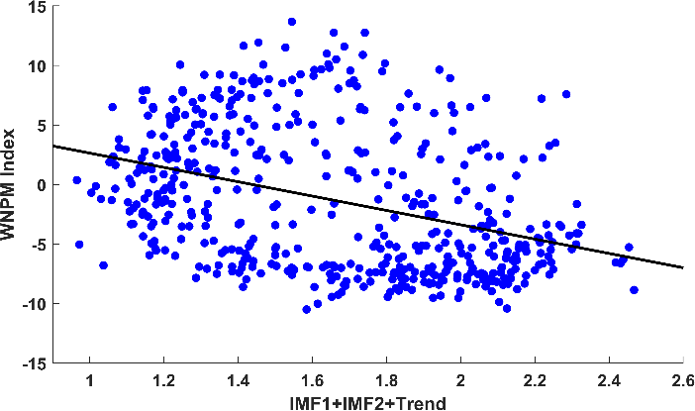
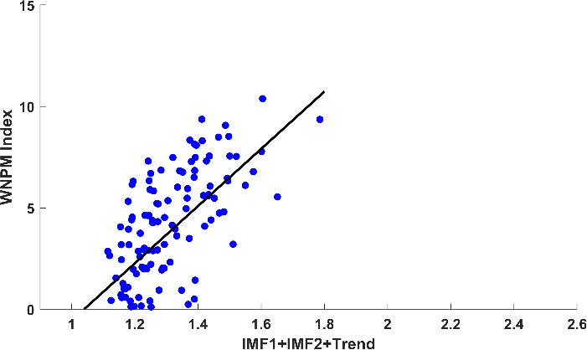
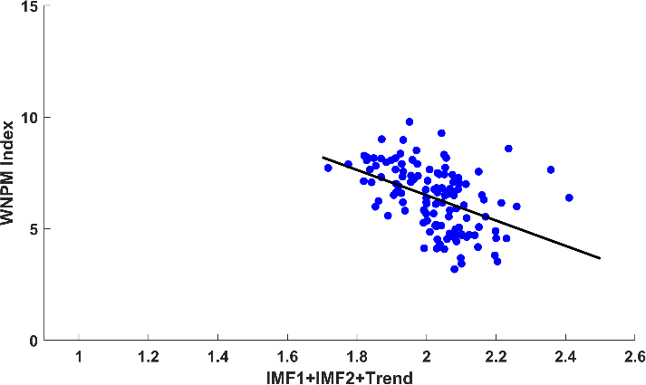
Results
1
2
3
4
2. Seasonality of Hs
European Geoscience Union General Assembly 2023
p = < 0.01
r = -0.45
Exhibit in-phase oscillation with a period of seasonal scale
Hs Higher, WNPMI negative phase
Stronger summer WNP monsoon, so do Hs
Contrast in winter
Notes:
First, for the seasonality of Hs, the time series comparison between 3-month run mean of Hs and IMF1, IMF2 and the trend (residual) from the EMD also confirm the in-phase oscillation with a period of seasonal scale. The relationship of seasonal Hs with the monsoon index is provided in this figure which shows the significantly inversed correlation. It means that the Hs values tend to be higher during the negative phase of WNP monsoon.
If we differentiate based on season, the summer WNP monsoon could increase Hs. In contrast, the winter WNP could reduce Hs values.

Slide 2
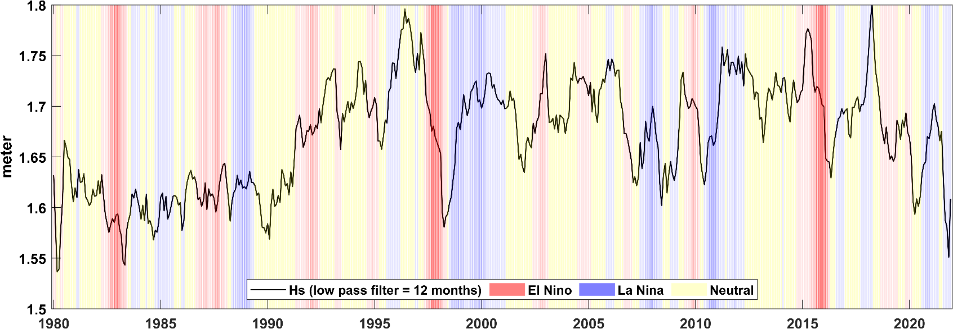
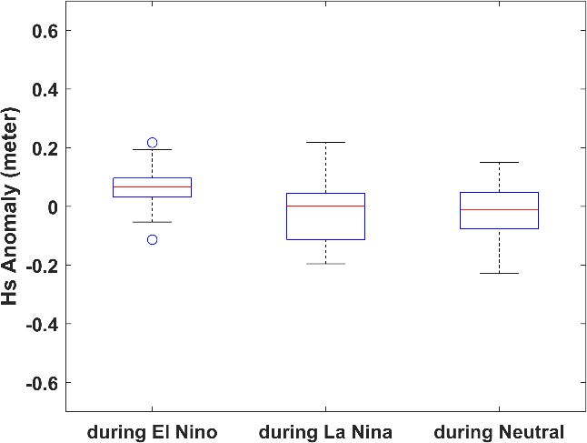
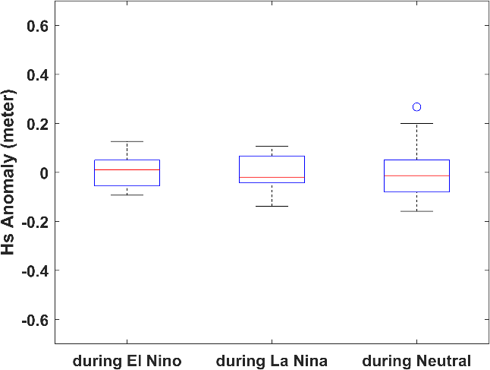
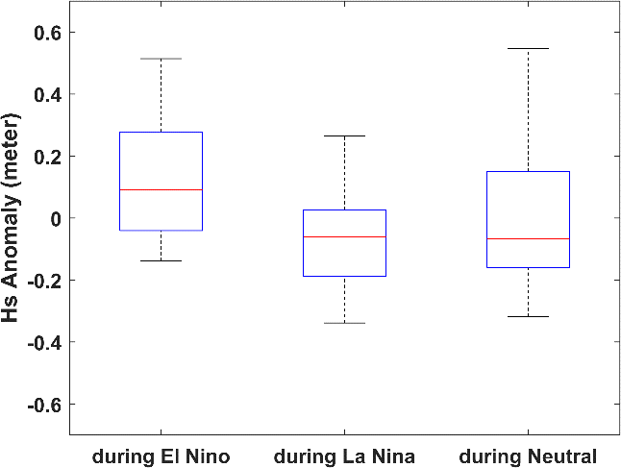
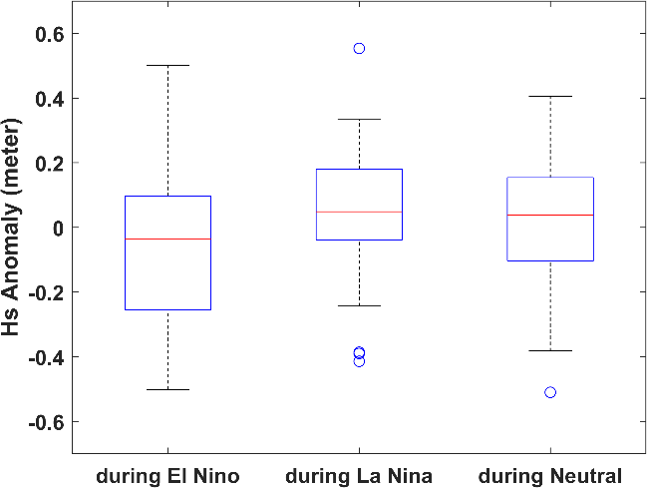
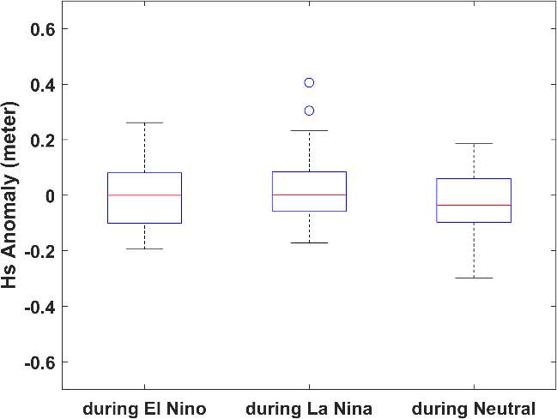
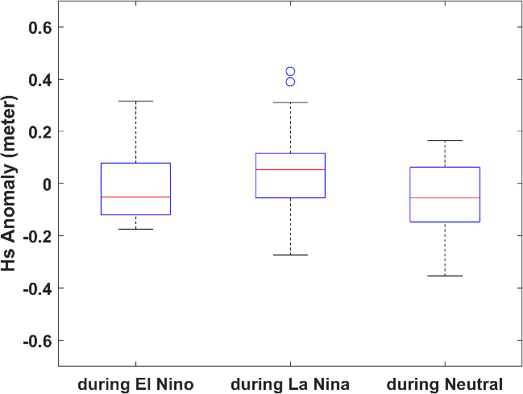
Results
1
2
3
4
3. Interannual Hs in relation to ENSO
European Geoscience Union General Assembly 2023
Hs Changes correspond to ENSO events
ES
YS
ECS
JJA
El Nino increased Hs in summer
Hs tend to be higher in winter La Nina
Hs YS is not significantly different during ENSO events
ES
YS
ECS
DJF
Notes:
And for the interannual Hs, the figure shows the time series of Hs with the lows pass 12 months denoted by black solid line and the ENSO conditions are represented by the shaded color. Red is for EL Nino and blue is for La Nina and the yellowish is for neutral condition. From this figure, Hs changes correspond to ENSO events. Hs tend to be higher during La Nina and declining during EL Nino. On the other hand, to what extent EL Nino also influence the Hs in EA? Since the seasonal monsoon system could be also altered by interannual signal like ENSO.
The distribution of Hs during ENSO conditions which separated by summer and winter season are provided in this boxplot. We can see that during summer, El Nino is more impactful than La Nina. It is indicated by the higher Hs values in ES and ECS during El Nino than neutral condition. On the other hand, during winter, Hs values tend to be lower than neutral. In fact, Hs values are higher during La Nina even though it is not significant. Furthermore, Among the EAMS, the YS is the region where the impact of ENSO is not significantly different than normal condition.

Slide 3
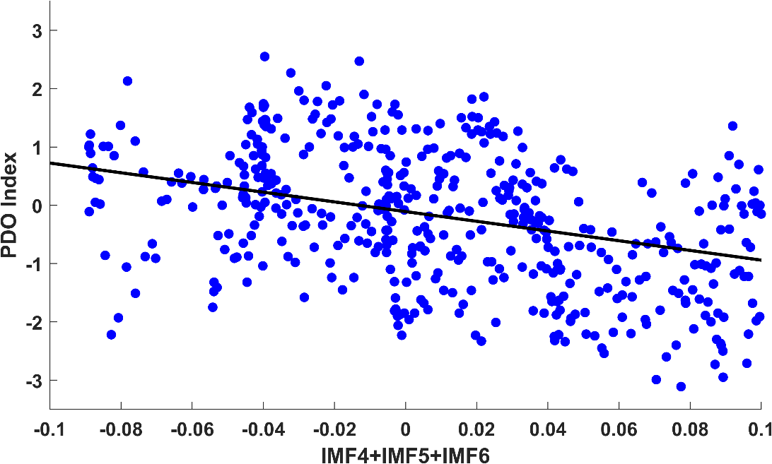
Results
1
2
3
4
4. Decadal Hs in relation to ENSO
European Geoscience Union General Assembly 2023
Decadal oscillations of Hs might be dependent on PDO

