Slide 1
Supplementary Materials

Slide 2
3.2 Understanding of Dissolved Inorganic Nitrogen transformation processes
Diagram of N transformation process
Bacterial metabolic versatile one specific bacteria does not involved in just one process

Slide 3
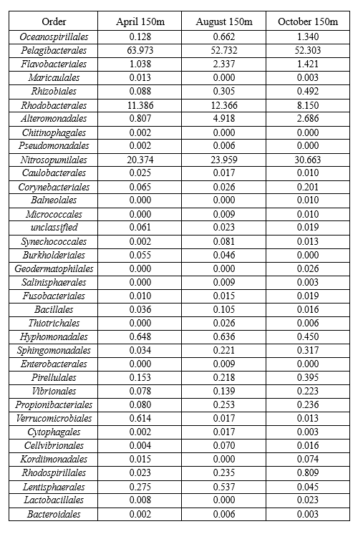
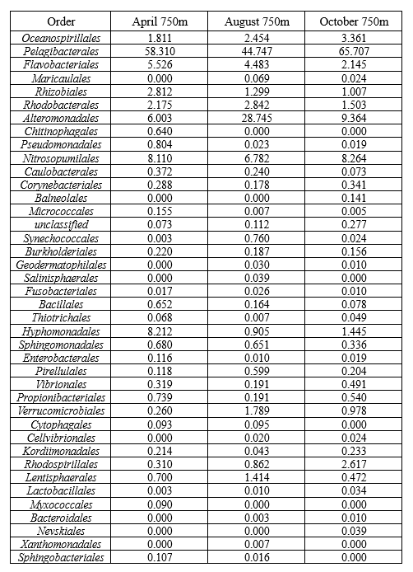
Supplementary Table. Relative abundance of bacteria taxa in order level at depth (a) 150m, (b) 750m in April, August and October of 2021.
(a)
(b)

Slide 4
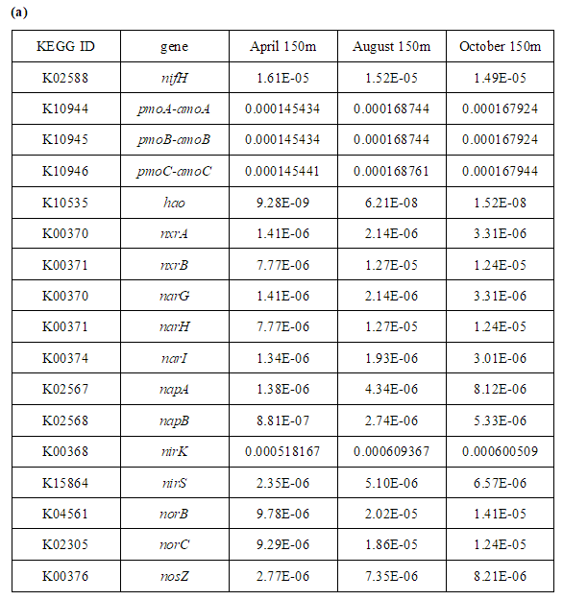
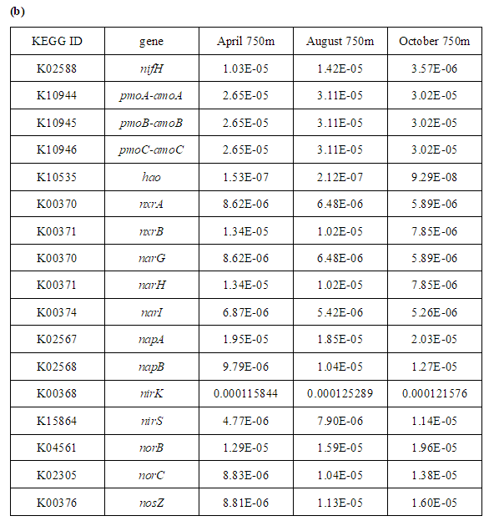
Supplementary Table. Bacterial functional gene abundance at depth (a) 150m, (b) 750m in April, August and October of 2021.

Slide 5
Supplementary Materials

Slide 6
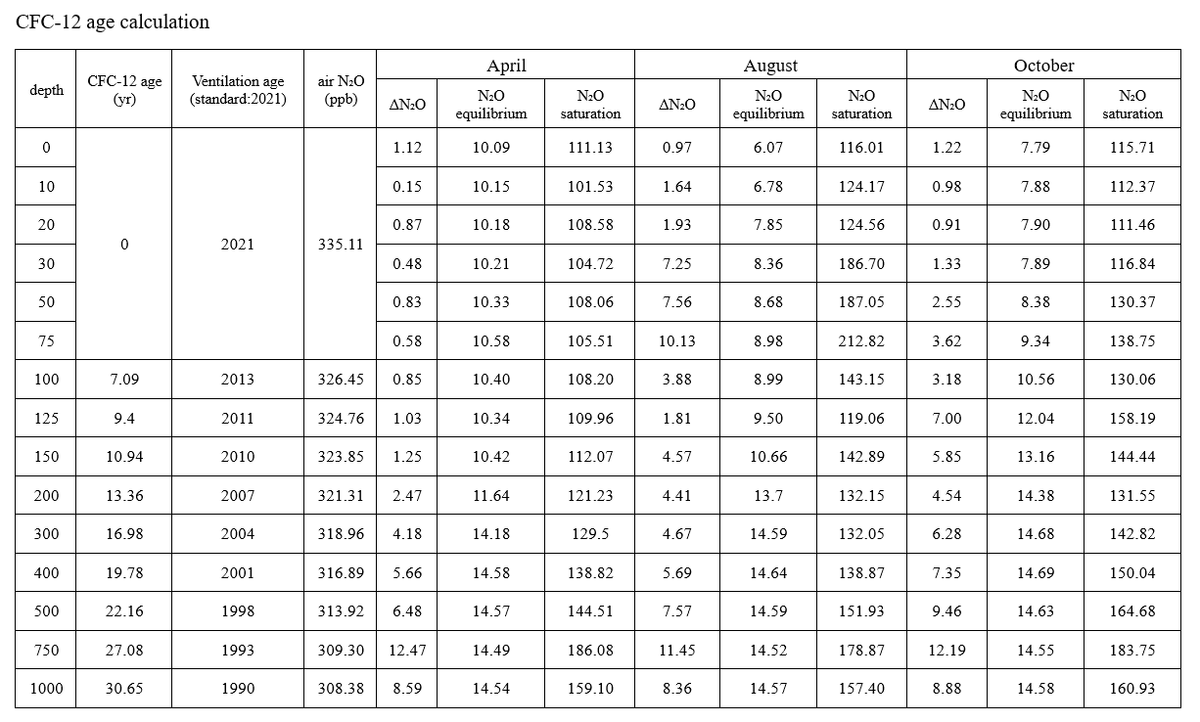
3.3 N2O production pathway

