Slide 1
An improved Weichselian seismic stratigraphic framework of the Kongsfjorden-Isfjorden Interfan region off western Svalbard from high frequency deep towed seismic data and its implication on fluid migration and methane venting
Akash Trivedi ¹, Sudipta Sarkar ¹, Stephan Ker ², and Timothy A. Minshull ³
Affiliations:
¹Department of Earth and Climate Science, Indian Institute of Science Education and Research Pune, Pune, 411008, India
² Ifremer, UMR 6538 Geo-Ocean, F-29280 Plouzané, France
³School of Ocean and Earth Science, University of Southampton, Waterfront Campus, European Way, Southampton SO14 3ZH, UK
Navigation
Click the buttons for more information
1: Introduction
2: Study area
3: Data
4: Results
5: Discussion
6: Conclusion
EGU23-4906

Slide 2
Navigation: Click the buttons for more information
Introduction
Study area
Data
Results
Discussion
Conclusion
The continental margin off the western coast of Svalbard is known for the accumulation of glaciogenic sediments, which have built up over the past 2.7 million years.
Active methane venting takes place in the upper continental slope, particularly in the interfan region between the Kongsfjorden and Isfjorden Trough Mouth Fans.
Methane venting is a result of methane hydrate dissociation caused by warming bottom water. Heterogeneous lithology in the glaciomarine sediments influences the migration, accumulation, and venting of fluids, including methane.
However, seismic imaging utilizing an airgun source in the methane venting region has not resolved the stratal architecture of the top 50 meters below the seafloor (mbsf).
We address this limitation by utilizing several deep-towed high-frequency (220–1050 Hz) SYSIF seismic lines, which offer a vertical resolution of 1 meter and a horizontal resolution of 3 meters.
Our seismic interpretation provides an improved stratigraphic framework and allows us to infer the depositional processes responsible for the distribution of glaciomarine sediments in the interfan region between the Kongsfjorden and Isfjorden Trough Mouth Fans.
Home
EGU23-4906

Slide 3
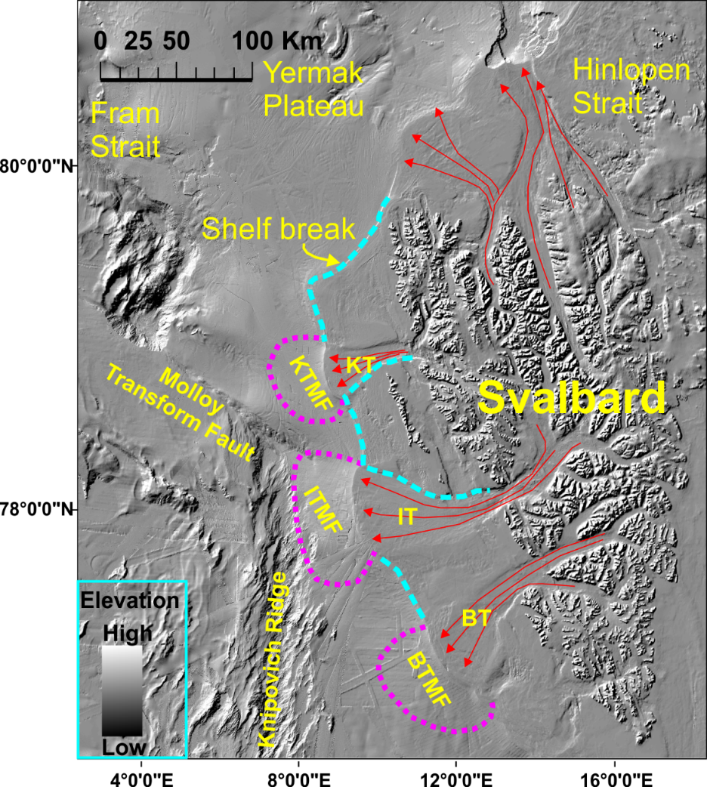
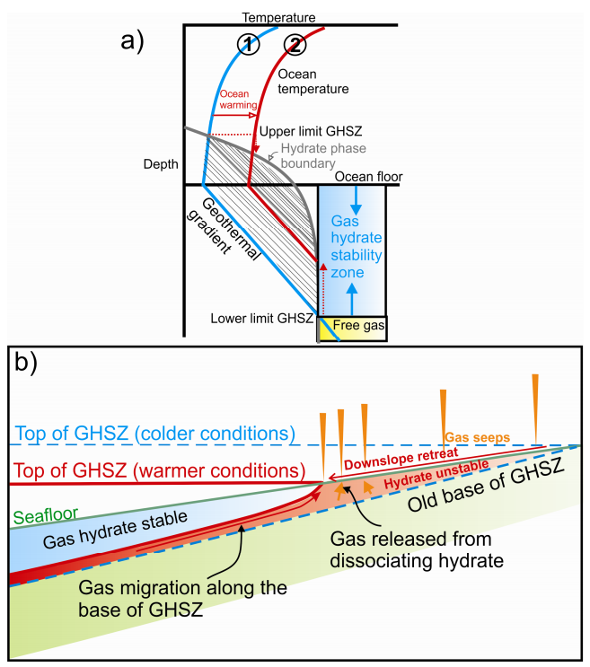
Navigation: Click the buttons for more information
Introduction
Study area
Data
Results
Discussion
Conclusion
Shaded relief bathymetry
Mebo 126
BMHSZ: Bottom of methane hydrate stability zone
GC10-164-09-PC
BMHSZ at 3ºC BWT (410 m water depth)
Shelf break
BMHSZ at 2ºC BWT (370 m water depth)
EGU23-4906
Red arrows indicate the ice stream direction flowing through troughs (KT: Kongsfjorden Trough, IT: Isfjorden Trough, and BT: Bellsund Trough). These ice streams delivered glaciogenic debris, which was deposited in front of these troughs, known as trough mouth fans (TMFs), like Kongsfjorden trough mouth fans (KTMF).
Home

Slide 4
Navigation: Click the buttons for more information
Introduction
Study area
Data
Results
Discussion
Conclusion
Seismic line coverage
Expedition JR269 (2011)
Survey: JR269A (SYSIF)
Used a deep-towed high-frequency SYSIF (SYstème SIsmique Fond) system
Towed at a depth: 100-150 m above the seafloor
High-frequency bandwidth of 220–1050 Hz
Home
Expedition JR269 (2011)
Survey: JR269B
Air gun volume: 150 cu. Inch
Towed at a depth: 3 m
Seismic data frequency: 30-150 Hz
Shot interval: 6 s
Sampling rate: 0.5 ms
Streamer length: 60 m
Group interval: 1 m
EGU23-4906

Slide 5
Navigation: Click the buttons for more information
Introduction
Study area
Data
Results
Discussion
Conclusion
Continental shelf
Here we present a comprehensive analysis of the glaciomarine seismic stratigraphy, including the identification and description of units, their thickness to infer depositional environments.
Additionally, fluid-related anomalies were mapped based on the seismic signatures.
We have divided the interfan area into two sections based on the resolution of the available seismic data.
For the continental shelf region, we primarily used JR269A air gun data, while high-resolution SYSIF data was used for the upper slope region.
Upper continental slope
Home
Fluid-related anomalies
EGU23-4906

Slide 6
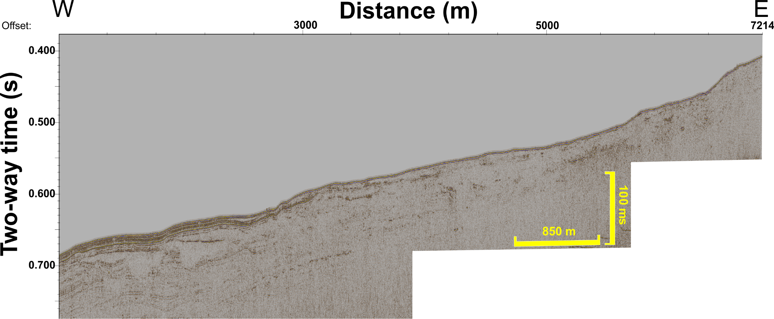
Navigation: Click the buttons for more information
Introduction
Study area
Data
Results
Discussion
Conclusion
Home
EGU23-4906
Interpreted section

Slide 7
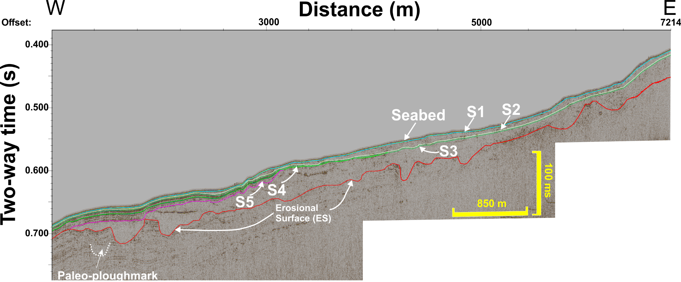
Navigation: Click the buttons for more information
Introduction
Study area
Data
Results
Discussion
Conclusion
Inset 4
Inset 3
Inset 2
Inset 1
Home
EGU23-4906
Un-interpreted section
Inset 1
Inset 2
Inset 3
Inset 4

Slide 8
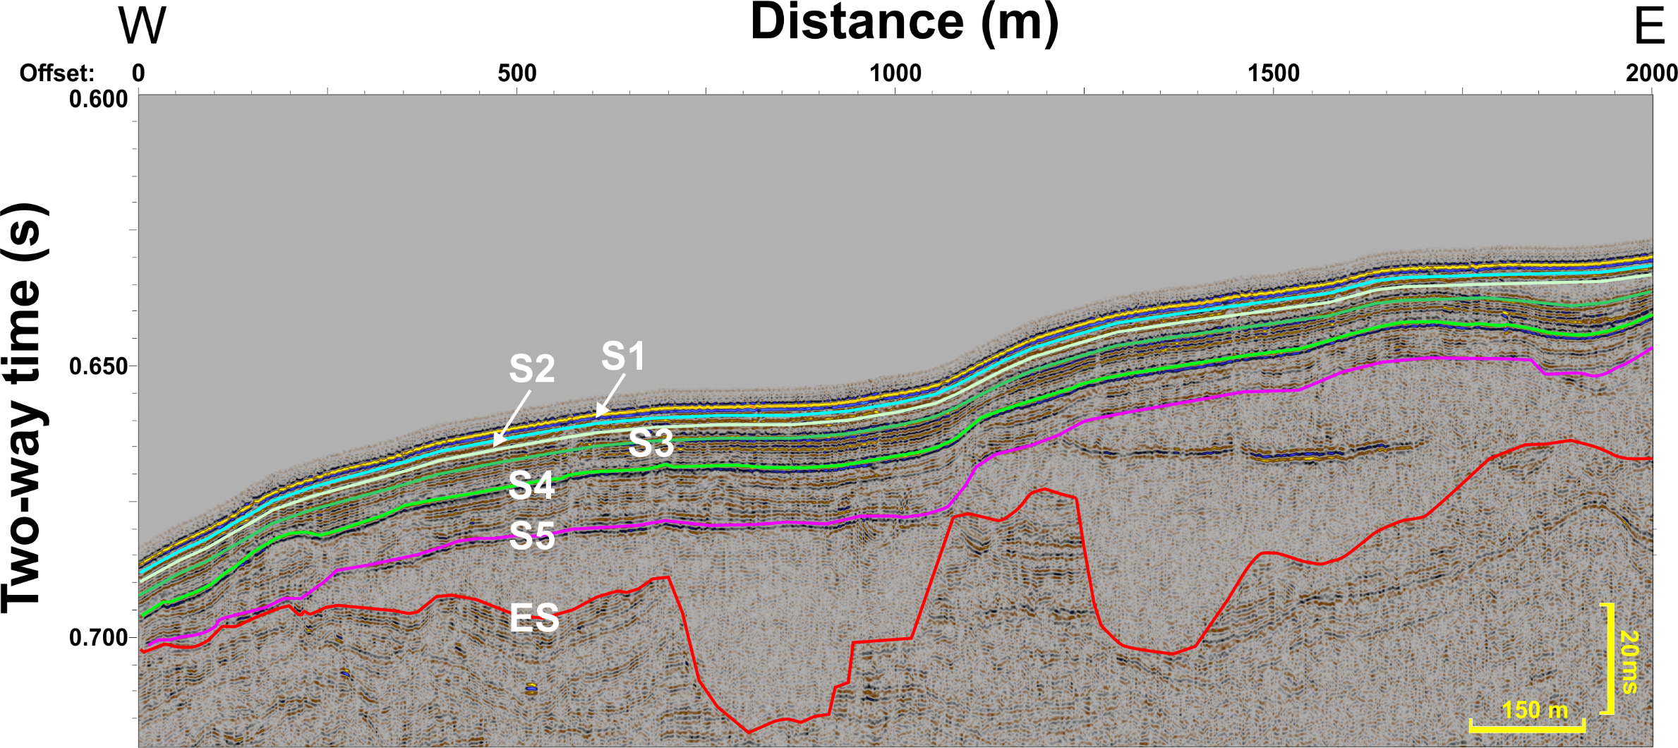
Navigation: Click the buttons for more information
Introduction
Study area
Data
Results
Discussion
Conclusion
Inset 1
Click here for Seismic units and facies present for the white box
Home
EGU23-4906
Return

Slide 9
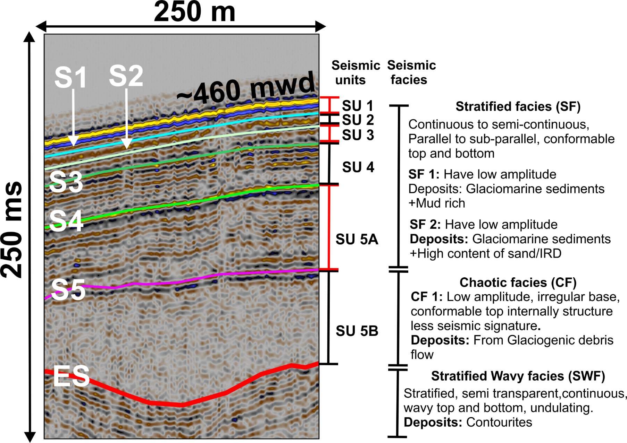
Navigation: Click the buttons for more information
Introduction
Study area
Data
Results
Discussion
Conclusion
Home
EGU23-4906
Inset 1
Return

Slide 10
Navigation: Click the buttons for more information
Introduction
Study area
Data
Results
Discussion
Conclusion
Inset 2
Home
EGU23-4906
Interpreted section
Return
Click here for Seismic units and facies present for the white box

Slide 11
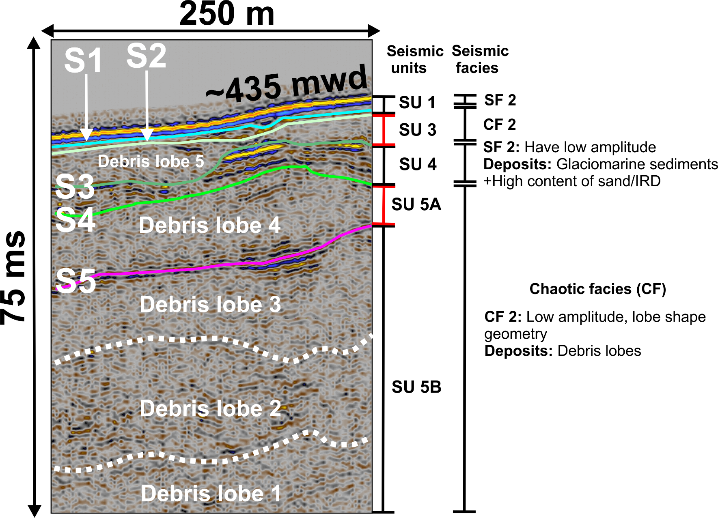
Navigation: Click the buttons for more information
Introduction
Study area
Data
Results
Discussion
Conclusion
Home
Inset 2
EGU23-4906
Interpreted section
Return

Slide 12
Navigation: Click the buttons for more information
Introduction
Study area
Data
Results
Discussion
Conclusion
Home
EGU23-4906
Inset 2
Return

Slide 13
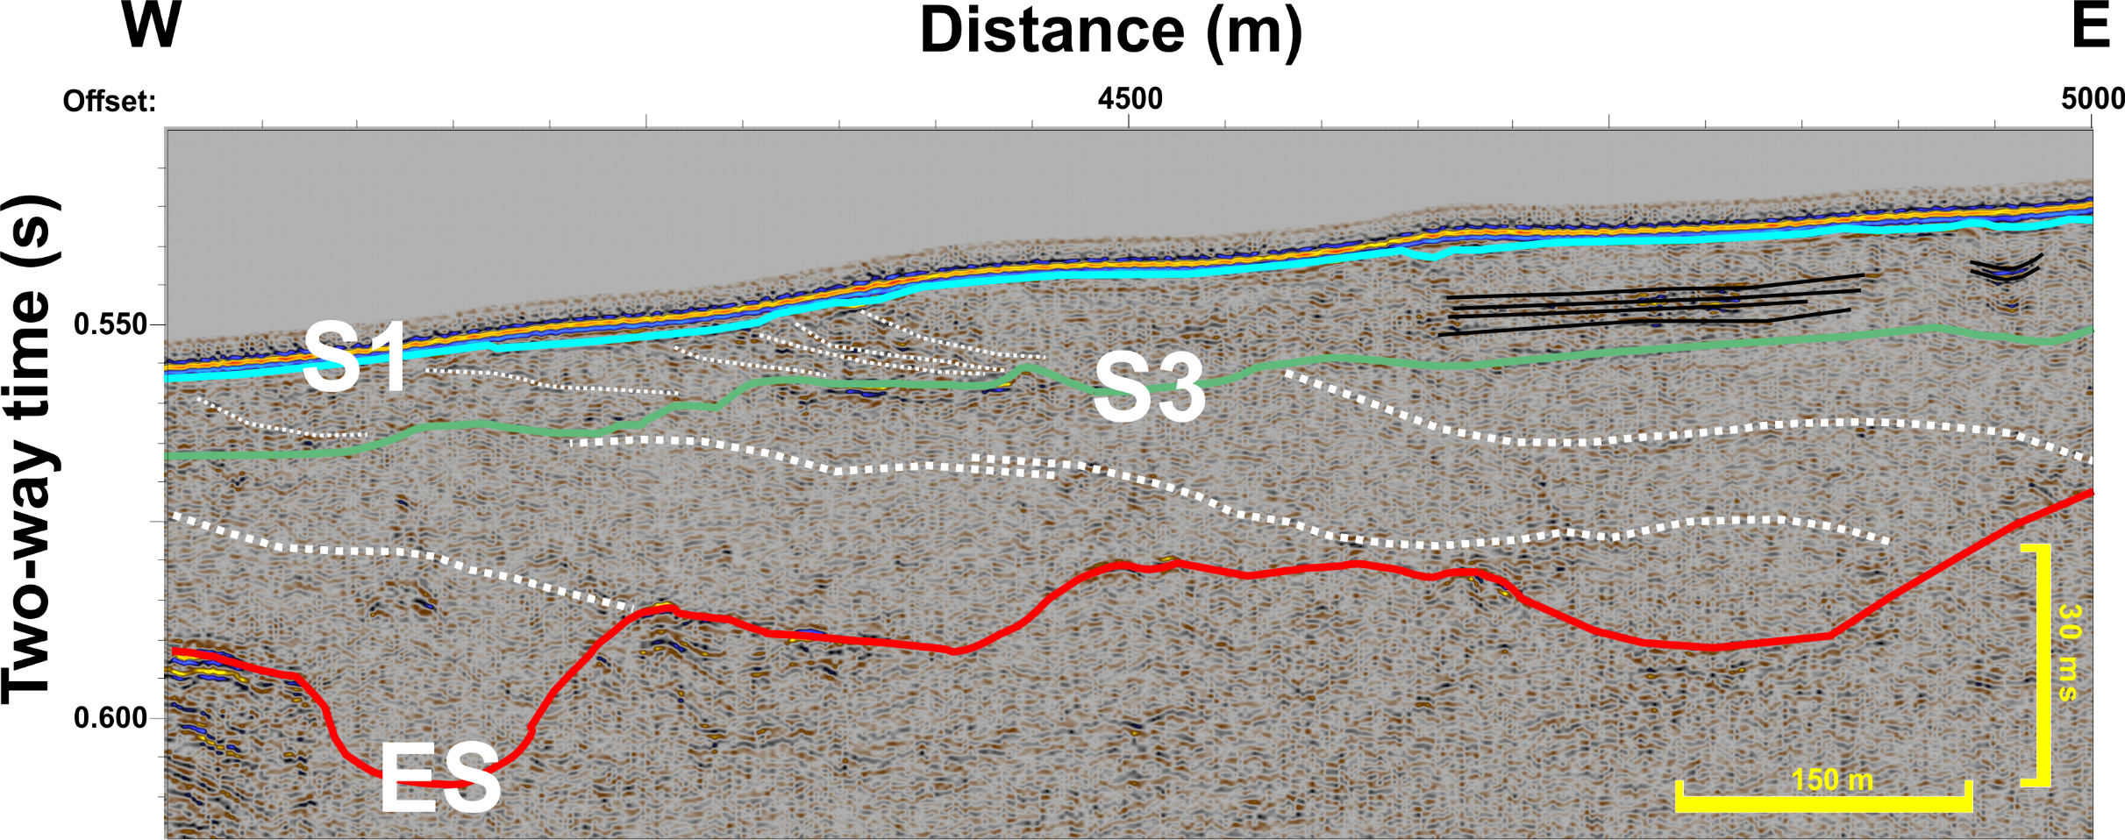
Navigation: Click the buttons for more information
Introduction
Study area
Data
Results
Discussion
Conclusion
Inset 3
Home
EGU23-4906
Return
Interpreted section

Slide 14
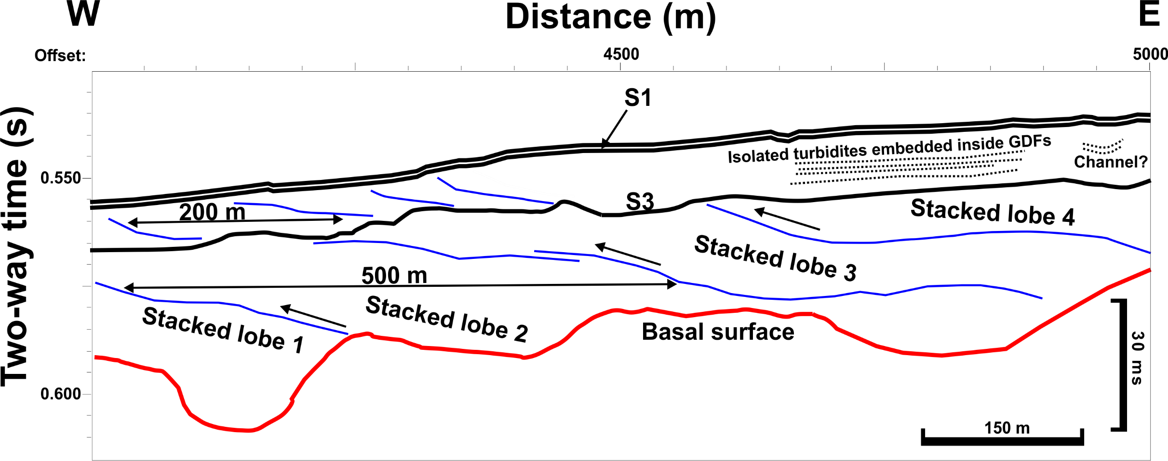
Navigation: Click the buttons for more information
Introduction
Study area
Data
Results
Discussion
Conclusion
Home
EGU23-4906
Return
Inset 3

Slide 15
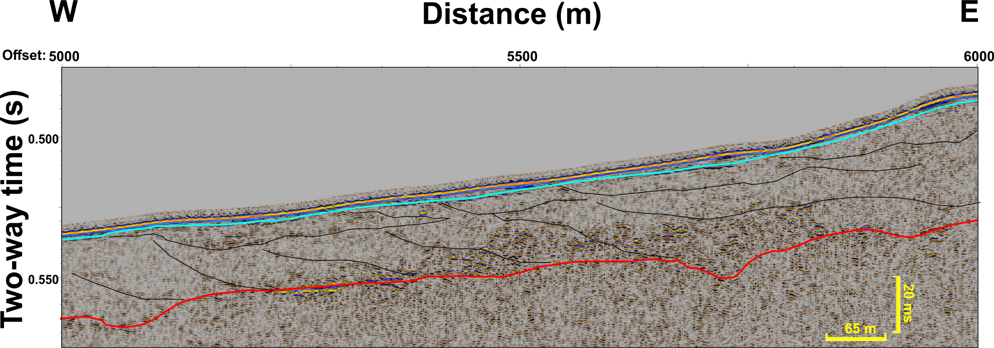
Navigation: Click the buttons for more information
Introduction
Study area
Data
Results
Discussion
Conclusion
Inset 4
Home
EGU23-4906
Interpreted section
Return
Click here for Seismic units and facies present for the white box

Slide 16
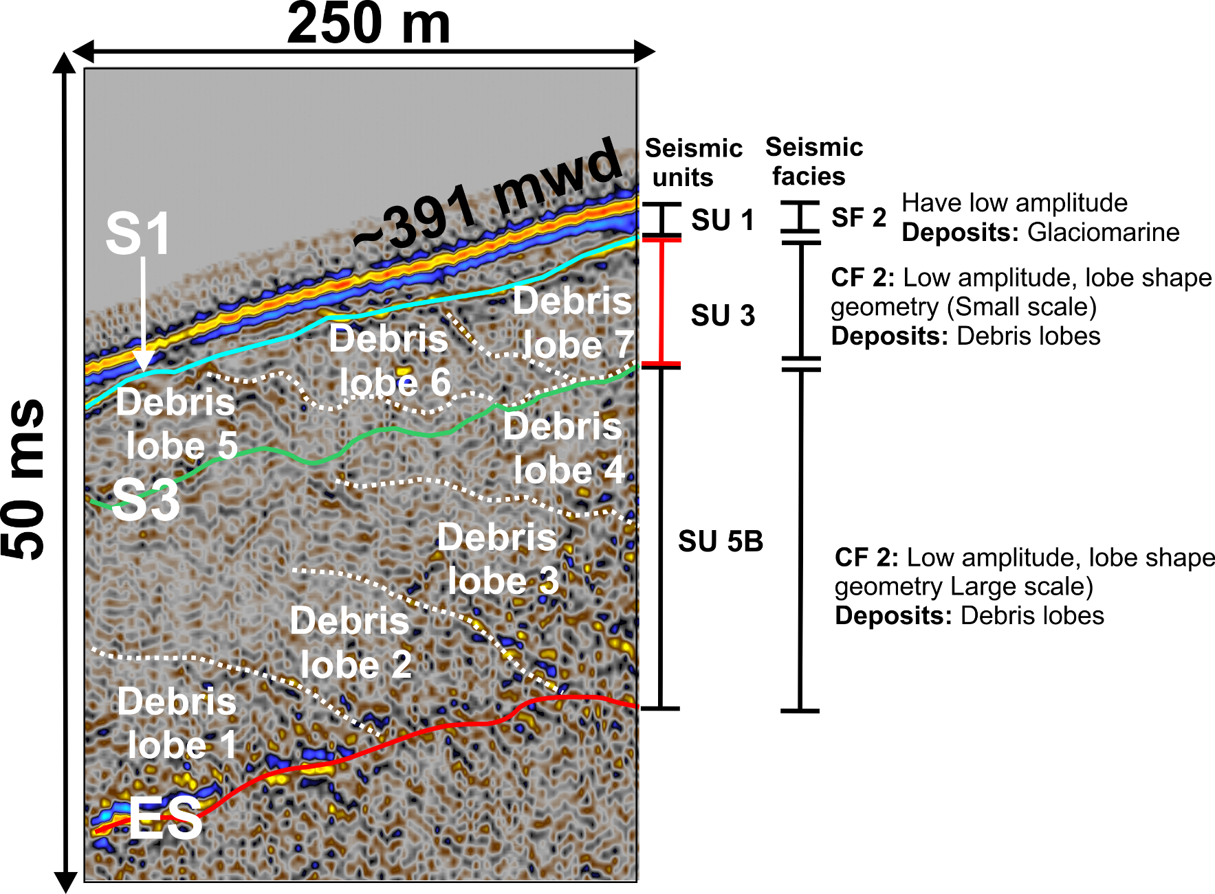
Navigation: Click the buttons for more information
Introduction
Study area
Data
Results
Discussion
Conclusion
Home
EGU23-4906
Inset 4
Return

Slide 17
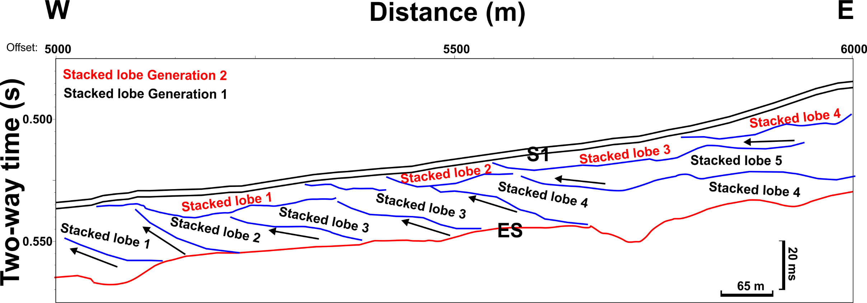
Navigation: Click the buttons for more information
Introduction
Study area
Data
Results
Discussion
Conclusion
Home
EGU23-4906
Inset 4
Return

Slide 18
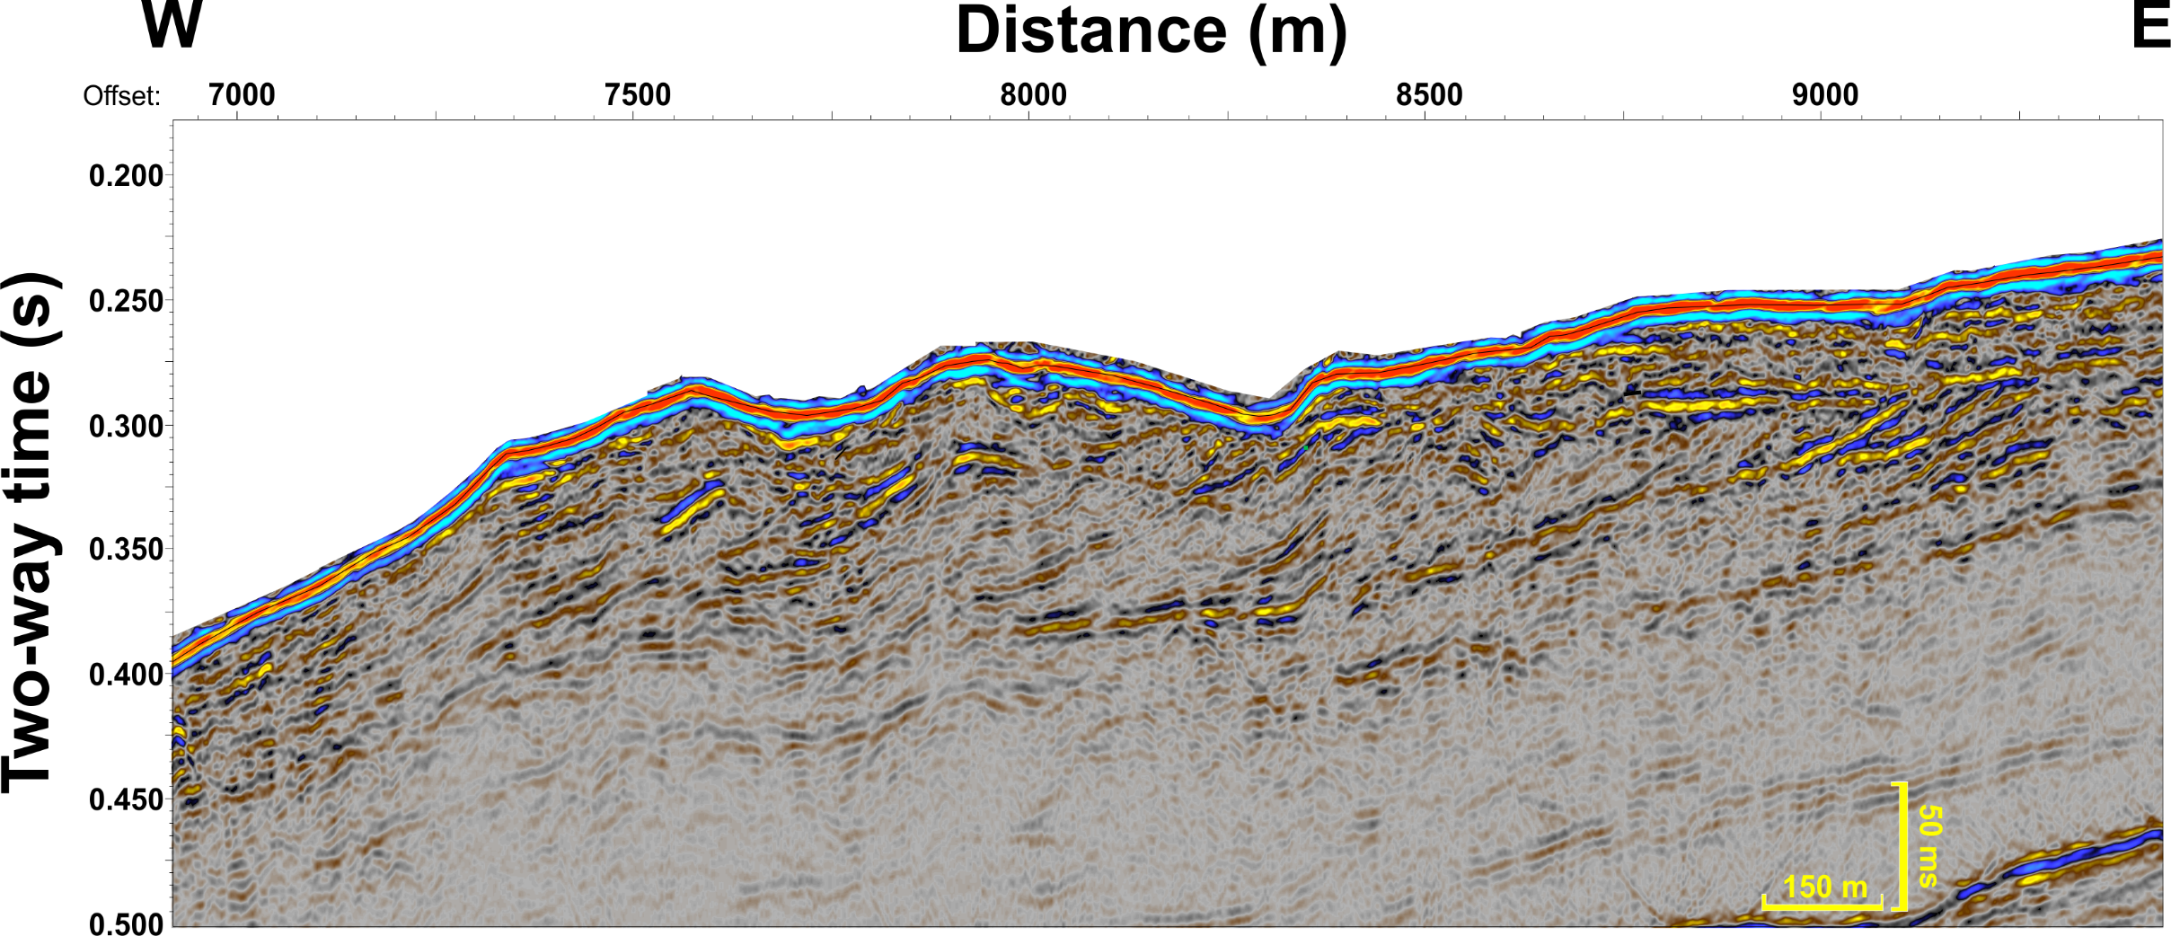
Navigation: Click the buttons for more information
Introduction
Study area
Data
Results
Discussion
Conclusion
Home
EGU23-4906
Interpreted section

Slide 19
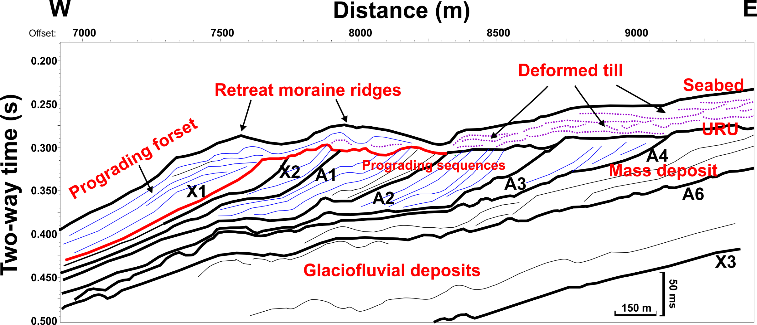
Navigation: Click the buttons for more information
Introduction
Study area
Data
Results
Discussion
Conclusion
Home
EGU23-4906
Un-interpreted section

Slide 20
Navigation: Click the buttons for more information
Introduction
Study area
Data
Results
Discussion
Conclusion
Bright spots: A bright spot anomaly is a local high amplitude anomaly having reversed polarity with respect to the seafloor polarity indicating the presence of gas).
A bright spot primarily results from the decrement in acoustic impedance contrast due to gas (with a lower acoustic impedance).
We observed bright spots in several places, please navigate to the following buttons for viewing them.
Home
3D seismic data
EGU23-4906

Slide 21
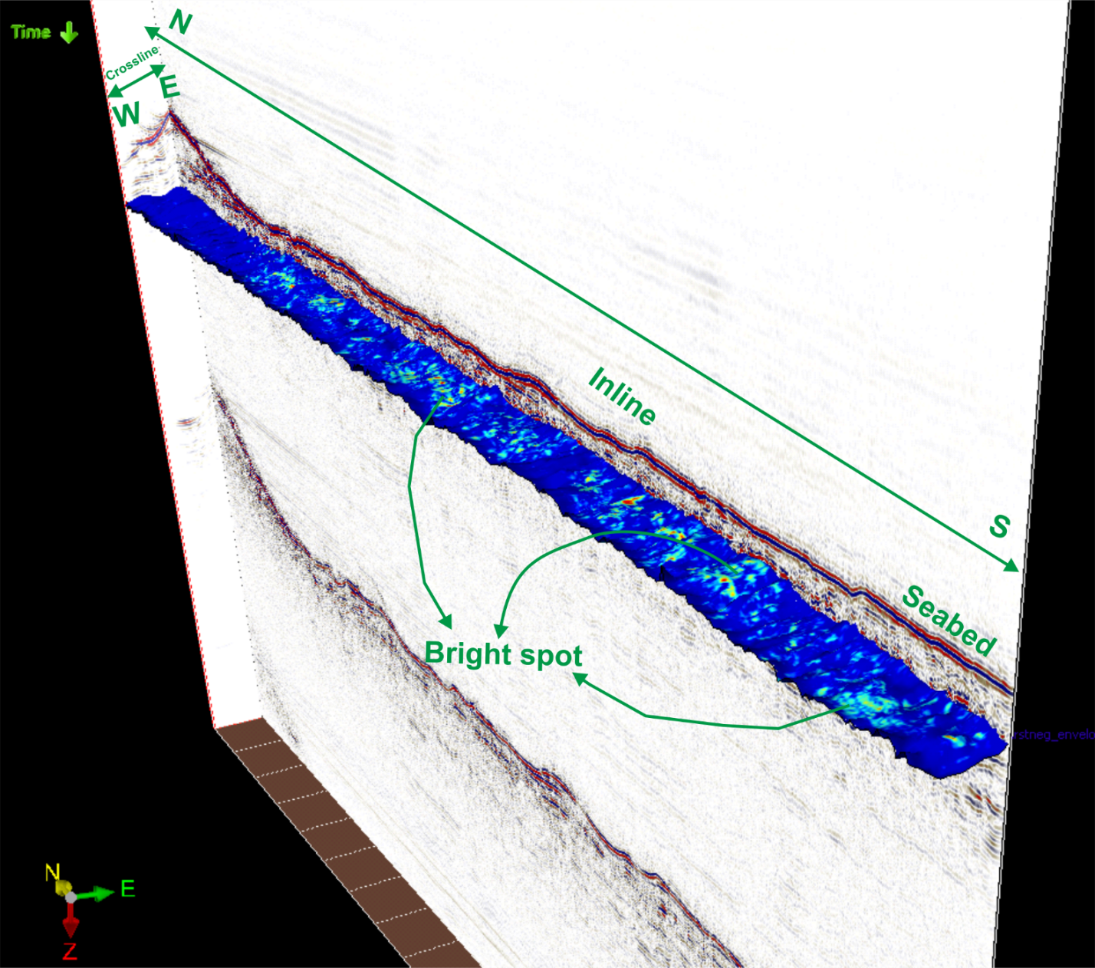
Navigation: Click the buttons for more information
Introduction
Study area
Data
Results
Discussion
Conclusion
The 3D seismic cube is shown in the white box
Home
Zone 2
Zone 1
Zone 1
Zone 2
EGU23-4906
Return

Slide 22
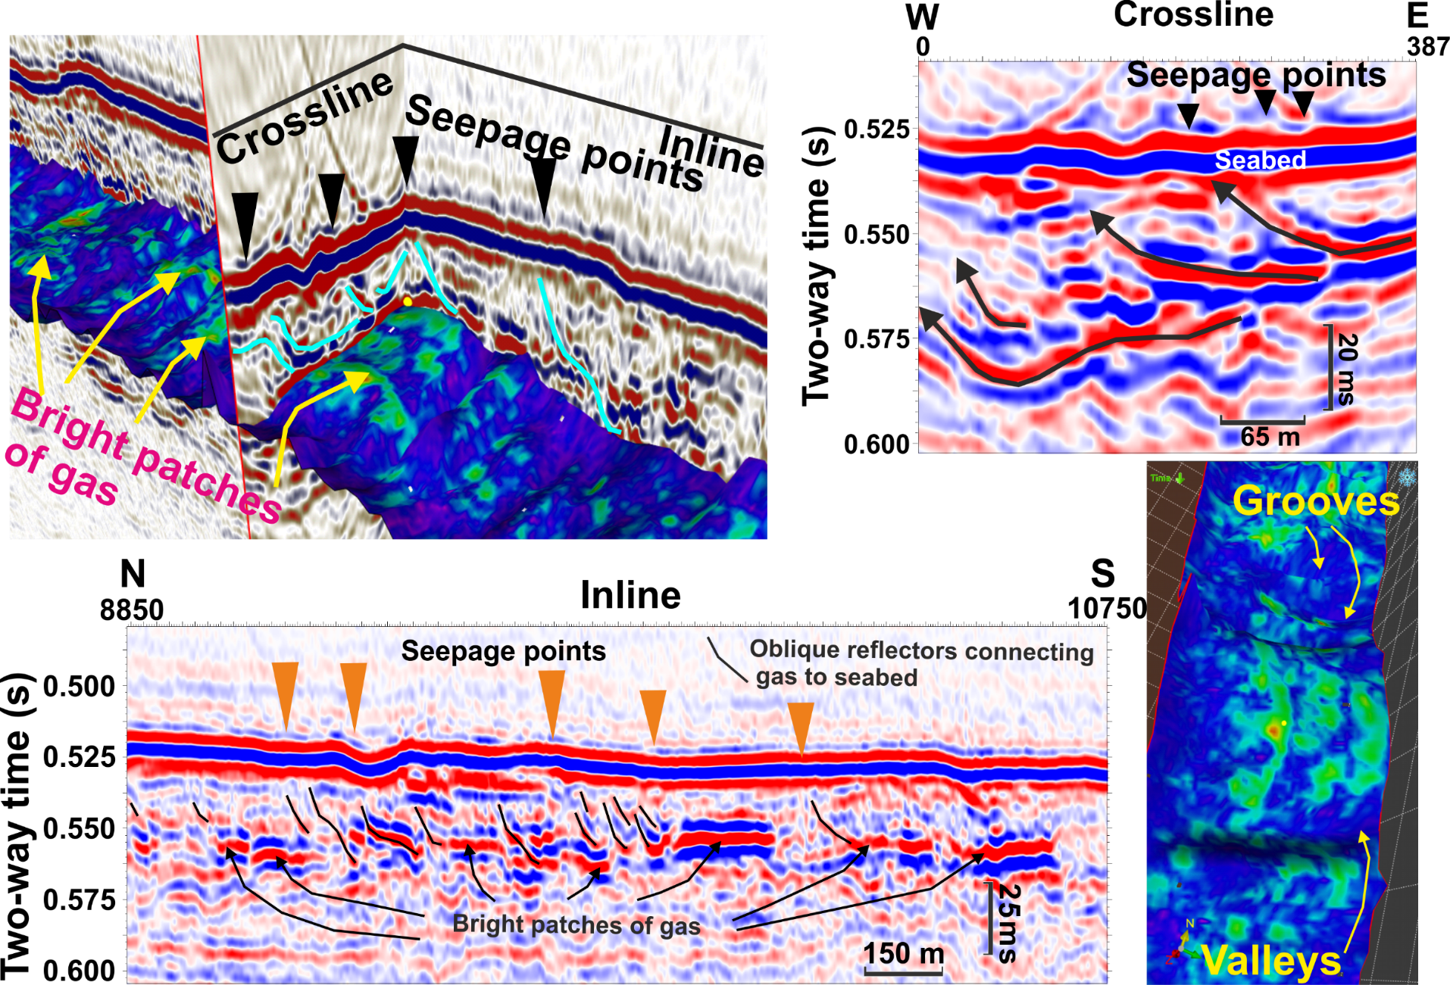
Navigation: Click the buttons for more information
Introduction
Study area
Data
Results
Discussion
Conclusion
Home
Zone 1
Zone 2
EGU23-4906
Return

Slide 23
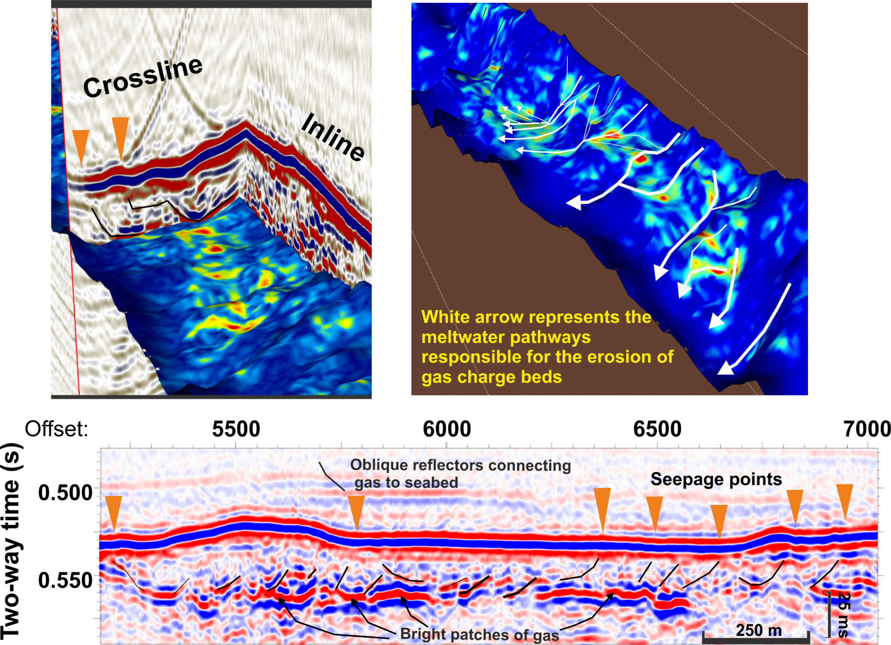
Navigation: Click the buttons for more information
Introduction
Study area
Data
Results
Discussion
Conclusion
Home
Zone 1
Zone 2
EGU23-4906
Return

Slide 24
Navigation: Click the buttons for more information
Introduction
Study area
Data
Results
Discussion
Conclusion
Glaciomarine progradation
Depositional pattern
Home
Updated seismo-stratigraphic framework
EGU23-4906

Slide 25
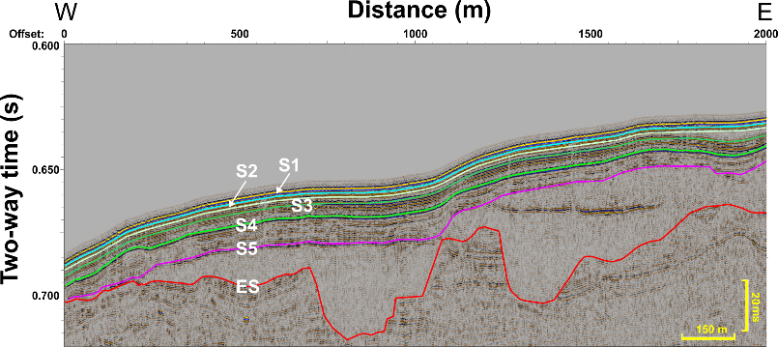
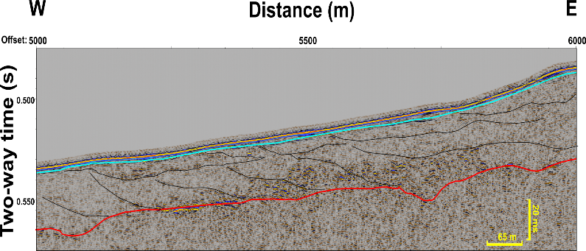
Unit 3
Navigation: Click the buttons for more information
Introduction
Study area
Data
Results
Discussion
Conclusion
Units 5B and 3 in the SYSIF lines are represented by glacial debris flow units
Unit 3
Unit 5B
Home
310 m
310 m
Unit 5B thickness
Unit 3 thickness
410 m
410 m
510 m
510 m
610 m
610 m
EGU23-4906

Slide 26
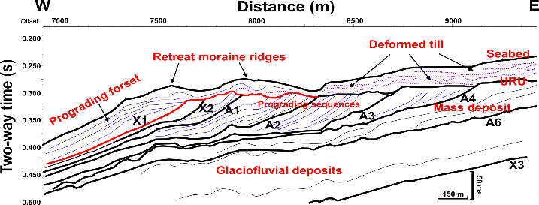
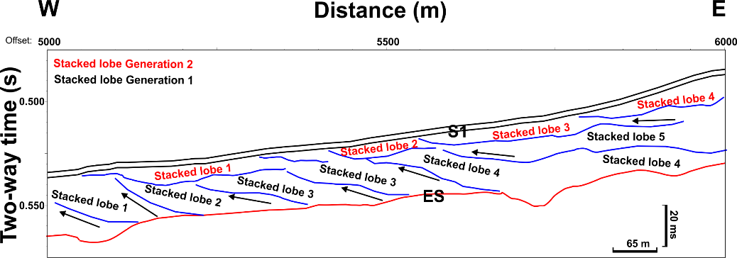
Navigation: Click the buttons for more information
Introduction
Study area
Data
Results
Discussion
Conclusion
Depositional events during glacial advancements (ES—S5 and S3—S2)
1: Ice reached shelf break, debris-rich meltwater eroded pre-existing strata on the slope—formation of Erosional surface (ES).
2: Formation of till delta at the shelf break—generation of glacial debris flows, which filled the erosional surface.
3: We observe the filling and subsequent stacking of debris lobes between ES and S5 in the distal slope.
4: The glacial lobes show moderate eastward tilt and toe thrusting in the uppermost slope, and the lobes are much smaller in dimension.
5: Stacking of debris lobes of generation 2 suggests a second ice sheet advancement (between S3 and S2).
Home
EGU23-4906
Downslope
Updated chronostratigraphic framework

Slide 27
Navigation: Click the buttons for more information
Introduction
Study area
Data
Results
Discussion
Conclusion
Mebo 126
Home
GC10-164-09-PC
EGU23-4906

Slide 28
Navigation: Click the buttons for more information
Introduction
Study area
Data
Results
Discussion
Conclusion
Conclusions:
Based on the seismic stratigraphic analysis, we found two district episodes of shelf edge glaciations during the past 75 kyr.
These shelf edge glaciations happened at 74-54 kyr (Early mid Weichselian) and 38-24 kyr before present (Late Weichselian/Last glacial maxima).
During glacial ice advancement to the shelf break, sedimentation was dominated by debris flow lobes that emerged from the till delta and amalgamated in the upper slope.
During glacial retreat, glacomarine sedimentation in the upper slope is dominated by turbidites deposited by the turbidity currents.
In the gas hydrate retreat zone, gas is predominantly stored in the turbidites, which show good reservoir character, such as stratified, continuous reflections that suggest presence of well-sorted sediments.
On the uppermost slope, the glaciogenic debris flow units impede lateral and vertical fluid migration. Still fluids migrate through these sediments and reach the seabed. This is possibly due several toe thrusts within the debris flow units that connect two vertically separated turbidite beds.
Methane migration in the glaciomarine sediments takes place through fractures. In addition, our new results suggest there is enhanced vertical flux through a set of thrust fabrics within the debris flow lobes.
The thickness of the glacial debris flow units also plays an important role in shallow gas focusing. Areas of thinner debris cover (< 35 m) facilitate fluid migration, whereas thicker regions (> 35 m) impede fluid flow.
Home
EGU23-4906

